Slide 1




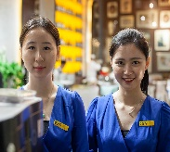
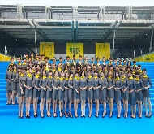
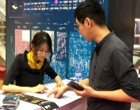
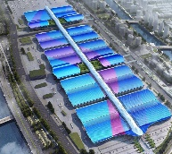
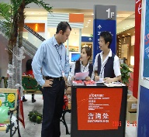
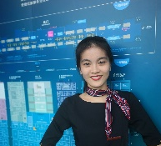
English for Exhibition and Conference
会 展 英 语

Slide 2
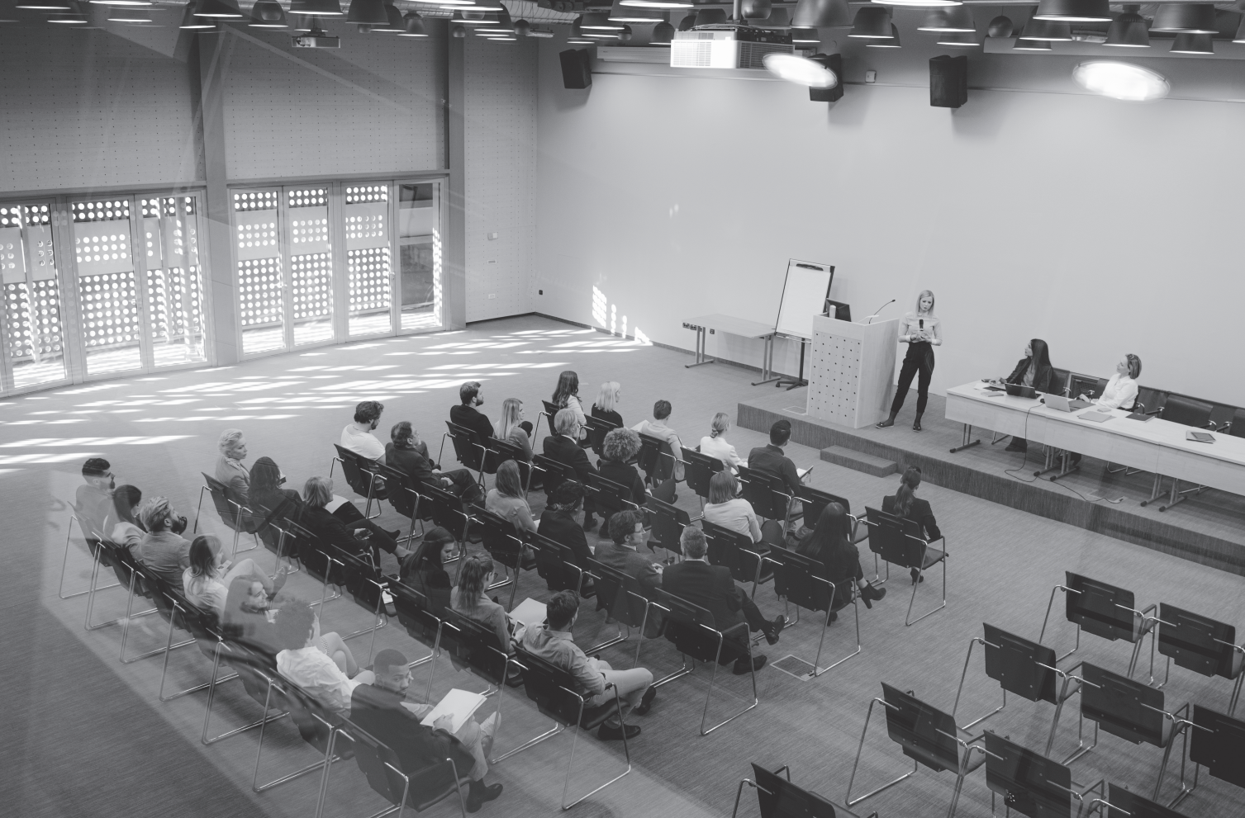
Unit 8
Conference Organizing and Attendance

Slide 3
Unit Objectives
After studying this unit, you will learn:
As an organizer:
  how to prepare for and operate a conference;
  how to invite a speaker to a conference.
As an attendee:
  how to apply for attendance at a conference;
  how to enquire about registration for a conference.

Slide 4
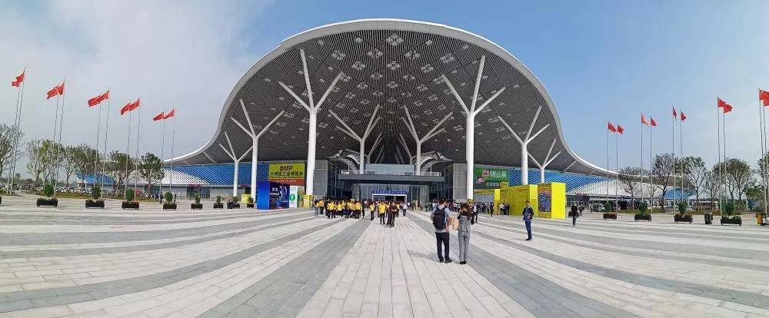
1
深圳国际会展中心
Organizer’s Diary

Slide 5
During this period, I will learn:
how to prepare for and operate a conference;
how to invite a speaker to a conference.

Slide 6
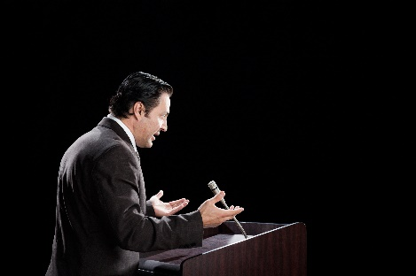
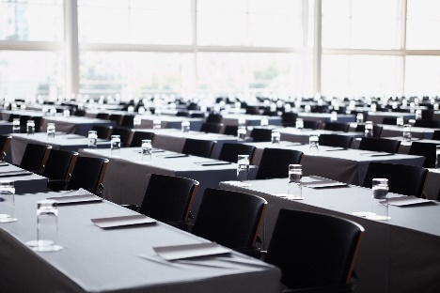
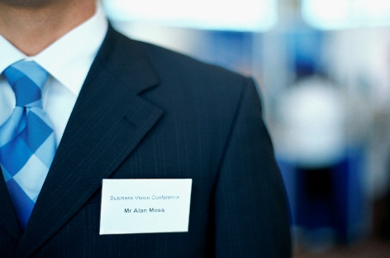


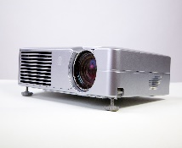
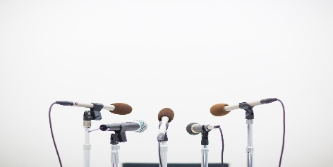
I. Lead-in Practice
Task 1 Vocabulary: Look at the pictures. Work with your partner and write
out the preparatory activities for a meeting.
speaker
seating
badges
1. inviting ___________ 2. arranging ___________ 3. preparing __________
an agenda
4. Making ___________ 5. preparing ___________
facilities

Slide 7
I. Lead-in Practice
Task 2 Brainstorming: Work in groups. Discuss the important points for
conference planning for an organizer based on Task 1 with your classmates.
Time
Whenever a conference is arranged, priority should be given to time. It is the most important point to be followed. The time of beginning and end should be planned before setting the conference.
Venue
Find a reasonable place to arrange your conference, make sure that the place is accessible for participants. Confirm all the bookings for the conference at least one week in advance to avoid any kind of mistakes in coordination.
Agenda
The agenda of the conference should be clear. All the members should be informed well in advance about the purpose of the conference.
Attendees
Before inviting the people to the conference, make sure that only concerned members are invited to have a specific discussion, to avoid unnecessary disturbance and to ensure that the conference go smoothly and yield results.

Slide 8
I. Lead-in Practice
Task 2 Brainstorming: Work in groups. Discuss the important points for
conference planning for an organizer based on Task 1 with your classmates.
Seating arrangements
Arrange the seats in a way that every member can have eye contact with the speaker and all the members can talk to each other easily. This will have a very positive impact on the attendees.
Equipment
Arrangement of the equipment for the conference is very important. Audio-video equipment should be arranged in advance. Arrange a rostrum for the speakers and a good screen for video slides.
Facilities
Some facilities and services, like a nice parking lot, catering, electricity supply, water supply and accommodation, can have a direct impact on whether the conference is successful.
Badges
The conference will work well with badges for the members; it would be easy for all the guests to know each other, so they would discuss the issues together.

Slide 9
II. Reading
Passage 1 Meetings and conferences
Both meetings and conferences are events where people gather and hold discussions. Meetings are held on a smaller scale and have fewer participants, while conferences are more formal, spread over several days and require accommodations and other facilities for the delegates.
There are many different categories of conferences and meetings and each type requires different structures and supports a different number of participants.
Public Conferences
A public conference is one where it is up to the organizer of the conference to attract people to attend. There may be a charge levied on attendees to cover the cost of the conference or it may be free, if the expenses are paid by the conference holders. These conferences are often held to get people from a certain sector together to discuss new development and to do business with each other.

Slide 10
II. Reading
Passage 1 Meetings and conferences
Conferences with Exhibitions
These are usually public conferences but they will have an exhibition attached where people can view new products and meet suppliers. In some cases, it’s not clear whether the conference is supporting the exhibition or the other way around, but the difference from a pure public conference is that there are likely to be a number of short seminars or speeches throughout the days of the conference.
Private Conferences
Private conferences are often held when large companies need to get all their employees, or certain sections, together to either celebrate a success or start a new initiative. In companies that are widespread across the globe, they often held conferences to update staff on new initiatives or to inform about new products and staff. Members of the public would not be allowed to attend.

Slide 11
II. Reading
Passage 1 Meetings and conferences
  Private conferences can afford to be a little more prescriptive about arrangements since employees of one company can be controlled a little more directly than the attendees of a public conference.
Virtual Conferences
  The final category, the one that is increasing in attractiveness to business as travel expenses increase, is the virtual conference. The cheap and fast connections of the Internet have allowed Internet conferences to be arranged with people all over the world. Audio conferences are easier and cheaper as the bandwidth requirements are lower than video conferences.
  There are also video-conferencing suites in most major towns and cities of the world where there will be equipment more suited to sharing diagrams and whiteboards electronically than sitting at a desk at work with a web cam.

Slide 12
II. Reading
Passage 1 Meetings and conferences
public conference 公共会议
levy v. to impose and collect 征收；收取
initiative n. an important new plan or process that has been started in order to achieve a particular aim or to solve a particular problem 计划；措施
prescriptive adj. pertaining to giving directives or rules 规定的；指定的
virtual conference 虚拟会议
audio conference 音频会议
bandwidth n. a data transmission rate; the maximum amount of information (bits/second) that can be transmitted along a channel 带宽
video conference 视频会议
web cam 网络摄像机

Slide 13
II. Reading
Passage 1 Meetings and conferences
Task 1 Read the text and fill in the form below with the information from the text.
Meetings and Conferences
Categories | Purposes
Public Conferences | For people to get together to_____________________ _______________________________________.
Conferences with Exhibitions | For people to _________________________________.
Private Meetings | For companies to _____________________ or _________________________________________.
Virtual Conferences | For people all over the world to attend _____________ ____________________________________________.
discuss new development
and to do business with each other
view new products and meet suppliers
either celebrate a success
start a new initiative
the Internet
conference

Slide 14
II. Reading
Passage 1 Meetings and conferences
Task 2 Read the text again and answer the following questions.
1. What is a possible reason for public conferences to be free?
The expenses are paid for by the conference holder .
2. How is a conference with exhibitions different from a public conference?
The difference is that a conference with exhibition there are likely to be a number of short seminars or speeches throughout the days of the conference, and there will have an exhibition attached where people can view new products and meet suppliers .

Slide 15
II. Reading
Passage 1 Meetings and conferences
Task 2 Read the text again and answer the following questions.
1. Why can private conferences afford to be a little more prescriptive?
Because the employees of one company can be controlled a little more directly than the attendees of a public conference.
2. What types of virtual conferences are mentioned?
Audio conferences and video conferences .

Slide 16
II. Reading
Passage 2 Meeting Room Setup
setup n. the way something is organized or arranged 安排；布局
utilization n. the act of using 利用
elevation n. distance of something above a reference point 高度；海拔
cluster v. to come together as in a flock 聚集
rectangular adj. having a set of mutually perpendicular axes; meeting at right angles 矩形的
designate v. to indicate a place, direction, person or thing 指定；标明
diameter n. the length of a straight line passing through the center of a circle and connecting
two points on the circumference 直径

Slide 17
II. Reading
Passage 2 Meeting Room Setup
Task 1 Read the text and fill in the blanks with the given words and phrase
according to the context.
form 2. face 3. setup
placed 5. presenter 6. audience

Slide 18
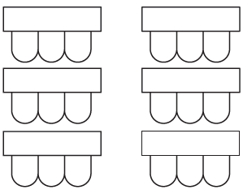

II. Reading
Passage 2 Meeting Room Setup
How tables and chairs should be arranged in a meeting room depends on how the content will be delivered to participants. Different setups allow for different types of learning and audience participation or interactions. Choose a 1 ______________ that will help you achieve your objectives for your event.
Classroom Style
Rows of tables are placed with two or three chairs at each one, with tables arranged to 2 ______________ the front of the room. This setup is ideal for note-taking, when the conference is an informational
type presentation.
setup
face

Slide 19
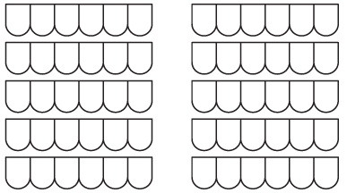
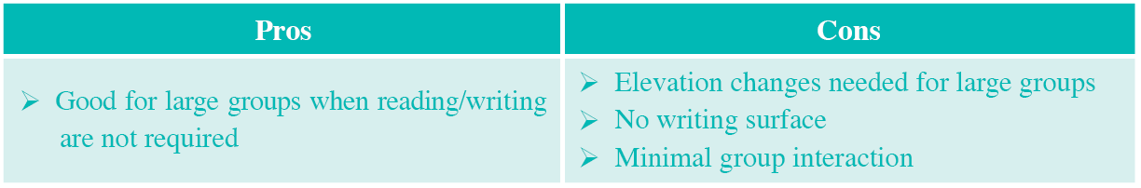
II. Reading
Passage 2 Meeting Room Setup
Theater Style
Rows of chairs face the front of the room, usually divided
by center and/or side aisles. Maximizes meeting room space
utilization. No tables are used for the 3 ______________ .
audience

Slide 20

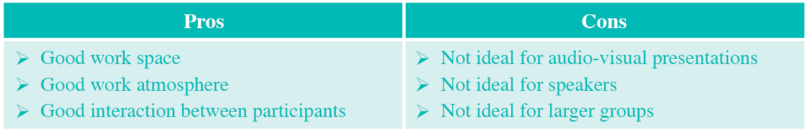
II. Reading
Passage 2 Meeting Room Setup
Conference Style
Conference tables are clustered in the center of the room to 4 ______________ one solid surface. Chairs are placed around the perimeter of the tables. It is good for small “brainstorming” sessions, and this setup promotes dialog between participants.
form

Slide 21
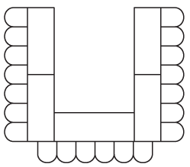
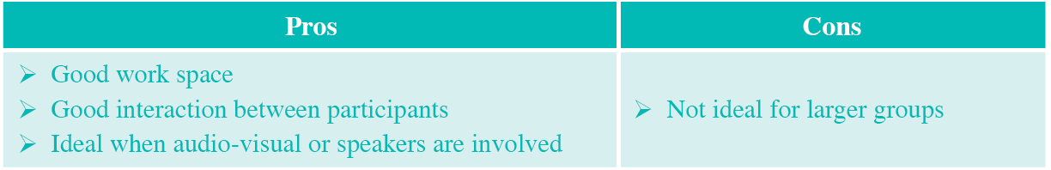
II. Reading
Passage 2 Meeting Room Setup
U-shape
Tables are placed end to end in the room to form the shape of a U. Chairs are placed around the outside of the U. It is appropriate for small groups that require conversations between the 5 ______________ and the audience, as well as conversations between the participants..
presenter

Slide 22

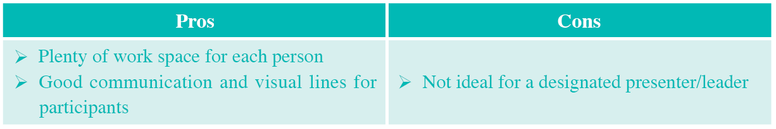
II. Reading
Passage 2 Meeting Room Setup
Hollow Square
Tables are 6 ______________ in a rectangular outline with open space in the middle. Chairs are placed around the perimeter of the square. It is suitable for small group discussion.
placed

Slide 23
II. Reading
Passage 2 Meeting Room Setup
Task 2 Read the text and fill in the form below with the information from
the text.
Meeting Room Setup
Types | Setup
Classroom style | Rows of tables are placed __________________________ _____________________________________________.
Theater style | Rows of chairs face _______________________________ _____________________________________________.
Conference style | Conference tables are clustered _____________________ _____________________________________________ ____________________________________________.
with 2 or 3 chairs at each one,
with tables arranged to face the front of the room
the front of the room, usually divided
by center and/or side aisles
in the center of the room to
form one solid surface. Chairs are placed around the perimeter
of the tables

Slide 24
II. Reading
Passage 2 Meeting Room Setup
Task 2 Read the text and fill in the form below with the information from
the text.
Meeting Room Setup
Types | Setup
U-shape | Tables are placed __________________________________ ______________________________________________.
Hollow square | Tables are placed __________________________________ ______________________________________________.
Banquet style | Standard round tables ______________________________ ______________________________________________.
end to end in the room to form the shape of
a U. Chairs are placed around the outside of the U
in a rectangular outline with open space in the
middle. Chairs are placed around the perimeter of the square
of either 60 or 72 inches in diameter are
used to seat 8 to 12 people

Slide 25
III. Sample Study
An agenda is a list of meeting activities in the order in which they are to be taken up, beginning with the call to order and ending with adjournment. It usually includes several specific items of business to be discussed. It may, but is not required to, include specific times for one or more activities.
The key sections of a meeting agenda include the following:
The header
topic of the meeting
location
date
starting and ending time
The body
Introductions
topics at hands
announcements
closing ceremony

Slide 26
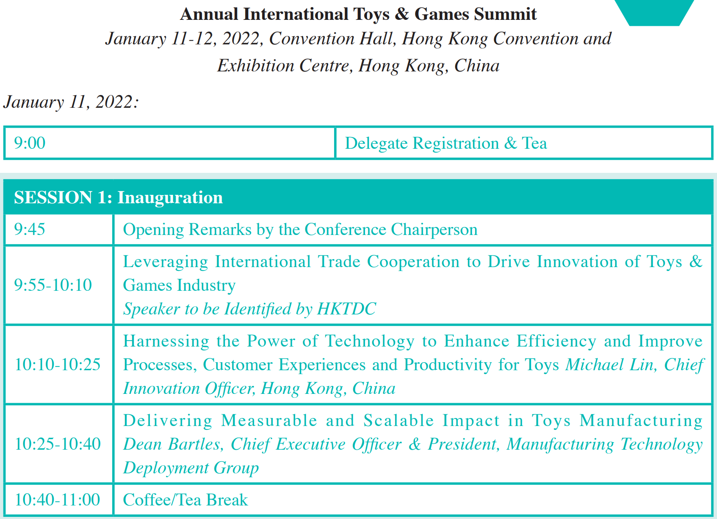
III. Sample Study
AGENDA

Slide 27
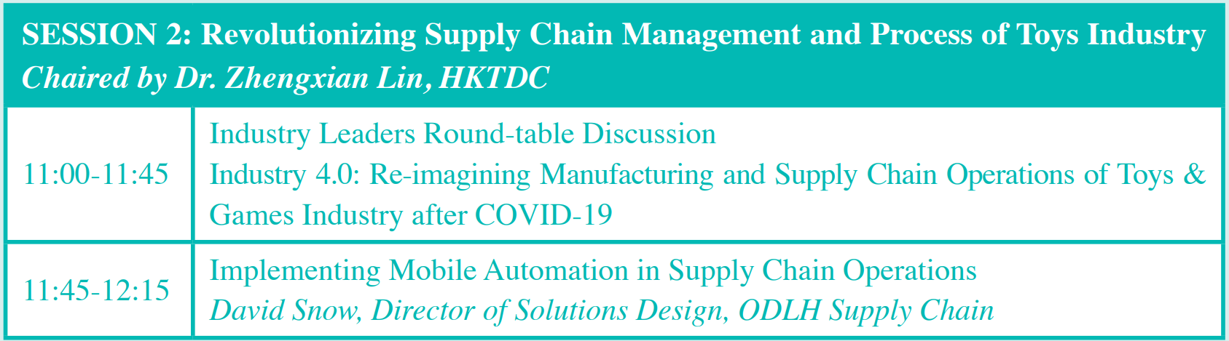
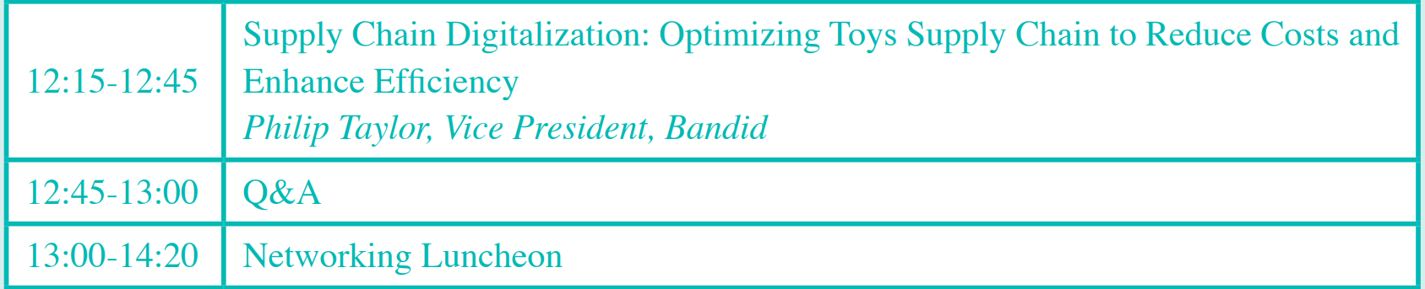
III. Sample Study
AGENDA

Slide 28
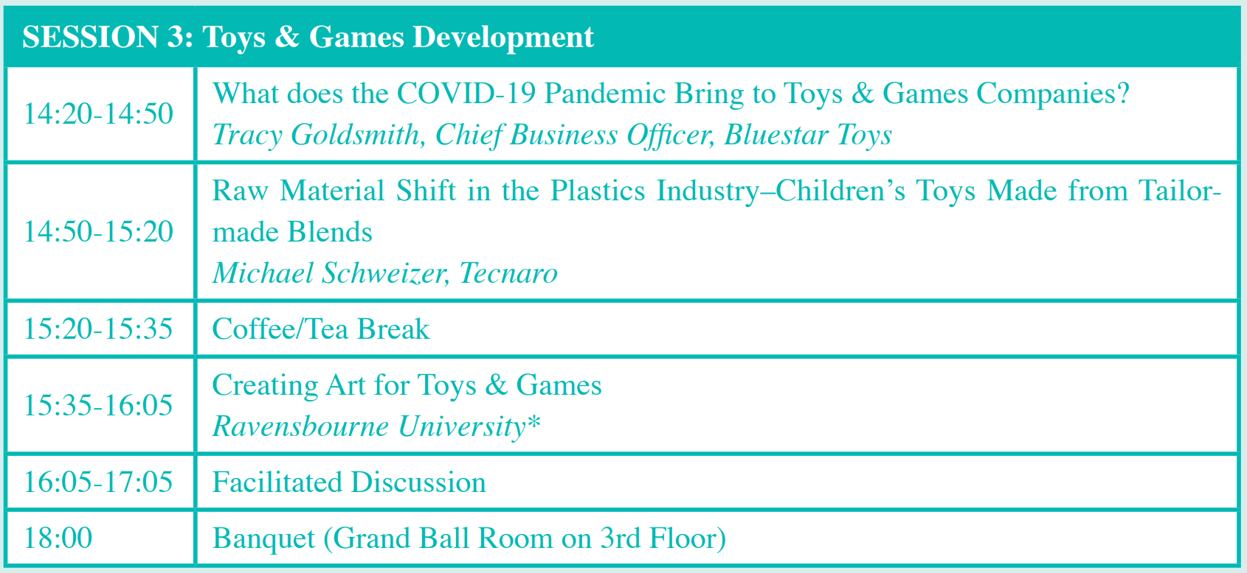
III. Sample Study
AGENDA

Slide 29
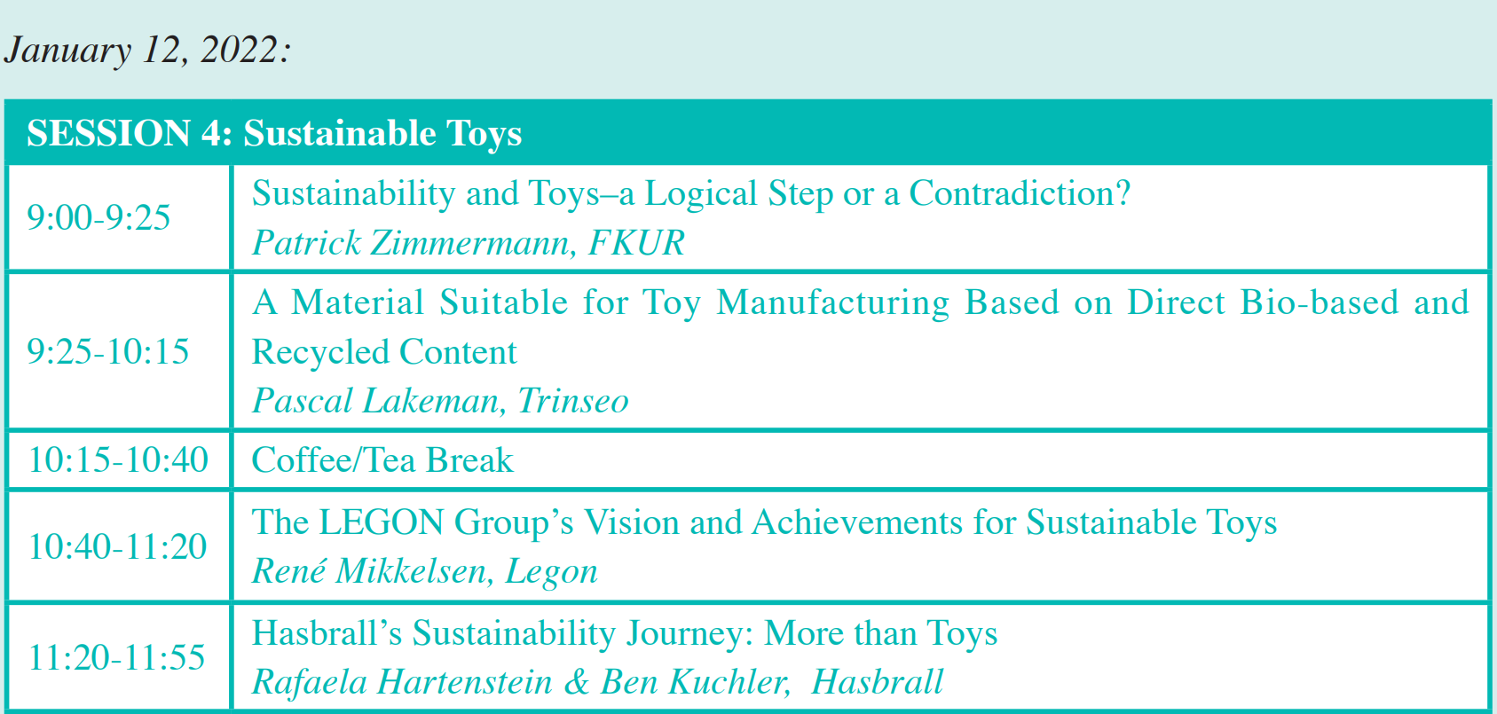
III. Sample Study
AGENDA

Slide 30
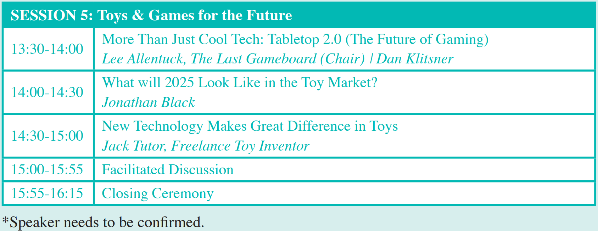
III. Sample Study
AGENDA

Slide 31
III. Sample Study
Task 1 Fill in the form with related information from the above sample.
The Header | Topic of the conference
 | Location
 | Duration
 | Starting and Ending dates
 | Welcome Activity
The Body | Topics at Hand
 | Time for Closing ceremony

Slide 32
III. Sample Study
Task 1 Fill in the form with related information from the above sample.
The Header | Topic of the Conference
 | Location
 | Duration
 | Starting and Ending dates
The Body | Topics at Hand
 | Time for Closing Ceremony
Annual International Toys & Games Summit
Hong Kong Convention & Exhibition Center
2 days
January 11 to 12, 2022
Revolutionizing Supply Chain Management and Process of Toys Industry
Toys & Games Development
Sustainable Toys
Toys & Games for the Future
15:55-16:15, January 12

Slide 33

IV. Situational Dialogs
Dialog one
Inviting speakers to an international conference
Chris Davis:
the Sales Manager of Saidel Exhibition Co., Ltd., a famous international
convention and exhibition company
Tracy Goldsmith:
Chief Business Officer of Bluestar Toys, Inc., Germany

Slide 34
IV. Situational Dialogs
Dialog one
Inviting speakers to an international conference
Task 1 Close your book and listen to the dialog.
I am calling to invite you to…
Where do you hold it?
I will check my schedule…
Who will be present at the convention?
We have invited professionals from all sectors of…
6. By joining the conference, you can communicate easily…

Slide 35
IV. Situational Dialogs
Dialog one
Inviting speakers to an international conference
Chris: Hello, can I speak to Tracy Goldsmith, please?
Tracy: Tracy speaking. Who is that?
Chris: This is Chris Davis, the Sales Manager of Saidel Exhibition Co., Ltd., an international convention and exhibition company. I am calling to invite you to speak at the annual Toys & Games Summit.
Tracy: Oh, that is interesting. When will it be held?
Chris: It is from January 11 to 12, 2022.
Tracy: I see. It is from Tuesday to Wednesday, right?

Slide 36
IV. Situational Dialogs
Dialog one
Inviting speakers to an international conference
Chris: Yes, that is right.
Tracy: And where do you hold it?
Chris: In the Hong Kong Convention and Exhibition Center.
Tracy: I will check my schedule later to see whether I am available or not. Can you tell me who will be present at the conference?
Chris: We have cooperation with many of the largest toys and games companies and we have invited professionals from all sectors of the toys and games industries. I am wondering if you could come and make a speech.

Slide 37
IV. Situational Dialogs
Dialog one
Inviting speakers to an international conference
Tracy: I will think about it.
Chris: Please give a serious thought to it. You are a reputable expert in this field. We do wish you can come. Besides, by joining the conference, you can communicate easily with suppliers, manufacturers, researchers and experts.
Tracy: I understand. What is the theme of the conference?
Chris: We focus on Toys & Games Industry for the Future this year.
Tracy: What is the title and time limits for the speech?

Slide 38
IV. Situational Dialogs
Dialog one
Inviting speakers to an international conference
Chris: The title and content are up to you, but please notify us before November 20. As for the time limits, we generally give each speaker 30 minutes.
Tracy: I got it. Thank you very much for your invitation.
Chris: You are welcome. If you have any further question, contact us at 400-000-0000.
Tracy: OK. Thanks.

Slide 39
IV. Situational Dialogs
Dialog one
Inviting speakers to an international conference
Task 2 Read the dialog again and recite the underlined expressions.
Task 3 Work in pairs. Act as Chris Davis and Tracy Goldsmith and
role-play the dialog.

Slide 40
IV. Situational Dialogs
Discussing with the host about
conference preparation
Dialog two
Chris Davis:
the Sales Manager of Saidel Exhibition Co., Ltd., a famous international convention and exhibition company
Leo Brogger:
the host of International Conference on Cultural and Tourism Innovation

Slide 41
IV. Situational Dialogs
Discussing with the host about
conference preparation
Dialog two
Task 1 Close your book and listen to the dialog.
The opening ceremony is on the corner.
We have finalized the plans for greeting, registration and accommodation.
Please test the audiovisual devices beforehand.
We have performed audiovisual tests already.
Is there anything we have yet to mention?

Slide 42
IV. Situational Dialogs
Discussing with the host about
conference preparation
Dialog two
Leo: Hello, Chris. The opening ceremony is on the corner. Is everything ready?
Chris: Yes, almost. We have already put the conference banner and clear signage outside the building. We have finalized the plans for greeting, registration and accommodation. The name tags for attendees are ready. And we also have emergency plans.
Leo: How about the volunteers? Are they clear about their jobs?
Chris: Yes, they have been assigned tasks for the day and they will wear name tags so attendees can easily identify them.

Slide 43
IV. Situational Dialogs
Discussing with the host about
conference preparation
Dialog two
Leo: Good. How about the room setup? The number of attendees is really big.
Chris: We should make sure we have enough chairs for attendees and all the necessary audiovisual devices are ready.
Leo: Great. Please test the audiovisual devices beforehand. They sometimes are troublesome.
Chris: Yes, we have performed audiovisual tests already, and checked the laptops and projectors as well.
Leo: Well done. Do you have refreshments and local programming?

Slide 44
IV. Situational Dialogs
Discussing with the host about
conference preparation
Dialog two
Chris: Yes, we have. The food is of good quality. We have detailed plans for local programming.
Leo: Sounds great! Is there anything we have yet to mention?
Chris: Yes, we have received the agenda already but we still have not received the script of the opening speech and the questionnaires for attendees’ feedback.
Leo: Sorry for the delay. I will arrange to send them to you this afternoon. I hope you will have time to print them out. Well, thank you very much for your efforts.
Chris: My pleasure.

Slide 45
IV. Situational Dialogs
Discussing with the host about
conference preparation
Dialog two
Task 2 Read the dialog again and recite the underlined expressions.
Task 3 Work in groups. Act as Chris Davis and Leo Brogger and role-play
the dialog.

Slide 46
IV. Situational Dialogs
Discussing with the host about
conference preparation
Dialog two
Task 4 Simulation: Make up a dialog with your partner, taking the roles
of Mr. Williams and Ms. Huang.
Mr. John Williams, the organizer of Asia Pacific Cities Summit, an international conference, receives a phone call from Ms. Susan Huang, the hostess of the conference. They are confirming the details of preparations of the conference.

Slide 47
IV. Situational Dialogs
Discussing with the host about
conference preparation
Dialog two
Event Info.: Asia Pacific Cities Summit 亚太城市高峰会
The Asia Pacific Cities Summit (APCS) is focused on bringing business, industry and cities together to enable them to build relationships and effectively contribute to the success and sustainability of cities into the future. APCS attracts city leaders and key influencers looking to engage with companies who can provide innovative urban solutions to cities. Since its establishment in 1996 by Brisbane City Council, the APCS has become a leading platform for cities and industry to identify common challenges, exchange knowledge and drive commercial outcomes.

Slide 48
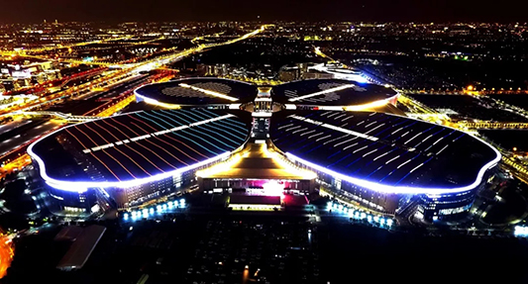
2
国家会展中心（上海）
Exhibitor’s Diary

Slide 49
During this period, I will learn:
how to apply for attendance at a conference;
how to enquire about registration for a conference.

Slide 50
I. Lead-in Practice
Task Work with your partner and collect your thoughts on the following
questions.
1. Why should an attendee prepare for a conference?
Preparation will make an attendee better able to contribute in a productive, efficient way. It also provides the attendee with the confidence and capability to work within a restrictive time schedule.
2. How can an attendee prepare for a conference?
Preparing for a self-introduction.
Dressing well.
Having a packing list.
Researching people who will be attending the conference, especially speakers.

Slide 51
II. Reading
Passage Tips for Meeting Attendance
If you are attending a meeting, it makes sense to prepare well before the event. Being well prepared means you will be more able to contribute in a productive, efficient way. Preparation also provides you with the confidence and capability to work within a restrictive time schedule.
Participation
In order to successfully contribute to any meeting, you will have to gather background information on the purpose of the meeting. Reading through the agenda before the meeting takes place will give you a good foundation of knowledge and enable you to contribute in a professional and well-informed manner. It will also allow you to work out what you want to say, how much time you have to say it and give you confidence in your ability to deliver the information.

Slide 52
II. Reading
Passage Tips for Meeting Attendance
Points of View
Meetings generally take place within a very tight time schedule and being aware of thiswill ensure your points of view are delivered in a professional and direct way. There is no room for time-wasting. So, make sure you are well-prepared, well-informed and capable of making your point of view heard.
Dress to Impress
Dress is important, and contributes to the message you are trying to communicate. Looking professional will earn you added respect and increase your confidence. First impressions count, so ensure your opening statement is powerful and meaningful. Make sure you have all your facts right, as you will only get one opportunity to have your say.

Slide 53
II. Reading
Passage Tips for Meeting Attendance
Speaking
Whilst the content of your speech is important, the way you deliver the information is equally important. Concentrate on speaking clearly and confidently. Take a deep breath before you begin and relax yourself mentally. Varying the tone of your voice throughout your speech will also help your presentation. Good speaking will create a positive impression.
When other people are speaking, acknowledge their contribution by paying attention and listening to what they have to say. Do not interrupt them in any way. Show others the respect that they have shown you by actively listening.
Tailor what you have to say to fit the mood of the meeting. For instance, you may discover that other speakers’ views are very similar to your own and you may want to elaborate on this in some way. There are many ways of changing what you want to say to make it sound more interesting. So adapt your contribution to suit the meeting, and the time schedule.

Slide 54
II. Reading
Passage Tips for Meeting Attendance
well-informed adj. possessing sound knowledge 知识渊博的
tailor v. to adjust to a specific need or market 按需定制
elaborate v. to add details, as to an account or idea; clarify the meaning in a learned way, usually in writing 详细地说明

Slide 55
II. Reading
Passage Tips for Meeting Attendance
Task 1 Read the text and fill in the form below with the information from
the text.
To-do List for Attending a Meeting
Participation | Gather background information on the purpose of the meeting. Read ___________________________________________________.
Points to view | Deliver points of view _____________________________________. Be well-prepared, well-informed and make your point of view heard.
Dress to impress | Look ___________________________________________________. Ensure the opening statement to be powerful and meaningful. Make sure ______________________________________________.
through the agenda
in a professional and direct way
professional
all facts are right

Slide 56
II. Reading
Passage Tips for Meeting Attendance
Task 1 Read the text and fill in the form below with the information from
the text.
To-do List for Attending a Meeting
Speaking | Concentrate on speaking clearly and confidently. Take a deep breath before the start and relax mentally. Vary ___________________________________________________. Pay attention to __________________________________________. Show others respect by actively listening. Tailor __________________________________________________.
the tone of voice throughout the speech
others’ speaking
what have to be said

Slide 57
II. Reading
Passage Tips for Meeting Attendance
Task 2 Read the text again and answer the following questions.
1. Why is reading the agenda beforehand important for an attendee to successfully contribute to a meeting?
It will give the attendee a good foundation of knowledge and enable him/her to contribute in a professional, well-informed manner. It will also allow the attendee to work out what he/she wants to say, how much time the attendee have to say it and give the attendee confidence in him/her ability to deliver the information.
2. Why is dress important?
It will contribute to the message you are trying to communicate, earn you added respect and increase your confidence.

Slide 58
III. Do It Yourself
Attending conferences is a great way to learn new skills, meet people, and build a network of support that helps grow your business and career. If you go in without a plan or conference guide, you’ll waste both your time and money. So, use checklists to make sure you get the most out of your conference experience.
Suppose you are going to attend a conference, make a checklist for it.
Before the conference:
Booking your conference
During the conference (Attending the conference)：
Register early
After the conference
Following up with new contacts

Slide 59
III. Do It Yourself
Suppose you are going to attend a conference, make a checklist for it.
Before the conference:
Booking your conference
Booking your accommodation
Booking your travel
Preparing to travel (making a packing list)
During the conference (Attending the conference)：
Register early
Planning your sessions
Participating actively
Taking notes
After the conference
Following up with new contacts
Sharing what you learned with your team and company
Updating your curriculum vitae

Slide 60

IV. Situational Dialogs
Enquiring about registration for an international
conference
Dialog
Chris Davis:
the Sales Manager of Saidel Exhibition Co., Ltd., a famous international convention and exhibition company
Jason Jones:
the Director of Business Recruitment and Expansion Department, Temple
Economic Development Corporation Business Services

Slide 61
IV. Situational Dialogs
Enquiring about registration for an international
conference
Dialog
Task 1 Close your book and listen to the dialog.
1. I am calling to enquire ...
2. What is the location of the convention center?
3. What is the dress code?
4. The dress code is business casual.
5. How do I register…?
6. How can I pay?

Slide 62
IV. Situational Dialogs
Enquiring about registration for an international
conference
Dialog
Chris: Hello, Saidel Exhibition Co., Ltd., how can I help you?
Jason: Hello, this is Jason Jones, Director of Business Recruitment and Expansion Department of Temple Economic Development Corporation Business Services. I am calling to enquire about the annual Toys & Games Summit. I have a few questions to ask.
Chris: Go ahead please.
Jason: When will the conference be held?
Chris: The conference is scheduled from January 11 to 12. The registration desk will be open at 8:00 am on Tuesday, January 11.

Slide 63
IV. Situational Dialogs
Enquiring about registration for an international
conference
Dialog
Jason: What is the location of the convention center?
Chris: Hong Kong Convention and Exhibition Center, 1 Expo Drive, Wanchai.
Jason: What is the dress code?
Chris: The dress code is business casual.
Jason: Is there transportation from your value-for-money hotels to the convention center?
Chris: Yes, shuttle buses will be available. A much more detailed schedule will be posted about three weeks before the conference begins.

Slide 64
IV. Situational Dialogs
Enquiring about registration for an international
conference
Dialog
Jason: How do I register if I want to attend?
Chris: All of our speakers are invited already. General attendees may go to our website and register by following the guide step by step.
Jason: Then, how can I pay?
Chris: During the registration process, follow the instructions on the invoice to complete the payment.
Jason: I got it. Thank you very much for all of your help.
Chris: You are welcome.

Slide 65
IV. Situational Dialogs
Enquiring about registration for an international
conference
Dialog
Task 2 Read the dialog again and recite the underlined expressions.
Task 3 Work in groups. Act as Chris Davis and Jason Jones and role-play
the dialog.

Slide 66
IV. Situational Dialogs
Enquiring about registration for an international
conference
Dialog
Task 4 Simulation: Make up a dialog with your partner, taking the roles of
Mr. Hemingway and Ms. Tao.
Mr. Joe Hemingway is the Marketing Manager of the Organizing Committee of International Conference on Frontiers of Artificial Intelligence and Machine Learning. Ms. Yue Tao, the Marketing Manager of an artificial intelligence company, calls to enquire about registration and detailed information about the conference she is going to attend.

Slide 67
IV. Situational Dialogs
Enquiring about registration for an international
conference
Dialog
Event Info.: International Conference on Frontiers of Artificial Intelligence
and Machine Learning 人工智能与机器学习国际会议
International Conference on Frontiers of Artificial Intelligence and Machine Learning (FAIML) is organized by the International Academy of Science and Engineering for Development (IASED). The conference is an ideal platform for keeping up with advances and changes to a consistently transforming AI field.

Slide 68
Project: Designing an Agenda
Work in groups of four. Search the Internet for information on a conference you are interested in.
Step 1
Design an agenda for the conference in paper form. Refer to Sample Study and involve the key sections.
the header
the body
Step 2
Step 3
Illustrate the agenda designed by your group in class next time.
Step 4
Give comments on the agendas of other groups in terms of content and creativity.

Slide 69



PPT模板下载：www.1ppt.com/moban/ 行业PPT模板：www.1ppt.com/hangye/
节日PPT模板：www.1ppt.com/jieri/ PPT素材下载：www.1ppt.com/sucai/
PPT背景图片：www.1ppt.com/beijing/ PPT图表下载：www.1ppt.com/tubiao/
优秀PPT下载：www.1ppt.com/xiazai/ PPT教程： www.1ppt.com/powerpoint/
Word教程： www.1ppt.com/word/ Excel教程：www.1ppt.com/excel/
资料下载：www.1ppt.com/ziliao/ PPT课件下载：www.1ppt.com/kejian/
范文下载：www.1ppt.com/fanwen/ 试卷下载：www.1ppt.com/shiti/
教案下载：www.1ppt.com/jiaoan/ PPT论坛：www.1ppt.cn
Thank you!

