Slide 1


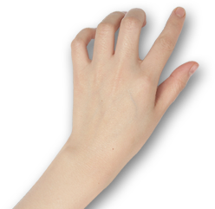

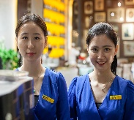
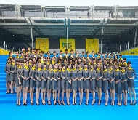
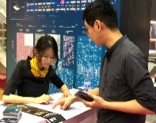
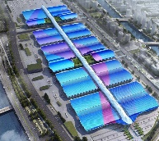
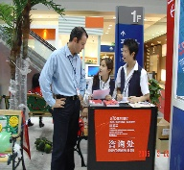
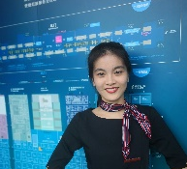
English for Exhibition and Conference
会 展 英 语

Slide 2
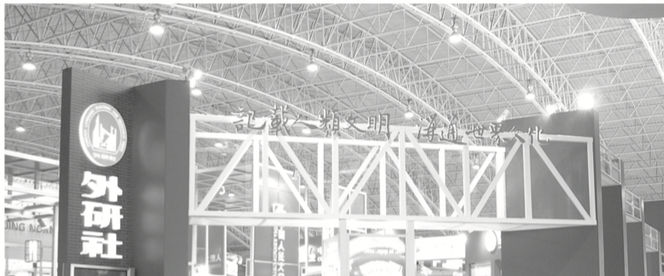
Unit 5
Exhibition Services and Booth Reception

Slide 3
Unit Objectives
After studying this unit, you will learn:
As an organizer:
  how to receive exhibitors and visitors during the show;
  how to provide services to exhibitors and visitors.
As an exhibitor:
  how to provide booth services;
  how to give introduction to the company and its products;
  how to negotiate prices and payment terms.

Slide 4
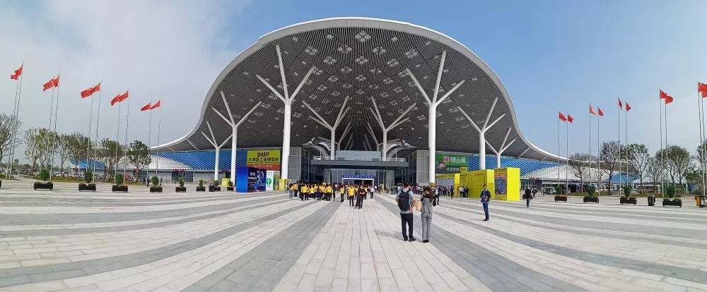
1
深圳国际会展中心
Organizer’s Diary

Slide 5
During this period, I will learn:
how to receive exhibitors and visitors during the show;
how to provide services to exhibitors and visitors.

Slide 6
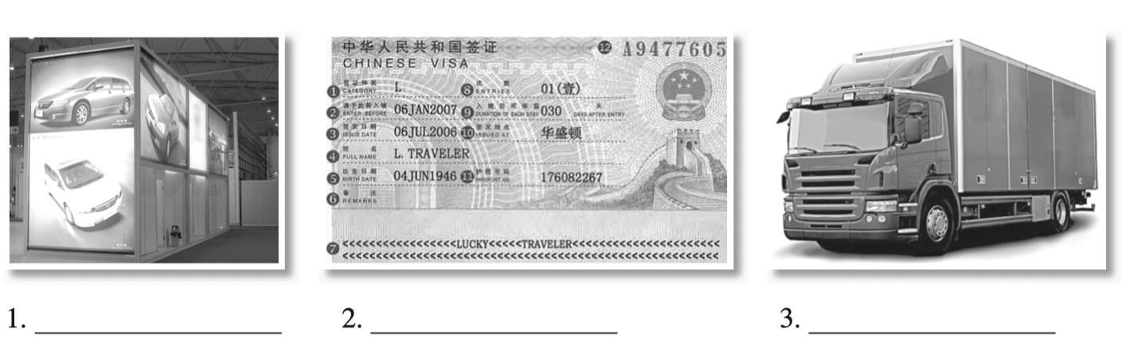
I. Lead-in Practice
Task 1 Vocabulary: Look at the pictures. Work with your partner and write out the services provided by an organizer.
standing advertising light boxes /advertising
visa/entry permit application
freight forwarder

Slide 7
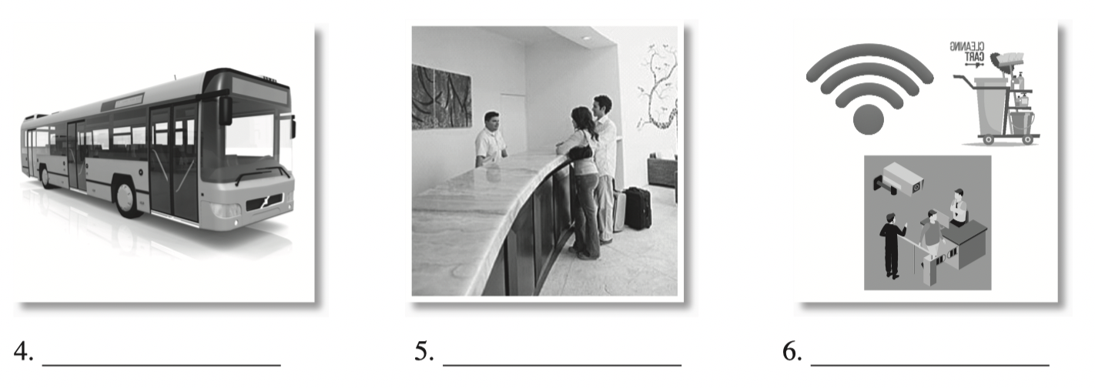
I. Lead-in Practice
Task 1 Vocabulary: Look at the pictures. Work with your partner and write out the services provided by an organizer.
(value-for-money) hotel /accommodation
shuttle bus
on-site service

Slide 8
I. Lead-in Practice
Task 2 Brainstorming: Work in groups. Discuss other services provided by the organizer during an exhibition based on Task 1 with your classmates.
Free shuttle bus services
official carrier
temporary staff agency
official stand contractor
furniture and facilities rental
official business center
printing services
stand cleaning
publicity arrangement
Wi-Fi
…

Slide 9
II. Reading
Passage 1 Exhibition Services
Planning and executing a trade show isn’t easy. Lacking attention to details, organizing a trade show can quickly become a logistical nightmare. Trade show organizers must select a time and place for the event, attract trade show exhibitors, and manage thousands of details in order to make the event a success. Besides, offering quality services to exhibitors is essential to attract reliable exhibitors to return year after year.
Services Before an Exhibition
Organizers should provide a wide variety of trade show services before an exhibition. For instance, organizers can offer exhibitors a list of designers and constructors who specialize in creating eye-catching trade show exhibits. The rest services could be: providing official freight forwarders, official air express companies, official carriers, value-for-money hotels, etc.

Slide 10
II. Reading
Passage 1 Exhibition Services
In an international exhibition, foreign exhibitors and buyers are part of the event. Organizers should assist exhibitors and buyers with visa application procedures when necessary. What’s more, organizers should meet the increasing demand for interpreters (including simultaneous interpreters) and translators to accommodate exhibitors and buyers from different countries.
Services During an Exhibition
During an exhibition, organizers could also provide services to make the exhibition run smoothly, such as temporary staff agencies, printing services, security services, official business center, installation and dismantling labor, cellphone charging services, stand cleaning, Internet access at the fair, parking, free shuttle buses, furniture and facilities rental, publicity arrangements, exhibit storage, etc.

Slide 11
II. Reading
Passage 1 Exhibition Services
Value-added Services
If organizers can provide additional services to make the trade show more attractive, exhibitors and buyers will be more likely to consider attending. For example, organizers can contract other companies to offer childcare services for exhibitors and visitors with young children. Organizers can even supply an easy-to-use trade show checklist to prospective exhibitors to help simplify their planning efforts. Exhibitors’ needs and preferences should also be considered when planning meals, entertainment, and seating arrangements.
Organizers focus on constructing a platform through which buyers and sellers can meet. A significant part of that task requires attracting exhibitors and visitors and working with dependable trade show contractors in order to create a successful event.

Slide 12
II. Reading
Passage 1 Exhibition Services
logistical adj. of or relating to the management of the flow of goods between the point of origin and the point of destination in order to meet the requirements of customers or corporations 后勤方面的
freight forwarder a company that serves as an intermediary between transportation companies that import and export goods and the businesses that need them 货运代理
carrier n. a firm in the business of transporting people or goods or messages 运输公司
value-for-money adj. worthy 物超所值的
simultaneous adj. occurring or operating at the same time 同步的
accommodate v. to make fit for, or change to suit a new purpose 使适应

Slide 13
II. Reading
Passage 1 Exhibition Services
Task 1 Read the text and answer the following questions.
1. Why should organizers provide quality services to exhibitors?
To attract reliable exhibitors to return year after year.
2. What extra services should an organizer provide when organizing an international exhibition?
An organizer should assist exhibitors and buyers with VISA application procedures when necessary, and provide interpretation and translation services.

Slide 14
II. Reading
Passage 1 Exhibition Services
Task 1 Read the text again and decide whether the following statements are true (T) or false (F).
 | 1. Choosing an appropriate time and place for a trade show is the most important thing to attract exhibitors.
 | 2. Organizers could design and construct booths for exhibitors.
 | 3. Organizers could provide interpretation services for international exhibitors and buyers.
 | 4. If childcare services are offered, exhibitors and visitors will be more likely to consider attending.
 | 5. A successful event needs good cooperation between organizers and trade show contractors.
F
F
F
T
T

Slide 15
III. Sample Study
A lead card is a client information sheet or a customer enquiry form, which can greatly increase follow-up sales. The lead card should be no larger than 4" × 7" (about 10 cm × 18 cm) and be easily recognized as a “note”. Enough space should be created on the card for personal information.
It generally includes the following key elements:
visitor’s name, address, tel, fax and email
budget in mind
product(s)/service(s) currently used
preferred method of contact
product(s)/service(s) of interest
rate of interest
comments
sales representative

Slide 16
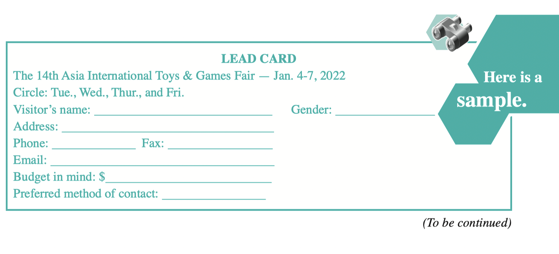
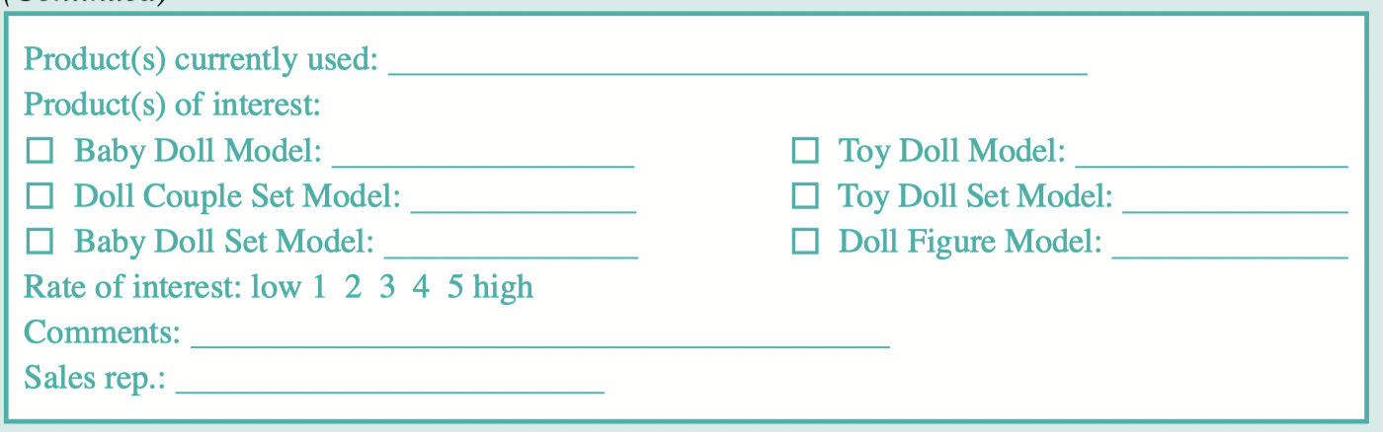
III. Sample Study
Sample 1

Slide 17
III. Sample Study
Task Match the terms in column A with the translations in column B.
A
Budget in mind
Comments
Product(s) currently used
Preferred method of contact
Product(s) of interest
Rate of interest
Sales rep.
B
目前使用产品
销售代表
首选联系方式
评价
感兴趣程度
预算
感兴趣的产品

Slide 18

IV. Situational Dialogs
Meeting exhibitors at the registration desk
Dialog one
Chris Davis:
the Sales Manager of Saidel Exhibition Co., Ltd., a famous international convention and exhibition company
Stella Li:
the Marketing Manager of Teicheng Toys Co., Ltd.

Slide 19
IV. Situational Dialogs
Meeting exhibitors at the registration desk
Dialog one
1. Welcome to the 14th Asia International Toys & Games Fair.
2. Please fill in the registration form. These are your badges.
3. I have booked a room in...
4. which is in the value-for-money hotel list.
5. We have free shuttle buses...from 8:30 am to 5:30 pm every hour.
6. I wonder whether we can apply for…
Task 1 Close your book and listen to the dialog.

Slide 20
IV. Situational Dialogs
Meeting exhibitors at the registration desk
Dialog one
Chris: Good morning. Welcome to the 14th Asia International Toys & Games Fair.
Stella: Morning. I’m Stella Li, from Teicheng Toys.
Chris: Stella, nice to meet you. I’m Chris. We have talked on the phone.
Stella: Oh, yes. Thanks for your help during our application.
Chris: You’re welcome. Please fill in the registration form. These are your badges.
Stella: Thanks. OK, I have finished the form. Here you are.

Slide 21
IV. Situational Dialogs
Meeting exhibitors at the registration desk
Dialog one
Chris: Thank you. Where will you stay during the fair? Have you booked a room in any hotel?
Stella: Yes. I have booked a room in Central Hotel, which is in the value-for-money hotel list.
Chris: Good. We have free shuttle buses from Central Hotel to the exhibition center, from 8:30 am to 5:30 pm every hour.
Stella: That’s great. You are really considerate. By the way, we have applied for an additional cabinet with sliding doors and a table showcase. Where can we get them?

Slide 22
IV. Situational Dialogs
Meeting exhibitors at the registration desk
Dialog one
Chris: Let me check. Yes, they are already in your booth.
Stella: Thanks a lot. I wonder whether we can apply for temporary booth staff now because we are in lack of hands.
Chris: I’m afraid it’s too late to apply now. You’ll have to contact the staff agency directly. But I’m not sure whether it can still be arranged.
Stella: You are really helpful. Thank you.

Slide 23
IV. Situational Dialogs
Meeting exhibitors at the registration desk
Dialog one
Task 2 Read the dialog again and recite the underlined expressions.
Task 3 Work in pairs. Act as Chris Davis and Stella Li and role-play the
dialog.

Slide 24
IV. Situational Dialogs
Meeting exhibitors at the registration desk
Dialog one
Task 4 Simulation: Make up a dialog with your partner, taking the roles
of Mr. Hemingway and Ms. Tian.
Mr. Joe Hemingway is the Marketing Manager of an exhibition company that organizes China-Northeast Asia Expo. Ms. Tian is an exhibitor at the exhibition. Mr. Hemingway greets Ms. Tian at the registration desk.

Slide 25
IV. Situational Dialogs
Meeting exhibitors at the registration desk
Dialog one
Event Info.: China-Northeast Asia Expo 中国—东北亚博览会（吉林·长春）
China-Northeast Asia Expo is a national-level exhibition, which has been held in Changchun since 2005. It builds an important window toward Northeast Asia and creates a center to further promote the cooperation in this region so as to accelerate comprehensive revitalization of Jilin in the new era.

Slide 26
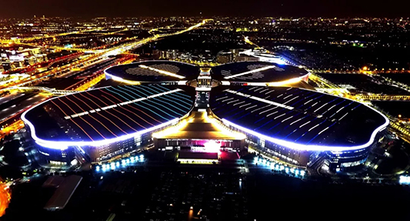
2
国家会展中心（上海）
Exhibitor’s Diary

Slide 27
During this period, I will learn:
how to provide booth services
how to give introduction to the company and its products;
how to negotiate prices and payment terms.

Slide 28
I. Lead-in Practice
Task Work with your partner and collect your thoughts on the following questions.
How important is the booth staff for the success of an exhibition?
Booth staff can make it a success or a mess.
2. What qualities are preferred for the booth staff?
They should be approachable, professional, product knowledgeable, outgoing; and they should be good communicators and good listeners.

Slide 29
II. Reading
Passage 1 Trade Show Staffing Strategies
The success of an exhibition depends on various factors such as visitors’ turnout, booth location and decoration, types of visitors and so on. Obviously some of these factors are beyond the exhibitors’ control; however, the most important thing they can do to ensure the success of the booth is selecting the right people to staff it.
Preparing a Sales Team
For the best performance, exhibitors always need to prepare a booth team prior to the event. The amount of time spent in preparation varies depending on the frequency of events, and the number and experience of people in the team. Doing the right thing at the right time will ensure great success.

Slide 30
II. Reading
Passage 1 Trade Show Staffing Strategies
Deciding the Number of Staff
Besides the timing, exhibitors have to decide the number of booth staff. The size of the exhibit, the duration of the show, the type of interactions required between the staff and visitors will decide the number of staff. Select one main supervisor to oversee the whole operation of the booth, and delegate to him/her the tasks of establishing dress code of all booth staff, and preparing name badges, brochures, pamphlets, business cards and some free gifts for visitors.
Doing a Mock Show for Booth Training
Have a mock show, try to simulate the amount of time that will be spent by a booth staff with a single visitor and consult more experienced trade show runners. Be sure to have sufficient staff to manage the booth at all times, and allocate breaktime every few hours for staff. Moreover, a mock show and training will be most effective if the staff could be well_x0002_versed in product knowledge, marketing methods, follow-up, lead generation and also know how to handle unexpected questions or situations.

Slide 31
II. Reading
Passage 1 Trade Show Staffing Strategies
Trade shows are one of the best marketing tools available because they allow exhibitors to meet target customers under one roof. However, selecting the wrong people to manage the booth may hurt the chances of success at the event. These employees will be the face of exhibitors’ company at the event; so choose wisely.

Slide 32
II. Reading
Passage 1 Trade Show Staffing Strategies
turnout n. attendance for a particular event or purpose 到场人数
timing n. the time when someone dose something or when something happens especially when you are considering how suitable it is 时间
delegate v. to transfer power to someone 授权
pamphlet n. a small book usually having a paper cover 小册子
mock adj. constituting a copy or imitation of something 模拟的
simulate v. to reproduce someone ’ s behavior or looks 模拟；模仿
allocate v. to give something to a particular person, especially after an official decision has been made 分配
well-versed adj. knowing a lot about something 通晓的；精通的
follow-up n. an activity that continues something that has already begun or that repeats something that has already been done 后续行动

Slide 33
II. Reading
Passage 1 Trade Show Staffing Strategies
Task 1 Read the text and fill in the form below with the information from the text.
Staffing Strategies | Decisive Points or Details
Preparing a sales team | The frequency of events
Deciding the number of staff | The size of the exhibit
Doing a mock show for booth training | Simulation of time that will be spent by a booth staff with a single visitor Sufficient staff to manage the booth at all times Staff well-versed in product knowledge, marketing methods, follow-up, lead generation and also knowing how to handle unexpected questions or situations

Slide 34
II. Reading
Passage 1 Trade Show Staffing Strategies
Task 1 Read the text and fill in the form below with the information from the text.
Staffing Strategies | Decisive Points or Details
Preparing a sales team | The frequency of events
Deciding the number of staff | The size of the exhibit
The number and experience of people in the team
The duration of the show
The type of interactions required between the staff and visitors

Slide 35
II. Reading
Passage 1 Trade Show Staffing Strategies
Task 1 Read the text and fill in the form below with the information from the text.
Staffing Strategies | Decisive Points or Details
Doing a mock show for booth training | Simulation of time that will be spent by a booth staff with a single visitor Sufficient staff to manage the booth at all times Staff well-versed in product knowledge, marketing methods, follow-up, lead generation and also knowing how to handle unexpected questions or situations
Consultation with more experienced trade show runners
Breaktime every few hours

Slide 36
II. Reading
Passage 1 Trade Show Staffing Strategies
Task 2 Read the text again and answer the following questions.
What can exhibitors do to ensure the success of the booth?
Select the right people to staff the booth.
2. What are the tasks for the main supervisor?
The tasks are overseeing the whole operation of the booth, establishing dress code of all booth staff, and preparing badges, brochures, pamphlets, business cards and some free gifts for visitors.

Slide 37
II. Reading
Passage 2 Interacting with Visitors
prequalify v. to qualify or certify someone or something as a candidate 提前认证资格
personify v. to represent something in a physical form 体现
effectiveness n. the quality of being able to bring about an expected result 有 效性
etiquette n. the practices and forms prescribed by social convention or by authority 礼节
packet n. a small flat package that is sent by post or delivered to someone 小包裹

Slide 38
II. Reading
Passage 2 Interacting with Visitors
Task 1 Read the text and fill in the blanks with the given words and phrases according to the context.
1. find out 2. demonstration 3. achieving
4. on display 5. buyers 6. complete

Slide 39
II. Reading
Passage 2 Interacting with Visitors
During an event, booth staff carry the responsibility for prequalifying exhibit visitors, establishing relationships with them and converting prospects into leads and then into 1 _______, as well as personifying products’ quality and image.
In other words, the effectiveness of the staff can make or break the success at any show. Therefore, staff should be friendly, lively, with proper trade show etiquette and fully engaged in
2 ________________ a company’s goals for attending a show.
Staff should greet and engage visitors quickly and warmly within 30 seconds. After that they introduce themselves with a one-minute overview of the company and its benefits; then questions are asked to 3 ________________ if the visitors are good prospects, followed by another30 seconds of details on products or services. For qualified prospects, staff should spend about10 minutes discussing needs and/or conducting a 4 ________________,and getting visitors’ information for effective follow-up after the event.
buyers
achieving
find out
demonstration

Slide 40
II. Reading
Passage 2 Interacting with Visitors
Once a prospect shows interest in the products or services 5 ________________ , make a careful note of his/her name, company, area of interest, etc. If completion of a lead card in the prospect’s presence is not appropriate, do obtain his/her business card, and 6 _______________ the lead card once he/she has left. The data collected will help send the appropriate material after the show and enable sales personnel to adequately prepare before contacting the prospect.
After return from the show, staff should contact each lead immediately with phone calls, packets, letters and invitations for meetings to discuss next steps.
on display
complete

Slide 41
II. Reading
Passage 2 Interacting with Visitors
Task 2 Read the text again and answer the following questions.
1. What are the responsibilities of the booth staff?
Prequalifying exhibit visitors, establishing relationships that convert prospects into leads and then into buyers, and personifying products’ quality and image.
2. What is the time allocation for booth reception?
Greeting and engaging visitors—30 seconds; Introducing themselves with an overview of the company and its benefits—1 minute; Asking questions to qualify prospects and giving details on products or services—30 seconds; Discussing needs and/or conducting a demonstration—10 minutes.
3. What are the purposes of completing a lead card?
It will help send the appropriate material after the show and enable the sales personnel to adequately prepare before contacting the prospect.

Slide 42
III. Do It Yourself
Browse the Internet or search the library in your school. Find out the qualities and trade show etiquette for booth staff.
Qualities for booth staff
Trade show etiquette (Do’s)

Slide 43
III. Do It Yourself
Browse the Internet or search the library in your school. Find out the qualities and trade show etiquette for booth staff.
Trade show etiquette (Don’ts)

Slide 44
III. Do It Yourself
Browse the Internet or search the library in your school. Find out the qualities and trade show etiquette for booth staff.
Qualities for booth staff
Trade show etiquette (Do’s)
Dedication, independence, persuasion, marketing skills; be good at dealing with people, be able to speak confidently, not be too imposing on the visitors, be professional, be approachable, be knowledgeable about the company and products, etc.
PEOPLE formula: P—people-oriented; E—enthusiastic; O—observant; P—product knowledgeable; L—listening; E—empathetic to the visitors’ situations.
Do smile.
Do wear a suit.
Do keep hair and nails clean and neat.
Do wear comfortable shoes and stockings to complement your outfit.
Do wear natural make-up.
Do wear appropriate jewelry.
Do trim facial hair.

Slide 45
III. Do It Yourself
Browse the Internet or search the library in your school. Find out the qualities and trade show etiquette for booth staff.
Trade show etiquette (Don’ts)
Don’t overpower your appearance with heavy perfume.
Don’t wear jeans or casual slacks.
Don’t have a breath mint or chewing gum in your mouth.
Don’t stand guard on the edge of your stand with your arms folded.
Don’t sit or stand in groups with other staff.
Don’t ignore visitors.
Don’t eat or drink in the booth.

Slide 46

IV. Situational Dialogs
Dialog one
Introducing the company and products to a visitor
Stella Li:
the Marketing Manager of Teicheng Toys Co., Ltd., an exhibitor in the 14th Asia International Toys & Games Fair
Eric Blaire:
the Purchasing Manager of New Kids’ Park, a visitor of the fair

Slide 47
IV. Situational Dialogs
Introducing the company and products to a visitor
Dialog one
1. I’m Stella Li, from Teicheng Toys, and this is my business card. Which product are you interested in?
2. Could you tell me something about your company?
3. Our company was established in 2005. It has been engaged in…
4. Currently there are five main product series in the company, including
5. I’d like to show you our new product.
6. If you have booklets about the product, it would be nice.
7. And if you could leave your business card, I will send you some more detailed information.
Task 1 Close your book and listen to the dialog.

Slide 48
IV. Situational Dialogs
Dialog one
Introducing the company and products to a visitor
Stella: Good morning, sir. Welcome to our booth.
Eric: Good morning.
Stella: I’m Stella Li, from Teicheng Toys, and this is my business card. Which product are you interested in?
Eric: Hmm, Teicheng Toys. Glad to see you. Could you tell me something about your company?
Stella: My pleasure. Our company was established in 2005. It has been engaged in design, research and development, manufacturing and marketing of toy series which combine education with entertainment functions.

Slide 49
IV. Situational Dialogs
Dialog one
Introducing the company and products to a visitor
Eric: Sounds good. What kinds of products do you manufacture?
Stella: Currently there are five main product series in the company, including electronic intelligent toys, plastic toys, model toys, cartoon toys and other toys. What are you interested in?
Eric: I am looking for some electronic intelligent toys.
Stella: Oh, I’d like to show you our new product—Amazing Annie. It’s an interactive talking doll and includes voice recognition technology. Annie sells well in our country.
Eric: That’s interesting. Would you please tell me more about it?

Slide 50
IV. Situational Dialogs
Dialog one
Introducing the company and products to a visitor
Stella: Yes. Amazing Annie is a toddler toy, which can “express” emotions and engage in a sort of two-way communication with its owner. The doll can speak “eat” or “drink” to different objects and recognize her mommy’s voice after hearing it just three times.
Eric: I’m really interested in it. If you have booklets about the product, it would be nice.
Stella: Sure. This is a brochure about our company and products. And if you could leave your business card, I will send you some more detailed information about the product.
Eric: Thank you. Here is my card. Nice talking with you.

Slide 51
IV. Situational Dialogs
Dialog one
Introducing the company and products to a visitor
Task 2 Read the dialog again and recite the underlined expressions.
Task 3 Work in pairs. Act as Stella Li and Eric Blaire and role-play the dialog.

Slide 52
IV. Situational Dialogs
Dialog two
Negotiating the price and payment
Stella Li:
the Marketing Manager of Teicheng Toys Co., Ltd., an exhibitor in the 14th Asia International Toys & Games Fair
Tom Keats:
the Purchasing Manager of Youth Co., Ltd., a visitor of the fair

Slide 53
IV. Situational Dialogs
Dialog two
Negotiating the price and payment
Task 1 Close your book and listen to the dialog.
1. Annie is our new invention and has been on the market for only a few weeks, but it has already become very popular.
2. How much is the doll?
3. Could you tell me how many you will order?
4. The minimum order quantity is 100 pieces, and the prices change according to your order.
5. I’m thinking of placing an order of 300.
6. If you don’t give me some discount, I’m afraid I will turn to other suppliers.
7. if the order is more than 500 pieces, we’ll give you another 3% discount
8. Let’s close the deal for…

Slide 54
IV. Situational Dialogs
Dialog two
Negotiating the price and payment
Tom: After your introduction, I think your products are very attractive, and I’m especially impressed by your talking doll—Amazing Annie.
Stella: I’m pleased that you’re interested in our products. Annie is our new invention and has been on the market for only a few weeks, but it has already become very popular.
Tom: That’s good. How much is the doll?
Stella: Could you tell me how many you will order? The minimum order quantity is 100 pieces, and the prices change according to your order.

Slide 55
IV. Situational Dialogs
Dialog two
Negotiating the price and payment
Tom: I’m thinking of placing an order of 300.
Stella: Let me see. It would be US$ 49 per piece.
Tom: That’s too expensive. I know the market quite well.
Stella: We provide quality goods, and we’re sure it will sell well in your market.
Tom: But your price is above the market price already, and it’s unacceptable. If you don’t give me some discount, I’m afraid I will turn to other suppliers.
Stella: Well, to show our sincerity for cooperation, I’ll give you a 5% discount. That is to say, $ 46.55 for each.

Slide 56
IV. Situational Dialogs
Dialog two
Negotiating the price and payment
Tom: It’s still high for me.
Stella: Well, if the order is more than 500 pieces, we’ll give you another 3% discount, which means 8% discount in total. That’s the lowest we can go.
Tom: All right. Let’s close the deal for 500 pieces, 8% discount. I hope neither of us will be disappointed. What about the payment terms?
Stella: We accept T/T, 30% deposit, and 70% payment balanced before shipment.
Tom: Done.

Slide 57
IV. Situational Dialogs
Negotiating the price and payment
Dialog two
Task 2 Read the dialog again and recite the underlined expressions.
Task 3 Work in pairs. Act as Stella Li and Tom Keats and role-play the dialog.

Slide 58
IV. Situational Dialogs
Negotiating the price and payment
Dialog two
Task 4 Simulation: Make up a dialog with your partner, taking the roles of Mr. Brake and Ms. Luo.
Mr. William Brake is the Marketing Manager of Gladtea Company which exhibits at Anhui International Tea Industry Expo. Ms. Grace Luo is a visitor of the company’s booth. Mr. Brake introduces his company and products to Ms. Luo. Then they negotiate the price of one product and the payment terms.

Slide 59
IV. Situational Dialogs
Dialog two
Negotiating the price and payment
Event Info.: Anhui International Tea Industry Expo 安徽国际茶产业博览会（安徽·合肥）
Anhui International Tea Industry Expo is an influential exhibition of tea industry in China. This Expo aims to carry forward Chinese tea culture, promote the development of the tea industry in Anhui Province, and comprehensively display the latest achievements of tea industry development in Anhui Province.

Slide 60
Project: Designing a Lead Card
Work in groups of three. Search the Internet for information on a trade show you are interested in.
Step 1
Design a lead card for an exhibitor who attends the trade show. Refer to Sample Study and involve all the key elements.
• visitor’s name, address, tel, fax and email
• budget in mind
• product(s)/service(s) currently used
• preferred method of contact
• product(s)/service(s) of interest
• rate of interest
• comments
• sales representative
Step 2

Slide 61
Project: Designing a Lead Card
Step 3
Illustrate the lead card of your group in class next time.
Step 4
Give comments on the lead cards of other groups in terms of content and creativity.

Slide 62



PPT模板下载：www.1ppt.com/moban/ 行业PPT模板：www.1ppt.com/hangye/
节日PPT模板：www.1ppt.com/jieri/ PPT素材下载：www.1ppt.com/sucai/
PPT背景图片：www.1ppt.com/beijing/ PPT图表下载：www.1ppt.com/tubiao/
优秀PPT下载：www.1ppt.com/xiazai/ PPT教程： www.1ppt.com/powerpoint/
Word教程： www.1ppt.com/word/ Excel教程：www.1ppt.com/excel/
资料下载：www.1ppt.com/ziliao/ PPT课件下载：www.1ppt.com/kejian/
范文下载：www.1ppt.com/fanwen/ 试卷下载：www.1ppt.com/shiti/
教案下载：www.1ppt.com/jiaoan/ PPT论坛：www.1ppt.cn
Thank you!

