Slide 1


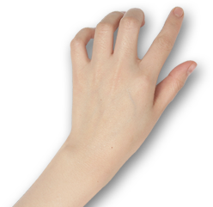

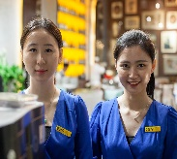
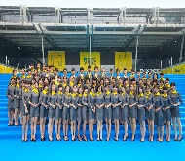
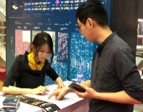
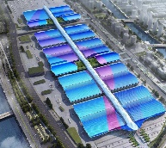
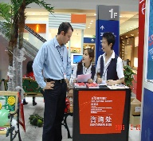
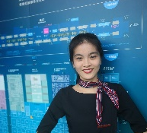
English for Exhibition and Conference
会 展 英 语

Slide 2

Unit 6
Dismantling and Follow-up Contact

Slide 3
Unit Objectives
After studying this unit, you will learn:
As an organizer:
  how to assist exhibitors to move out;
  how to acquire feedback from exhibitors.
As an exhibitor:
  how to dismantle display items;
  how to make follow-up contact;
  how to express gratitude to customers and the organizer.

Slide 4
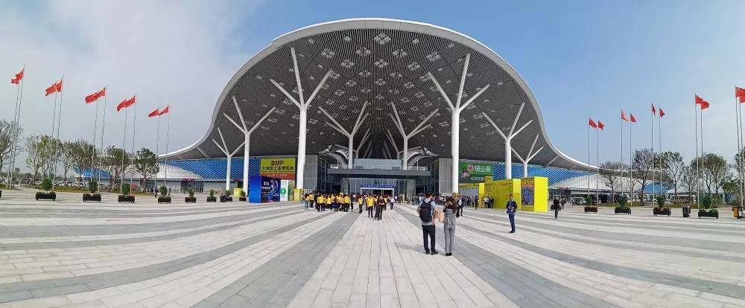
1
深圳国际会展中心
Organizer’s Diary

Slide 5
During this period, I will learn:
how to assist exhibitors to move out;
how to acquire feedback from exhibitors.

Slide 6
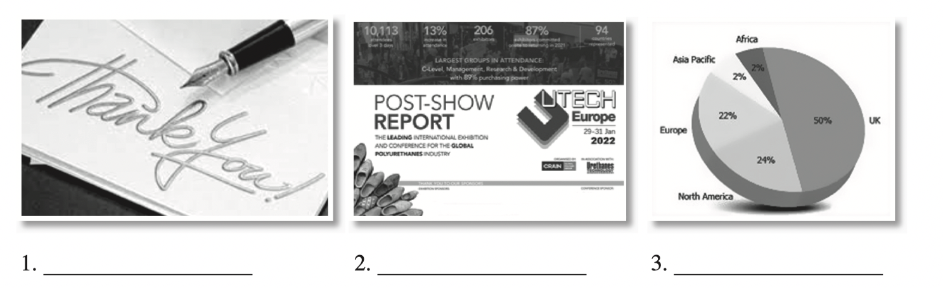
I. Lead-in Practice
Task 1 Vocabulary: Look at the pictures. Work with your partner and write out the post-show activities.
exhibition summary report /post-show report
follow-up letter
exhibition analysis

Slide 7
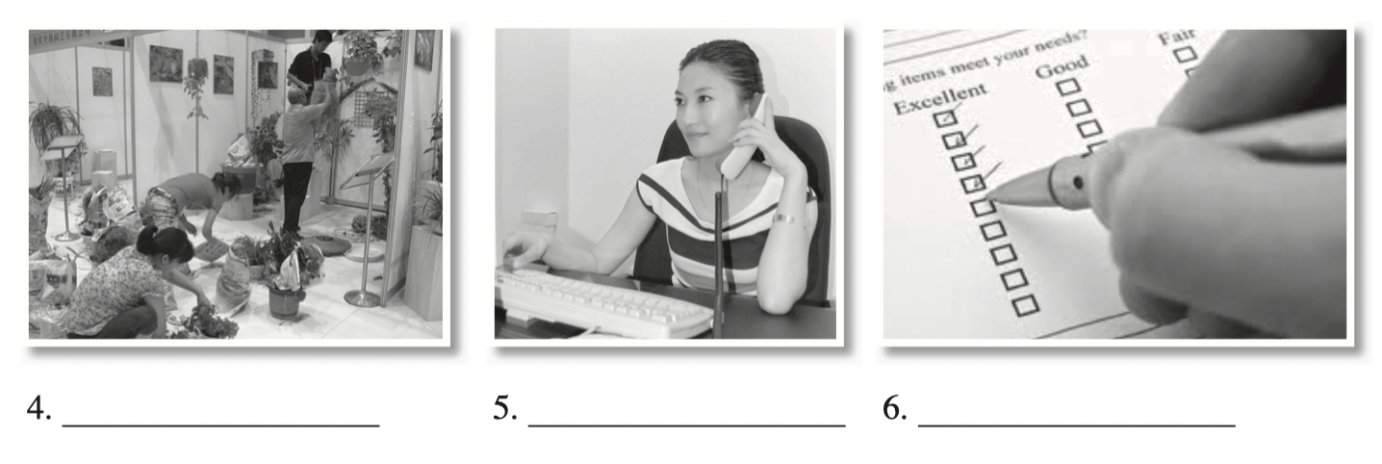
I. Lead-in Practice
Task 1 Vocabulary: Look at the pictures. Work with your partner and write out the post-show activities.
booth dismantling
follow-up phone call
gathering feedback by questionnaires

Slide 8
I. Lead-in Practice
Task 2 Brainstorming: Work in groups. Discuss the post-show work for an
organizer based on Task 1 with your classmates.
Dismantling
Questionnaire
Feedback
Exhibition analysis
Exhibition review
Dismantling the booth as soon as the show is over. Displays and products should be moved out of the venue in set time.
Distributing a questionnaire to exhibitors, buyers and visitors
Gathering feedback by analyzing the questionnaire
Analyzing the results of the exhibition
Summarizing the exhibition as a whole

Slide 9
II. Reading
Passage 1 Post-show Work for an Organizer
Most people think that organizing and promoting the exhibition is all that is needed. This is not entirely true. There is so much involved in making your organization of a trade show successful.
As soon as the exhibition is over, the organizer needs to evaluate the effectiveness of the organizing of the exhibition. A form for each visitor and exhibitor should be filled out and collected to survey visitors and stand personnel. A result analysis from key indicators such as the number of visitors, exhibitors and contracts signed should be conducted. This is to assess the economic and non-economic effect of the exhibition. The organizer will compare the results with the set goals and previous exhibition if there is any. This can be used for the next exhibition and for exhibitors’ reference.
Another important aspect of organizing trade shows is following up with exhibitors afterward. The organizer doesn’t want all of the hard work, time, and energy to be wasted by not following through and will make sure the show is productive.

Slide 10
II. Reading
Passage 1 Post-show Work for an Organizer
One of the most important elements for post-show work is time. As soon as the show is over and all visitors and exhibitors have left the exhibition site, the organizer will start to work for the follow-up contact right away to show the clients how dedicated he/she is. It shouldn’t be put off to reconnect those exhibitors as the organizer wants a positive image to be easily recalled and wants to continue the helpful, eager impression created. An organizer should try to be helpful when the exhibitors need any analytical statistics from this exhibition. If some of the exhibitors need more information on the sales of one particular product or if there is information that they need to investigate, the organizer should make giving them the required information a post-show priority. Demonstrate your speediness and ability to keep your word. This will build credibility and support your image as well.

Slide 11
II. Reading
Passage 1 Post-show Work for an Organizer
To reiterate, post-show work is very important for the success of an exhibition. It is a very critical part of the trade show process. Besides distributing your brochures, handing out your promotional materials and networking, remember the closing procedures of a trade show. You’re there to establish contacts, so strengthen them and stay connected by following up soon after the closure of the trade show event.

Slide 12
II. Reading
Passage 1 Post-show Work for an Organizer
survey v. to ask a large number of people questions in order to find out their attitudes or opinions 调查
assess v. to judge the worth of something 评定；评估
dedicated adj. giving a lot of time and energy to a specific person, activity, or cause 专注的
statistics n. data that can be represented numerically 统计数据
credibility n. the quality of being believable or trustworthy 信誉；可靠性
reiterate v. to say, state, or perform again 重申

Slide 13
II. Reading
Passage 1 Post-show Work for an Organizer
Task 1 Read the text and fill in the form below with the information from the text.
Post-show Work for an Organizer
Evaluating the Effectiveness | Following Up with Exhibitors
Surveying _______________ | Reconnecting _______________
Analyzing _______________ | Being helpful _______________
Assessing _______________ | Sending ___________________
Comparing ______________ | Demonstrating ______________

Slide 14
II. Reading
Passage 1 Post-show Work for an Organizer
Task 1 Read the text and fill in the form below with the information from the text.
Post-show Work for an Organizer
Evaluating the Effectiveness | Following Up with Exhibitors
Surveying | Reconnecting
Analyzing | Being helpful
Assessing | Sending
Comparing | Demonstrating
visitors and stand personnel
exhibitors
the result from key indicators
when the exhibitors need any analytical statistics from this exhibition
the economic and non-economic effect
the required information
the result with the set goals and previous exhibition
your speediness and ability to keep your word

Slide 15
II. Reading
Passage 1 Post-show Work for an Organizer
Task 2 Read the text and answer the following questions.
1. What should an organizer do to evaluate the effectiveness of the organizing of the exhibition?
2. Why should an organizer follow up with exhibitors after the show?
3. Why is time so crucial to post-show work for organizers?
4. What should an organizer do when exhibitors need statistical information from the exhibition?

Slide 16
II. Reading
Passage 1 Post-show Work for an Organizer
Task 2 Read the text and answer the following questions.
What should an organizer do to evaluate the effectiveness of the organizing of the exhibition?
Design a questionnaire to survey visitors and stand personnel. Analyze key
indicators such as the number of visitors, exhibitors and contracts signed.
2. Why should an organizer follow up with exhibitors after the show?
To make sure the show is productive.

Slide 17
II. Reading
Passage 1 Post-show Work for an Organizer
Task 2 Read the text and answer the following questions.
3. Why is time so crucial to post-show work for organizers?
Firstly, the organizers want to show the clients their dedication. Secondly, they want their positive image to be easily recalled and to continue the helpful, eager impression they have already created.
4. What should an organizer do when exhibitors need statistical information from the exhibition?
An organizer should be helpful and make it a post-show priority to give them the required information.

Slide 18
II. Reading
Passage 2 Post-show Dismantling
dismantle v. to take a machine or piece of equipment apart so that it is in separate
pieces 拆开；拆卸
assets n. the things that a company owns 资产；财产
merchandise n. goods bought and sold 商品；货物
precaution n. an action done to avoid possible danger, discomfort, etc. 预防措施

Slide 19
II. Reading
Passage 2 Post-show Dismantling
Task 1 Read the text and fill in the blanks with the given words and phrase
according to the context.
dismantle 2. products 3. exhibitions
move-out 5. display 6. transport

Slide 20
II. Reading
Passage 2 Post-show Dismantling
When the lights dim and the show comes to a close, having a team of professionals to dismantle the booths is critical for organizers. The team will take down the booths with care, make sure the booths are packaged efficiently, and 1 _______________ all assets from the show correctly. Hiring a professional team to 2 _______________ the booths will be cost effective and free organizers to deal with other details.
All exhibits and materials must be moved out of the exhibition hall within the set time. During the 3 _______________ , it is very important to secure valuables such as computers, electronics or merchandise, and to ensure that exhibits are dismantled properly so that they can continue to serve for future 4 _______________.
As for exhibitors, take precautions to safeguard the 5 _________ and products at the rush at the close of the show. Don’t make it easy for them to be broken or for someone to walk away with part of your display. Exhibitors are not encouraged to give away their 6 ____________to visitors, other exhibitors, models, or workers. This will cause embarrassing delay and unnecessary confusion.
transport
dismantle
move-out
exhibitions
display
products

Slide 21
II. Reading
Passage 2 Post-show Dismantling
Task 2 Read the text again and answer the following questions.
1. Why should organizers hire a professional team to dismantle the booths?
It will be cost effective and free organizers to deal with other details.
2. Why should exhibit and display materials still be kept when the show is over?
They can continue to serve for future exhibitions.
3. Can an exhibitor give away his/her products at the end of the show?
No. This will cause embarrassing delay and unnecessary confusion.

Slide 22
III. Sample Study
A customer satisfaction questionnaire is a simple, productive tool to aid an organization in obtaining constructive feedback from both existing and potential customers. Feedback from the target audience could determine whether the business succeeds or fails. A well-designed questionnaire can help identify clients’ habits and determine their satisfaction with features of products or services or their inclination to purchase the products or services. It can also help the organization to better define its customer base.

Slide 23
III. Sample Study
The following are some suggestions for designing a questionnaire:
• deciding what information to gather from the survey
• asking only those questions that will provide useful information
• making the questions easy for almost anyone to understand
• arranging the questions in logical order and making them evolve from
general to specific
• using multiple-choice questions whenever possible
• avoiding leading questions that might generate negative responses
• using the same rating scale throughout the survey for questions requiring the
respondent to rate items
• testing the survey on some people beforehand

Slide 24
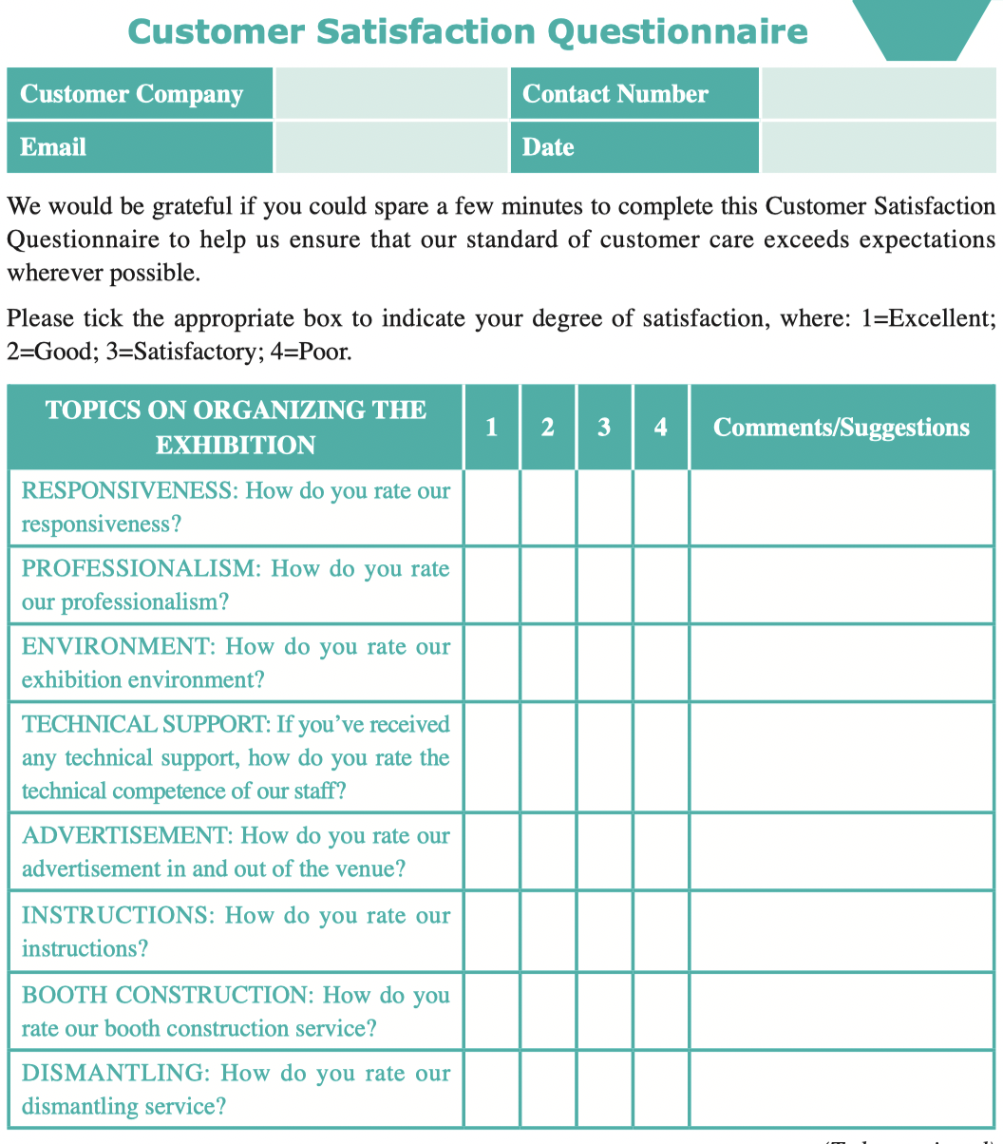
III. Sample Study
Sample 1

Slide 25
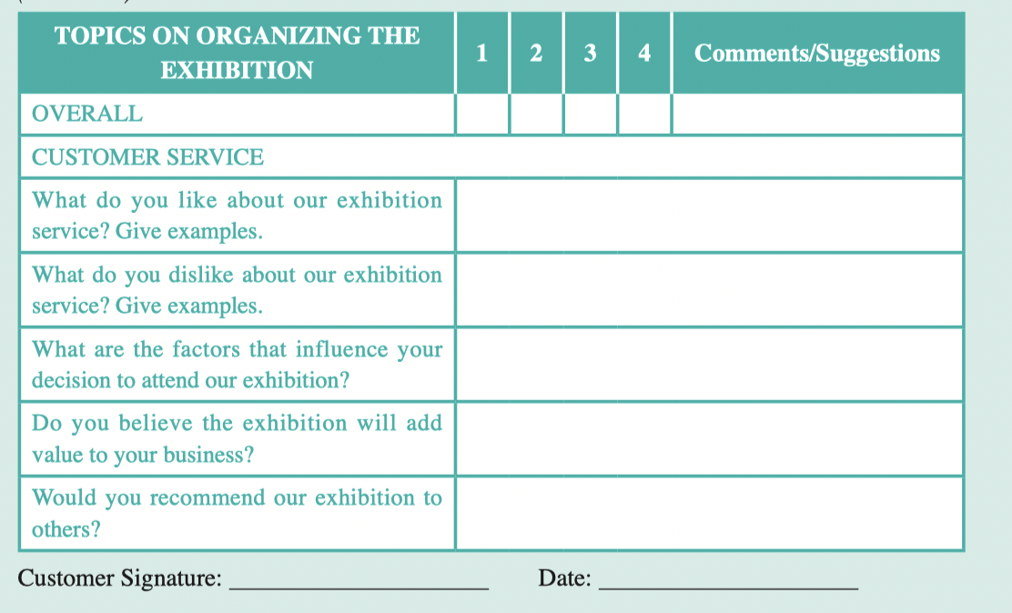
III. Sample Study
Sample 1

Slide 26
III. Sample Study
Task 1 Fill in the form with related questions asked in the above sample.
Topics | Questions Asked
Responsiveness
Professionalism
Environment
Technical support
Likes
Dislikes
Decision-making
Recommendation

Slide 27
III. Sample Study
Task 1 Fill in the form with related questions asked in the above sample.
Topics | Questions Asked
Responsiveness
Professionalism
Environment
Technical support
Likes
How do you rate our responsiveness?
How do you rate our professionalism?
How do you rate our exhibition environment?
If you’ve received any technical support, how do you rate the technical competence of our staff?
What do you like about our exhibition service? Give examples.

Slide 28
III. Sample Study
Task 1 Fill in the form with related questions asked in the above sample.
Topics | Questions Asked
Dislikes
Decision-making
Recommendation
What do you dislike about our exhibition service? Give examples.
What are the factors that influence your decision to attend our exhibition?
Would you recommend our exhibition to others?

Slide 29

IV. Situational Dialogs
Reminding an exhibitor to move out of the
venue within the set time
Dialog one
Chris Davis:
the Sales Manager of Saidel Exhibition Co., Ltd., a famous international convention and exhibition company
Stella Li:
the Marketing Manager of Teicheng Toys Co., Ltd.

Slide 30
IV. Situational Dialogs
Reminding an exhibitor to move out of the
venue within the set time
Dialog one
1. Can we dismantle our display items right now?
2. the dismantling of the booths can be started only after
3. Can you tell me the earliest possible time for dismantling?
4. Empties will be available after
5. When will the official forwarding agent come into the exhibition venue?
6. The exhibition venue will be closed after
Task 1 Close your book and listen to the dialog.

Slide 31
IV. Situational Dialogs
Reminding an exhibitor to move out of the
venue within the set time
Dialog one
Stella: Hi, Chris, the show is almost over. Can we dismantle our display items right now?
Chris: Oh. Why?
Stella: We need to return home urgently.
Chris: I am sorry but the dismantling of the booths can be started only after the exhibition has ended.
Stella: I understand. Can you tell me the earliest possible time for dismantling?

Slide 32
IV. Situational Dialogs
Reminding an exhibitor to move out of the
venue within the set time
Dialog one
Chris: It is 2:00 pm on January 7. You can get your release form at 12:00 pm and then you can dismantle and pack everything.
Stella: We are really worried about our packing work.
Chris: Well, you don’t have to be. We have already had plans for that. Due to the extremely high volume of empty containers, from 5:00 pm to 10:00 pm on January 6, the exhibition grounds will be closed to permit delivery of empties to the stands. Empties will be available after 8:00 am on January 7.

Slide 33
IV. Situational Dialogs
Reminding an exhibitor to move out of the
venue within the set time
Dialog one
Stella: That is great. When will the official forwarding agent come into the exhibition venue?
Chris: It can come after 2:00 pm on January 7. Then you must move out efficiently. The exhibition venue will be closed after 11:00 pm on January 7.
Stella: I see. Thank you very much for the information.
Chris: You are welcome!

Slide 34
IV. Situational Dialogs
Reminding an exhibitor to move out of the
venue within the set time
Dialog one
Task 2 Read the dialog again and recite the underlined expressions.
Task 3 Work in pairs. Act as Chris Davis and Stella Li and role-play the dialog.

Slide 35
IV. Situational Dialogs
Helping an exhibitor with special demands
Dialog two
Chris Davis:
the Sales Manager of Saidel Exhibition Co., Ltd., a famous international convention and exhibition company
Amy Wang:
the Marketing Manager of Kispark Furniture Group, a furniture company specialized in children’s products

Slide 36
IV. Situational Dialogs
Helping an exhibitor with special demands
Dialog two
Task 1 Close your book and listen to the dialog.
1. Are you ready for moving out?
2. The regular dismantling period ends at
3. After the exhibition’s dismantling hours are over, our logistics partner
Hunter will remove the items
4. continuous electrical supply will be cut off

Slide 37
IV. Situational Dialogs
Helping an exhibitor with special demands
Dialog two
Chris: Are you ready for moving out?
Amy: Not yet. I am a little worried. What can we do if we need extra time for dismantling?
Chris: The regular dismantling period ends at 11:00 pm on January 7. If you need more time, please apply for it.
Amy: Where shall I apply for it?
Chris: You can go to the Customer Services Counter. It is in Hall 4C.
Amy: Thank you. Do I need to pay extra money for the delay?

Slide 38
IV. Situational Dialogs
Helping an exhibitor with special demands
Dialog two
Chris: Yes. The charge is US$100 per stand per hour. Late applications will be subject to a surcharge of 100%. Extended dismantling ends at 4:00 pm on January 8 at the latest.
Amy: OK. I’m afraid it is a bit expensive. We need to finish everything before the deadline.
Chris: Yes, you should. After the exhibition’s dismantling hours are over, our logistics partner Hunter will remove the items left in the hall. They must be collected from the forwarding agent’s storage within one month, and the storage cost must be paid.

Slide 39
IV. Situational Dialogs
Helping an exhibitor with special demands
Dialog two
Amy: I see. We will try our best to move out efficiently.
Chris: You should. Besides, continuous electrical supply will be cut off after the dismantling hours have ended. If you need electricity at your stand after that, you can call us at (021) 56783421. You also must pay for it.
Amy: I got it. Thank you very much for your help!
Chris: My pleasure.

Slide 40
IV. Situational Dialogs
Helping an exhibitor with special demands
Dialog two
Task 2 Read the dialog again and recite the underlined expressions.
Task 3 Work in pairs. Act as Chris Davis and Amy Wang and role-play the dialog.

Slide 41
IV. Situational Dialogs
Helping an exhibitor with special demands
Dialog two
Task 4 Simulation: Make up a dialog with your partner, taking the roles
of Mr. Hemingway and Ms. Hu.
Mr. Joe Hemingway is the Marketing Manager of the Organizing Committee of ChinaASEAN Expo and China-ASEAN Business and Investment Summit. He is calling Ms. Hu, the Marketing Manager of a famous electrical wire and cable company, which has attended the China-ASEAN Expo, to talk about details of dismantling when the exhibition is almost over.

Slide 42
IV. Situational Dialogs
Helping an exhibitor with special demands
Dialog two
Event Info.: China-ASEAN Expo and China-ASEAN Business and Investment Summit 中国—东盟博览会和中国—东盟商务与投资峰会（广西·南宁）
China-ASEAN Expo (CAEXPO) and China-ASEAN Business and Investment Summit (CABIS) have been held annually in Nanning since 2004. They are the most important bilateral activities, cooperative mechanisms and channels of communication and exchange for the construction of the China and the ASEAN Free Trade Area.

Slide 43
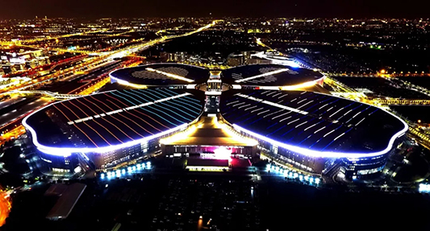
2
国家会展中心（上海）
Exhibitor’s Diary

Slide 44
During this period, I will learn:
how to dismantle display items;
how to make follow-up contact;
how to express gratitude to customers and the organizer.

Slide 45
I. Lead-in Practice
Task Work with your partner and collect your thoughts on the following
questions.
How should exhibitors dismantle their booth displays in good order after the show?
The exhibitor should have a good plan for dismantling beforehand and follow the
instructions given by the organizer.
2. Why should exhibitors follow up with exhibition visitors when the show is over?
Exhibitors want to establish good contacts. If too much time has passed before you’ve made contact, a hot prospect becomes a cold lead.

Slide 46
II. Reading
Passage The Significance of Show Follow-up
The success of attending exhibitions requires immediate follow-up on leads and activities resulted from the trade show floor. Giving booth visitors your company literature, collecting contact information about leads, and engaging in meaningful conversations with prospects about your products represent only a small portion of the exhibit sales process.
Immediate and continual follow-up by mail, email, phone calls and personal visits is essential to maximizing your revenue potential. Determining how you will collect information and the materials you will use in your follow-up activities needs to occur during your trade show planning process.
Different information and literature should be included for your marketing before, during and after the event. For example, rather than sending the same company promotional brochure that you mailed ahead of time to registrants or made available in your exhibit booth, plan ahead to send a new piece with additional information and selling points that appeal to the needs of your potential customers.

Slide 47
II. Reading
Passage The Significance of Show Follow-up
In your follow-up communication, be sure to address specific interests or needs the customer shared while visiting your booth. Any way in which you can personalize your written or verbal communication will yield greater marketing impact and put you closer to a new client.
The style and form of follow-up in which you engage should be determined by the sales potential of the lead. Before the event, you should develop a “scoring” system for leads generated from booth visitors and segment prospects into different types of follow-up based on potential to buy. So a potential customer that has decision-making authority and a large budget would get a higher score. He/She should be given more intense follow-up attention than someone picking up your literature as they represent a business that is auxiliary to your product offering.

Slide 48
II. Reading
Passage The Significance of Show Follow-up
When making a follow-up contact, include a special and specific offer to encourage your potential customers to take action. This may include special pricing or value-added offers that are meaningful to prospective customers.
Among all event marketing and follow-up activities, timing is critical. Don’t let a hot prospect become a cold lead because too much time has passed before you’ve made contact. Leads from trade shows should first be contacted within a week of the show.

Slide 49
II. Reading
Passage The Significance of Show Follow-up
literature n. printed matter (such as leaflets or circulars) 印刷品
registrant n. a person who is formally entered (along with others) in a register (and who obtains certain rights thereby) 注册人
segment v. to divide or split up 细分；划分
authority n. the power or right to give orders or make decisions 权力；权威
auxiliary adj. providing added support 辅助的

Slide 50
II. Reading
Passage The Significance of Show Follow-up
Task 1 Read the text and fill in the form below with the information from
the text.
Points | Key Words | Detailed Rules
Time | Immediate | 1 ____________ follow-up is essential.
 | Good timing | For marketing and follow-up activities, 2__________ is critical.
Items | Different | Include 3_________ for your marketing before, during and after the event.
 | Specific | Address 4 ____________ the customer shared while visiting your booth.
 | Style and form | Be determined by 5__________.
 | Offer | Include 6____________ your prospects to take action.

Slide 51
II. Reading
Passage The Significance of Show Follow-up
Task 1 Read the text and fill in the form below with the information from the text.
Points | Key Words | Detailed Rules
Ways | 7 ____________.
 | 8 ____________.
 | 9 ____________.
 | Personal visits

Slide 52
II. Reading
Passage The Significance of Show Follow-up
Task 1 Read the text and fill in the form below with the information from the text.
Points | Key Words | Detailed Rules
Time | Immediate | 1 ____________________ follow-up is essential.
 | Good timing | For marketing and follow-up activities, 2 _______ is critical.
Items | Different | Include 3 ___________________________ for your marketing before, during and after the event.
 | Specific | Address 4 ______________________ the customer shared while visiting your booth.
 | Style and form | Be determined by 5 ___________________________
 | Offer | Include 6 _______________________ your prospects to take action.
Immediate and continual
timing
different information and literature
specific interests or needs
the sales potential of the lead
a special and specific offer

Slide 53
II. Reading
Passage The Significance of Show Follow-up
Task 1 Read the text and fill in the form below with the information from the text.
Points | Key Words | Detailed Rules
Ways | 7
 | 8
 | 9
 | Personal visits
Phone calls
Email
Mail

Slide 54
II. Reading
Passage The Significance of Show Follow-up
Task 2 Read the text again and answer the following questions.
What is the difference between the materials sent to potential customers before and after the exhibition?
The material sent after the exhibition should be a new piece with additional information and
selling points that appeal to the needs of the potential customers.
2. Why is good timing so important in follow-up contact?
Because if too much time has passed before follow-up contact, a hot prospect could become a cold lead.

Slide 55
III. Do It Yourself
Fill in the Customer Satisfaction Questionnaire in Sample Study with the information below.
Peter Date is the Managing Director of New-tech Equipment, which was established in 1993 and is situated in the prime industrial belt of Hong Kong, China. The company is engaged in manufacturing machinery and tooling unit. He has just attended China Hi-Tech Fair and is quite satisfied with the overall service of the organizer.

Slide 56
III. Do It Yourself
Here are the comments from him:
“We have continuously exhibited since September 2000. Every day of the show we had a few hundred interested visitors watching our machines perform magic—we cannot achieve this every day at our showroom. Once again we managed to sell every machine off our stand, and have some very good deals that we will close in the next few weeks.”
“I believe that the show was well-organized and the standard of the stands was higher than I have seen in previous years.”
“The show’s organization was excellent through the attention to details.”
“We were surprised and delighted with the quality of visitors and the leads generated from the show.”

Slide 57

IV. Situational Dialogs
Showing gratitude to clients
Dialog
Stella Li:
the Marketing Manager of Teicheng Toys Co., Ltd.
Eric Blaire:
the Purchasing Manager of New Kids’ Park, who had visited the 14th Asia International Toys & Games Fair

Slide 58
IV. Situational Dialogs
Dialog
Showing gratitude to clients
Task 1 Close your book and listen to the dialog.
1. Thank you very much for stopping by our booth.
2. Your team and products have left me a very good impression.
3. I am fascinated by…
4. can you forward us your latest product catalog?
5. if you can place an order
6. we will give you a special offer.
7. I will consider your products after…

Slide 59
IV. Situational Dialogs
Dialog
Showing gratitude to clients
Stella: Hello, can I speak to Mr. Blaire?
Eric: Speaking! Who is that?
Stella: This is Stella Li, the Marketing Manager of Teicheng Toys.
Eric: Oh, Ms. Li, nice to talk to you. I am so glad to have received your phone call. How are you?
Stella: I am fine. Thank you. I am calling to show my gratitude. Thank you very much for stopping by our booth at the 14th Asia International Toys & Games Fair.

Slide 60
IV. Situational Dialogs
Dialog
Showing gratitude to clients
Eric: Not at all. Your team and products have left me a very good impression. To be frank, I am fascinated by your series of talking dolls.
Stella: I am glad you like them. Our talking dolls are our latest inventions. We have great confidence in them. Do you still have any question on these products?
Eric: Not for the moment. But can you forward us your latest product catalog?
Stella: No problem. I will send it to you immediately after our talk. In addition, if you can place an order before the end of March, we will give you a special offer.

Slide 61
IV. Situational Dialogs
Dialog
Showing gratitude to clients
Eric: That is interesting. I will think about it.
Stella: If you would like further information, please give me a call at (021) 87654321.
Eric: I will consider your products after discussing with our team.
Stella: Thank you. Looking forward to cooperating with you.
Eric: Me too.

Slide 62
IV. Situational Dialogs
Dialog
Showing gratitude to clients
Task 2 Read the dialog again and recite the underlined expressions.
Task 3 Work in pairs. Act as Stella Li and Eric Blaire and role-play the dialog.

Slide 63
IV. Situational Dialogs
Dialog
Showing gratitude to clients
Task 4 Simulation: Make up a dialog with your partners, taking the roles
of Ms. Wang and Mr. Bush.
Ms. Wang, the Marketing Manager of Gadgets Internet of Things, has come back from China International Big Data Industry Expo, where she had met so many potential customers at her booth. She is now calling one of her newly-met clients, Mr. Bush, the Purchasing Manager of New-tech Company and showing her wish to keep in touch with him.

Slide 64
IV. Situational Dialogs
Dialog
Showing gratitude to clients
Event Info.: China International Big Data Industry Expo 中国国际大数据产业博览会 （贵州·贵阳）
China International Big Data Industry Expo, held annually in Guiyang, is the world’s first exposition with the theme of big data. Since its establishment in 2015, the Big Data Expo has become a trendsetter and a world-class platform, providing solutions for global big data development and promoting global big data technology application and industrial development.

Slide 65
Project: Designing a Customer Satisfaction Questionnaire
Step 1
Work in groups of four. Search the Internet for information on a trade show you are interested in.
Design a Customer Satisfaction Questionnaire for an exhibitor to his/her clients in paper form. Refer to Sample Study and consider the following questions.
• What kind of information do you need to get?
• Who are you going to ask?
• What questions are to be asked?
• How are you going to arrange your questions?
• How are you going to design the questions?
• What is your rating system?
Step 2

Slide 66
Project: Designing a Customer Satisfaction Questionnaire
Step 3
Illustrate the questionnaire of your group in class next time.
Step 4
Give comments on the questionnaires of other groups in terms of content and creativity.

Slide 67



PPT模板下载：www.1ppt.com/moban/ 行业PPT模板：www.1ppt.com/hangye/
节日PPT模板：www.1ppt.com/jieri/ PPT素材下载：www.1ppt.com/sucai/
PPT背景图片：www.1ppt.com/beijing/ PPT图表下载：www.1ppt.com/tubiao/
优秀PPT下载：www.1ppt.com/xiazai/ PPT教程： www.1ppt.com/powerpoint/
Word教程： www.1ppt.com/word/ Excel教程：www.1ppt.com/excel/
资料下载：www.1ppt.com/ziliao/ PPT课件下载：www.1ppt.com/kejian/
范文下载：www.1ppt.com/fanwen/ 试卷下载：www.1ppt.com/shiti/
教案下载：www.1ppt.com/jiaoan/ PPT论坛：www.1ppt.cn
Thank you!

