Slide 1





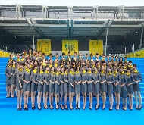
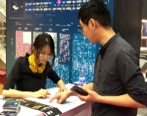
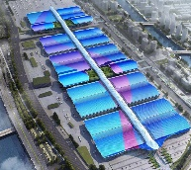
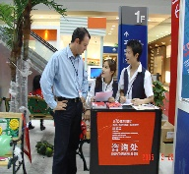
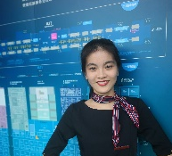
English for Exhibition and Conference
会 展 英 语

Slide 2

Unit 7
Virtual Exhibition Organizing and Attendance

Slide 3
Unit Objectives
After studying this unit, you will learn:
As an organizer:
  how to organize a virtual exhibition;
  how to promote a virtual exhibition.
As an exhibitor:
  how to apply for a virtual exhibition;
  how to enquire about details of a virtual exhibition.

Slide 4
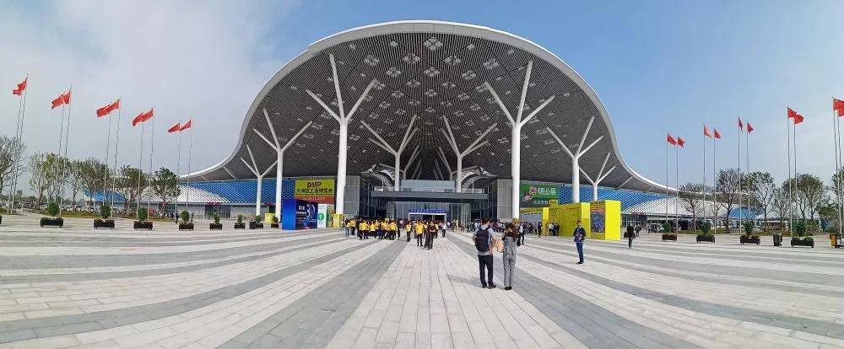
1
深圳国际会展中心
Organizer’s Diary

Slide 5
During this period, I will learn:
how to organize a virtual exhibition;
how to promote a virtual exhibition.

Slide 6
I. Lead-in Practice
Task 1 Work with your partner and place the activities of organizing a virtual exhibition in the right order.
A. virtual exhibition promotion
B. selecting a platform
C. exhibition planning
D. follow-up survey
E. motivating attendees to engage & interact
The right order is: C-B-A-E-D

Slide 7
I. Lead-in Practice
Task 2 Brainstorming: Work in groups. Discuss the advantages and disadvantages of a virtual exhibition with your classmates.
A virtual exhibition
Advantages | Disadvantages
It’s green.
It’s not exactly exciting.
It’s logical.
It’s technically vulnerable.
It’s easier to track lead generation.
It’s harder to make an impact with sponsorship.
It’s a good way to save money.
It’s not personal.
It’s time-saving and long-lasting.
…
…

Slide 8
II. Reading
Passage 1 Pros and Cons of Virtual Trade Shows
Virtual trade shows are one of the most recent trends affecting the trade show industry. A virtual trade show or virtual fair is where exhibitors and visitors meet and interact in an online environment. Essentially, a virtual trade show is the same as a traditional trade show, but the entire event is online. The whole trade show experience, from exhibition hall setup, to booth design, to seminars, takes place right from an attendee’s laptop.
Can virtual trade shows ever really take over traditional face-to-face events? Let’s see the pros and cons of virtual trade shows.

Slide 9
II. Reading
Passage 1 Pros and Cons of Virtual Trade Shows
Benefits
Save Time and Money
One of the most obvious advantages about a virtual trade show is the amount of money and time saved on travel and lodging. Instead of providing flights and hotels for numerous staff members, attendees get to enjoy the trade show from their office or home.
Easy Access to Information
Lead retrieval and follow-up are also much easier, because all of the attendee information is automatically saved in the registration database. Also, instead of printing and handing out hundreds of flyers, exhibitors’ services are available in one downloadable file that can be viewed online by everyone in attendance.

Slide 10
II. Reading
Passage 1 Pros and Cons of Virtual Trade Shows
Technology Support
The current software for virtual trade shows mimics the style of the traditional trade show, down to the entrance into the exhibition hall. Similar to a video game, the software makes a virtual trade show look and feel like you are really at a live event.
Drawbacks
No Personal Interaction
The fact that there is no actual interaction between the buyer and the exhibitor during a virtual trade show seems to be the biggest drawback. As we begin to rely more and more on technology, the importance of a traditional trade show is still focused on people interacting face to face.

Slide 11
II. Reading
Passage 1 Pros and Cons of Virtual Trade Shows
Different Time Zones
Additionally, there is the effect of different time zones. Because not everyone can attend a virtual trade show online at the same time, it is important to look at how varying time zones affect attendance. Virtual trade shows apply to some industries better than others. While a virtual trade show makes a lot of sense for computer programming companies, web design companies, or other web centric platforms, it may not be a good fit for industries focused on physical viewing and touch, like craft or book industries. The virtual trade show may never completely replace the face-to-face event, but it is a growing trend in the industry and there is an opportunity for both sides to learn from each other.

Slide 12
II. Reading
Passage 1 Pros and Cons of Virtual Trade Shows
pros and cons the advantages and disadvantages of something 利弊
lead retrieval a method for capturing and processing sales leads generated at an event, a trade show or a conference 潜在客户检索
mimic v. to behave or operate in exactly the same way as something or someone else 模仿
centric adj. having or situated at or near a center 中心的；中央的

Slide 13
II. Reading
Passage 1 Pros and Cons of Virtual Trade Shows
Task 1 Read the text and fill in the form below with the information from the text.
Pros and Cons of Virtual Trade Shows
Benefits | Drawbacks
_____________________ is saved on travel and lodging. | There is no _____________between the buyer and the exhibitor.
____________________ are much easier. | There is the _______________________.
The software makes a virtual trade show __________ like you are really at a live event. | It may not be a good fit for industries focused on ______________ and touch.
The amount of money and time
actual interaction
Lead retrieval and follow-up
effect of different time zone
look and feel
physical viewing

Slide 14
II. Reading
Passage 1 Pros and Cons of Virtual Trade Shows
Task 2 Read the text again and answer the following questions.
1. What is a virtual trade show?
A virtual trade show is where exhibitors and visitors meet and interact in an online environment.
2. Will virtual trade shows replace traditional trade shows?
No. The virtual trade show may never completely replace the face-to-face event.

Slide 15
II. Reading
Passage 2 How to Organize a Virtual Exhibition?
customizable adj. used to describe something that you can change according to a customer ’ s or user ’ s particular needs 可定制的
gamification n. the practice of making activities more like games in order to make them more interesting or enjoyable 游戏化
robust adj. strong and unlikely to break or fail 强大的；稳固的
hot spot a popular and exciting place （某种活动的）活跃地点；热点
immersive adj. seeming to surround the audience, player, etc. so that they feel completely involved in something 虚拟的；沉浸式的

Slide 16
II. Reading
Passage 2 How to Organize a Virtual Exhibition?
Task 1 Read the text and fill in the blanks with the given words and phrase
according to the context.
exhibition hall 2. follow-up 3. virtual attendees
appointment 5. hosting 6. gather

Slide 17
II. Reading
Passage 2 How to Organize a Virtual Exhibition?
A virtual exhibition is an online event that is organized on a web-based comprehensive virtual exhibition platform. However, the same efforts are required to make them happen, though costs for virtual events are considerably lower.
Firstly, determine the goals of 1 _______________ a virtual exhibition and outline what you want to achieve. Once the goals of organizing a virtual exhibition is clear in the mind, move ahead to virtual event planning and strategy.
Look for a platform that enables you to organize customizable 3D virtual booths, offer live chat functionality and engaging features such as live polls, surveys, Q&A, gamification, photo
booths, etc. In addition, the robust data tracking feature is also needed to 2 _______________ all the attendee data from the start till the event ends.
Once you have selected a virtual exhibition platform, engagement comes next. Enable global delegates to access the content and information at virtual exhibitions easily. Facilitate them to book a live virtual 3 ______________and have one-to-one chats at virtual booths. Engaging hot spots should be clearly defined at your virtual exhibitions. Also, enable attendees to share, download and review files, PDFs, videos, audio, content at virtual exhibitions.
hosting
gather
appointment

Slide 18
II. Reading
Passage 2 How to Organize a Virtual Exhibition?
Then, create an interactive floor design, helping global delegates to engage and navigate around the virtual 4 ______________ seamlessly. With an interactive floor design, attendees can click at the branded logo stands to visit an exhibitor’s booth. Meanwhile, design brilliant virtual booths to attract and impress 5 ________________, and deliver immersive virtual event experiences to them.
During the virtual exhibition, try to engage the attendees at the virtual gallery by organizing live polls, games, Q&A, contests, etc. to keep the interest of attendees alive. Remember to track every digital attendee footprint to keep a record of every attendee move.
After the exhibition, sending a 6 ______________ survey via email is a necessary step to convert the fresh qualified leads. It helps you in knowing the areas which need improvement for future events.
exhibition hall
virtual attendees
follow-up

Slide 19
II. Reading
Passage 2 How to Organize a Virtual Exhibition?
Task 2 Read the text again and answer the following questions.
1. What functionalities should a virtual exhibition platform have?
The virtual exhibition platform should enable the organizer to construct
customizable 3D virtual booths, offer live chat functionality, data tracking
and engaging features such as live polls, surveys, Q&A, gamification,
photo booths, etc.
2. How do organizers engage attendees during a virtual exhibition?
The organizer can engage the attendees by organizing live polls, games, Q&A, contests, etc. to keep the interest of attendees alive.

Slide 20
III. Sample Study
A virtual show registration form is a form to be filled in by an exhibitor when applying for exhibiting on the online virtual platform.
It generally includes the following key elements:
title of the virtual trade show
virtual trade show details (date, website, etc.)
exhibitor’s information
exhibiting options
registration fees
applicant requirements and eligibility

Slide 21
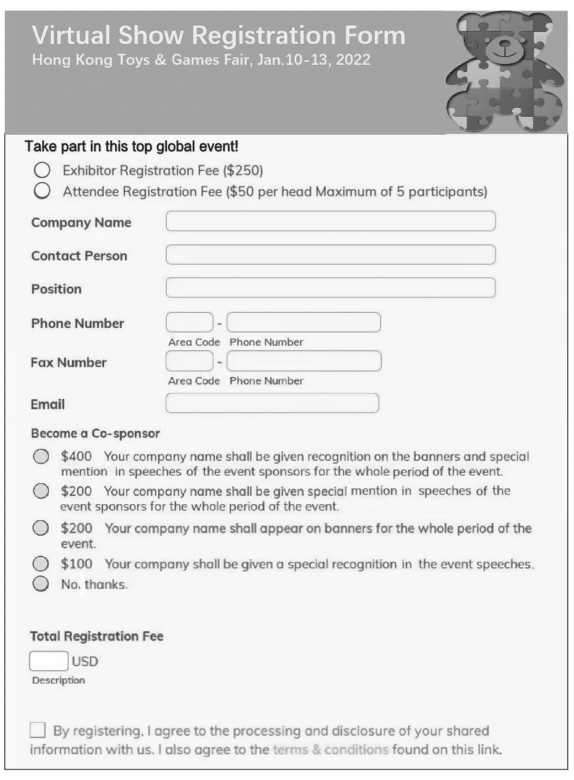
III. Sample Study
Sample 1

Slide 22
III. Sample Study
Task Fill in the virtual trade show registration form on page 109 according
to the following information.
Suppose you are Ms. Selina Yang, the Marketing Manager of Migo Toys Co., Ltd., which is going to attend Hong Kong Toys & Games Fair (Online) in 2022. The company plans to develop overseas market this year, so it needs recognition on the banners and special mention as the event sponsor for the whole period of the event to gain as much exposure as possible. Fill in the virtual show registration form according to the company’s situation.
Migo Toys Co., Ltd. was established in 2010, with 5,000 square meters of workshops and nearly 200 employees. Its product portfolio includes die-cast, collectable and radio control vehicles, plus action figures, dolls, preschool toys and etc.

Slide 23
III. Sample Study
Task Fill in the virtual trade show registration form on page 109 according
to the following information.
Contact Information:
Head office | Migo Toys Co., Ltd. No.2220, 22nd Floor, Onelink International Plaza Jiefang South Rd. 39 Guangzhou 510000 Guangdong Province, China
Tel | +86-20-8000-0000, +86-137xxxx5635
Fax | +86-20-8000-0001
Email | Selina_Yang@migo.com

Slide 24

IV. Situational Dialogs
Dialog
Inviting a VIP exhibitor to a virtual exhibition
Chris Davis:
the Sales Manager of Saidel Exhibition Co., Ltd., a famous international convention and exhibition company
Jane Wen:
the Marketing Manager of Taggcast Inc., a company producing and selling electronics

Slide 25
IV. Situational Dialogs
Dialog
Inviting a VIP exhibitor to a virtual exhibition
Task 1 Close your book and listen to the dialog.
1. reaches a wider audience
2. brings exhibitors greater exposure.
3. as good as traditional ones
4. access the online show 24/7
5. make on-the-spot sales
6. engage in conversations
7. what kind of service do you provide in that respect?
8. gain in-depth insights to optimize your sales promotion

Slide 26
IV. Situational Dialogs
Dialog
Inviting a VIP exhibitor to a virtual exhibition
Chris: Hello, this is Chris from Saidel Exhibition Co., Ltd., and I am calling to invite you to our virtual trade show scheduled in December this year.
Jane: Oh, hello, Chris. Actually we used to take part in face-to-face trade shows, and have never considered online ones. Why would you recommend a virtual trade show?
Chris: Well, to start with, a virtual trade show saves you a substantial amount of money and time on travel and lodging. An online event also reaches a wider audience more easily and brings exhibitors greater exposure.
Jane: Sounds good. Yet I am not sure whether online shows are as good as traditional ones.

Slide 27
IV. Situational Dialogs
Dialog
Inviting a VIP exhibitor to a virtual exhibition
Chris: They have other advantages. For example, buyers can access the online show 24/7, which brings a lot of convenience to buyers in different time zones.
Jane: Hmm… and that will help me bring in more potential customers. Still, I am worried that the lack of personal contact at a virtual event may make it difficult for us to strike deals.
Chris: To better attract attendees, we provide a rich, visually compelling landing page, highly customizable interface, and booth designs and layouts for your company and products. A highlight will be our e-commerce platform that allows exhibitors to make on-the-spot sales.

Slide 28
IV. Situational Dialogs
Dialog
Inviting a VIP exhibitor to a virtual exhibition
Jane: But how do I engage in conversations with buyers, and answer their questions? These are crucial to me, well in fact, to all sellers.
Chris: To that end we have live chat tools and webinars. For example, sales representatives can open live chat rooms and invite interested buyers—very much like real meetings, only with more flexible time and zero restraints on locations.
Jane: How is that done?
Chris: If you subscribe to our virtual fair, we will send you a brochure with specific instructions on how to create booths, hold Q&A sessions, and track leads.

Slide 29
IV. Situational Dialogs
Dialog
Inviting a VIP exhibitor to a virtual exhibition
Jane: Right, about tracking leads, what kind of service do you provide in that respect?
Chris: I’m glad you asked this. Our online system allows you to track attendees’ journey during the event closely, so that exhibitors can gain in-depth insights to optimize your sales promotion.
Jane: Thank you for all this information. You have successfully aroused my interest in a virtual event.
Chris: I am glad to hear that. If you have any question, don’t hesitate to contact me.

Slide 30
IV. Situational Dialogs
Dialog
Inviting a VIP exhibitor to a virtual exhibition
Task 2 Read the dialog again and recite the underlined expressions.
Task 3 Work in groups. Act as Chris Davis and Jane Wen and role-play the dialog.

Slide 31
IV. Situational Dialogs
Dialog
Inviting a VIP exhibitor to a virtual exhibition
Task 4 Simulation: Make up a dialog with your partner, taking the roles
of Mr. Zhang and Ms. Moore.
Mr. James Zhang is the Sales Manager of the Organizing Committee of China Import and Export Fair. He is calling Ms. Lisa Moore, the Marketing Manager of TSS Technology, to invite her to attend the virtual Canton Fair.

Slide 32
IV. Situational Dialogs
Dialog
Inviting a VIP exhibitor to a virtual exhibition
Event Info.: China Import and Export Fair 中国进出口商品交易会（广交会）（广东· 广州）
China Import and Export Fair, also known as Canton Fair, was established in 1957. It is held every spring and autumn in Guangzhou. The fair is a comprehensive international trading event with the longest history, the largest scale, the most complete exhibit variety, the largest buyer attendance, the broadest distribution of buyers’ source country and the greatest business turnover in China. Since 2020, the Canton Fair has been moved online. 26,000 Chinese and international exhibitors displayed products in live marketing and conducted online negotiations via virtual Canton Fair. The success of the virtual fair has blazed a new path of international trade development, and laid a solid foundation for online - offline integrated development.

Slide 33
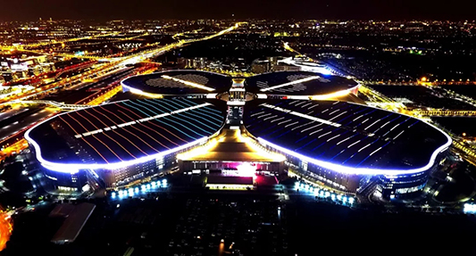
2
国家会展中心（上海）
Exhibitor’s Diary

Slide 34
During this period, I will learn:
how to apply for a virtual exhibition;
how to enquire about details of a virtual exhibition.

Slide 35
I. Lead-in Practice
Task Work with your partner and collect your thoughts on the following
questions.
1. Do you want to attend a virtual exhibition? Why or why not?
Yes. A virtual trade show can be fun. It is also convenient for me, without having to make travel
arrangements. And it is cost efficient.
No. I will not be able to touch and feel the real products in a virtual trade show. And communication in
a virtual trade show lacks the personal touch that is vital to establishing business relationships.
2. How do exhibitors make a booth stand out at a virtual exhibition?
➢ Branding: Consistent branding, logos, and anything to stand out go a long way with visitors.
➢ Clear video and audio: Ensure that those working your booth have great audio, cameras, and a reliable Internet connection.
➢ Virtual materials to share: Have downloadable materials at hand to provide attendees with more information.
➢ Quick commercial pitches to introduce company: Prepare a 30-second pitch and practice it ahead of time.
➢ Sending gifts to attendees: Give attendees a digital gift such as an online voucher or special offer.

Slide 36
II. Reading
Passage Successful Participation in a Virtual Trade Show
Technology Support
A virtual trade show is a perfect space to generate leads and promote products. While most platforms are relatively simple, good preparation is the key to success for exhibitors. Below are tips for successful trade fair participation.
Preparing objectives and choosing the right fair
With any trade fair, the first question to ask an exhibitor is why to participate. An exhibitor needs to set goals and objectives and prepare a strategy clearly. After setting clear objectives, it is time for an exhibitor to choose the right fair. Just like a face-to-face event, there are some questions to consider:
Will the virtual trade show meet the existing and potential customers’ needs?
Is accurate information on the number of expected visitors available?
Are competitors participating in the fair?

Slide 37
II. Reading
Passage Successful Participation in a Virtual Trade Show
If these questions are largely answered with yes, an exhibitor should definitely consider participating.
Investing in a virtual booth and getting to know the event technology
Before investing in the booth, an exhibitor should check out what the possibilities are at the fair. Getting to know the technology is essential! There might exist restrictions when it comes to creating a virtual booth—such as size limits for uploading photos and videos. Take the time to review all training materials, resources, event instructions, and schedules provided by the event organizers.
Most trade fair platforms offer ready-to-use templates. An exhibitor should test out every link and familiarize himself/herself with the booth content. Don’t forget to practice all chat and matchmaking functions! In digital trade fairs, content needs to be clearer and stronger than anywhere else.

Slide 38
II. Reading
Passage Successful Participation in a Virtual Trade Show
Studying the attendee list and making appointments before the fair
Most virtual fairs share the attendee list with exhibitors a few days prior to the event. Study the list and identify potential leads. Most virtual platforms allow exhibitors to book one-on-one meetings or offer a matchmaking tool. Make sure to start making appointments weeks before the event, as many of potential leads and existing customers will soon have a full agenda.
Engaging in trade fair marketing
Before, during, and after the virtual fair, an exhibitor wants to draw attention from visitors to his/her booth as much as possible. Before the trade fair, an exhibitor can do this by using trade fairs hashtags on social channels. Invite existing customers, potential customers, suppliers, and other contacts that might also attend the event. Stay active on social media during the event as well. An exhibitor could even host a contest or a giveaway to draw extra attention to his/her booth.

Slide 39
II. Reading
Passage Successful Participation in a Virtual Trade Show
Leads registration and follow-up
During a virtual fair, the organizer may have a Customer Relationship Management (CRM) system, to capture any potential leads directly. If not, exhibitors can have their own representatives register leads in a document. Take time to ensure effective follow-up on the contacts gathered during the virtual fair. Send a short, personalized email to all leads generated. Create trust and try to meet the expectations of the potential customer. This will increase chances for new business.

Slide 40
II. Reading
Passage Successful Participation in a Virtual Trade Show
template n. a model or standard for making comparisons 模板
matchmaking n. the activity to find a suitable thing for something else 匹配
hashtag n. a word or phrase with the symbol “ # ” in front of it, used on social media
websites and apps so that you can search for all messages with the same subject
帖子主题

Slide 41
II. Reading
Passage Successful Participation in a Virtual Trade Show
Task 1 Read the text and fill in the form below with the information from the text.
Successful Participation in a Virtual Trade Show
Tip 1 | Setting clear objectives
Tip 2 | Checking out what the possibilities are at the fair Testing out every link and familiarizing himself/herself with the booth content
Tip 3 | Studying the list and identifying potential leads
Tip 4 | Drawing visitors’ attention as much as possible.
Tip 5 | Capturing potential leads
Choosing the right fair
Getting to know the technology
Practicing all chat and matchmaking functions
Making appointments weeks before the event
Ensuring effective follow-up on the contacts

Slide 42
II. Reading
Passage Successful Participation in a Virtual Trade Show
Task 2 Visit virtual exhibition websites, and get familiar with steps
of designing a virtual exhibition.

Slide 43
III. Do It Yourself
Suppose you are going to participate in a virtual exhibition. Write out the details of standing out your booth in the virtual exhibition.
Steps | Details
Create pre-event promotions
Design a virtual exhibition booth
collaborating with the virtual trade show speakers
creating a brochure for the booth with company’s logo and one-liner content
organizing pre-event registration
choosing eye-catching designs and layouts for the virtual booth
making the brand memorable for visitors

Slide 44
III. Do It Yourself
Suppose you are going to participate in a virtual exhibition. Write out the details of standing out your booth in the virtual exhibition.
Steps | Details
Host an educational session
Provide networking opportunities
telling attendees what can be offered and give them something educational
giving two or three tangible learning takeaways
providing chat rooms and discussion panels
giving the attendees a memorable experience

Slide 45

IV. Situational Dialogs
Dialog one
Preparing for the virtual exhibition
Chris Davis:
the Sales Manager of Saidel Exhibition Co., Ltd., a famous
international convention and exhibition company
Jane Wen:
the Marketing Manager of Taggcast Inc., a company producing
and selling electronics

Slide 46
IV. Situational Dialogs
Dialog one
Preparing for the virtual exhibition
1. Since we don’t have any relevant experience, what can we do to gain success in such a virtual show?
2. certain preparations are similar to those required for a traditional trade fair.
3. You may want to develop your own creative idea of a virtual booth that’s aesthetic and eye-catching.
4. Your sales representatives need to familiarize themselves with the technology
5. I will have my sales representatives examine them…
Task 1 Close your book and listen to the dialog.

Slide 47
IV. Situational Dialogs
Dialog one
Preparing for the virtual exhibition
Jane: Now I am considering participating in your virtual trade show. Since we don’t have any relevant experience, what can we do to gain success in such a virtual show?
Chris: Well, certain preparations are similar to those required for a traditional trade fair. You still need to do the usual pre-show marketing, such as contacting existing customers and potential buyers. It’s particularly important for a virtual show to increase your leads.
Jane: You mean asking them to attend or visit the virtual show?
Chris: Yes, exactly.

Slide 48
IV. Situational Dialogs
Dialog one
Preparing for the virtual exhibition
Jane: But even in the usual marketing preparation, something should be different from the virtual fair, I assume?
Chris: Indeed. The biggest difference is that instead of giving out a location, you provide a web link along with the time of the fair. In a virtual world, it’s more difficult to attract visitors. So preparing a program of small conferences and workshops is crucial.
Jane: I see. What about the booth design in the virtual show?
Chris: Don’t worry. We provide you with a variety of booth options, equipped with spaces where you can put images, videos, and even website pages.

Slide 49
IV. Situational Dialogs
Dialog one
Preparing for the virtual exhibition
Jane: And we need to prepare such materials, I assume?
Chris: Correct. You may want to develop your own creative idea of a virtual booth that’s aesthetic and eye-catching. To start with, you need to prepare pictures, videos, and other electronic files related to your exhibits.
Jane: How is that accomplished?
Chris: We will send you a brochure, with specific instructions in regard to how to make and upload these files.
Jane: That will be very helpful. What else do I need to do?

Slide 50
IV. Situational Dialogs
Dialog one
Preparing for the virtual exhibition
Chris: Your sales representatives need to familiarize themselves with the technology—how to launch online chatting, how to invite attendees to a chatting room, etc. And test runs are highly recommended.
Jane: I see. Could you send the instructions to my email? I will have my sales representatives examine them and they will probably send you more questions.
Chris: No problem. Along with the instructions I will send you the link to our online registration form. You can fill that in and we can get the process started right away.
Jane: Great. Thank you for all this information.

Slide 51
IV. Situational Dialogs
Preparing for the virtual exhibition
Dialog one
Task 2 Read the dialog again and recite the underlined expressions.
Task 3 Work in pairs. Act as Jane Wen and Chris Davis and role-play the dialog.

Slide 52
IV. Situational Dialogs
Inviting potential buyers to the virtual exhibition
Dialog two
Jane Wen:
the Marketing Manager of Taggcast Inc., a company producing and selling electronics
Reeves Johnson:
the head of the Purchasing Department of an IT company

Slide 53
IV. Situational Dialogs
Inviting potential buyers to the virtual exhibition
Dialog two
Task 1 Close your book and listen to the dialog.
1. We are venturing into this new and popular format.
2. We can arrange face-to-face meetings in advance.
3. This technology sounds a little overwhelming.
4. But our interface is quite intuitive—the webpage looks like a real exhibition hall.

Slide 54
IV. Situational Dialogs
Inviting potential buyers to the virtual exhibition
Dialog two
Jane: Good morning, Mr. Johnson. This is Jane.
Reeves: Hi, Jane. How is everything?
Jane: Great. I am preparing for the virtual show in December. We would like to invite you to attend the event.
Reeves: Actually, I was just making my schedule for exhibition visits. But you just mentioned it’s a virtual show? That’s quite new.
Jane: True. We are venturing into this new and popular format, hoping that a virtual show can make everything easier for customers. Instead of traveling all the way to the venue, you only need to make a few clicks on the website.

Slide 55
IV. Situational Dialogs
Inviting potential buyers to the virtual exhibition
Dialog two
Reeves: But I won’t be able to really see or touch the products.
Jane: To compensate for that, our virtual booth allows you to see 3D displays of our new products. You can rotate and examine the exhibits closely.
Reeves: Sounds cool. Will I be able to talk to the salesperson directly?
Jane: Yes. We can arrange face-to-face meetings in advance. Though you need to register and log in online first.
Reeves: That’s not much trouble. But I will surely miss face-to-face discussions with other buyers!

Slide 56
IV. Situational Dialogs
Inviting potential buyers to the virtual exhibition
Dialog two
Jane: There are virtual meeting rooms that you can jump in for instant communication. In addition, we can also have one-on-one purchase meeting.
Reeves: And most importantly, how do I make enquiries and find the ideal products?
Jane: That is also done online. You can post either oriented enquiries to specific suppliers, or non-oriented enquiries. Then the system will match you to potential exhibitors.
Reeves: I can see you really make a great effort to prepare for this virtual show. But all this technology sounds a little overwhelming. I can imagine I’ll feel quite disoriented.

Slide 57
IV. Situational Dialogs
Inviting potential buyers to the virtual exhibition
Dialog two
Jane: Truth be told, I shared your concern. But our interface is quite intuitive—the web page looks like a real exhibition hall. You can check out the website and pictures I sent you previously.
Reeves: Oh. I see them in my email. The pictures do look appealing.
Jane: Exactly. You can move around in the virtual hall with your clicks, quite similar to what you do with a map on your phone.
Reeves: I think I would like to come to the show.
Jane: Great! I will send you a formal invitation, along with more details. And please feel free to contact me whenever you have any questions.

Slide 58
IV. Situational Dialogs
Inviting potential buyers to the virtual exhibition
Dialog two
Task 2 Read the dialog again and recite the underlined expressions.
Task 3 Work in pairs. Act as Jane Wen and Reeves Johnson and role-
play the dialog.

Slide 59
IV. Situational Dialogs
Inviting potential buyers to the virtual exhibition
Dialog two
Task 4 Simulation: Make up a dialog with your partner, taking the roles
of Ms. Liu and Mr. Thompson.
Ms. Liu is the Marketing Manager of Hidia Electronic Technology Co., Ltd., a company producing and selling screws. The company is going to attend China Fastener Show Online, and Ms. Liu is calling Mr. John Thompson, the head of the Purchasing Department of a construction company, to invite him to visit the virtual exhibition and her company’s booth.

Slide 60
IV. Situational Dialogs
Inviting potential buyers to the virtual exhibition
Dialog two
Event Info.: China Fastener Show Online 中国紧固件线上展览会
Making full use of 18-year experience in B2B platform operation and 13-year experience in Fastener Expo Shanghai, China Fastener show Online devotes all efforts to link the needs of upstream and downstream enterprises at home and abroad. The highlights of the exhibition include one-on-one purchase meetings, eight-day around-the-clock visiting, and cloud factory visiting. A combination of the technology helps attendees reduce costs and seal deals more efficiently.

Slide 61
Project: Designing and Filling in a Booth Application Form for a Virtual Exhibition
Step 1
Work in groups of four. Search the Internet for information on a virtual exhibition.
Step 2
Two of you take the role as the staff of an exhibition organizing committee, and the other two as the employees of an exhibiting company. The two organizing staff design a booth application form for a virtual exhibition. Refer to Sample Study and make sure that all the key elements are included.
Step 3
The two company employees fill in the application form and discuss how to prepare for a virtual exhibition.

Slide 62
Project: Designing and Filling in a Booth Application Form for a Virtual Exhibition
Step 4
Illustrate the booth application form and virtual booth preparation of your group in class next time.
Step 5
Give comments on the booth application forms and preparations of other groups in terms of content and creativity.

Slide 63



PPT模板下载：www.1ppt.com/moban/ 行业PPT模板：www.1ppt.com/hangye/
节日PPT模板：www.1ppt.com/jieri/ PPT素材下载：www.1ppt.com/sucai/
PPT背景图片：www.1ppt.com/beijing/ PPT图表下载：www.1ppt.com/tubiao/
优秀PPT下载：www.1ppt.com/xiazai/ PPT教程： www.1ppt.com/powerpoint/
Word教程： www.1ppt.com/word/ Excel教程：www.1ppt.com/excel/
资料下载：www.1ppt.com/ziliao/ PPT课件下载：www.1ppt.com/kejian/
范文下载：www.1ppt.com/fanwen/ 试卷下载：www.1ppt.com/shiti/
教案下载：www.1ppt.com/jiaoan/ PPT论坛：www.1ppt.cn
Thank you!

