Slide 2
Unit 4
Booth Design and Installation

Slide 3
After studying this unit, you will learn:
As an organizer:
  how to set booth design rules and regulations;;
  how to design an exhibitor order form.
As an exhibitor:
  how to design and construct/install an effective booth;
  how to work with an exhibit designer.

Slide 5
how to set booth design rules and regulations;
how to design an exhibitor order form.

Slide 6
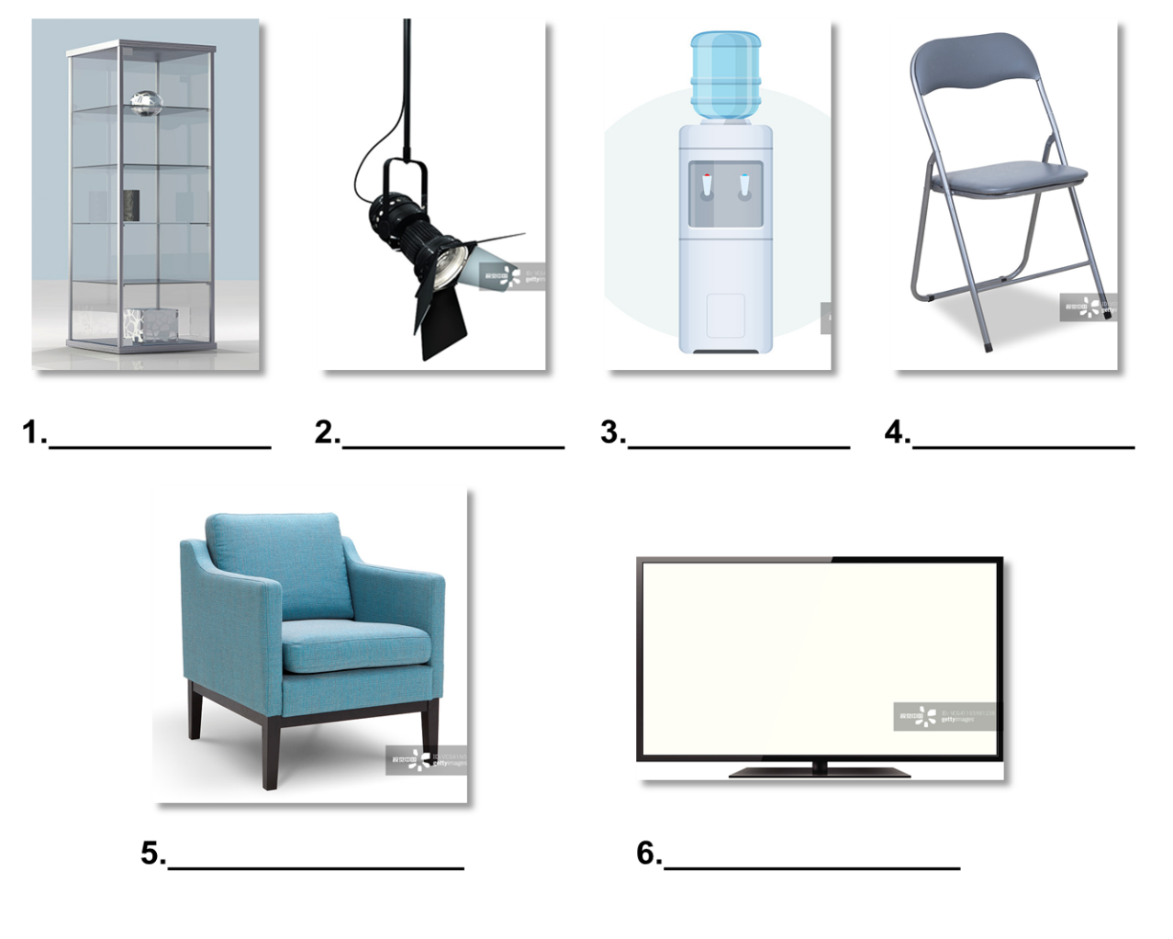
Task 1 Vocabulary: Look at the pictures. Write out the name of each booth facility below.
tall glass showcase
long arm spotlight
water dispenser
folding chair
1. ________________ 2. ________________ 3. ________________ 4. ________________
single seat sofa
plasma display
5. ________________ 6. ________________

Slide 7
Task 2 Brainstorming: Work in groups. Discuss other booth facilities used during an exhibition with your classmates.
☆ power socket
☆ spotlight
Other booth facilities may include power socket, shelf, spotlight, information counter, round table, folding door, lockable drawer, wall panel, computer, speaker, projector, etc.

Slide 8
Passage Booth Design Rules and Regulations
Management Regulations for Construction of All Stands:
All exhibitors should select the contractor with proven qualifications to construct their booths and are obliged to require the contractor to implement the construction considering the relevant regulations and construction specifications and carry out corresponding safety measures.
All stands plans MUST be sent to the organizer for approval.
The structure of all exhibition stands must be reasonably designed to ensure security and safety. The construction materials shall be non-flammable.
All exhibitors should display their company name and stand number prominently on their stand so they can be easily viewed by visitors.

Slide 9
Passage Booth Design Rules and Regulations
The designed structural strengths of all exhibition stands shall meet the strength required by the load. During the construction period, efforts shall be made to ensure the overall strength, stiffness, and stability of the exhibition stand structure.
The area of an exhibition stand constructed by each contractor must comply with the area specified in the submitted application. The area of construction of an exhibition stand must not exceed the leased area.
The maximum building height for single story stands is 4 meters. Double decker or multi-deck exhibition stands are not allowed.
The ceiling of any booth must not be covered over 15% of its area. Totally enclosed ceilings are strictly prohibited.
All structural back walls of neighboring exhibition stands must be properly decorated. Back walls over 2.5 meters in height must be finished in white.

Slide 10
Passage Booth Design Rules and Regulations
For exhibition stand structures decorated with glass ornaments, the glass must be safety glass to ensure security in construction and installation and also must be marked with conspicuous signs in order to prevent glass breaking.
All construction institutions must not damage the facilities in the exhibition hall. They are not allowed to drive nails, punch holes, paste adhesives, apply paints or post advertisements within the exhibition hall, on the exterior floor or wall surfaces.
When each contractor is constructing an exhibition stand, it shall not create an obstruction in front of fire-fighting facilities, electric equipment, emergency exits and aisles, etc. inside the exhibition hall.
Contractors shall complete the construction within the prescribed time and area. All contractors working in the hall must wear identification badges provided by the organizer.

Slide 11
Passage Booth Design Rules and Regulations
qualification: n. an ability, quality, or record of experience that makes a person suitable for a particular job or position 资格
non-ﬂammable: adj. not easily ignited 不易燃的
prominently: adv. in a way that is easily seen or noticed 显著地；显眼地
load: n. something that is being or is to be carried 负荷
stiffness: n. the quality of being firm, hard, or unable to bend 劲度；刚硬
stability: n. the quality or state of being steady 稳定性

Slide 12
Passage Booth Design Rules and Regulations
comply with: to do as one is requested, commanded, etc. 服从；遵守
lease: v. to use a building, car, etc. under a lease 租用；租借
double decker: a thing with two floors, one on top of the other 双层结构
prohibit: v. to forbid especially by rules or regulations 禁止
adhesive: n. a substance that you use to make things stick together 黏合剂
prescribed: adj. decided by a rule 规定的
Task

Slide 13
Passage Booth Design Rules and Regulations
Task 1 Read the text and match the phrases in the left column with the phrases in the right column according to the text.
1. the contractor
2. All stands plans
3. The construction materials
4. The company name and stand number
5. The strengths of the stands
6. The area of an exhibition stand
A. be approved.
B. be non-flammable.
C. meet the requirements.
D. be prominently displayed.
E. be with proven qualifications.
F. comply with the area specified
shall

Slide 14
Passage Booth Design Rules and Regulations
Task 2 Read the text again and decide whether the following statements are true (T) or false (F).
______ 1. Multi-deck exhibition stands are allowed.
______ 2. The ceiling of any booths can be covered over 15% of its area..
______ 3. Totally enclosed ceilings are not allowed.
______ 4. The contractor can paste adhesives and post advertisements within the hall. ______ 5. Contractors can postpone the construction time if necessary.
F
F
T
F
F

Slide 15
An exhibitor order form is a form to be filled in by an exhibitor to order additional facilities and services. Generally, the form should be sent several days before the first date of booth installation. Surcharges will be paid for orders after the deadline.
It generally includes the following key elements:
name of exhibition
exhibition details: date, venue, email, tel., fax, etc.
exhibitor information
payment method/information
deadline
description of facilities
charge (unit price/rate, quantity, rental days, total amount, surcharge)
exhibitor’s signature
date of the signature

Slide 16
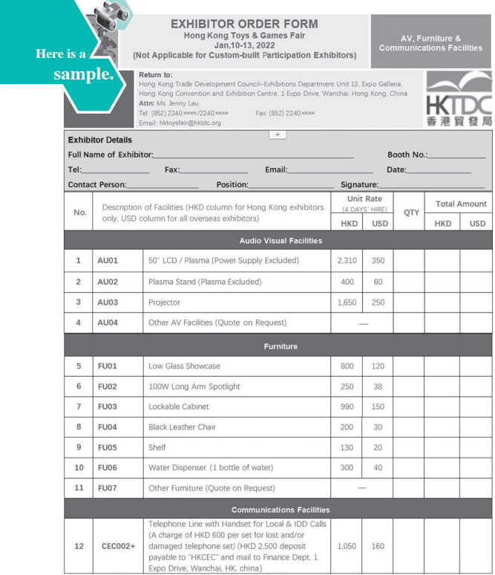
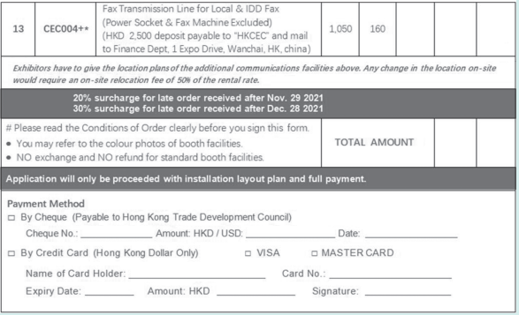

Slide 17
Task 1 Study the sample and decide whether the following statements are true (T) or false (F).
______ 1. Orders after November 29, 2021 should be rejected.
______ 2. All overseas exhibitors must pay the rental rate in US dollar.
______ 3. If an exhibitor orders a fax transmission line for local and IDD fax, he/she
must pay a deposit of HKD 4,000.
______ 4. A surcharge will be paid if there is any change in the location of the
additional communications facilities on-site.
______ 5. Hong Kong exhibitors can only pay by credit card.
F
T
F
T
F

Slide 18
Talking about standard row booth installation
Chris Davis:
the Sales Manager of Saidel Exhibition Co., Ltd., a famous international convention and exhibition company
Jason Wang:
the Marketing Manager of HanMa Exhibition Services Co., Ltd., a booth contractor

Slide 19

Talking about standard row booth installation
Task 1 Close your book and listen to the dialog.

Slide 20
Talking about standard row booth installation
Chris: Good afternoon. Is that Mr. Jason Wang, the Marketing Manager of HanMa Exhibition Services?
Jason: Yes, Jason speaking.
Chris: This is Chris Davis from Saidel Exhibition Co., Ltd., the organizer of the 13th Asia International Toys & Games Fair held this January.
Jason: Oh, Chris, nice to hear from you. We had a wonderful cooperation last time.
Chris: Yeah, that’s why I’m calling you now. We’re going to hold the 14th Toys & Games Fair from January 4 to 7 next year. Considering your good service provided last time, we’d like you to be our official booth contractor again this time.

Slide 21
Talking about standard row booth installation
Jason: Really? Thanks. We’re so glad to cooperate with you again.
Chris: So are we. This time we have approximately 110 standard row booths to be built, 70 of which are 9 m2 booths and 40 are 12 m2 booths.
Jason: OK. What’s the time for construction?
Chris: January 1 to 3 will be the days for construction, and the working time is from 9:00 am to 8:00 pm.
Jason: All right. We’ll get it done as requested.

Slide 22
Talking about standard row booth installation
Chris: Great. Thank you. For more information, please refer to the booth design rules and regulations which will be sent to you later. We also want to put you in the Exhibitor’s Manual as our official booth contractor. What do you think of it?
Jason: That’s really our great honor.
Chris: Please send your detailed contact information to us, so that we can put it in the Manual.
Jason: OK. Thank you. I’m looking forward to our happy cooperation.
Chris: Me too.

Slide 23
Talking about standard row booth installation
Task 2 Read the dialog again and recite the underlined expressions.
1. We’d like you to be our official booth contractor again this time.
2. This time we have approximately 110 standard row booths to be built,
70 of which are 9sqm booths and 40 are 12sqm booths.
3. What’s the time for construction?
4. We’ll get it done as requested.
5. For more information, please refer to…
Task 3 Work in groups. Act as Chris Davis and Jason and role-play the dialog.

Slide 24
Talking about standard row booth installation
Task 4 Simulation: Make up a dialog with your partner, taking the roles of Mr. Sun and Mr. Chen.
Mr. James Sun is the Secretary of the Organizing Committee of China-South Asia Expo to be held in Kunming from June 6 to 10. He is calling Mr. Justin Chen, the Marketing Manager of a booth contractor—TXQZ-EXPO Ltd., to ask the company to be the official booth contractor for the exhibition and talk about the booth construction of standard row booths.

Slide 25
Talking about standard row booth installation
Event Info.: China-South Asia Expo 中国—南亚博览会（云南·昆明）
China-South Asia Expo, co-hosted by China’s Ministry of Commerce and the People’s Government of Yunnan Province, was established in 2012, and has evolved into a main carrier for reinforcing economic and trade cooperation and exchanges with South Asia and Southeast Asia, and an important platform for the Belt and Road Initiative.

Slide 27
how to design and construct/install an effective booth;
how to work with an exhibit designer.

Slide 28
Task Work with your partner and collect your thoughts on the following questions.
1. What is an effective and attractive booth design?
An effective and attractive booth design should be able to attract visitors to
enter the booth. To do that, the design should be tailored to the products and
should incorporate audiovisual features to attract visitors.
2. What should an exhibit booth designer know before designing?
An exhibit booth designer should know something about the company and its
products, the objective of the trade show, the budget, etc.

Slide 29
Passage 1 Secrets to Designing Effective Exhibit Booths
Your exhibit booths open a small window of opportunity to attract attendees. Therefore, each element of your display booth must be designed to communicate your company’s message, showcase your products, and attract your audience to investigate further. These things are the critical precursors that allow your booth staff to engage visitors in conversation in order to qualify them as targeted leads. But, they don’t happen without careful planning and design. Use the following tips to gain a competitive advantage.
Grab Attention
Nothing happens until people visit your exhibit booth. The challenge is that you only have a few seconds to grab their attention as they’re walking by. Your booth must make an immediate impact upon attendees. An attractive, uncluttered design that incorporates motion and creative lighting can stand apart from the crowd.

Slide 30
Passage 1 Secrets to Designing Effective Exhibit Booths
Limit the Message
As attendees walk through the exhibition center, they’re faced with many stimuli. In order for them to remember clearly, limit your trade show marketing message to its most powerful elements. Rather than communicating a dozen features, focus upon three or four key benefits which speak directly to your audience’s needs.
Use a Tactile Approach
If possible, include demonstrations that allow your visitors to have an opportunity to interact with your products. For example, if your company sells business software, let attendees experience it first-hand.

Slide 31
Passage 1 Secrets to Designing Effective Exhibit Booths
Engage Multiple Senses
Exhibit booths should be attractive on several levels. If you can simultaneously reach your audience through sight, smell and sound, you will make a greater impact upon them. Your trade show graphics and other display elements will already create a visual connection. Consider using music to appeal to their ears and food to appeal to their sense of smell.
Extend Your Brand
Your trade show booths should represent a visual extension of your company’s brand. By communicating the same powerful message in your display booth graphics, staff apparel, and promotional giveaways, you maintain consistency. Over time, that consistency creates familiarity in your audience, bridging the gap between you and your prospects more quickly.

Slide 32
Passage 1 Secrets to Designing Effective Exhibit Booths
precursor: n. something that happened or existed before something else and influenced its development （事物的）前身，先驱
lead: n. an individual or organization that expresses an interest in your goods or services 潜在客户
uncluttered: adj. having nothing extraneous 整洁的，整齐的
incorporate: v. to include something as part of a group, system, plan, etc. 把（某事物）并入；包括

Slide 33
Passage 1 Secrets to Designing Effective Exhibit Booths
stimulus: n. (plural stimuli) something that helps a process to develop more quickly or more strongly 刺激（物）；促进因素
tactile: adj. relating to the sense of touch 触觉的
simultaneously: adv. at the same instant 同时的
apparel: n. (formal) clothes （正式）服装
giveaway: n. thing that is given to somebody without charge 赠品

Slide 34
Passage 1 Secrets to Designing Effective Exhibit Booths
Task 1 Read the text and fill in the form below with the information from the text.
Secrets | Suggestions to Booth Design
Grab Attention | Incorporate motion and creative lighting.
Limit the Message | Focus upon ____________________
Use a Tactile Approach | Include ________________________
Engage Multiple Senses | Reach ________________________
Extend Your Brand | Represent _____________________

Slide 35
Passage 1 Secrets to Designing Effective Exhibit Booths
Task 1 Read the text and fill in the form below with the information from the text.
Secrets | Suggestions to Booth Design
Grab Attention | Incorporate motion and creative lighting.
Limit the Message | Focus upon
Use a Tactile Approach | Include
Engage Multiple Senses | Reach
Extend Your Brand | Represent
three or four key benefits which speak directly to your audience’s needs.
demonstrations that allow your visitors to interact with your products.
your audience through sight, smell and sound.
a visual extension of your company’s brand

Slide 36
Passage 1 Secrets to Designing Effective Exhibit Booths
Task 2 Read the text again and answer the following questions.
1. What are the requirements for designing each element of a display booth?
Each element of a display booth must be designed to communicate your
company’s message, showcase your products, and attract your audience to
investigate further.
2. Why should trade show marketing messages be limited?
Because attendees are faced with many stimuli when walking through the exhibition
center, and it’ll be hard for them to remember everything they see at every booth.

Slide 37
Passage 2 Working with an Exhibit Designer
highlight: v. to make a subject easy to notice so that people pay attention to it 强调；使突出
bid: n. an offer to do work or provide services for a specific price 投标

Slide 38
Passage 2 Working with an Exhibit Designer
Task 1 Read the text and fill in the blanks with the given words and phrases according to the context.
1. literature 2. result in 3. budget
4. shop around 5. cost effective 6. compare

Slide 39
Passage 2 Working with an Exhibit Designer
An exhibit designer can be an important element in your overall trade show success. It’s no longer necessary to go with a full-scale “exhibit house” company for your overall booth development. An independent designer can be much more 1 ________________ , easier to work with, more flexible, and provide only the services you want to pay for.
If you use the services of an exhibit designer, it’s important to 2 ________________ to be sure you’re getting one who understands your company and products, your trade show goals, and who is willing to provide good value for your 3 ________________ .
cost effective
shop around
budget

Slide 40
Passage 2 Working with an Exhibit Designer
An exhibit designer will have at least one initial meeting with you, to discuss your goals, your ideas for a booth theme, the products you plan to highlight, graphics, market research, and your competitors. It’s helpful to have photos, product 4 ________________ , and anything else that may help the designer understand your needs and vision. You can invite bids from more than one designer, and 5 ________________ their ideas and quotes. Negotiating a lower price may be possible in some cases, if you like a particular designer but can’t afford his/her services. However, a reduced bid may 6 ________________ reduced quality.
literature
compare
result in

Slide 41
Passage 2 Working with an Exhibit Designer
Task 2 Read the text again and answer the following questions.
1. Why is it advised that an exhibitor use an independent designer?
Because an independent designer can be much more cost effective, easier to work
with, more flexible, and provide only the services the exhibitor wants to pay for.
2. What kind of exhibit designer should an exhibitor get？
One who understands the company and its products, the trade show goals, and is
willing to provide good value for the budget.
3. What can an exhibitor discuss with an exhibit designer during their initial meeting?
The exhibitor’s goals, the ideas for a booth theme, the products to be highlighted,
graphics, market research, and competitors.

Slide 42
Search the Internet or have a discussion with your classmates or consult a designer to learn how to design an eye-catching booth for clothing and accessories display at a trade show. You may refer to the following points:
the backdrop
audio stimuli
visual stimuli
brochures
models
staff
facilities

Slide 43
Chris Davis:
the Sales Manager of Saidel Exhibition Co., Ltd., a famous international convention and exhibition company
Stella Li:
the Marketing Manager of Teicheng Toys Co., Ltd.

Slide 44

Task 1 Close your book and listen to the dialog.
prior to: 在 ... 之前
access card: 出入卡；门禁卡
on-site service: 现场服务
resort to: 求助；依靠
be subject to: 遭受；服从
surcharge: 附加费；额外费

Slide 45
Chris: Hello, Chris speaking.
Stella: Hey, Chris. It’s Stella.
Chris: Oh, Stella, is there anything I can help you with?
Stella: Yes. You know, this is our first time to attend Asia International Toys & Games Fair, so I have a few things to confirm with you about raw space installation.
Chris: Please go ahead.

Slide 46
Stella: You’ve recommended your official booth contractor to us, but is it OK that we ask other contractors to design and build our company’s booth?
Chris: Of course. But you should inform your booth contractor to submit their workers’ name list as well as ID copies one week prior to the booth construction, so that the exhibition center can issue access cards for the workers. Without access cards they will not be allowed to enter the center.
Stella: How much do you charge for each card?
Chris: CNY30. What’s more, you should let the contractor know our rules and regulations of design and installation.

Slide 47
Stella: OK, I see. If we need any additional furniture or other facilities, is there any on-site service that we can resort to?
Chris: Yes, there is, but an on-site order will be subject to a surcharge of 30%.
Stella: Oh, I got it. Thank you for your patience.
Chris: With pleasure.

Slide 48
Task 2 Read the dialog again and recite the underlined expressions.
1. I have a few things to confirm with you about raw space installation.
2. You’ve recommended your official booth contractor to exhibitors…
3. …you should inform your booth contractor to submit their workers’ name list as well as ID copies one week prior to the booth construction…
4. … issue Access Cards for the workers.
5. If we need any additional furniture or other facilities, is there any on-site service that we can resort to?
6. ... on-site order will be subject to a surcharge of 30%.

Slide 49
Task 3 Work in pairs. Act as Chris Davis and Stella Li and role-play the dialog.

Slide 50
Steven Liu:
a booth designer from GOT Ltd., a booth designing
Stella Li:
the Marketing Manager of Teicheng Toys Co., Ltd.

Slide 51
Task 1 Close your book and listen to the dialog.

Slide 52
Stella: Morning, Mr. Liu. Have you got some ideas about the construction of our end booth?
Steven: Yes. But I need to confirm some details with you before we put the plan into practice.
Stella: OK. I hope the booth construction is not too difficult.
Steven: No, it’s not. I’ve worked out 10 designs here. Please have a look and select the one you like.
Stella: Let me see. Hmm… I like No. 4.

Slide 53
Steven: Good. Then select your furnishings. We also have a list of furnishings with pictures for you to choose from.
Stella: Well, for each corner booth, I will choose two 6-layer store shelves, one counter, one computer desk, three folding chairs, one literature rack, and one trash bin.
Steven: All right. We will send some workers to set up the booths according to the design you’ve chosen and move in the furnishings you’ve ordered.
Stella: OK. You must begin the construction on January 1. The working time is from 9:00 am to 8:00 pm. Is there any problem?
Steven: Of course no.

Slide 54
Task 2 Read the dialog again and recite the underlined expressions.
1. Have you got some ideas about…?
2. I need to confirm with you about some details before we put
the plan into practice.
3. I’ve worked out 10 designs here.
4. Then select your furnishings.
5. We will send some workers to set up the booths according to…
6. …move in the furnishings you’ve ordered.

Slide 55
Task 3 Work in pairs. Act as Steven Liu and Stella Li and role-play the dialog.

Slide 56
Task 4 Simulation: Make up a dialog with your partner, taking the roles of
Mr. Scavo and Mr. Su.
Mr. Bill Scavo is a booth designer from BTA Exhibition Services Co., Ltd., which is a booth contractor. He is talking with Mr. Martin Su, the Sales Manager of Tianxing Trading Co., Ltd., about the design and construction of the island booth that Mr. Martin Su has ordered at China Xinjiang International Agriculture Fair.

Slide 57
Event Info.: China Xinjiang International Agriculture Fair 中国新疆国际农业博览会 （新疆·乌鲁木齐）
China Xinjiang International Agriculture Fair (CXIAF) has been held annually in August in Urumqi. The fair is known as the “Olympics of Agriculture”. With the Belt and Road Initiative, CXIAF has become one of the biggest platforms for transactions between China and the Central Asian areas.

Slide 58
Project: Design an Exhibitor Order Form
Step 1
Work in groups of four.
Step 2
Two students search the Internet for information about an international exhibition you are interested in. The other two students design an exhibitor order form for the organizer. Refer to Sample Study and involve all the key elements.
Step 3
Illustrate the exhibitor order form of your group in class next time.
Step 4
Illustrate the booth application form of your group in class next time.
Step 5
Give comments on the exhibitor order forms of other groups in terms of content and creativity.

Slide 59


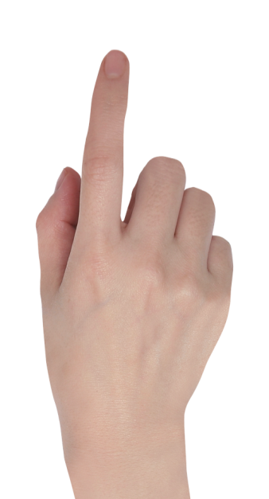
PPT模板下载：www.1ppt.com/moban/ 行业PPT模板：www.1ppt.com/hangye/
节日PPT模板：www.1ppt.com/jieri/ PPT素材下载：www.1ppt.com/sucai/
PPT背景图片：www.1ppt.com/beijing/ PPT图表下载：www.1ppt.com/tubiao/
优秀PPT下载：www.1ppt.com/xiazai/ PPT教程： www.1ppt.com/powerpoint/
Word教程： www.1ppt.com/word/ Excel教程：www.1ppt.com/excel/
资料下载：www.1ppt.com/ziliao/ PPT课件下载：www.1ppt.com/kejian/
范文下载：www.1ppt.com/fanwen/ 试卷下载：www.1ppt.com/shiti/
教案下载：www.1ppt.com/jiaoan/ PPT论坛：www.1ppt.cn
Thank you!

