Slide 1




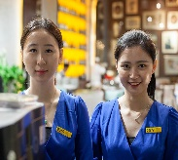
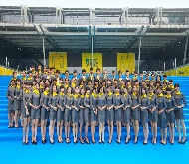
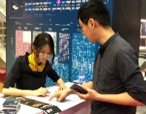
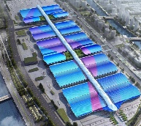
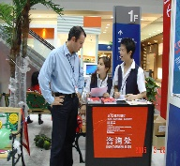
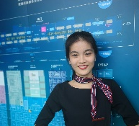
English for Exhibition and Conference
会 展 英 语

Slide 2

Unit 1
Preparations for Exhibitions

Slide 3
Unit Objectives
After studying this unit, you will learn:
As an organizer:
  how to choose the time for an exhibition;
  how to choose the venue for an exhibition.
As an exhibitor:
  why attend an exhibition;
  how to prepare for an exhibition.

Slide 4
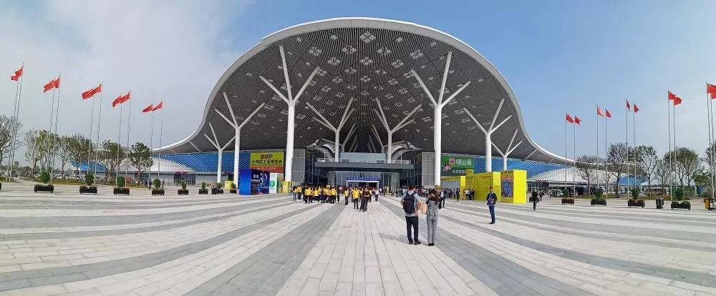
1
深圳国际会展中心
Organizer’s Diary

Slide 5
During this period, I will learn:
how to choose the time for an exhibition;
how to choose the venue for an exhibition.

Slide 6
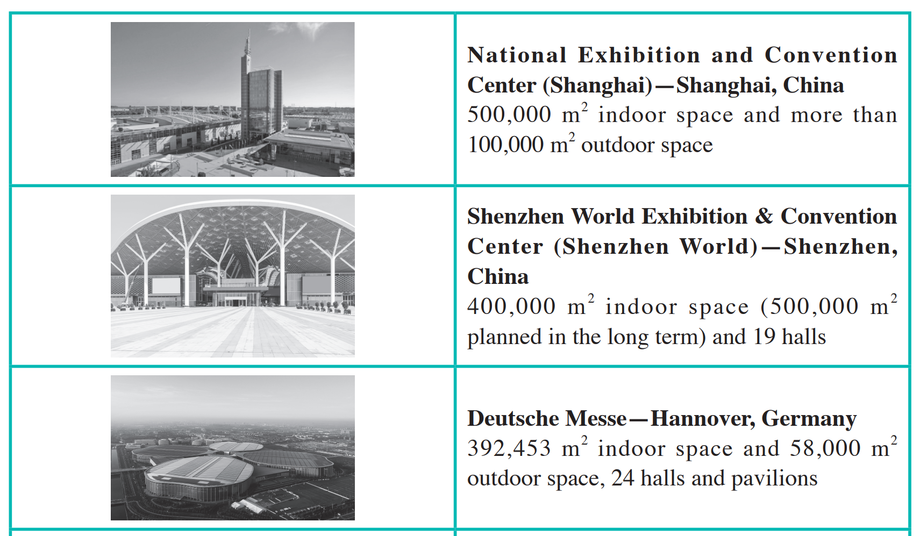
I. Lead-in Practice
Task 1 Vocabulary: Look at the pictures. Match the pictures on the left with
the equivalent information about exhibition centers on the right.

Slide 7
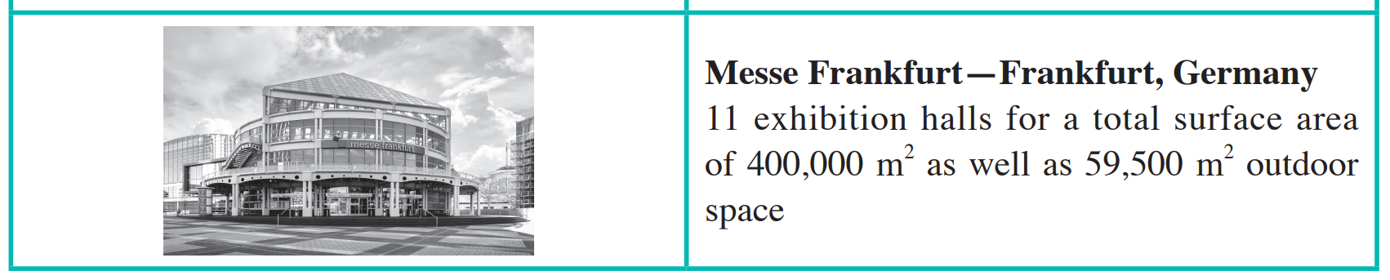
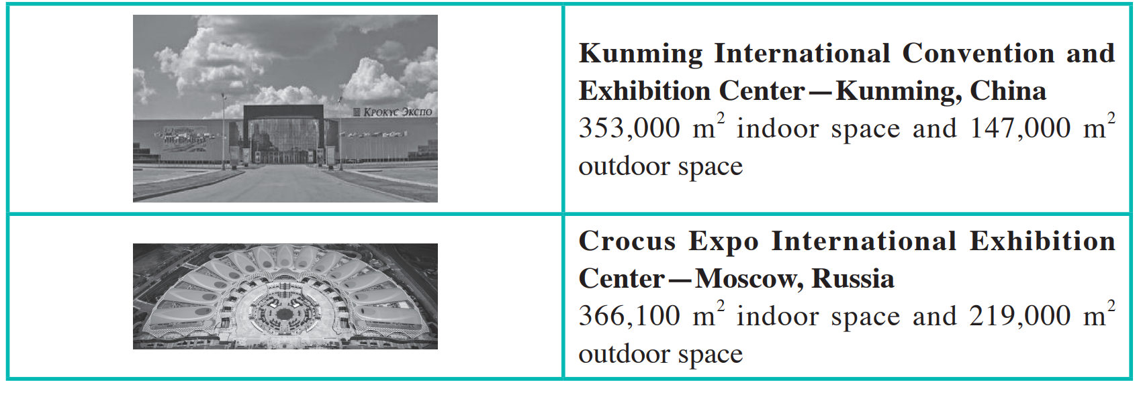
I. Lead-in Practice
Task 1 Vocabulary: Look at the pictures. Match the pictures on the left with
the equivalent information about exhibition centers on the right.

Slide 8
I. Lead-in Practice
Task 2 Brainstorming: Match the terms in column A with the definitions in
column B.
A
organizer
exhibitor
buyer
sponsor
contractor
forwarder
visitor
B
someone whose job is to choose and buy goods for a large store, factory, or shop to sell
someone who visits a place or an event
a person or company that pays for an event in exchange for the right to advertise at that event
a company that arranges for goods to be transported
a person or group who plans and arranges an event or activity
a person or company whose job is to provide goods or to do work for another person, organization, company etc. at a particular price
a person, company, or organization that has made something shown in an exhibition

Slide 9
II. Reading
Passage 1 UFI and Exhibitions
UFI was founded in Milan, 1925 and created under the name “Union des Foires Internationales” (UFI) in French. It is now the world’s leading association of trade fair organizers, exhibition and convention centers, professional exhibition associations and industry partners. Up to 2022, 820 member organizations in 86 countries and regions around the world are signed up as members, and more than 909 UFI approved (international) events proudly bear the UFI approved label.
The name change to “UFI”, accompanied by the tag line “The Global Association of the Exhibition Industry”, was decided upon by the General Meeting in Cairo, 2003.
According to UFI, the concepts of “fair”“exposition” and “exhibition” are used similarly in informal speech. However, there are some conceptual developments which show the variability of today’s exhibition industry.

Slide 10
II. Reading
Passage 1 UFI and Exhibitions
Fair comes from Latin “feria”, meaning “holiday”, as well as “market fair”, a periodic gathering for sale of goods, often with shows or entertainment, at a place and time fixed by custom.
Exhibition comes from the Latin word “expositio”, meaning “displaying” or “putting on a show”. Expositions and exhibitions have always been combined with the display of goods and products.
Exhibitions differ from fairs in four major ways:
Exhibitions are usually one-time events.
Exhibitions are housed in permanent facilities built specifically for them.
Although fairs are held regularly, they are not highly organized events. Exhibitions, however, are highly organized events.

Slide 11
II. Reading
Passage 1 UFI and Exhibitions
Exhibitions differ from fairs in the very way in which business is conducted. Goods are bought and sold at fairs. At exhibitions, the commercial activity or selling of the displayed goods is not usually involved. However, the inherent purpose of displaying the goods is to hopefully stimulate future sales.
World EXPO is the general name for various large expositions held since the mid-19th century. World expositions last from 3 to 6 months in duration, usually having themes based upon which pavilions are made to represent the country’s interpretation on that theme.
Trade Fairs have been the primary marketing medium of exporting countries. The exhibits are confined to one industry or a specialized segment of a special industry.
Trade Shows are B2B (Business to Business) events. Companies in a specific industry demonstrate their new products and services. Generally trade shows are open to the public and are attended by company representatives and members of the press.

Slide 12
II. Reading
Passage 1 UFI and Exhibitions
Consumer Shows (Public Shows) are events that are open to the general public. Exhibitors are typically retail outlets, manufacturers or service organizations looking to bring their goods and services directly to the end user.
Virtual Fairs appeared in the 1970s when Internet use became widespread. Possible advantages include the elimination of usual trade show time constraints, space factors and exhausting, long-distance travel.

Slide 13
II. Reading
Passage 1 UFI and Exhibitions
tag line: n. a variant of a branding slogan typically used in marketing materials and advertising （广告中的）主题句
inherent: adj. existing as an essential constituent or characteristic; intrinsic 固有的；内在的
pavilion: n. a usually temporary structure erected at a fair or show for use by an exhibitor 临时搭建的棚架或建筑物
outlet: n. a store that sells the goods of a particular manufacturer or wholesaler 出售特定制造商或批发商的货物的商店
elimination n. the process of removing something 消除；清除
constraint n. something that controls what you do by keeping you with particular limits 限制；约束

Slide 14
II. Reading
Passage 1 UFI and Exhibitions
Task 1 Read the text and fill in the form below with the information from the text.
UFI (The Global Association of the Exhibition Industry)
Founding time
Founding place
Initial name (French)
Number of members
Tag line
1925
Milan
Union des Foires Internationales
820
The Global Association of the Exhibition Industry

Slide 15
II. Reading
Passage 1 UFI and Exhibitions
Task 2 Read the text again and tick the features of the two concepts according to the text.
 | Exhibition | Fair
Coming from Latin “feria”
Coming from Latin “expositio”
Usually one-time events
Being housed in permanent facilities
Being held regularly
Not being highly organized
Being highly organized
Goods being bought or sold
Displaying goods to stimulate future sales
√
√
√
√
√
√
√
√
√

Slide 16
II. Reading
Passage 2 A Guide to Successful Exhibition Planning
assemble: v. to bring or call together into a group or whole 集合或召集到一起
revenue: n. all the income produced by a particular source 收入
venue: n. a place for large gatherings 会场
publicity: n. the act or process of disseminating information to gain public interest 宣传
sure-fire: adj. certain to succeed 一定能成功的
seminar: n. a meeting for an exchange of ideas; a conference 研讨会；讨论会
workshop: n. a period of discussion and practical work on a particular subject, in which a group of
people share their knowledge and experience 研讨会；讲习班

Slide 17
II. Reading
Passage 2 A Guide to Successful Exhibition Planning
Task 1 Read the text and fill in the blanks with the given words and phrase
according to the context.
anticipated expenses 2. appoint 3. invitation
negotiations 5. thoughtful 6. venue

Slide 18
II. Reading
Passage 2 A Guide to Successful Exhibition Planning
As with any organized event which involves schedules and deadlines, the planning of an exhibition takes a lot of coordination and dedication to make it successful. There are various steps that need to be completed.
Setting Up a Planning Committee
The first and most logical step in exhibition planning is assembling a team of people who
have the necessary skills and experience. Once you have assembled your team, the next step is to 1 ________________ an experienced exhibition coordinator.
Planning a Budget
An exhibition budget should be prepared through a 2 ________________ process involving the sponsor, planning committee and coordinator. A budget is a listing of all 3 ___________________, funding sources and projected revenue.
appoint
thoughtful
anticipated expenses

Slide 19
II. Reading
Passage 2 A Guide to Successful Exhibition Planning
Selecting a Venue and Negotiating Contracts
Choosing a suitable 4 ________________ should be arranged as early as possible in order to avoid any last minute nightmare. The site should be located as centrally as possible with regard to your target audience. After selecting, it is a good practice to enter into a formal contract agreement with the venue, and the 5 ________________ should be handled professionally.
Sourcing Exhibitors
Next in the planning process is finding potential exhibitors to take part in your show. Sending out personal 6 ________________ is probably the most effective way to go.
Publicizing Your Exhibition
Publicity is of utmost importance in the planning of an exhibition. A sure-fire way of increasing the amount of interest in your show is to offer a diverse range of activities, such as seminars and interactive workshops.
venue
negotiations
invitations

Slide 20
II. Reading
Passage 2 A Guide to Successful Exhibition Planning
Task 2 Read the text again and answer the following questions.
1. What should be included in a budget?
All anticipated expenses, funding sources and projected revenue.
2. What kind of place is suitable for an exhibition?
The site should be located as centrally as possible with regards to your target audience.
3. What is the most important thing in planning an exhibition?
Publicity.

Slide 21
III. Sample Study
A printed invitation or invitation email letter is a key business marketing tool that is typically used to invite clients or customers to participate in special business events.
It generally includes the following key elements:
date, venue, and time of the event
name of the person or organization sponsoring the event
people to be invited
type of the social event being held
deadline for application or reply
directions or a simple map if the location may be difficult to find

Slide 22

III. Sample Study
Sample 1

Slide 23
III. Sample Study
Task 1 Fill in the form with the information from Sample 1.
Item | Content
Exhibition name
Date
City
Expected number of attendees
Priority deadline for booth application
Exhibition rank
The 19th Qingdao International Furniture Fair
May 19-22, 2022
Qingdao
Over 350,000
The end of March, 2022
The highest profile fairs of its kind in the furniture and interior decoration fields in Asia

Slide 24

III. Sample Study
Sample 2

Slide 25
III. Sample Study
Task 2 Fill in the form with the information from Sample 2.
Item | Content
Exhibition name
Date
venue
Purpose of exhibition
Booth number
The Garment Technology Expo
Sept. 3 to 6, 2023
NSIC Exhibition Complex, New Delhi, India
To provide an opportunity for everybody who is interested in Hark’s products to interact with one another
W408, W409

Slide 26

IV. Situational Dialogs
Dialog one
Discussing the exhibition time
Chris Davis:
the Sales Manager of Saidel Exhibition Co., Ltd., a famous international convention and exhibition company
Lily Wang and Charles Zhang:
Chris’ colleagues in the Sales and Marketing Department

Slide 27
IV. Situational Dialogs
Dialog one
Discussing the exhibition time
1. which features a wide spectrum of light-industry products.
2. We will choose a suitable time for the show.
3. It is the best time slot before the launch of major trade fairs.
4. The suppliers can accommodate the buyers’ needs.
5. … which gather a large number of buyers in the region for sourcing products.
6. As the consumer products cycle shortens, international buyers are now sourcing more frequently.
Task 1 Close your book and listen to the dialog.

Slide 28
IV. Situational Dialogs
Dialog one
Discussing the exhibition time
Chris: Morning everyone. You know we will organize a new trade fair—Asia Spring Fair, which features a wide spectrum of light-industry products. And today we will choose a suitable time for the show. Lily, please take meeting minutes.
Lily: OK.
Charles: Organizing a new show is really hard, because few people want to attend a new show.
Chris: I know. That’s why we should choose an appropriate time and venue.
Charles: As the name is Spring Fair, what do you think of the middle of March?

Slide 29
IV. Situational Dialogs
Dialog one
Discussing the exhibition time
Chris: I’m afraid it will be too late. I prefer late February.
Lily: But the traditional Chinese Spring Festival will be in February. How about the middle of January? I think it is the best time slot before the launch of major trade fairs in Europe and the United States.
Chris: Sounds good. The suppliers can accommodate the buyers’ needs.
Charles: I agree. And there are many similarly themed trade shows held in Asia during January, which gather a large number of buyers in the region for sourcing products.

Slide 30
IV. Situational Dialogs
Dialog one
Discussing the exhibition time
Chris: Yes. As the consumer products cycle shortens, international buyers are now sourcing more frequently. And January is the best timing for manufacturers to meet new buyers from around the globe.
Lily: Don’t forget an old Chinese saying—A year’s plan starts with spring. January is the beginning of the year, which provides buyers the most ideal time slot to source the latest products of the year.
Chris: Great. You should write down this sentence in our prospectus to promote our show.
Lily: No problem.

Slide 31
IV. Situational Dialogs
Dialog one
Discussing the exhibition time
spectrum: 系列，幅度，范围
light-industry: 轻工业
(meeting) minutes: 会议记录
time slot: 时间空挡
accommodate: 适应，顾及
source: 购进，采购
A year’s plan starts with spring.一年之计在于春
prospectus: 展会宣传书

Slide 32
IV. Situational Dialogs
Dialog one
Discussing the exhibition time
Task 2 Read the dialog again and recite the underlined expressions.
Task 3 Work in groups. Act as Chris Davis, Lily Wang and Charles Zhang
and role-play the dialog.

Slide 33
IV. Situational Dialogs
Dialog two
Discussing the exhibition venue
Chris Davis:
the Sales Manager of Saidel Exhibition Co., Ltd., a famous international convention and exhibition company
Lily Wang and Charles Zhang:
Chris’ colleagues in the Sales and Marketing Department

Slide 34
IV. Situational Dialogs
Dialog two
Discussing the exhibition venue
Task 1 Close your book and listen to the dialog.
1. Location, of course, is a top priority. It is a magnificent, multiuse venue located right in the heart of Hong Kong.
2. The closer the venue is to such places, the easier it will be for people to come to the exhibition.
3. Adjacent and linked to the HKCEC there are two world-class hotels.
4. As far as facilities and infrastructural capabilities are concerned, I think…

Slide 35
IV. Situational Dialogs
Dialog two
Discussing the exhibition venue
Chris: Last meeting was really productive and effective. We decided the time of the new Spring Fair, and today we will discuss the venue of the fair.
Lily: We will organize it in Hong Kong SAR, right?
Chris: Sure. That means we have two options—Hong Kong Convention and Exhibition Center, or HKCEC, and AsiaWorld-Expo.
Charles: I think the former is better.
Chris: OK. Tell us your reason.

Slide 36
IV. Situational Dialogs
Dialog two
Discussing the exhibition venue
Charles: Location, of course, is a top priority. It is a magnificent, multiuse venue located right in the heart of Hong Kong on the famous Victoria Harbor.
Lily: However, location is not just important for the venue itself, but for its distance from such things as airports, bus stations, and the train stations. The closer the venue is to such places, the easier it will be for people to come to the exhibition. So, I think AsiaWorld-Expo is better.
Chris: Yes, AsiaWorld-Expo is located right next to the Hong Kong International Airport and at the center of an efficient air, land and marine transportation network.

Slide 37
IV. Situational Dialogs
Dialog two
Discussing the exhibition venue
Lily: And it boasts an in-venue MTR station.
Charles: I agree. But distance from hotels is another thing we should consider. Adjacent and linked to the HKCEC there are two world-class hotels and there are over 6,000 rooms within walking distance.
Chris: What’s more, it is one of the largest multiuse venues in Asia and continues to be a globally recognized landmark in Hong Kong.
Lily: Our fair attracts international exhibitors and buyers. It is desirable that a trade fair venue should be closer to the airport. AsiaWorld-Expo’s good location and facilities will create a great atmosphere to both exhibitors and buyers.

Slide 38
IV. Situational Dialogs
Dialog two
Discussing the exhibition venue
Chris: As far as facilities and infrastructural capabilities are concerned, I think both of them are great. When choosing a location for the exhibition, don’t forget the budget and availability.
Lily: Right. I will check whether they are available in January.

Slide 39
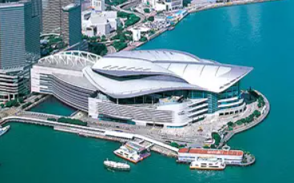
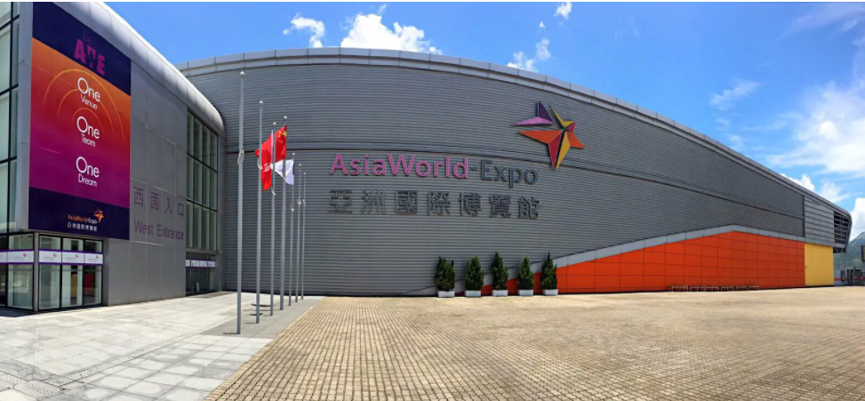
IV. Situational Dialogs
Dialog two
Discussing the exhibition venue
Hong Kong SAR: Hong Kong Special Administration Region 香港特别行政区
Hong Kong Convention and Exhibition Center: HKCEC,香港会议展览中心
Asia World-Expo: 亚洲国际博览馆
priority: 优先，优先顺序

Slide 40
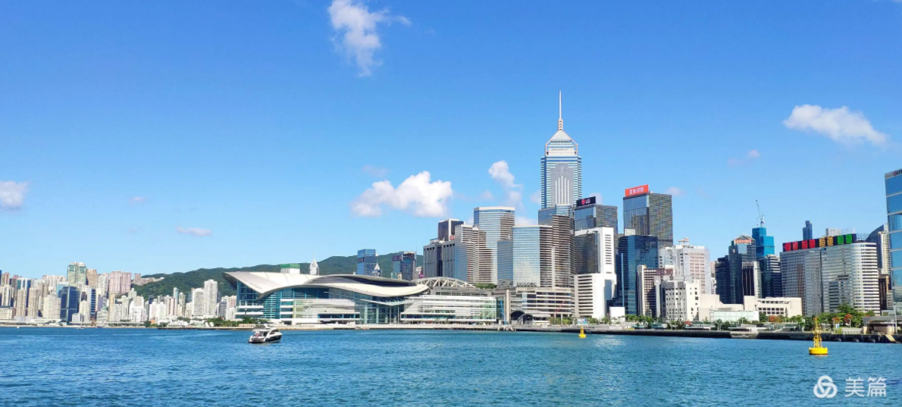
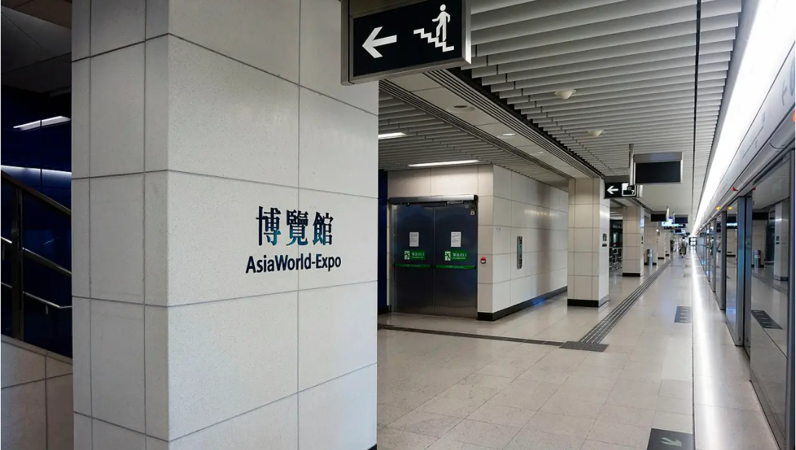
IV. Situational Dialogs
Dialog two
Discussing the exhibition venue
Victoria Harbor: （香港）维多利亚港
boast：以…为荣
in-venue MTR: Mass Transit Railway 馆内机场快线/港铁（内置港铁站）
adjacent: 邻近的，毗连的
landmark: 地标，陆
infrastructural: 基础的，基础结构

Slide 41
IV. Situational Dialogs
Dialog two
Discussing the exhibition venue
Task 2 Read the dialog again and recite the underlined expressions.
Task 3 Work in groups. Act as Chris Davis, Lily Wang and Charles Zhang
and role-play the dialog.

Slide 42
IV. Situational Dialogs
Dialog two
Discussing the exhibition venue
Task 4 Simulation: Make up a dialog with your partner, taking the roles
of Mr. Hemingway and Ms. Yao.
Mr. Joe Hemingway is the Marketing Manager of an exhibition company, the organizer of a toy exhibition. He is discussing with his colleague Ms. Yao about choosing the time and venue of a new trade fair—Hong Kong Toys & Games Fair in Hong Kong, China.

Slide 43
IV. Situational Dialogs
Dialog two
Discussing the exhibition venue
Event Info.: Hong Kong Toys & Games Fair 香港玩具展（香港）
Organized by the HKTDC (Hong Kong Trade Development Council) and held at the HKCEC (Hong Kong Convention and Exhibition Center) annually in January, Hong Kong Toys & Games Fair is the largest toy industry event in Asia and the second largest in the world. It features over 2,000 international exhibitors and caters to the needs of buyers from around the world.

Slide 44
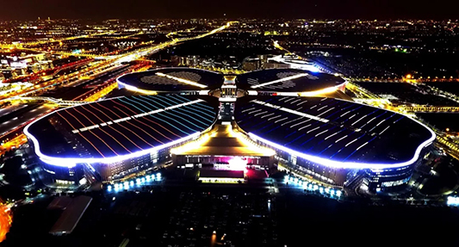
2
国家会展中心（上海）
Exhibitor’s Diary

Slide 45
During this period, I will learn:
why attend an exhibition;
how to prepare for an exhibition.

Slide 46
I. Lead-in Practice
Task Work with your partner and collect your thoughts on the following
questions.
What are the purposes of attending trade shows?
➢ Opening up to a large market
➢ Launching new products
➢ Reinforcing the market position and brand message
➢ Strengthening relationships with existing customers
➢ Developing new contacts and build customer database
➢ Expanding customer awareness of the product or service
➢ Conducting inexpensive market research
2. What should be considered before attending a show?
➢ The purposes/goals of attending the show
➢ Selecting a suitable show
➢ Budget of attending the show
➢ The cost and number of people for the show
➢ Preparing equipment, booking tickets and accommodations, planning displays, etc.

Slide 47
II. Reading
Passage Why Exhibit at Trade Shows?
Exhibitions are one of the most effective media for establishing and maintaining customer relations. They allow a company or an individual to showcase the latest products; they are also used by sellers to find buyers for their products and vice versa.
Making Connections
The primary benefit of attending a trade show is networking. Besides strengthening relationships with existing customers, developing new contacts and potential new business partners can help expand your business and build a database for your company. Trade shows are good places to expand customer awareness of your products or services. They allow you to save time and energy in working to get meetings to develop business relationships since both buyers and sellers are represented at trade shows.

Slide 48
II. Reading
Passage Why Exhibit at Trade Shows?
Staying Updated on Industry Trends
Keeping abreast of current trends is another excellent reason to attend a trade show in your industry. From new technological innovations to the fast-paced world of fashion, change is an essential element to virtually any industry. This is why understanding the ebb and flow of your industry requires you to keep a keen eye on what is old, new and on the horizon. Trade shows present the state of the art for an industry to both exhibitors and attendees. Therefore, exhibitions not only serve as a part of the marketing mix and provide an opportunity for the exchange of information, but also act as a medium for market research and development.

Slide 49
II. Reading
Passage Why Exhibit at Trade Shows?
Scoping Out the Competition
A trade show gives you, or your company, an opportunity to see what your competitors will be offering as a part of their future product line. This can be advantageous if, for example, your company is considering assigning funding to develop a product, the equivalent of which is about to be marketed by a competitor. You, as exhibitors, not only sell or promote your products but you can also compare your products with those of your competitors.
Keeping Your Name Out There
Another important reason for attending trade shows is to reinforce your market position and brand message. If your company decides to be a no-show for the major trade shows, your absence itself may generate comments, likely negative ones. Rumors that your company is on the decline may not be true, but can become a self-fulfilling prophecy if the public and other businesses believe them and act accordingly.

Slide 50
II. Reading
Passage Why Exhibit at Trade Shows?
showcase: v. to exhibit, especially in an attractive or favorable aspect 展现，展示
networking: n. the practice of meeting and talking to people who may be useful 童you in your work 建立人际关系网
keep abreast of: to make sure that you know all the most recent facts about a subject 了解最新情况
the ebb and flow: the repeated, often regular, movement from one state to another; the repeated change in level, numbers or amount 涨落；起伏
on the horizon: likely to happen soon 即将发生的
state of the art: adj. the most modern or advanced techniques or methods 前沿动态；最先进展
marketing mix: a business tool to assist in defining the marketing strategy 营销组合
scope out: to examine in more detail; to take a closer look at 了解；查清；探明
reinforce: v. to make a structure or material stronger 加强
prophecy: n. a statement that something will happen in the future 预言

Slide 51
II. Reading
Passage Why Exhibit at Trade Shows?
Task 1 Read the text and fill in the form below with the information from the text.
Reasons for Attending Trade Shows | What Can an Exhibition Do or Help You Do?
Making connections | To strengthen relationships with existing customers To develop new contacts and potential new business partners
Staying updated on industry trends | To present the state of the art for an industry To act as a medium for market research and development
Scoping out the competition | To provide an opportunity to see what your competitors will be offering as a part of their future product line
Keeping your name out there
To expand customer awareness of your products or services
To save time and energy in working to get meetings to develop business
relationships
To provide an opportunity for the exchange of information
To compare your products with those of your competitors
To reinforce your market position and brand message

Slide 52
II. Reading
Passage Why Exhibit at Trade Shows?
Task 2 Search the Internet and find out more reasons for attending
trade shows.

Slide 53
III. Do It Yourself
Visit exhibition center(s)/hall(s) in your city and fill in the form according to the information you gather. If there is no exhibition center/hall in your city, search the Internet or the library in your school, and gather information on a famous exhibition center/hall.
Name of the Exhibition Center/Hall
Location
History
Appearance and Design
Transportation
Advantages
Facilities
Successful Events

Slide 54

IV. Situational Dialogs
Dialog
Discussing attending a show
Stella Li:
the Marketing Manager of Teicheng Toys Co., Ltd.
Lisa Su and Martin Zhao:
Stella’s colleagues in the Sales and Marketing Department

Slide 55
IV. Situational Dialogs
Dialog
Discussing attending a show
Task 1 Close your book and listen to the dialog.
1. Trade shows are recognized as a major segment of a company’s marketing mix.
2. They are an incredibly effective promotion and sales tool for…
3. We not only sell products but also compare our products with those of our competitors.
4. We have chances to meet our customers and competitors in one place at the same time.
5. There are many objectives for exhibiting, like selling products, launching new products, researching the market.
6. We can make use of the chance to increase brand awareness and reinforce our company’s image.
7. Once we choose a particular trade show, we will…
8. We’d better take advantage of early-bird discounts on…

Slide 56
IV. Situational Dialogs
Dialog
Discussing attending a show
Stella: Our company decides to attend trade shows to promote our products next year. You know that trade shows are more and more recognized as a major segment of a company’s marketing mix.
Martin: Oh, yes. They are an incredibly effective promotion and sales tool for small-and medium-sized businesses like us. We not only sell products but also compare our products with those of our competitors.
Lisa: Sounds exciting! We have chances to meet our customers and competitors in one place at the same time.

Slide 57
IV. Situational Dialogs
Dialog
Discussing attending a show
Martin: What are our major goals for participation? There are many objectives for exhibiting, like selling products, launching new products, researching the market. What’s more, we can make use of the chance to increase brand awareness and reinforce our company’s image.
Stella: Selling products and reinforcing our company’s image are our major purposes.
Martin: OK. We should search for some trade shows and try to select the best show for our purpose.
Stella: Yes. Martin, please do some research on trade shows in our industry, and submit a report this Friday.

Slide 58
IV. Situational Dialogs
Dialog
Discussing attending a show
Martin: No problem.
Lisa: Stella, what’s the budget of attending a trade show?
Stella: Good question. Once we choose a particular trade show, we will plan our budget.
Lisa: I think the budget should be calculated based on the expected costs and must be defined before the trade show participation is contracted.
Stella: Sure. We will calculate the costs and number of people for the event, and then list all the things we need to do before and during the show.

Slide 59
IV. Situational Dialogs
Dialog
Discussing attending a show
Lisa: We’d better take advantage of early-bird discounts on booth space, travel and hotel accommodations.
Martin: How many of us will attend the show?
Stella: Four, I think. We have a lot of things to do, for example, preparing equipment, booking a booth, booking travel tickets and accommodations.
Lisa: Don’t forget to plan our trade show displays, and advertise by inviting our clients, customers and suppliers.

Slide 60
IV. Situational Dialogs
Dialog
Discussing attending a show
brand awareness:品牌意识，商标意识
take advantage of：利用
early-bird discount: 早期预订特别优惠
accommodation: 膳宿，住处

Slide 61
IV. Situational Dialogs
Dialog
Discussing attending a show
Task 2 Read the dialog again and recite the underlined expressions.
Task 3 Work in groups. Act as Stella Li, Lisa Su and Martin Zhao and
role-play the dialog.

Slide 62
IV. Situational Dialogs
Dialog
Discussing attending a show
Task 4 Simulation: Make up a dialog with your partners, taking the roles
of Mr. Ford, Ms. Lau and Mr. Lin.
Mr. Douglas Ford is the Marketing Manager of New-tech Company. Ms. Carol Lau and Mr. George Lin are Mr. Ford’s colleagues. They are planning to attend China Hi-Tech Fair.
Event Info.: China Hi-Tech Fair 中国国际高新技术成果交易会（广东·深圳）
Renowned as “the No.1 Technology Show in China”, China Hi-Tech Fair (CHTF) is the largest and most influential scientific and technological fair in China. CHTF has been held annually in Shenzhen since 1999 which is co-hosted by Ministries and Commissions of the national government and Shenzhen Municipal People’s Government.

Slide 63
Project: Writing and Replying to an Invitation Email
Work in groups of four. Search the Internet for information on a trade show you are interested in.
Step 1
Step 2
Two students write an invitation email of the event either to exhibitors or to visitors in email involving all the key elements, as listed in Sample Study.
Step 3
The other two students write a reply email to accept or decline the invitation.
Acceptance:
• compliments
• accepting the invitation
• confirming the date, venue, and time of the event
Decline:
• compliments
• declining the invitation
• giving reasons (inconvenience of time, attending other exhibitions, no budget, etc.)

Slide 64
Project: Writing and Replying to an Invitation Email
Step 4
Give an example of the invitation email and reply the email of your group in class next time.
Step 5
Give comments on the invitation and reply emails of other groups in terms of content and creativity.

Slide 65



PPT模板下载：www.1ppt.com/moban/ 行业PPT模板：www.1ppt.com/hangye/
节日PPT模板：www.1ppt.com/jieri/ PPT素材下载：www.1ppt.com/sucai/
PPT背景图片：www.1ppt.com/beijing/ PPT图表下载：www.1ppt.com/tubiao/
优秀PPT下载：www.1ppt.com/xiazai/ PPT教程： www.1ppt.com/powerpoint/
Word教程： www.1ppt.com/word/ Excel教程：www.1ppt.com/excel/
资料下载：www.1ppt.com/ziliao/ PPT课件下载：www.1ppt.com/kejian/
范文下载：www.1ppt.com/fanwen/ 试卷下载：www.1ppt.com/shiti/
教案下载：www.1ppt.com/jiaoan/ PPT论坛：www.1ppt.cn
Thank you!

