Slide 2
Unit 3
Booth Sale and Application

Slide 3
After studying this unit, you will learn:
As an organizer:
  how to design a booth application;
  how to sell exhibit booths.
As an exhibitor:
  how to apply for exhibit booths;
  how to cancel a booth reservation.

Slide 5
how to design a booth application;
how to sell exhibit booths.

Slide 6
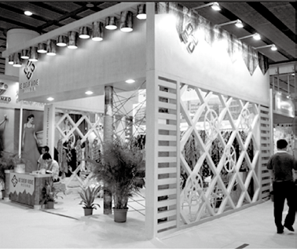
Task 1 Vocabulary: Look at the pictures. Choose the right word for each of the marked items.
information desk
aisle
booth number
carpet
booth personnel
fascia
1
2
3
4
5
6
1.____________ 2.___________ 3._____________
4.____________ 5.___________ 6._____________
booth number
fascia
booth personnel
information desk
carpet
aisle

Slide 7
Task 2 Brainstorming: Work in groups. Discuss the procedures of selling booths to an exhibition organizer.
Put application form and order form on website;
Contact the potential exhibitors to invite them to attend your trade show;
Send invitation letters to them through mail;
Ask those who have confirmed the attendance to download and fill in the application form and send it back;
Allocate booths according to exhibitors’ conditions;
Sign contracts and charge booth fees.

Slide 8
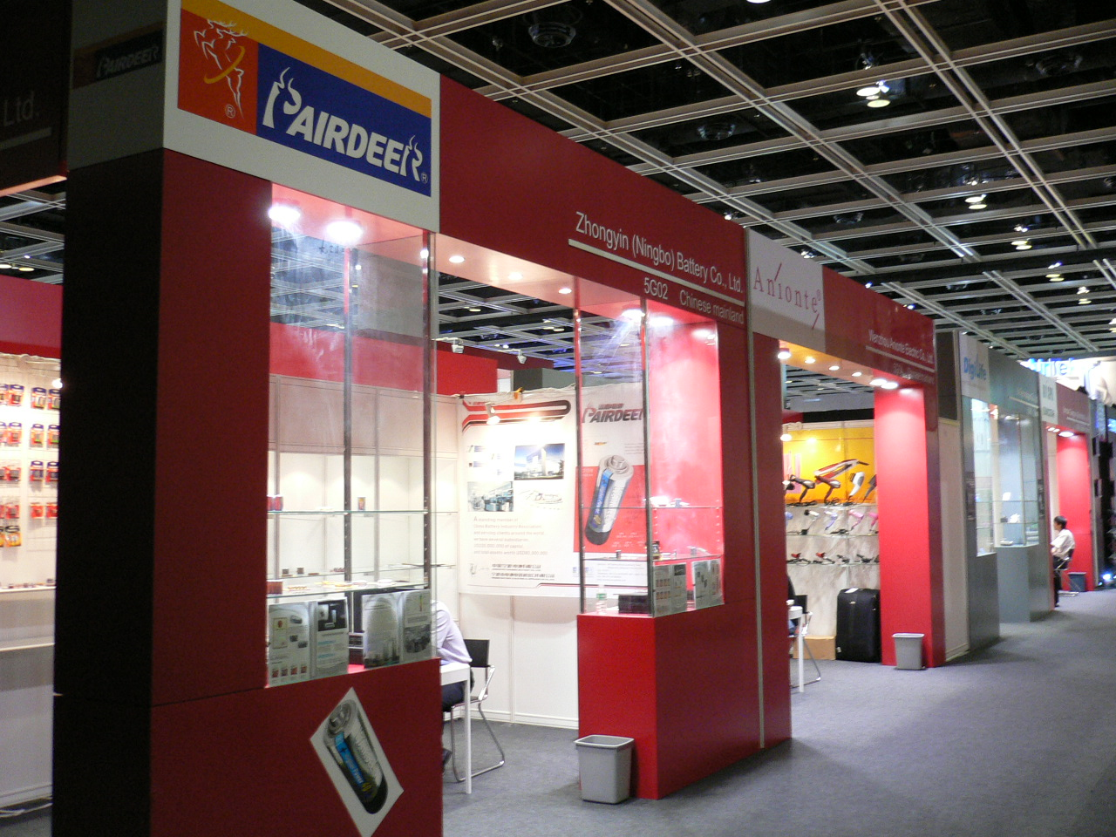
Row Booth

Slide 9
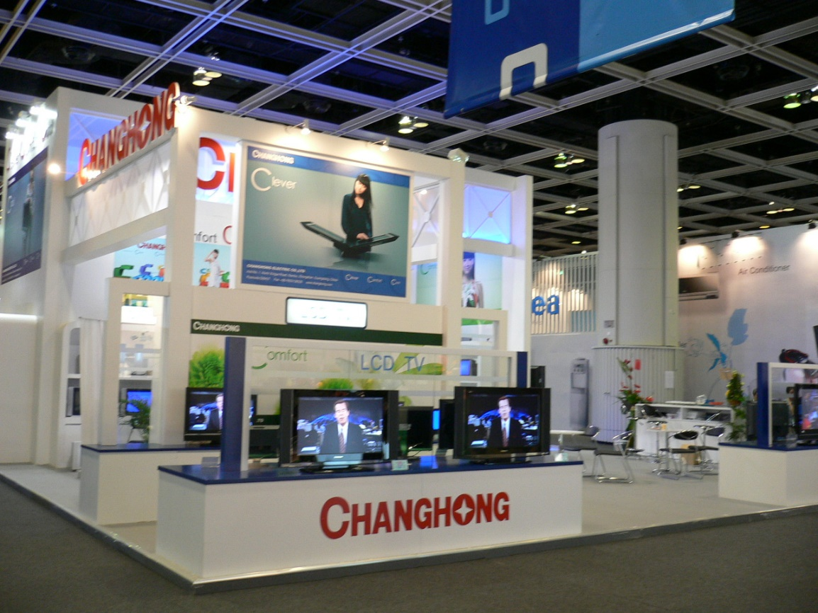
Corner Booth

Slide 10
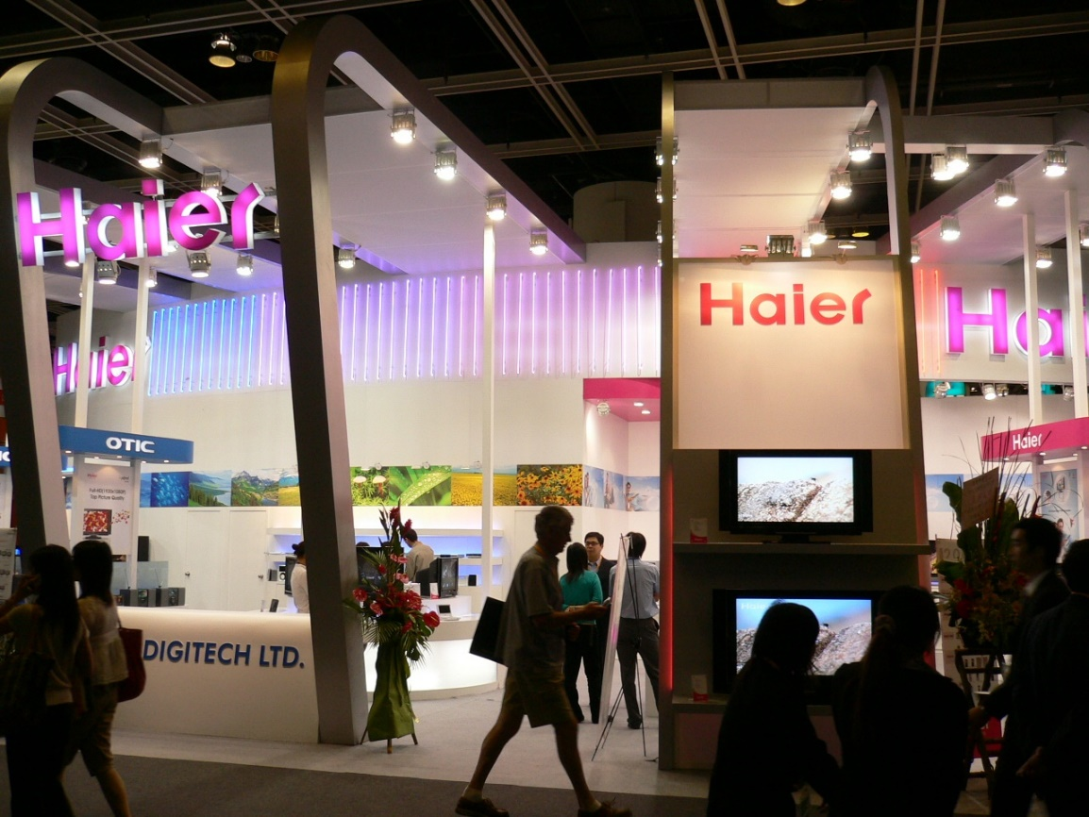
End Booth

Slide 11
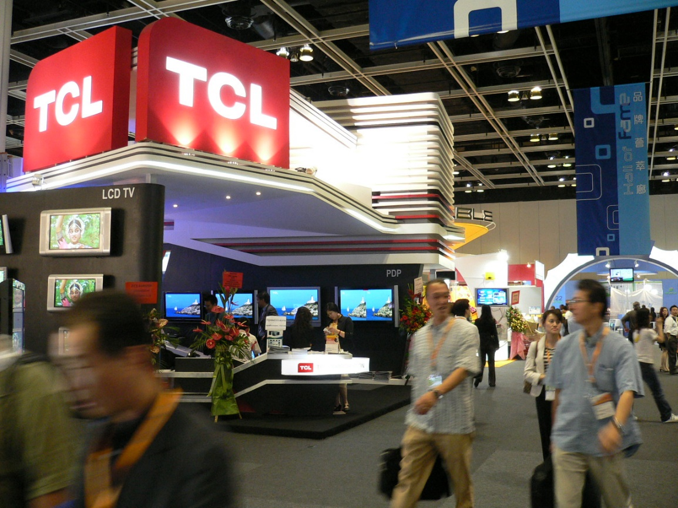
Island Booth

Slide 12
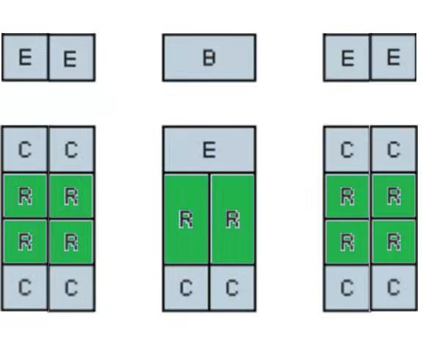
Passage 1 Booth Type
The various types of trade fair booths are influenced by space allocation and access to the aisles. There are four basic types of booths:
● Row booth or in-line booth (R)
● Corner booth (C)
● End booth or peninsula booth (E)
● Block booth or island booth (B)
Row booth or in-line booth (R)
Inline booths are the most common booths in a trade show. The standard row booth or in-line booth is designed to stand back-to-back with an opposite row or a wall and will have adjacent booths on both sides. Only one side faces an aisle. The dimension of the open booth front is used to distinguish a narrow, deep booth from a wide one which is less deep. The typical size of an inline booth is 3m x 3m or 6m x 3m.

Slide 13
Corner booth (C)
A corner booth is situated at the end of a row. It provides access from two sides—from the aisle along the row and from the one vertical to it. A corner booth has more sides accessible to the public, but the same overall area, and is therefore more effective than a booth located in a row. As a corner booth can be seen from two aisles, a larger number of visitors can be expected.
End booth or peninsula booth (E)
An end booth or peninsula booth is at the end of a row, surrounded by aisles on three sides, with another booth against the back. It is qualitatively superior to the above-mentioned types, as it appears more inviting and more representative if used properly. There are two types of peninsula booths:
The first type has its back against an in-line booth or two in-line booths.
The second type has its back against another peninsula booth which creates an island booth.

Slide 14
Block Booth or Island Booth (B)
The block booth or island booth is bordered by aisles on all four sides. Since it is accessible to visitors from all sides, it attracts a great deal of attention due to the fact that itis completely independent from other booths. The block booth or island booth is the most expensive type of booth. It requires more elaborate design, which is reflected in the higher costs for booth assembly and fittings.

Slide 15
Passage 1 Booth Type
adjacent: adj. neighboring 邻近的；毗连的
dimension: n. the measurement of something in a particular direction (length, width, height, etc.) 尺寸（长度、宽度、高度等）
vertical: adj. pointing up in a line that forms an angle of 90° with a flat surface 垂直的；直立的
elaborate: adj. carefully prepared and finished 精心制作的

Slide 16
Passage 1 Booth Type
assembly: n. the process of putting the parts of something together 组装；装配
fittings: n. furnishings and equipment 固定装置；家具，设备
row booth or in-line booth: 列内展位或线型展位
corner booth: 墙角型展位
end booth or peninsula booth:顶端展位或半岛型展位
block booth or island booth: 独立展位或岛型展位

Slide 17
Passage 1 Booth Type
Task 1 Read the text and fill in the form below with the information from the text.
Types of Booth | Location | No. of Sides Open to Aisles
Row booth | Stands back-to-back with an opposite row or a wall | Only one side
Corner booth
End booth
Block booth

Slide 18
Passage 1 Booth Type
Task 1 Read the text and fill in the form below with the information from the text.
Types of Booth | Location | No. of Sides Open to Aisles
Row booth | Stands back-to-back with an opposite row or a wall | Only one side
Corner booth | At the end of a row | Two sides
End booth | At the end of a row | Three sides
Block booth | Completely dependent from other booths | Four sides

Slide 19
Passage 1 Booth Type
Task 2 Read the text again and answer the following questions.
1. What are the advantages of a corner booth compared with a row booth?
A corner booth has more sides accessible to the public than a row booth,
and therefore can expect higher numbers of visitors.
2. Which type of booth is the most expensive? Why?
The most expensive type of booth is block booth or island booth, because it
attracts a great deal of attention and requires more elaborate design, and
the booth assembly and fitting cost more.

Slide 20
Passage 2 How to Effectively Sell Exhibit Booths
prospective: adj. expected to be or to occur; possible 预期的；可能的
brochure: n. booklet or pamphlet containing information about something or advertising something （作介绍或宣传用的）小册子
compile: v. to get or gather together 收集
testimonial: n. something that serves as evidence 证明；证言
privilege: n. a special right, advantage or benefit not enjoyed by all 特有的特权、优势或利益

Slide 21
Passage 2 How to Effectively Sell Exhibit Booths
Task 1 Read the text and fill in the blanks with the given words and phrases according to the context.
1. feedback 2. selling points 3. by participating in
4. type of booth 5. registration forms 6. potential customers

Slide 22
Passage 2 How to Effectively Sell Exhibit Booths
Exhibition organizers sell exhibit booths to companies and organizations to fund the exhibition, while exhibitors buy exhibit booths to attract and meet 1 ___________________or clients. To effectively sell booths to exhibitors, organizers may find some value in the following suggested ways.
Create a list of prospective exhibitors. Depending on your trade show, identify companies within the industry. Reach out by contacting them through mail or email, since this will allow you to send additional information such as brochures and 2 _________________. Follow up and introduce your trade show, detailing the benefits for them to exhibit.
Gather data from previous shows, including the number of convention attendees, the estimated number of convention attendees visiting each booth, and the number of exhibitors. This data will support your 3 _______________. For example, if the main goal of the prospective exhibitor is to sell products at the show, provide data regarding product sales during the gathering.
potential customers
registration form
selling point

Slide 23
Passage 2 How to Effectively Sell Exhibit Booths
Compile testimonials from past exhibitors. Positive 4 _______________from previous exhibitors will give credibility and popularity to your show. Testimonials display the success others have attained 5 _______________your event.
Provide details about special exhibitor privileges depending on the 6 _____________ taken. Many companies may want space for particular large exhibitions, and you should show how your show could meet this need. You might have an online service to represent these booths, or provide media exposure to them.
feedback
by participating
type of booth

Slide 24
Passage 2 How to Effectively Sell Exhibit Booths?
Task 2 Read the text again and answer the following questions.
1. How should the prospective exhibitors be contacted? Why?
They should be contacted through mail, because by this way you can send
additional information such as brochures and registration forms.
2. What data should be gathered from previous shows?
The number of convention attendees, the estimated number of convention
attendees visiting each booth, and the number of exhibitors, etc.
3. Why are testimonials from past exhibitors so important?
Because positive testimonials or feedback will give credibility and popularity to
your show and can display other participants’ success attained in your event.

Slide 25
A booth application form is a form to be filled in by an exhibitor when applying for an exhibit booth at the exhibition venue.
It generally includes the following key elements:
title of exhibition
exhibition details (date, venue, official website, email, tel., fax, etc.)
exhibitor information
product categories/exhibits
options of participation
booth fee/booth space costs
terms of payment/payment method
confirmation (date, company signature and stamp/seal)

Slide 26
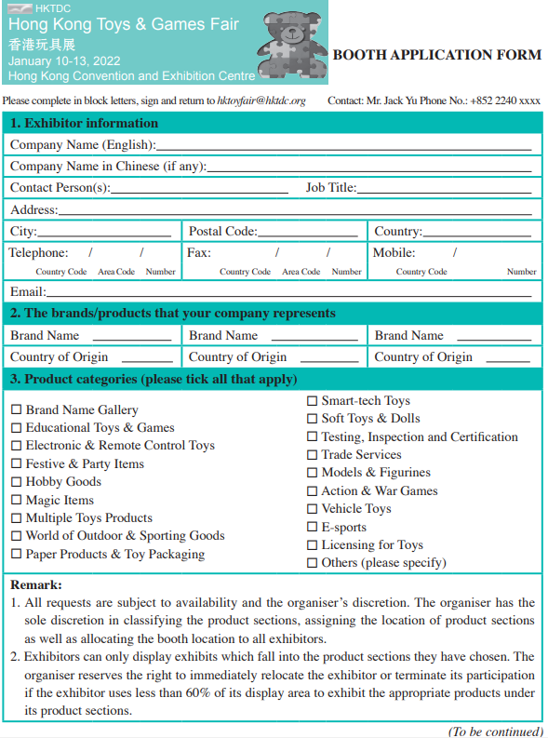
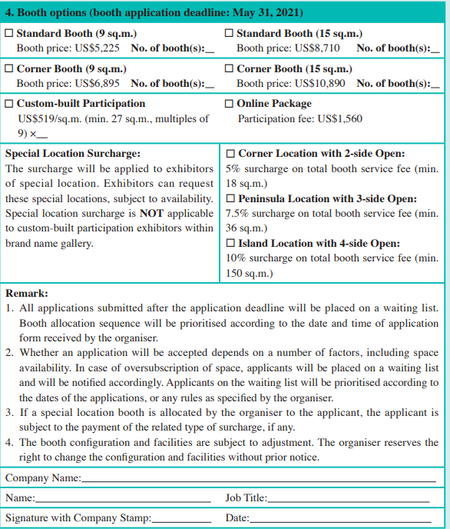

Slide 27
Task 1 Search the Internet for China Hi-Tech Fair and design a booth application form. Pay attention to the key elements listed in the form given above.

Slide 28
Inviting a VIP exhibitor to an exhibition
Chris Davis:
the Sales Manager of Saidel Exhibition Co., Ltd., a famous international convention and exhibition company
Kate Wen:
the Marketing Manager of Youth Code Gifts and Souvenirs Co., Ltd.

Slide 29

Inviting a VIP exhibitor to an exhibition
Task 1 Close your book and listen to the dialog.

Slide 30
Inviting a VIP exhibitor to an exhibition
Kate: Good morning, Kate speaking.
Chris: Morning, Kate. It’s me, Chris.
Kate: Oh, Chris. How is everything going?
Chris: Pretty well, thank you. I’m calling to invite you to our annual exhibition to be held this autumn. You are one of our VIP exhibitors, so you’re warmly welcomed to participate as usual.
Kate: Thank you so much for inviting us. We’d love to. But since we are one of your VIP exhibitors, I was wondering if you could give us some discount on the booth price.

Slide 31
Inviting a VIP exhibitor to an exhibition
Chris: About that... ah... generally, we don’t do that. But, considering our preceding successful cooperation and our further cooperation in the future, I’ll give you a 3% discount.
Kate: Great. Thanks.
Chris: You’re welcome. Then, we are going to prepare a guest card for you.
Kate: That’s kind of you.
Chris: And you need to fill in the registration form with your official stamp and send it to the organizing committee by mail or by fax. As for detailed information, please search our website.

Slide 32
Inviting a VIP exhibitor to an exhibition
Kate: Good. I will. By the way, what’s your fax number again?
Chris: It’s 23456789.
Kate: 23456789. OK, I got it. Thank you. We will send you the registration form as soon as it is ready.
Chris: Sure. After receiving your form, we’ll help reserve the booth for you.
Kate: Good. You are so considerate.
Chris: Thank you. See you then.

Slide 33
Inviting a VIP exhibitor to an exhibition
I was wondering if you could give us some discount on the booth price.
But, considering our preceding successful cooperation and our further cooperation in the future…
… fill in the registration form with your official stamp.
We’ll help reserve the booth for you.
Task 2 Read the dialog again and recite the underlined expressions.
Task 3 Work in groups. Act as Chris Davis and Sally Thompson and role-play the dialog.

Slide 34
Inviting a VIP exhibitor to an exhibition
Task 4 Simulation: Make up a dialog with your partner, taking the roles of
Mr. Robinson and Miss Jin.
Mr. Peter Robinson is the Secretary of the Organizing Committee of China International Fair for Trade in Services. He is calling Ms. Blair Jin, the Marketing Manager of a famous logistics company, to invite her to attend the fair. As a VIP visitor, Ms. Blair Jin is bargaining for the booth price.

Slide 35
Inviting a VIP exhibitor to an exhibition
Event Info.: China International Fair for Trade in Services 中国国际服务贸易交易 会（北京）
China International Fair for Trade in Services (CIFTIS) has been held annually in Beijing since 2012. CIFTIS is the largest comprehensive exhibition in the field of global trade in services and has become an important platform for spreading ideas, connecting supply and demand, sharing business opportunities, and promoting common development in the field of international trade in services.

Slide 37
how to apply for exhibit booths;
how to cancel a booth reservation.

Slide 38
Task Work with your partner and collect your thoughts on the following
questions.
1. What will an exhibitor consider when choosing a booth?
When choosing a booth, an exhibitor will consider the booth type, size,
location, price, etc.
2. What steps should an exhibitor follow if he/she is to apply for an
exhibit booth?
➢ Step 1: Download the application form from the website or contact the organizer for the original
application form;
Step 2: Fill in the booth application form, with authorized signature and company stamp on it;
Step 3: Fax the copy or mail the original application form to the organizer;
Step 4: Confirm booth allocation;
Step 5: Sign the agreement;
Step 6: Arrange the payment and receive the exhibitor manual.

Slide 39
Passage Tips on Trade Show Booth Selection
Seniority
Trade show exhibit booth spaces are assigned based on an exhibitor’s past participation in the show. Exhibitors who have attended in the past are contacted first and allowed to select their spaces. New exhibitors are contacted later. However, for new exhibitors with a sharp eye, prime spaces may be available later in the selection process. It is common for exhibitors to cancel their reservation for a booth space, sometimes months and even weeks before the show. The show organizers will be happy to move you into this more favorable location if they know you are willing to move.
Location
Location is only one factor to a successful show. Depending on the show, your location may not offer much advantage. Pre-show promotion, a clear marketing message, and good trade show booth staff are generally more important than the good booth placement.

Slide 40
Passage Tips on Trade Show Booth Selection
Booth Size
Consider factors such as how much space your competition has committed to, projected attendance, how many employees will staff the booth, and how much space is required for products, demos, meetings, etc. You will also want to consider your plan for growth in the industry. Downsizing your display booth space from one year to the next is not recommended.
Other Tips
Large expensive display booths are generally located near the show hall entrance. They typically fan out and give way to smaller booth spaces toward the back and perimeter.
Keep some distance from your closest competitors.
Look for opportunities to stand out. Often, there are great opportunities away from the entrance or in another hall that can give you an advantage. Consider exhibiting near the restaurant entrance or in a space flanked by primary traffic aisles.

Slide 41
Passage Tips on Trade Show Booth Selection
There are restrictions on height. Some shows strictly enforce these regulations. Don’t assume the regulations are the same in Europe, Asia, and America. They’re not.
Consider splitting an island booth space with another company. Many shows allow two exhibitors to share a booth space and divide it to suit. An island can be converted into two peninsulas, for example.

Slide 42
Passage Tips on Trade Show Booth Selection
seniority: n. higher rank than that of others especially by reason of longer service 老资格；资深
assign: v. to give something to somebody as a share of things to be used 分配
attendance: n. the number of people that are present 出席人数
demo: n. a visual presentation showing how something works 演示
downsize: v. to reduce in size 缩减

Slide 43
Passage Tips on Trade Show Booth Selection
fan out: to spread in the form of a fan 成扇形散开
flank: v. to place (somebody/something) on each side or at the side of somebody/something 置（某人或某物）于某人（或某物）的两侧或一侧
split: v. to separate or divide into 分裂成，分成
convert: v. to change (something) from one form or use to another 改变（某事物）的形式或用途

Slide 44
Passage Tips on Trade Show Booth Selection
Task 1 Read the text and decide whether the following statements are true (T) or false (F).
It is impossible for new exhibitors to get a booth at a good location.
Good booth placement is the most important factor to a successful trade show.
It is not recommended to downsize your display booth space from one year to the next.
It’s good to stay far away from your competitors.
It is advisable to share an island booth space with another company by dividing it into two peninsula booths.
F
F
T
F
T

Slide 45
Suppose you are Mr. Jacky Chen, the Marketing Manager of Mejin Innovative Technology, which is going to attend Hong Kong Toys & Games Fair. The company plans to book one corner booth (15 sq. m.) at the corner location. Fill in the application form according to the company’s situation：
Guangdong Mejin Innovative Technology Co., Ltd. was established in 1991, with 40,000 square meters of workshops and nearly 1,000 employees. It is a hi-tech company that focuses on research and development of toys, specializing in remote control toys including drones, helicopters, boats and cars; it also produces creative toys like outdoor foam-based weaponry goods (some are made of rubber and/or plastic), and traditional educational toys, such as board games and puzzles.

Slide 46
Contact Information:
Head Office | Guangdong Mejin Innovative Technology Co., Ltd. No. 2028, 20th Floor, Jinhui Building Xindong Rd. 2 Huizhou 516000 Guangdong Province
Tel. | +86-752-0000-0000, +86-139××××9988
Fax | +86-752-0000-0001
Email | jacky12@mejin.com

Slide 47
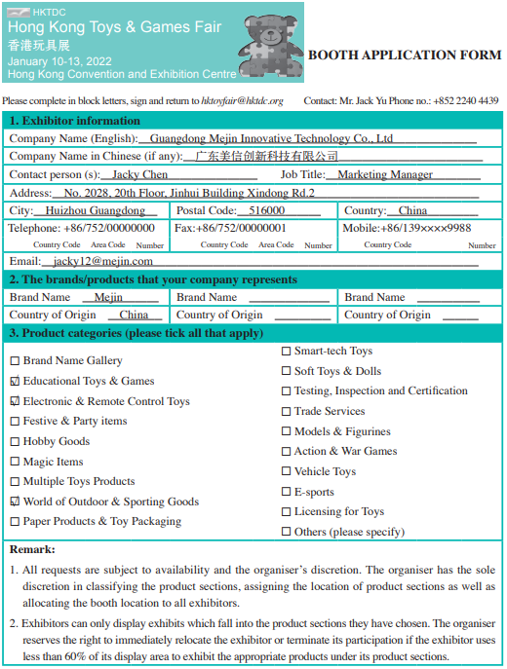
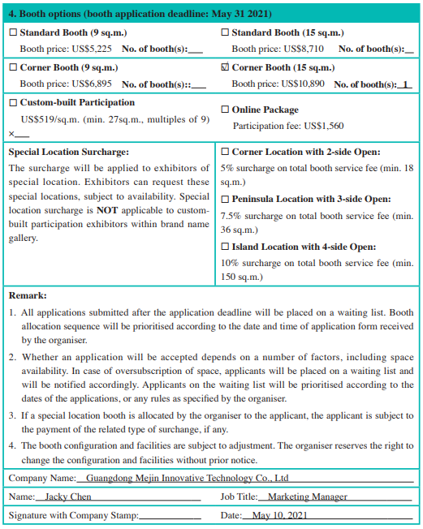

Slide 48
Chris Davis:
the Sales Manager of Saidel Exhibition Co., Ltd., a famous international convention and exhibition company
Stella Li:
the Marketing Manager of Teicheng Toys Co., Ltd.

Slide 49
Task 1 Close your book and listen to the dialog.
back to back: 背靠背的
two neighboring corner booths: 两个相邻的墙角型展位
traffic:流动的车辆或行人,交通(量)

Slide 50
Stella: Hello, may I speak to Chris Davis?
Chris: This is he speaking. Who is that?
Stella: This is Stella Li, the Marketing Manager of Teicheng Toys.
Chris: Yeah, I remember you. You called me last week, and your booth application form was received yesterday.

Slide 51
Stella: Good. That’s what I want to talk about now. We booked one standard booth in the application form, but now I want to change it to an end booth of 24 square meters. Is that OK?
Chris: Oh, wait a minute. Let me check… Unfortunately, end booths have been sold out, but we still have two corner booths standing back to back, 9 square meters for each.
Stella: How much do you charge for one corner booth?

Slide 52
Chris: US$5,150. I suggest you book those two neighboring corner booths, and we can change them to an 18-square-meter end booth. They have three sides open to aisles, and that will invite higher traffic.
Stella: Sounds good. OK, I’ll take those two corner booths, and you will make them as one end booth, right?
Chris: Sure, we will do it. Thank you for your cooperation.
Stella: Thank you.

Slide 53
Task 2 Read the dialog again and recite the underlined expressions.
1. We booked one standard booth …
2. End booths have sold out.
3. How much do you charge for …?
4. That will invite higher traffic.
5. I’ll take…

Slide 54
Task 3 Work in pairs. Act as Chris Davis and Stella Li and role-play the dialog.

Slide 55
Chris Davis:
the Sales Manager of Saidel Exhibition Co., Ltd., a famous international convention and exhibition company
Kate Wen:
the Marketing Manager of Y&C Gifts and Souvenirs Co., Ltd.

Slide 56
Task 1 Close your book and listen to the dialog.

Slide 57
Kate: Good afternoon. Is that Chris Davis?
Chris: Yes. What can I do for you?
Kate: This is Kate. I made a booth reservation four months ago. I’m sorry to tell you that there is no way I can attend the exhibition due to a fire in our factory the other day; all the products were burned out.
Chris: I’m so sorry to hear that.
Kate: So I wonder what I should do to cancel my reservation.

Slide 58
Chris: Well, we will see what we can do. Let me check…You’ve reserved a corner booth on the second floor, and the booth number is HN89. Am I right?
Kate: Yes, exactly.
Chris: OK, I have a few things to clarify. You need to fax us a written notice with an official stamp by the end of this month, or we will not accept your cancellation. According to the exhibition regulations, you may receive a 50% refund from us if you give us the notice 100 days before the exhibition starts, i.e. by the end of this month.
Kate: I want to get a full refund.

Slide 59
Chris: I’m sorry. You can only get a 50% refund. That’s the rule.
Kate: OK. It’s better than nothing. When can you mail the refund to me?
Chris: The refund will be mailed to you when the show is over.
Kate: That’s OK. Thank you. Goodbye.
Chris: You’re welcome. We look forward to your participation in our next fair.

Slide 60
Task 2 Read the dialog again and recite the underlined expressions.
1. …there is no way I can attend the exhibition due to …
2. I wonder what I should do to cancel my reservation.
3. You need to fax us a written notice with official stamp ...
4. You may receive a 50% refund from us.
5. When can you mail the refund to me?
6. You’re welcome. We look forward to your participation in our next fair.

Slide 61
Task 3 Work in pairs. Act as Chris Davis and Kate Wen and role-play the dialog.

Slide 62
Task 4 Simulation: Make up a dialog with your partner, taking the roles of Mr. Geller and Ms. Jin.
Mr. David James is the Sales Manager of an exhibition company, the organizer of China Food and Drinks Fair. Ms. Lily Liu, the Marketing Manager of Eversuccess Co., Ltd., is calling Mr. David James to cancel the booth reservation due to the financial problem of her company.

Slide 63
Event Info.: China Food & Drinks Fair 全国糖酒商品交易会 （四川·成都或其他城市）
China Food and Drinks Fair (CFDF) is a national level biannual trading fair, which has been held since 1955. CFDF is one of the oldest large-scale exhibition fairs, and has been considered as the most important branding and communication platform for food and wine industry in China. CFDF is held every spring regularly in Chengdu, and autumn in another selected city.

Slide 64
Project: Design and Filling in a Booth Application Form
Step 1
Work in groups of four. Choose one regional, national or international exhibition from the Internet to work on. Two of you take the role as the staff of an exhibition organizing committee, and the other two as the employees of an exhibiting company.
Step 2
The two organizing staff design a booth application form for the exhibition. Refer to Sample Study and make sure that all the key elements are included.
Step 3
The two company employees fill in the application form.
Step 4
Illustrate the booth application form of your group in class next time.
Step 5
Give comments on the booth application forms of other groups in terms of content and creativity.

Slide 65


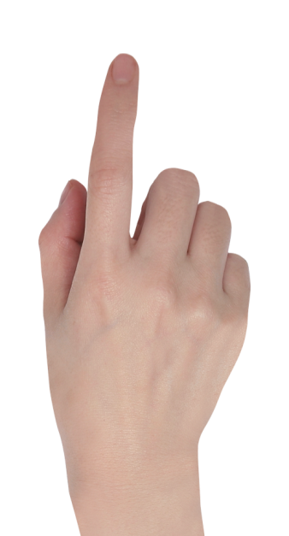
PPT模板下载：www.1ppt.com/moban/ 行业PPT模板：www.1ppt.com/hangye/
节日PPT模板：www.1ppt.com/jieri/ PPT素材下载：www.1ppt.com/sucai/
PPT背景图片：www.1ppt.com/beijing/ PPT图表下载：www.1ppt.com/tubiao/
优秀PPT下载：www.1ppt.com/xiazai/ PPT教程： www.1ppt.com/powerpoint/
Word教程： www.1ppt.com/word/ Excel教程：www.1ppt.com/excel/
资料下载：www.1ppt.com/ziliao/ PPT课件下载：www.1ppt.com/kejian/
范文下载：www.1ppt.com/fanwen/ 试卷下载：www.1ppt.com/shiti/
教案下载：www.1ppt.com/jiaoan/ PPT论坛：www.1ppt.cn
Thank you!

