Slide 1
项目二 任务14
邮件回复

Slide 2
邮件回复注意事项
亚马逊买家来信一般是针对售后问题，售前咨询很少。
售前问题5%
买
家
来
信
售后问题95%

Slide 3
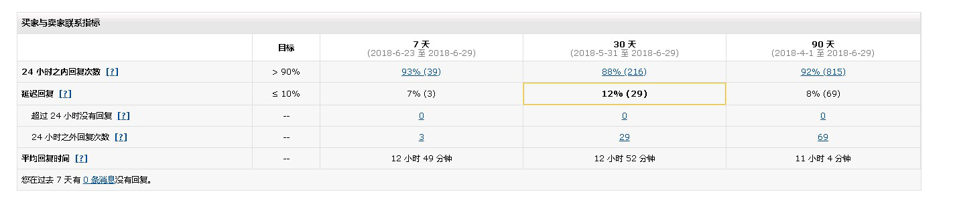
邮件回复注意事项
根据亚马逊指标要求，卖家需要在24小时内回复买家邮件，如果超过24小时变成延迟回复，
会影响该项指标。24小时内回复目标是>90,延迟回复率≤ 10%。

Slide 4
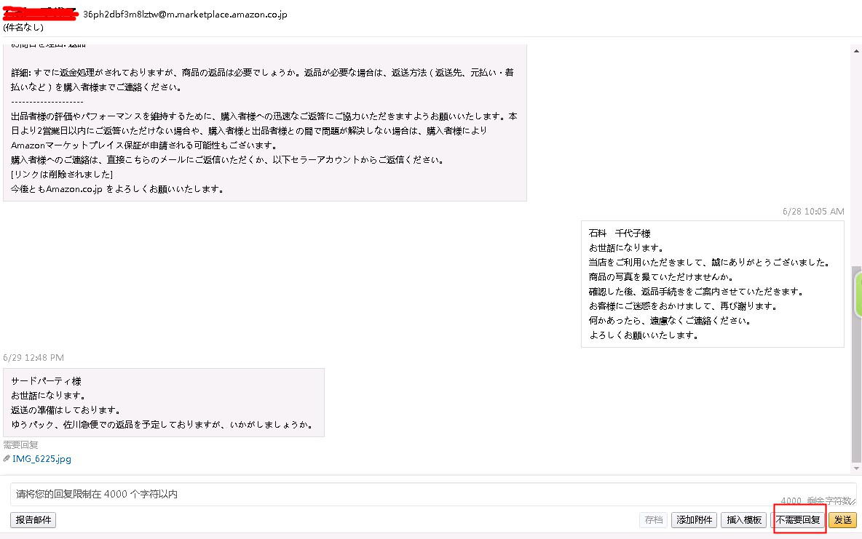
邮件回复注意事项
如果不能及时回复买家问题，可以点击回复邮件页面的右下角【不需要回复】按钮，这样就不会
计入延迟回复指标。

Slide 5
邮件回复注意事项
B回复思路：
1.诚恳道歉。
2.让客户拍下照片，我们需要跟仓库确认。
3.收到照片后建议给客户重发，如果客户实在不想要，那就退款，可以根据货损程度，尽量通过给予部分退款解决问题。
B货损
A回复思路：
1.诚恳道歉。
2.解释货物为什么延迟，比如海关严查，货物被退回一次然后重发等。
3.货物目前的运输情况，预计何时到达。
4.给予一定的补偿。
5.有任何问题请联系我们。
C尺码问题，不喜欢等
C回复思路：
1.感谢客户购买。
2.判断下如果不是我们商品本身质量问题，跟客户解释下可以换货或者退货，但是需要客户承担运费。
3.给客户部分退款作为补偿是否可以。
A到货迟
售后
问题
D发错货，漏发等
E回复思路：
1.感谢客户购买。
2.如果货物没有发出，可以给予客户取消订单，如果货物已经发货，跟客户解释下货物在路上，目前没有办法取消。等到货后联系我们处理。
3.有任何问题请联系我们。
E取消
订单
D回复思路：
1.诚恳道歉。
2.让客户拍下照片，我们需要跟仓库确认。
3.查询下是否确实发错货，可以核查库存，和快递重量。
4.给客户补发漏掉的部分或者正确的货物，或者询问给予部分退款是否可以。

Slide 6
邮件回复注意事项
邮件范例：
有质量问题让客户提供照片
Dear customer,
Sorry for the inconvenience.
We are sorry to hear about the unfortunate situation. Would you please take a picture of the item you received? We are going to confirm with the Warehouse. Hope you could understand us. Once we confirm it, a satisfactory solution will be offered to you. If you have any question, please do not hesitate to contact us.
Have a nice day.
Best regards
Customer service department
客户拍照片过来确认有质量问题
Dear customer,
We apologize for it.And We just want to confirm if you still want it.If you still want it ,we will resend a replacement to you.If you do not want it,we will refund you.Your earlier reply will be much appreciated.If you have any question, please do not hesitate to contact us.
Have a nice day.
Best regards
Customer service department

Slide 7
索评邮件干货分享
亚马逊索评邮件，其实就是在用户进行下单购买之后的邮件跟踪，给用户提供附加价值的操作，包括给用户提供产品购买信息，客服服务支持，产品相关的使用说明，或者其他的相关信息，总之能够帮助用户解决问题。
要写好留评率较高的亚马逊索评邮件，可以从以下三个步骤入手：
1. 收到订单，发送第一份提醒邮件
这时发出的邮件有两个目的：
一是告知买家订单状况，表明他们的订单并没有被遗忘；
二是给买家提个醒，避免他们在过一阵还没收到货物时给你来个差评。
邮件模板
邮件主题：[Important] Your order has been confirmed!
邮件内容：Hi, [buyer name]. I'm just writing to let you know that Amazon has confirmed your new order: [Order ID]. I am personally following up on every order to make sure everything was delivered safe and smoothly! If you have any question, please be sure to write back, I will make sure to set things right. Our small team at Company works hard to ensure that you have a happy shopping here. Have a good day. Thank you very much for your support!
★需要注意的是，在邮件主题中加入[Important]一词，能够有效减少退信率，以及提高邮件的阅读率。

Slide 8
索评邮件干货分享
2. 发货后，发送跟进邮件
最好是发货后第一时间发送，让卖家能够实时了解货物的物流情况，有利于提高买家的购物体验。
这一次的邮件内容就要开始涉及到正题了。在这封邮件中，我们需要请消费者来留下评价，这是最重要的目的。
邮件模板
邮件主题：[Important]Your order has been shipped!
邮件内容：Hi, [buyer name]. I'm writing to let you know that Amazon has shipped your new order: [order ID, order time]. Once your order arrives, please be sure to write back if there is any problem with the order or if you have any question. I will make sure that your problems are well solved, and that you receive the best customer service and are 100 percent Happy with your purchase. Thanks ，Have great day!
3. 卖家确认收货后，发送索评邮件
这将是索评三步走的最后一次索评邮件，它会呼应前两封邮件，让整个流程有始有终，进一步为消费者呈现一个负责，热情的卖家形象，同时完成我们的索评需求。
最后这一封索评邮件，可以在卖家收到货后的1-3天内发送，既给买家一定的时间体验产品，又可以趁着买家享受新产品的那份热情去索评，成功率更高。

Slide 9
索评邮件干货分享
邮件模板
邮件主题：[Important]Thank you for your [product-name] purchase!
My name is X and I am the owner of [Your Amazon Store Name]. I want to personally thank you for being one of our customers!
I noticed that your order was delivered recently. Product Ordered: X
Your order: https://www.amazon.com/gp/your-account/------------------------------s]
I hope that you've had a chance to try the product. I want to make sure that you are 100% happy. If you have any issues, please reply to this email so I can make it right! (In fact, I love to hear from people who are enjoying my products, so I'd like to hear from you even if everything has gone smoothly!)
If you are not satisfied with the product, please give us a chance to make it right! Respond to this email, and I will do whatever it takes to make you happy.

Slide 10
索评邮件干货分享
We'd be honored to get your honest comment of the product!
https://www.amazon.com/review/review-your-purchases#
Thank you again for ordering from [Your Amazon Store Name]. We truly appreciate your business. We LOVE our customers and we will always be here if you need us.
Wishing you the best！
[Your Name], Owner
[Your Amazon Store Name]
Changing the world...one dime at a time. [replace with your own slogan]

Slide 11
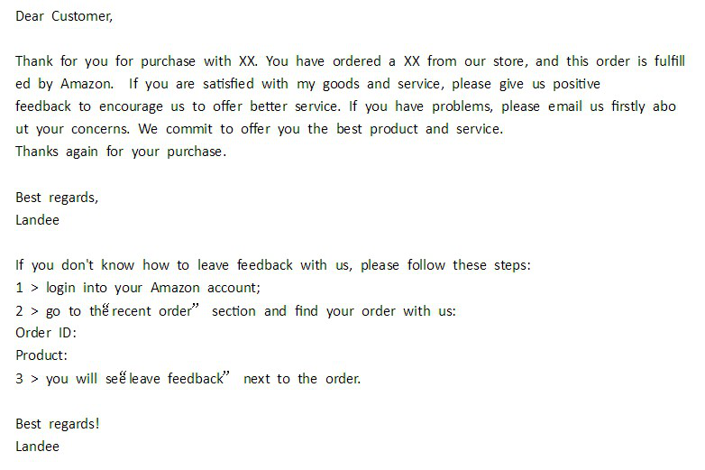
索评邮件干货分享
索评实例

Slide 12
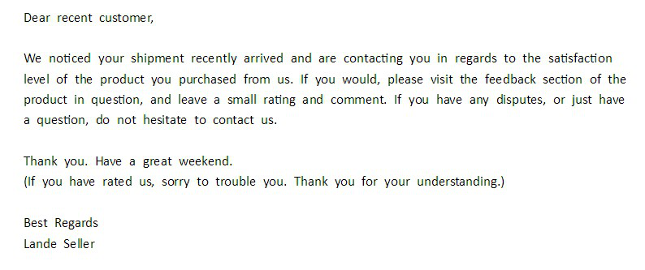
索评邮件干货分享
索评实例

