Slide 1

Theme of the 7th United Nations Environment Assembly
“珍惜地球 保护生物多样性”

Slide 2

第七届联合国大会
主题
设计起源
The theme of the 7th United Nations Environment Assembly (UNEA-7) is "Advancing sustainable solutions for a resilient planet". This theme emphasizes the need to accelerate sustainable solutions and effective responses to create a safer and more resilient planet. It recognizes that striving for a just, equitable and inclusive world depends on promoting sustainable development, economic growth, social development and environmental protection.

Slide 3
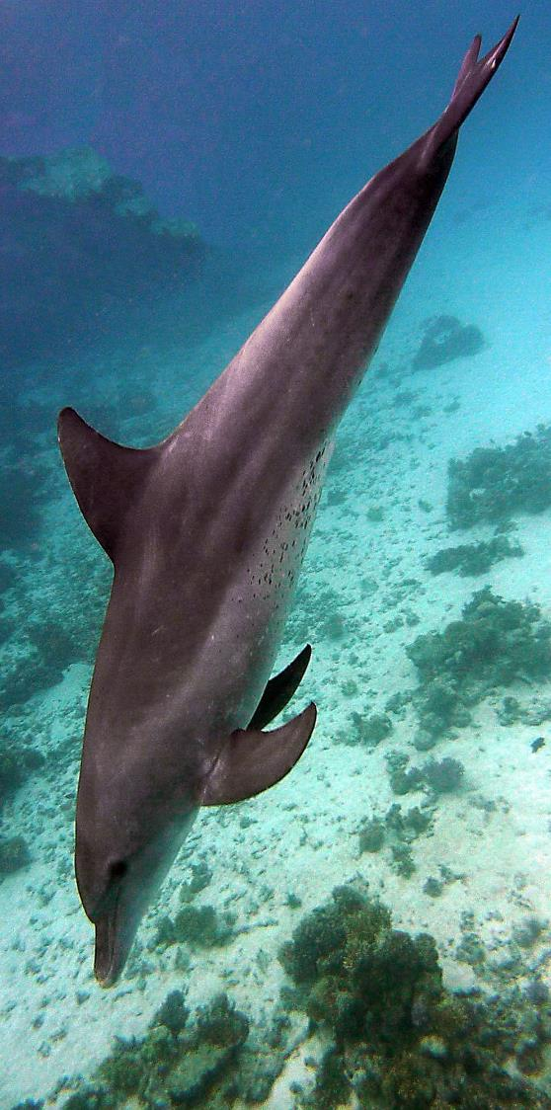
2024 "Greening the Blue" Report
联合国发布的2024年《绿色联合国》报告显示，联合国系统人均温室气体排放量从2022年的4.6吨二氧化碳当量增至2023年的4.8吨，总体增幅为9%，但仍比疫情前水平低24%。人均废弃物量减少4%，废弃物经再利用、回收、堆肥或能源回收处理的比例从2022年的13%提升至2023年的31%。此外，70%的实体以自愿或强制形式为工作人员提供环境培训，83%的报告实体已制定可持续采购政策。
The 2024 "Greening the Blue" report released by the United Nations shows that the per capita greenhouse gas emissions of the United Nations system increased from 4.6 tons of CO2 equivalent in 2022 to 4.8 tons in 2023, with a total increase of 9%, but still 24% lower than before the pandemic. Per capita waste decreased by 4%, and the proportion of waste reused, recycled, composted or used for energy recovery increased from 13% in 2022 to 31% in 2023. In addition, 70% of the entities provided environmental training for their personnel on a voluntary or mandatory basis, and 83% of the reporting entities had sustainable procurement policies.

