Slide 1
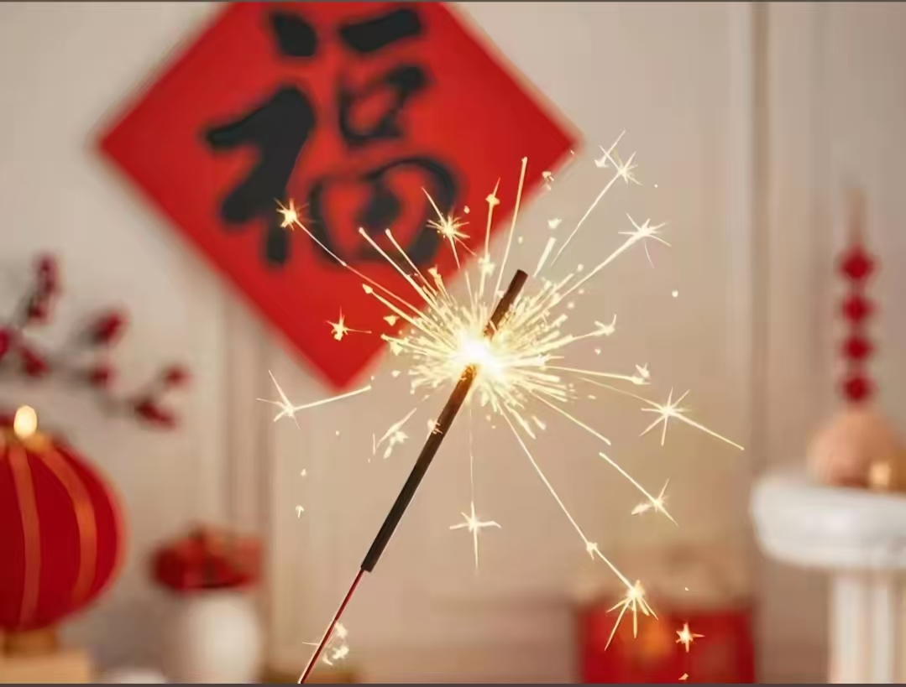
The Spring Festival

Slide 2
Content
内容
01
Introduce the Spring Festival
02
The traditional customs of the Spring Festival
03
The importance of the Spring Festival

Slide 3
01 Introduce the Spring Festival

Slide 4
The first day of the first lunar month is Spring Festival,the beginning of a new year for China .
Spring Festival is the biggest festival in China and a day for family reuion.Many of those living away from their hometowns return home during Sring Festival.
It is said that the custom of Spring Festival started in when people offered sacrifice to ancestors in the last month of Chinese lunar calendar. At that time, people prepared the sacrifice by doing thorough cleaning, having bathes and so on. Later, people began to worship different deities as well on that day.

Slide 5
There are many legends about Spring Festival in Chinese culture. In folk culture, it is also called “guonian” (meaning “passing a year”). It is said that the “nian” (year) was a strong monster which was fierce and cruel and ate one kind of animal including human being a day. Human beings were scared about it and had to hide on the evening when the “nian” came out. Later, people found that “nian” was very scared about the red color and fireworks. So after that, people use red color and fireworks or firecrackers to drive away “nian”. As a result, the custom of using red color and setting off fireworks remains.

Slide 6
02 the traditional customs of the spring festival

Slide 7
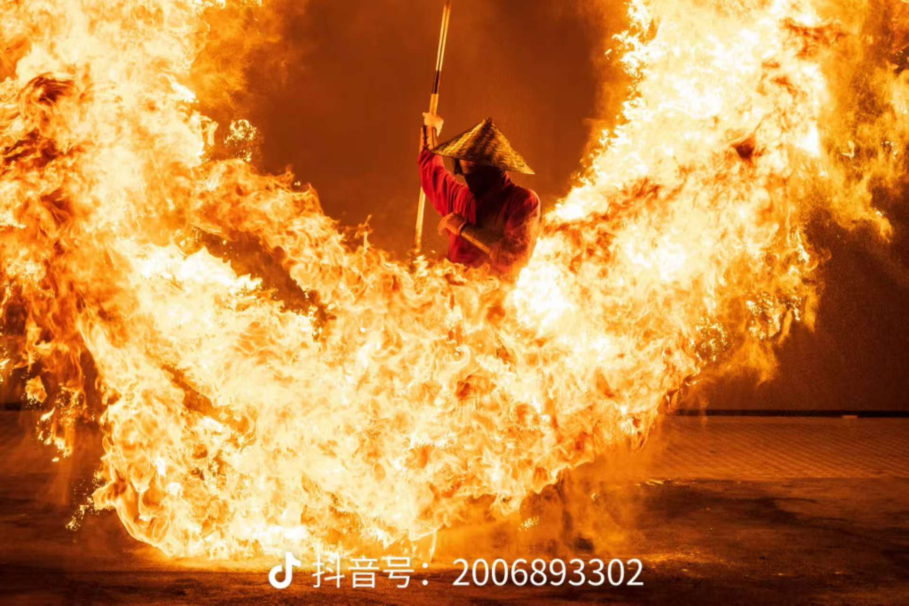
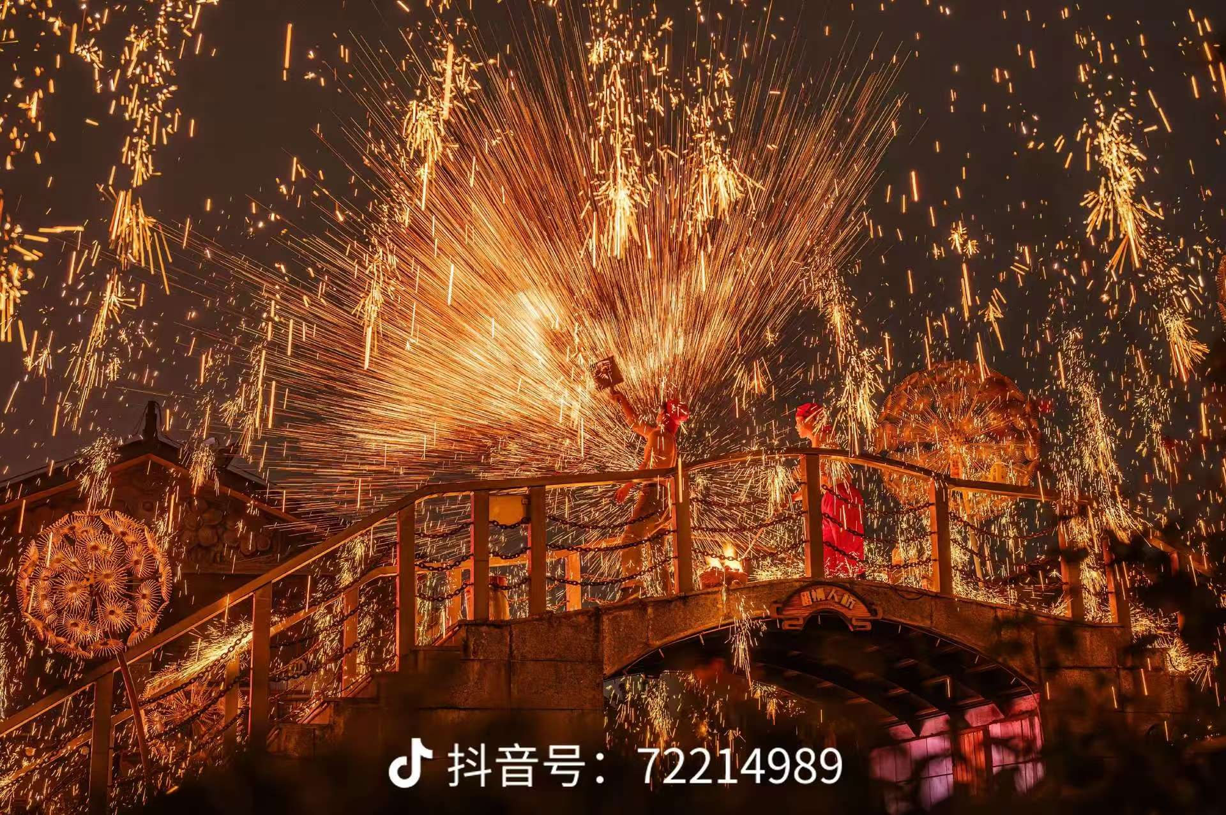
Henan Iron Flower

Slide 8
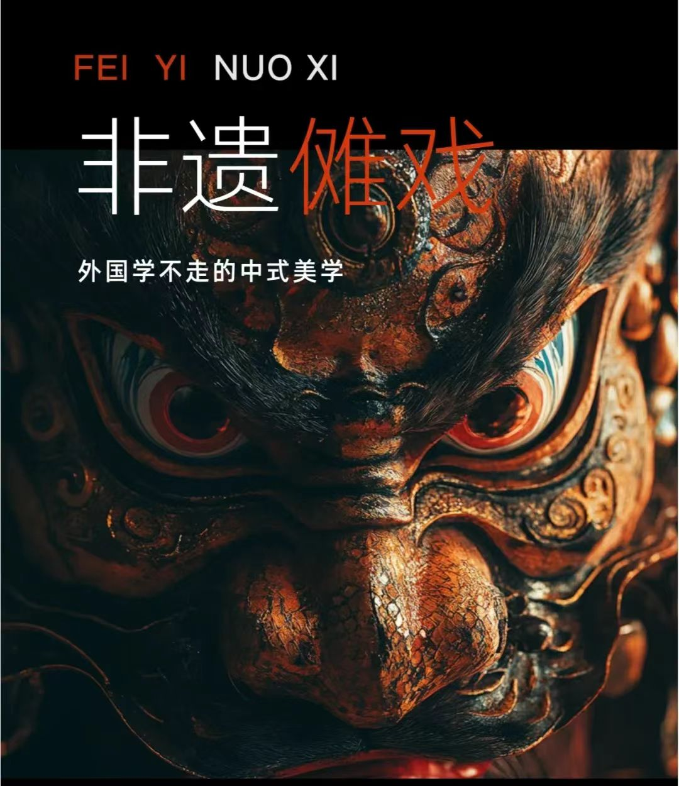
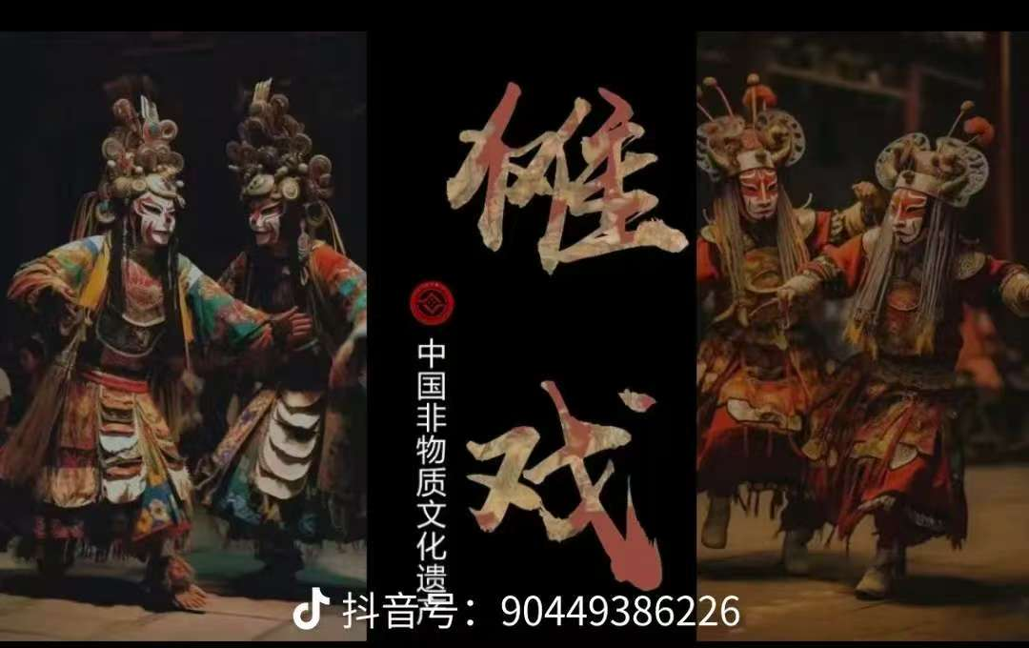
Jiangxi Nuo Opera

Slide 9
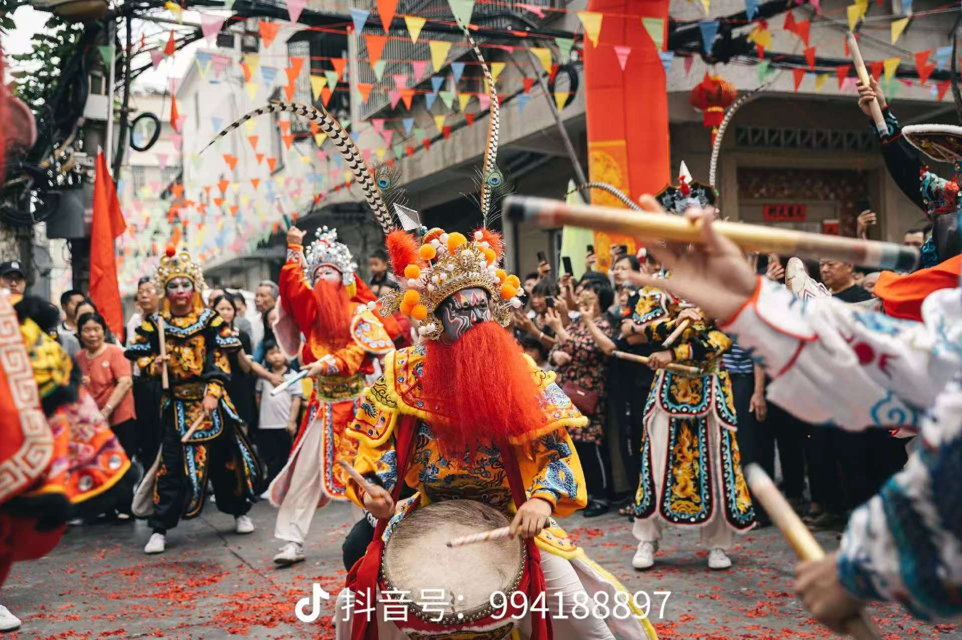
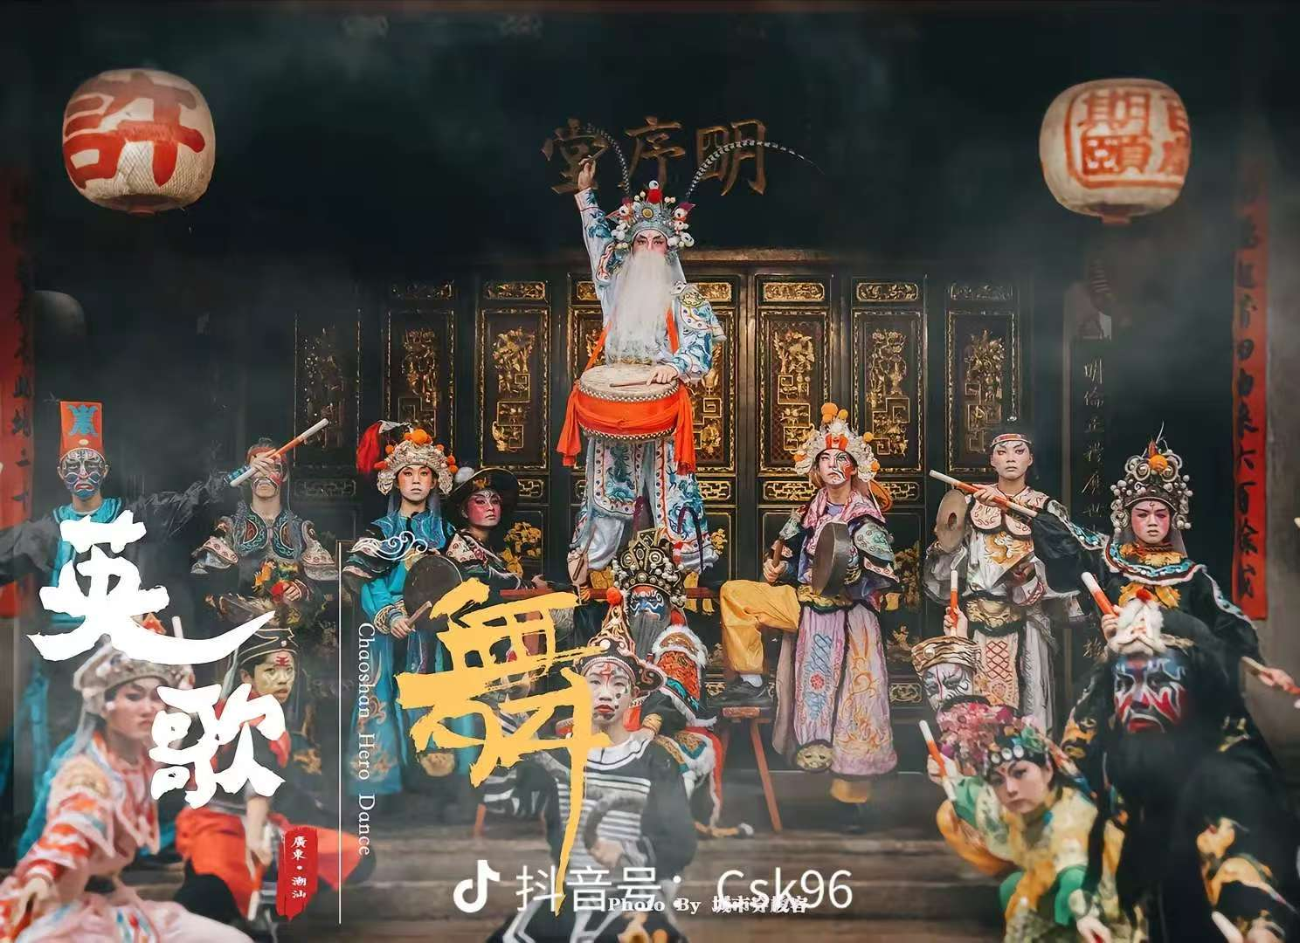
Guangdong Yingge Dance/Heroes Dance

Slide 10

03
The importance of the Spring Festival

Slide 11
The Spring Festival is very important to the Chinese people.The Spring Festival represents family reunion, new beginnings, and the warmth of home.

Slide 12
Thank you!!!

