Slide 1
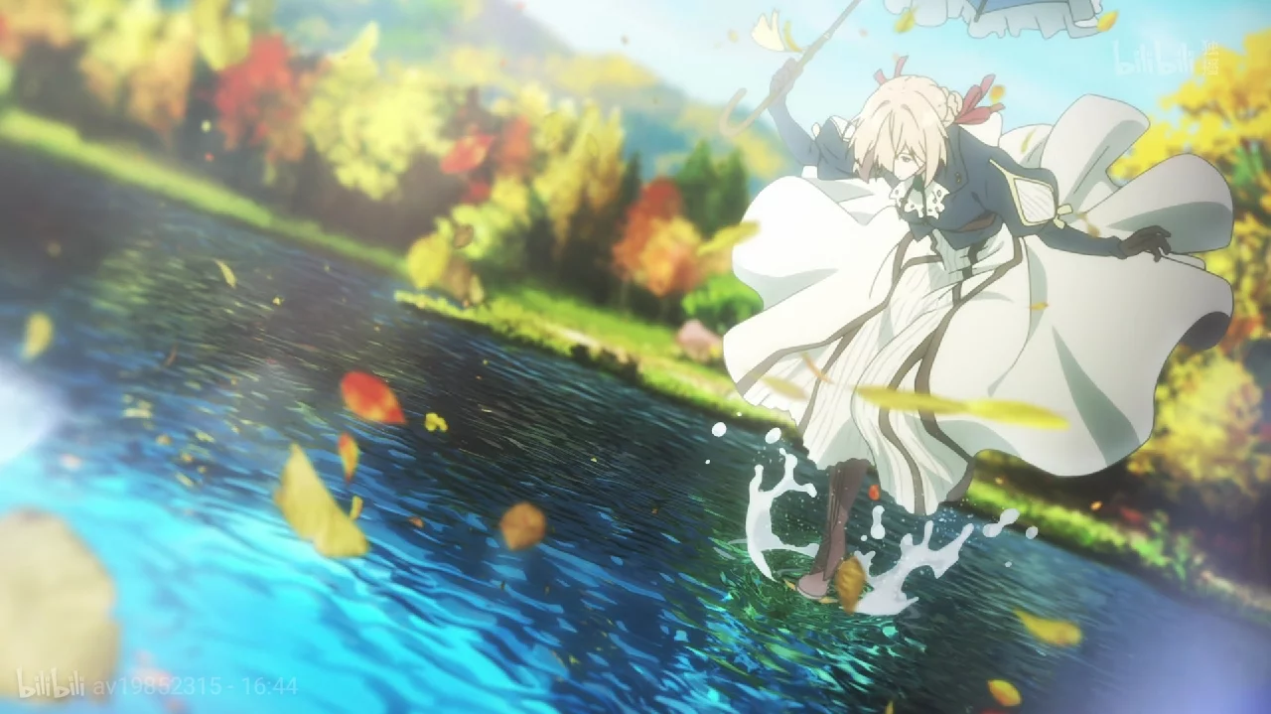
Classic Anime: Themes & Artistic Value
经典动漫：主题与艺术价值

Slide 2


Explore the charm and educational significance of classic animation
Introduction:

Slide 3

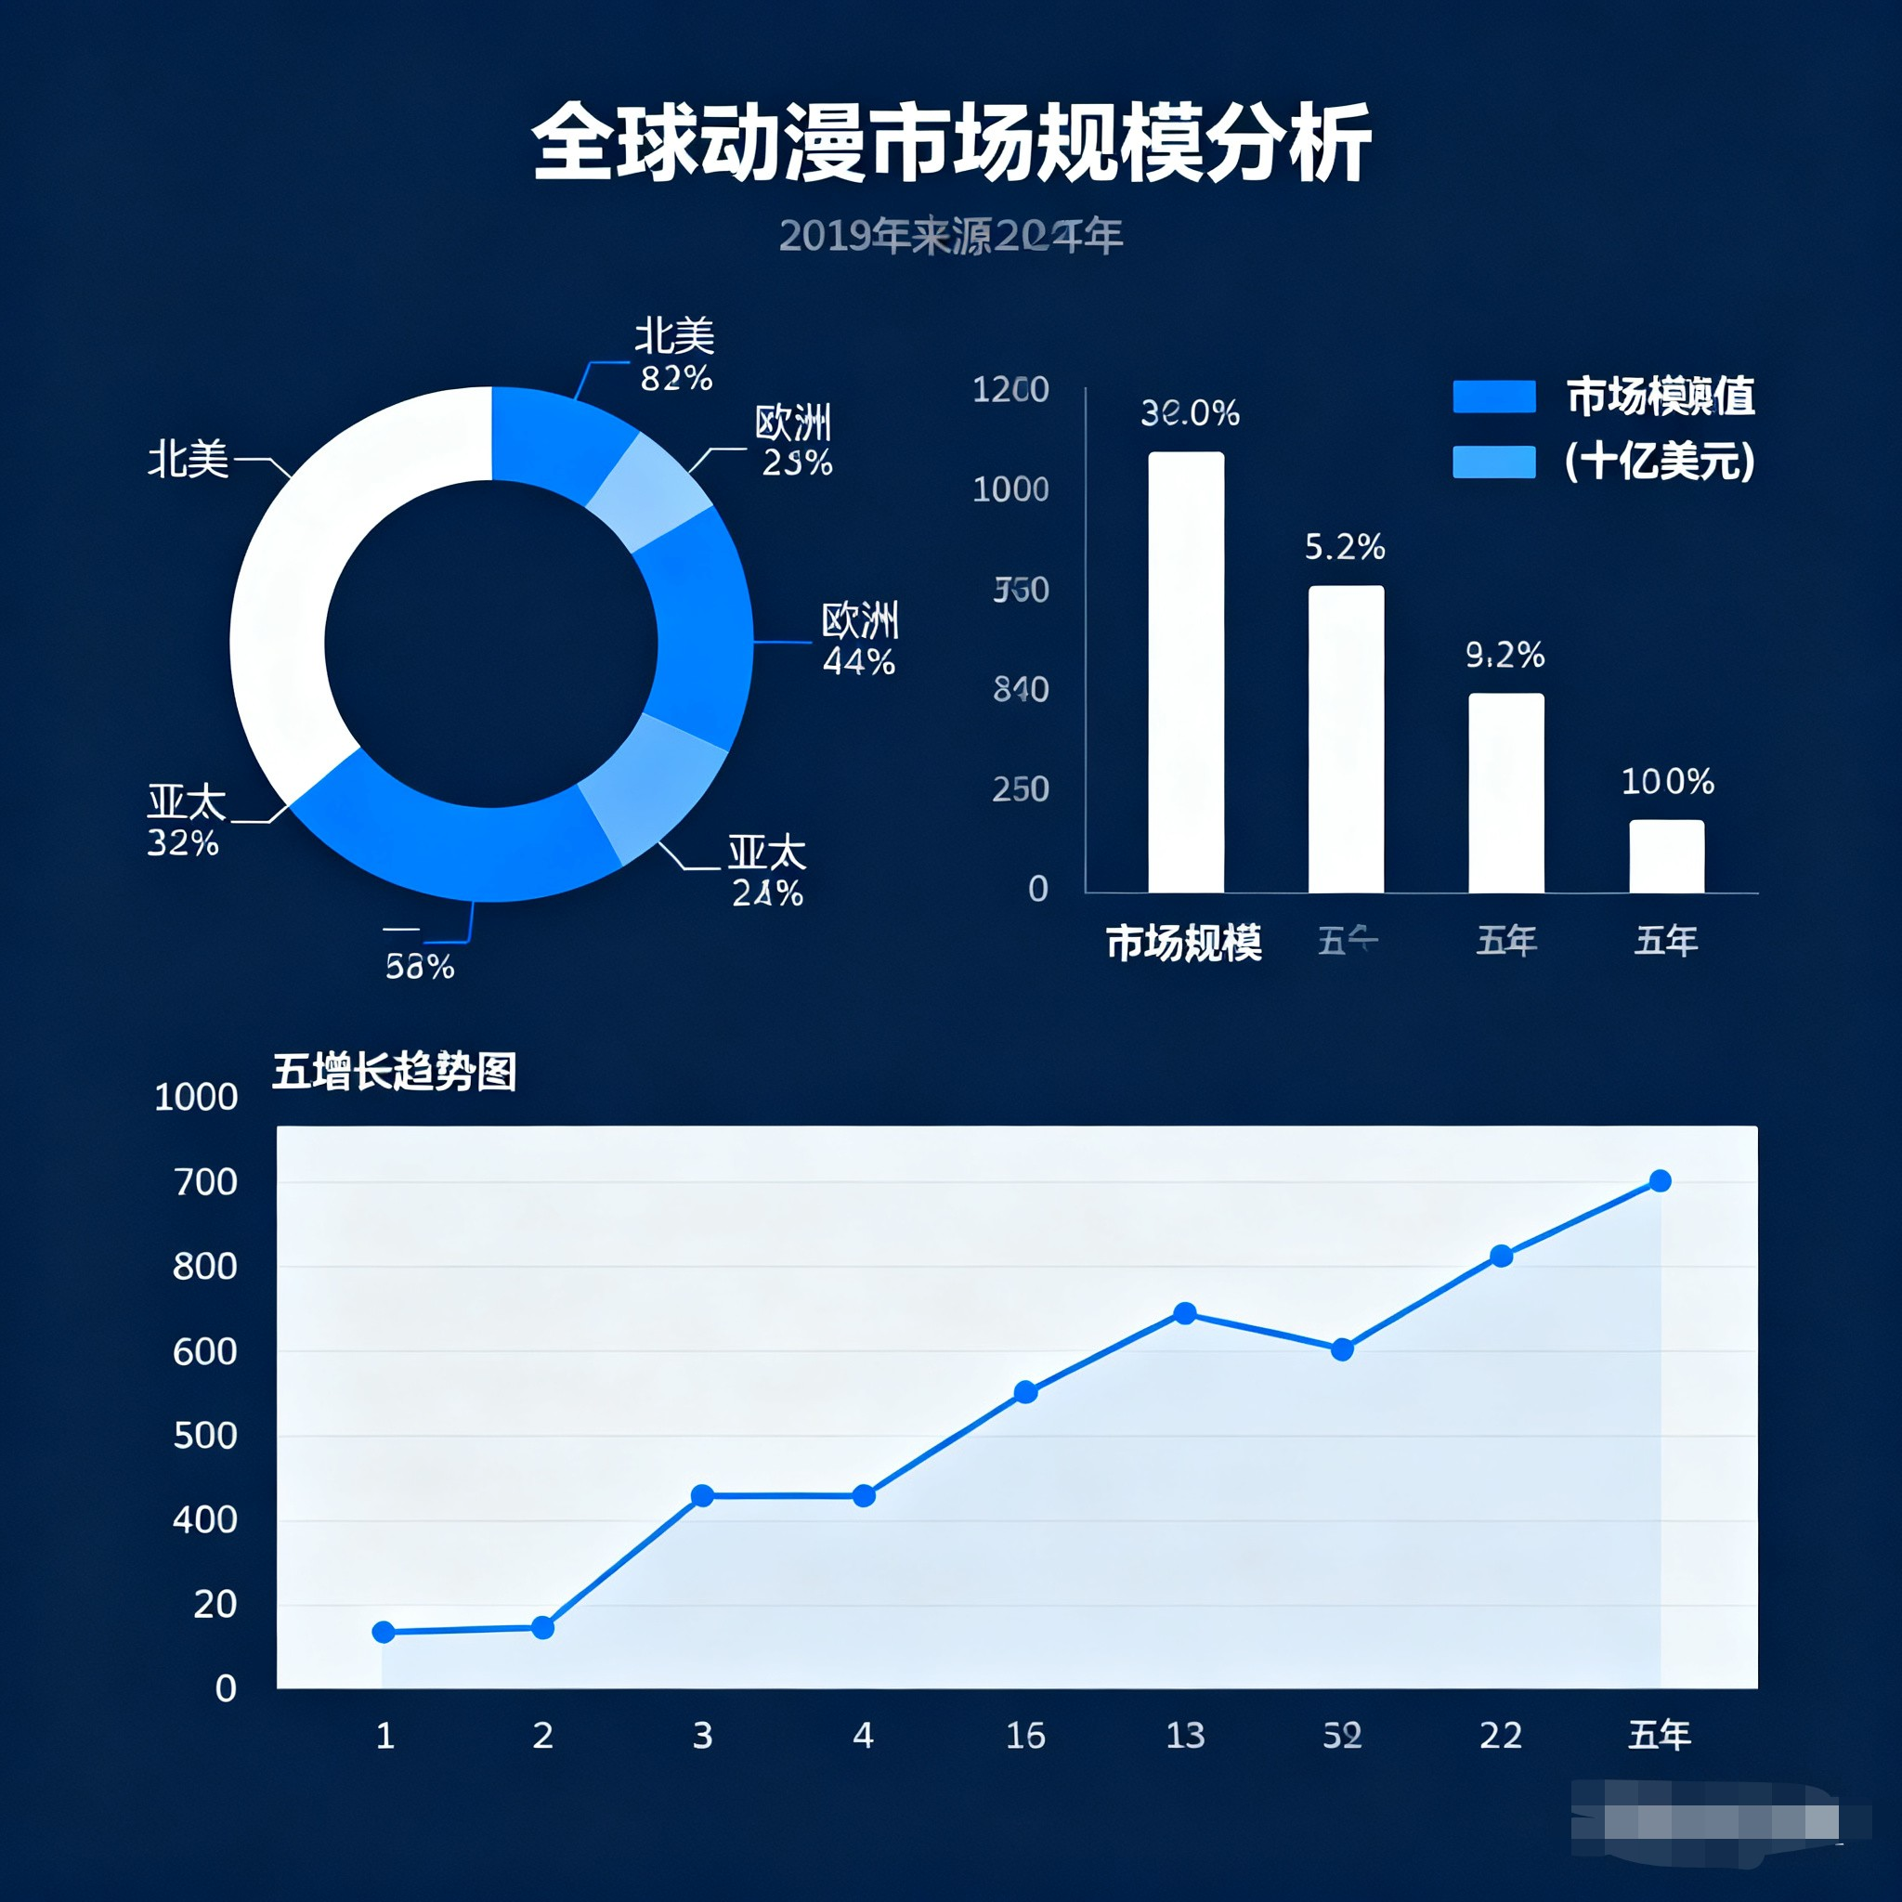
Audience & Cultural Impact of Anime
1. Audience: Teens (12-25, core), kids (educational), adults (25-40, in-depth plots), seniors (classic IPs).
2. Impact: Cultural export, boosts derivatives (toys, games, tourism like Disney parks), conveys positivity, shapes aesthetics.

Slide 4
Passion：
Represented by 《Demon Slayer》, featuring gorgeous battle scenes, and focusing on themes of friendship, courage, and perseverance.
以《鬼灭之刃》为代表，拥有华丽战斗场景，聚焦友情、勇气与坚持主题。

Slide 5
Slice of Life：
Typified by 《Spy x Family》, telling interesting daily stories, emphasizing family bonds and light humor.
以《间谍过家家》为代表，讲述趣味日常生活故事，侧重家庭羁绊与轻幽默。

Slide 6
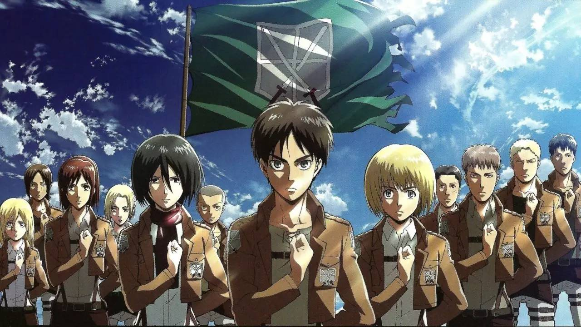
Fantasy：
Exemplified by 《Attack on Titan》, with an epic plot setting, involving reflections on human nature and society.
以《进击的巨人》为代表，剧情设定宏大，包含对人性与社会的思考。

Slide 7
Core Themes：
Common themes include Friendship, Courage, and Self-Growth. For example, 《One Punch Man》 breaks the traditional shounen routine with anti-routine humor, reflecting on the meaning of "strength".
核心主题包括友情、勇气、自我成长等。如《一拳超人》以反套路幽默打破传统热血模式，引发对“力量”意义的思考。

Slide 8
Artistic Features
《Violet Evergarden》 is famous for its wallpaper-level frames, with exquisite details and beautiful color matching.
​视觉方面——《紫罗兰永恒花园》以壁纸级画面著称，细节精致、配色优美。
《Attack on Titan》 has an epic OST such as "Guren no Yumiya", which enhances the emotional expression of the plot.
音乐方面——《进击的巨人》拥有《红莲之弓矢》等史诗级原声音乐，强化剧情情感表达。

Slide 9
Core Summary
Anime is not only a form of entertainment but also integrates positive values such as kindness, perseverance, and justice. It has become a global cultural carrier, promoting cross-cultural communication and understanding.
​ 中文：动漫不仅是娱乐形式，更融合了善良、坚持、正义等正能量价值观，已成为全球文化载体，推动跨文化交流与理解。

Slide 10
Personal Insight
Through this report, I have a deeper understanding of anime's charm. The positive spirit conveyed by anime teaches me empathy and perseverance, helping me better understand different cultures.
​通过本报告，我对动漫的魅力有了更深认知，其传递的积极精神教会我共情与坚持，助力我更好地理解不同文化。
​

Slide 11
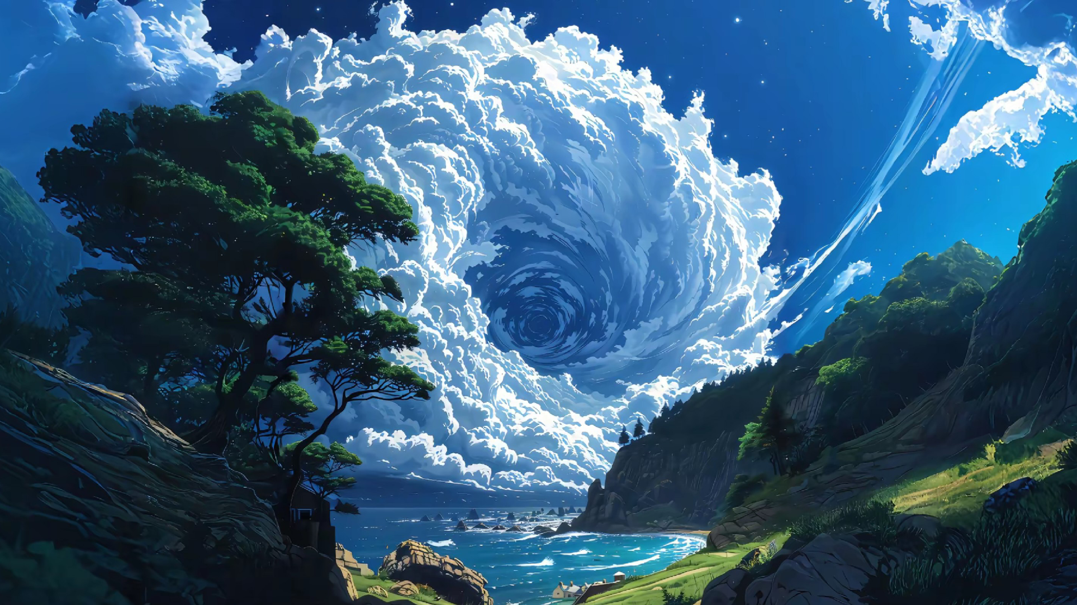
Thank you !

