Slide 1
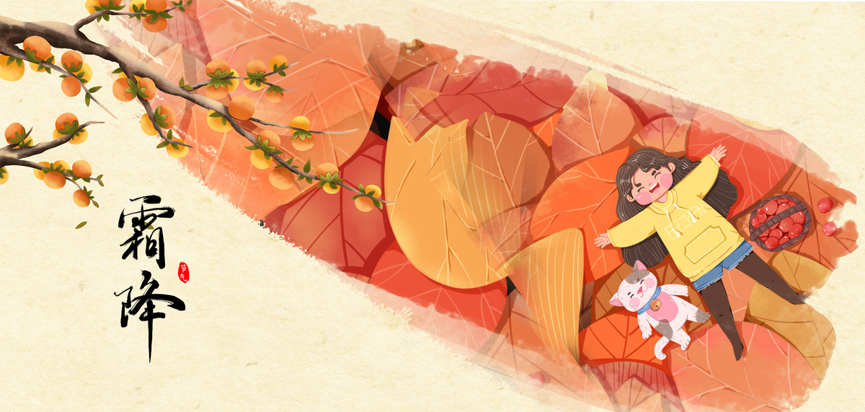
Frost's Descent
何佳慧

Slide 2
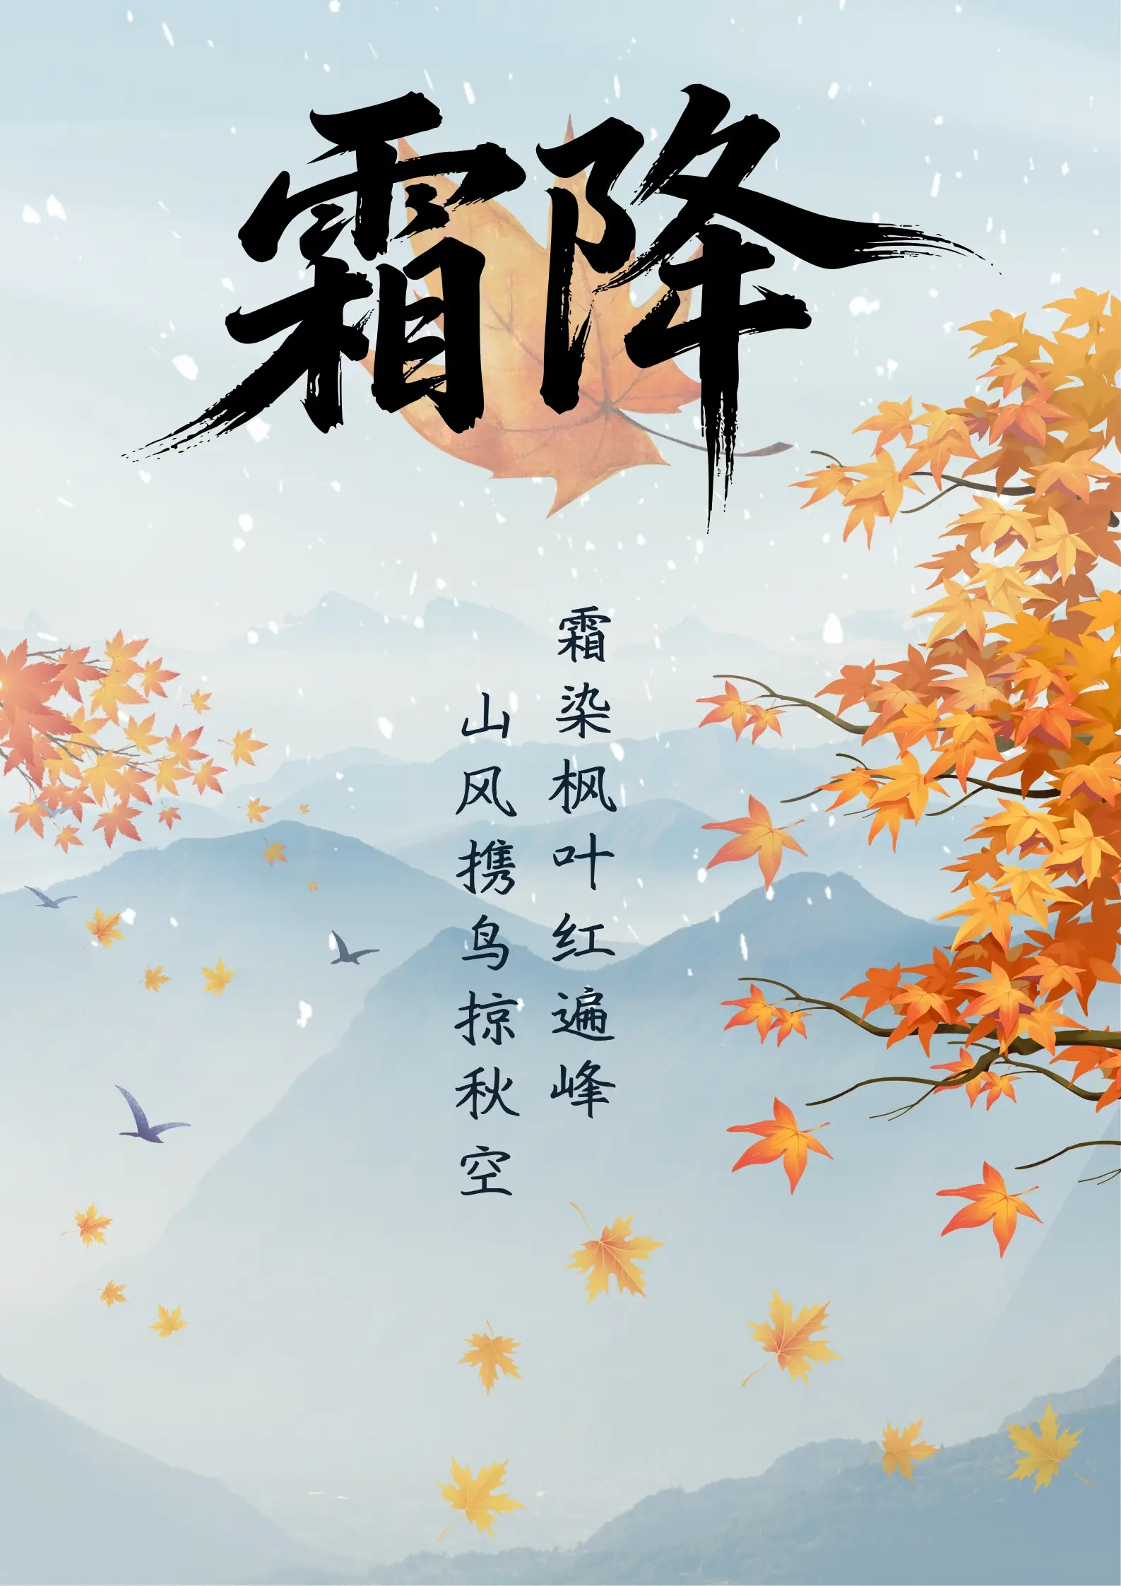
Frost's Descent is the last solar term of autumn, during which time the weather becomes much colder than before and frost begins to appear.But in the lower reaches of the Yellow River region, frost first appears in late October or early November.
As Frost's Descent comes, the world is filled with the atmosphere of late autumn.The trees lose their leaves, and some animals prepare for winter. Farmers also enter the harvest season gathering late- maturing crops, stockpiling food and firewood in preparation for the impending cold weather.

Slide 3
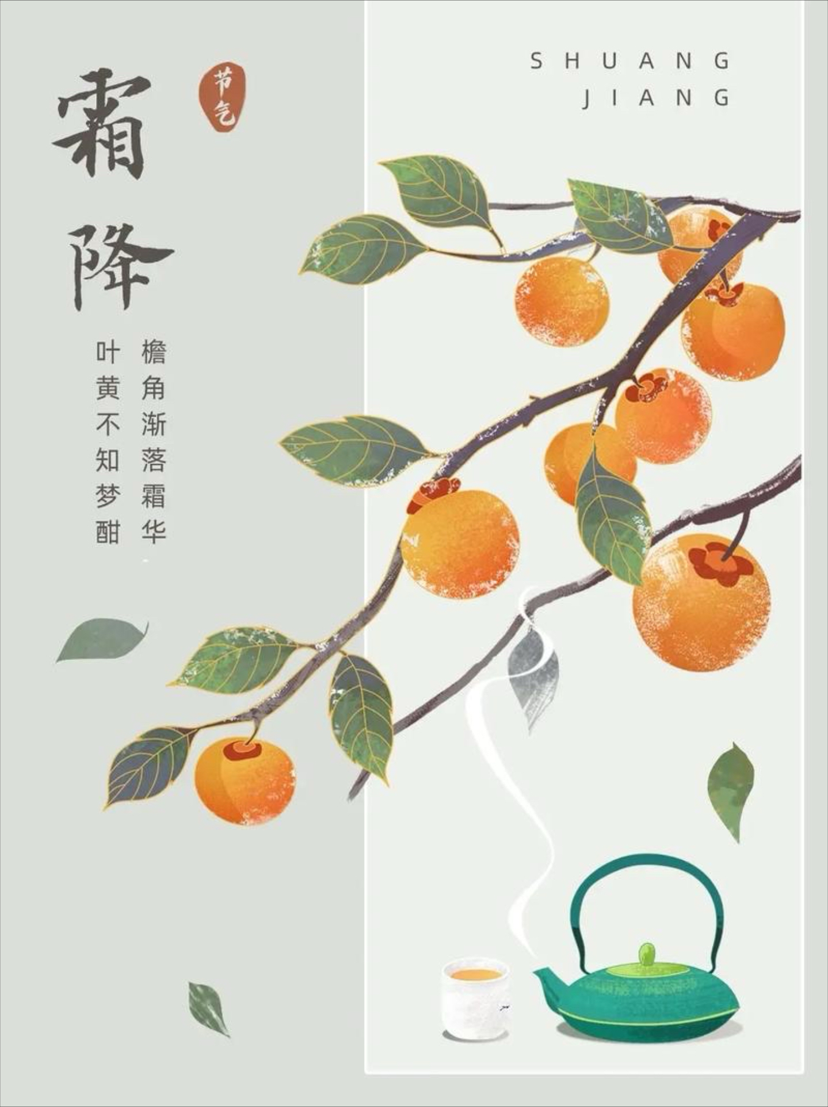
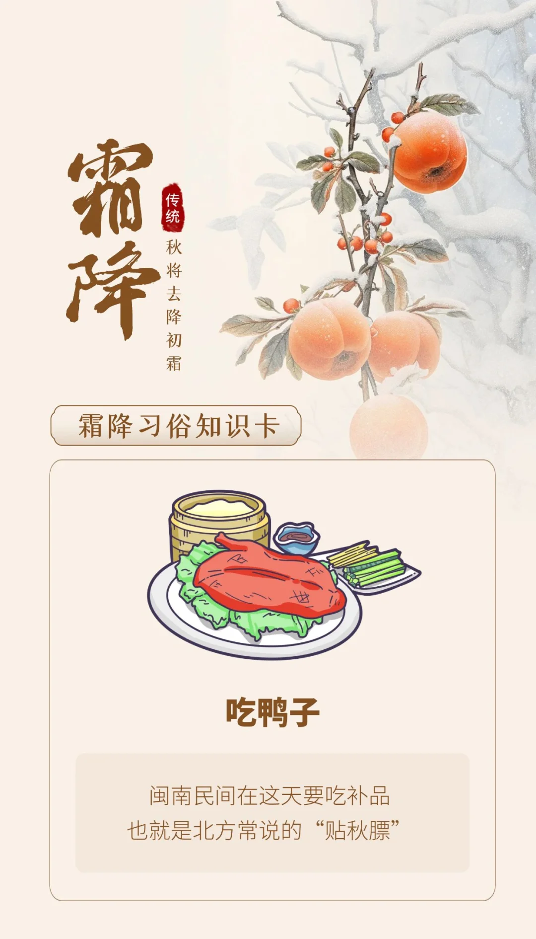
Eating persimmons during Frost's Descent can help people resist the cold and protect the bones.
In the countryside, people believe that their lips will crack if they don't eat persimmons during this period.
There is a saying in Fujian which goes, "Even nourishing all year is not as good as nourishing the human body on the day of Frost's Descent."Eating duck is a way for people there to gain weight.

Slide 4
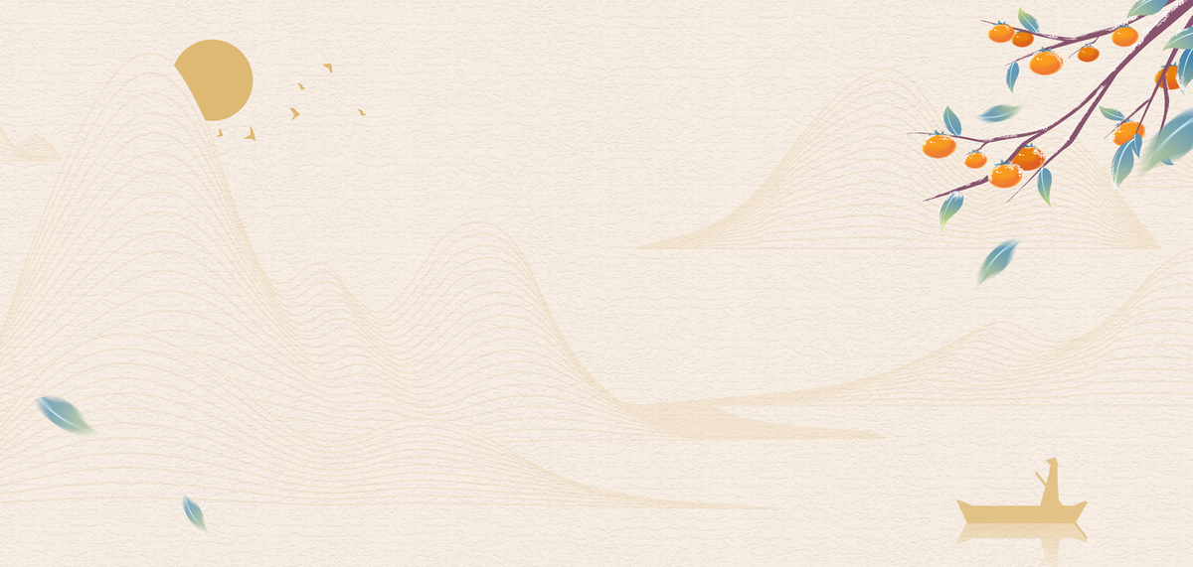
In summary,Frost's Descent signifies the transition from autumn to winter symbolizing the changing of nature and reminding us of the rhythm of nature and how people adapt in their lives.

