Slide 1
Embrace your imperfect self
拥抱不完美的自己
探索自我，开启新的旅程
Exploring oneself and embarking on a new journey
报告人：吴伟佳
2025.10.26

Slide 2

目录
There is no one in the world who is absolutely perfect
1.
发现不完美的魅力
Discovering imperfect charm
2.
接受与成长
Acceptance and Growth

Slide 3
Discovering imperfect charm
发现不完美的魅力
理解不完美，发现自己的独特价值
Understanding imperfections and discovering one's unique value

Slide 4
认识不完美 Knowing imperfections
自我接纳的勇气
促进目标达成
The courage to self accept
Promote the achievement of goals
探索不完美背后的力量
Explore the power behind imperfection.
驱动自我成长
促进价值观的完善
Drive self growth
Promote the improvement of values

Slide 5
不完美的美丽 There is also a beautiful aspect to imperfection
欣赏不完美带来的独特魅力
Appreciate the unique charm brought by imperfection
Don't be obsessed with living a perfect life without any wrinkles.
不必执着于把人生过成毫无褶皱的完美答卷
接纳自己的不完美，不是妥协，而是与自我和解的开始 。你无需因一次失误就否定全部，也不用为了迎合他人标准刻意伪装，就像手工陶瓷的冰裂纹、老唱片的轻微杂音，你身上那些“不完美”的特质，让你摆脱了模板化的僵硬，成为鲜活、立体、能被真心感知的人 。

Slide 6
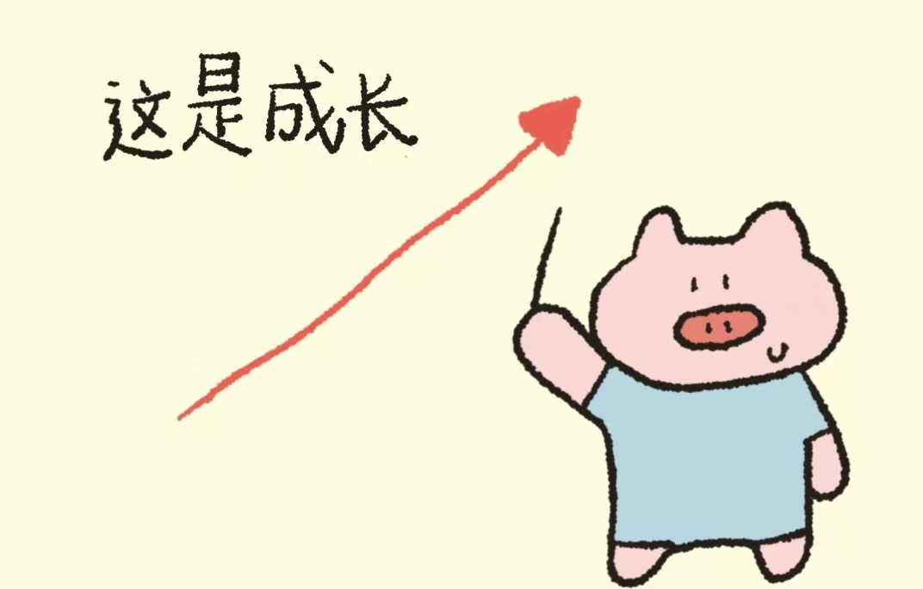

接受与成长
在与不完美的相处中向上生长
Growing upwards in the midst of imperfect interactions.
学会接受不完美，实现自我成长
Learn to accept imperfection and achieve self growth.

Slide 7
接受自己的不完美 We need to accept our imperfections.
让我们开启自我接纳的旅程
Let's embark on a journey of self acceptance.
自我接纳的重要性
日常生活中的实践
冥想与自我反思
01
02
03
Embracing imperfection is the cornerstone of personal growth, as it can enhance confidence and increase happiness.
Gradually cultivate the habit of self acceptance through small changes, such as changing self-evaluation methods.
Meditation helps us delve deeper into ourselves, while reflection allows us to better understand and accept our imperfections.
接受自己的情感
制定积极的目标
04
05
Allowing oneself to feel and express all emotions, including vulnerability and unease, is the key to accepting oneself.
Integrating personal values into goal setting helps to gradually achieve growth through self acceptance.

Slide 8
成长的动力
利用不完美推动自我成长
Learn to use imperfections to drive personal growth.
也要学习自我激励的技巧
We also need to learn the skills of self motivation.
04
既要拥有接受反馈的勇气
03
Having the courage to accept feedback is essential.
其次寻找自我提升的方法
Secondly, seek ways to improve oneself.
02
首先感受不完美带来的动力
01
Firstly, feel the power brought by imperfection.

Slide 9
谢谢观看
Thank you all for listening to my report
报告人：吴伟佳
2025.10.26
内容由夸克AI生成

