Slide 1
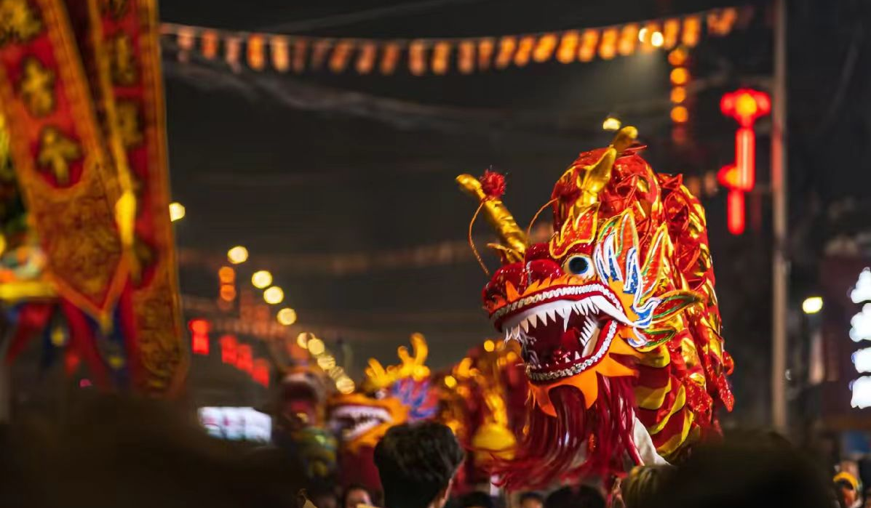
Traditional culture
Fujian Youshen

Slide 2
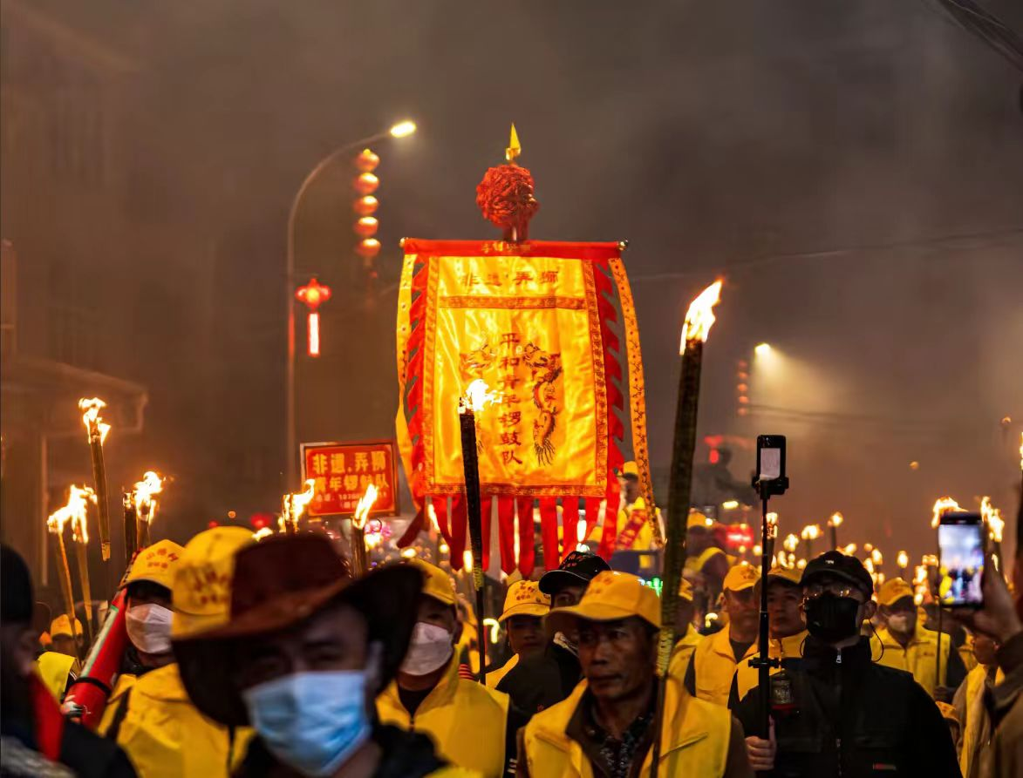
The origin of the wandering god
The origin of the wandering god can be traced back to the Ming Dynasty, and it truly emerged in the mid Qing Dynasty, evolving from the “Nuo dance”. Fujian’s folk beliefs are well-developed, and the people have migrated south to avoid wars, natural disasters, epidemics, and other factors, which have prompted them to seek divine protection, thus giving rise to the activity of wandering gods.

Slide 3
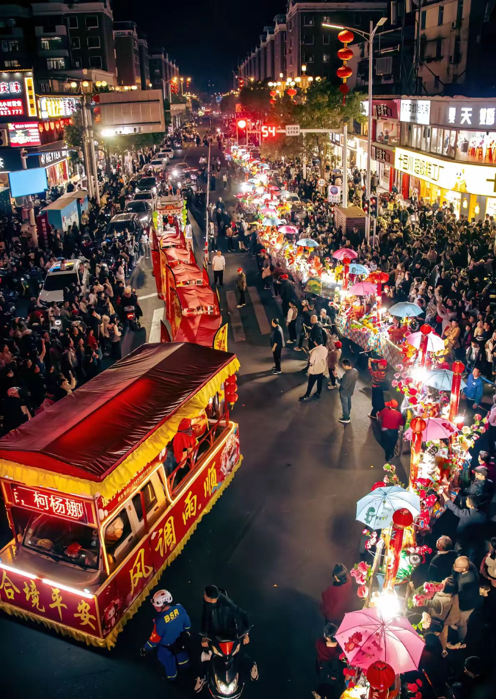
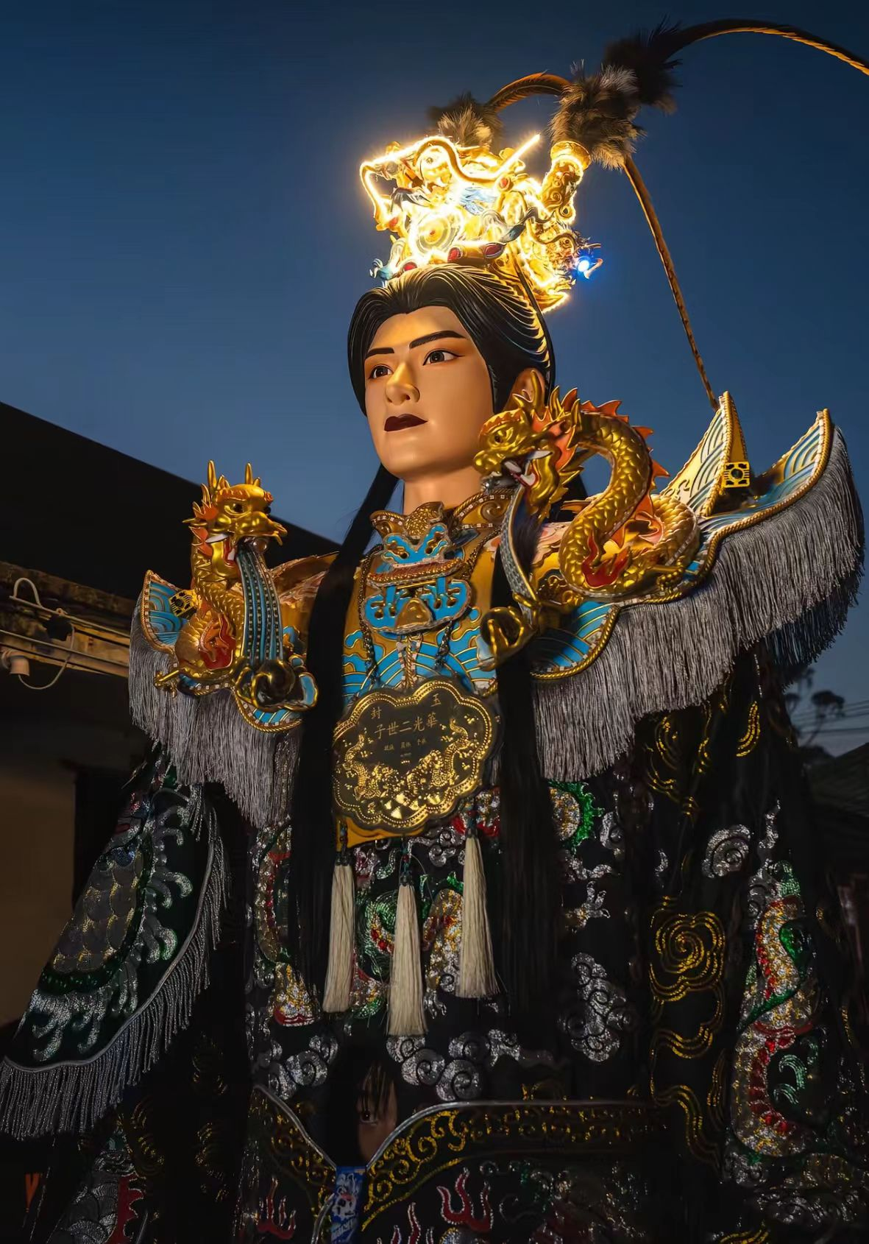
Time and purpose of the activity
Tourists are usually held during festivals such as the Yuanxiao (Filled round balls made of glutinous rice-flour for Lantern Festival) Festival, God’s Birthday or sacrificial ceremonies, aiming to reward the gods, eliminate disasters and pray for blessings, and bless the peace of the world.

Slide 4
Activity process
Throwing the Holy Grail
Please go to the divine realm
Accept worship
Returning to the Palace

Slide 5
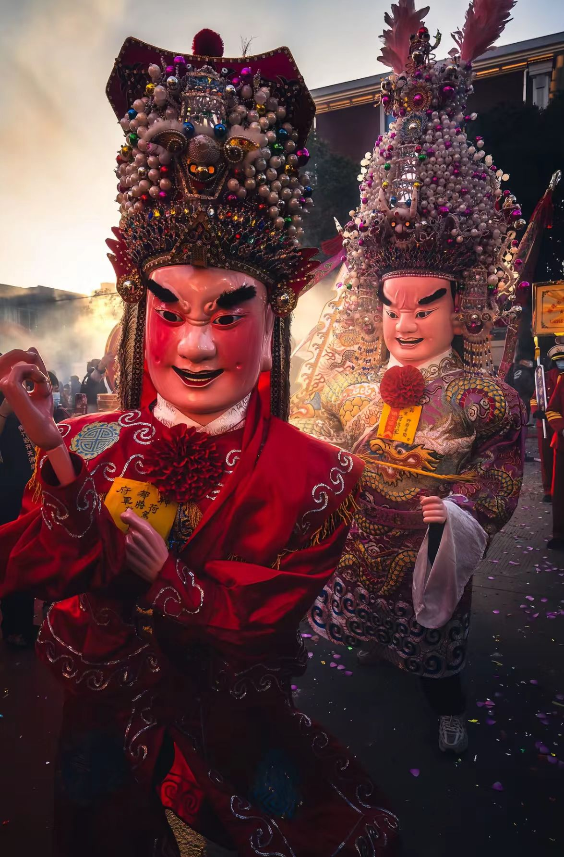
Cultural significance
The gathering of folk beliefs and folk culture in the temple fair not only reflects people's respect for the gods and their desire for blessings and disaster relief, but also has obvious local customs characteristics. It is a form of activity in temple fair culture, highlighting the interactive relationship and localization trajectory of regional Chinese society.

Slide 6
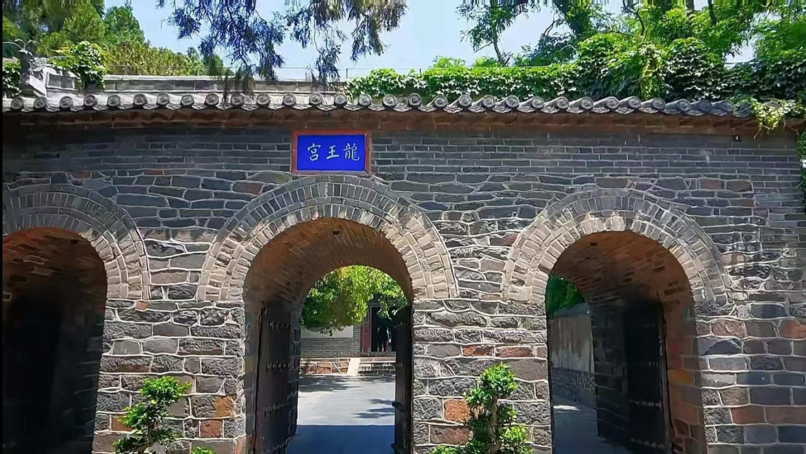
龙王宫

Slide 7
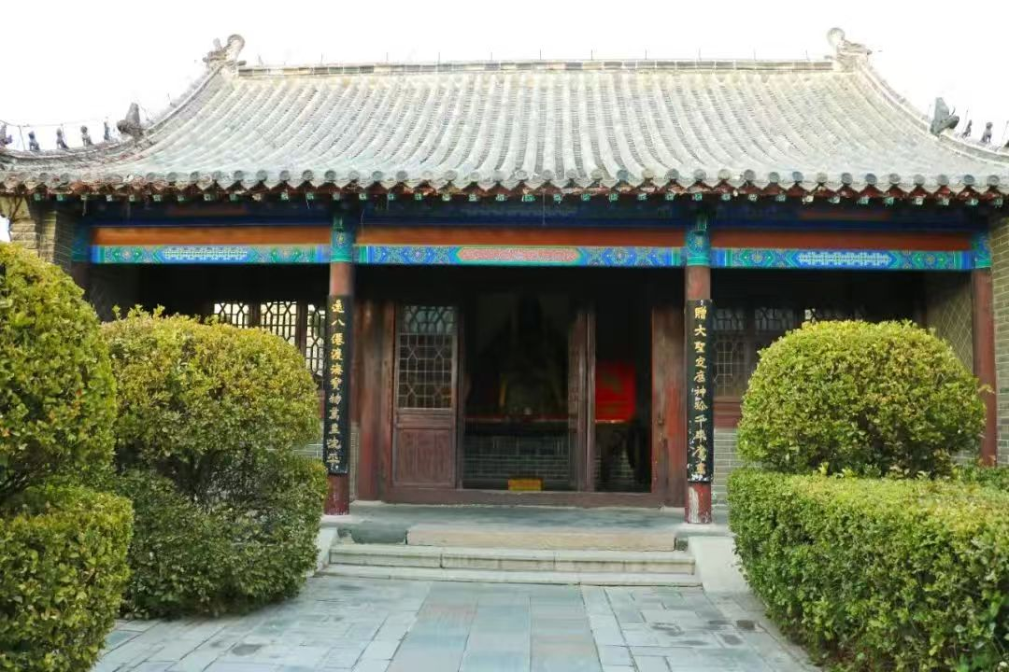
This extends to the Dragon King Palace of Penglai Pavilion
As is well known, the Dragon King Palace enshrines the East China Sea Dragon King Ao Guang, reflecting the ancient fishermen's worship and reverence for the Dragon King. They pray for the Dragon King to bless the sea with no hurricanes, fishermen's safety, and good weather. The couplets, plaques, and various auspicious patterns inside the hall, such as elephants carrying bottles, lions rolling embroidered balls, etc., all contain rich cultural meanings and embody the beautiful wishes of the people.

Slide 8
Both are worship and reverence for ancient myths. This also fully demonstrates people's yearning for a better life

Slide 9
That concludes my speech.
Thank you all

