Slide 1
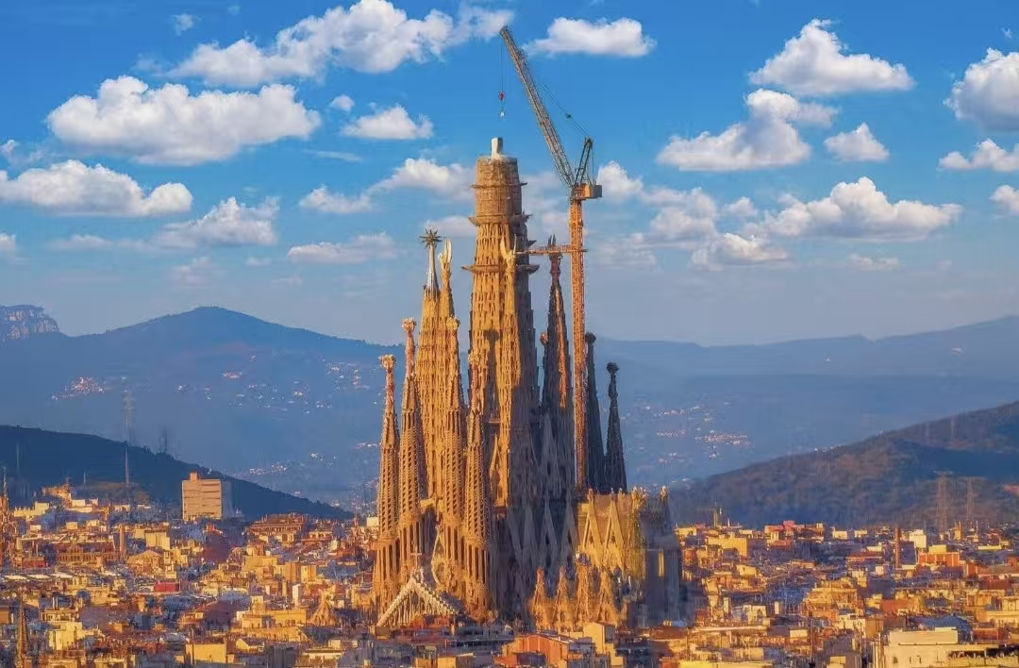
La Sagrada Familia
A Famous Church in Spain
Name：付淑雅

Slide 2

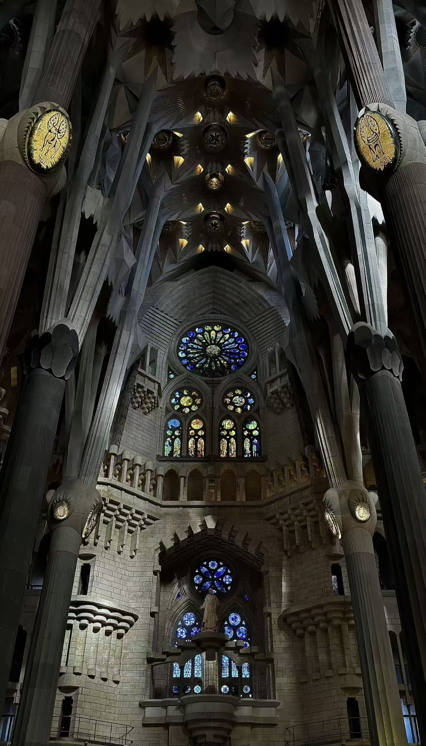
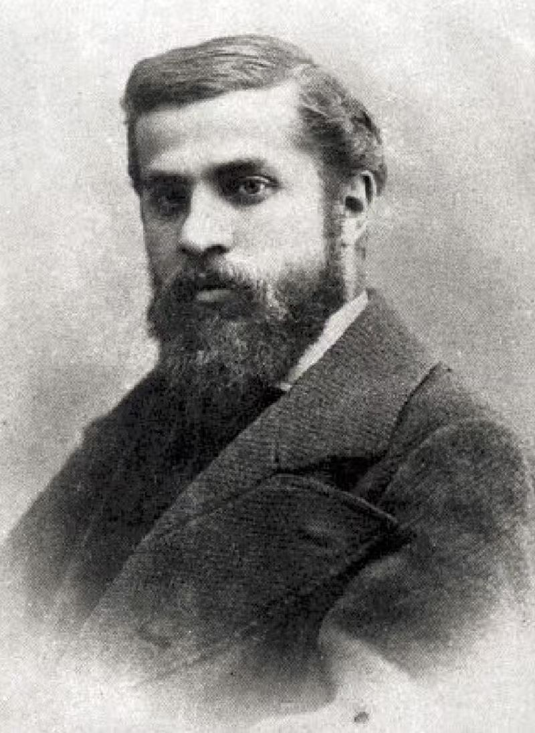
A Special Building
This church is special for two reasons.First,the inside looks like a stone forest.The columns look like trees.It was designed by the famous architect Antoni Gaudi.He loved nature.Second,the building is very old but not finished.It started in 1882,and it is still under construction today.

Slide 3
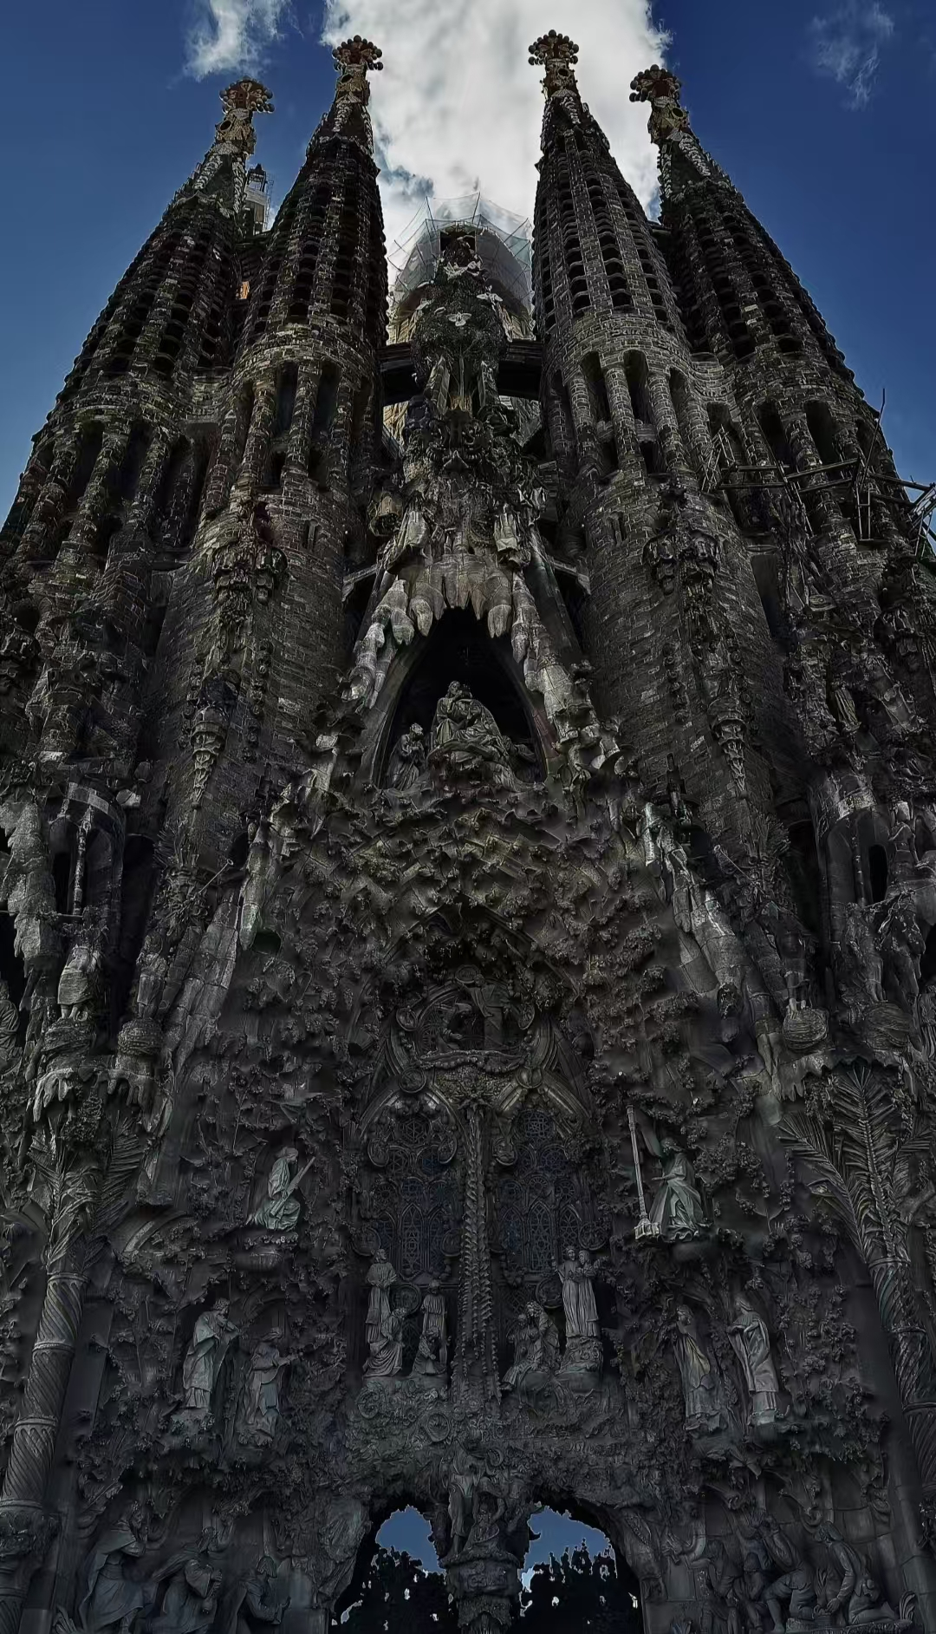
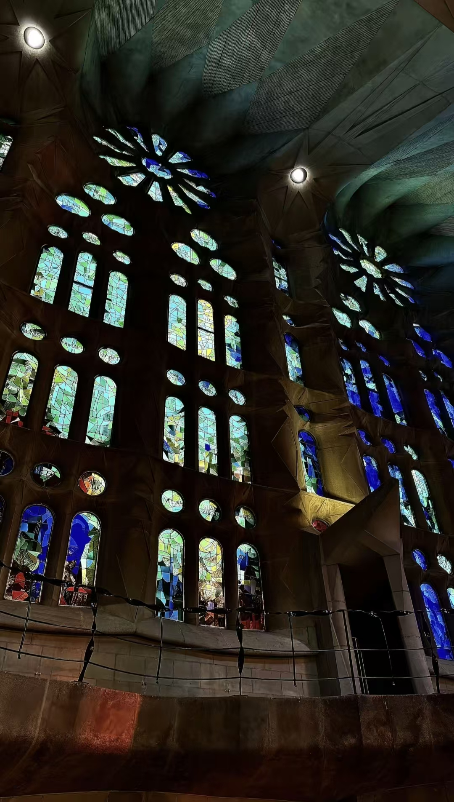
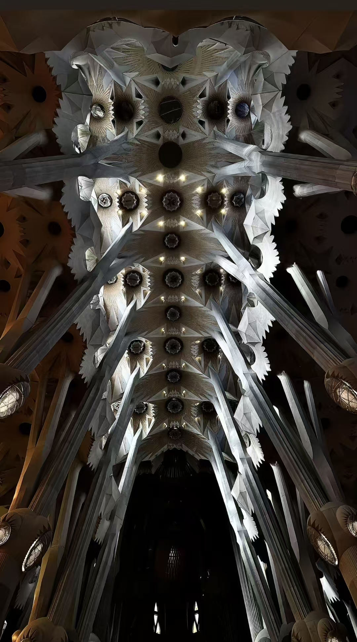
A World Famous Place
Because it is so unique,it is a UNESCO World Heritage Site.This means it is very important to the whole world.Milions of tourists visit it every year.It is a symbol of creativity and patience.That’s all for my report.Thank you!

