Slide 1
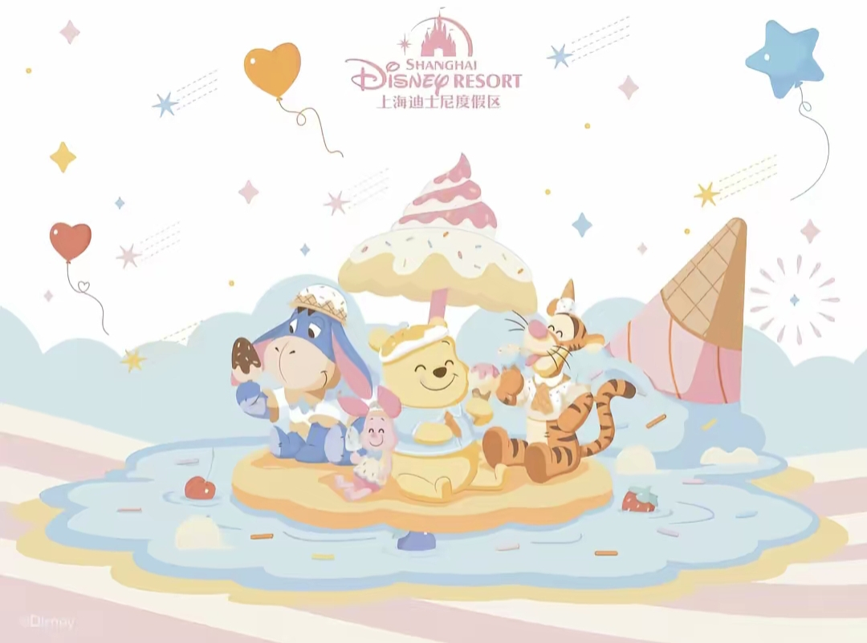
Shanghai Disney Resort
联合国及多个国家呼吁双方立即停火，并提出多项和平解决方案，但目前和平进程仍面临诸多挑战。

Slide 2

The early origins
Introduction
Must-try rides
Beautiful buildings

Slide 3
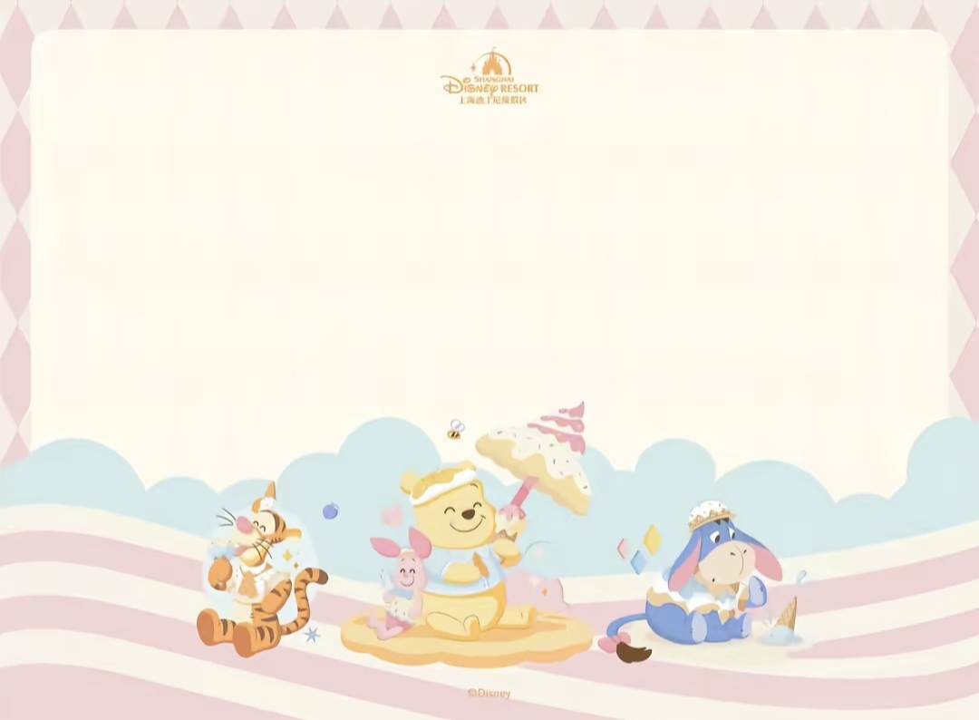
The early origins:
The bond between Disney and Shanghai can be traced back to 1938, when Disney's first full-length color animated film Snow White and the Seven Dwarfs arrived in Shanghai and topped the box office. In 1990, Zhu Rongji, then the mayor of Shanghai, visited the Disneyland in Los Angeles and expressed the hope that Disney could establish a presence in Shanghai.
早期渊源：迪士尼与上海的缘分可追溯到1938年，当年迪士尼第一部彩色动画长片《白雪公主与七个小矮人》登陆上海并拿下票房冠军。1990年，时任上海市市长朱镕基参观洛杉矶迪士尼乐园时，希望迪士尼能落户上海。

Slide 4

Introduction：
Shanghai Disney Resort is a magical kingdom loved by families worldwide. It features thrilling rides, enchanting shows, and beloved Disney characters. Visitors can explore themed lands like Tomorrowland and Fantasyland. The park offers a blend of traditional Disney magic and unique cultural touches that reflect China's rich heritage. It's a place where fantasy becomes reality, making it a favorite destination for both children and adults.

Slide 5
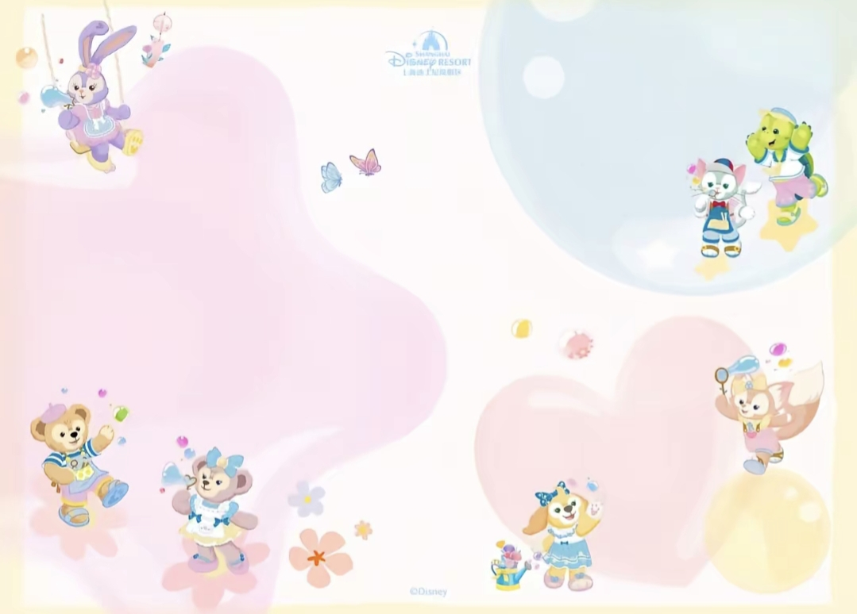
must-try rides
Soaring Over the Horizon (Adventure Isle): A world-first 5D spherical-screen flying ride. Within 90 seconds, visitors soar over 12 global wonders including the Arctic glaciers, African savannas, and the Great Wall. The swinging seats and scent system create an immersive experience.
Seven Dwarfs Mine Train : The first half winds through a diamond mine, showcasing the dwarfs' playful mining scenes. The second half features outdoor steep dives, perfect for visitors trying mild thrills.
翱翔·飞越地平线：位于探险岛，是全球首创的5D球幕飞行项目。游客能在90秒内穿越北极冰川、非洲草原、长城等12个世界奇观，座椅摆动与香氛系统配合，带来身临其境的体验。
七个小矮人矿山车：在梦幻世界园区，前半段穿越钻石矿山，可看到小矮人采矿的童趣场景，后半段则是户外急速俯冲，适合初尝刺激的游客。

Slide 6
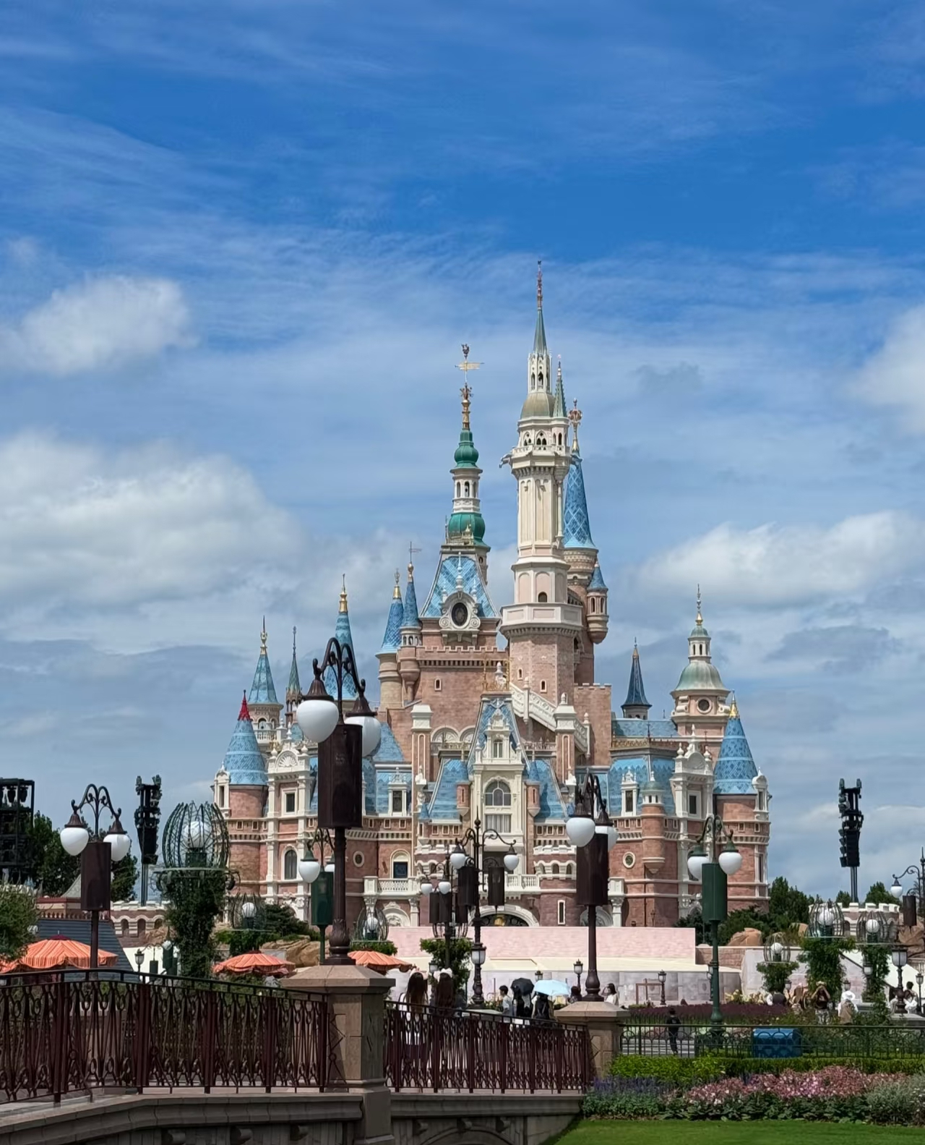
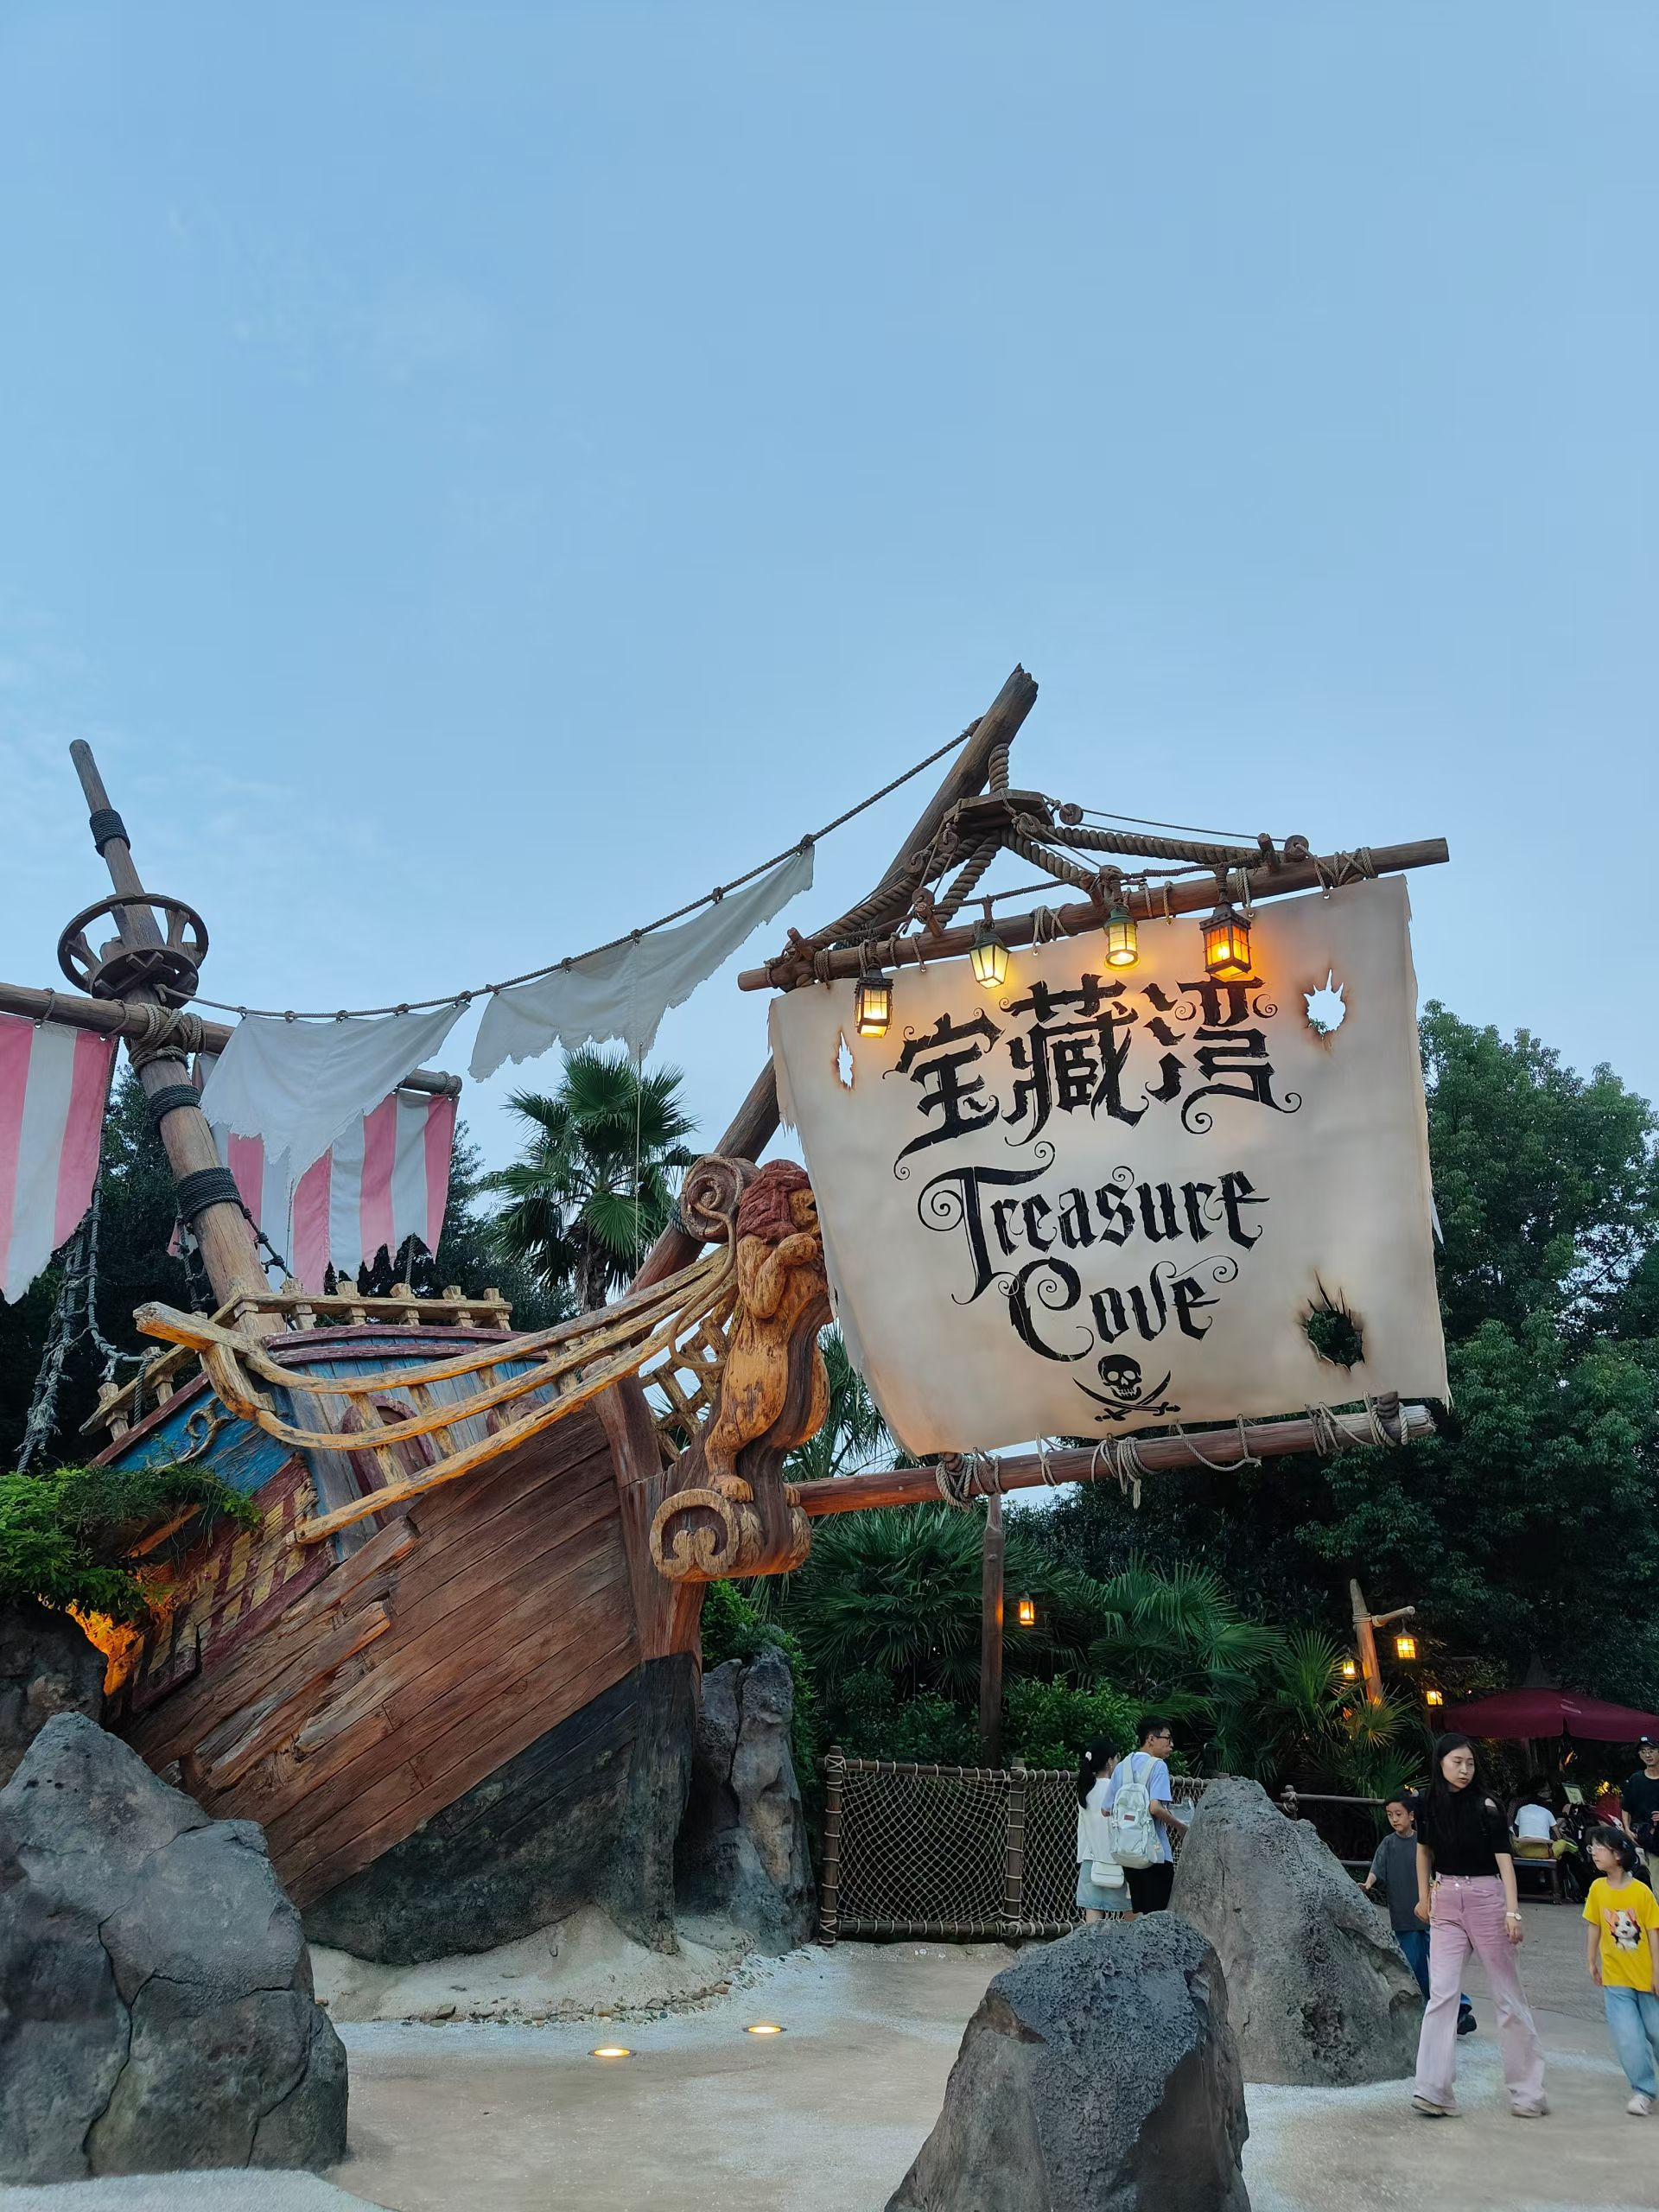
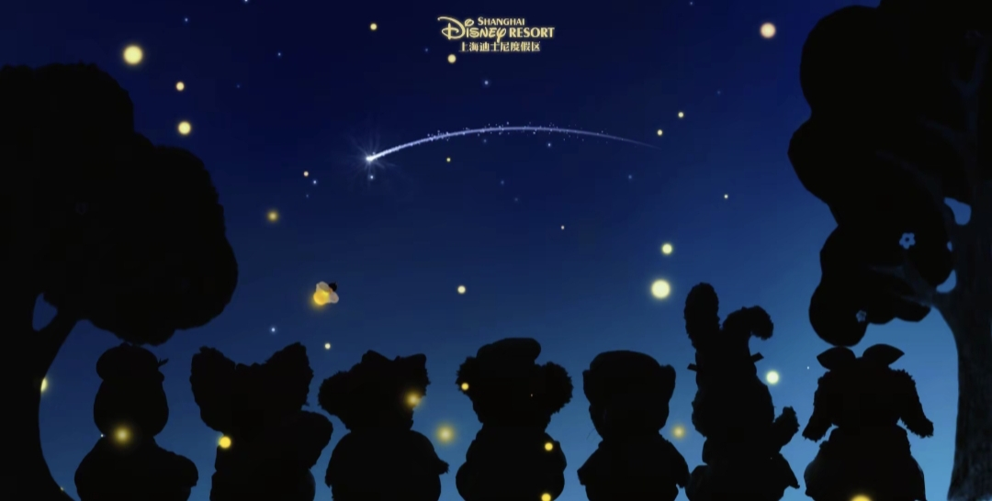
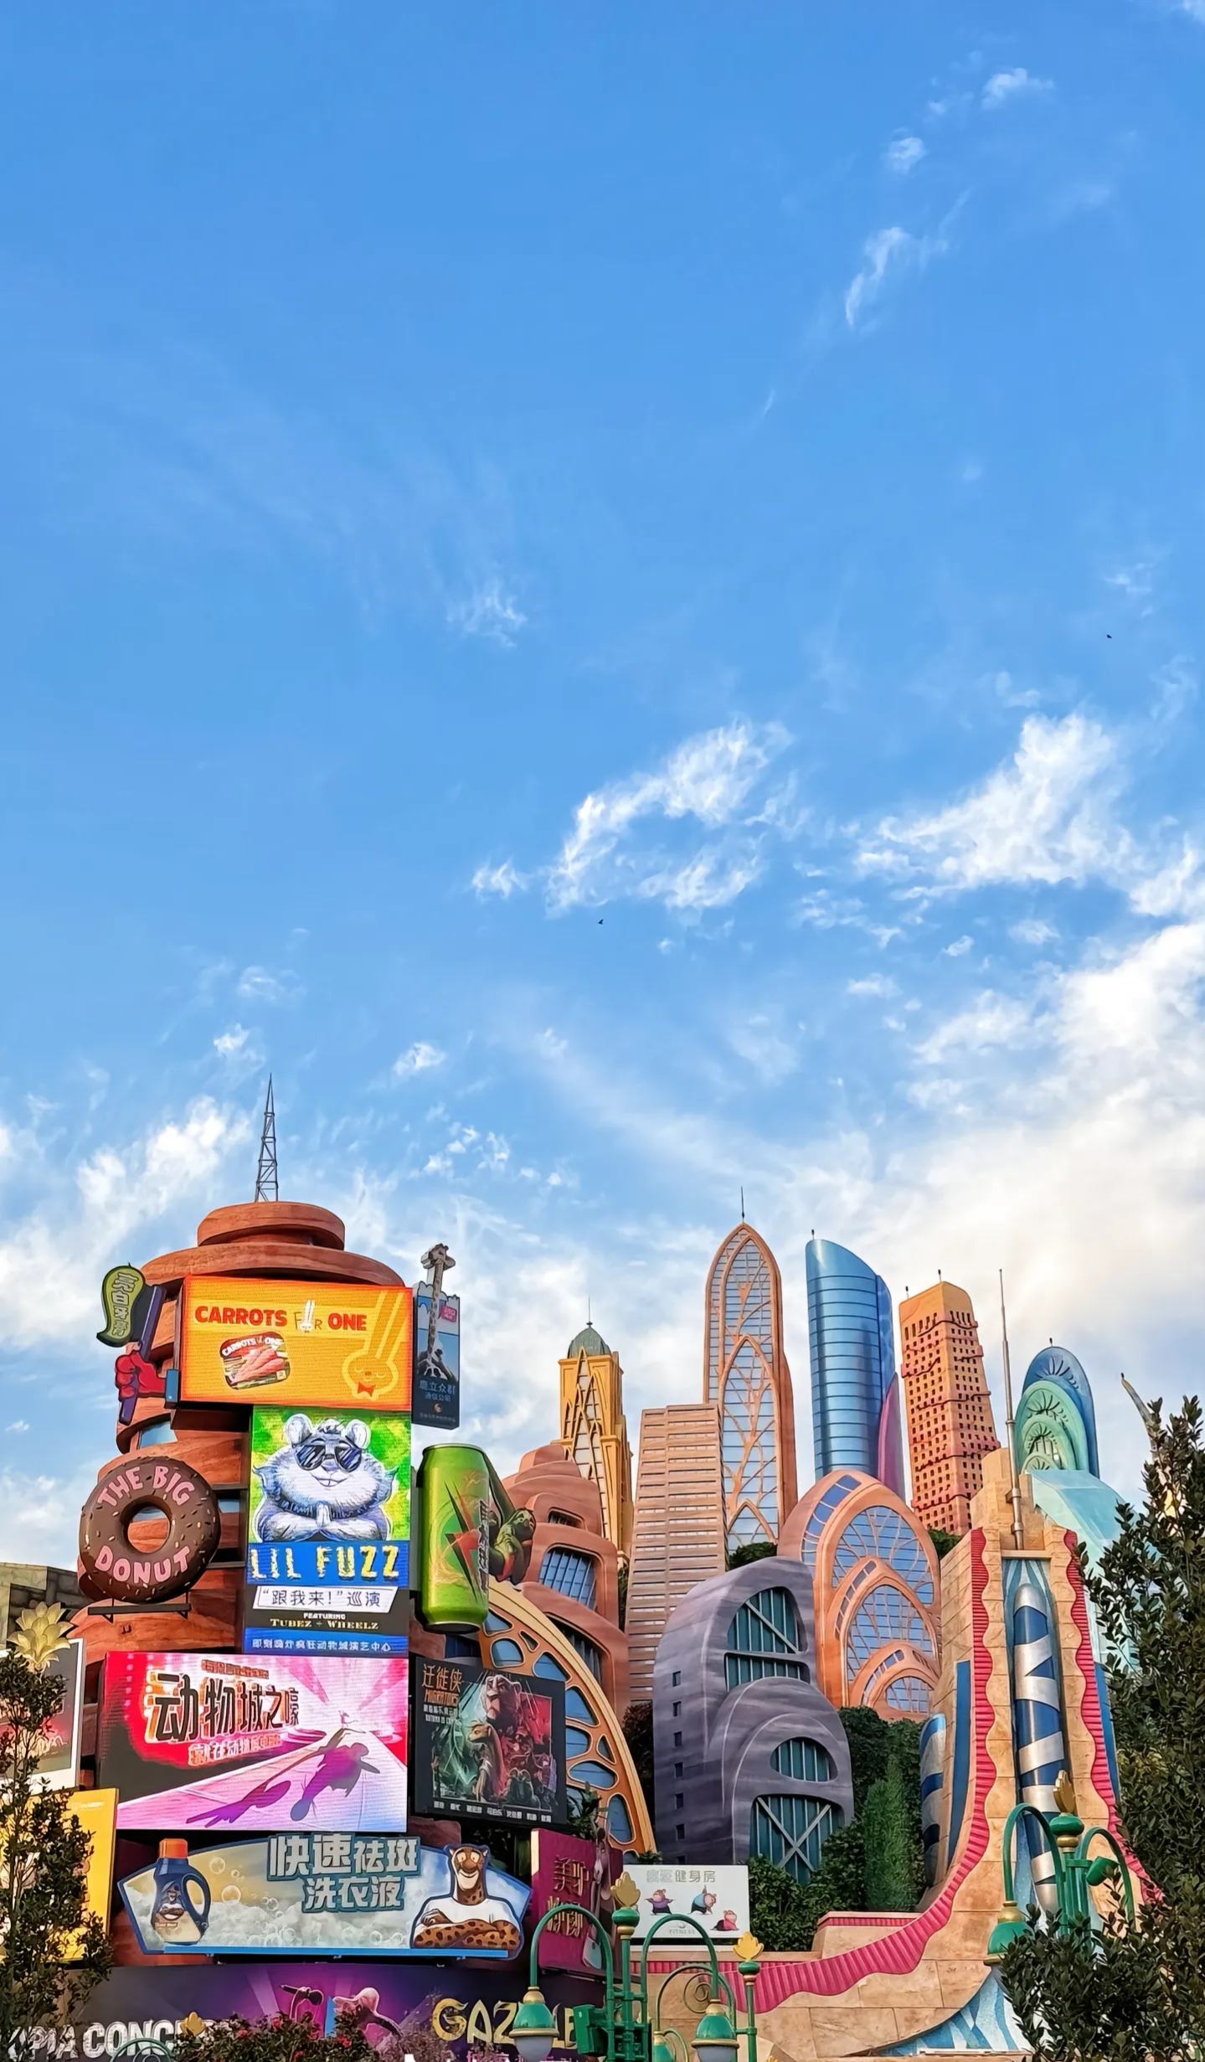
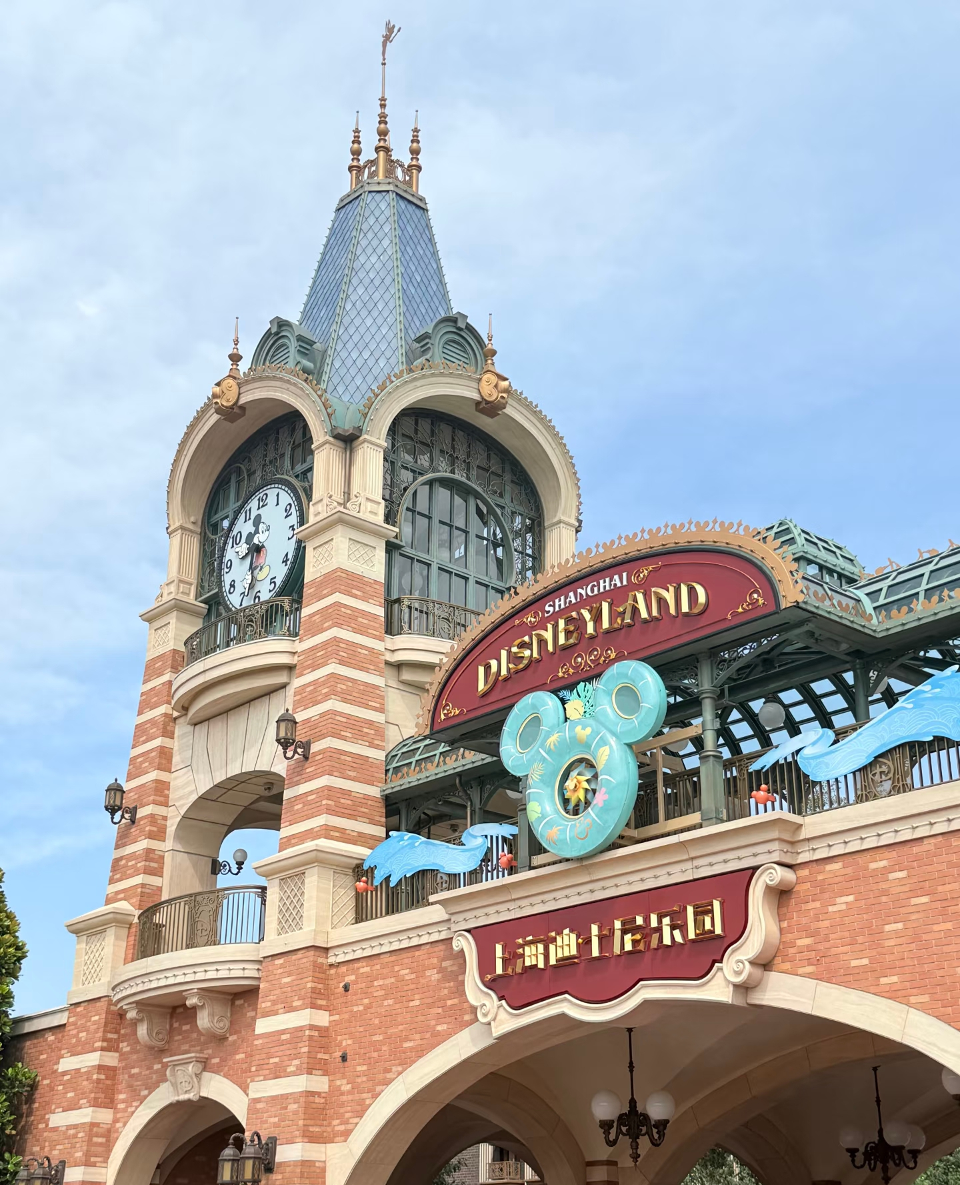
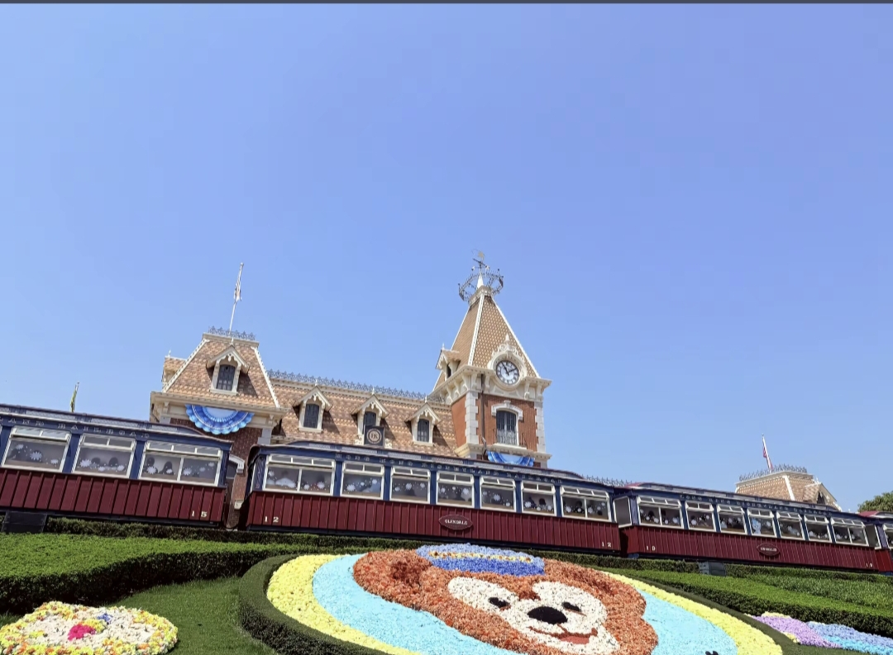
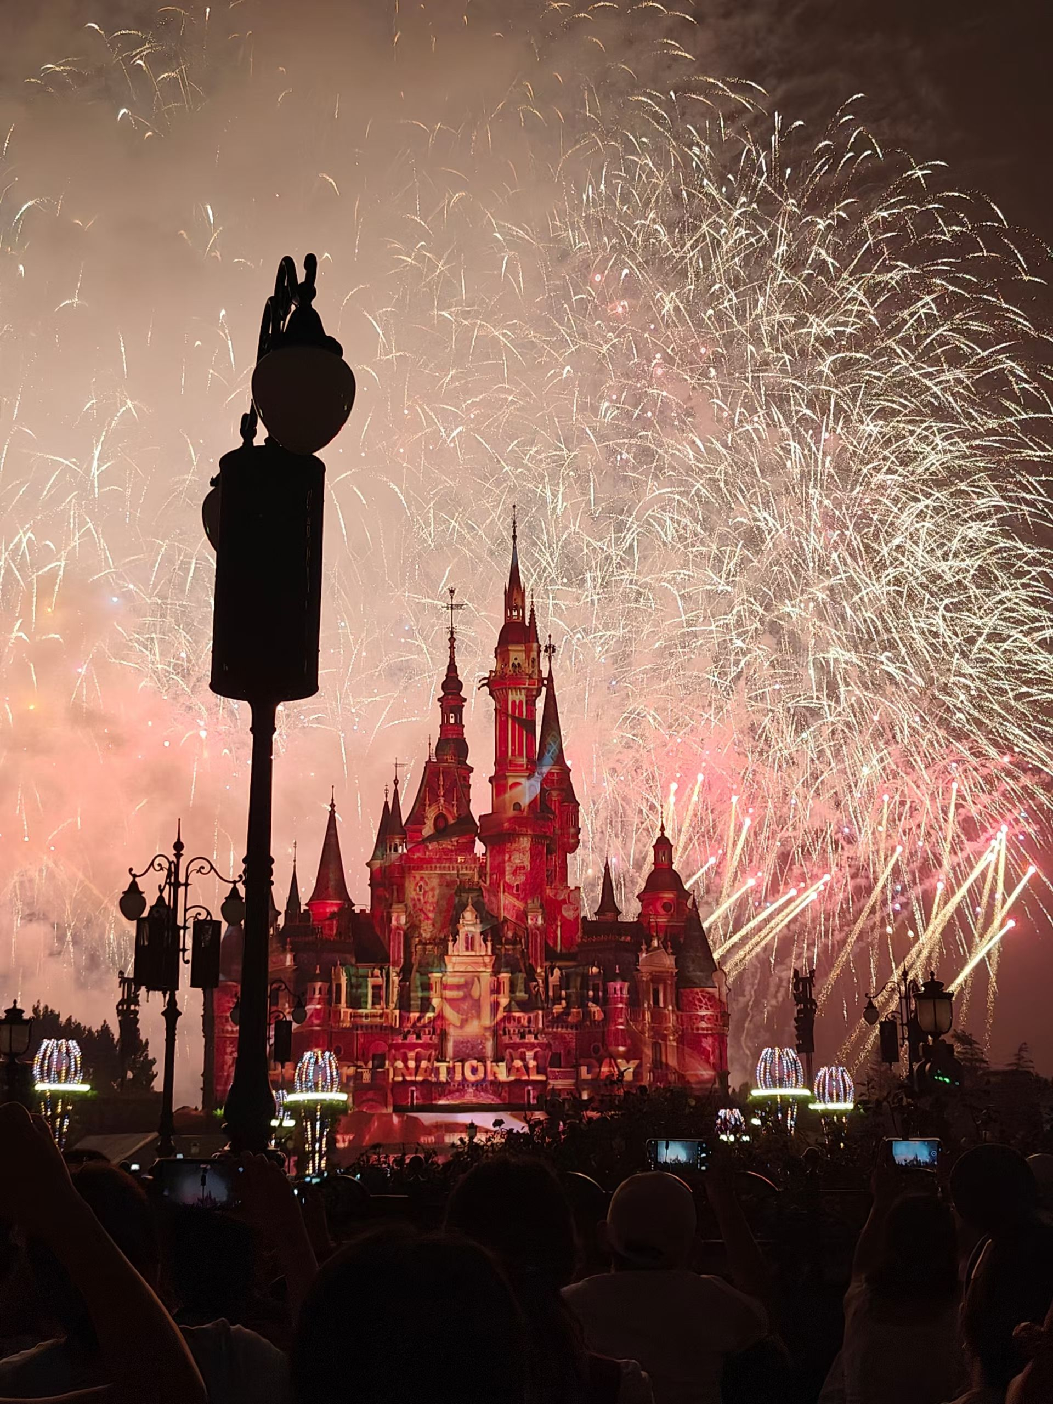
Beautiful buildings

Slide 7
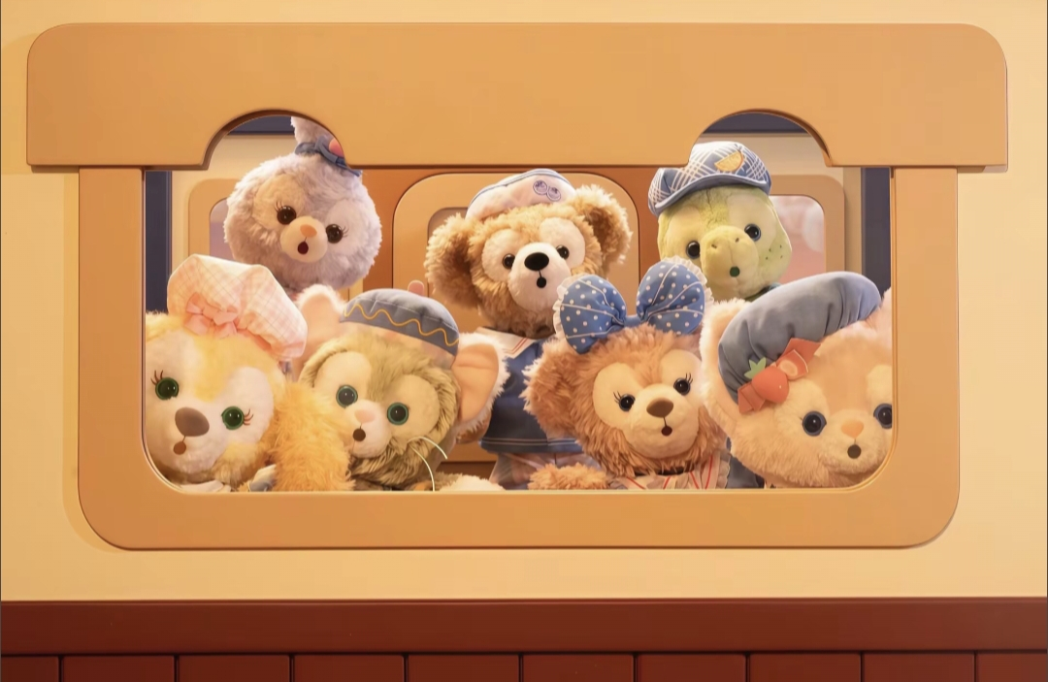
Thank you for your listening

