Slide 1


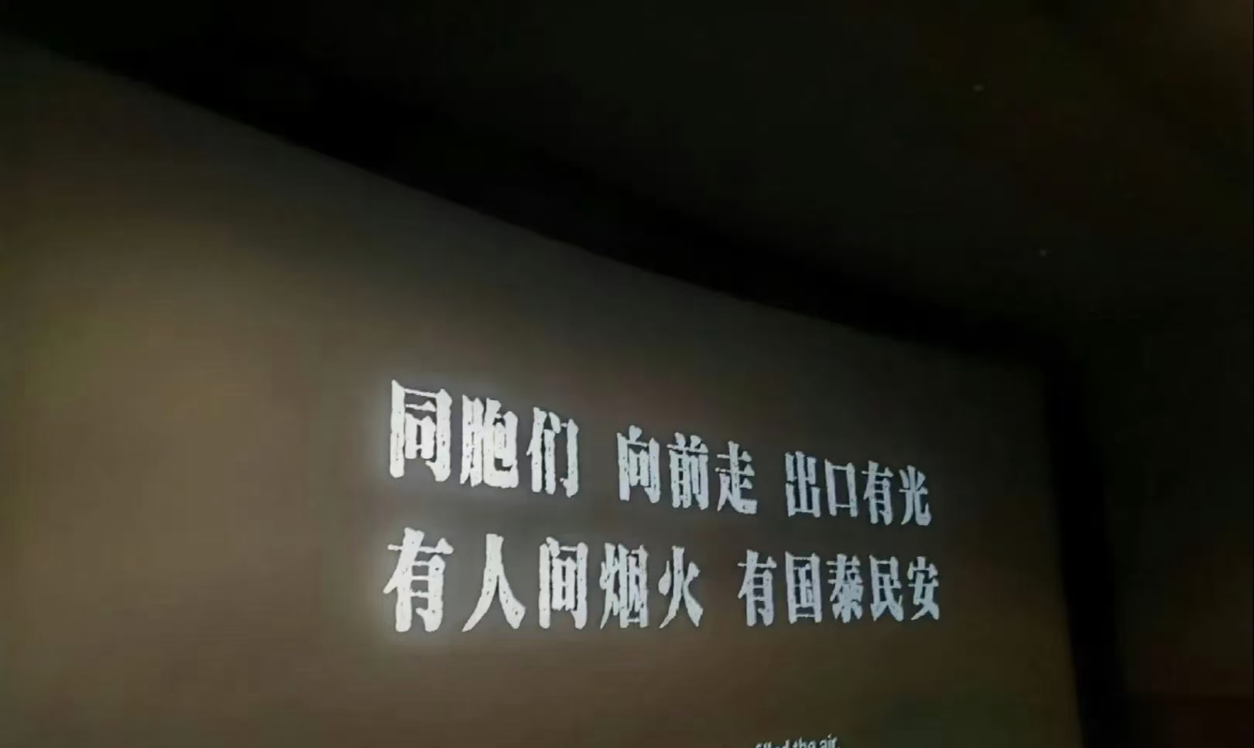
The Movie “731”
汇报人：高士杰

Slide 2

Movie “731”:Remember History,Cherish Peace
The movie "731" was released on September 18th,
2025. It is a significant film that uncovers the heinous crimes of the Japanese Unit 731 during the Second World War. The film shows the cruel and inhumane experiments the unit carried out on innocent people.
Key words
cherish v.珍视；珍惜
release v.发行；发布
uncover v.揭露；揭开
heinous adj.极恶的；可憎的

Slide 3

This army unit conducted cruel
human experiments on people in
Harbin. The movie shows how
ordinary Chinese people fought against the invaders.
As of November 6, 2025, the film "731" has been in theaters for 50 days. Today's real-time cumulative box office is 409,000 yuan.
Key Words
cumulative adj.积累的

Slide 4

Its popularity comes from two main reasons: First, it helps us remember a painful part of history that we must not forget. Second, 2025 marks the 80th anniversary of the victory of the Second Word War, which makes people reflect more history.
Key words
anniversary n.周年纪念日

Slide 5

This movie is more than just a film; it is a history lesson that reminds us never to forget the past. It makes us cherish peace even more. Although some scenes are quite intense, it's really worth watching. It is a way to remember history and honor the victims.
Key words
scenes n.场景
intense adj.严肃紧张的
victims n.受害者

