Slide 1
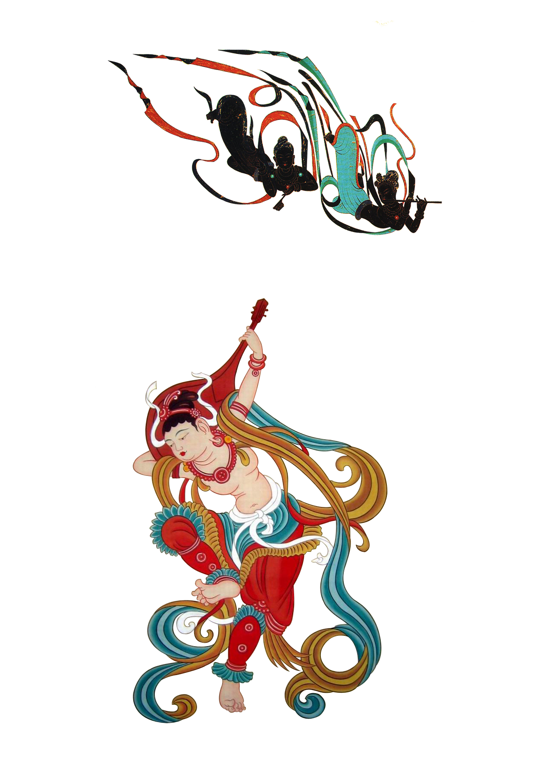

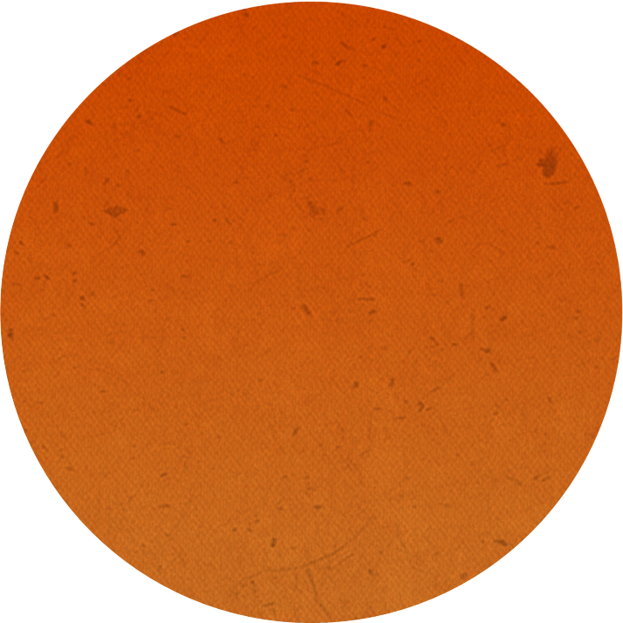
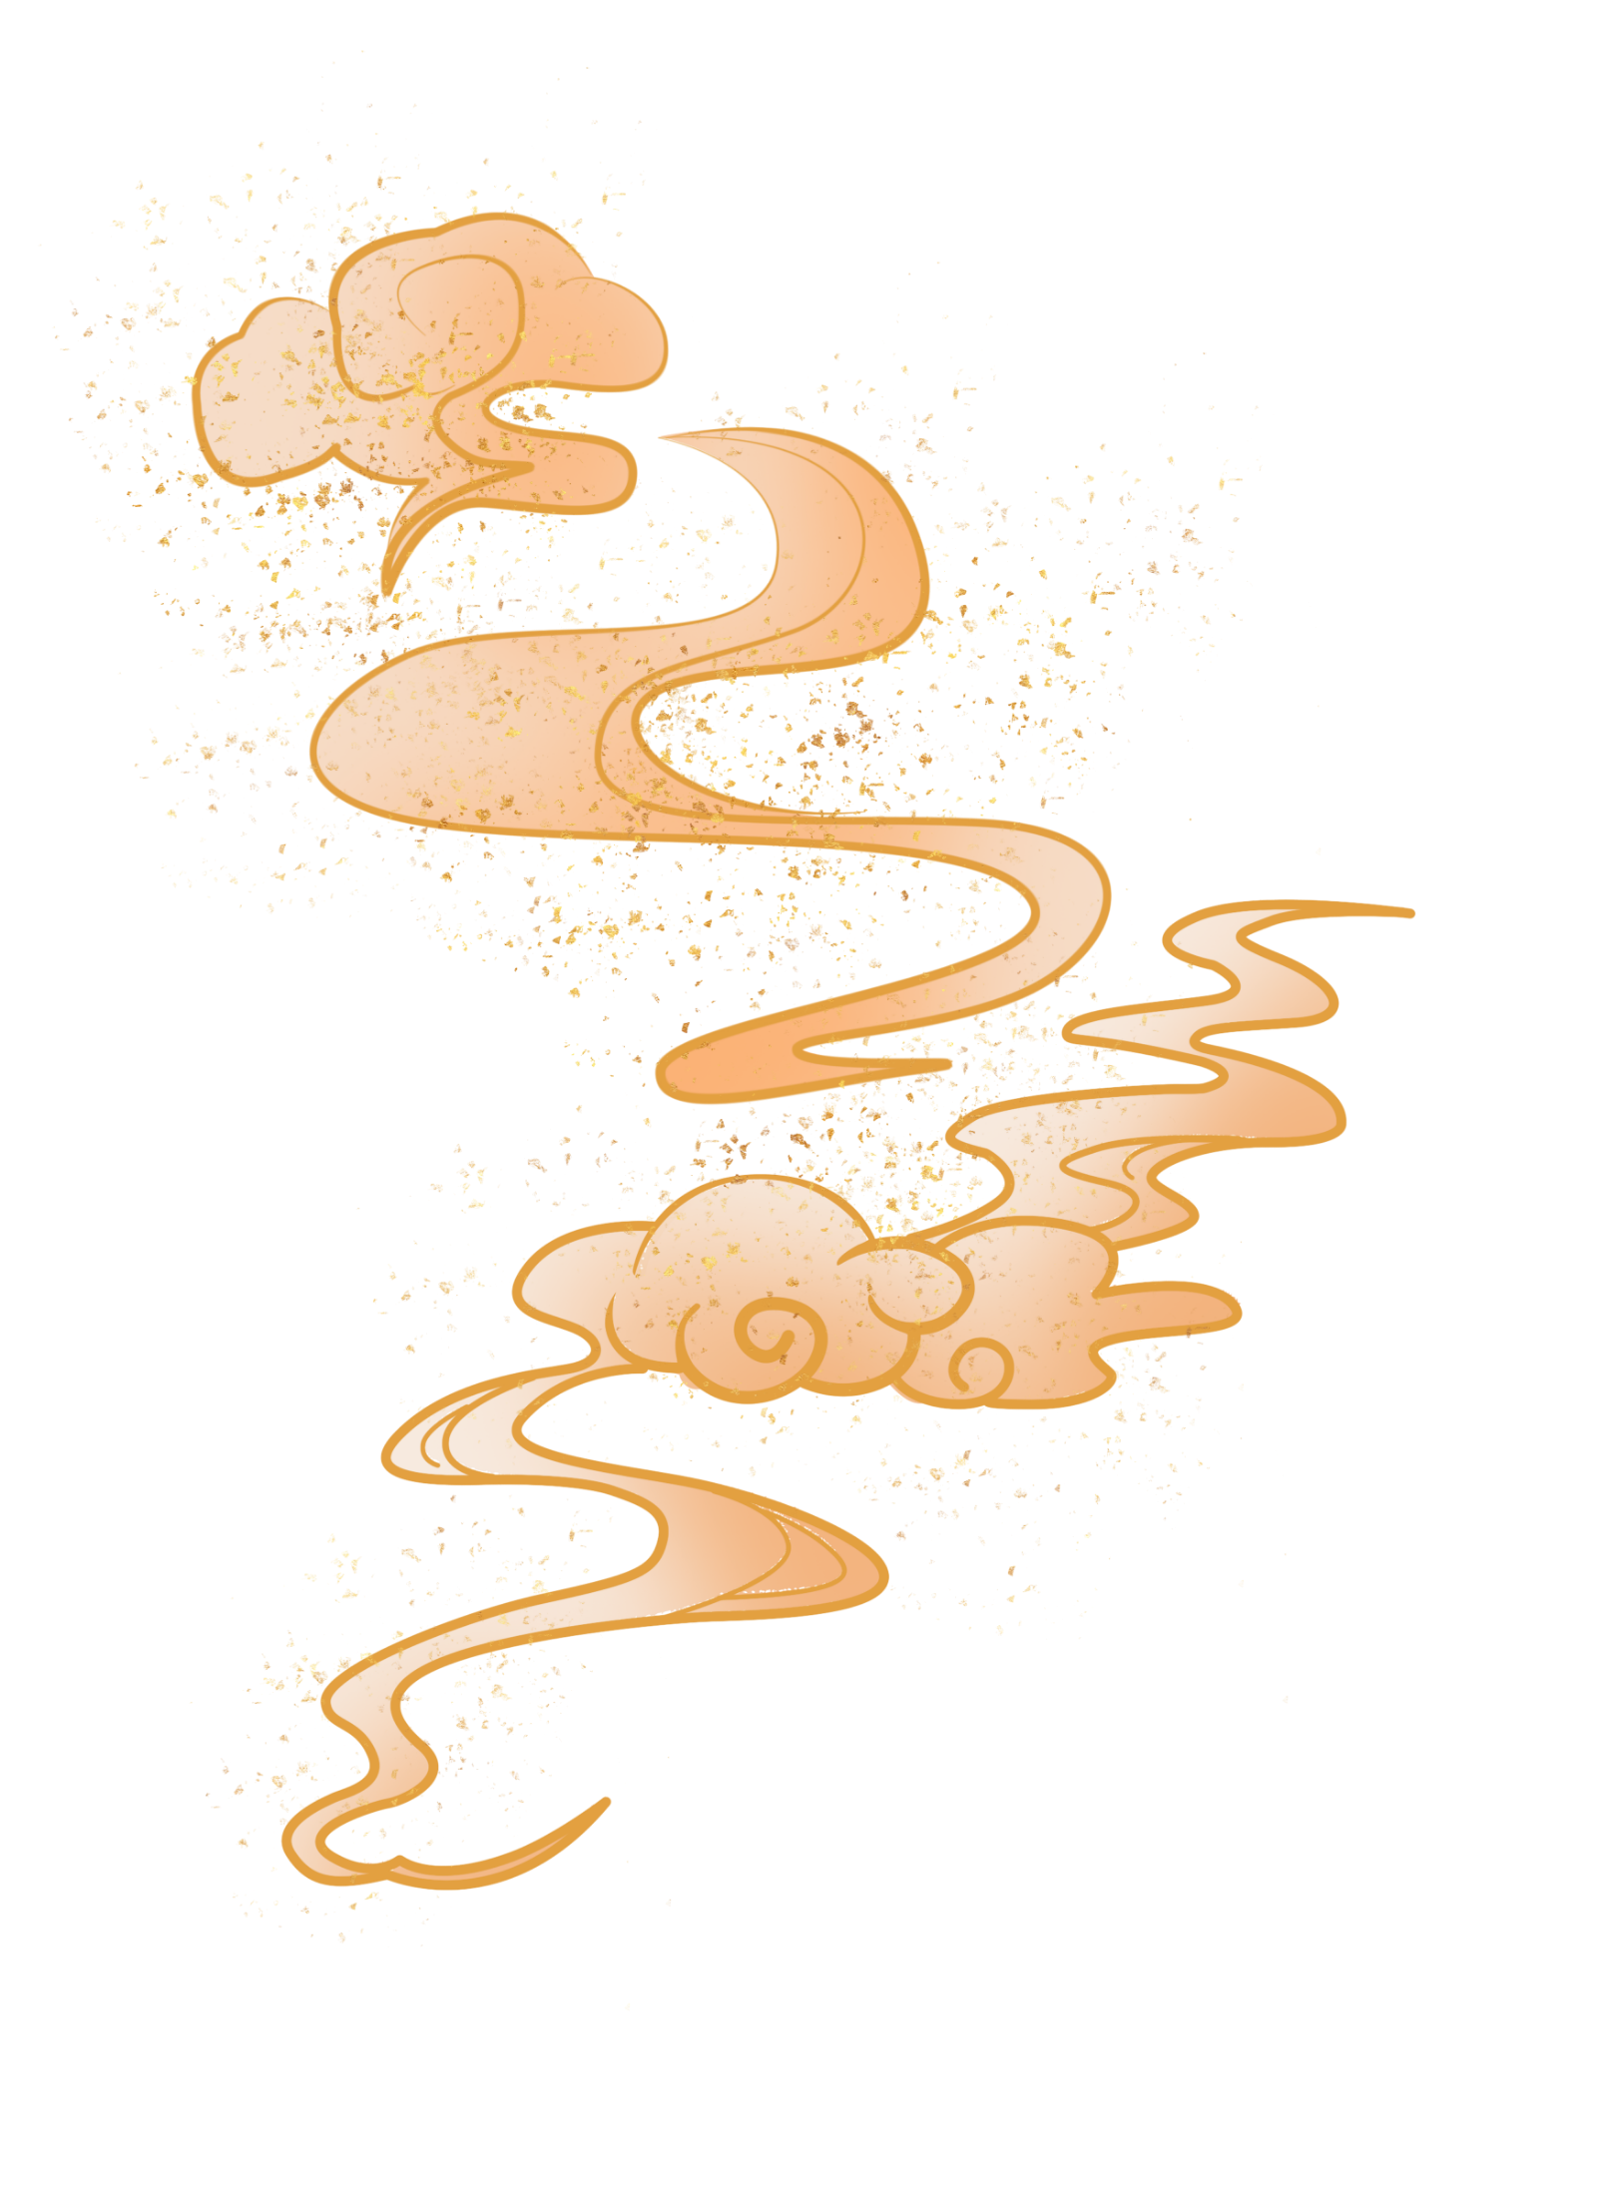
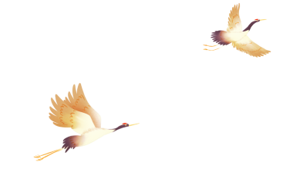
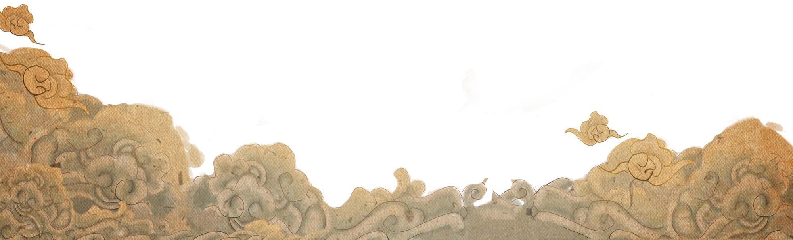
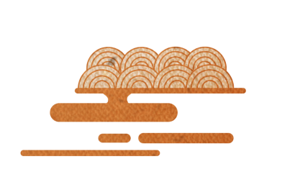
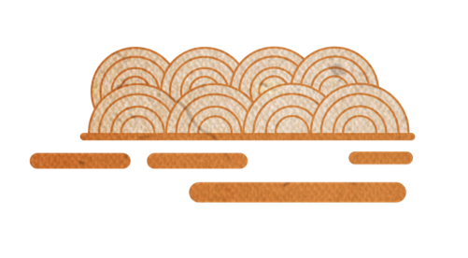

敦
煌
主讲人王爽
莫
高
窟
Mogao Grottoes in Dunhuang

Slide 2
目录
catalogue
Location地理
01
02
origin起源
03
scenery景色

Slide 3
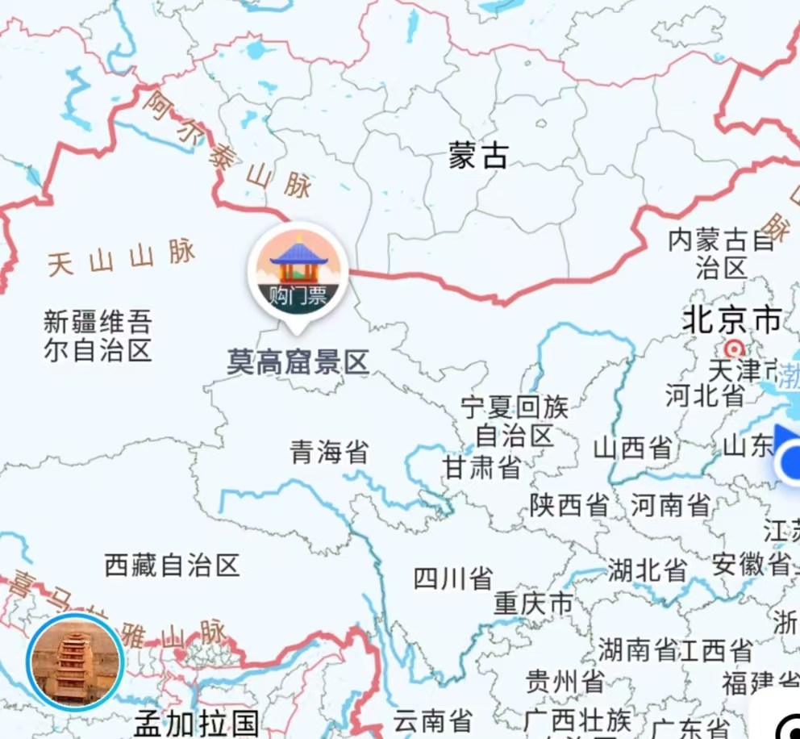
Location位置
The Mogao Caves are located on the cliff at the eastern foot of the Mingsha Mountain, about 25 kilometers southeast of Dunhuang City, Gansu Province, China. They face east and overlook the Dangquan River. They are 1,680 meters long from north to south and 50 meters high.
莫高窟位于中国甘肃省敦煌市东南约25公里处的鸣沙山东麓断崖上，前临宕泉河，面向东，南北长1680米，高50米。

Slide 4
origin起源
The term "Dunhuang Grottoes" is usually used to refer to the Mogao Caves and is the collective name for the Mogao Caves and the Western Thousand Buddha Caves. Sometimes, it also includes the Yulin Caves in Anxi. The time when the Mogao Caves were excavated and built varies slightly in different historical documents. Currently, the majority of scholars agree that in the second year of Jianyuan of the Former Qin Dynasty (366), the monk Le Zun initiated the excavation of the caves at the Mogao site, and the monk Fa Liang continued the construction.
敦煌石窟一名通常用以指莫高窟，是莫高窟、西千佛洞的总称，有时也包括安西的榆林窟。莫高窟开凿兴建的年代，不同的文献资料记载稍有出入。目前多数学者所同意的观点是前秦建元二年（366）乐僔和尚在莫高窟创凿洞窟，法良禅师接续建造。

Slide 5
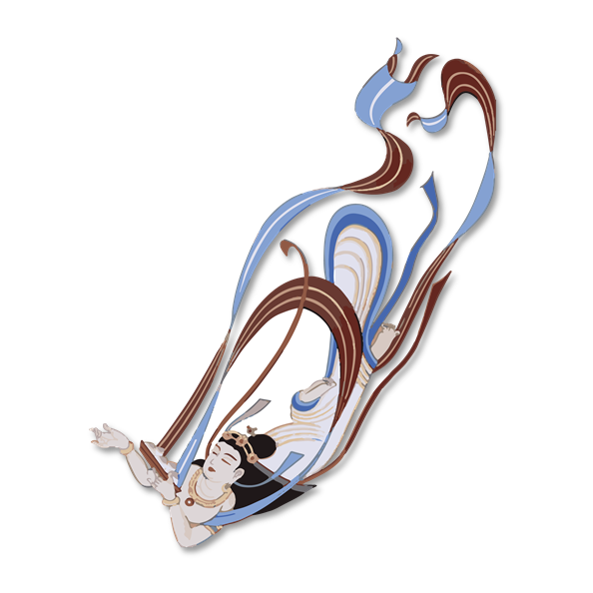
In summary, the Mogao Caves flourished during the Sixteen Kingdoms period and continued through the Northern Wei, Sui, Tang, Song, and Western Xia dynasties until the Yuan Dynasty.
概括而言，莫高窟兴于十六国时期，历经北魏、隋、唐、宋、西夏而讫元代。

Slide 6
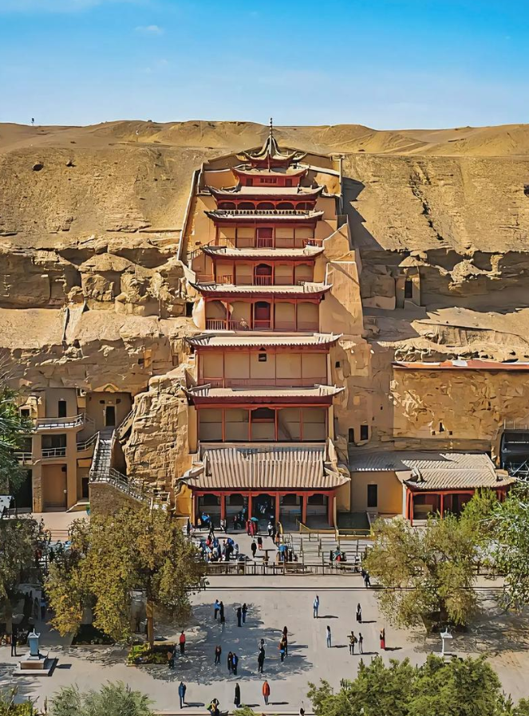
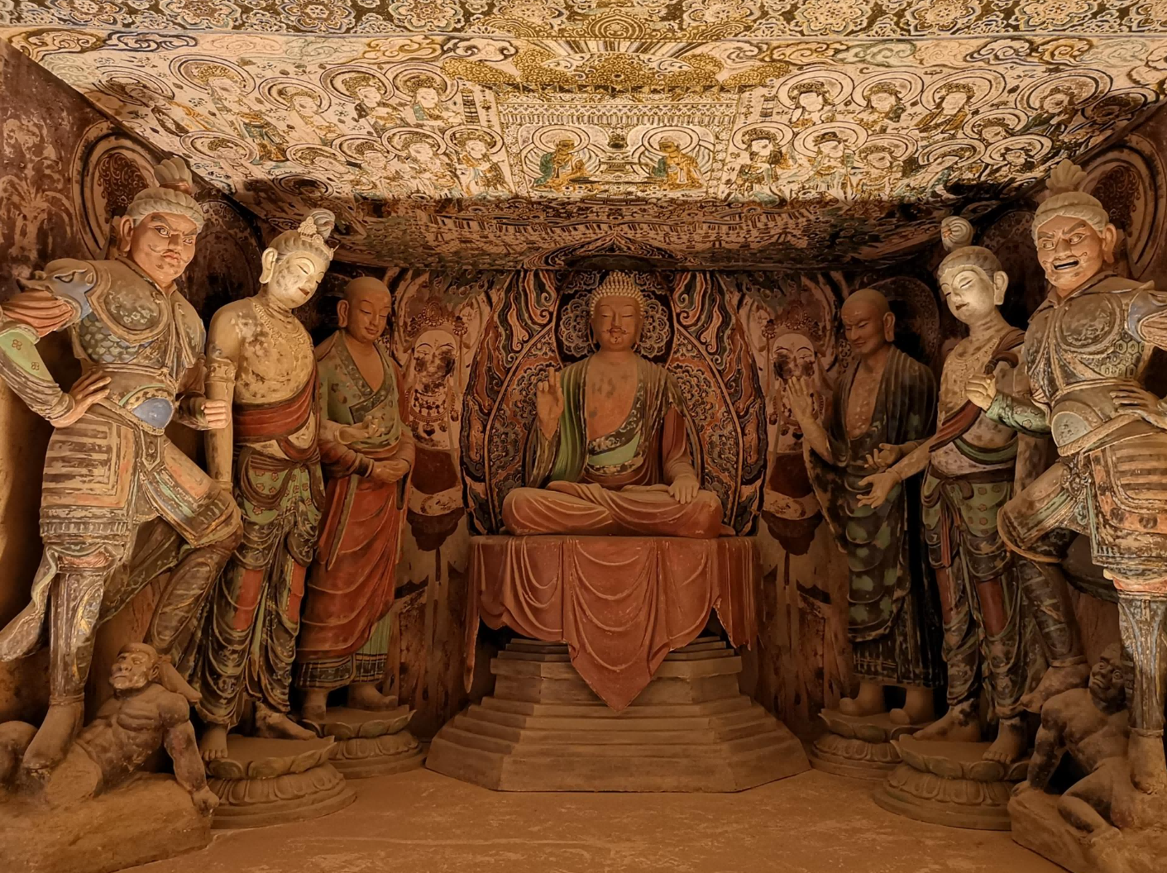
scenery景色
Nine-story building九层楼
mold a statue
塑像

Slide 7
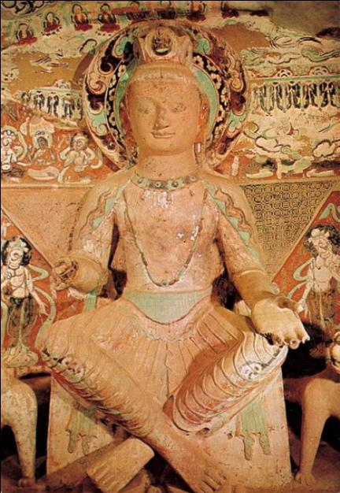
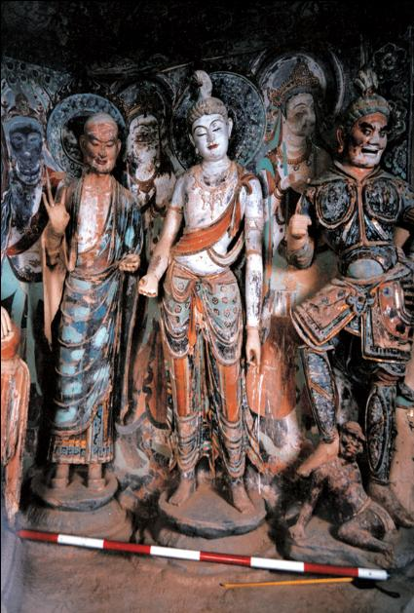

Slide 8
The scenery of the Mogao Caves in Dunhuang is a thousand-year dialogue between the sand dunes and the Buddhist caves, a time-lapse collection of colors and faith. It not only showcases the rugged grandeur of the northwest desert, but also conceals the exquisite elegance of Eastern architecture. It is an artistic epic shaped by wind and sand, and a civilization flower that has bloomed for thousands of years on the parched land.
敦煌莫高窟的景色，是一场沙山与佛窟的千年对话，是色彩与信仰的时光凝萃。既显西北荒漠的苍劲雄浑，又藏东方建筑的精巧雅致。它是风沙打磨的艺术史诗，是在干涸土地上绽放了千年的文明之花。

Slide 9
敦煌莫高窟是中西文化交流的见证，融合了中原、西域乃至印度的艺术元素，在佛教艺术史、中国美术史等领域具有不可替代的地位，也为研究古代丝绸之路的历史、文化、商贸等提供了丰富的线索。
The Mogao Caves in Dunhuang are a testament to the cultural exchanges between the East and the West. They integrate artistic elements from Central China, the Western Regions, and even India, and hold an irreplaceable position in the history of Buddhist art and Chinese art history. They also provide rich clues for the study of the history, culture, and trade along the ancient Silk Road.

Slide 10
Thank you for watching.
谢谢观看

