Slide 1


Thanksgiving Unwrapped: Heritage, Hospitality & Holiday Travel

Slide 2

01
Origins & Evolution
目录
02
Customs & Contemporary Meaning
CONTENTS
03
Audience Engagement

Slide 3


Part.
01
Origins & Evolution
CHAPTER

Slide 4
From Pilgrims to National Holiday
1621: The Pilgrims, aided by Native Americans, celebrated their first successful harvest with a three-day feast, forging a legacy of gratitude and cooperation.
1863: President Abraham Lincoln proclaimed Thanksgiving a national holiday, to be observed on the final Thursday of November, unifying a nation during the Civil War.
Today: The holiday is celebrated on the fourth Thursday of November, a cornerstone of American culture and a peak period for the travel and tourism industry.

Slide 5
Part.
02
Customs & Contemporary Meaning
CHAPTER

Slide 6
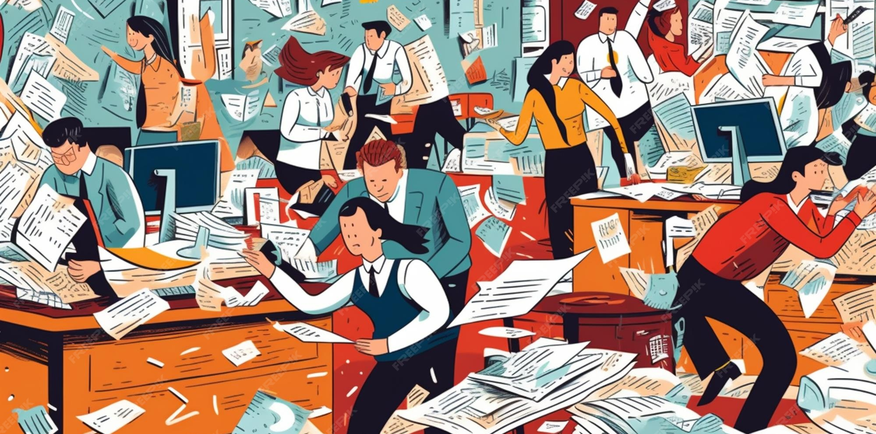
Tableside Traditions & Travel Rush
The Quintessential Feast
Families reunite over roast turkey, pumpkin pie, and shared expressions of gratitude, forming the heart of the celebration.
Parades & Pigskin
The day is marked by iconic televised parades with giant balloons and afternoon American football games.
The Great Migration
Charity & Commerce
This is the busiest travel period in the United States, as millions journey vast distances to reunite with family, creating a massive logistical and hospitality challenge.
Many volunteer at shelters, while others kick off the holiday shopping season with Black Friday deals.

Slide 7
Modern Meaning & Tourism Impact
The Ultimate Family Holiday
Peak Travel Season
A Commercial Opportunity
The official gateway to the winter holidays, marked by a nationwide surge in air, road, and rail traffic, straining and enriching the tourism infrastructure.
A critical revenue window for hotels, airlines, and restaurants, requiring strategic service design to balance culture and commerce.
A cherished occasion that many Americans favor above all others, emphasizing togetherness and gratitude.

Slide 8
Thank you for watching

