Slide 1
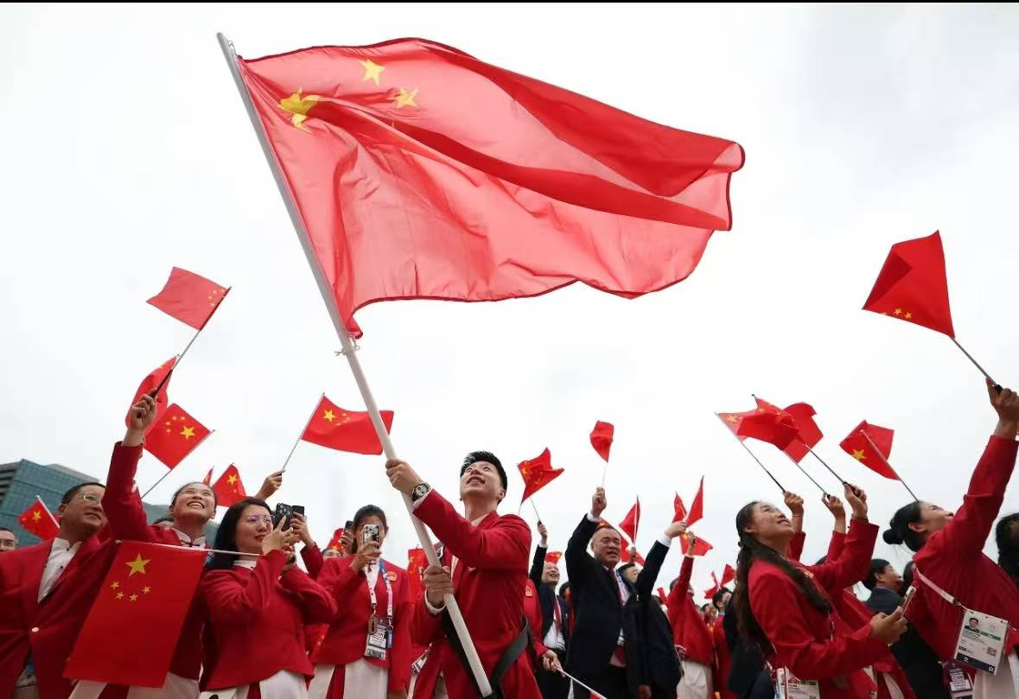
The Spirit of Chinese Table Tennis
国乒精神

Slide 2
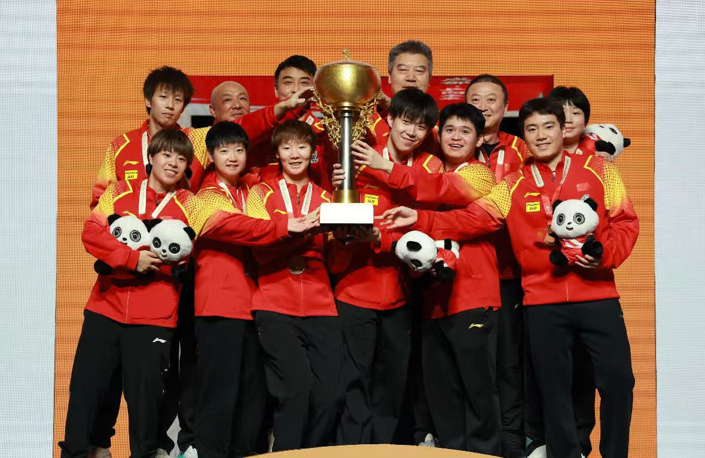

A Legend of Glory
For decades, the Chinese table tennis team has dominated the world stage, securing numerous Olympic and world championship titles.
This success is not only a victory of skills, but more a reflection of the spiritual strength behind the team.

Slide 3
What is the spirit of table tennis?
First: Indomitable struggle. Think of Ma Long—he won championships even with severe knee injuries. He once said, 'I fight until the last ball drops.'
Second: Collective honor. No single player takes all the credit. Even the best athletes rely on their teammates.
Third: Endless innovation. They’re always creating new tactics—like tricky serves that baffle opponents.
Fourth: Humble inheritance. Veterans like Zhang Jike pass their skills to young stars like Sun Yingsha. It’s a cycle of excellence."

Slide 4
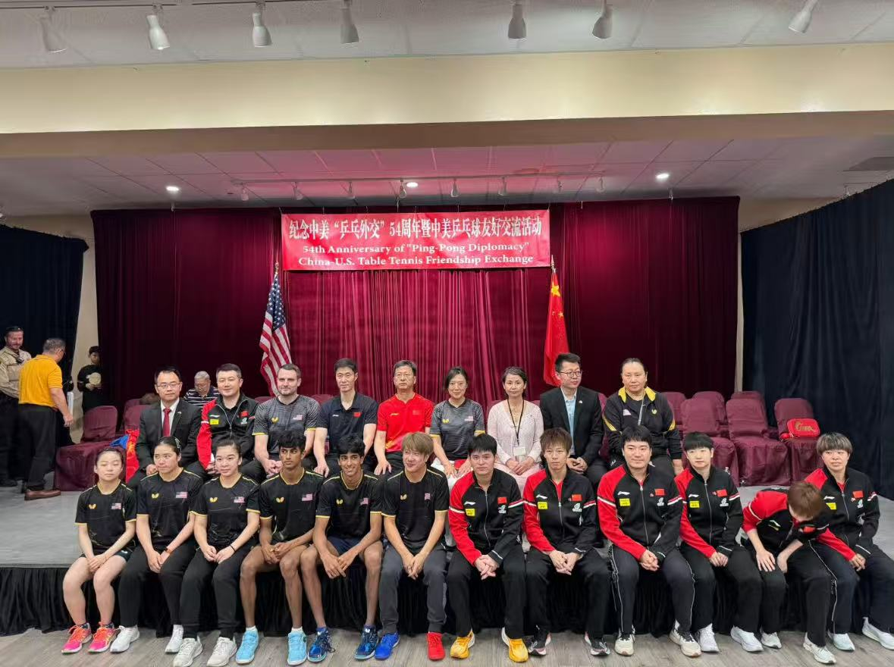
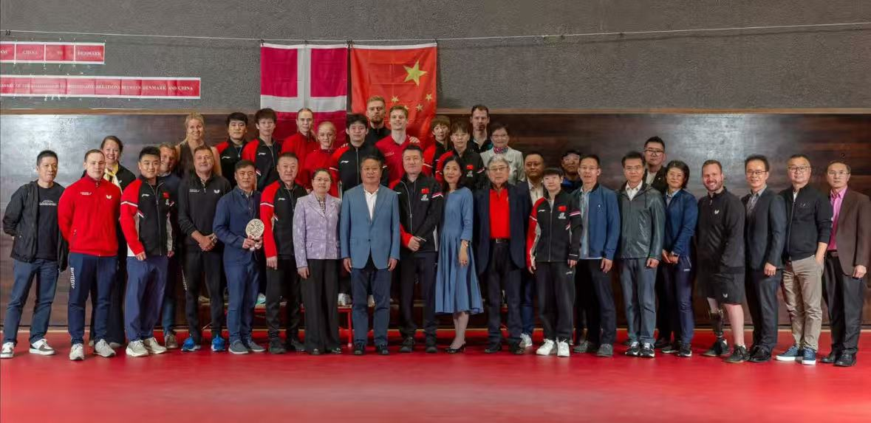
Beyond the spirit of the stadium
The spirit goes far beyond the stadium. First, it's a symbol of national pride, showing Chinese resilience when facing challenges. More importantly, it built a bridge between countries. In 1971, 'Ping-Pong Diplomacy' broke the ice between China and the US, starting friendly exchanges. Now, the team still promotes sportsmanship worldwide, making the spirit a cultural link.

Slide 5
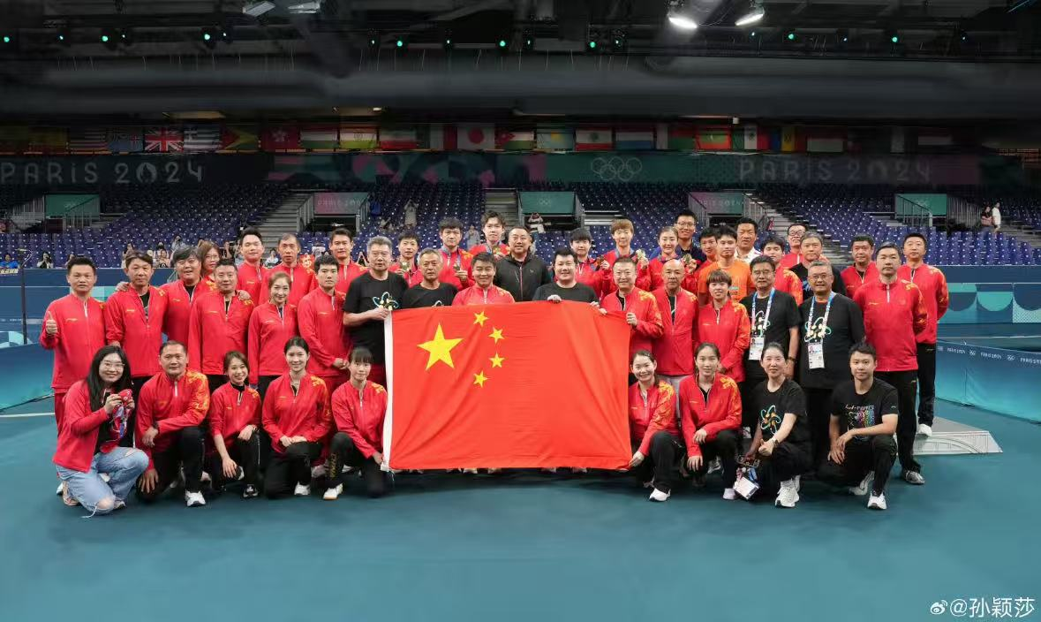
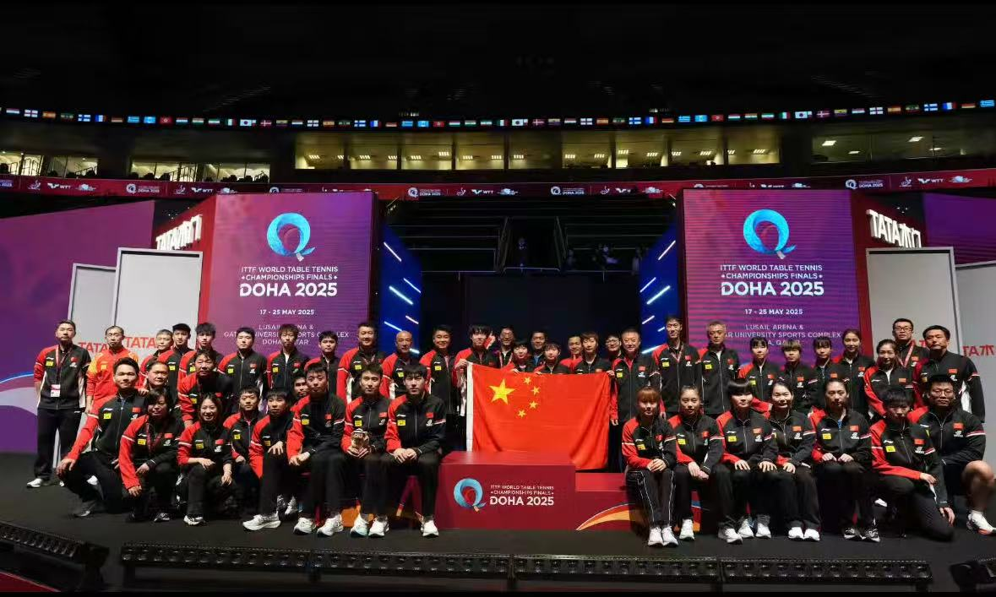
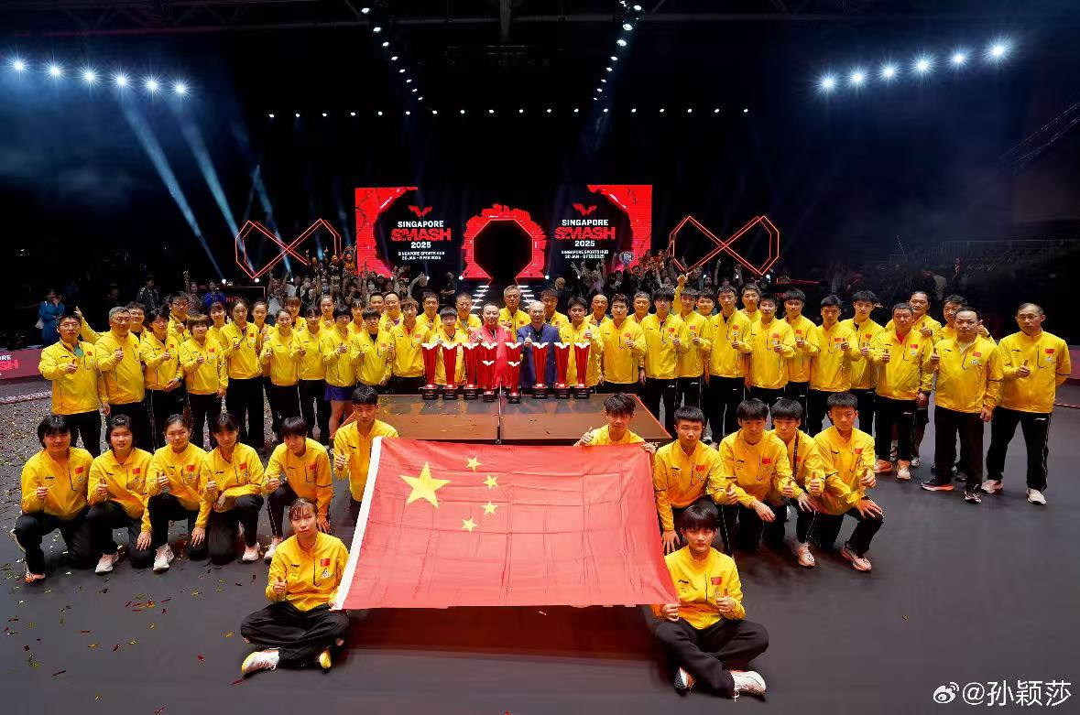
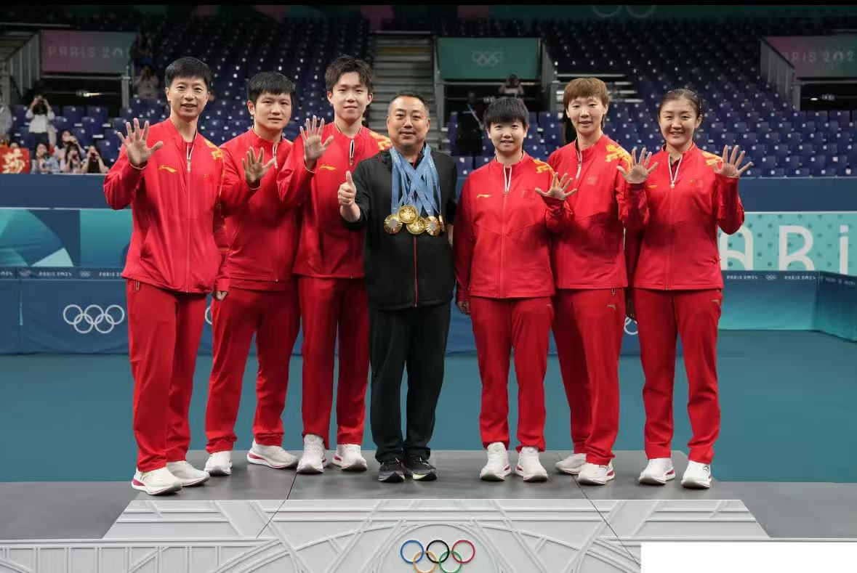
The Summary
The spirit of China's table tennis team is not just about winning medals. It's the courage to fight, the wisdom to innovate, and the power of unity. It inspires every Chinese to move forward.

