Slide 1

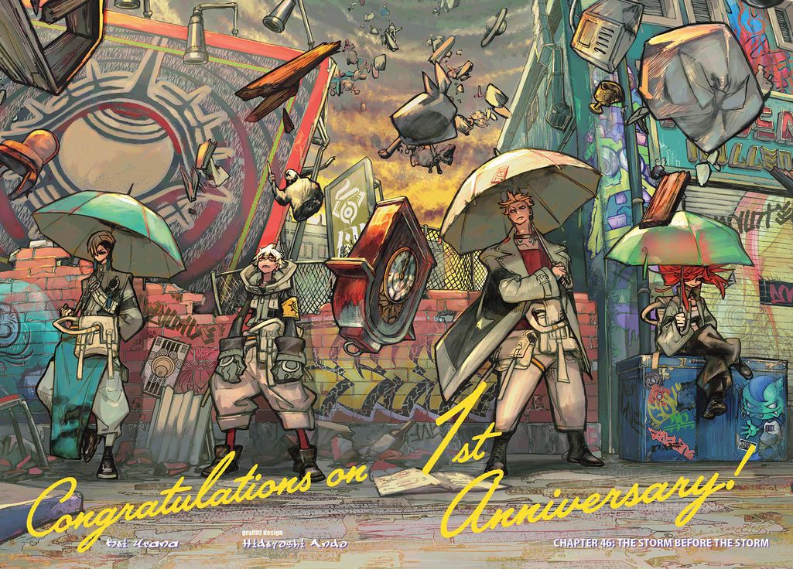
ガチアクタ
GACHIAKUTA

Slide 2
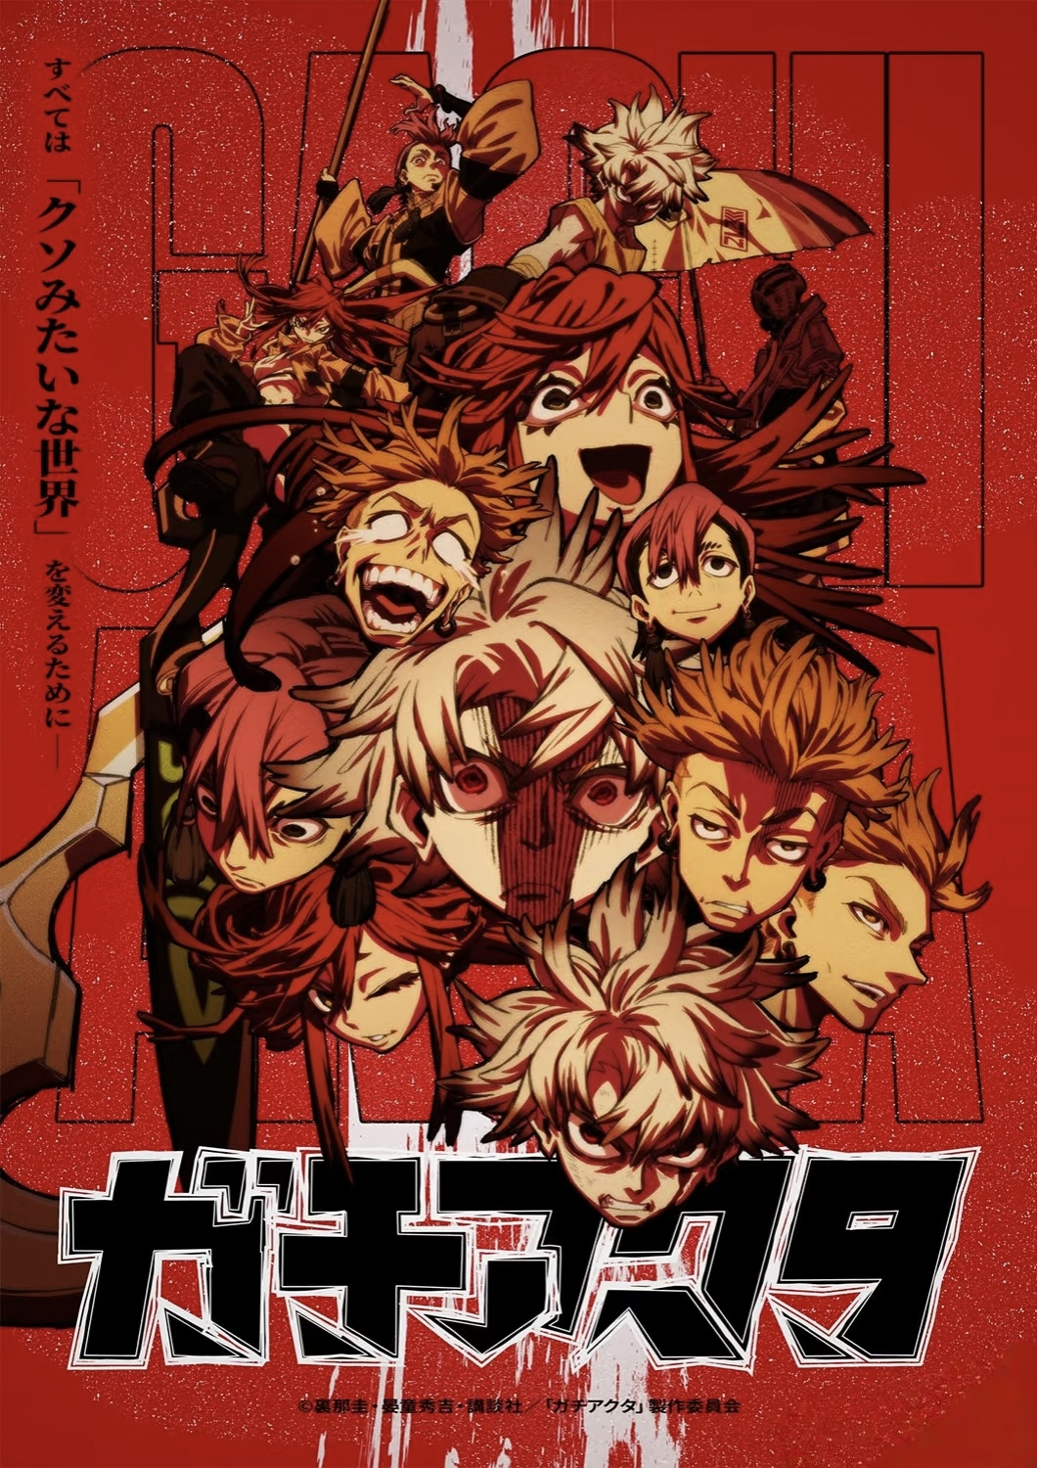
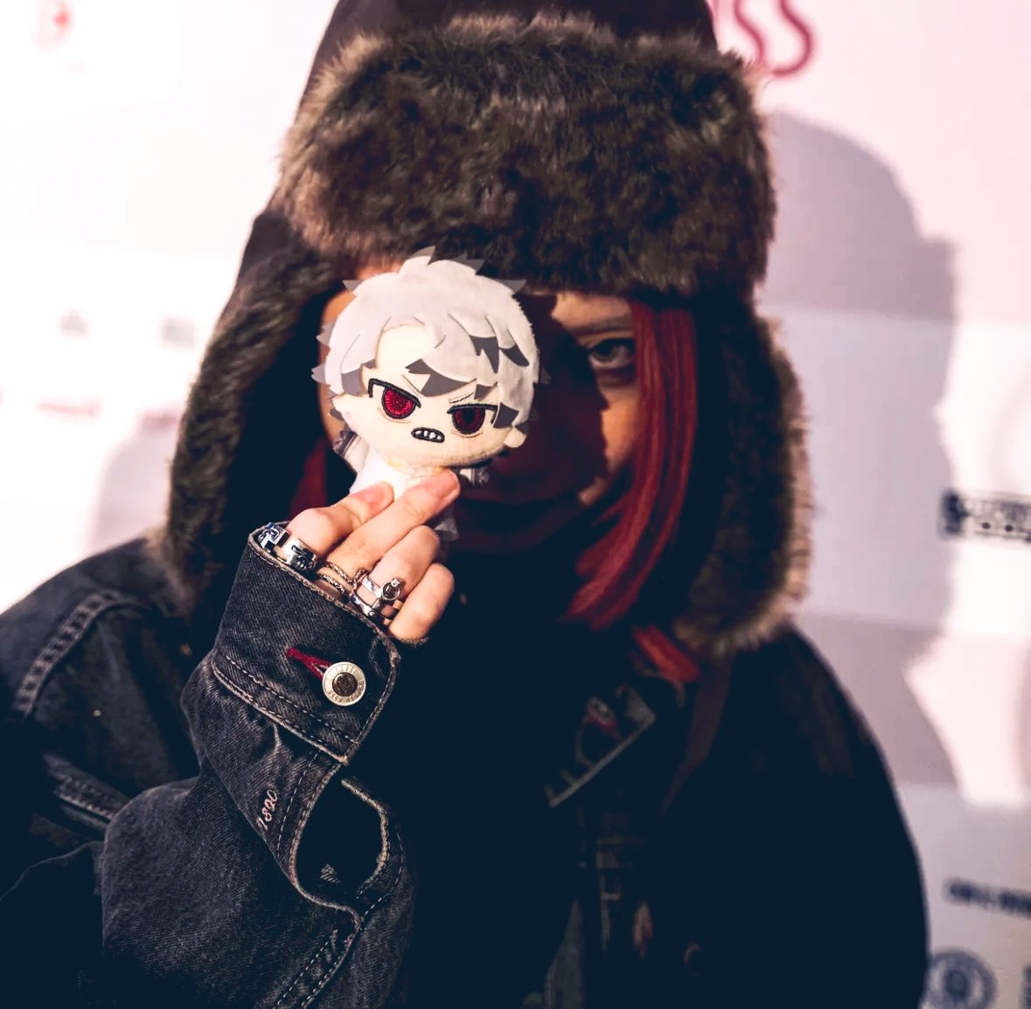
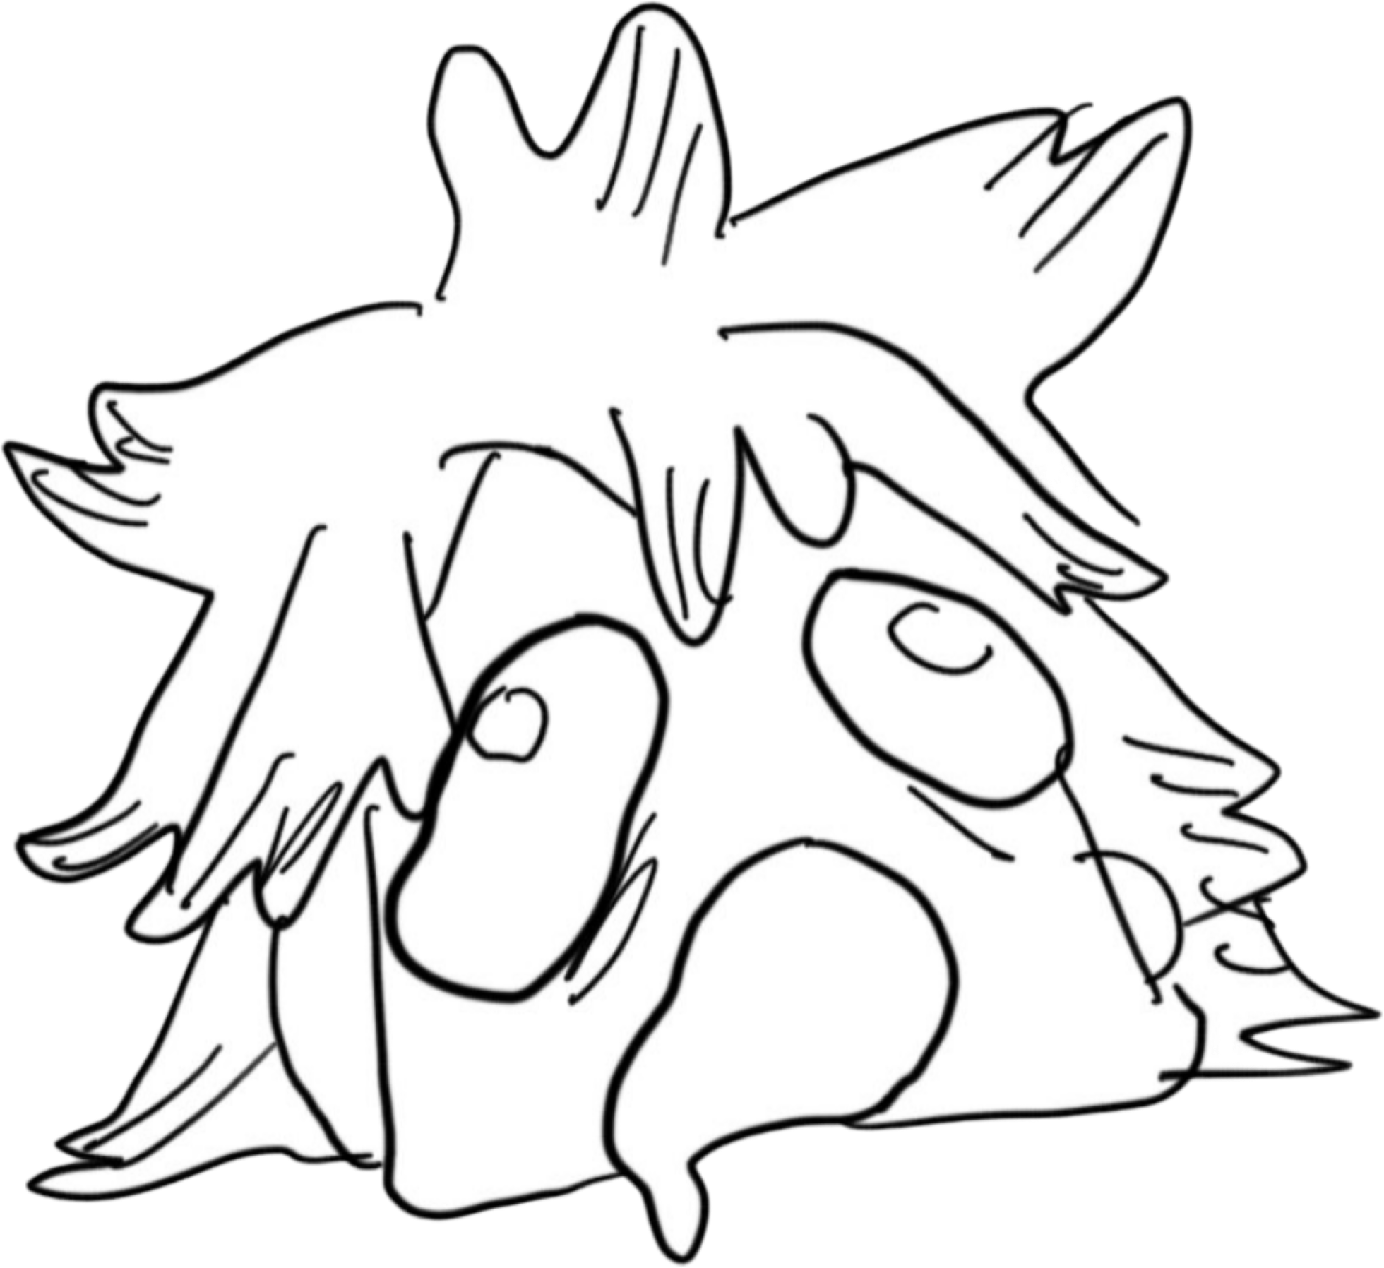
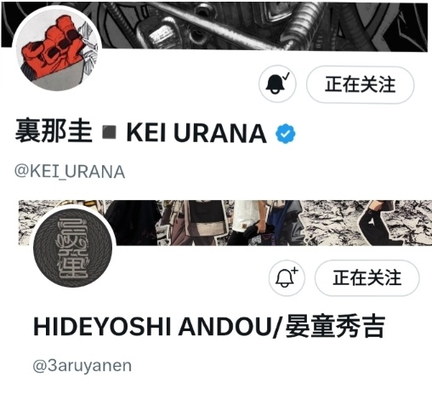
Gachiakuta is an action manga written and illustrated by manga artist Kei Urana With graffiti design by Hideyoshi Andou.
It began serialization in Kodansha’s Weekly Shōnen Magazine in February 2022 and won the Global Special Prize in the Comics category of the Next Manga Awards 2022.

Slide 3
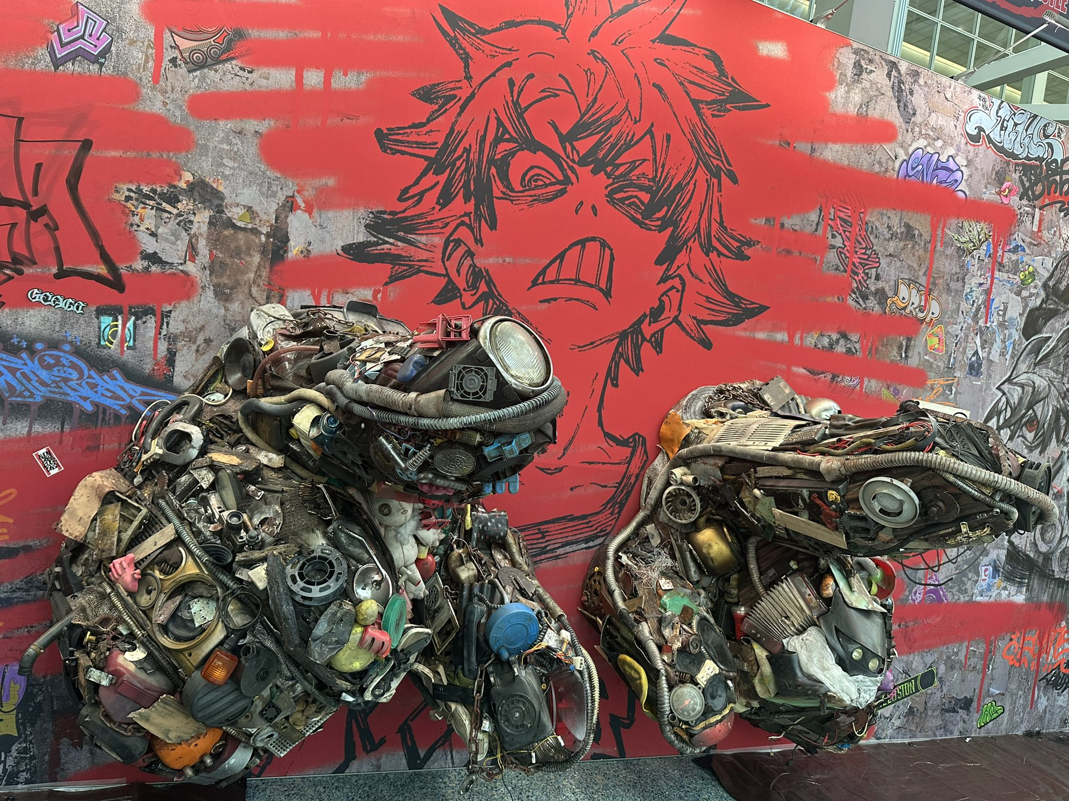
gachiakuta makes extensive use of graffiti art, post-apocalyptic punk art and trash art. It presents a picture with a strong sense of impact
Moreover, the character design is highly memorable, using changes in clothing to display the characters' experiences and changes in their moods
Crawl back from the abyss of Hell to change this lousy world!

Slide 4
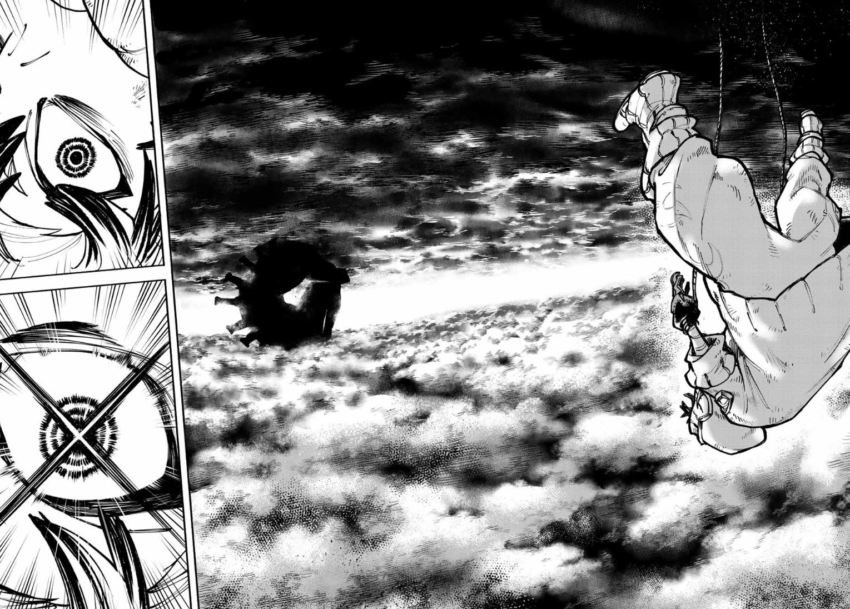
Rudo lives in the slums of a floating town, where the poor scrape by under the shadow of the rich who live a sumptuous life, simply casting their garbage off the side, into the abyss.
Then one day, he’s falsely accused of murder, and his wrongful conviction leads to an unimaginable punishment—exile off the edge, with the rest of the trash.

Slide 5
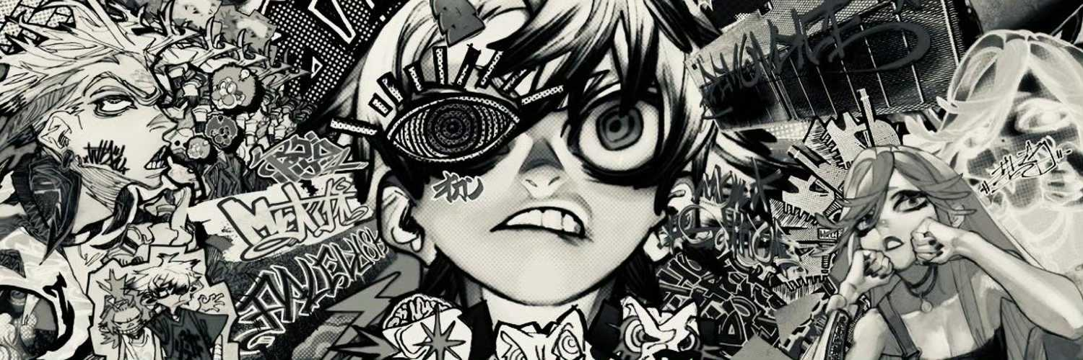
Down on the surface, the cast-off waste of humanity has bred vicious monsters, and if Rudo wants to have any hope of discovering the truth and seeking vengeance against those who cast him into Hell,
he will have to master a new power and join a group known as the Cleaners who battle the hulking trash beasts of the Pit!

Slide 6
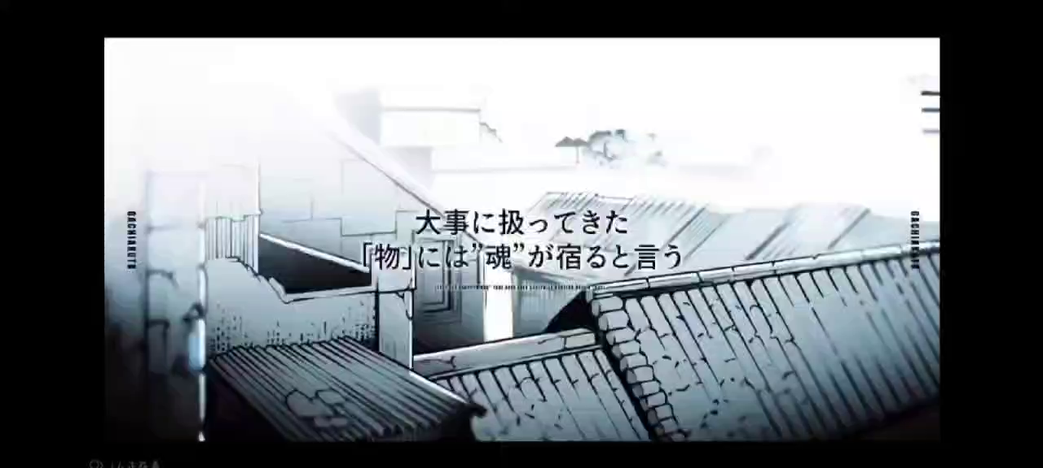

Slide 7

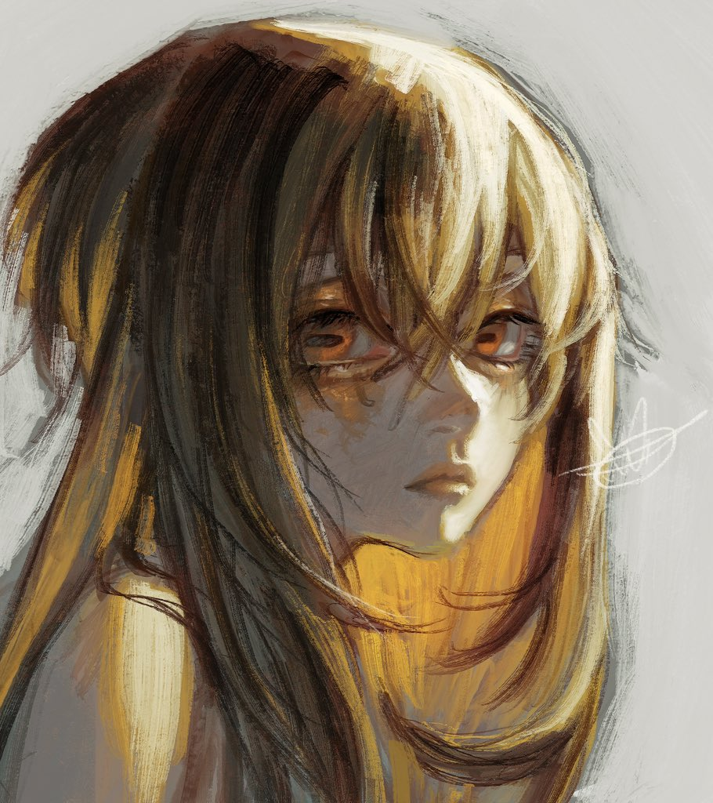
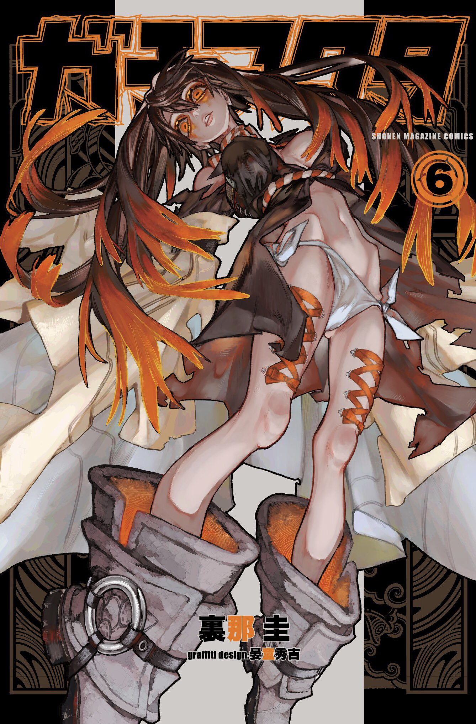

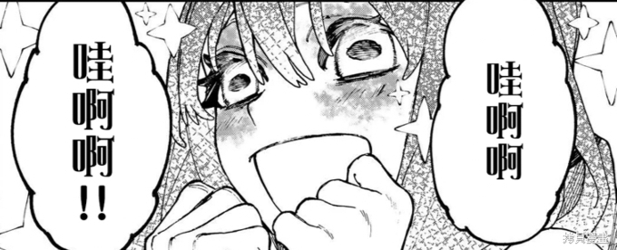
Angel in the Abyss——
꒰১ ♡ ໒꒱ Amo Empool
A girl who lives alone in a tower that rises out of the desert No Man's Land, Penta.
She wears shoes that have the same logo on them as
Rudo's gloves

Slide 8
