Slide 1
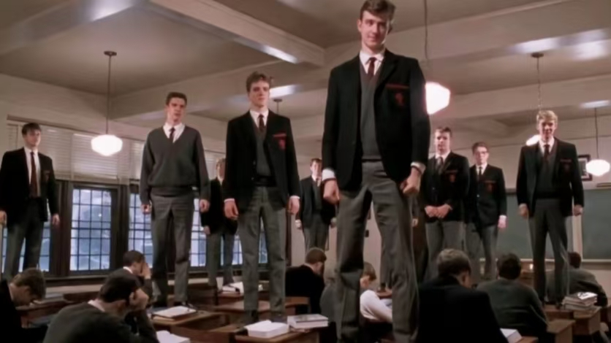
DEAD POETS SOCIETY

Slide 2


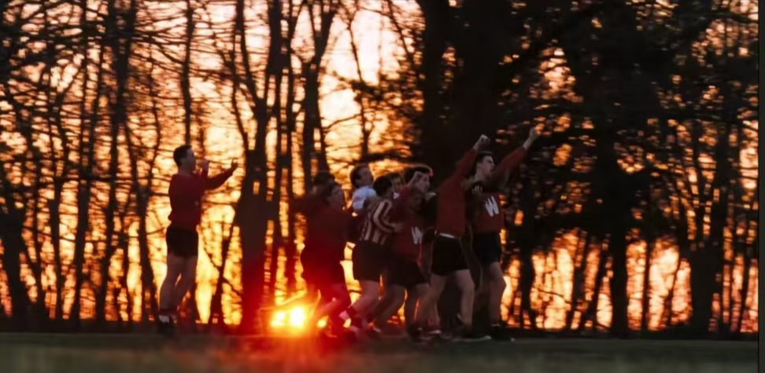
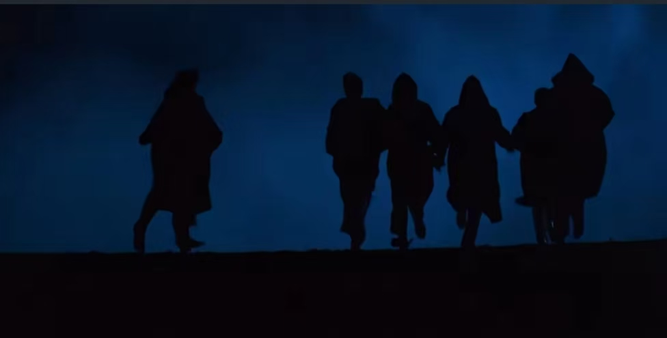
Basic Information
The movie is set in a traditional boy’s school in the late 1950s,where a group of reengers,guide by their new teacher Mr.Keating,break free from restructions and pursue their individuality and dreams.The frlm reflects the conflict between conservative and progressive forces in mid-20th century American society.The story is set in 1959,a time when the U.S. was at a crossroads between tarditional values and new liberal ideas.
Part1

Slide 3

Part 02
climax
Neil Perry is a young boy with a talent for acting ,but he lives in very controlling household.Encouraged by Mr.keating,Neil reignites his passion for theater and secretly participates in the school’s play.However, Neil’s father strongly opposes his paticipation in the play.Eventually,under the heavy pressure form his family and the shattering of his dreams, Neil chooses to take his own life.To calm things down,the school places the blame on Mr.Keating.In the flim’s final scene Mr.Keating is made to leave the school.As he packs up to leave the classroom,Todd leading the other students,stands on his desk and calls out “O Captain!My Captain!”

Slide 4


Slide 5

Part 03
The classic lines
I went to the woods because I want to live deliberately.I want to live deep and suck out all the marrow of life.
我步入丛林，因为我希望生活有意义。我希望活得深刻，汲取生命所以的精髓。
No matter what anybody tells you,words and ideas can change the word.
不管别人怎么说，文字和思想的确能改变世界。

