Slide 1
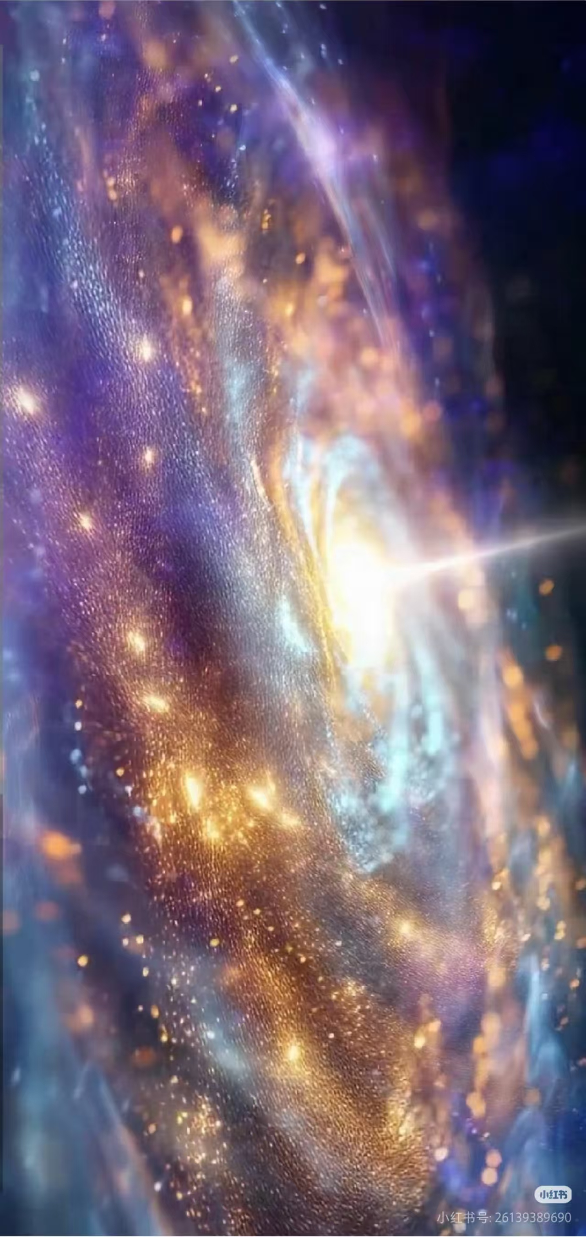
Swallowed Star
吞噬星空

Slide 2
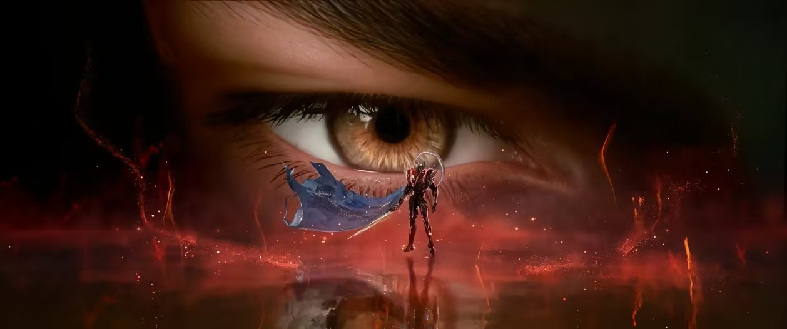
The Earth arc of "Swallowed Star" is like the overture to a grand cosmic symphony, unfolding a magnificent epic of survival, dignity, and evolution upon the cradle of human civilization. What is most awe-inspiring
《吞噬星空》地球篇犹如一曲宏大宇宙交响曲的序章，在人类文明的摇篮上，演绎了一场关于生存、尊严与进化的壮丽史诗。这部作品最令人震撼的，不是那些毁天灭地的战斗场面，而是它揭示了这样一个真理：人类最伟大的武器，不是任何科技，而是那种直面深渊却依然仰望星空的不屈意志

Slide 3
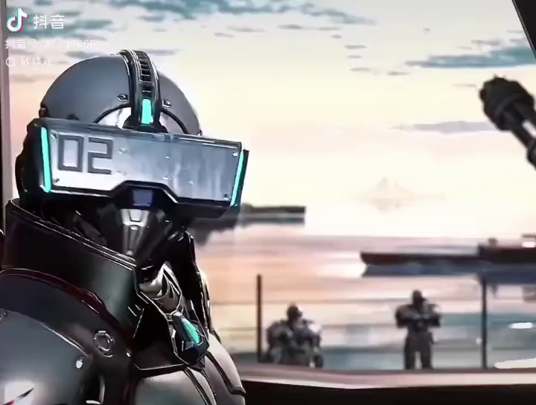

Slide 4
This perfectly embodies the significance of a community with a shared future for mankind—in the face of disasters, it is only through the collective efforts of all humanity that solutions can be found, rather than resorting to endless external conflicts.
这完美诠释人类命运共同体重要作用，在灾难面前，唯有全人类共同努力才能解决，而不是一味对外战争。

Slide 5


感谢观看

