Slide 1


Slide 2
How To Enjoy Desserts Without The Guilt
汇报人：王心怡

Slide 3
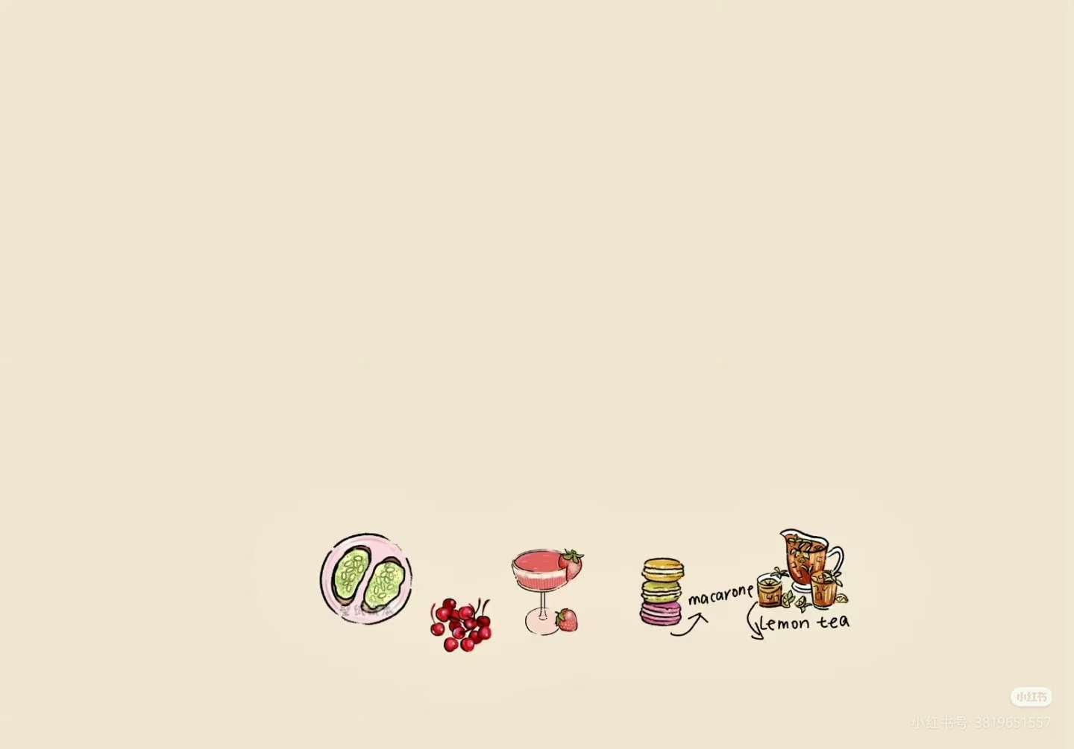
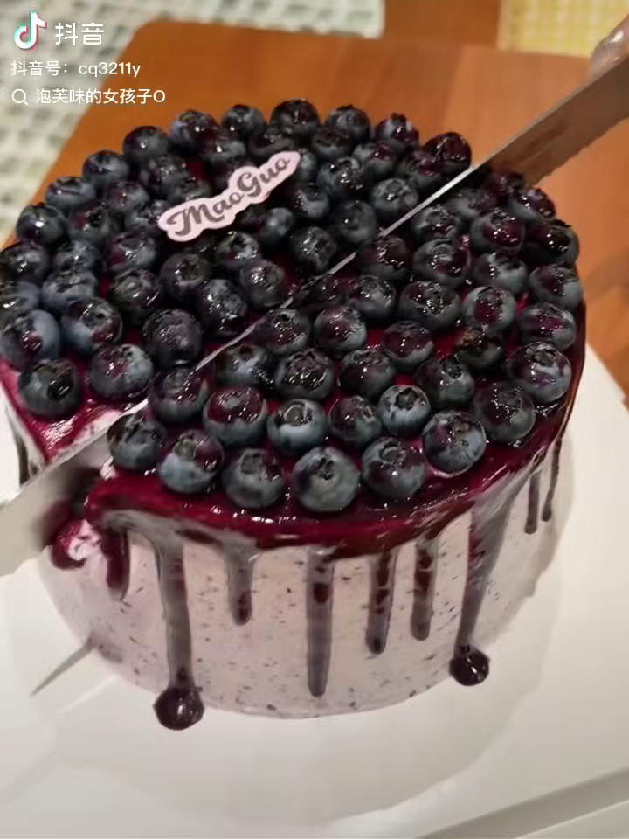
压力大的时候就应该吃甜品！因为stressed倒反过来就是desserts

Slide 4
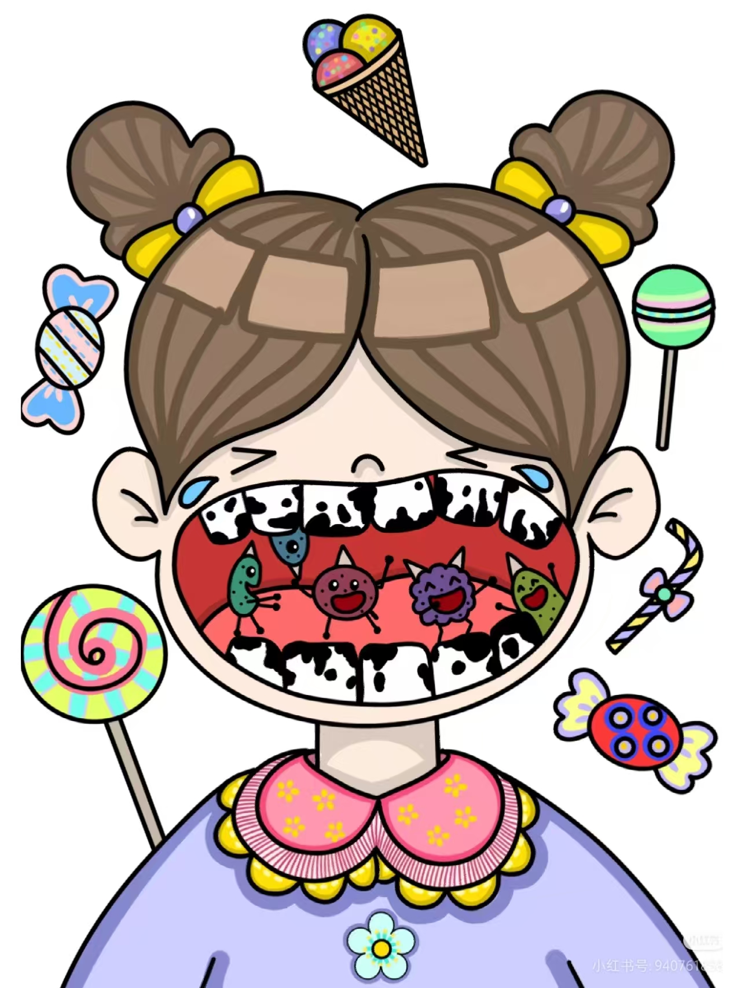
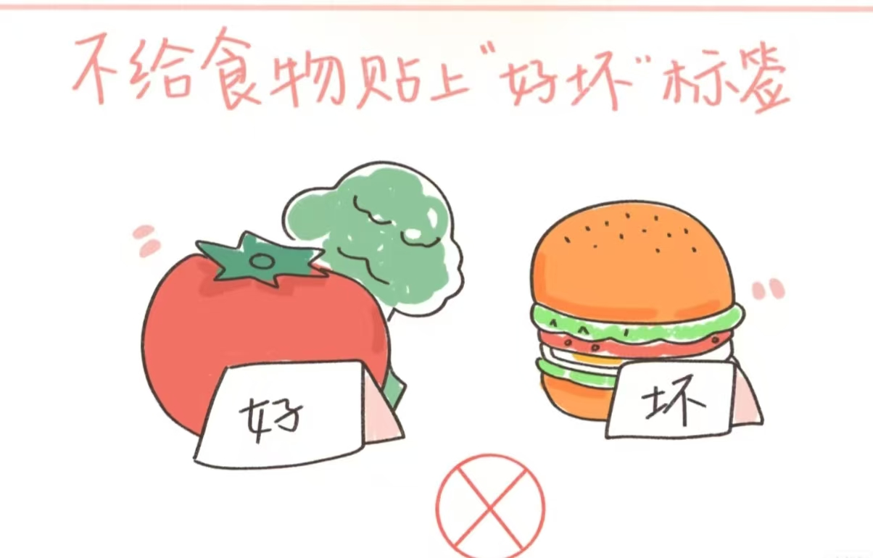
Childhood experiences often shape how we relate to sweets, influencing our attitudes well into adulthood.
Many adults internalize messages such as: you must "earn" dessert, indulgence is wrong, or cravings signal lack of self-control.Early feeding practices, societal norms, and marketing labels that classify foods as "good" or "bad" reinforce these beliefs.

Slide 5


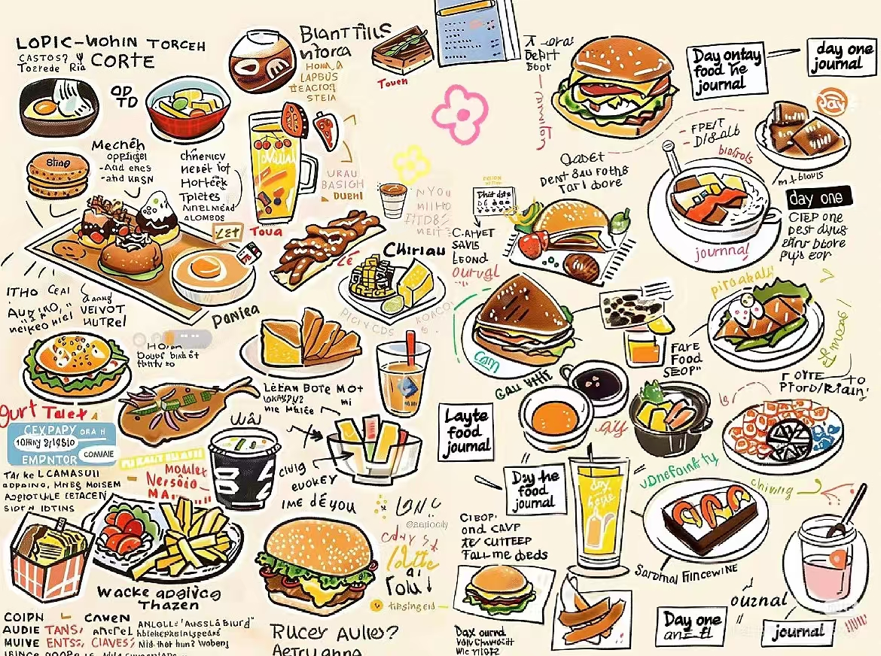



Research shows that strict dietary restraint can paradoxically fuel compulsive eating rather than prevent it, creating a cycle of guilt and overindulgence.

Slide 6

Instead of avoiding Halloween candy or other treats, integrate small portions into meals intentionally.
Planning indulgences reduces anxiety, while removing moral labels like "good" or "bad" frees individuals to enjoy foods they truly desire. Keeping favorites accessible also helps counter the scarcity mindset, which often amplifies cravings and stress.
Registered dietitian Dawn Clifford recommends a mindful and structured approach to overcome these patterns.
Mindful eating enhances satisfaction and control.By paying attention to flavor, texture, aroma, and the overall eating experience, people can experience heightened awareness and enjoyment.

Slide 7
significance
This approach fosters moderation, self-compassion, and curiosity, turning dessert from a source of guilt into an opportunity for pleasure.Over time, mindful indulgence strengthens a balanced relationship with food and reduces the likelihood of binge episodes
Incorporating these strategies encourages healthier, sustainable eating habits.It empowers individuals to embrace dessert without shame while maintaining overall nutritional balance.
By combining mindful choices with self-compassion, desserts become a guilt-free, enjoyable part of life, supporting both psychological and physical well-being.

Slide 8

Ultimately, the goal is to transform lifelong patterns of food-related stress into habits of joy, balance, and conscious indulgence.

Slide 9
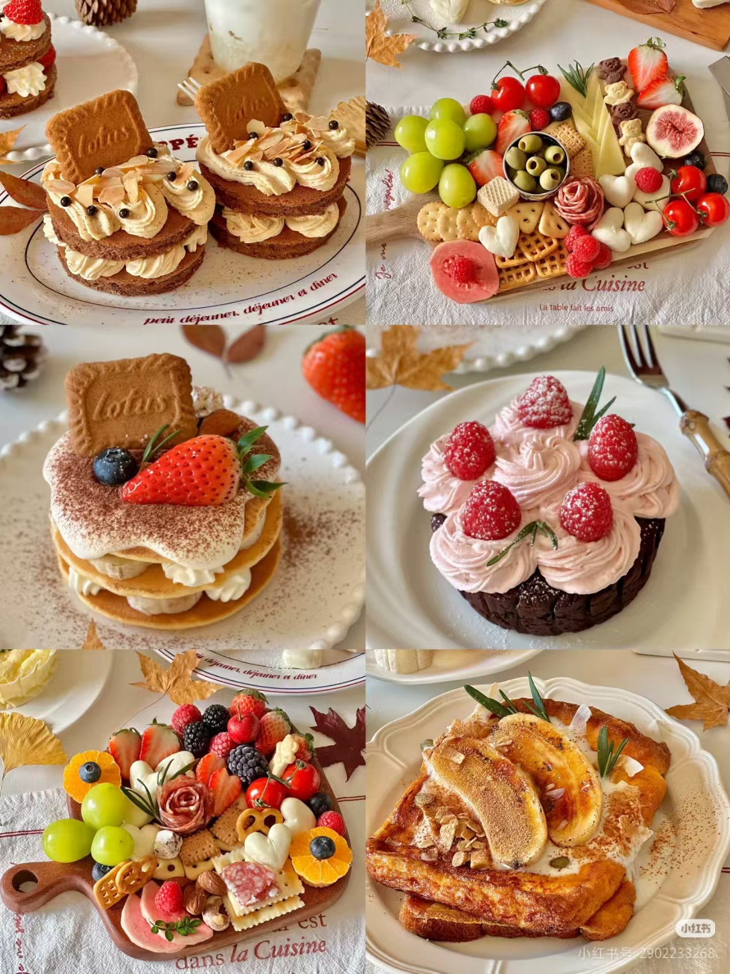
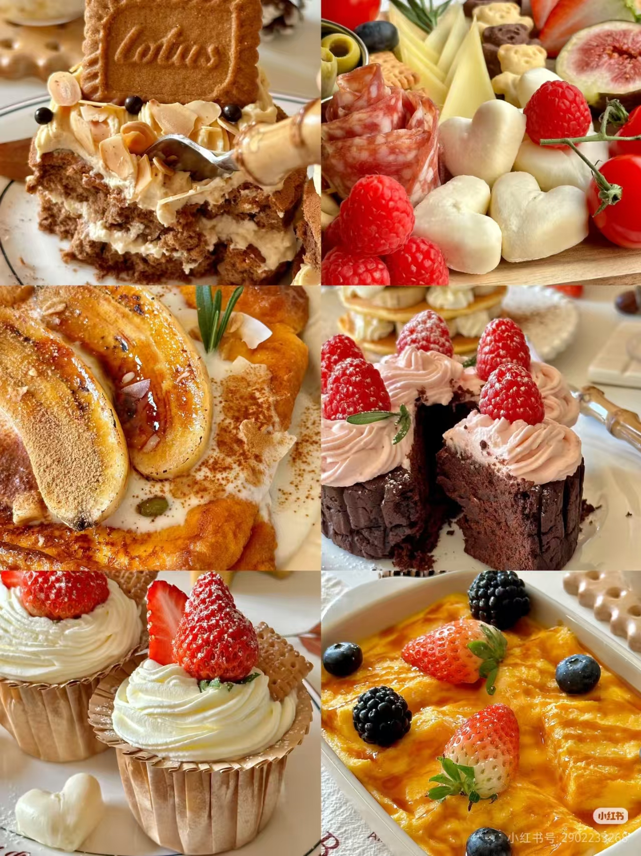
Thanks

