Slide 1
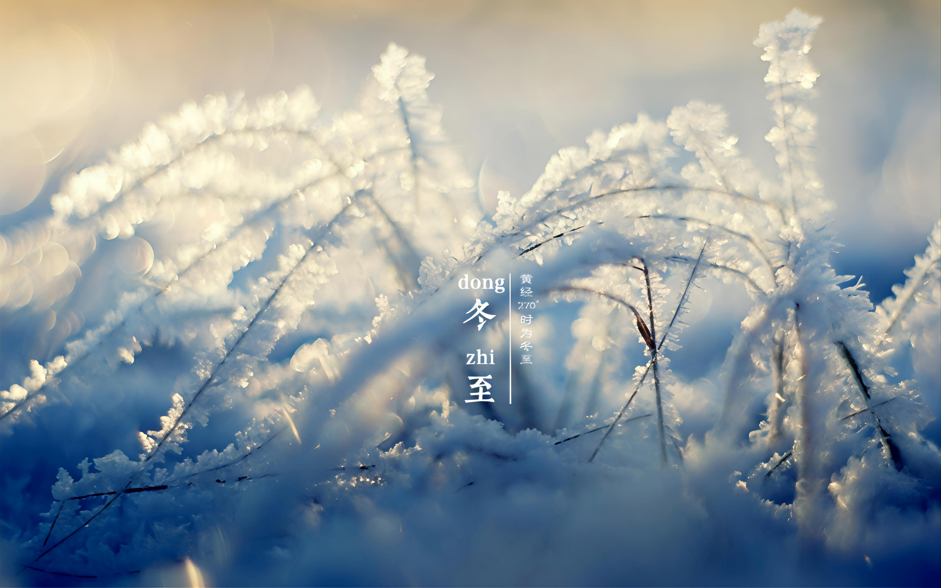
Winter Solstice
A Warm traditional Chinese Festival
——四班郭嘉乐

Slide 2
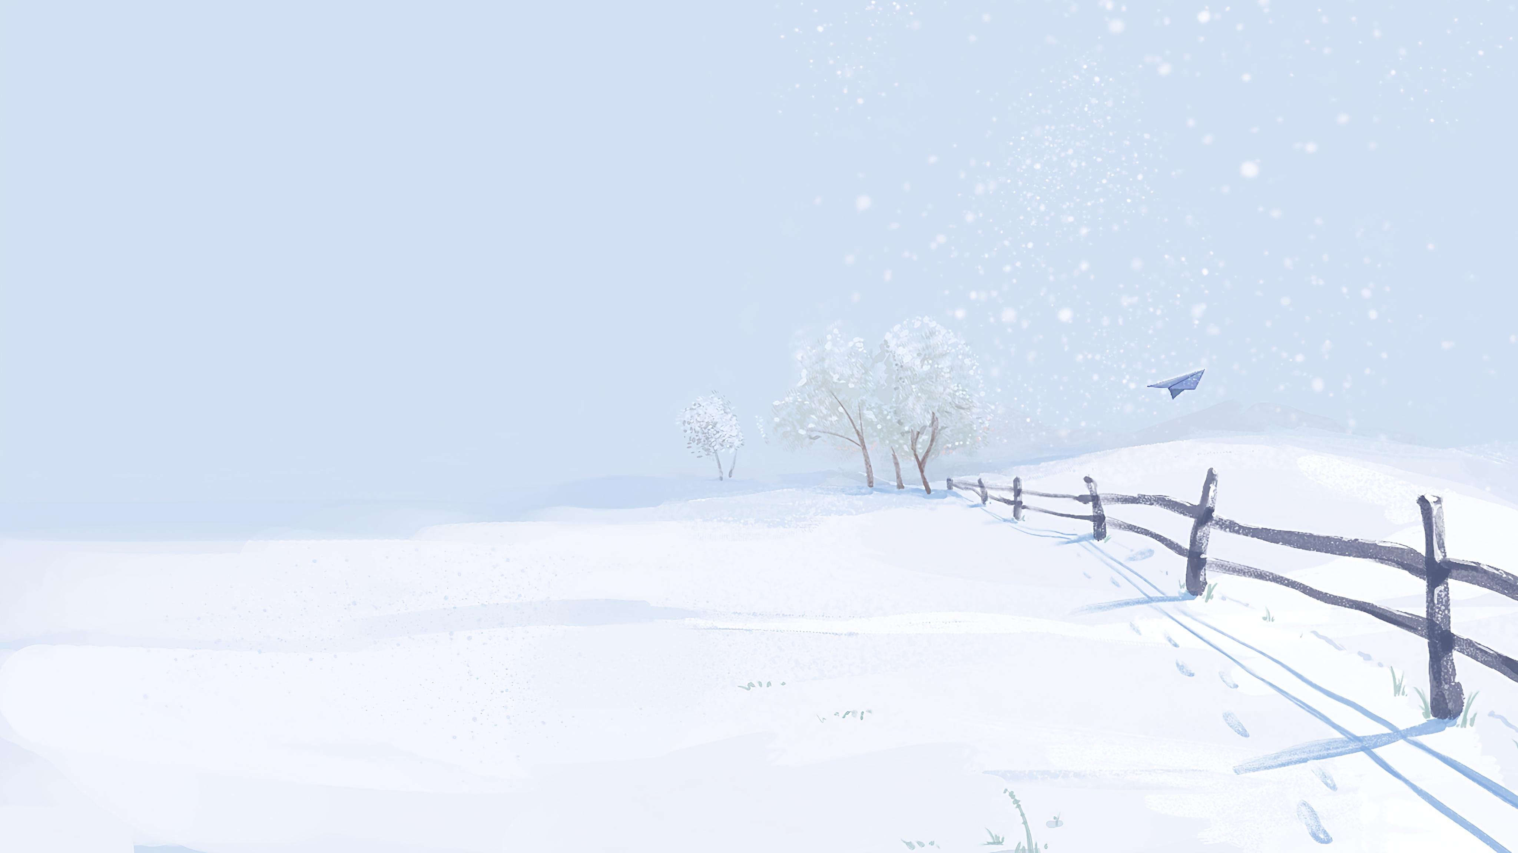
Basic Introduction to the Winter Solstice
The Winter Solstice is an important traditional festival in China. It is also one of the 24 solar terms. It usually comes between December 21st and 23rd every year, and most often on December 22nd. On this day, in the Northern Hemisphere, the day is the shortest and the night is the longest. After the Winter Solstice, the days get longer little by little, and the nights get shorter slowly. Ancient people thought it was very important. There is a famous saying: "The Winter Solstice is as important as the Spring Festival." It stands for warm family gatherings and is a meaningful day in winter.

Slide 3
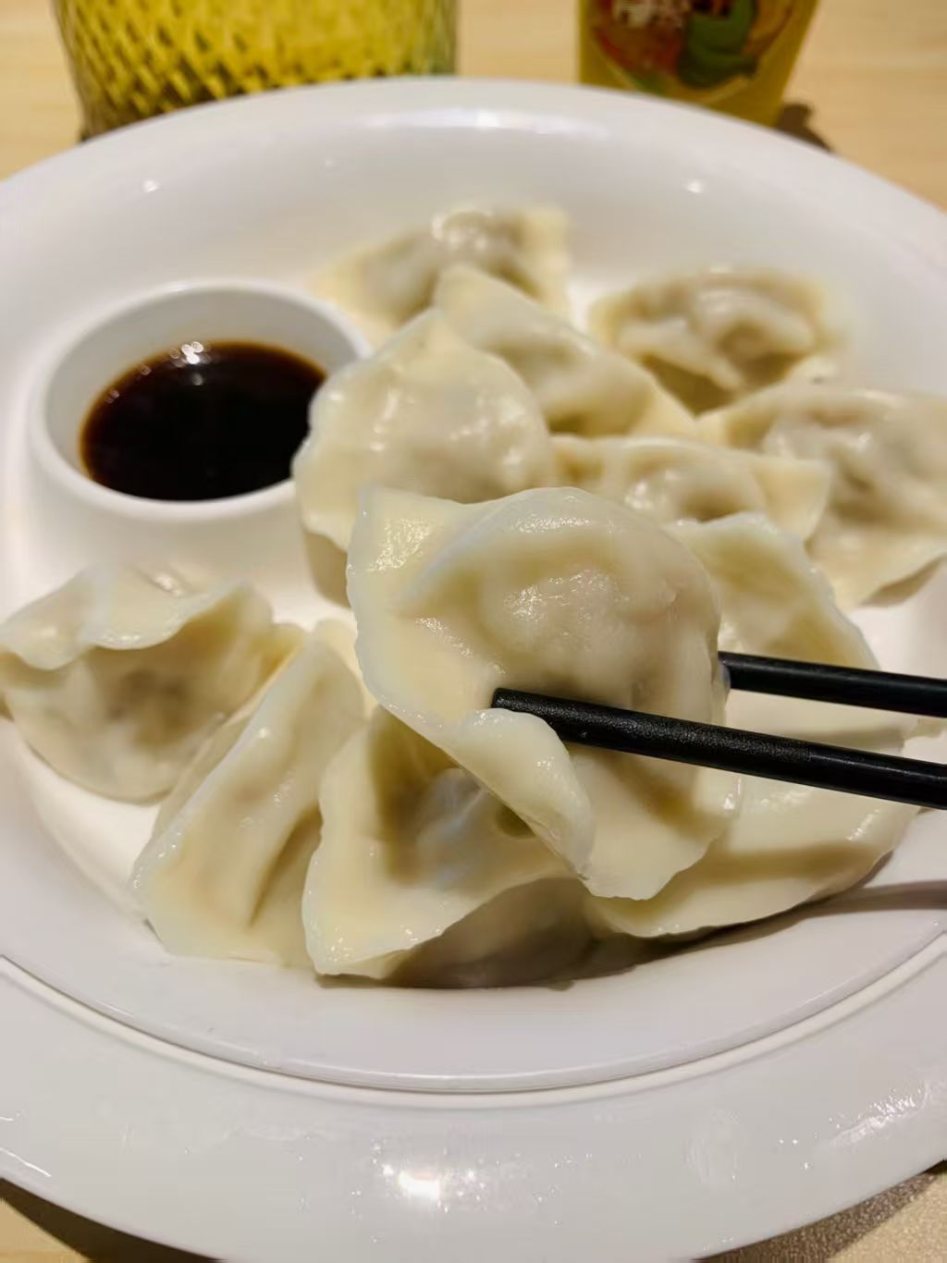
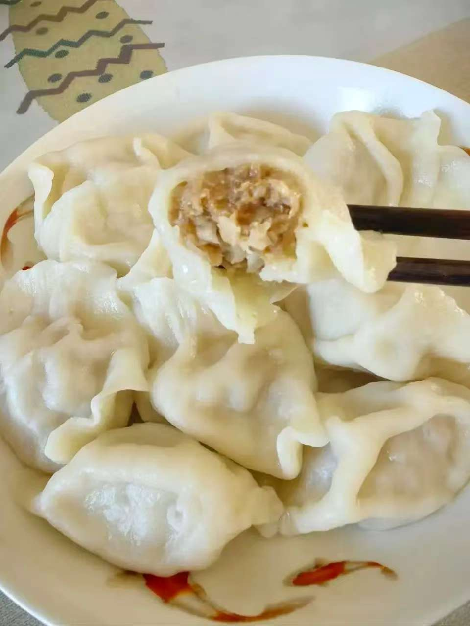
Special Customs of the Winter Solstice in Various Regions
On the Winter Solstice, there are different traditional customs in different parts of China. The main thing is to eat special food, which means warmth and reunion.
Northern China: People usually eat dumplings. Families often make dumplings together. There are many kinds of tastes. It’s lively and warm. People also say eating dumplings can keep warm on this day.

Slide 4
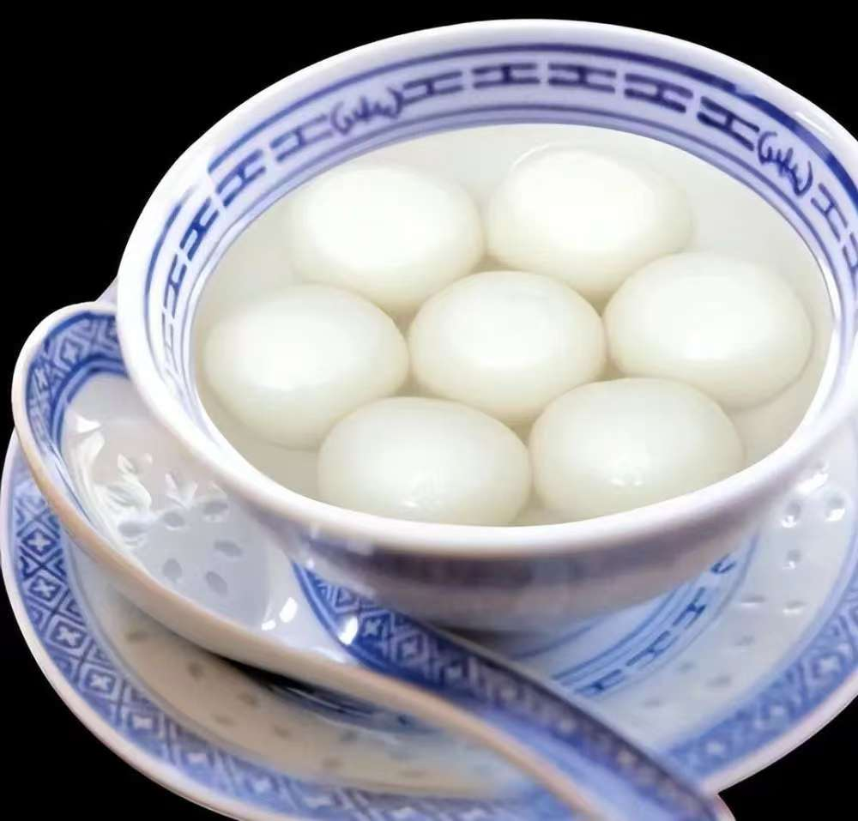
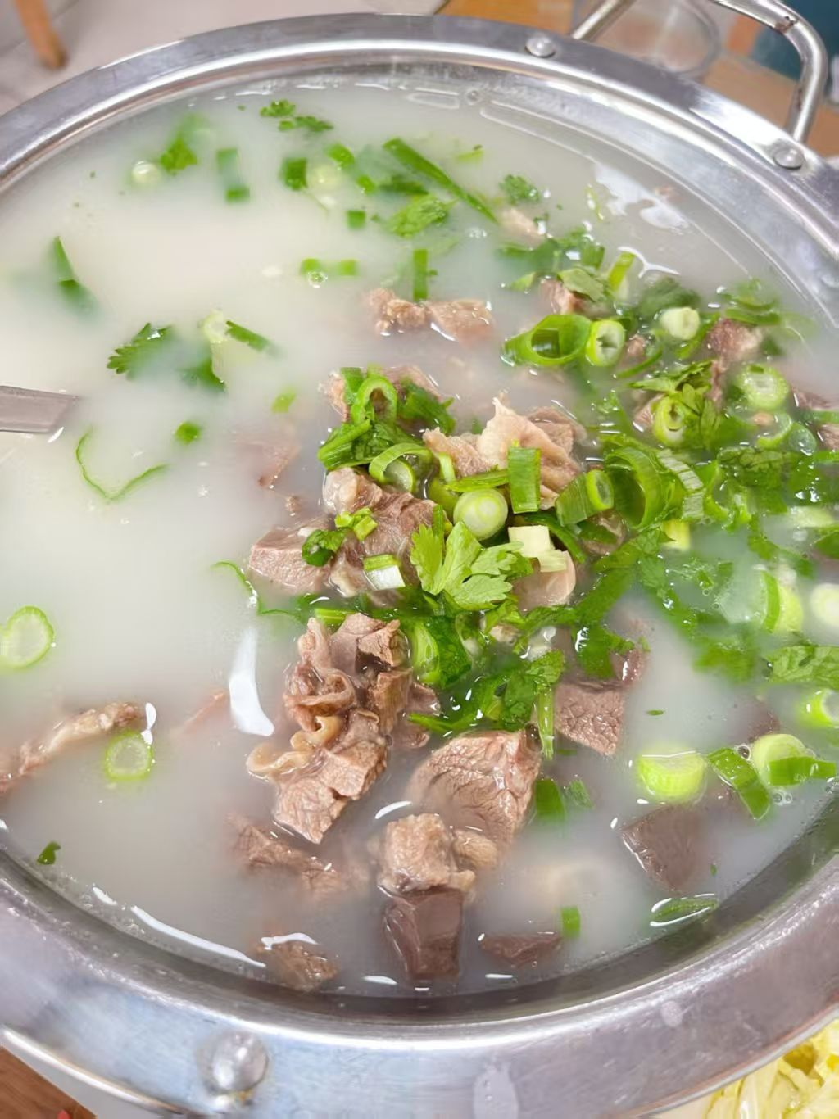
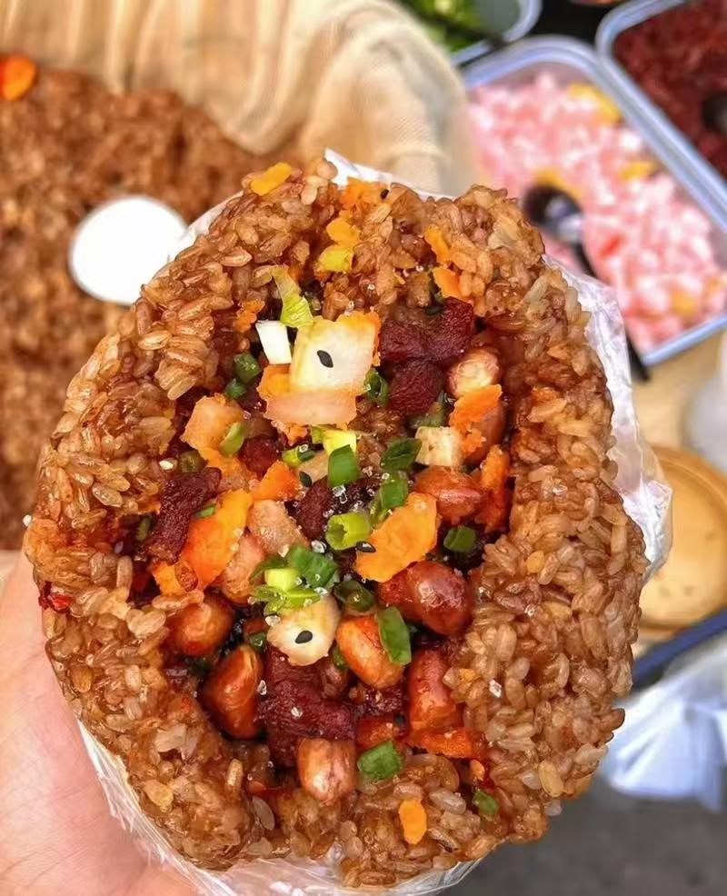
Special Customs of the Winter Solstice in Various Regions
Southern China: People mainly eat tangyuan. Tangyuan is round, which stands for family reunion and happiness. It tastes soft and sweet. Many families make tangyuan together and enjoy the happy time.
Other special customs: In some places, people also drink mutton soup or eat glutinous rice. They can keep away the cold in winter and carry good wishes for life.

Slide 5
Conclusion
The Winter Solstice is not only an important solar term, but also a warm traditional festival, carrying Chinese people's expectation for reunion. Customs vary in different regions, but the core is to pass warmth and beauty, which is the unique charm of the Winter Solstice. May warmth always be with you, and wish everyone peace, well-being and joy on the Winter Solstice!

Slide 6
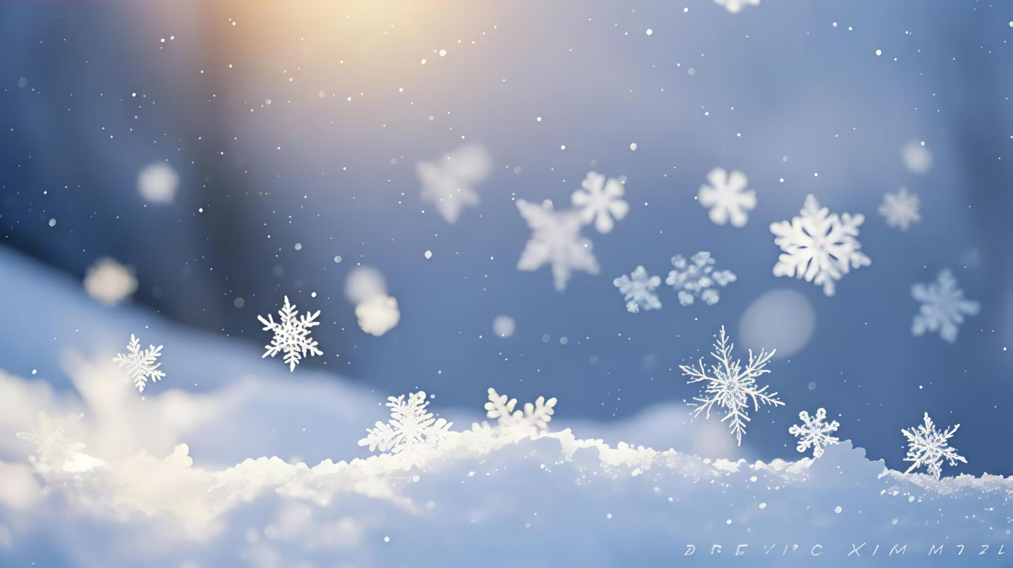
Thank you for listening！

