Slide 1
TRAVEL
STANDARD TEMPLATE
TRAVEL
辛卓航
OfficePLUS

Slide 2
CONTENTS
What is the travel?…
Why do we travel?…
The conclusion…

Slide 3
What is the travel?
/01
.

Slide 4
​
Travel is a trip away from home for a while — to explore, experience or grow, no matter how far it is.
旅行，是为探索、体验或成长，暂时离开常住地的出行过程，无关距离长短
Travel is leaving with curiosity, and meeting new views and your true self in a new place.
旅行是带着好奇出发，在陌生的境遇里，遇见新的风景与真实的自己。
Travel is a small adventure outside daily life — measure the world with your feet and feel beauty with your heart.
旅行是跳出日常的小冒险，用脚步丈量世界，用心灵感受美好。

Slide 5
/02 Why do we travel?

Slide 6
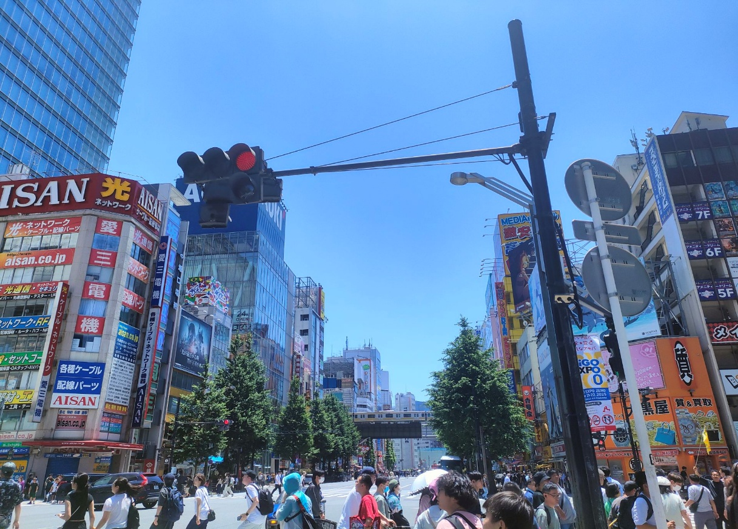
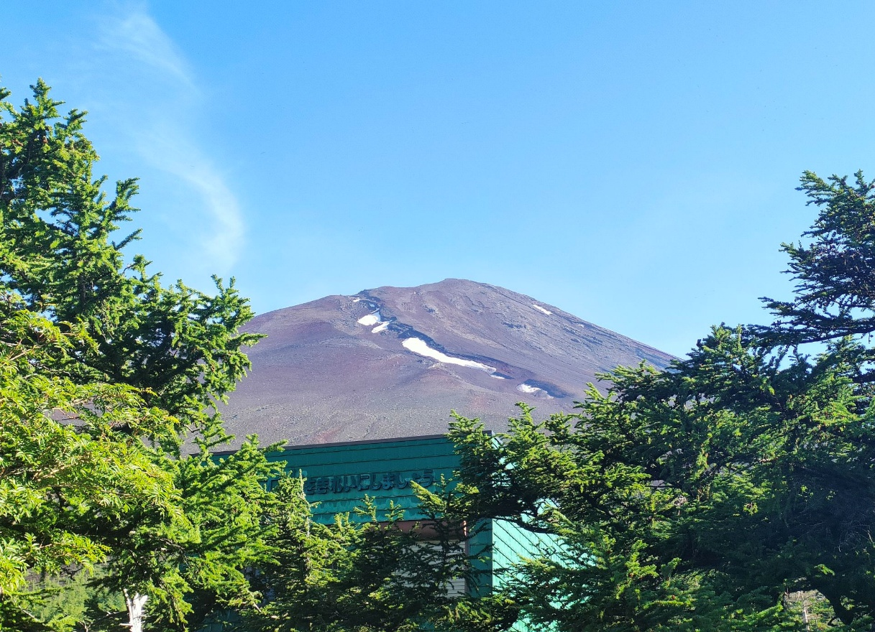
歌德：People love traveling not to get to the end, but to enjoy the good things along the way
人们热爱旅行，不是为了到达终点，而是为了享受沿途的美好事物。
。

Slide 7
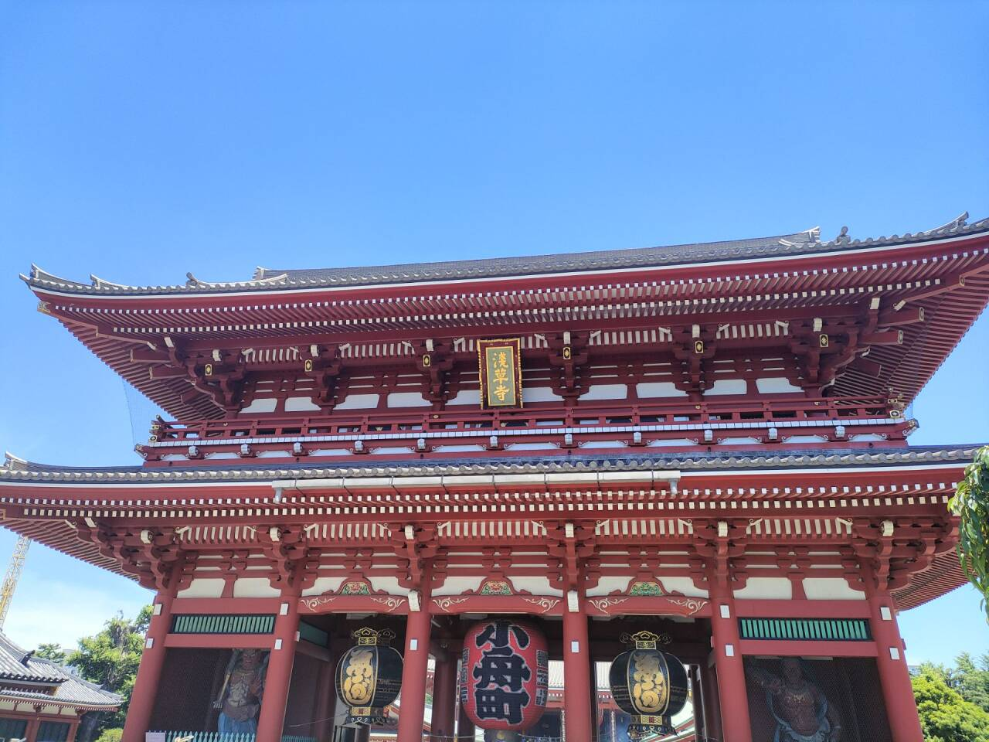
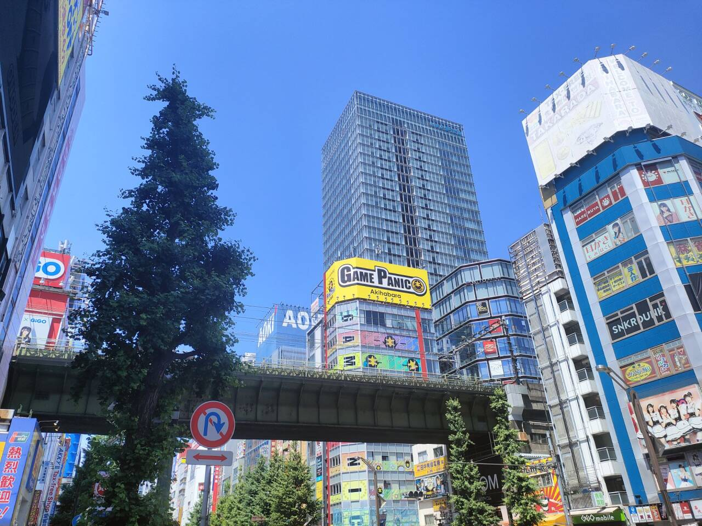
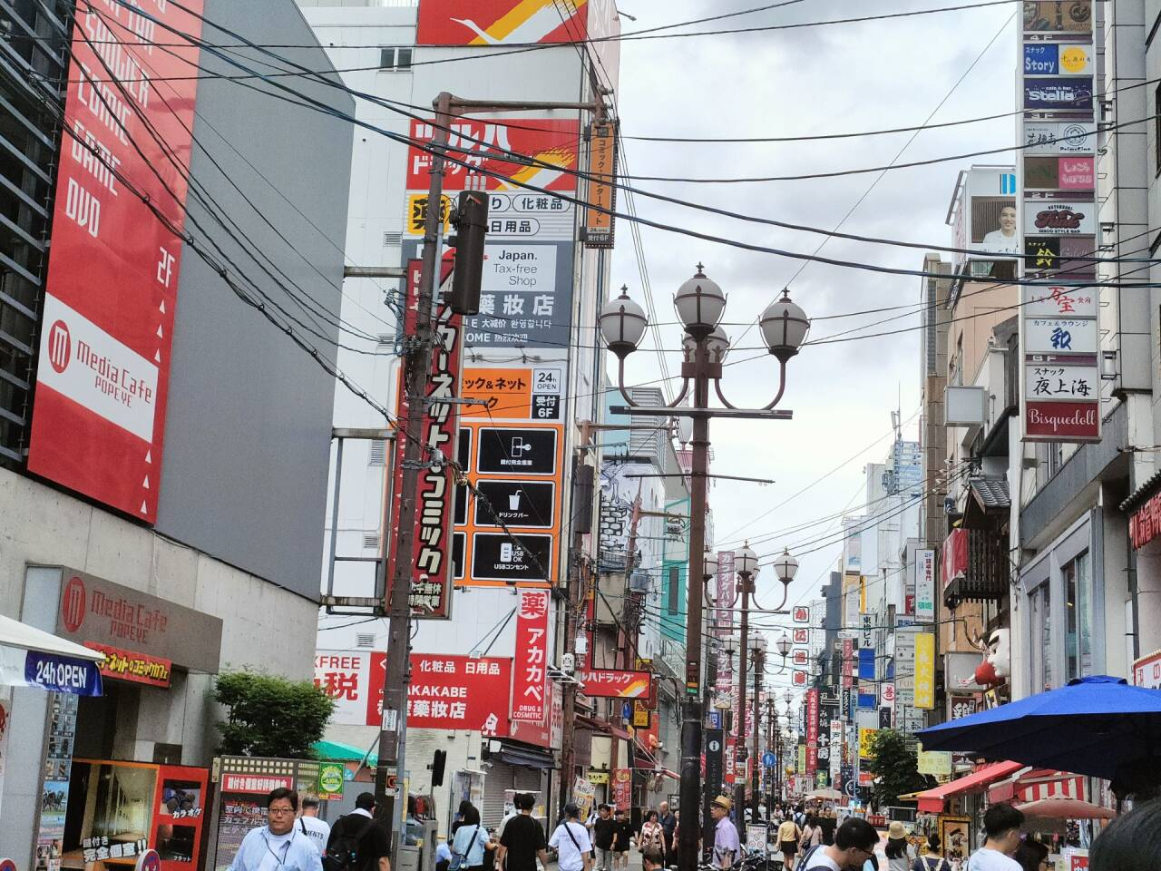
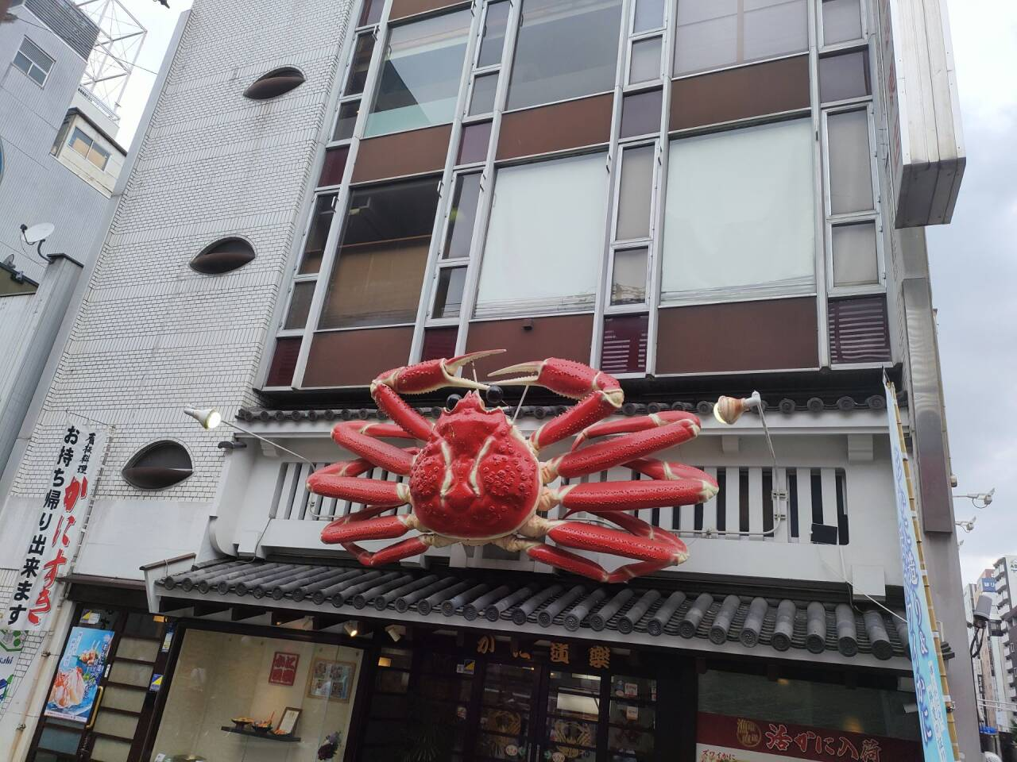

Slide 8
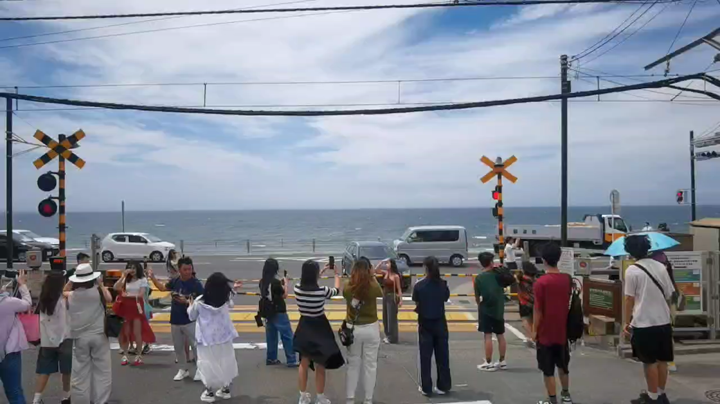
雨果：Life is like a trip. Your dream is the path of the trip. If you lose the path, you have to stop.​
生活就像一场旅行，梦想是旅行的道路。如果失去了道路，你就不得不停下来。

Slide 9
The conclusion
/03

Slide 10
The meaning of travel is never just about how many views you see or how far you go. It’s more about stepping out of your daily routine, learning to welcome the unknown with curiosity, accept differences with openness, and treat life with passion. May we carry the breadth and enthusiasm from travel, live every ordinary day to the fullest, always move forward with a positive attitude, and enjoy every gift of life with optimism.

Slide 11
Thank you for listening
Xin zhuo hang
2025.11

