Slide 1
Winter Solstice
2025/12/
冬至
汇报人：李一非

Slide 2
目录
01
Introduction to Winter Solstice
介绍冬至
02
CONTENTS
Cultural Traditions
冬至传统

Slide 3
Introduction to Winter Solstice
01

Slide 4
01
Understanding the Winter Solstice
The Winter Solstice is the shortest day and longest night of the year, marking a significant astronomical event in the Northern Hemisphere.
昼短夜长
02
Cultural and Historical Significance
Many cultures celebrate the Winter Solstice, recognizing it as a time of rebirth and renewal, symbolizing the return of longer days.
象征重生与焕新 寓意白昼渐长
03
Modern Celebrations and Traditions
Contemporary Winter Solstice celebrations often include lighting candles, sharing meals, and participating in festive activities to honor the occasion.
点蜡烛 吃饺子

Slide 5
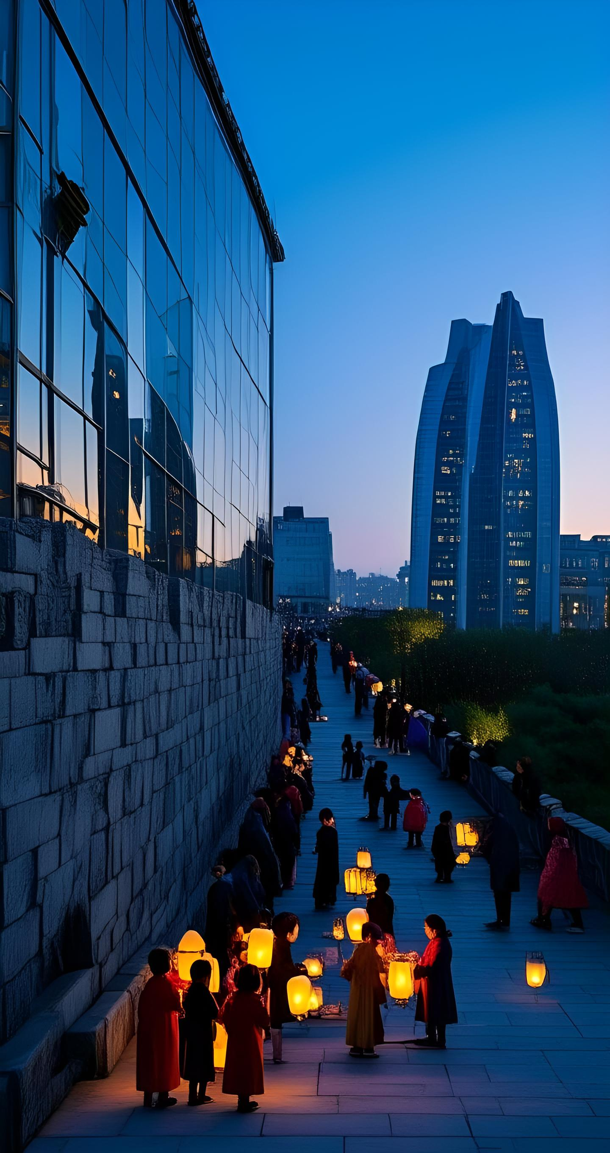
Historical Background
起源
Origins of Winter Solstice Celebrations
Explore the ancient origins of Winter Solstice celebrations, which date back to Neolithic times and were significant in various cultures.
Cultural Significance in Different Civilizations
文化意义
Discuss how different ancient civilizations, such as the Chinese, Romans, and Nordic peoples, celebrated the Winter Solstice and its cultural importance.
Modern Interpretations and Festivities
Examine how the Winter Solstice is observed today, including modern festivities and traditions that have evolved from historical practices.

Slide 6
Cultural Traditions
02

Slide 7
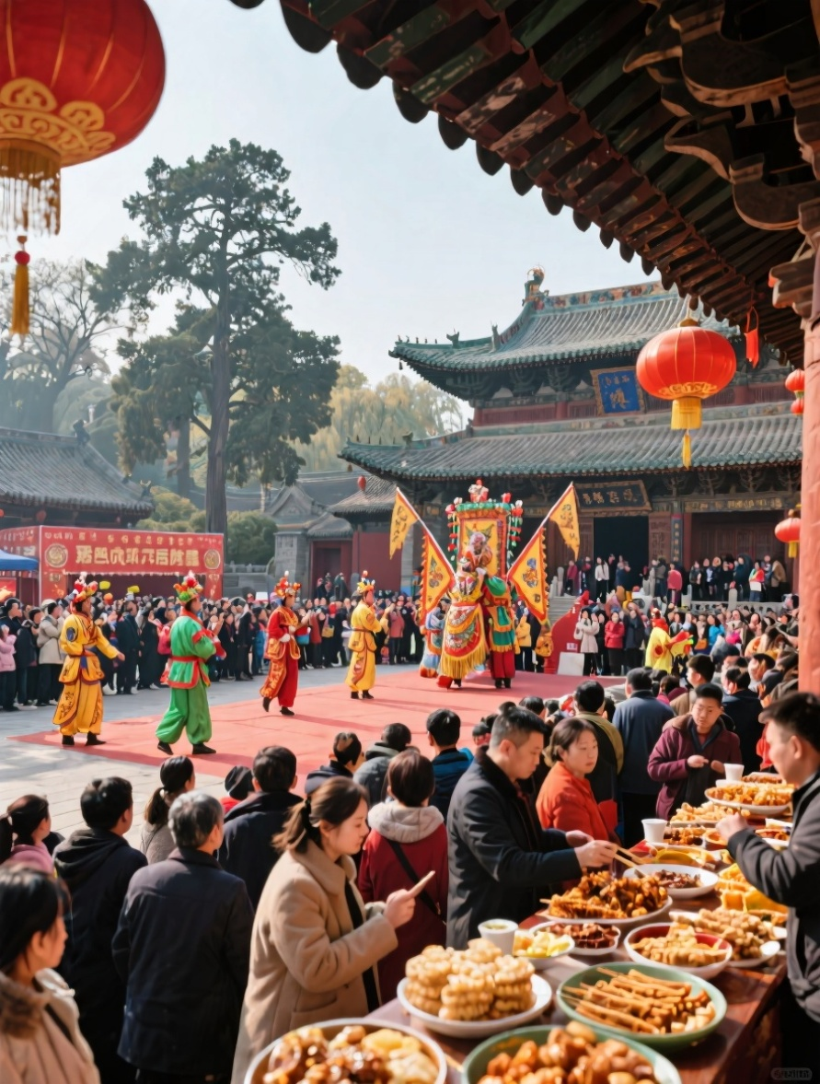
Customs Around the World
Winter Solstice Celebrations in China
The Chinese celebrate the Winter Solstice with family reunions, eating dumplings, and participating in traditional customs like ancestor worship.
Yule Log Tradition in Europe
欧洲圣诞原木传统
In various European countries, the Yule log is burned to symbolize the return of the sun and ward off evil spirits during the darkest time of the year.
Makha Bucha Day in Thailand
泰国马哈布查节
Makha Bucha Day, a Buddhist（佛教） festival, is observed with candlelit processions and offerings to pay homage to the teachings of Buddha on the full moon of the third lunar month.
农历三月的满月之夜，人们会举行烛光游行并进行供奉

Slide 8
谢谢
THE END

