Slide 1
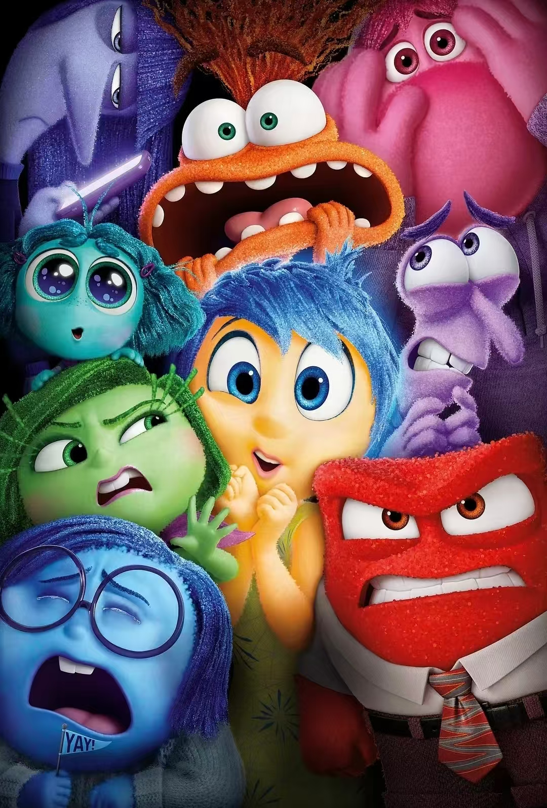
Inside Out
– A Journey of Emotions

Slide 2
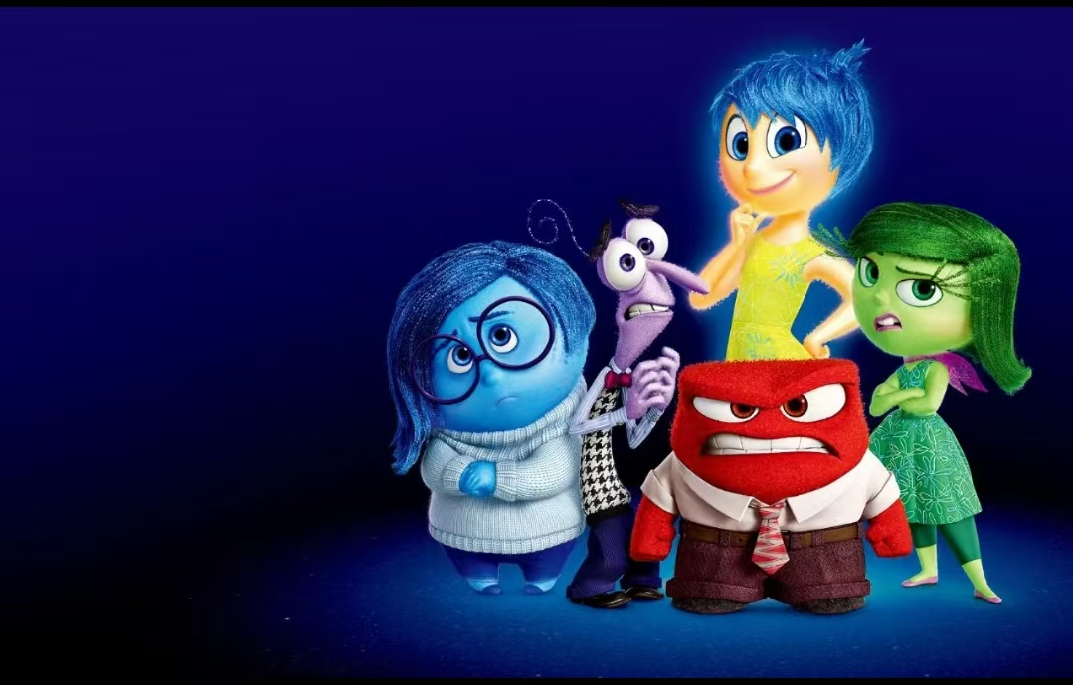
Film introduction
Inside Out combines brain science with vivid imagination to create a wonderful mental world, using emotional characters to intuitively show how emotions, memories and growth work in the brain. Emotions cannot be simply added or subtracted; growth is about embracing complexity and all feelings, as suppressed emotions will eventually erupt extremely. Sadness is not the opposite of joy but the foundation for joy to take root in reality, and accepting and understanding sadness is the right way.

Slide 3
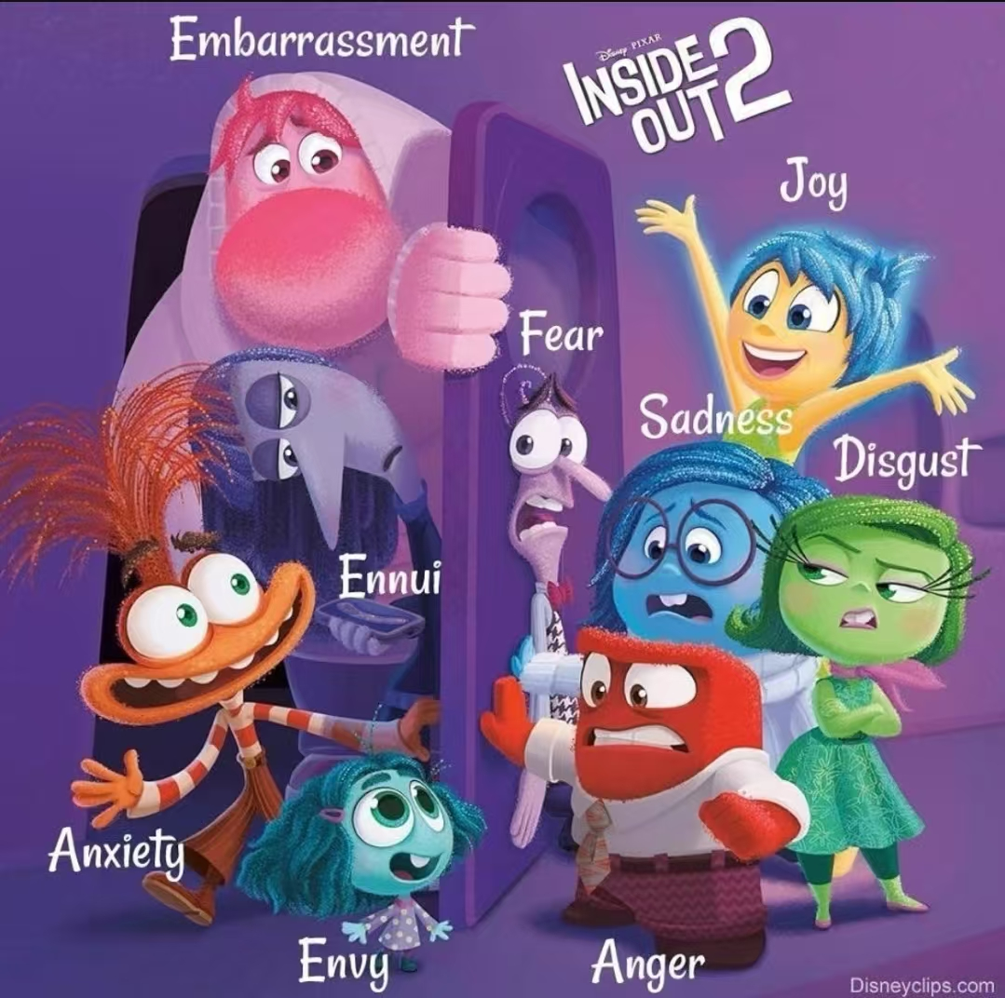

Slide 4
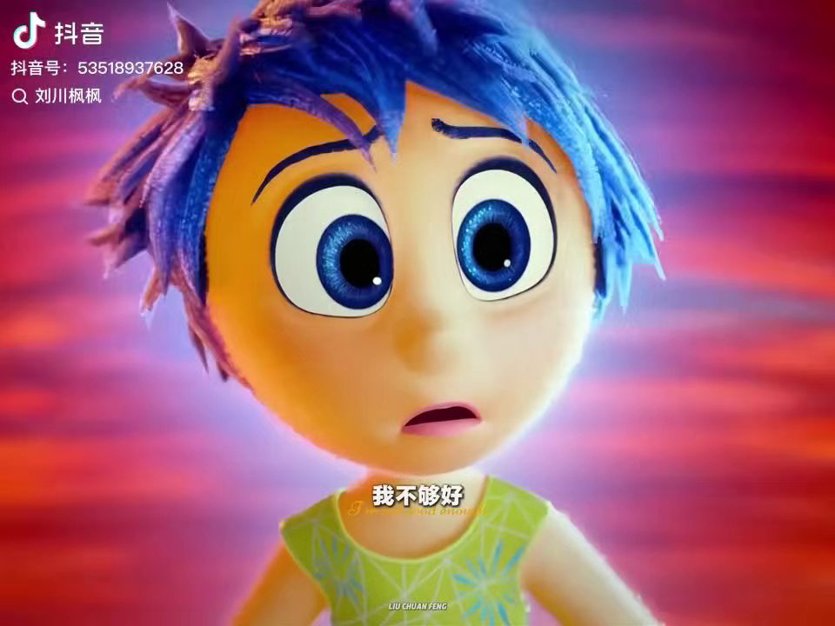

Slide 5
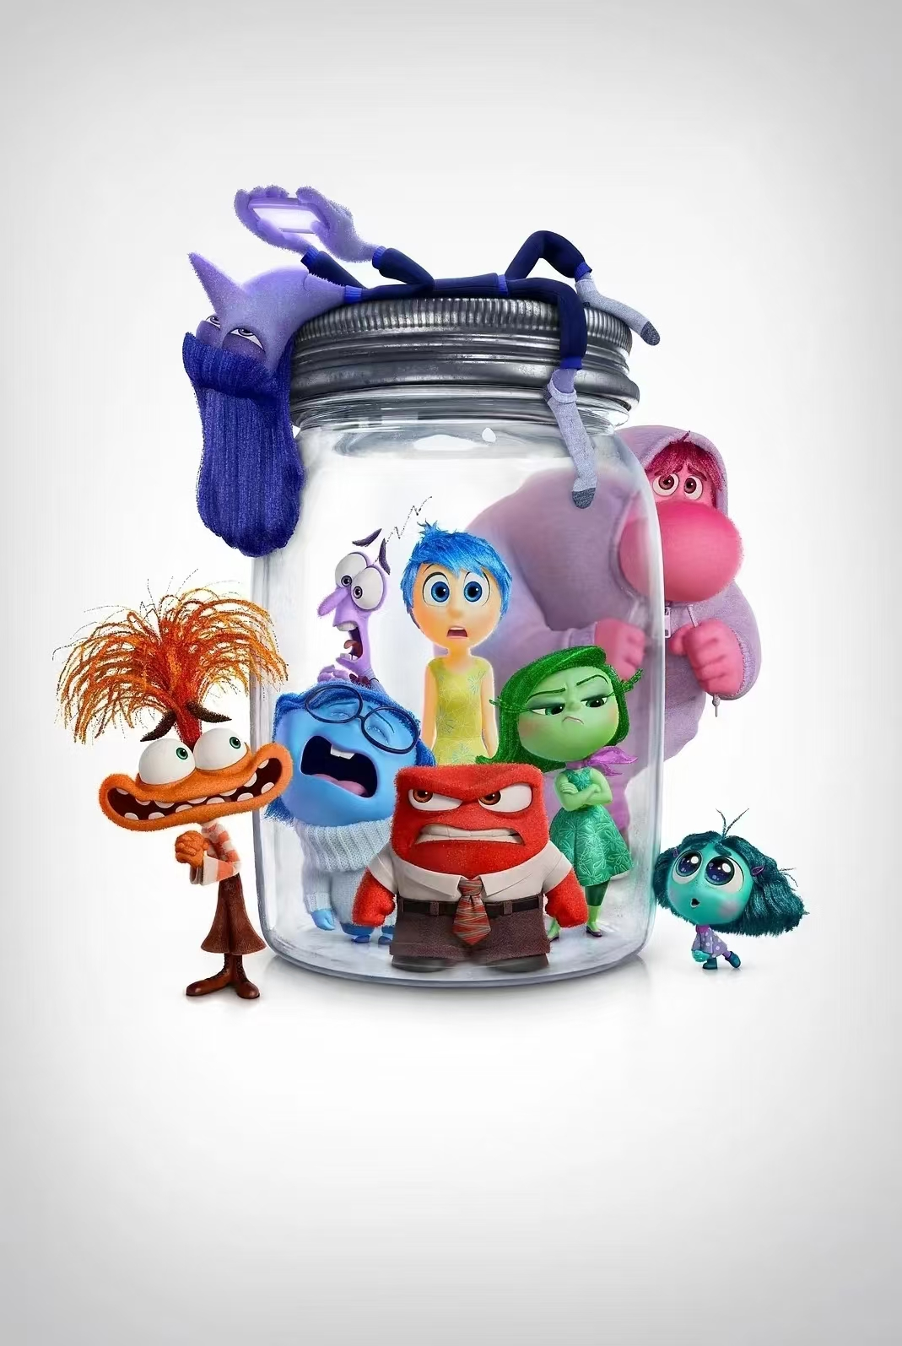
This movie tells us that emotions are not good or bad; Sadness is as important as Joy .
Accepting all emotions makes people more complete and mentally healthy.
When you fall apart, all emotions will embrace you.

Slide 6
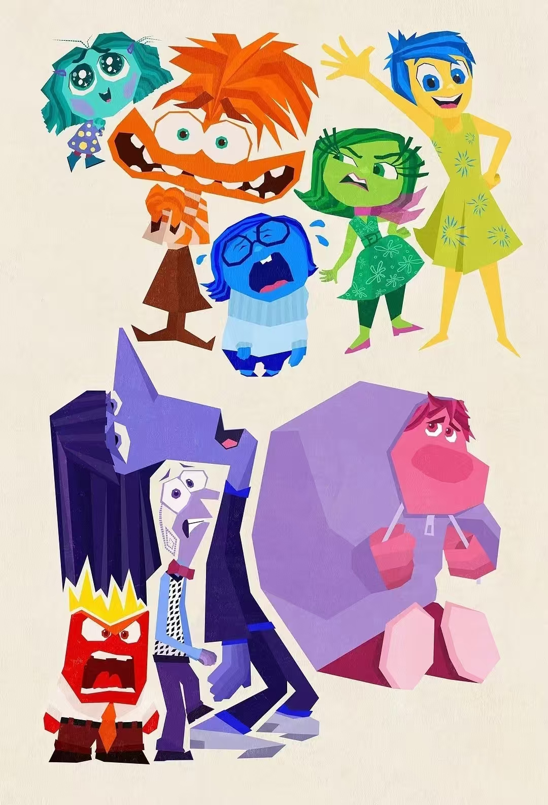
Thank you!

