Slide 1
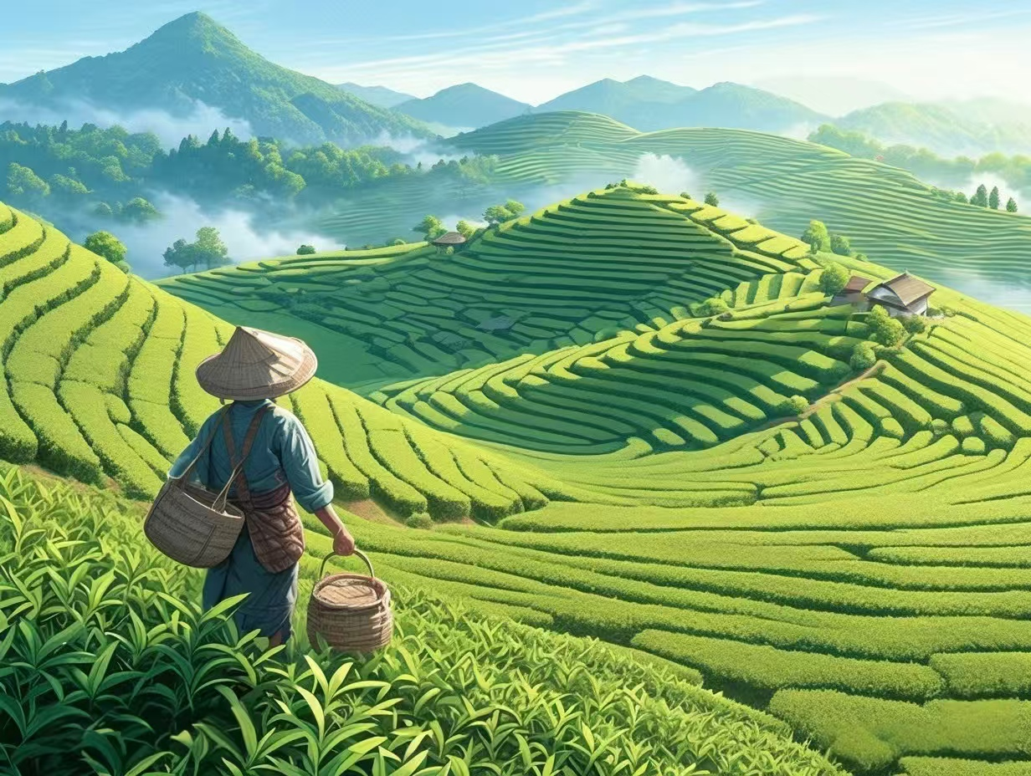
Chinese Tea Culture
中国茶文化
Reporter:秦墨真

Slide 2
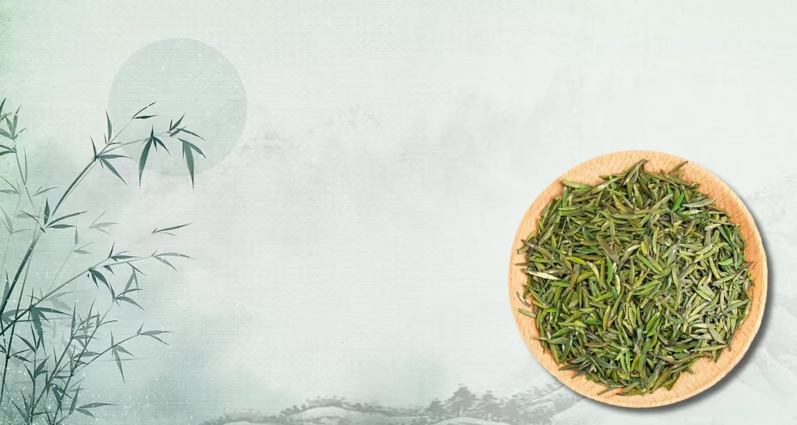
Table of Contents
01
The Origin and History of Tea Culture
茶文化的起源与历史
02
Major Types of Chinese Tea
中国茶的主要种类
03
Traditional Tea Art and Tea Ceremony
传统茶礼与茶道
04
Modern Heritage and Global Influence of Tea Culture
茶文化的现代传承与影响

Slide 3

Part 01
The Origin and History of Tea Culture
茶文化的起源与历史

Slide 4
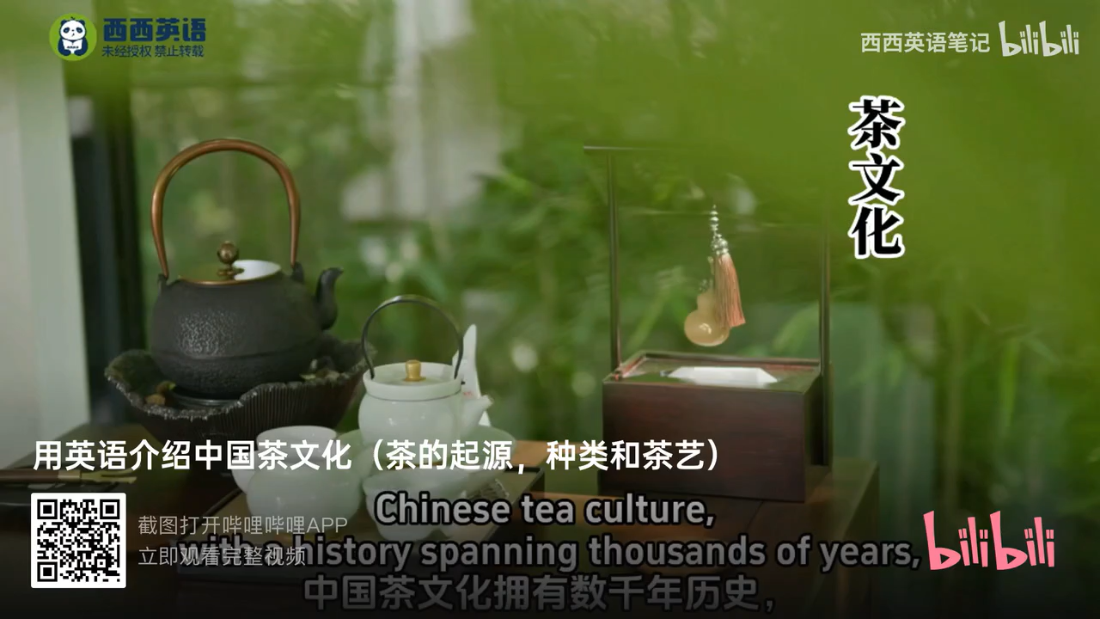


Slide 5
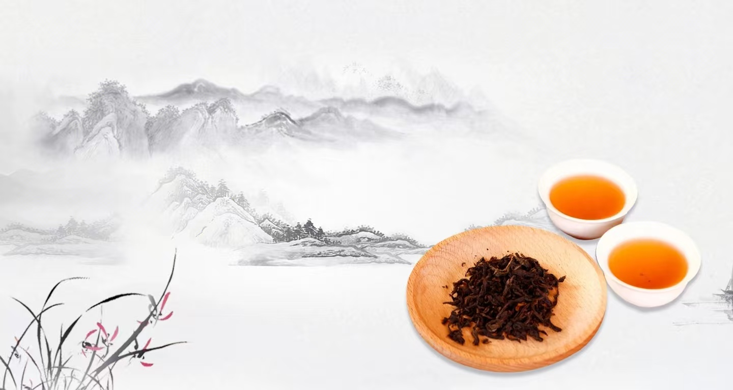
Chinese tea culture has a long history. It started with the story of Emperor Shennong finding tea. In the Tang Dynasty, it took shape because of Lu Yu’s book The Classic of Tea. During the Song Dynasty, people improved the way of making whisked tea. In the Ming and Qing Dynasties, loose-leaf tea became popular and there were many ways to brew it. Later, it became a valuable cultural heritage.
中国茶文化历史悠久，最初源于神农帝发现茶的传说。唐代，因陆羽的《茶经》问世，茶文化得以成型。宋代，人们改良了点茶的制作方法。明清时期，散叶茶开始流行，冲泡方式也变得多种多样。后来，茶文化成为了珍贵的文化遗产。

Slide 6
Part 02
Major Types of Chinese Tea
中国茶的主要种类

Slide 7
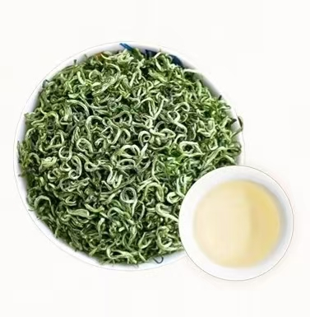
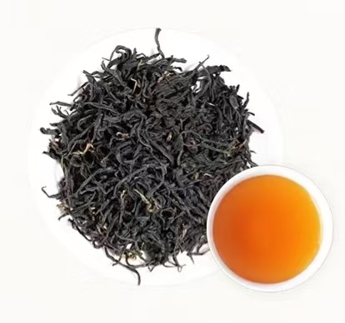
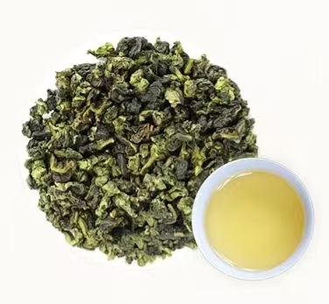
Green tea
Black tea
Oolong tea
such as Longjing,which tastes fresh and light.
such as Keemun,which is rich and full of flavor.
like Tieguanyin,which lies between green and black tea in taste.
绿茶：例如龙井，口感清新淡雅
红茶：例如祁门红茶，滋味醇厚浓郁
乌龙茶：例如铁观音，口味介于绿茶与红茶之间

Slide 8
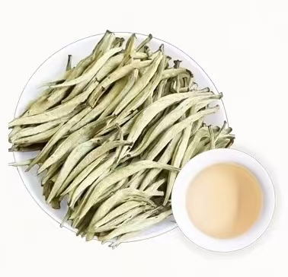
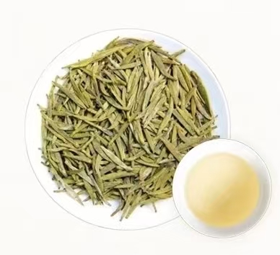
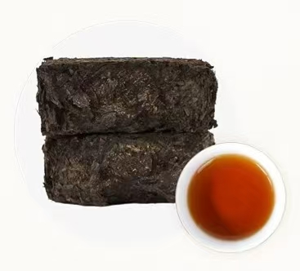
White tea
Yellow tea
Dark tea
Silver Needle,which is delicate and slightly sweet.
a rare type such as Junshan Yinzhen,smooth and mellow.
like Pu’er,which is fermented and has a very unique earthy flavor.
白茶：例如白毫银针，口感清雅，略带甘甜
黄茶：一种珍稀茶类，例如君山银针，口感温润醇厚
黑茶：例如普洱茶，经过发酵，带有独特的陈香与醇厚风味

Slide 9
Part 03
Traditional Tea Art and Tea Ceremony
传统茶礼与茶道

Slide 10
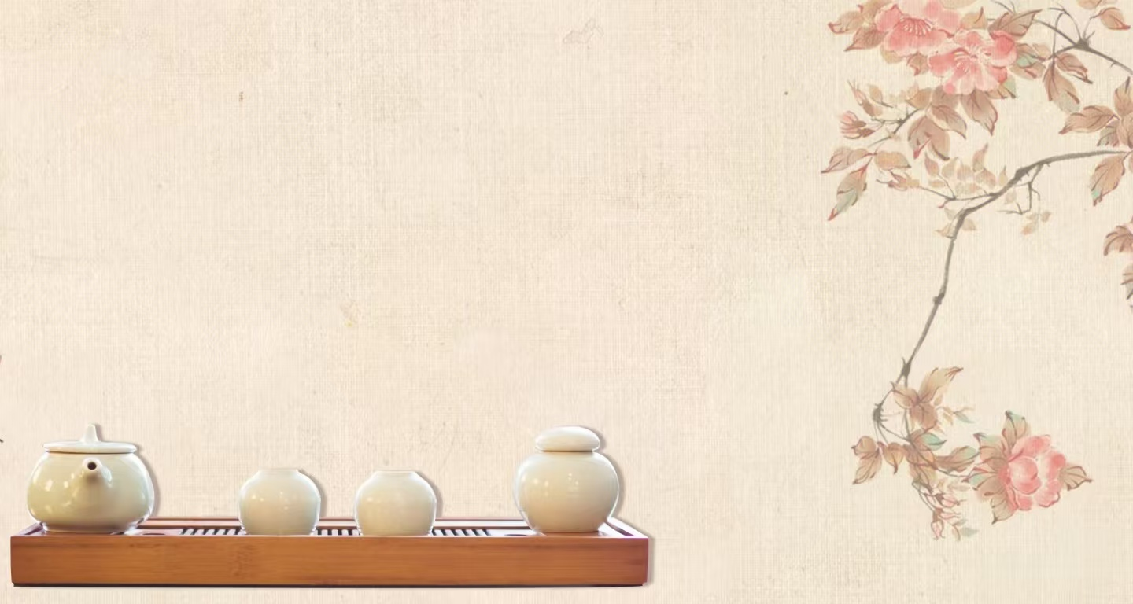
Tea art is a part of Chinese tea culture. It includes steps like picking tea, getting tools ready, making tea, and drinking it. The tea ceremony is the heart of tea art. It focuses on harmony, respect, purity, and peace. It aims to make people’s hearts clean and improve their character.
茶艺是中国茶文化的一部分，涵盖采茶、备器、泡茶、品茶等环节。茶道是茶艺的核心，讲求和、敬、清、寂，旨在涤荡心灵、涵养品性。

Slide 11
In the Song Dynasty, people made tea by whisking it. In the Ming Dynasty, they brewed it. Both ways had their own beauty and ideas, showing the culture of their times.
宋代流行点茶法，明代则盛行泡茶法。两种方式各有其美、各蕴其意，彰显了所属时代的文化特质。

Slide 12
Part 4
Modern Heritage and Global Influence of Tea Culture
茶文化的现代传承与影响

Slide 13
- Modern Life: Tea houses and tea-themed spaces are popular in China.
- Health Benefits: Tea is rich in antioxidants and has many health benefits.
- Global Spread: Chinese tea culture has influenced Japanese tea ceremony and British afternoon tea.
Visual: Modern tea spaces, global tea culture scenes.
现代生活：茶馆及茶主题空间在中国十分流行。
健康益处：茶富含抗氧化剂，并有诸多健康益处。
全球传播：中国茶文化影响了日本茶道与英国下午茶。
视觉呈现：现代茶空间、全球茶文化场景。

Slide 14
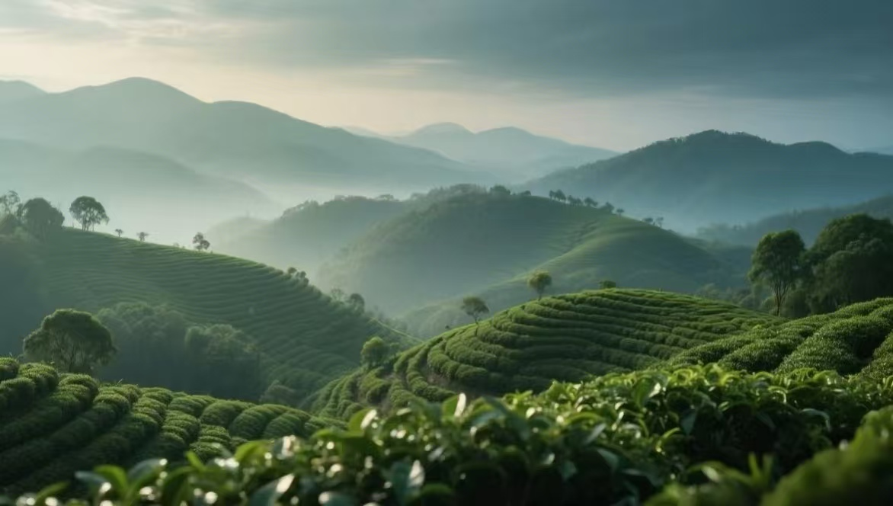
Thank You

