Slide 1


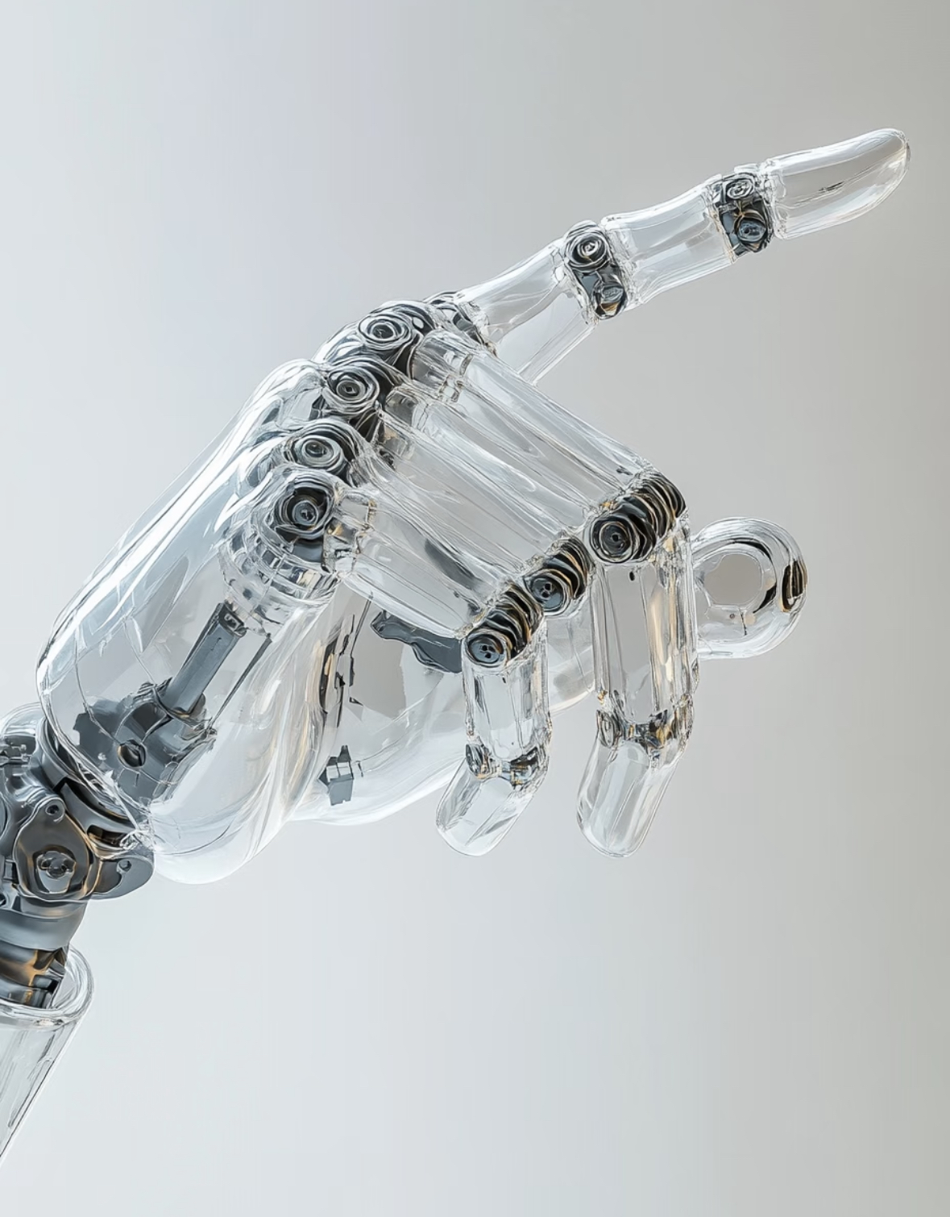
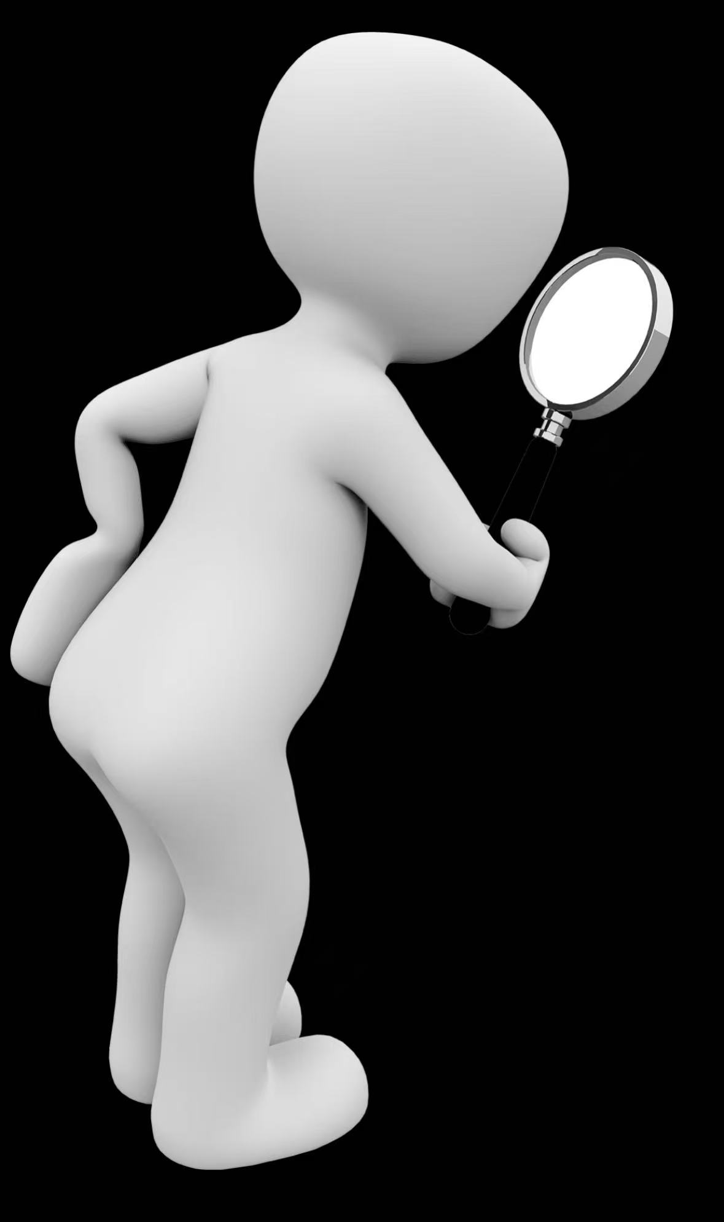
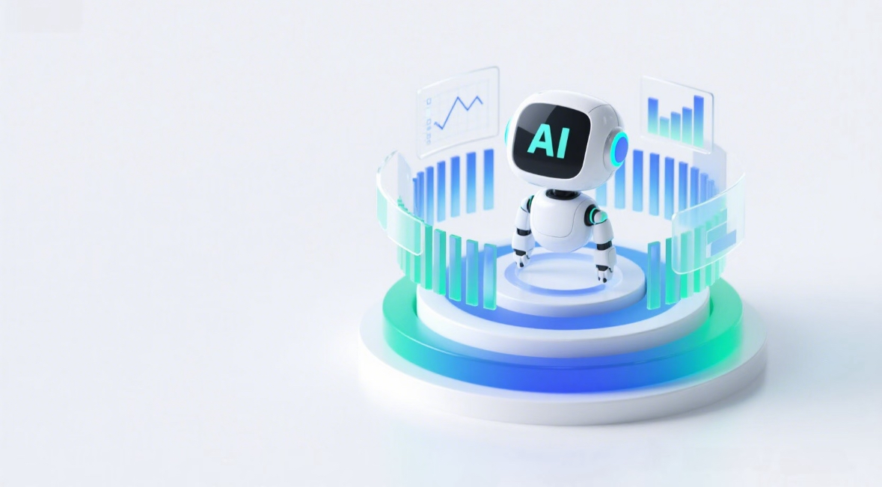
Artificial intelligence enters daily life

Slide 2
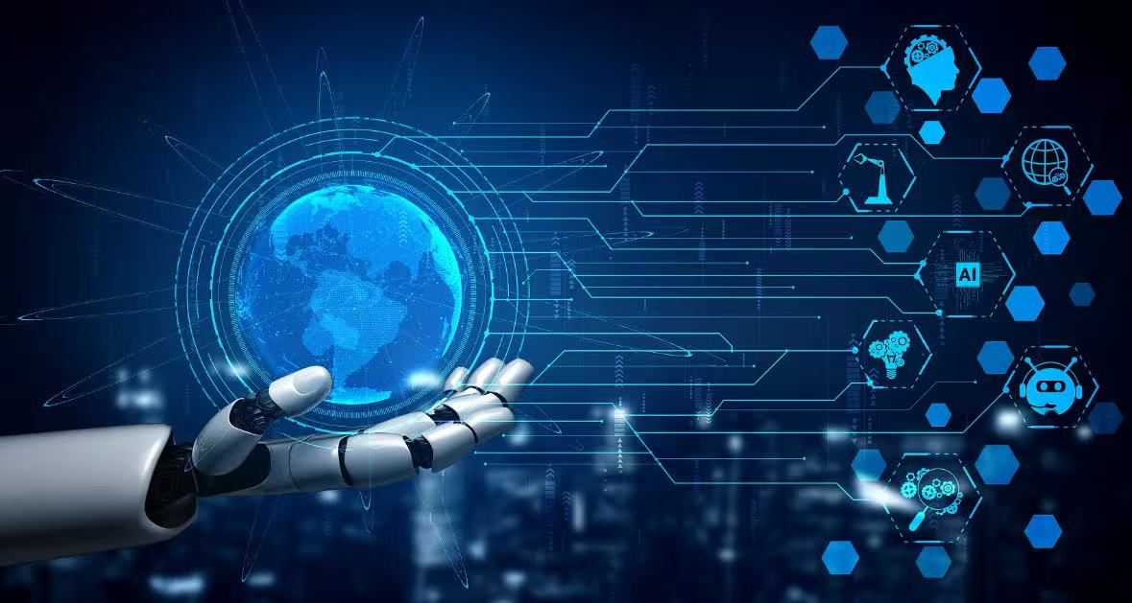
AI

Slide 3

part1
what is arttificial itelligence（AI）

Slide 4
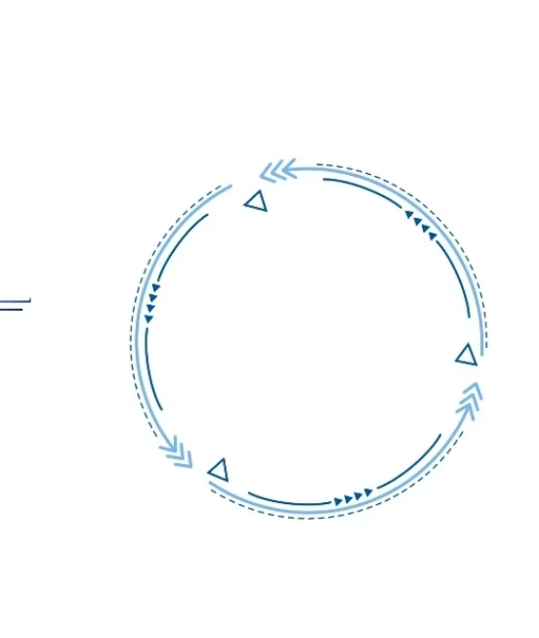
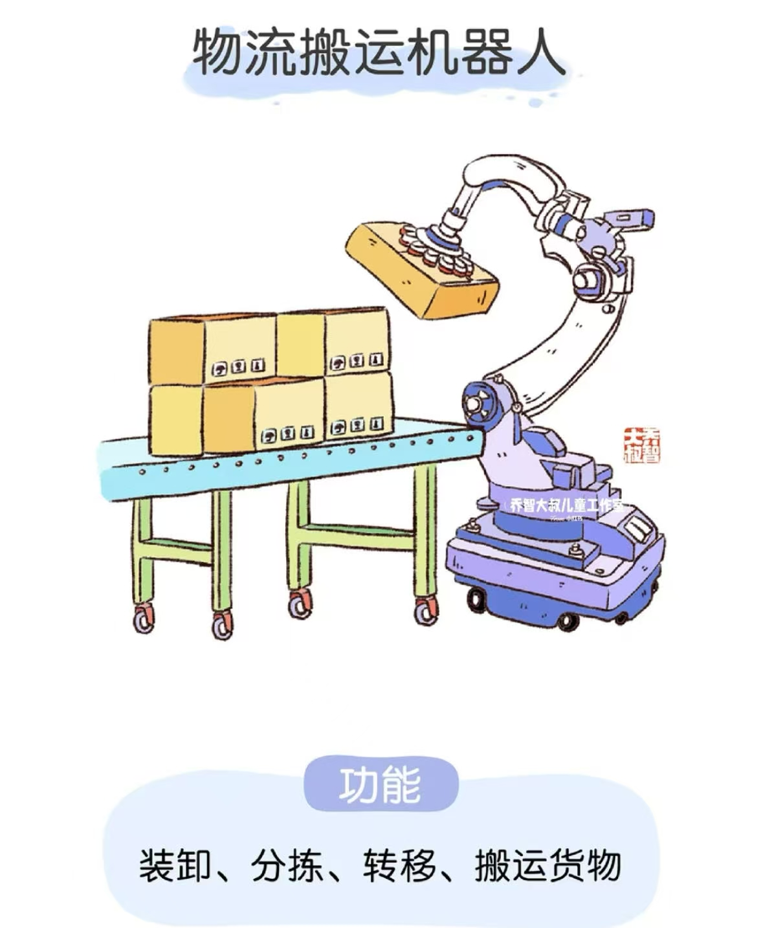
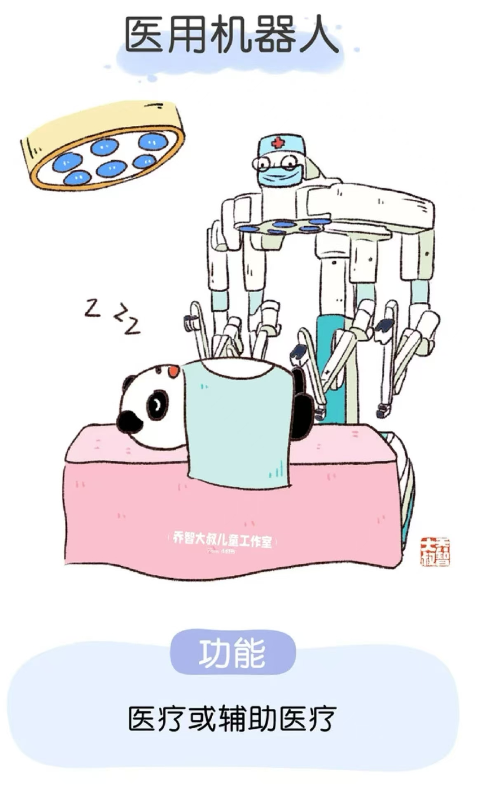
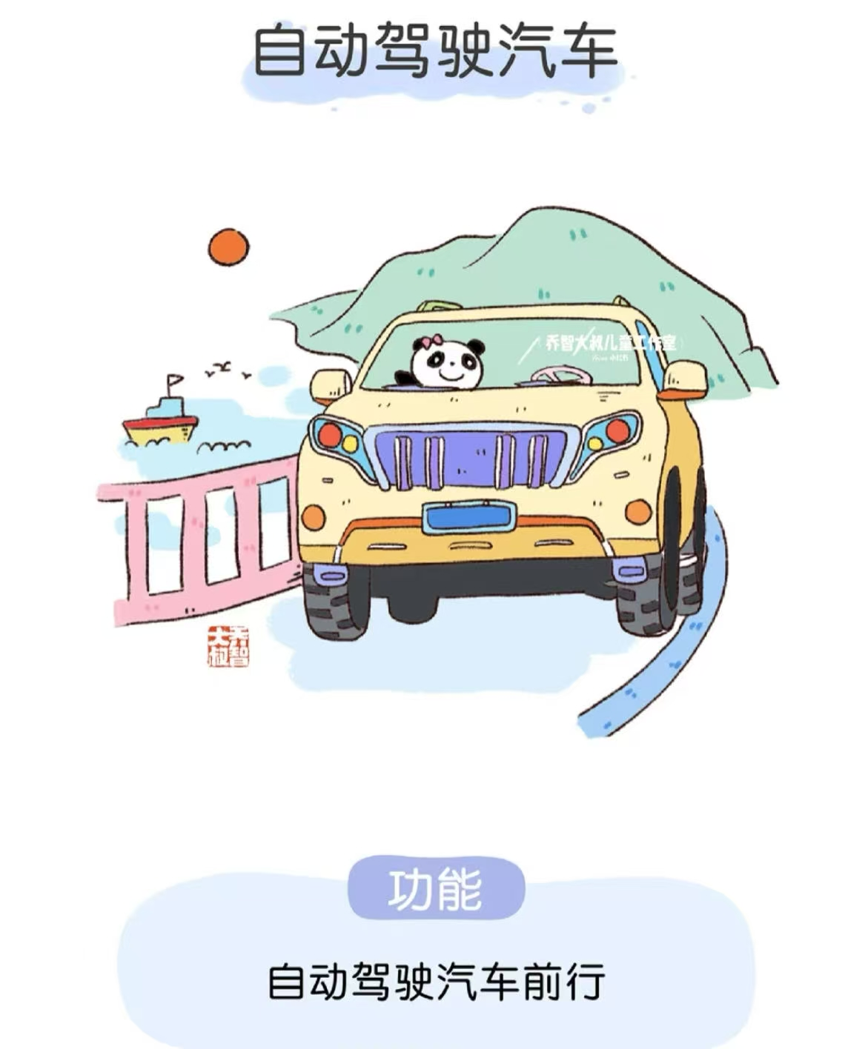
what is artificial intelligence
AI gradually enters daily life, changing the way we live bit by bit. When you ask a smart speaker to play your favorite songs in the morning, when a food delivery robot delivers meals to your door at noon, and when an AI translation tool helps you chat smoothly with foreign friends at night, you can feel the subtle and powerful influence of this technology. It is no longer a distant concept in sci-fi movies, but a part of our ordinary days.

Slide 5

part2
The advantages of artificial intelligence

Slide 6


Slide 7
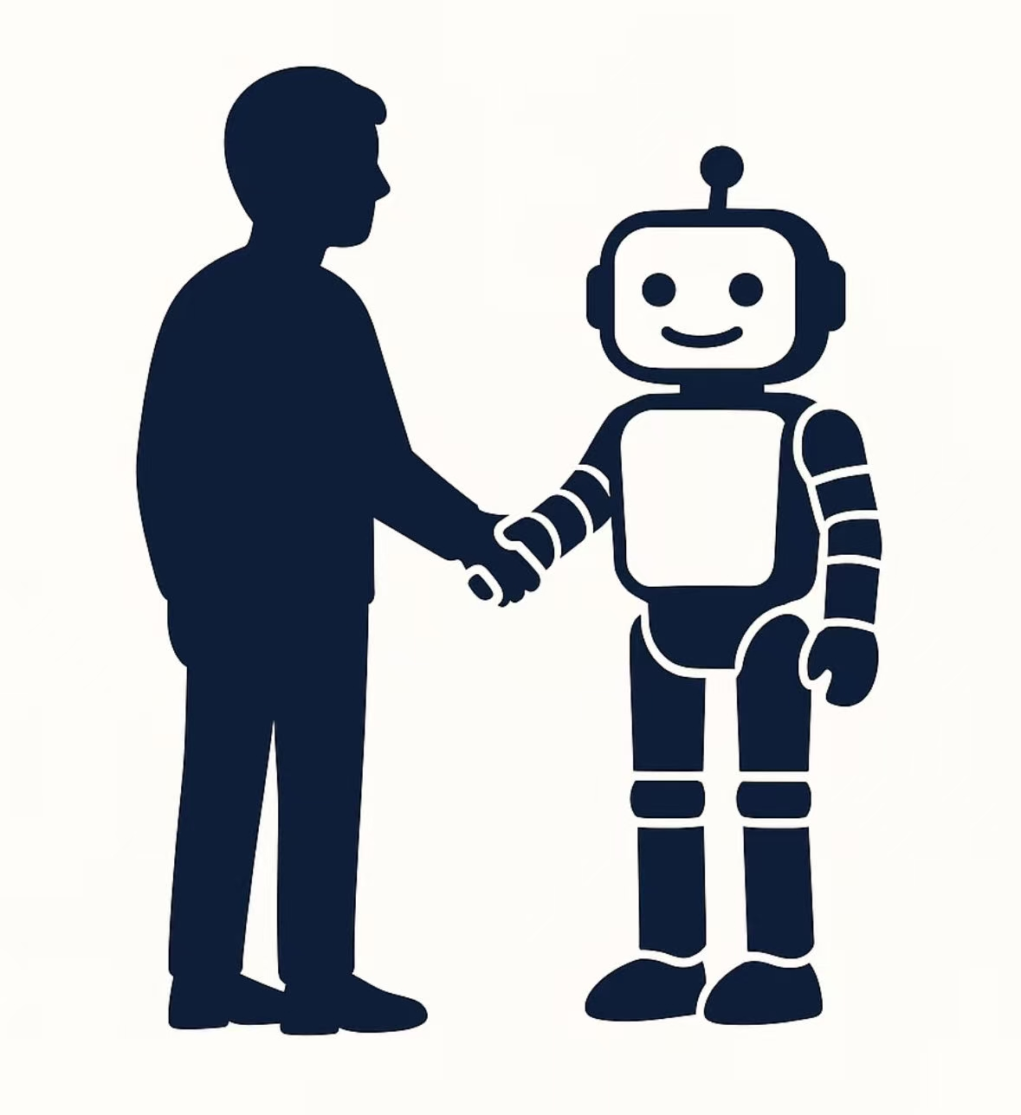
The advantage of artificial intelligence
1.AI tailors exclusive solutions for users based on their behavioral data and preferences, such as personalized learning paths and customized travel itineraries.
2. It minimizes errors caused by human fatigue or subjective judgment in fields like precision calculation, risk early warning and medical testing.
3. AI optimizes resource allocation through advanced algorithms, for example, regulating urban traffic flow and managing tourist flow in scenic spots.

Slide 8
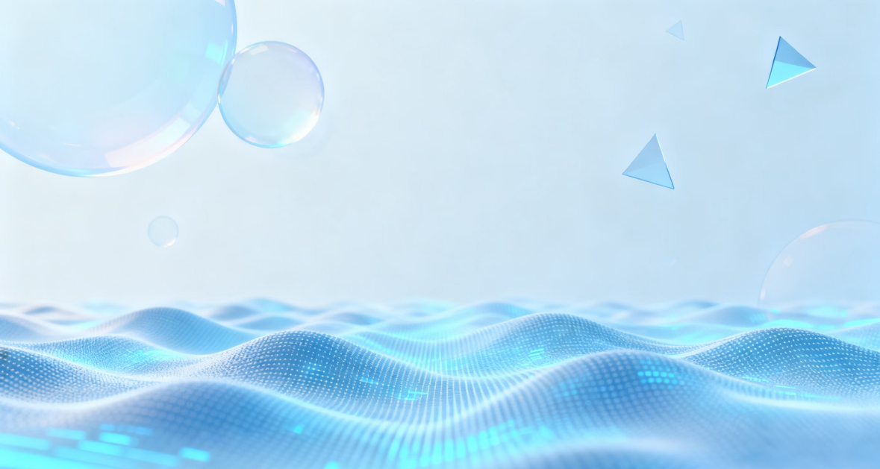
part3
The disadvantages of artificial intelligence

Slide 9
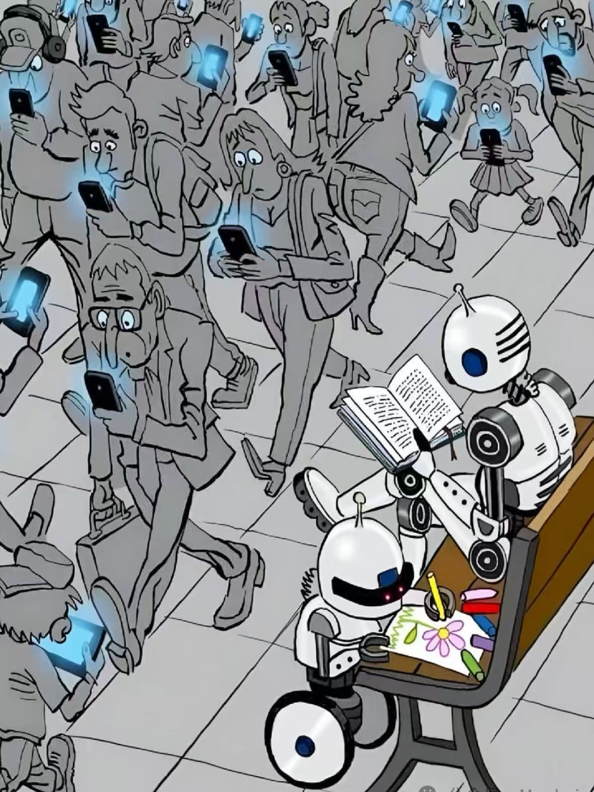
The disadvantages of artificial intelligence
1. Data privacy risks: AI training requires massive data, which may lead to personal information leakage and abuse (e.g., targeted fraud, privacy theft).
2. Algorithmic bias: Training data contains hidden human biases, which may result in unfair decisions.
3. Over-reliance on technology and weakened creativity: Excessive dependence on AI tools may reduce humans' ability to think independently and innovate.

Slide 10

part4 How to use AI

Slide 11
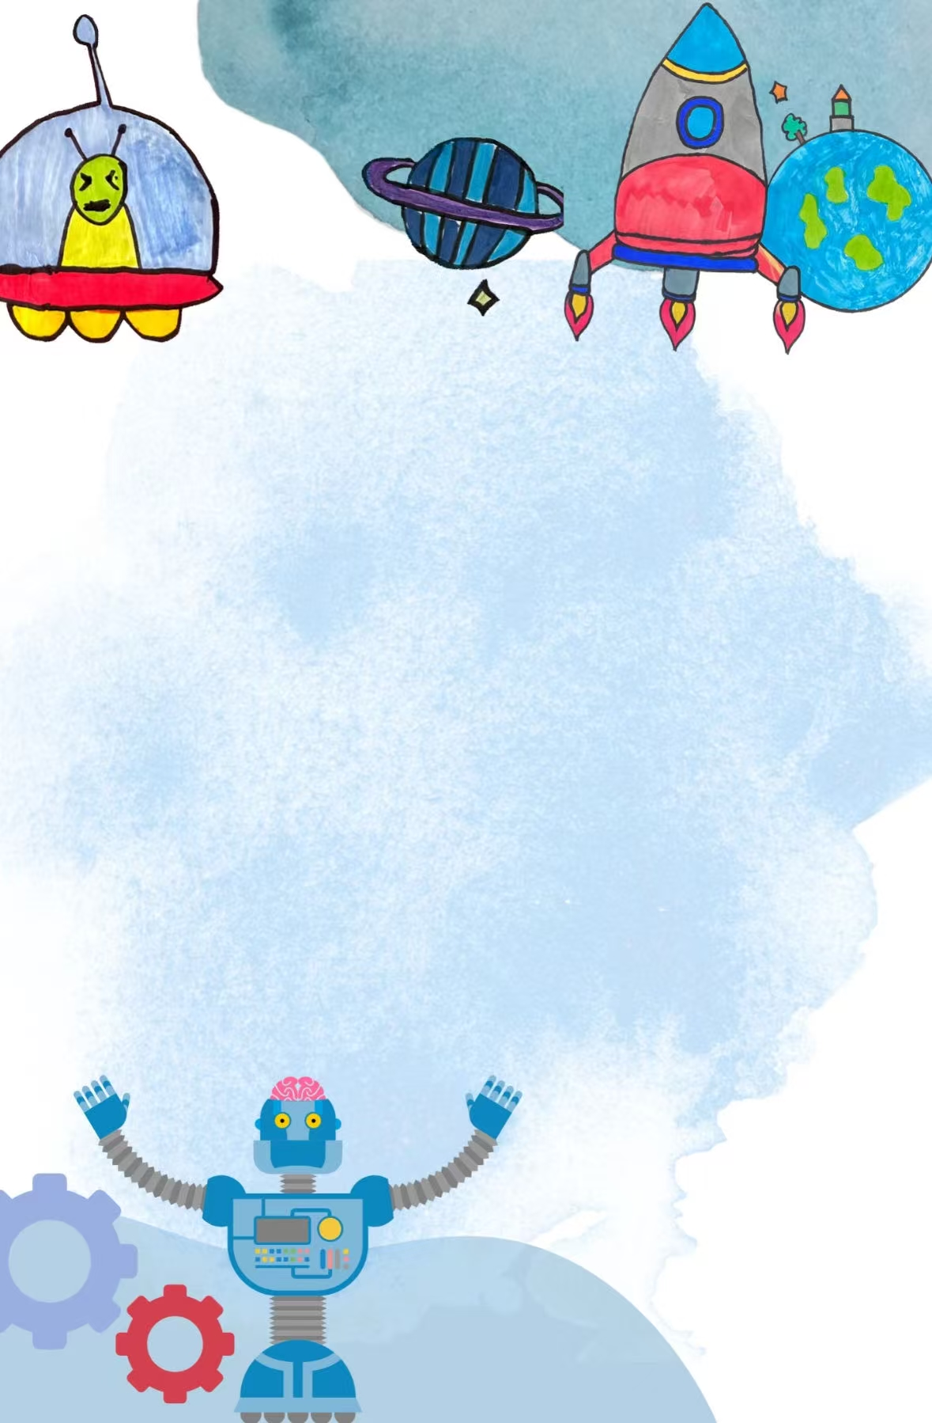
1. Use it for the right things
Help you save time (e.g., researching, polishing copy), never use it for cheating or deceiving others.
2. Never share sensitive info
Never input confidential content (passwords, personal privacy) into AI.
3. Make the final call yourself
Always check the accuracy of AI-generated content before using it.

Slide 12
THANKS

