Slide 1
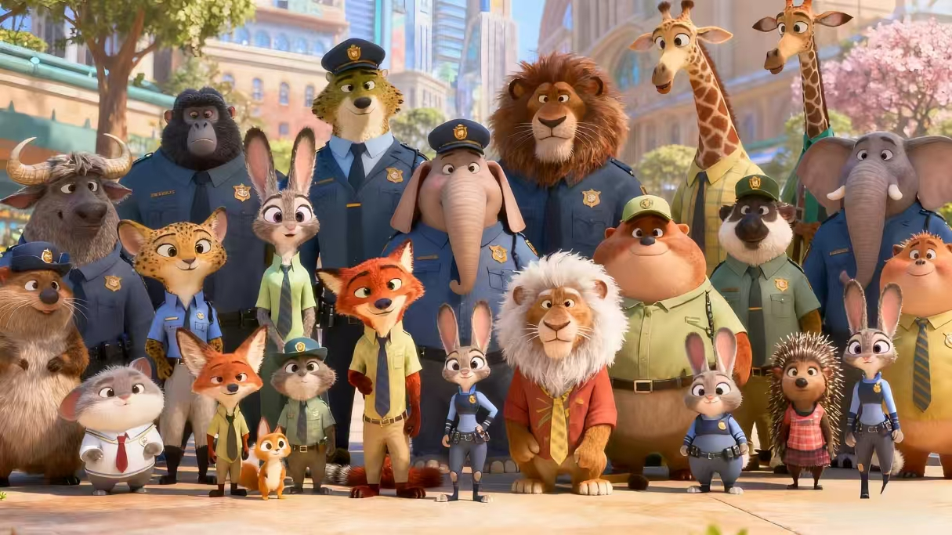
Zootopia 2: Beyond Prejudice, AboveSymbiosis

Slide 2

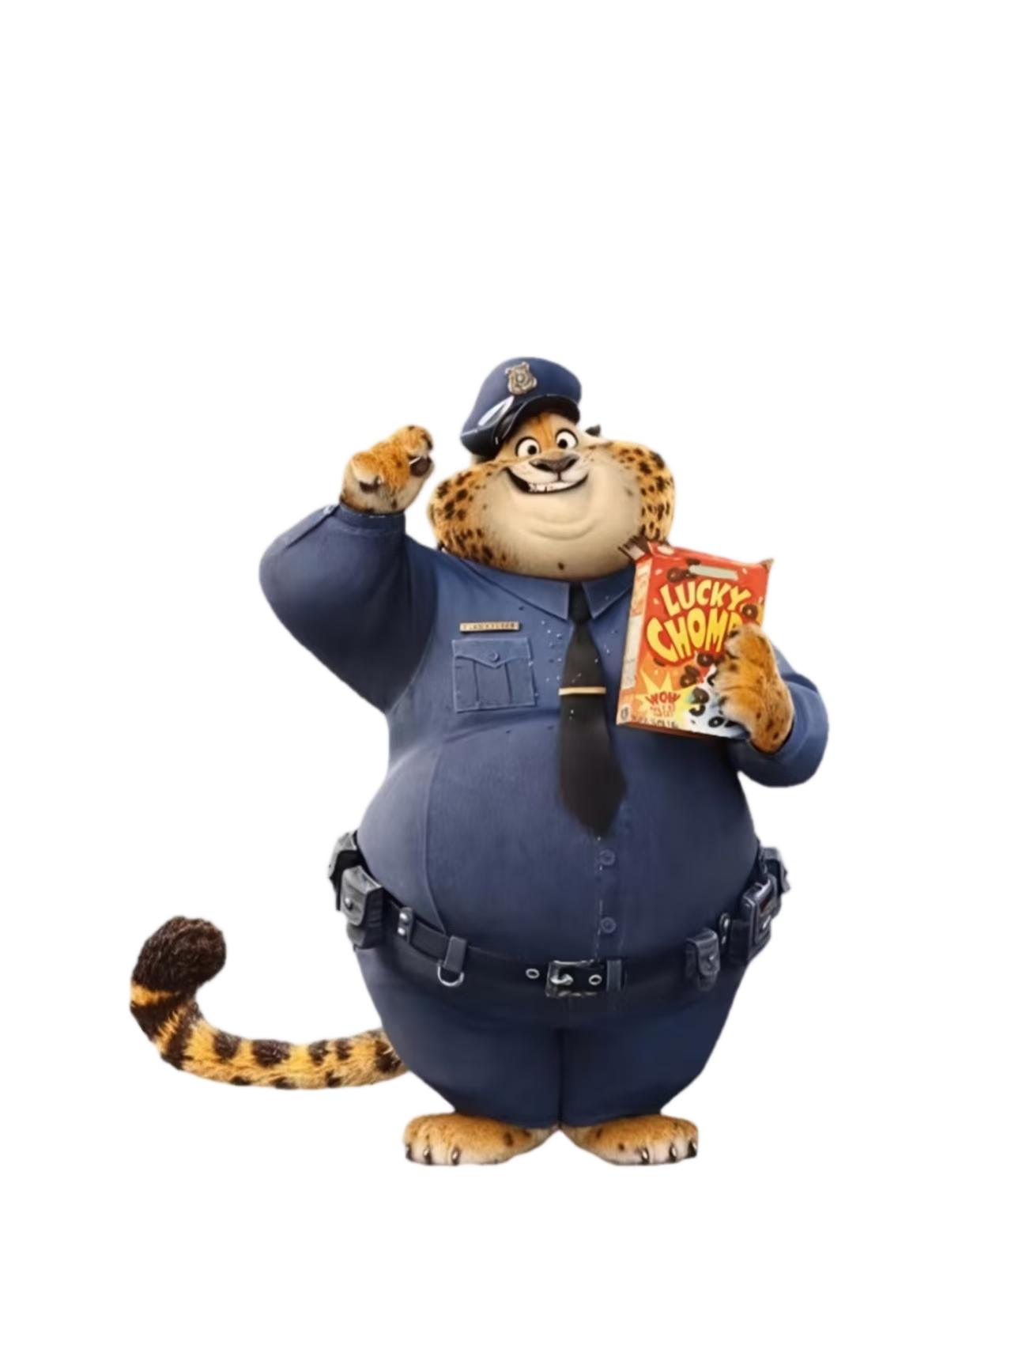
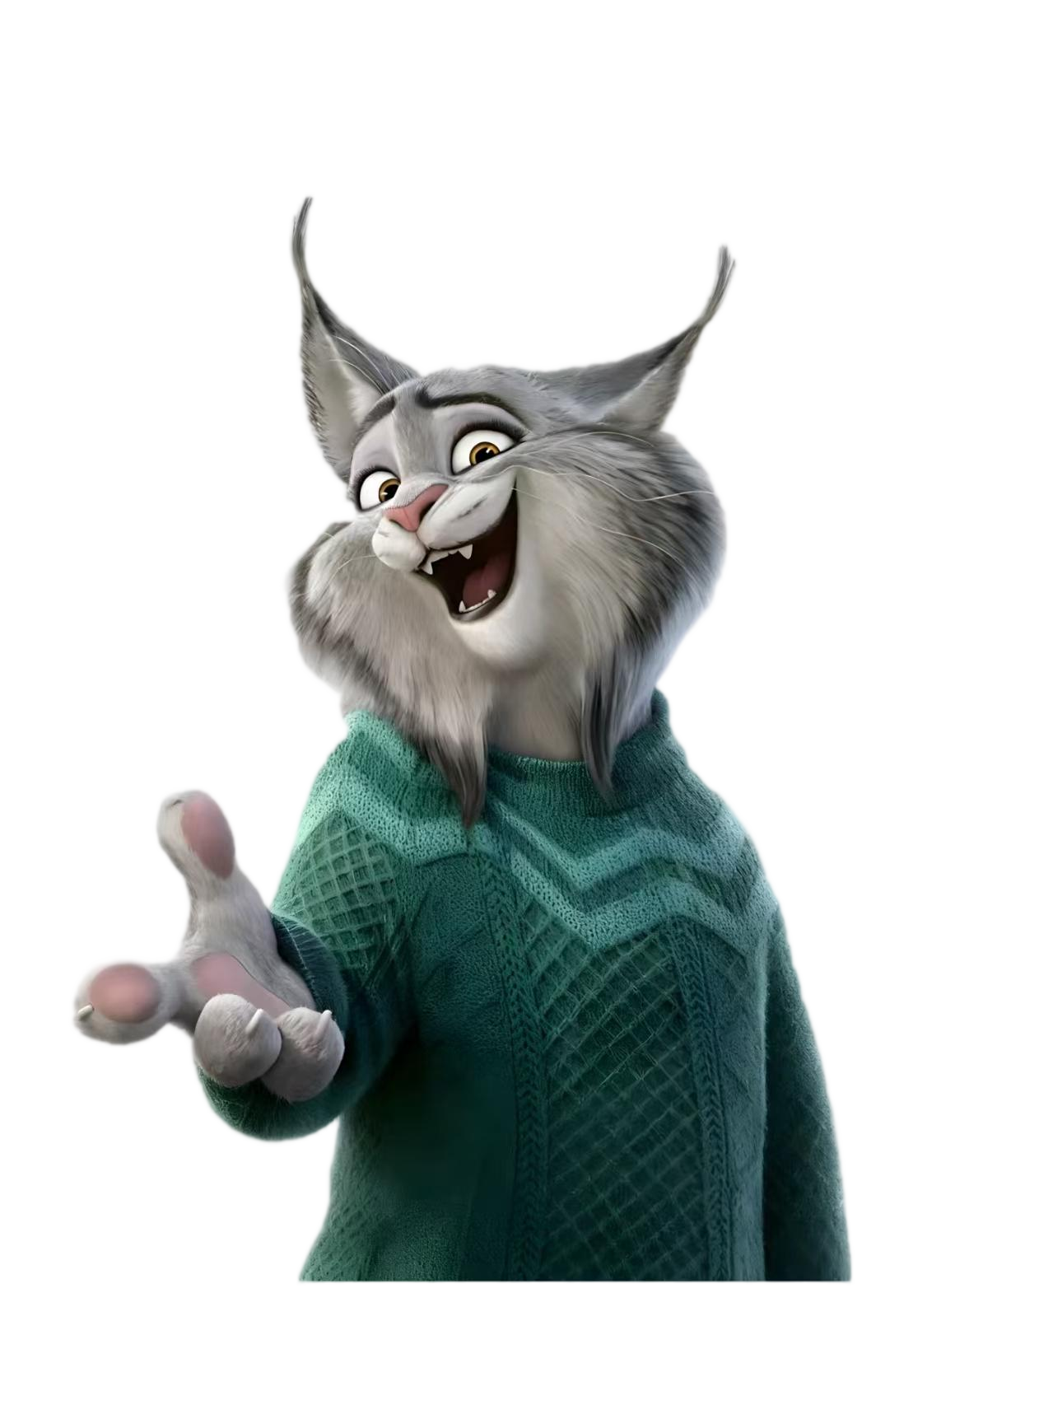
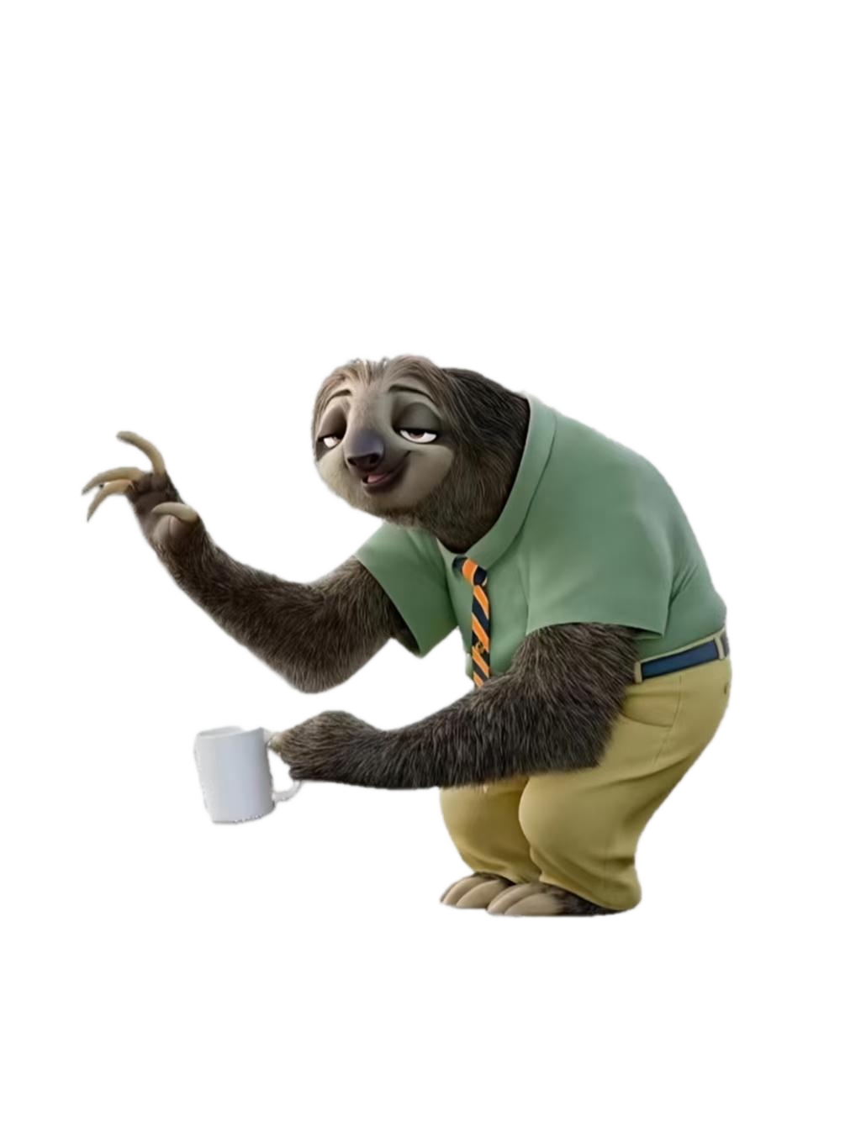
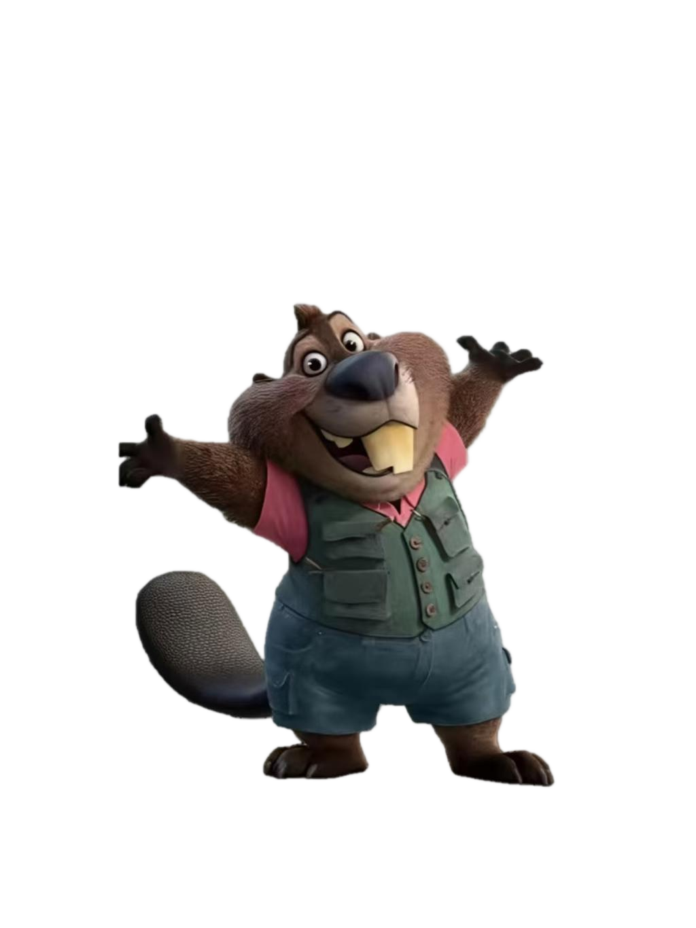
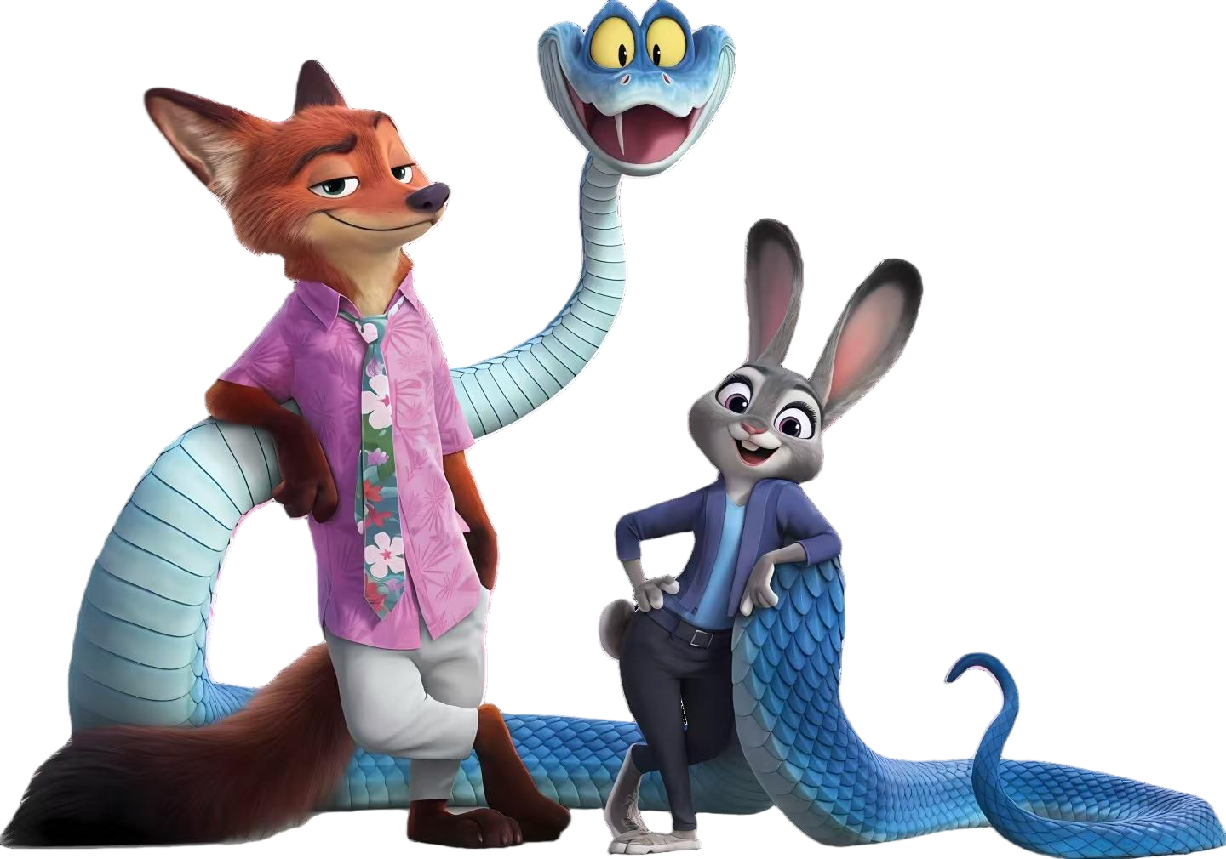
Symbiosis: The Harmonious Destiny Beyond "Natural Enemy Instincts"
Carnivores and herbivores join hands to crack down on smuggling cases, establish an interspecies joint defense mechanism, and resolve conflicts in ecological zones.

Slide 3
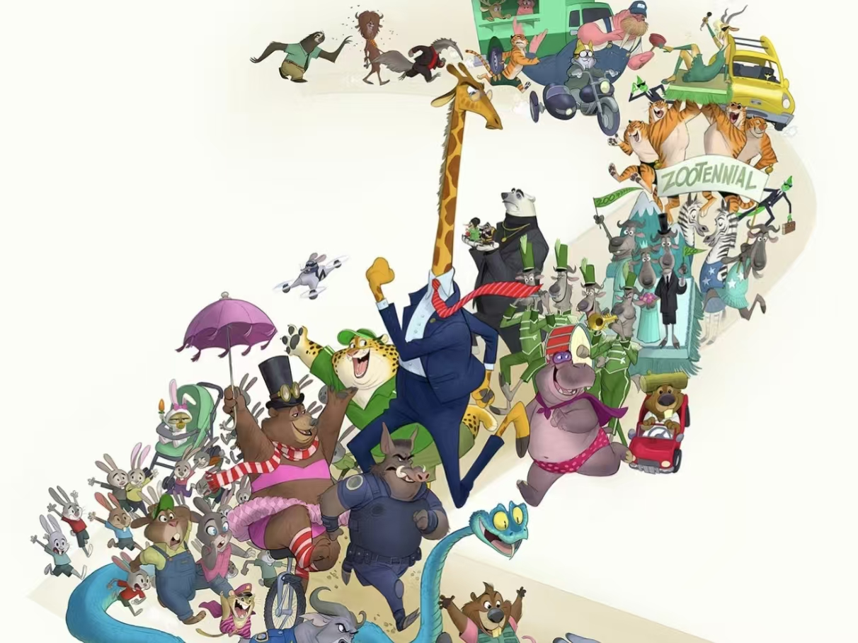
Exploring the Logic of Interspecies Cooperation and Community Symbiosis in Zootopia
The crisis in Zootopia has never stemmed from "interspecies contradictions", but from a small number of people exploiting these contradictions for personal gain; the safety of individuals is deeply bound to the stability of the group, and no species can stand alone.

Slide 4
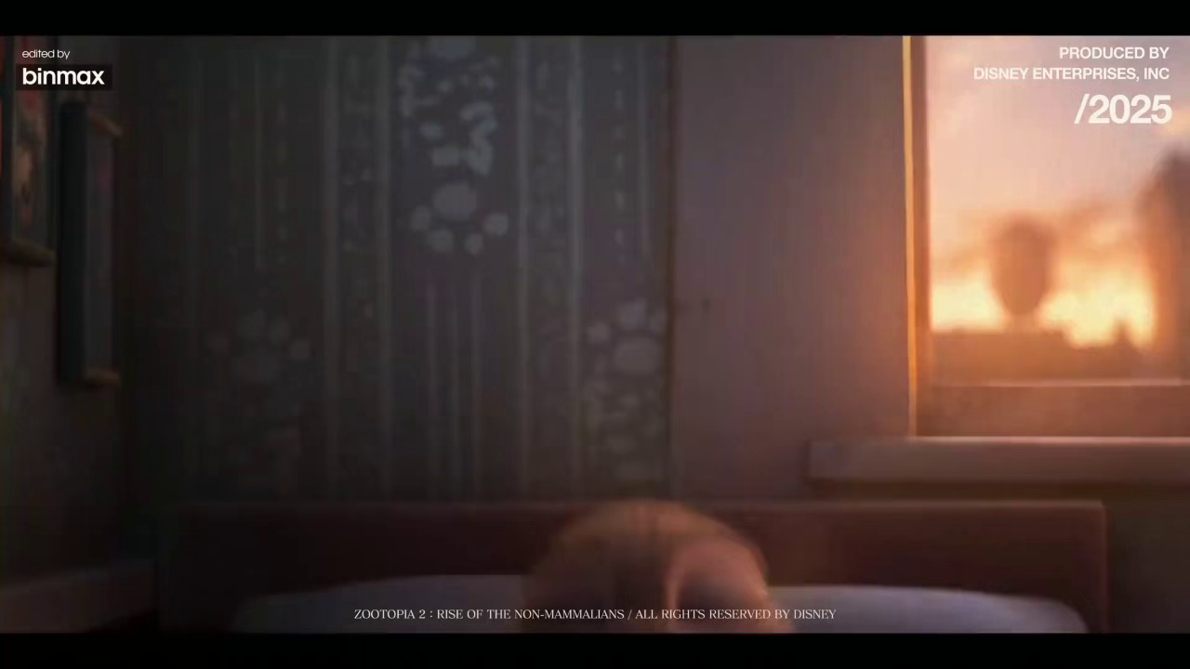

Slide 5
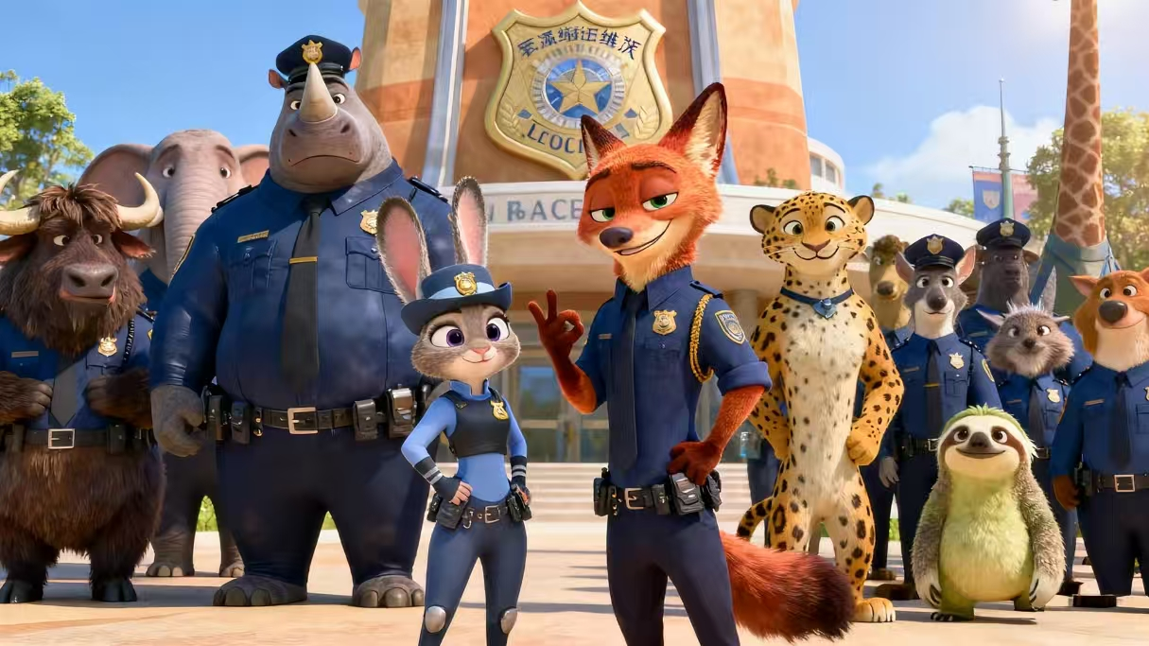
conclusion:
Symbiosis is not about "compromise and tolerance", but about complementary advantages after acknowledging differences — the fox’s cunning, the rabbit’s perseverance, and the elephant’s strength are all pieces of the puzzle in safeguarding their home.

Slide 6
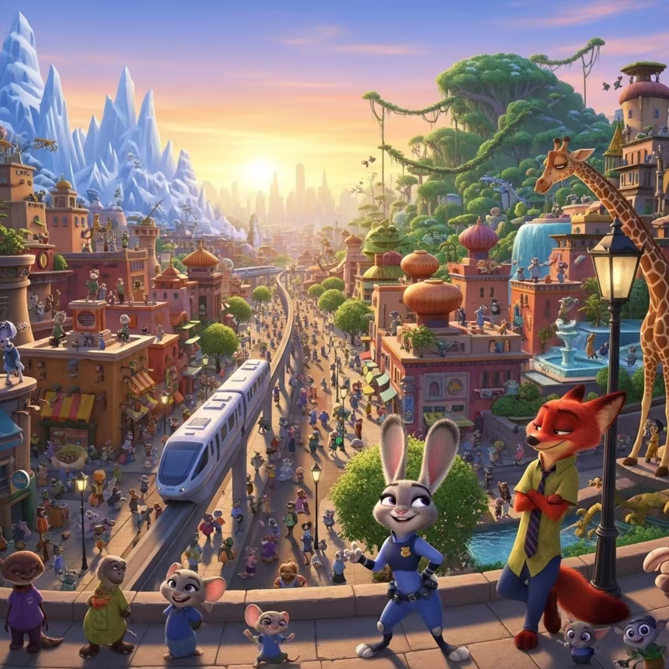
The ultimate antidote to prejudice is not to eliminate differences, but to learn to seek common ground amid them; the highest state of symbiosis is not to merge into one, but to let each shine in its own beauty and all beauties thrive together.

Slide 7
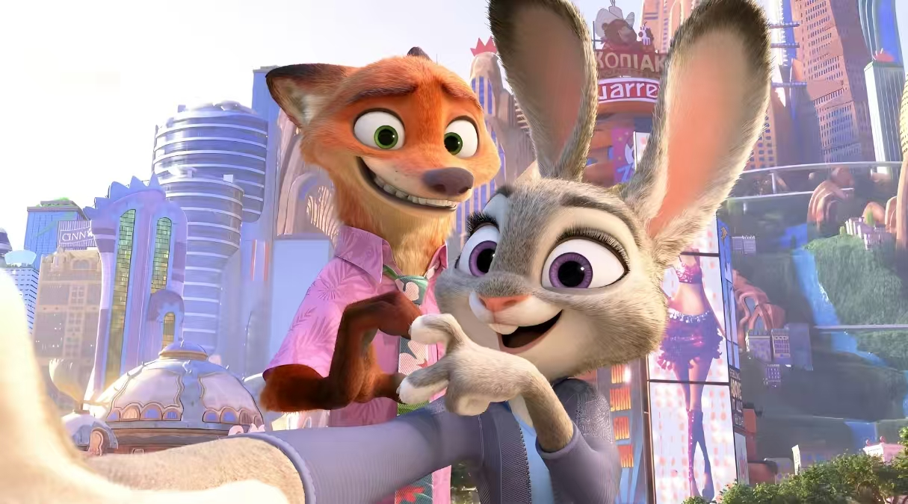
May every "Judy" dare to chase their dreams, every "Nick" be trusted, and every world become a Zootopia.
May prejudice fade away, and symbiosis endure forever.
Thank you for watching.

