Slide 1
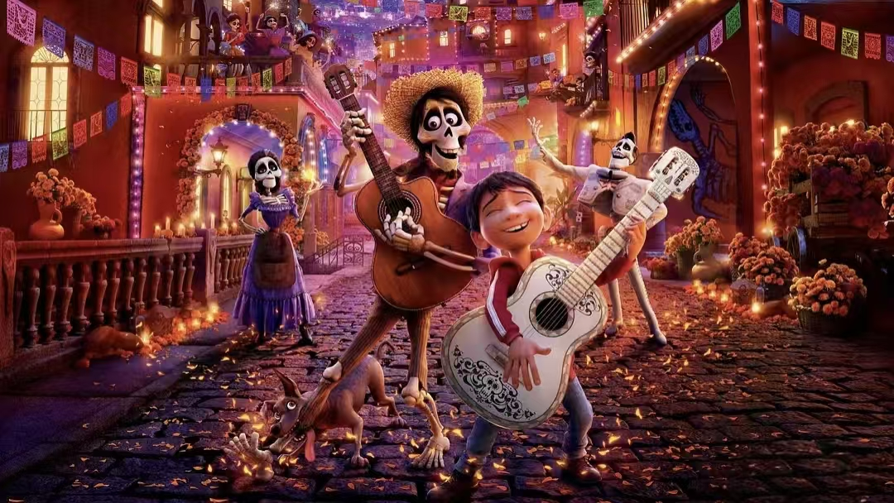
Coco:A Journey Through Memory,Family,and Dreams

Slide 2
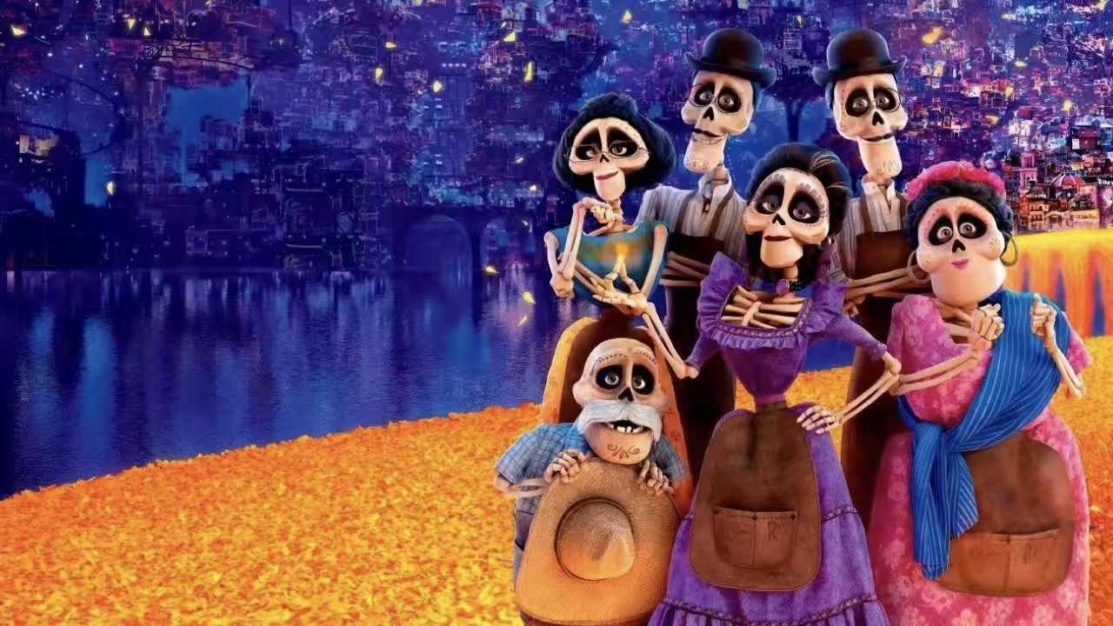
Introduction:A World of Color and Tradition
Coco is a 3D computer-animated musical fantasy film produced by Pixar Animation Studios and released by Disney. Set against the backdrop of Mexico's traditional Día de los Muertos (Day of the Dead) festival, the film tells a heartwarming story about family, memory, and dreams.
It has won the hearts of audiences worldwide not only for its stunning visual effects and touching music but also for its profound themes and cultural significance.

Slide 3
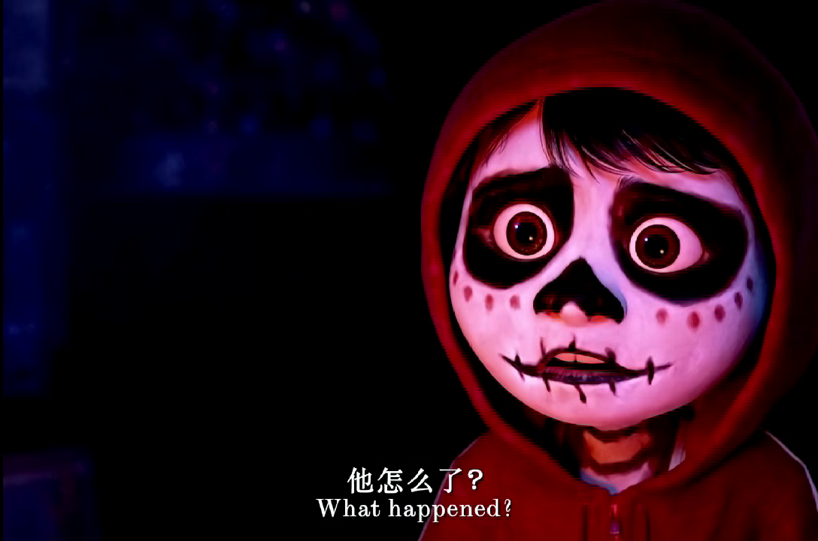

Slide 4
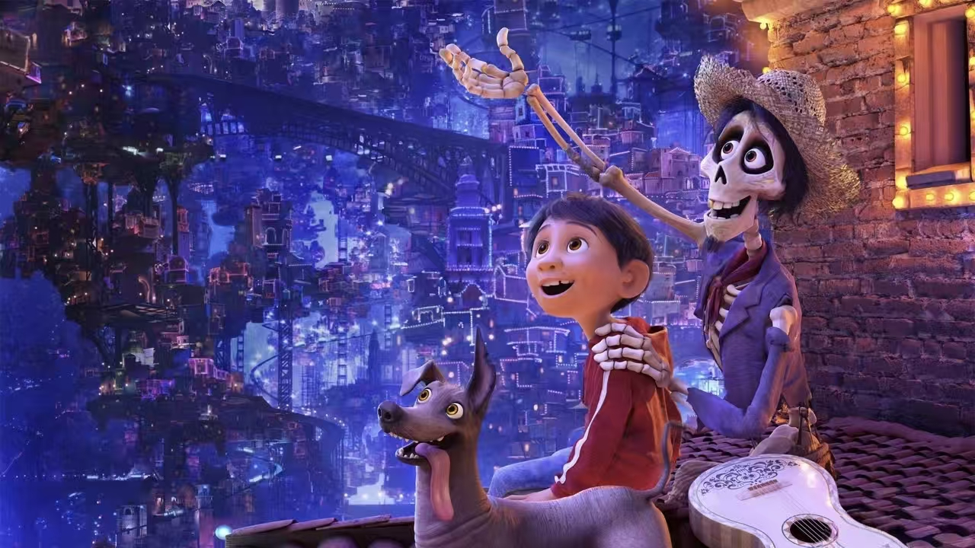
Themes：Dreams and Passion
Miguel's love and pursuit of music are the driving forces behind the entire story. The film encourages us to bravely pursue our dreams and not give up because of external pressures. As long as we persist, we will surely achieve our goals.

Slide 5
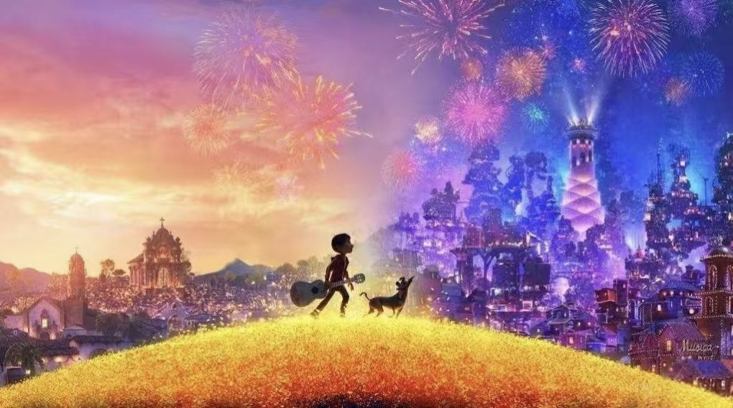
Conclusion:Remember Me
The core theme of 'Coco' is love and family. Through Miguel's story, the film shows the powerful strength of family bonds. No matter how far we go, home will always be our roots. The love between family members is the most precious treasure in our lives.

Slide 6
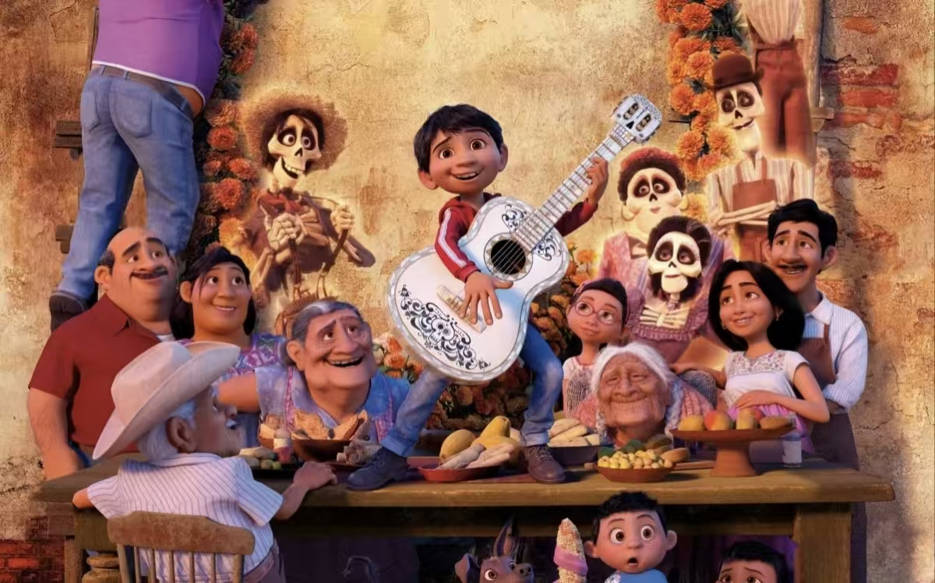
Thank you

