Slide 1

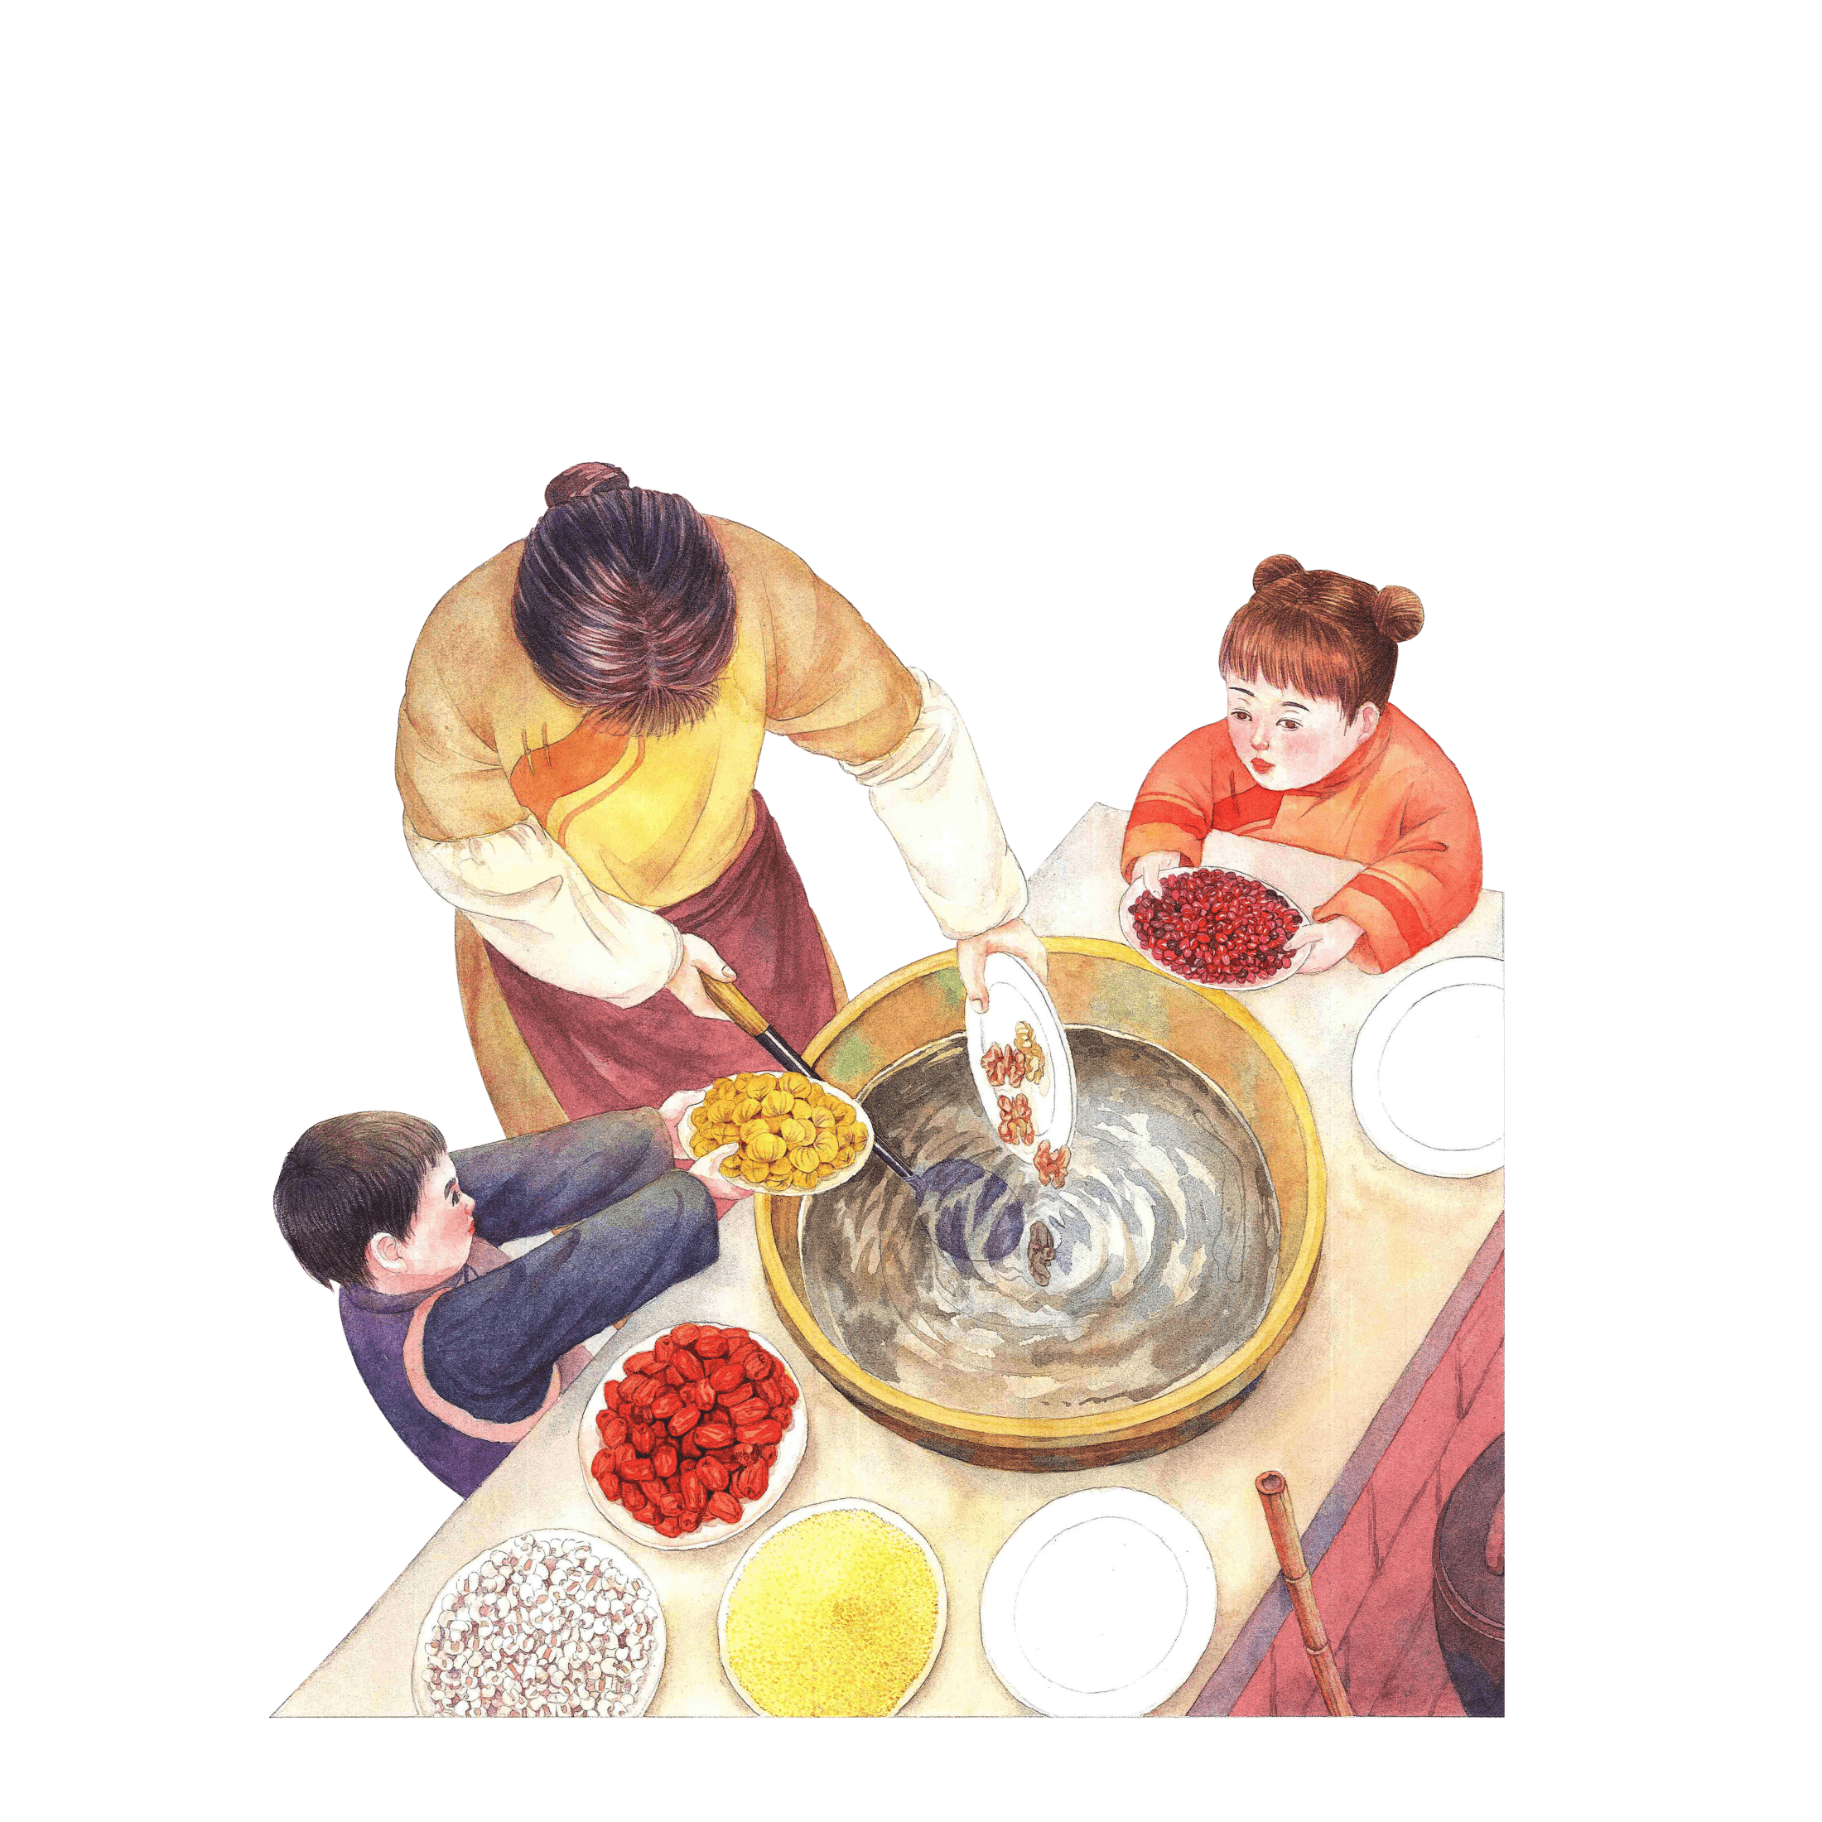


La Ba Festival

Slide 2
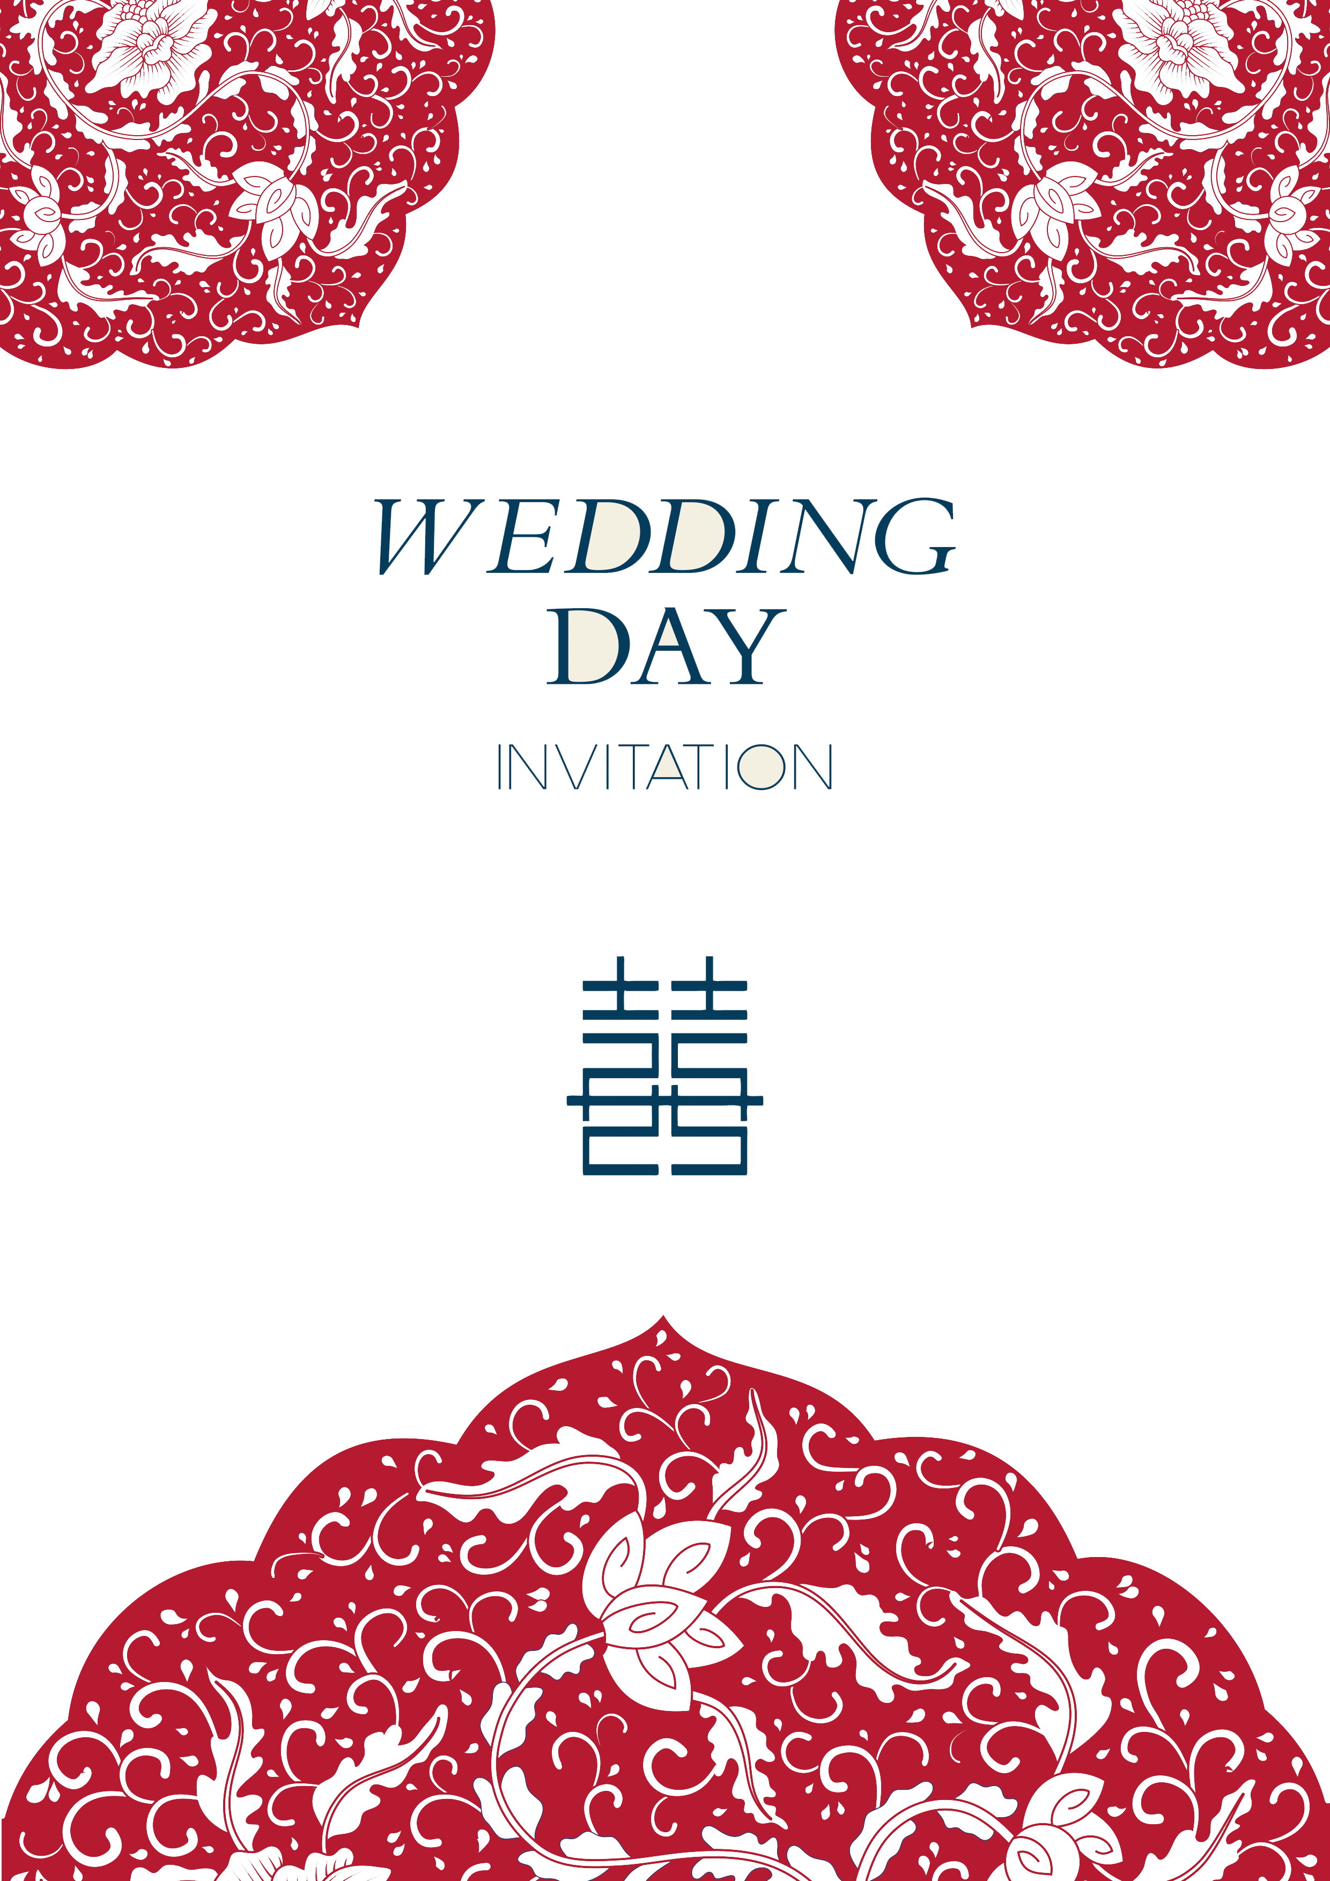
1.THE Origin of Laba Festival
2.THE Legend of Laba Festival
3.THE custom of Laba porridge

Slide 3

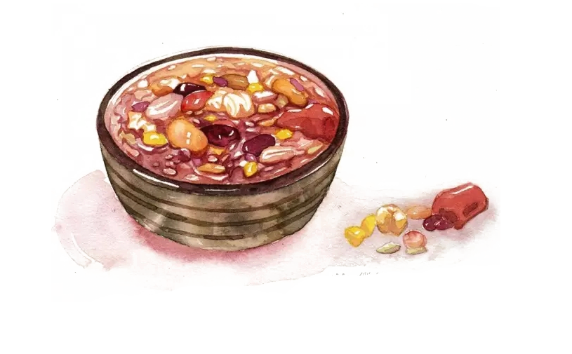
1. THE Origin of Laba Festival

Slide 4

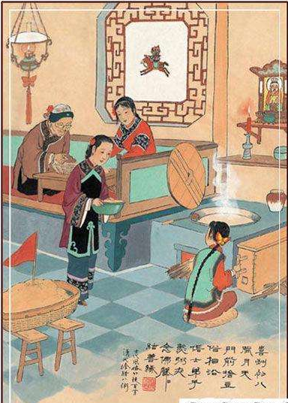
1. THE Origin of Laba Festival
Tales of legendia
Since the pre-Qin period, the Laba Festival has been used for ancestral and divine worship, praying for a bountiful harvest and auspiciousness. In addition to the activities of ancestor veneration and deity worship, people also engage in epidemic expulsion during the Laba Festival. This practice originates from ancient rituals of exorcising evil spirits and preventing epidemics. One of the medical methods in prehistoric times was the expulsion of evil spirits to treat epidemics.

Slide 5

2. THE Legend of Laba Festival

Slide 6
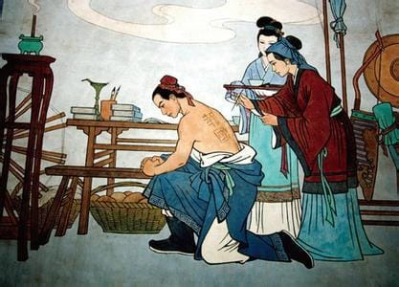
2.THE Legend of Laba Festival
The Laba Festival originated from people's remembrance of Yue Fei. During the harsh winter when Yue's army fought against the Jin invaders, the troops faced severe food shortages and freezing conditions. The local populace sent them porridge, and the Yue Army feasted on the "Thousand-Home Porridge" provided by the people, ultimately achieving a decisive victory. This day fell on the eighth day of the twelfth lunar month. After Yue Fei's death, the people began commemorating him by cooking porridge with coarse grains and nuts on the eighth day of the twelfth lunar month, which eventually became a lasting tradition.

Slide 7
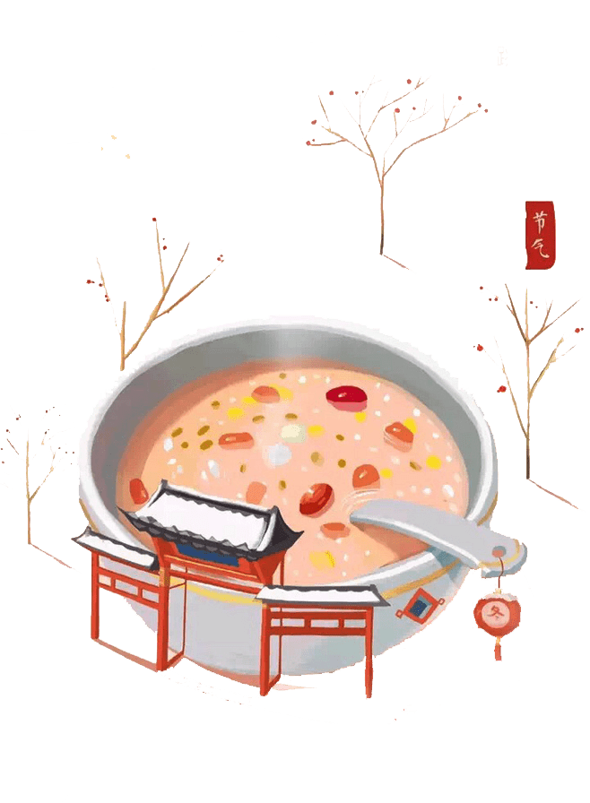
3. THE custom of Laba porridge

Slide 8
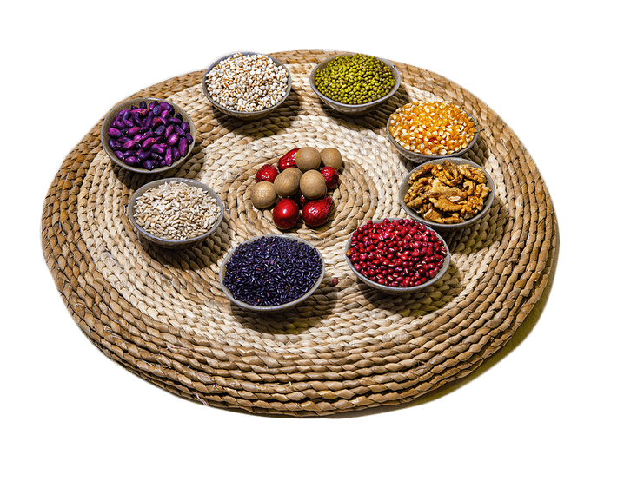
3. THE custom of Laba porridge
Laba porridge, also known as "Seven Treasures and Five Flavors Porridge," has a history of over a thousand years in China. Its earliest origins can be traced back to the Song Dynasty. On the day of Laba, Laba porridge was prepared by the imperial court, government offices, temples, and households of common people. By the Qing Dynasty, the custom of consuming Laba porridge had become even more prevalent.

Slide 9
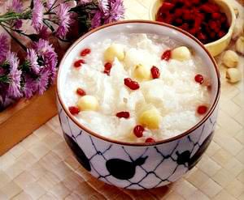
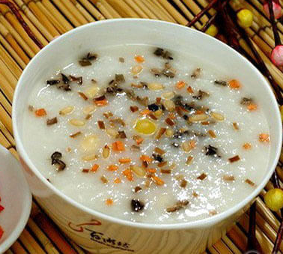
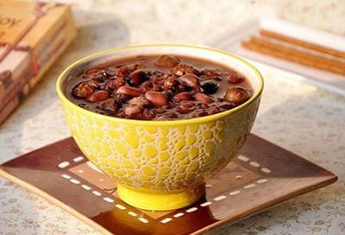
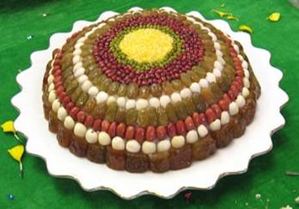
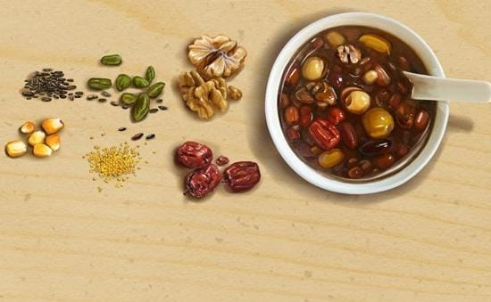
3. THE custom of Laba porridge
Laba porridge in different places

Slide 10

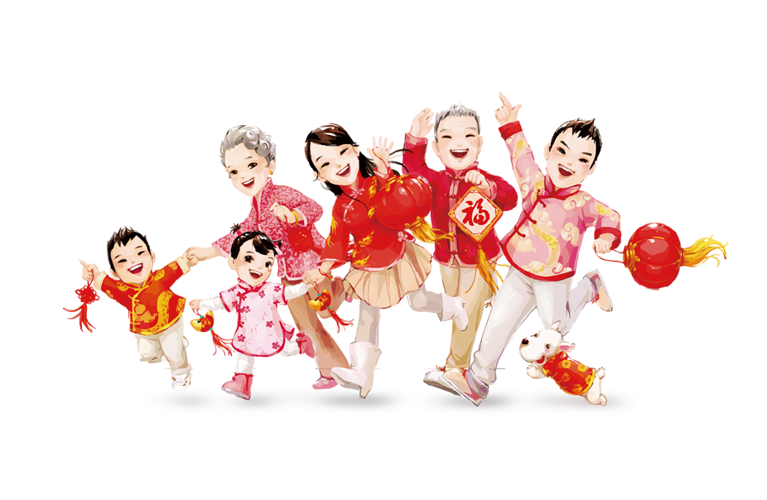
thank you

