Slide 1
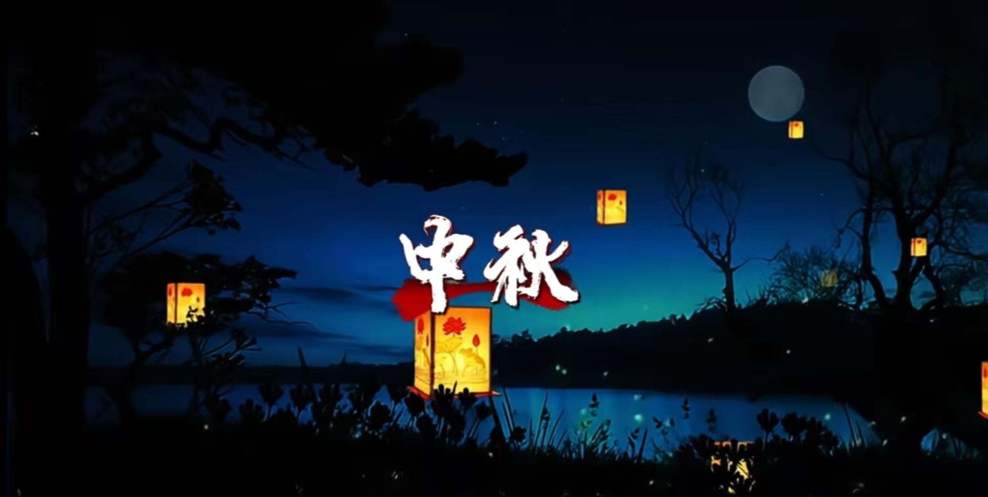
Mid-Autumn Festival

Slide 2
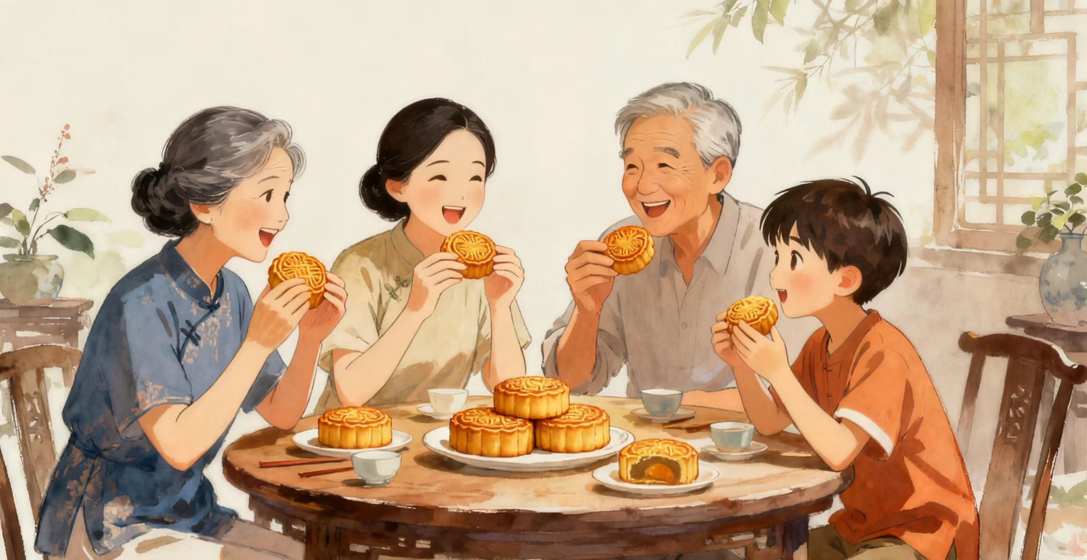
Mid-Autumn Festival is a special day in China.It happens in autumn,when the moon is biggest and brightest.
Every year families come together to celebrate. We eat moon cakes on this day. Moon cakes are round like the full moon. Some have sweet egg yolks inside. Others have nuts red bean paste. They taste delicious and families share them together.

Slide 3
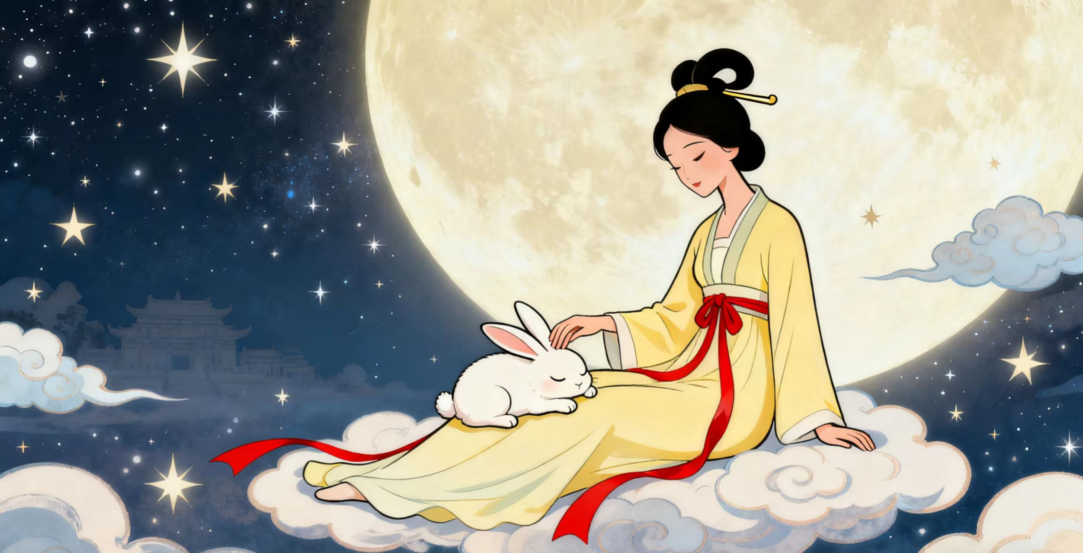
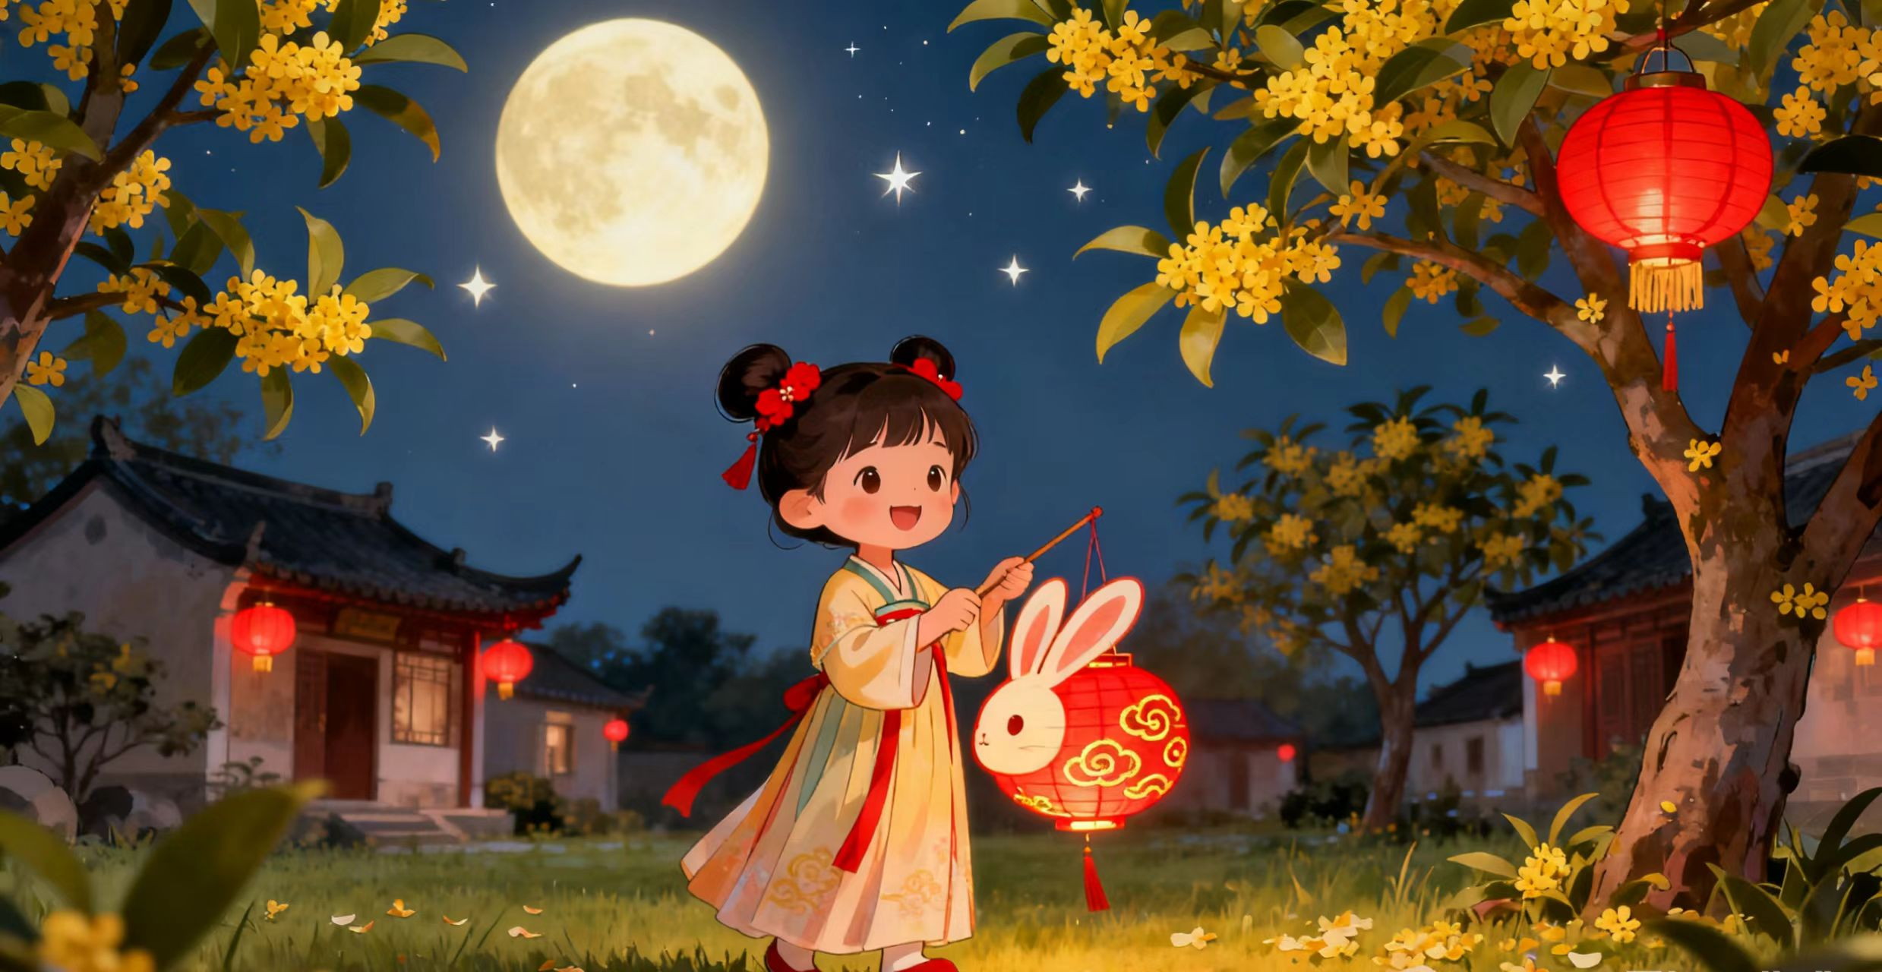
Ther is a beautiful story about this festival. A lady named Chang'e lives on the moon with her rabbit. Long ago she flew to the moon and stayed there. When we look at the moon, we think of Chang'e and her rabbit friend. Children carry colorful lanterns during Mid-Autumn Festival. The lanterns glow like small moons in the dark. We play games and tell stories under the moonlight. Some children make wishes on the bright moon.

Slide 4
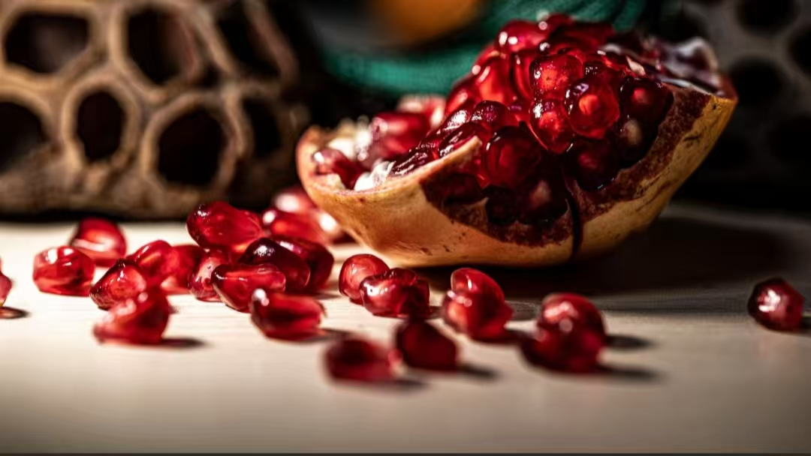
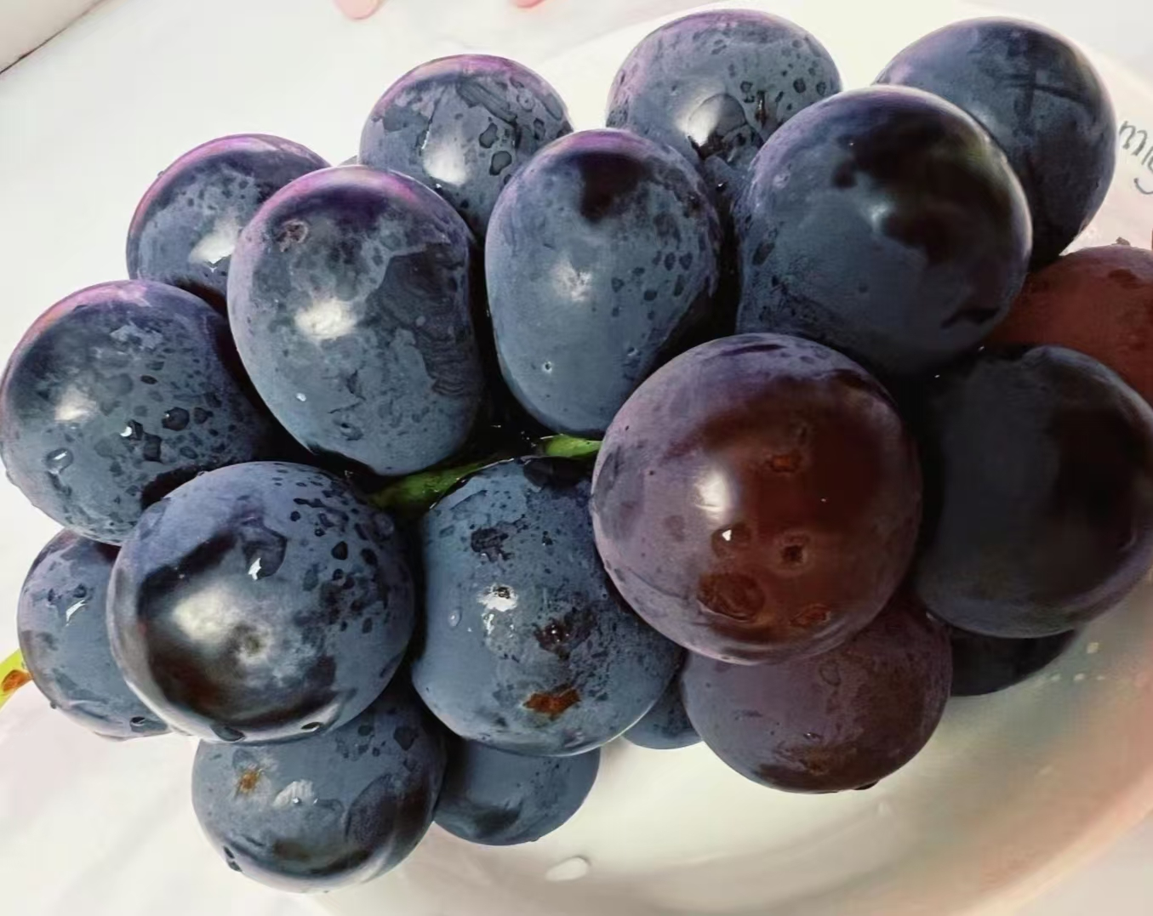
In the Mid-Autumn Festival,we also enjoy fruits like pomegranates and grapes.These fruits are in season during autumn.Everything we eat is round to match the full moon.
Mid-Autumn Festival teaches us about family love.When the moon is full and bright,we remember how important our family is.

Slide 5
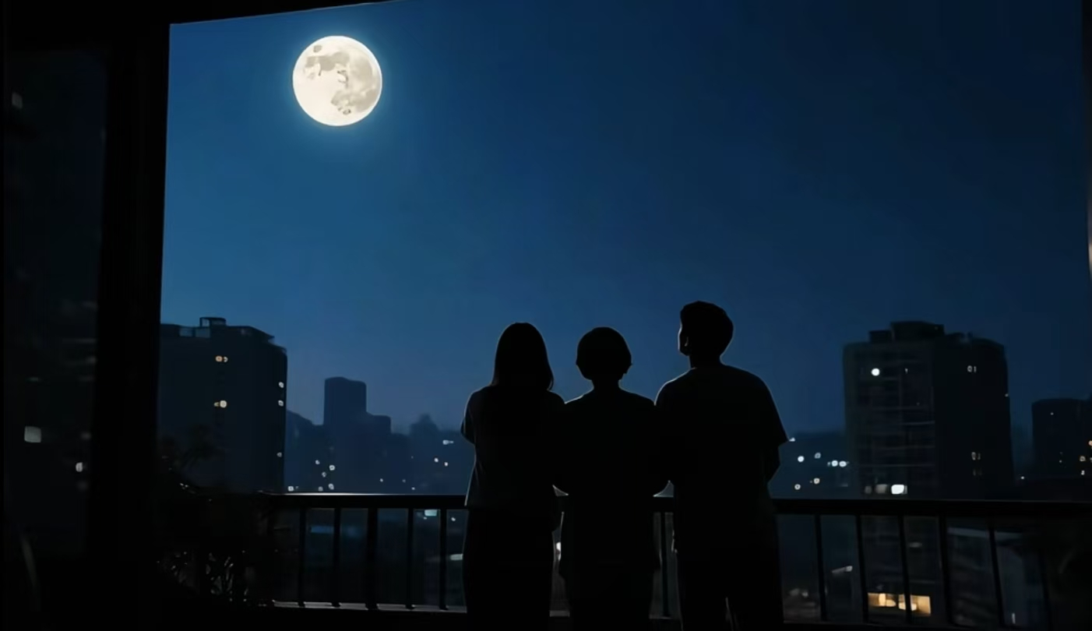
Families sit outside together on this night.Even if relatives live far away,they look at the same moon.This makes everyone feel connected and happy.The round moon means family unity and togetherness.No matter how times change,it remains a warm festival in people’s hearts,giving a home to every piece of longing and hope.

Slide 6
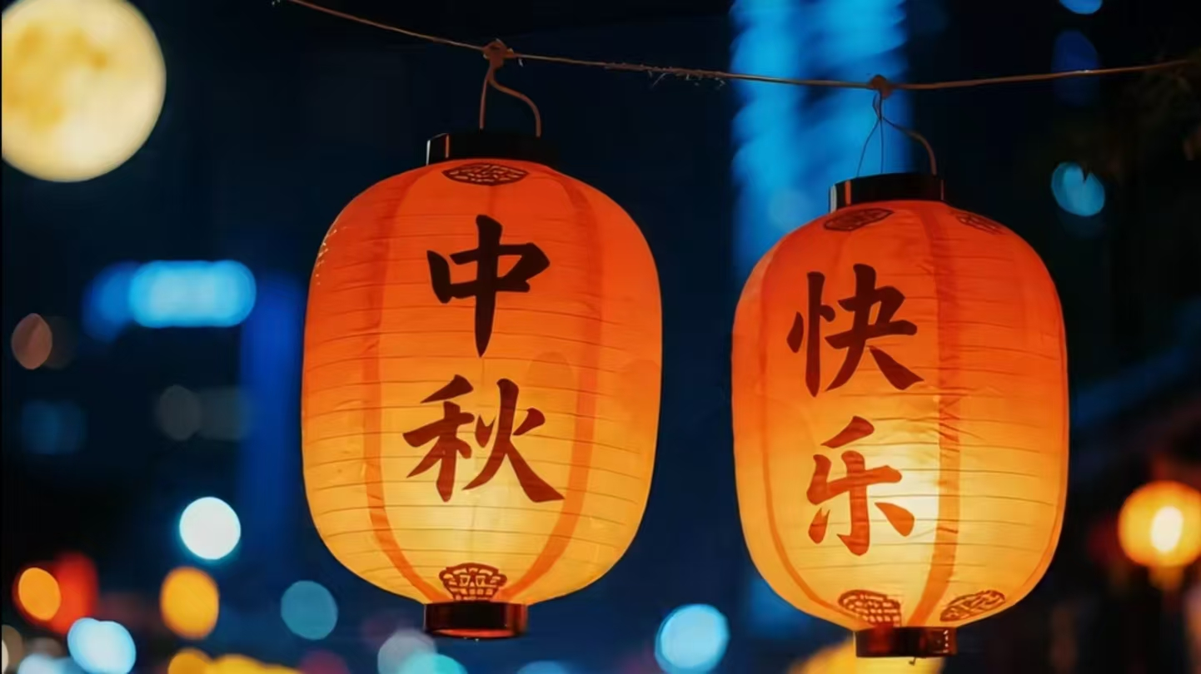
THANK YOU !

