Slide 1

How to Introduce People

Slide 2
01.
Dicussion
目
02.
7 situations
03.
exercise
录

Slide 3

主观题
10分
Why does Janet introduce Mr. liu first, and herself last?
作答

Slide 4
Discussion
Why does Janet introduce Mr. liu first, and herself last?

Slide 5
7 situations
Individuals to each other

Slide 6
填空题
5分
individuals using [填空1]
作答

Slide 7
7 situations
someone who has a title

Slide 8
填空题
5分
答案解析
someone who has a title [填空1]
此处添加答案解析
作答
可为此题添加文本、图片、公式等解析，且需将内容全部放在本区域内。

Slide 9
7 situations
younger or less prominent

Slide 10
7 situations
specific relationship

Slide 11
7 situations
specific relationship

Slide 12
填空题
5分
specific relationship
[填空1]
作答

Slide 13
7 situations
individual and group

Slide 14
conclusion

Slide 15
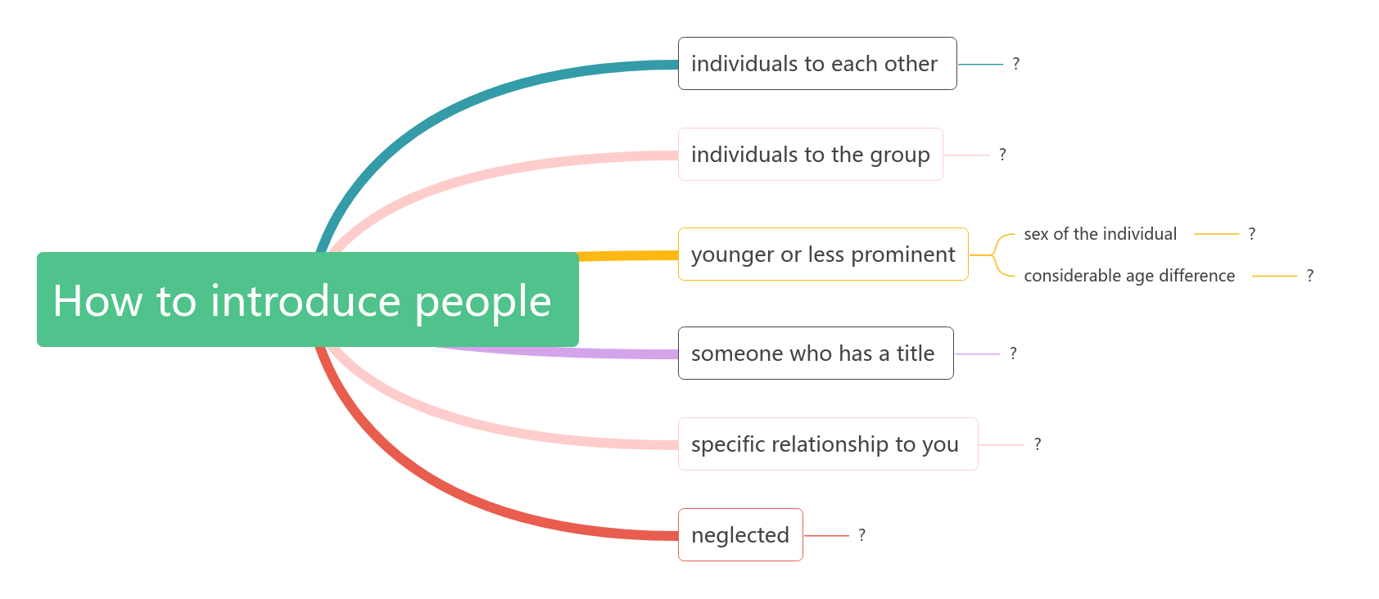
主观题
10分
请您编辑题干
作答

