Slide 1
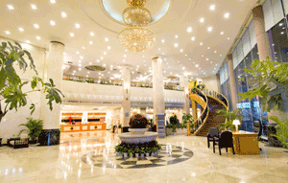
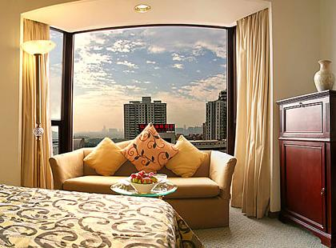
锦江十条礼仪准则 仪表、微笑、问候、让路、起立 优雅、关注、尽责、致歉、保洁

Slide 2
仪表 按照岗位要求着装，保持良好仪容、仪表。胸牌完整整洁戴在左胸前。

Slide 3
Dress according to job requirements and maintain good appearance. Wear a badge on the left chest.

Slide 4
微笑 始终向你目光相遇的客人微笑

Slide 5
Always smile at the guests who meet your gaze.

Slide 6
问候 在迎面相逢并且目光相遇时，都要热情问候客人，自然亲切，声音适中，并尽可能尊称客人的姓氏。

Slide 7
When facing each other and meeting with eyes, warmly greet the guests. Respectfully address the guest's surname.

Slide 8
让路 与客人相逢时，要止步侧身礼让，并致微笑和问候。

Slide 9
When encountering guests, one should stop and yield to them with a smile and greetings.

Slide 10
起立 居坐时遇客人来访，要主动起立，微笑，问候并热忱服务。

Slide 11
When encountering guests visiting while sitting, one should take the initiative to stand up, smile, greet, and provide enthusiastic service.

Slide 12
优雅 在客人活动场所要动作轻缓，言语低调，举止优雅。铃响三声内接听电话，通话结束后，要等客人先挂电话，方可轻挂电话

Slide 13
In the guest activity area, movements should be gentle, language should be low-key, and behavior should be elegant.

Slide 14
关注 目光要始终关注客人，尽量预先察觉并提前满足客人需求。

Slide 15
Dress according to job requirements and maintain good appearance. Wear a badge on the left chest.

Slide 16
尽责 永远不对客人说“不”，按首问负责制度和程序，遇有自己不能解答的问题，或不属于本岗位职责的事宜，要主动联系办理。遇有客人询问店内场所，不仅要指明去向，还要尽可能陪同前往。

Slide 17
Dress according to job requirements and maintain good appearance. Wear a badge on the left chest.

Slide 18
致歉 为自己或同事的失误向客人真诚道歉，并要使投诉的顾客立即得到安抚，及时快速采取补救行动，尽最大可能让客人满意，并予以复核。

Slide 19
Dress according to job requirements and maintain good appearance. Wear a badge on the left chest.

Slide 20
保洁 维护饭店环境整洁，遇有烟头、纸屑等废弃物要主动捡拾，发现有摆放不当的物品，要主动恢复。

Slide 21
Dress according to job requirements and maintain good appearance. Wear a badge on the left chest.

