Slide 1
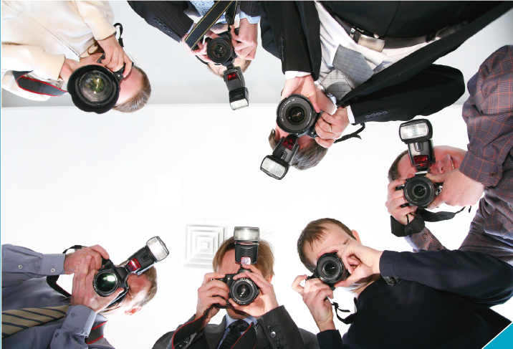
Unit 10
Advertising

Slide 2
Job Interviews
Warm-up
UNIT 10
CONTENTS
Part I
Part II
Listening Practice
Language Focus A
Part III
Part IV
Video 1
Language Focus B
Part V
Part VI
Video 2
Business Culture
Part VII

Slide 3
Part I
Warm-up

Slide 4
Work in pairs. The following are logos of eight famous companies. How and where do they advertise their products?
Ikea: catalogues
Nestlé: TV commercials, magazines
McDonald’s: sports sponsorship, outdoor billboards, TV commercials
China Unicom: outdoor billboards, TV commercials
Starbucks: word of mouth
Volkswagon: magazines, TV commercials, outdoor billboards

Slide 5
Part II
Listening Practice

Slide 6
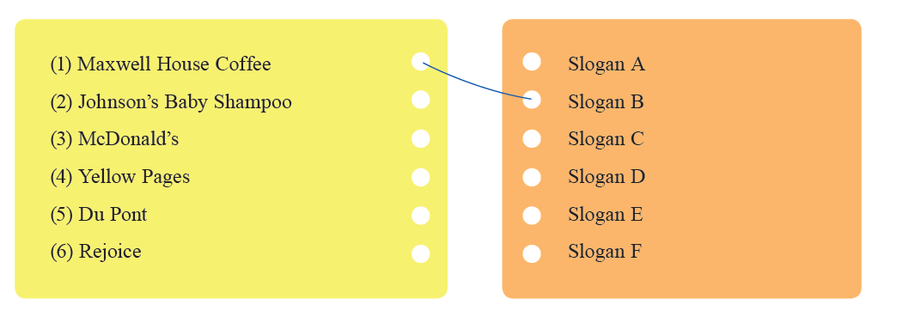
Task 1
Listen to the advertising slogans twice, and then decide which companies they are from. The first one has been done for you.
Script

Slide 7
Script

Slide 8
Task 2

Slide 9
1. Listen to Martin Jones, an Advertising Manager, talking about his job and fill in the blanks.
products
companies
image
hear
read
information
respond to
prospects
salespeople
customers
Script

Slide 10
Script

Slide 11
2. Listen to the advertisements from three advertising agencies: Verity, Impact Ads and Transworld. What different images do they stress in their ads?
a
c
b
Script

Slide 12
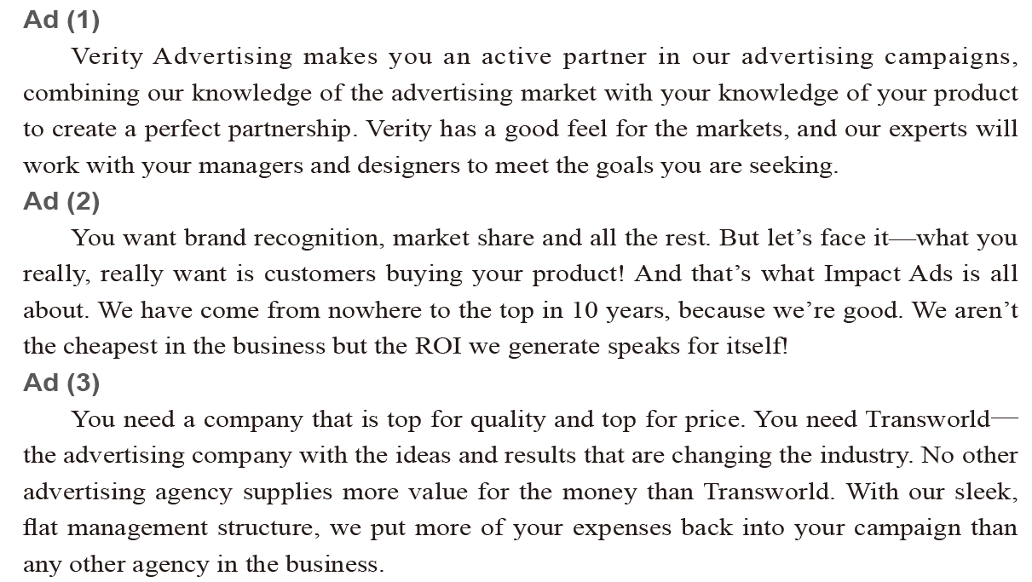
Script

Slide 13
Part III
Language Focus A

Slide 15
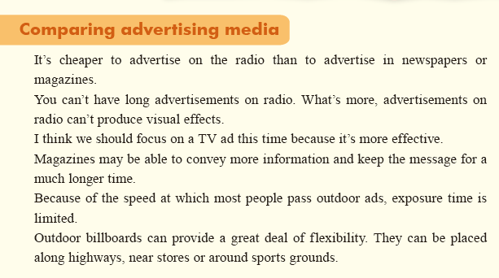

Slide 16
Follow-up Practice
1. 1. Review the following methods by which a company can advertise its product. Have you noticed these forms of advertising media in your daily life? Can you give the names of the companies who apply these methods?
Reference answer:
Leaflets & flyers: local shops and fitness clubs
Showrooms: Nokia, Toyota
Sports sponsorship: Coca-Cola, Benz
Radio advertising: local restaurants
TV commercials: Amway, McDonald’s
The Internet: IBM
Magazines: Omega, Dell
Outdoor billboards: China Unicom, PetroChina

Slide 17
Follow-up Practice
2. Listen to the dialogue between two staff members from Advertising Department about their choice of advertising approaches. How do they evaluate their options?
expensive
budget
too expensive
highway
subway
train
young people
Script

Slide 18
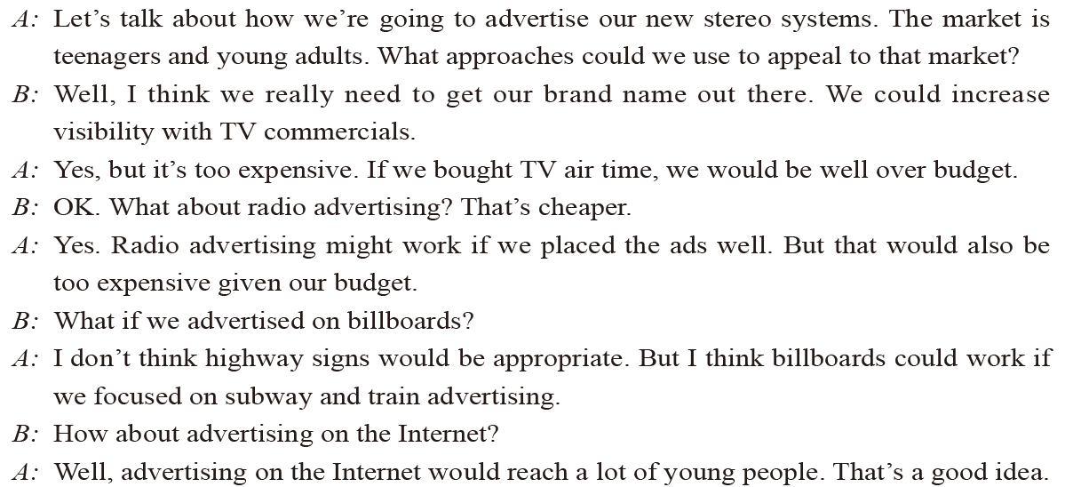
Script

Slide 19
Part IV
Video 1
Advertising media

Slide 21
Pre-viewing
1. Suppose you are the Advertising Manager of a clothing company. The company is planning to promote a range of casual clothing targeted at young people. Which of the following media would you choose in the advertising campaign?
√
√
√

Slide 22
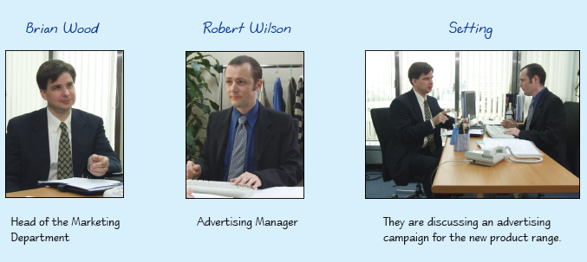
Pre-viewing
2. Look at the following pictures to have a rough idea of the video.

Slide 23
Viewing
1. Watch the video. Note down how many kinds of advertising media are mentioned in the discussion, and what they are.
sponsorship; posters; radio; TV commercials
Script

Slide 24
Script
Advertising media
Brian: We’ve got a number of promotions coming up over the summer.
Robert: And are we going to be promoting new product lines or old stock?
Brian: A bit of both. First of all we’re planning introductory offers on some of our major
new products—the casual clothing range. We’ll be running a major advertising
campaign for them.
Robert: Well, the advertising campaign obviously has to be aimed at young people.
Brian: Yes, and what’s urgent now is to come up with something that is really attractive
and effective.
Robert: Did our sponsorship proposals go anywhere?
Brian: Not certain yet, but it looks as though we could be signing a sponsorship deal
with one of China’s first league football clubs.
Robert: Great. And what about the posters? I suggest we don’t put up posters outside
urban areas. Posters in the countryside are seen as environmentally unfriendly by
our target customers. We’ve chosen one or two sites in major cities and put up
very large posters on the side of buildings and smaller ones on bus stops used by
university and college students.
Brian: That’s good. Any other ideas?
Robert: What if we advertised on rock radio stations? That would reach the right
audience. And it wouldn’t be too expensive.

Slide 25
Script
Brian: But time is rather limited. You can’t have long advertisements on radio. What’s
more, advertisements on radio can’t produce visual effects.
Robert: What about advertising on TV?
Brian: TV commercials would be very good. We need to create strong visual effects
for our products. We’d better advertise at prime time and early evening to catch
the late teenagers and college students before they go out for the evening.
Robert: Right! You mentioned older product lines, too.
Brian: That’s right. We’ve got a problem with excess stock on a couple of lines.
Robert: So we need to come up with ways to move the stock.
Brian: Exactly. Profitability isn’t really important with this one. We could drop prices
by maybe 25% across the board and we need to work out some special offers too.
Robert: Maybe we could double the discount for loyalty card holders on selected
products.
Brian: Yes, that would probably be workable. And mail all card holders to let them
know about the special offers.
Robert: OK. I’ll take care of that.
Brian: So much for today then. Let’s discuss the details with the others later. Thank you
for your input.

Slide 26
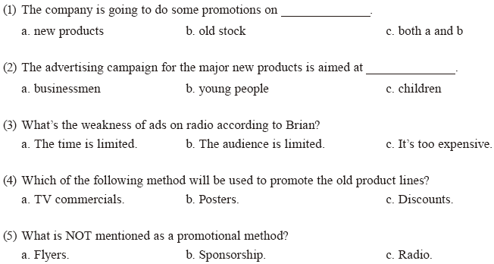
2. Watch the video again. Choose the correct answer to each question.
c
b
a
c
a

Slide 27
Post-viewing
Work in pairs. Make up a dialogue according to the following situation.

Slide 28
Part V
Language Focus B

Slide 30
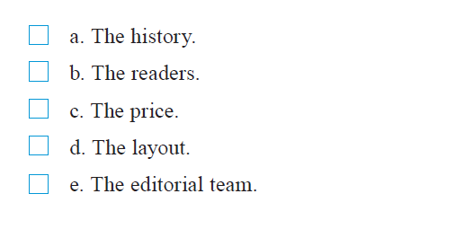
Follow-up Practice
1. Read the items listed below. Which of them are mentioned in the ad you hear?
√
√
Script

Slide 31
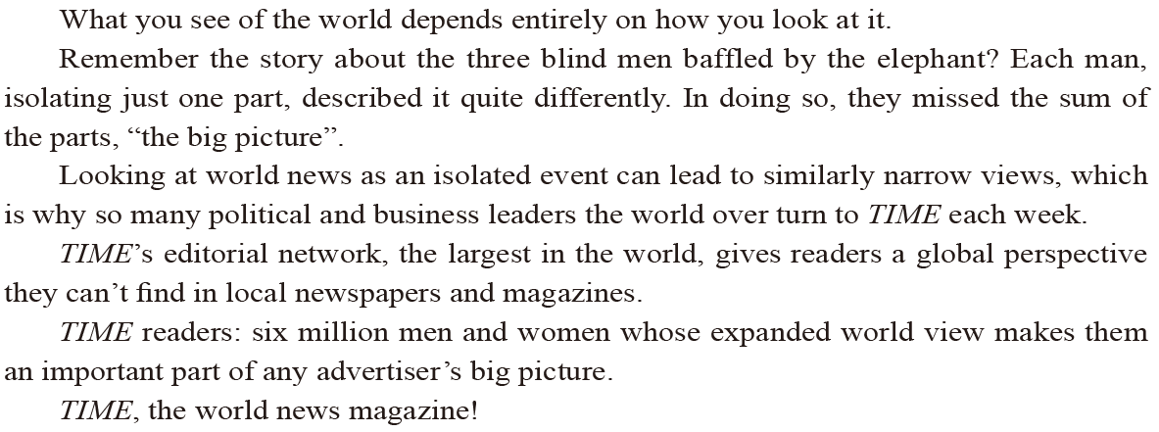
Script

Slide 32
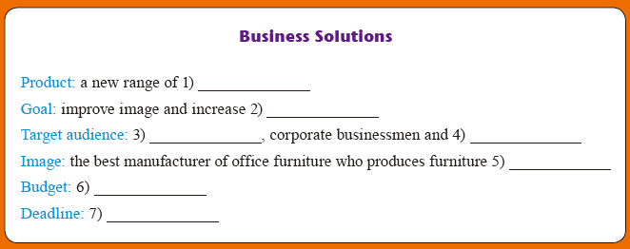
Follow-up Practice
2. Ms. Lynch from a furniture company is consulting Mr. Howard about how to make a TV commercial. Listen to their conversation and complete the note.
office furniture
brand awareness
self-employed professionals
business executives
successful people dreamt of
under half a million dollars
April 15
Script

Slide 33
Script
Mr. Howard: Good morning, Ms. Lynch. What can I do for you?
Ms. Lynch: We need someone to design and make a TV commercial for our
new products.
Mr. Howard: Then you’ve found the right person. I’ve got five years’ experience in
the advertising field. What kind of product would you like to
advertise, Ms. Lynch?
Ms. Lynch: A new range of office furniture.
Mr. Howard: What’s the main goal you want to achieve?
Ms. Lynch: We’d like to improve our image as well as to increase awareness of
our brand.
Mr. Howard: What kind of image would you like to develop?
Ms. Lynch: We want to create an image which symbolises modern efficiency,
elegance, prosperity and product reliability as well.
Mr. Howard: OK. What kind of target audience would you like to reach?

Slide 34
Script
Ms. Lynch: Business executives, corporate businessmen and self-employed
professionals.
Mr. Howard: What kind of message do you want to send to your potential customers?
Ms. Lynch: We’d like them to realise that we’re the best manufacturer of office
furniture and that we produce furniture successful people dream of.
Mr. Howard: Now, could you tell me what your budget is?
Ms. Lynch: Sure. We’d like to cover all the costs of designing and making the ad in
under half a million dollars.
Mr. Howard: I see. How soon would you like it to be finished?
Ms. Lynch: The sooner the better. April 15 is the deadline.
Mr. Howard: OK. I’ll draft three alternative options for you to choose from within the
next week. But first I need to have a look at your products. Is it
convenient if I pay you a visit at ten tomorrow morning?
Ms. Lynch: Yes, of course.
Mr. Howard: See you tomorrow then.
Ms. Lynch: Thank you. See you then.

Slide 35
Part VI
Video 2
What makes a good ad?

Slide 36
Pre-viewing

Slide 37
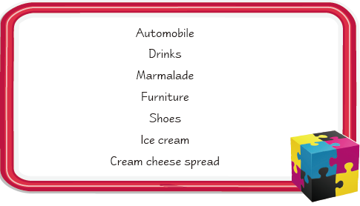
Viewing
1. Watch the video. The ads of some of the following products are mentioned in the discussion. What are they?
√
√
√
√
Script

Slide 38
Script
What makes a good ad?
Teacher: Well, we’ve listened to a couple of radio ads and watched two TV commercials
as well. What do you think of them? Are they good ads?
Student 1: I like the one about the breakfast marmalade. I think an ad is only successful if
it reaches the target market. Marmalade is a product mainly consumed by old
people at breakfast. So placing the ad on a radio station which plays classical
music in the morning makes a lot of sense. Old people love classical music.
Every morning when they sit down for breakfast, they will hear this ad.
Teacher: Yes. It’s a good match. An ad can’t be effective unless it gets through to the
target customers.
Student 2: Speaking of target customers, a good ad should take these customers’ tastes
into account. The TV commercial about ice cream targets children. This ad
is funny. It makes children laugh. And it’s also simple and so it can be easily
understood. It appeals to the target customers.

Slide 39
Script
Teacher: That means a good ad should attract the attention of the target customers.
Student 3: The Toyota commercial appeals to me because it tells an interesting story. It
doesn’t hurt that it provides a bit of shock either.
Student 4: I love that one too. If an ad tells a story, it’ll draw more people in. And
it is easier for the audience to remember a story than just some empty or
meaningless words that brag about how good the product is.
Teacher: Yes. You’ve got the point there!
Student 3: Sometimes the power of ads is unbelievable. I remember a TV commercial
about furniture. It created such a warm atmosphere that I felt like getting
married right then and there. I really wanted to have a home like that!
Teacher: That’s the immediate response to an ad that advertisers are looking for. Ads
can also be emotional, to make people want to buy the product immediately.
Student 2: Those are the most effective ads.
Teacher: Yes. The ultimate aim of the manufacturers is to get customers to buy their
products. So if an ad sells products, then it’s a good ad… OK, so much for
today. Next time, we’ll move on to the advertising media…

Slide 40
2. Watch the video again. Match each product with the reason that the student gives for liking its ad.

Slide 41
Post-viewing
Work in small groups. What are your favourite TV commercials? Describe them to your partners and explain why you think they are effective.

Slide 42
Sample
I like the Kodak commercial. Several pictures of a little boy are taken in the commercial. For example, in the morning, the little boy is brushing his teeth together with his dad. They are bending over shoulder to shoulder and they have toothpaste bubbles in their mouths. Then they look at each other and smile. The photograph catches the smile perfectly. In another clip, the little boy is having a haircut. He has a white towel under his neck and scissors snipping about his head. The boy suddenly cries and the photograph is taken. It’s very funny. I think the commercial conveys the message that Kodak records your life. It’s very impressive.

Slide 43
Part VII
Business Culture

Slide 46
Text Bank

Slide 47
THANKS

