Slide 1
Unit 3
Making
Enquiries

Slide 2
Making
Enquiries
Warm-up
UNIT 3
CONTENTS
Part I
Part II
Listening Practice
Language Focus A
Part III
Part IV
Video 1
Language Focus B
Part V
Part VI
Video 2
Business Culture
Part VII

Slide 3
Part I
Warm-up

Slide 4
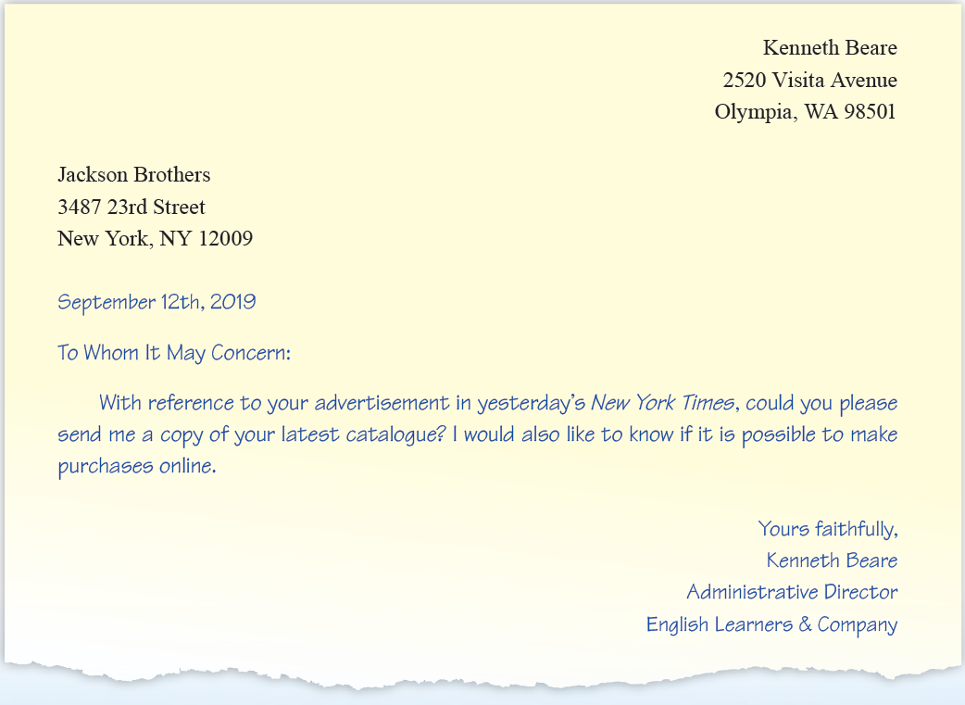
We write an enquiry when we want to ask for more information concerning a product or service that interests us. Read the enquiry letter and answer the following questions.

Slide 6
Part II
Listening Practice

Slide 7
Task 1
Contracts involving international business often contain abbreviated trade terms that describe matters such as the time and place of delivery and the payment method. Listen to the definitions of the shipping terms and payment methods and match the definitions with the following terms.
C (Free Alongside Ship)
B (Free on Board)
A (Cost & Freight )
Script

Slide 8
Script

Slide 9
Task 2

Slide 10
2. You will hear an importer talking about enquiries. Listen and fill in the blanks.
General
articles
Specific
content
specifications
Script

Slide 11
Script

Slide 12
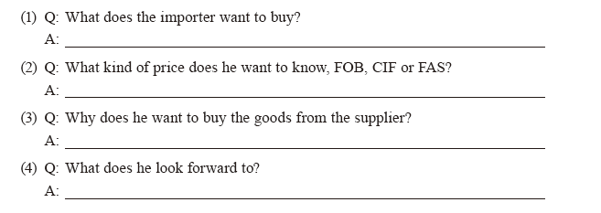
2. Listen to an enquiry made by an importer and answer the following questions.
Steel screws in all sizes.
CIF.
Because the supplier is able to supply larger quantities at more attractive prices.
The supplier’s offer.
Script

Slide 13
Script

Slide 14
Part III
Language Focus A
Enquiry

Slide 15
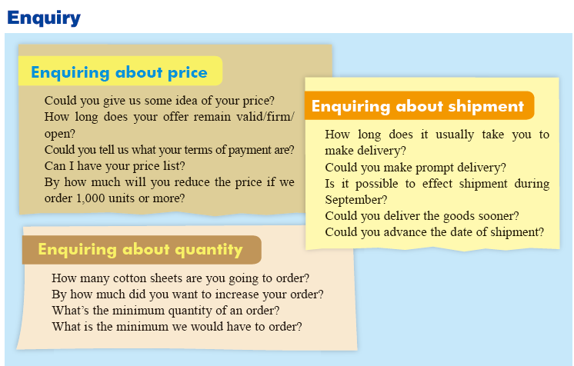

Slide 17
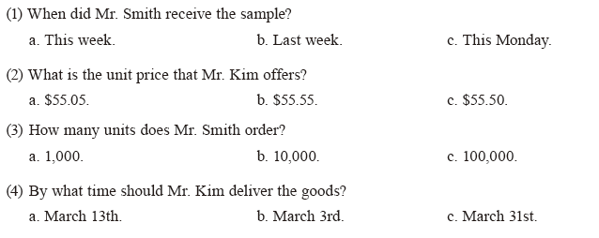
Follow-up Practice
1. You will hear a conversation between Mr. Kim, a seller, and Mr. Smith, a buyer. Listen to the conversation and then choose the correct answers to the questions.
b
c
b
c
Script

Slide 18
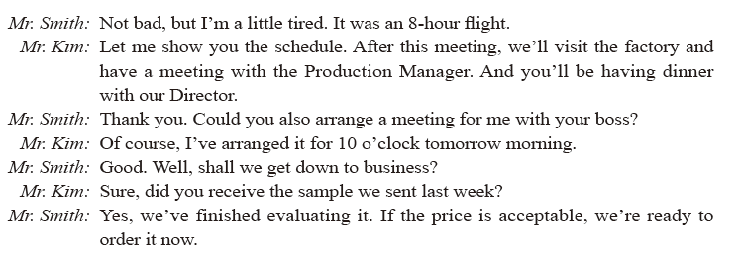
Script

Slide 19
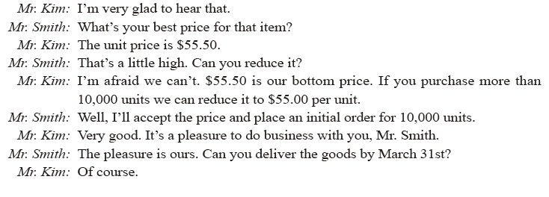
Script

Slide 20
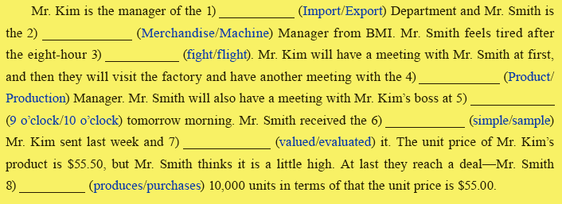
Follow-up Practice
2. Listen to the conversation again and choose the correct answers to complete the paragraph.
Export
Merchandise
flight
Production
10 o’clock
sample
evaluated
purchases
Script

Slide 21
Part IV
Video 1
Enquiring about price

Slide 23
Pre-viewing

Slide 24
Viewing
1. Watch the video and fill in the following blanks.
Script

Slide 25
Viewing
1. Watch the video and fill in the following blanks.
speedboats
around the corner
price quote
pay

Slide 26
2. Watch the video again. This time please pay attention to what Rocky says and fill in the blanks.
US$6,500
10%
shipment
US$7,850
Script

Slide 27
Script
Enquiring about price
Jacques: Good morning, is that Rocky speaking?
Rocky: Morning, this is Rocky. Is that Jacques?
Jacques: Yes.
Rocky: Nice talking to you again. How’s the weather in your part of the world?
Jacques: Terrific. Sunny, 28°C, light breeze...
Rocky: Stop! I can’t take any more. It’s snowing here! So, what can I do for you, Jacques?
Jacques: I need a couple of your Q2000 speedboats to rent to my guests. Can you give me a quote?
Rocky: Let’s see... Uh, the list price is US$6,500. You’re a valued customer, so I’ll give you a 10% discount.
Jacques: That’s very reasonable. Do you have them in stock?

Slide 28
Script
Rocky: Sure we do! We set up new inventory controls last year, so we don’t have any backlogs any more.
Jacques: That’s good. The tourist season is just around the corner, so I need them pretty quick. What’s the earliest shipping date you can manage?
Rocky: They can be ready for shipment in two to three weeks.
Jacques: Perfect. What’s the total CIF price, Rocky?
Rocky: Hang on... The price will be US$7,850 to your usual port. Do we have a deal?
Jacques: You bet! Send me a fax with all the information, and I’ll send you my order right away. I’ll organise a letter of credit, as usual. Same terms as always?
Rocky: Of course.
Jacques: Great, Rocky. Bye. Wait a minute. Please say hello to your family for me.
Rocky: Thank you and the same goes for me. Bye, Jacques.

Slide 29
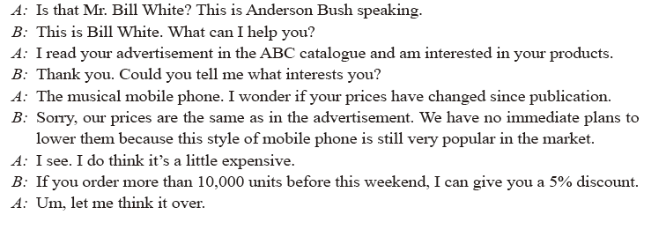
Post-viewing

Slide 30
Part V
Language Focus B
Counter-offers

Slide 34
Follow-up Practice
1. You Listen to the conversation and decide whether the following statements are true (T) or false (F).
F
T
F
T
Script

Slide 35
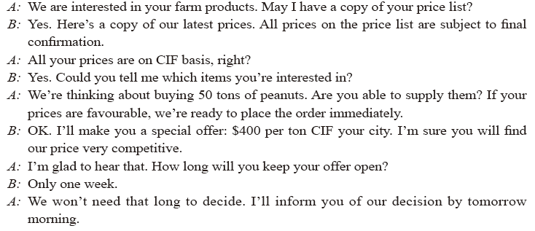
Script

Slide 36
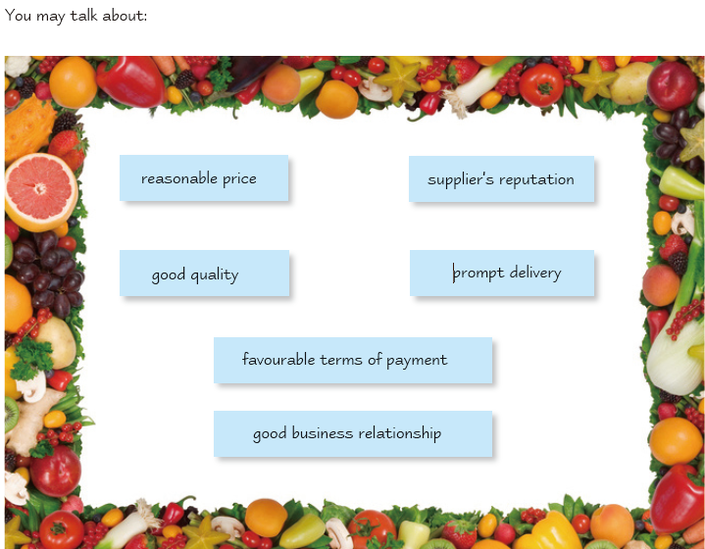
Follow-up Practice
2. Work in pairs. Discuss with your partner what would concern you most if you were buying products from a farm.

Slide 38
Part VI
Video 2
Commission in business

Slide 40
Pre-viewing

Slide 41
Viewing
1. Watch the video and choose the correct answer to each question.
Script

Slide 42
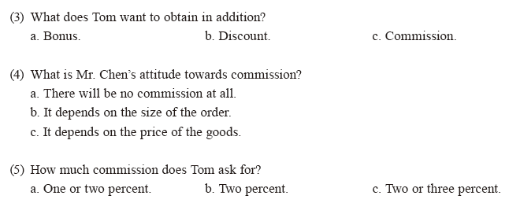
Viewing
1. Watch the video and choose the best answer to each question.
c
a
c
b
Script
c

Slide 43
Script
Commission in business
Tom: I’m glad to have the chance to visit your corporation. I’m eager to do business
with you.
Mr. Chen: That’s good to hear. I believe you’ve seen the exhibits in the showroom. What particular items are you interested in?
Tom: I’m interested in your hardware. I’ve seen the exhibits and studied your
catalogues. I think some of the items will find a ready market in Italy. Here’s a list of my requirements. I’d like to have your lowest quotations, CIF Rome.
Mr. Chen: Thank you. Tell us the quantity you need, so we can work out the offer.
Tom: I’ll do that. Meanwhile, could you give me an indication of price?
Mr. Chen: This is our FOB price list. All the prices on the list are subject to confirmation.
Tom: What about the commission? From European suppliers I usually get a 3–5%
commission for my imports. It’s the general practice.
Mr. Chen: As a rule, we do not give any commission. But if the order is large enough,
we’ll consider it.
Tom: You see, I do business on commission basis. A commission on your prices would make it easier for me to promote sales. Even just 2% or 3%.
Mr. Chen: We’ll discuss this when you place your order with us.

Slide 44
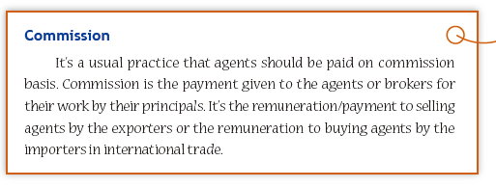
2. Watch the video again, think over and discuss what role commission plays in business.

Slide 45
Post-viewing
1. Work in pairs. Work in pairs. One of you is the representative of the seller and the other is the representative of the buyer. Choose a card and make a conversation according to the situation described on the card.

Slide 46
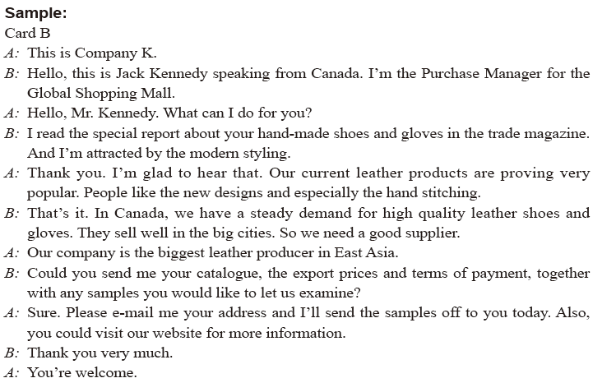

Slide 47
Part VII
Business Culture

Slide 49
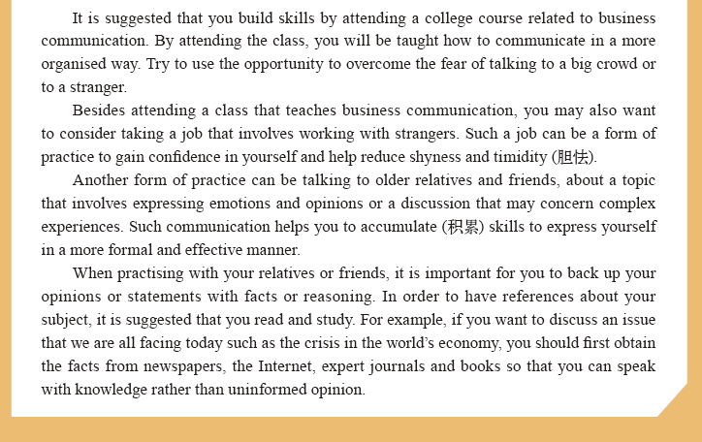

Slide 50
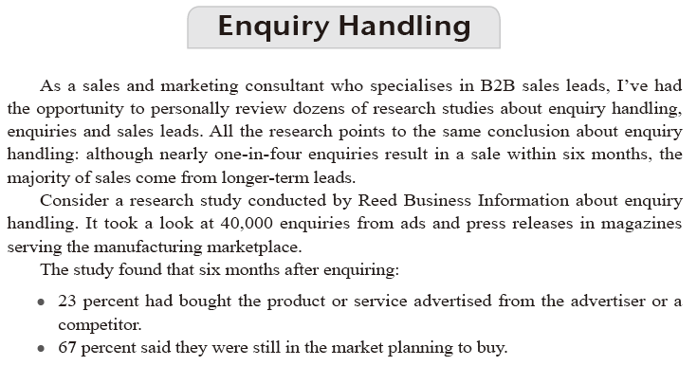
Text Bank

Slide 51
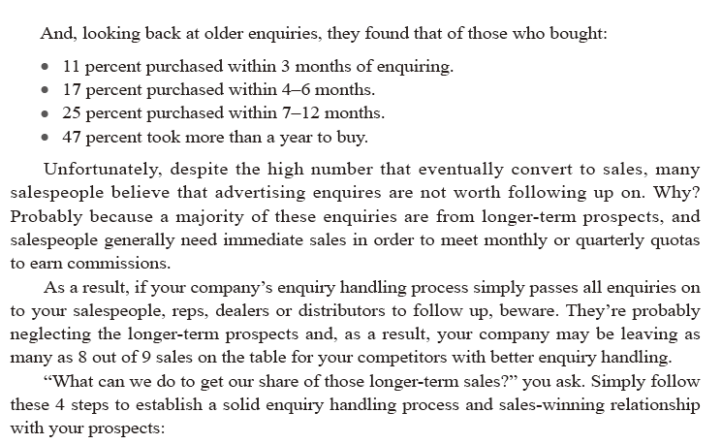

Slide 52
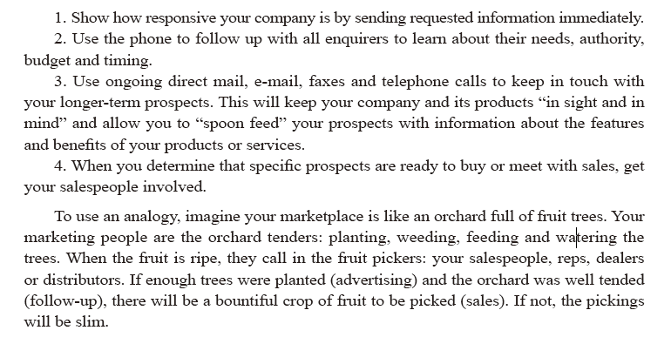

Slide 53
THANKS

