Slide 1

虚拟语气在其他场合的运用

Slide 2

新思维建构英语语法
请根据虚拟语气在不同句子结构中的运用，对下列句子进行分类
① I suggest that you (should )stay at home in the evening.
② His proposal is that she (should )apply for the post.
③ I wish I were young again.
④ It is essential that we(should ) learn English well.
⑤ I would rather you played with your friend outside.
⑥ It is desirable that interest rates(should ) be reduced.
⑦ My mother wishes she hadn’t said that.
⑧ He would rather he had been there then.
⑨ He give orders that everyone (should )be present in the meeting.
⑩ They would rather they stayed at home tomorrow.
⑪ It was requested that the meeting (should )be cancelled.
⑫ We wish housing prices would come down further.
焦作师范高等专科学校

Slide 3

新思维建构英语语法
请根据虚拟语气在不同句子结构中的运用，对下列句子进行分类
类别一 _______①②⑨⑪ _______________________
类别二 _______④⑥ ___________________________
类别三 _______③⑦ ⑫ ________________________
类别四 _______⑤⑧⑩ _________________________

Slide 4

新思维建构英语语法
系统归纳
① I suggest that you (should) stay at home in the evening.（宾语）
② His proposal is that she (should) apply for the post.（表语）
⑨ He give orders that everyone (should) be present in the meeting.（同位语）
⑪ It was requested that the meeting (should) be cancelled.（主语）

Slide 5

新思维建构英语语法
系统归纳
④ It is essential that we (should)learn English well. （主语）
⑥ It is desirable that interest rates (should ) be reduced. （主语）

Slide 6

新思维建构英语语法
系统归纳
③ I wish I were young again. （宾语）
⑦ My mother wishes she hadn’t said that. （宾语）
⑫ We wish housing prices would come down further. （宾语）

Slide 7
新思维建构英语语法
系统归纳
⑤ I would rather you played with your friend outside. （宾语）
⑧ He would rather he had been there then.（宾语）
⑩ They would rather they stayed at home tomorrow. （宾语）
焦作师范高等专科学校

Slide 8
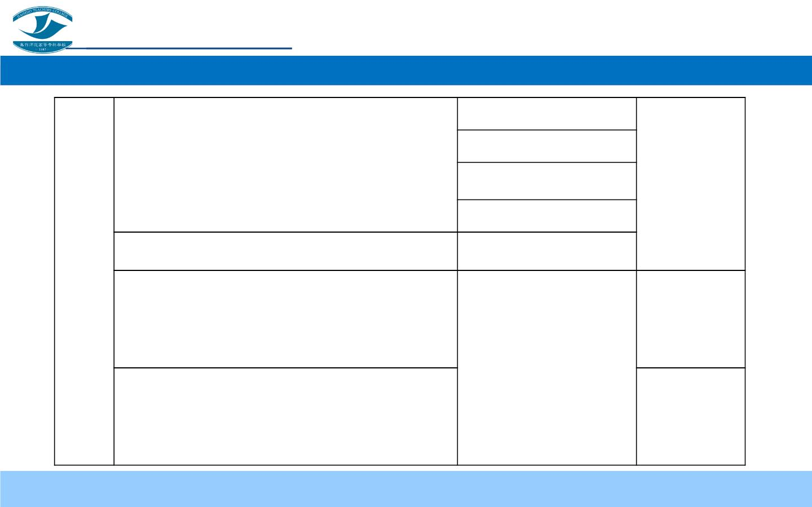
新思维建构英语语法
虚拟条件句
主+ 建议v. +分句
建议n.+be +分句
虚 拟
表“建议、命令、要求、坚持”等词
（should）
主+动+建议n+分句
语 气
在 其
他 场
do
It + be +建议pp.+分句
necessary，appropriate，urgent，important It + be +形容词+分句
were/did ;
had done;
would do
were/did ;
had done;
were/did
合 的 wish
与现在事实相反
与过去事实相反
运用
(一)
would rather, would as soon, might as well, 与将来事实相反
would prefer

Slide 9

新思维建构英语语法
知识拓展
The teacher treats me well as if I were her own child.
He remembered the accident exactly as if it had happened yesterday.
She cannot stand steadily as if she were going to faint.
If only I were you.
If only you had been on the spot then.
If only I would be the richest person in the future.

Slide 10

新思维建构英语语法
知识拓展
Even if he were rich, he wouldn’t spend money like that.
Even if I had met her in person, I couldn’t have recognized her.
Even if he were handsome, I wouldn’t make me fall in love him.

Slide 11

新思维建构英语语法
知识拓展
He run away lest he (should) be arrested.
I dare not tell you her address for fear that she should be angry with me.

Slide 12
新思维建构英语语法
知识拓展
It is high time that you made up your mind.
It is time that you should go to school.

Slide 13
新思维建构英语语法
知识拓展
May you succeed!
God bless you!
Long live the People’s Republic of China!

Slide 14
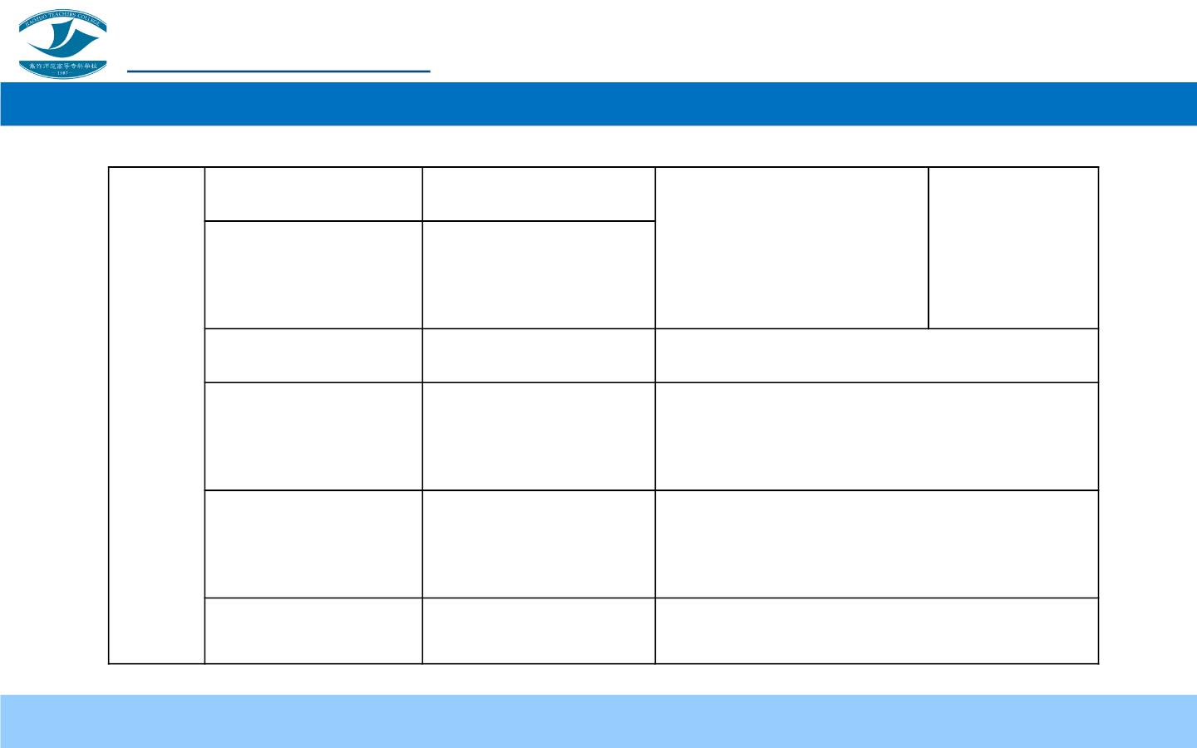
新思维建构英语语法
仿佛
虚 拟 要是…就好了
语 气
as if/as though
If only
与现在事实相反
与过去事实相反
与将来事实相反
were/did ;
had done;
would do
在 其 即使
他 场 以免，为了
合 的
even if
同if虚拟条件句
lest/in case/
for fear that
It is (high/
should do
运 用
were/did/
should do
be
该……时间
(二)
about)time that
May…/固定句
表祝愿、诅咒

Slide 15
新思维建构英语语法
请结合今天学习的知识，选出最恰当的一项，并给出一个合理的解释。
(1) His advice is that I _____ to apologize to her.
A. went
B. go
C. goes
D. has gone
(2) I don’t think it advisable that Tom _____ the news.
A. be informed
B. is informed
C. will be informed
D. has been informed
(3) It is necessary that she _____ her homework tomorrow.
A. finished B. will finish C. would finish
(4) It’s high time _____ about the traffic problem.
D. finish
A. something is done
C. anything will be done
B. something was done
D. nothing be done

Slide 16
新思维建构英语语法
请结合今天学习的知识，选出最恰当的一项，并给出一个合理的解释。
(5) If you _____the medicine earlier, you would be better soon.
A. takes
(6) I would rather you _____ to the party with her.
A. go B. will go C. went
B. would take
C. took
D. had taken
D. has gone
(7) I wish he _____ here yesterday. All of us were waiting for him.
A. come B. had come C. came D. will come
(8) It is requested that the tuition _____ in advance.
A. will have to be paid
C. should be paid
B. has to be paid
D. should have to be paid

Slide 17
新思维建构英语语法
请结合今天学习的知识，选出最恰当的一项，并给出一个合理的解释。
(9) We all agree to his proposal that the competition _____.
A. was put off
B. be put off
C. will be put off
D. should put off
(10) If only the committee_____ the regulations.
A. approve
C. can approve
B. will approve
D. would approve

Slide 18
新思维建构英语语法
答案呈现
(1) (B)
(6) (C)
(2) (A)
(7) (B)
(3) (D)
(8) (C)
(4) (B)
(9) (B)
(5) (D)
(10) (D)

