Slide 1
虚拟条件句

Slide 2
1
知识激活

Slide 3
2
探究学习

Slide 4
请根据句中动词的形式，并结合句意表达的不同时间概念，对下列句子进行分类。
① If I were you, I would choose this dress.
② If he were to be here next Monday, I would tell him the truth.
③ What would happen if there were no network one day?
④ If there were no cell phone, many people would not adapt to life.
⑤ If you had worked harder, you would have passed the CET6.
⑥If he had come earlier, he would have caught the train.
⑦ If she should leave right now, she would get there on Christmas.
类别一 __________________________________
类别二 __________________________________
类别三 __________________________________

Slide 5
请根据句中动词的形式，并结合句意表达的不同时间概念，对下列句子进行分类。
① If I were you, I would choose this dress.
② If he were to be here next Monday, I would tell him the truth.
③ What would happen if there were no network one day?
④ If there were no cell phone, many people would not adapt to life.
⑤ If you had worked harder, you would have passed the CET6.
⑥If he had come earlier, he would have caught the train.
⑦ If she should leave right now, she would get there on Christmas.
类别一 ______① ④_____________________
类别二 _____ ⑤ ⑥_____________________
类别三 ______② ③ ⑦ _______________

Slide 6
3
答疑解惑

Slide 7
4
系统归纳

Slide 8
系统归纳
① If I were you, I would choose this dress.
④ If there were no cell phone, many people would not adapt to life.

Slide 9
系统归纳
⑤ If you had worked harder, you would have passed the CET6.
⑥If he had come earlier, he would have caught the train.

Slide 10
系统归纳
② If he were to be here next Monday, I would tell him the truth.
③ What would happen if there were no network one day?
⑦ If she should leave right now, she would get there on Christmas.

Slide 11
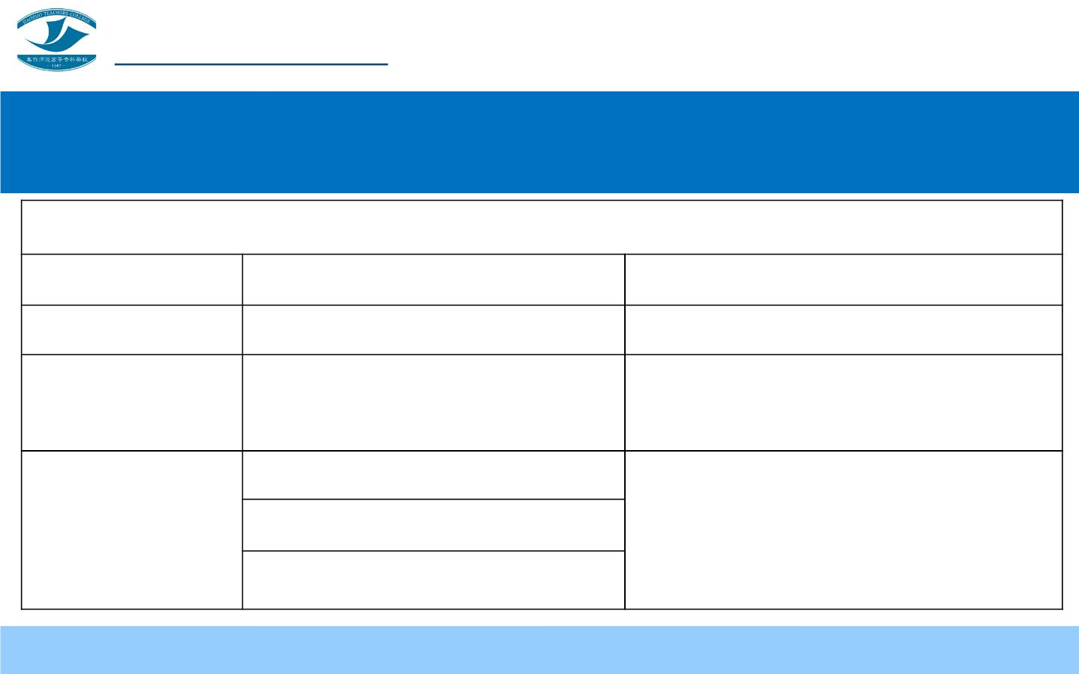
虚拟条件句
虚拟条件句
条件从句（动词形式）
主句（动词形式）
与现在事实相反 过去式（did/were）
should/would/could /might+do
should/would/could/might+have done
与过去事实相反 过去完成式（had done）
过去式（did/were）
与将来事实相反 should +动词原形（should do） should/would/could /might+do
were to+动词原形 (were to do)

Slide 12
5
自我评价

Slide 13
6
知识拓展

Slide 14
知识拓展
A . If I had worked harder，I would make more success now.
B. Without the Communist Party, there would be no such good life.
C. Were my mother alive, she would be happy with me.

Slide 15
名言翻译（1）
If things were to be twice, all would be wise.
假如凡事都可以重新做一次，人人皆可成为聪明人。
Life would be too smooth if it had no rubs in it.
生活若无波折险阻， 就会过于平淡无奇。
If a beard were a sign of smartness, the goat would be a Socrates.
要是胡子就是知识的象征，那么山羊也会成为苏格拉底。

Slide 16
名言翻译（2）
Were there no fools, there would be no wise man.
没有傻瓜就没有聪明人。
Had you the world on your chessboard, you could not fill all to your
mind.
即使把整个世界都放在你的棋盘上，也不能随你的心思布局。
Without books the development of civilization would have been
impossible.
没有书，就把不可能有文明的发展 。

Slide 17
7
巩固提高

Slide 18
请结合今天学习的知识，选出最恰当的一项，并给出一个合理的解释。
(1) _____ his advice, you wouldn’t have made such a mistake.
A. Had you taken
C. If you took
B. Were you to take
D. Have you taken
(2) If it had not been your help, we _____ .
A. wouldn’t succeed
C. would succeed
B. wouldn’t have succeeded
D. should succeed
(3) Without sunlight, air and water, plants on the earth _____ well .
A. would not grow
C. would not be grown
B. will not grow
D. had not grown

Slide 19
请结合今天学习的知识，选出最恰当的一项，并给出一个合理的解释。
(4) If he had got on the train, he _____ here now.
A. would be
(5) If you _____the medicine earlier, you would be better soon.
A. takes B. would take C. took D. had taken
(6) If I _____ her number, I _____ contact with her.
B. were to be
C. will be D. is
A. know; would
C. had known; would
B. knew; would
D. should know; can
(7) If he had been a better health, he _____ more books.
A. could write
C. have written
B. can write
D. could have written

Slide 20
请结合今天学习的知识，选出最恰当的一项，并给出一个合理的解释。
(8) _____ Sunday today, I would go there to visit him.
A. If it is
C. Were it
B. Is it
D. It is
(9) Without his wise mother, he _____ such a great writer.
A. would not become
B. may not have become
C. could not have become
D. should not have become
(10) If she _____ live in 2050, she would be a grandmother.
A. can B. will C. would D. were to

Slide 21
答案呈现
(1) (A)
(6) (B)
(2) (B)
(7) (D)
(3) (A)
(8) (C)
(4) (A)
(9) (A)
(5) (D)
(10) (D)

