Slide 1

限定词
限定词与三类名词的搭配

Slide 2

1
知识激活

Slide 3
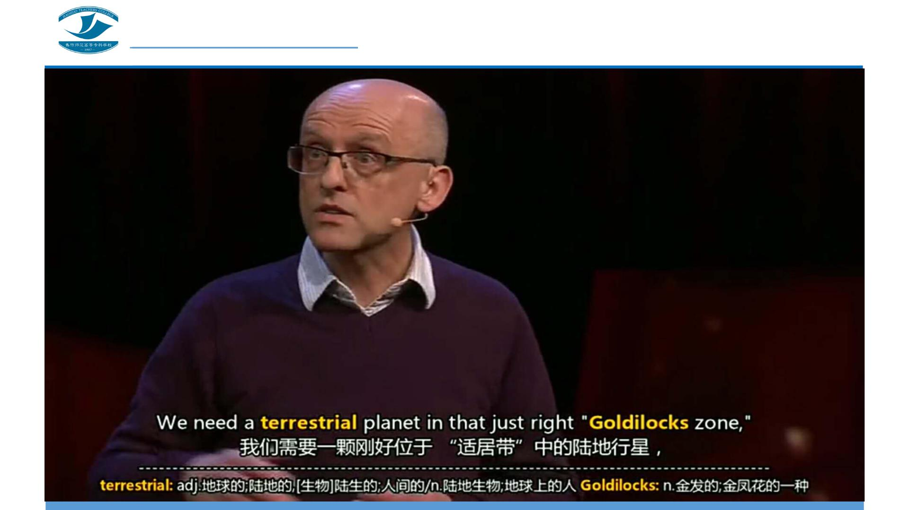

Slide 4
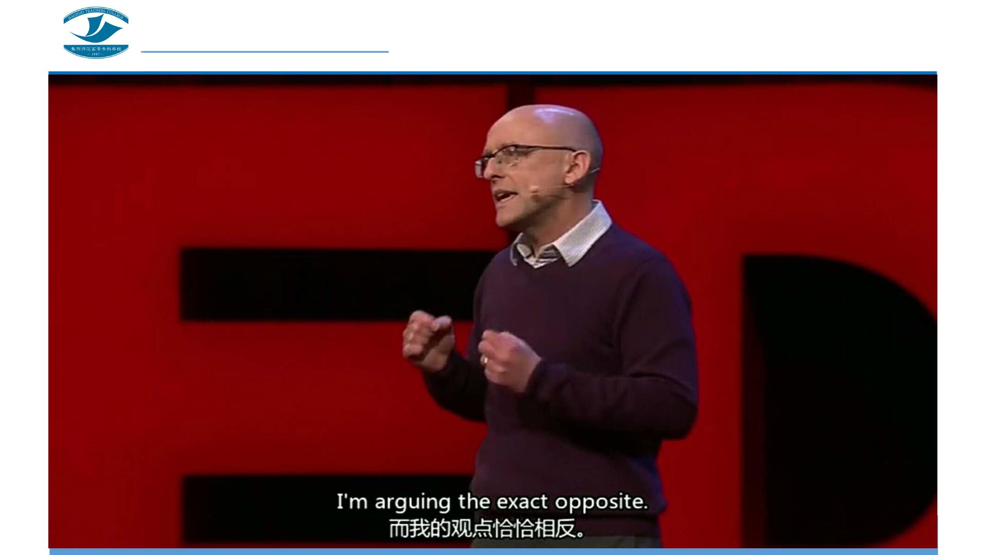

Slide 5
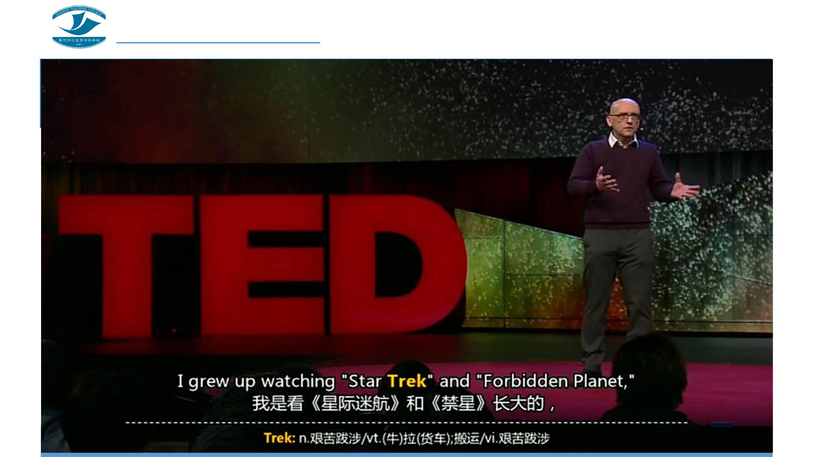

Slide 6

2
探究学习

Slide 7

观察下列各句中数量限定词及其所修饰的名词的特征，归纳数量限定词和各类名
词的搭配关系。
1. Each student has a pencil and an eraser in his pencil-box.
2. Those people have collected many stamps.
3. There is still much time left.
4. He has bought plenty of books in the past few years. There is plenty of rain
here in summer.
5. This is my book and those are Peter ’s books. His money in the pocket was
stolen yesterday.

Slide 8

3
答疑解惑

Slide 9

困惑 1
第一个句子里each后面用的是单数名词student，each只能修饰单数
名词吗？

Slide 10

困惑 2
第四个句子中出现了两个plenty of，后面分别用了复数名词和不可
数名词，plenty of可以修饰两种名词吗？

Slide 11

答案呈现
上述5个句子中数量限定词与三类名词的搭配关系：
1. each，a，an只与单数名词搭配。
2. those，many只与复数名词搭配。
3. much只与不可数名词搭配。
4. plenty of和不可数名词、复数名词均可搭配。
5. my， his，Peter’s和单数名词、复数名词、不可数名词均可搭配。

Slide 12

4
系统归纳

Slide 13
只能与单数名词搭配的限定词
如句1中的each，a, an等，此外常见的这类限定词还有each,
either, neither, another, every, one，many a, such a等。

Slide 14
只能与复数名词搭配的限定词
如句2中的those和many。此外常见的这类限定词还有both,
few, a few, fewer, a number of, several, these和大于2的基数词
等。

Slide 15
只能与不可数名词搭配的限定词
如句3中的much只能修饰不可数名词。此外常见的这类限定
词还有little, a little, less, a bit of, a great amount／deal of等。

Slide 16
能与不可数名词、复数名词搭配的限定词
如句4中的plenty of，既可修饰可数名词，也可修饰不可数
名词。此外这类限定词常见的还有a lot of, lots of, more, most，
enough，such , other等。

Slide 17
能与单数名词、不可数名词搭配的限定词
既能与单数名词搭配，又能与不可数名词名词搭配，如this,
that等。

Slide 18
能与单数名词、复数名词搭配的限定词
有些限定词既能与单数名词搭配，又能与复数名词搭配，
如the first ,the second , the last , the next 等。

Slide 19
与单数名词、复数名词、不可数名词均可搭配的限定词
有些限定词和三类名词均能搭配，即可以与单数名词、复
数名词和不可数名词均可搭配。如句5中的形容词性物主代
词my，his和名词所有格Peter ’s等。此外这类限定词常见的
还有any, some, no, the，other, whose等。

Slide 20

5
自我评价

Slide 21

6
知识拓展

Slide 22

请阅读下列名言警句，并注意观察限定词和名词的搭配关系。
1.The shortest way to do many things is to only one thing at a time.
做许多事情的捷径就是一次只做一件一件事。
2.All things in their being are good for something.
天生我才必有用。
3.There's only one corner of the universe you can be sure of improving, and that's your
own self.
这个宇宙中只有一个角落你肯定可以改进,那就是你自己。
4.The world is like a mirror: Frown at it and it frowns at you; smile, and it smiles too.
世界犹如一面镜子：朝它皱眉它就朝你皱眉,朝它微笑它也朝你微笑。
5.Living without an aim is like sailing without a compass.
生活没有目标，犹如航海没有罗盘。

Slide 23
请阅读下列名言警句，并注意观察限定词和名词的搭配关系。
6.A man can't ride your back unless it is bent.
你的腰不弯,别人就不能骑在你的背上。
7.Fear not that the life shall come to an end, but rather fear that it shall never have a
beginning. ·
不要害怕你的生活将要结束,应该担心你的生活永远不会真正开始。
8.The stupid speak of the past, the wise of the present, and fools of the future.
聪明的人谈现在,愚蠢的人谈过去,傻子才谈未来。
9.Energy and persistence conquer all things.
能量加毅力可以征服一切。
10.A thousand-li journey is started by taking the first step.
千里之行,始于足下。

Slide 24

7
巩固提高

Slide 25
选择填空。
1.There were ______ students in the reading room.
A. neither B. not C. no D. none
2.If it is of ______ use to you, please take it.
A. some B. many C. no D. any
3.I’ve invited five people to tea this afternoon. Out of them, only John and Mary can
come,______ can’t.
A. other B. the other C. others D. the others
4.I don’t think we have met before. I’m afraid you’re confusing me with ______.
A. some other B. some other person C. other person D. one other
5.Weekends last from Friday evening to Sunday night.______ days are week-days.
A. The other B. Another C. Other D. Every other

Slide 26
选择填空。
6.We had ______ good time that we hated to leave the party.
A. such a B. such C. so D. pretty
7.______ are about the American Independent Wa r.
A. Both book B. Both books C. All the two book D. all of two books
8.When I am in trouble, my friends will give me their hands without ______
hesitation.
A. some B. a C. any D. the
9.There is a line of trees in ______ side of the river.
A. every B. each C. per D. none
10.Have you got ______ copies to go around?
A. much B. a large amount of C. enough D. great

Slide 27
参考答案
1-5. C D D B A
6-10. A B C B C

Slide 28

8
灵活运用

Slide 29
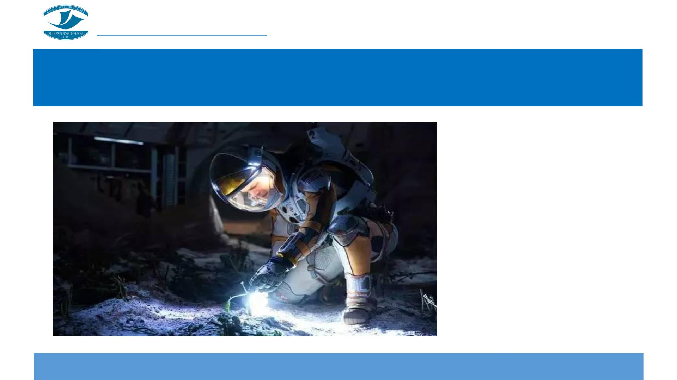
电影欣赏《火星救援》
请写一篇150词
左右的观后感，
注意在名词前
正确使用各类
限定词。

