Slide 1

连词的句法功能

Slide 2
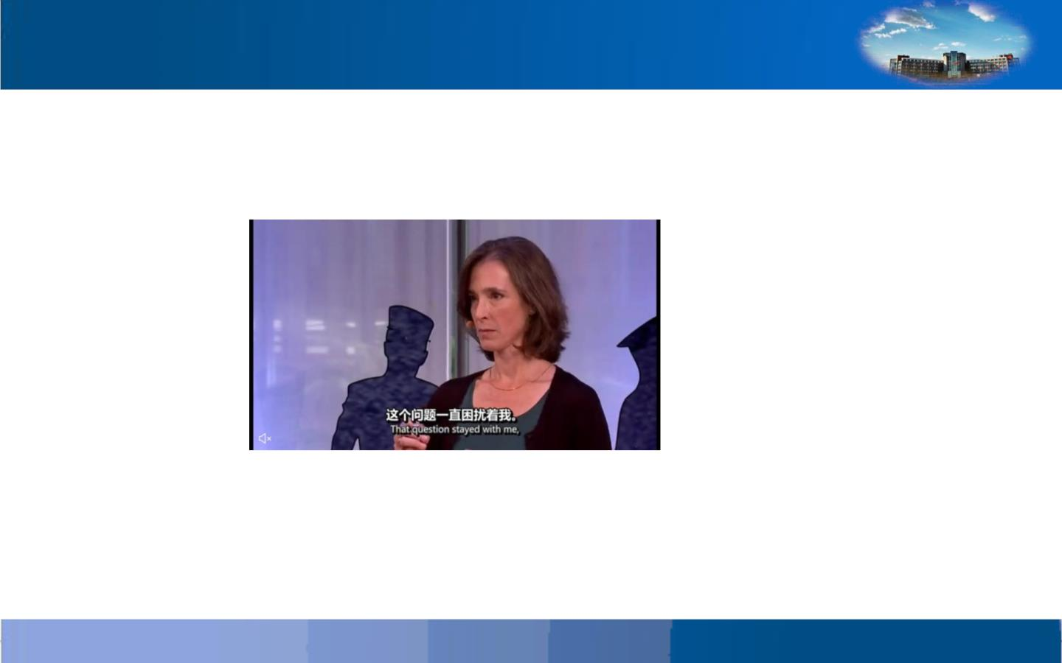
《我在纽约垃圾中的发现》为主题的TED演讲: 找
介词
第一张截图中的句子
That question stayed with me, and it simplified a little.

Slide 3
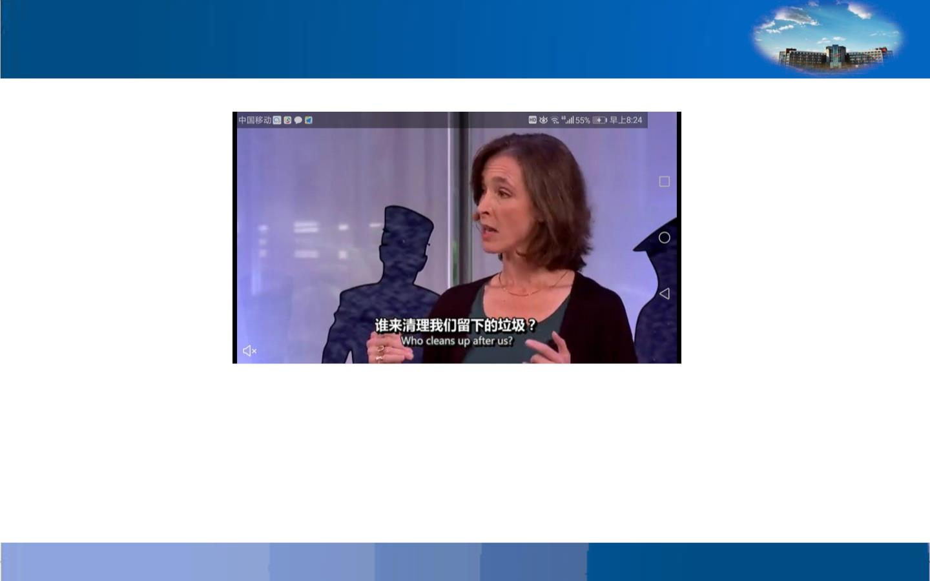
第二张截图中的句子
Who cleans up after us?

Slide 4
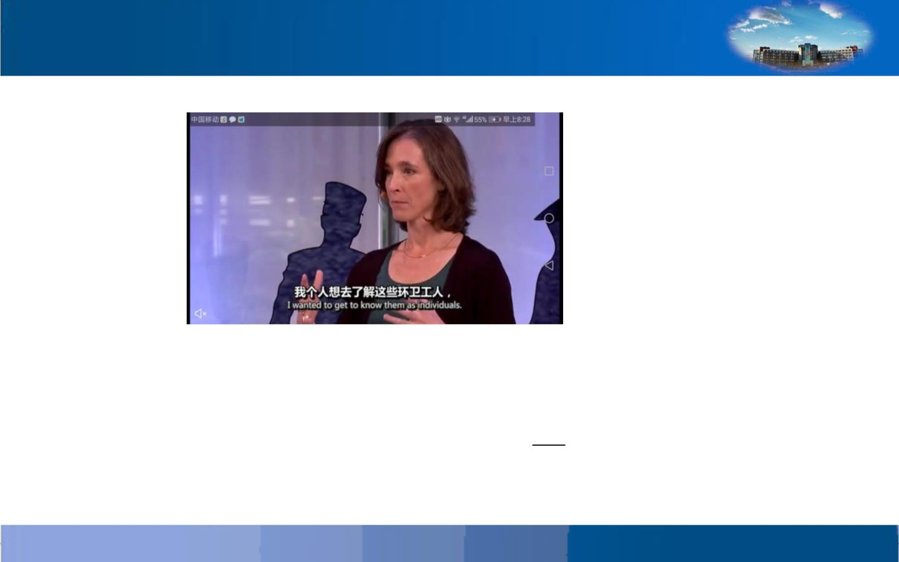
第三张截图中的句子
I wanted to get to know them as individuals.

Slide 5

找出连词, 并进行分类
1.Strike while the iron is hot.
2.I will come unless it rains.
3.He started to shout and sing.
4.Are you gonging to water the garden
before or after supper ?
5.Do as I tell you.
9. Either you or
Maria will have to go.
10. I have lived
here since I was a
child.
6.He went on working though she was
tired.
7.Honey is sweet, but the beer
stings.
8.Wait until I come back.
类别1________________
类别2________________

Slide 6

1. Strike while the iron is hot. 从属连词
2. I will come unless it rains.从属连词
3. He started to shout and sing. 并列
7. Honey is sweet, but the beer
stings. 并列
8. Wait until I come back. 从属
9. Either you or Maria will have
to go. 并列
4. Are you gonging to water the garden
10. I have lived here since I was
a child.从属
before or after supper ?并列
类别1 while、unless、 or、 as、
though、until 、since表示从属关
系
5. Do as I tell you. 从属
6. He went on working though she was
tired. 从属
类别 2 and、but、or、either --
-or、表示并列

Slide 7
通过观察，分析，我们发现下面就一些规律性东西
归纳如下：
1.连词可以分为两类：从属连词 （subordinating
conjunctions)和并列连词( coordinating conjunctions)。
2. while、unless、as、until、since等连词连词主
要引起一个从句，所以称为从属连词。
3.and、but、either、or、not only等连词主
要连接互不依从的分句，有的连接两个并列的词或短
语，所以称并列连词。

Slide 8
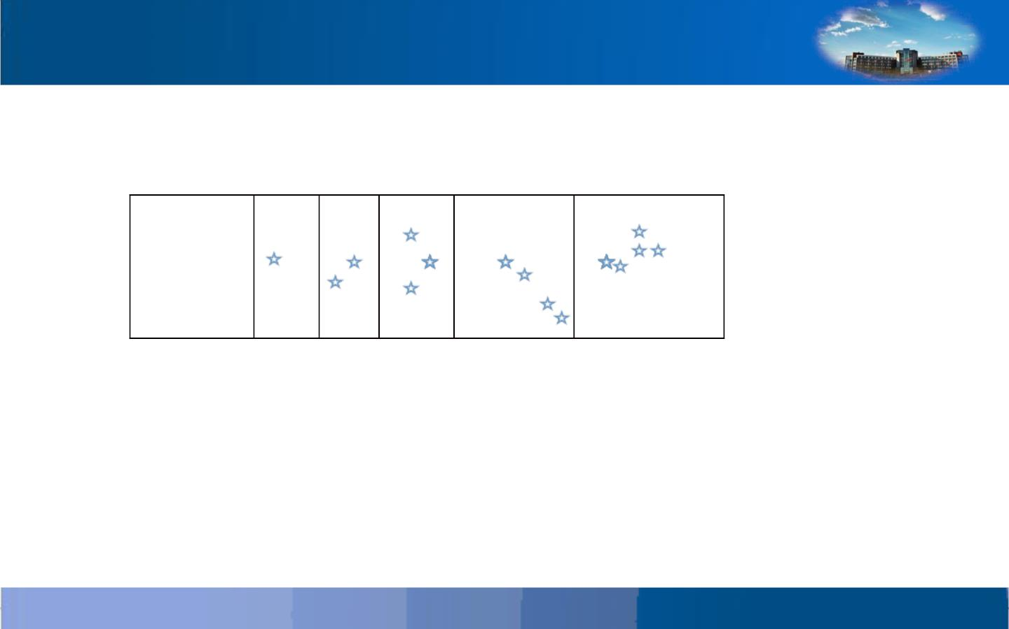
自我测评
同学们，你对自己今天的表现满意吗？请为自己作出评价吧！

Slide 9
1.晒草趁天晴。
2.趁热打铁。
3.工作不为名不为利。
4.冬天来了，春天还会
远吗？
7.不要自寻烦恼。
8.有志者事竟成。
9.入乡随俗。
10.己所不欲勿施于
人。
11.做自己的路让别
人说去吧。
5.金窝银窝不如自家的
草窝。
6.山中无老虎，猴子称
大王。

Slide 10
英语
1. Make hay while the sun
7. Don’t trouble
trouble until trouble
troubles you.
8. Where there is a
will, there is a way.
9. When in Rome do
as Romans do.
10. Treat other people
as you hope they will
treat you.
shines.
2. Strike while the iron is
hot.
3. Work neither for fame
nor for personal gains
4. If winter comes, can
spring be far behind?
5. East or west, home is
best.
6. When the cat is away,
the mice will play.
11. Follow your own
course, and let people
talk.

Slide 11
辨别其中连词的属性以及在句中
所起的作用。
1.Now that we are alone, we can speak freely.
2.In case of fire, ring the bell.
3.Supposing he won’t agree, what shall we do?
4.We wouldn’t lose heart even if we should fail
ten times.
5.She was so moved that tears came to her eyes.
6.He distrusted me because I was new.
7.As he talked on, he got more excited.
8.The judge is stern, yet completely fair.
9.He is charming; nevertheless I don’t quite trust
him.
10.Tonight Mary will both sing and dance.

Slide 12
1.Now that we are alone, we can speak freely.从属，原因
状语从句，既然。
2.In case of fire, ring the bell. 从属连词，条件状语，万一。
3.Supposing he won’t agree, what shall we do?从属连
词，条件状语，假定。
4.We wouldn’t lose heart even if we should fail ten
times.从属，条件状语从句
5.She was so moved that tears came to her eyes.从属连
词，结果状语从句。
6.He distrusted me because I was new.从属，原因状语从句。

Slide 13

7.As he talked on, he got more excited.从属，时间状语从句。
8.The judge is stern, yet completely fair.并列，连接表语，
转折。
9.He is charming; nevertheless I don’t quite
trust him.并列，转折，连接分句。
10.Tonight Mary will both sing and dance.并列，连接并列谓
语。

Slide 14

经过今天的项目训练，相信大家已经掌握了“连词
的种类”的内容。请同学们欣赏电影《幸福来敲门》，
在这部影片中，我们可以理解幸福是需要奋斗这个朴素
的道理。在奋斗过程中，只要你就坚强不屈，坚持不懈，
最后成功和幸福一定会来敲你的门。请同学们在欣赏电
影同时，尤其注意英语中的连词现象，看看你能听到或
看到多少个连词，是并列连词还是从属连词。试着写下
来，完成以后请上传你的习作吧。
（需插入视频《幸福来敲门》_高清完整版在线播放_
碟调网
https://www.diediaow.com/play/18445-0-0.html
0:00-2:00

Slide 15
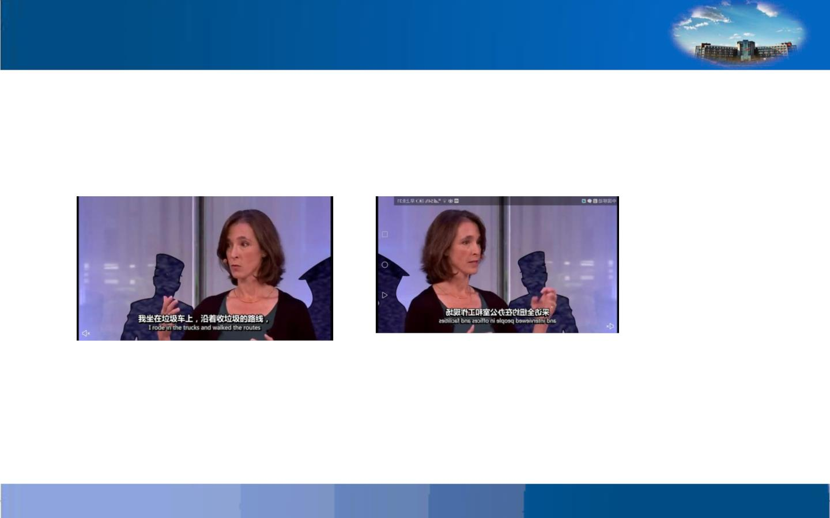
在《我在纽约垃圾中的发现》为主题的演讲中，有
没有给你记忆深刻含有连词的句子呢？
第一张截图中的句子
I rode in the trucks and walked the routes
and interviewed people in offices and
facilities all over the city,

Slide 16
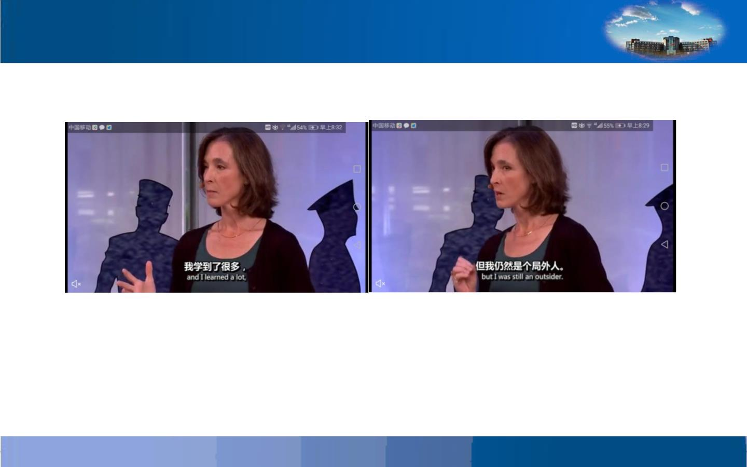
I learned a lot, but I was still an
outsider

Slide 17
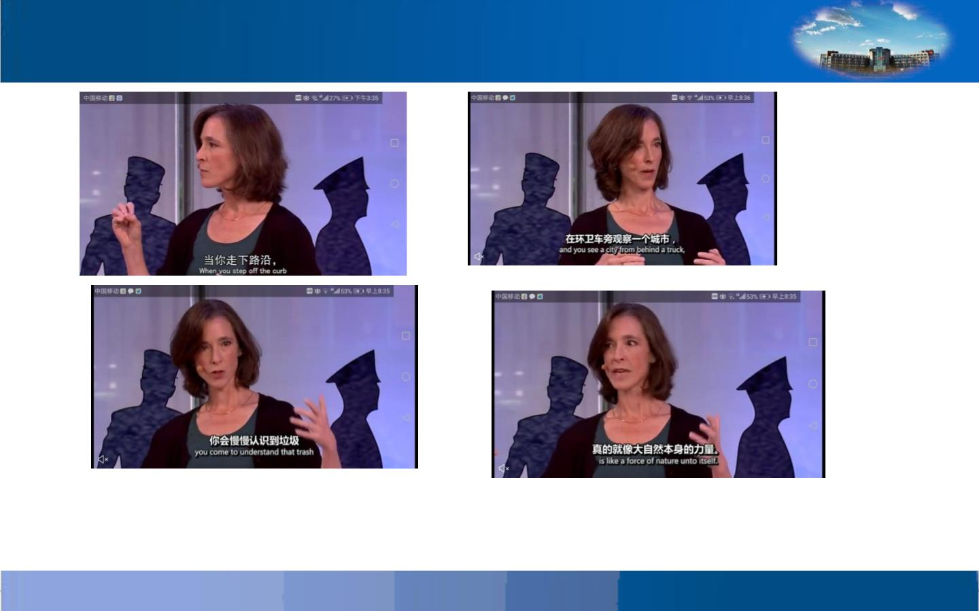
When you step off the curb and you see a city from behind a truck, you
come to understand that trash is like a force of nature unto itself

Slide 18
找出句中的连词，并写出连词的
属性及其句法功能
1.Make hay while the sun shines.
2.I have not seen you since I have been back.
3.He gained a B in English and now he plans to
study Spanish.
4.Do you want a bath at once,or shall I have
mine first?
5.You will fail unless you work hard.
6. In case I forgot, please remind me about
it.
7.Hurry up, or you will be late for school.
8.They see the trees but the forest.
9.Speak clearly so that they may understand
you.
10.We can go there either by boat or by train.

Slide 19
1.Make hay while the sun shine. 从属连词，引导时间状语从句
2.I have not seen you since I have been back. 从属，时间状语
从句
3.He gained a B in English and now he plans to study
Spanish. 并列分句
4.Do you want a bath at once,or shall I have mine first?并列
分句
5.You will fail unless you work hard. 从属，条件状语从句
6. In case I forgot, please remind me about it.从属，条件状
语从句
7.Hurry up, or you will be late for school.并列，连接并列分
句，转折
8.They see the trees but the forest.并列连词，并列名词，作谓
语转折
9.Speak clearly so that they may understand you.从属，目的状
语从句
10.We can go either by boat or go by train. 并列介词短语，
作状语

Slide 20
1. 连词不能单独在句子中担任成分，只能
和其他词、短语或句子连接，表示从属关系
或并列关系。
2. 从属连词主要引起从句，表示时间、地点、
条件、目的、结果、原因、让步、方式等。
3.并列连词连接互不依从的分句、短语
或单词。并列连词也可以表示意义转折，有
时表示因果关系。

Slide 21

同学们，你对自己今天的表现满意吗？请为自己作出评
价吧！
自我测评

Slide 22
英语大约有48万左右的单词，而连词却只
有70个左右，它们总是非常高频率的出现在
各类文章、对话、电子邮件中，像胶水一样
将相关的句子连接起来。国际心理学家、语
言学家、教育家龙飞虎又把它称之为“胶水
词”。胶水词就像英语的骨架一样重要，学
会了胶水词，同时拥有词组的累积，我们就
可以轻松灵活的造出任何需要的长句，让我
们的英文交流如鱼得水。

Slide 23
辨别其中连词的属性以及在句中
所起的作用
1.Now that we are all back, we had better start
the work right away.
2.Whenever she looked at To m she always lost her
temper.
3.Men and women,old and young, all joined in the
battle.
4.Seeing that I shall be here again tomowrrow, I
won’t wait any longer.
5.We study the stragety so that we can defeat
them.
6.He distrusted me because I was new.
7.The speech is good, though it could be better.
8.She is a funny girl, but yet you can’t help liking
her.
9.He is charming; nevertheless I don’t quite trust
him.
10.Tonight Candy will both sing and dance.

Slide 24

参考答案
1.Now that we are all back, we had better
start the work right away.从属，原因状语从句，
既然。
2.Whenever she looked at To m she always
lost her temper.从属，时间状语从句。
3.Men and women,old and young, all joined
in the battle. 并列，连接主语。
4.Seeing that I shall be here again tomorrow,
I won’t wait any longer.从属，原因状语从句，
反正。
5.We study the stragety so that we can
defeat them.从属，目的状语从句。
6.He distrusted me because I was new.从属，
原因状语从句

Slide 25
7.The speech is good, though it could be better.
从属，让步状语从句
8.She is a funny girl, but yet you can’t help
liking her.并列，连接分句
9.He is charming; nevertheless I don’t quite
trust him.并列，连接分句
10.Tonight Candy will both sing and dance.并列，
连接谓语

Slide 26

经过今天的项目训练，相信大家已经掌握了“连词的句
法功能”的内容。下面请欣赏电影《律政俏佳人 2》，在
这部影片中，金发美女艾莉•伍兹既得到了法学学位，又
收获了甜蜜爱情。艾莉•伍兹很爱小动物，但有的人却虐
待动物。为了她的小狗朋友，也为了更多可爱的小生灵，
天真的艾莉只身前往华盛顿，开始了她的保护小动物权益
之旅。请大家在欣赏电影的同时，留意语言中连词及其句
法功能，试着写下听到看到的连词，完成以后请上传你的
习作吧。
（需插入视频《律政俏佳人 2》_高清完整版在线播放_碟
调网
https://www.diediaow.com/play/32365-0-0.html 0:00-
2:00

