Slide 1
代词
代词的句法功能

Slide 2

新思维建构英语语法
1
知识激活

Slide 3
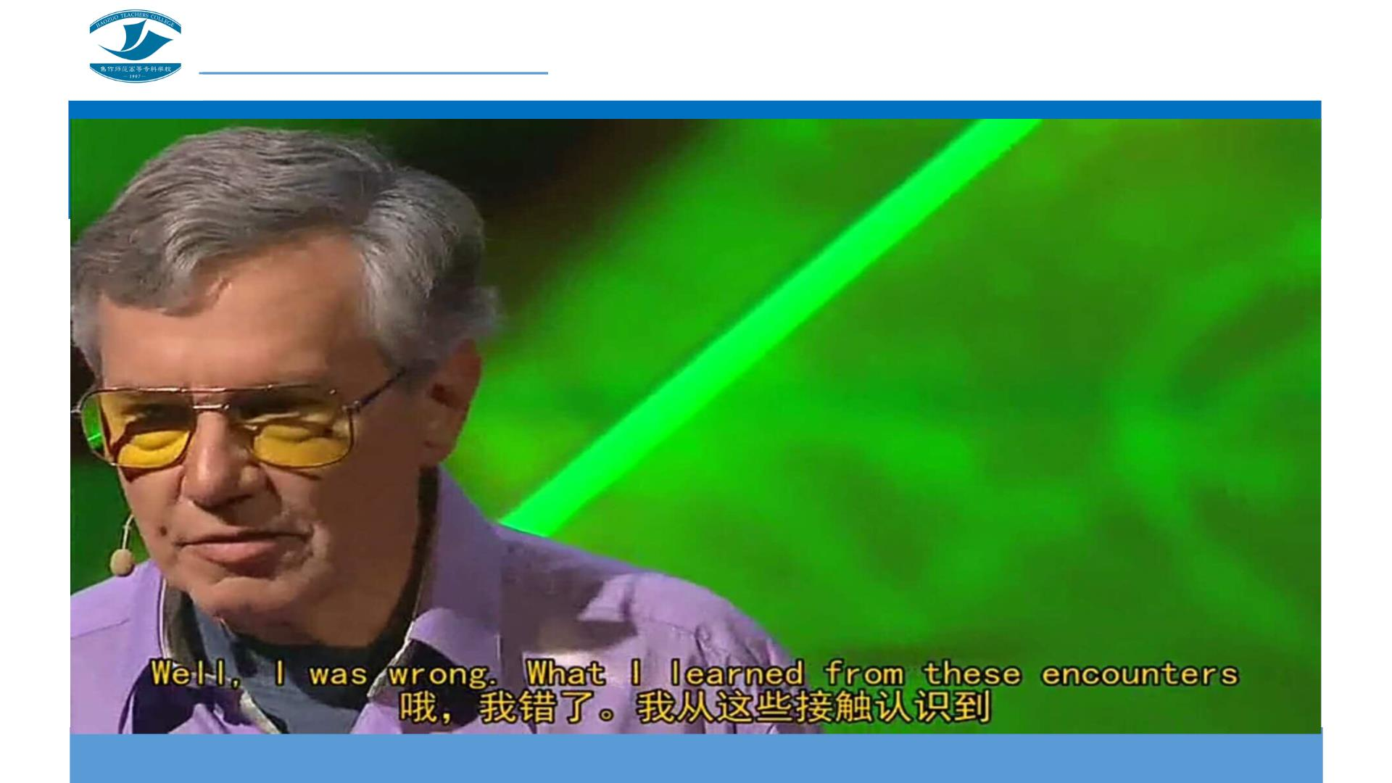

Slide 4
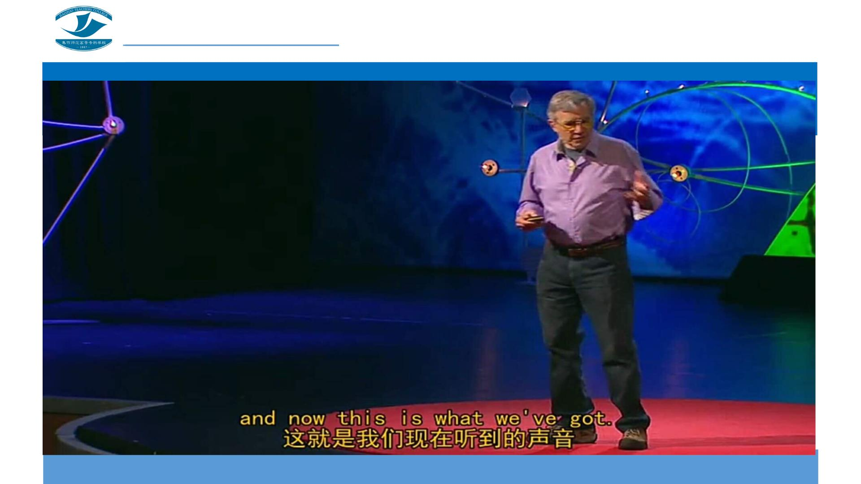
新思维建构英语语法

Slide 5

2
探究学习

Slide 6

观察划线代词，分析它们充当的成分。
1. I won’t forget the gift you sent me on my birthday.
2 .His parents went to New York last year, and none of them wrote
letters to him.
3.None of them knew about the plan because it was kept a secret.
4.My father bought me a new bike on my birthday.
5.The book on the desk is mine.

Slide 7

观察划线代词，分析它们充当的成分。
6.Every student in this class is hard-working.
7.---Who’s that?
---Oh, it’s me.
8.You may go and ask the teacher himself.
9.Your new dress is really beautiful. Where did you buy it?
10.The thing itself is not important.

Slide 8

3
答疑解惑

Slide 9

困惑 1
me是宾格形式，不是只能作宾语吗？

Slide 10

困惑 2
第8句中的himself用在句末，它充当的是什么成分呢？

Slide 11

答案呈现
1.作主语。
2.作宾语。
3.作表语。
4.作定语。
第1句中的I；第3句中的None
第2句中him；第4句中的me
第5句中mine；第7句中的me
第6句中的Every；第9句中的Your
5.作同位语。 第8句中的himself；第10句中的itself

Slide 12

4
系统归纳

Slide 13

新思维建构英语语法
作主语
1. I won’t forget the gift you sent me on my birthday.
3.None of them knew about the plan because it was kept a
secret.

Slide 14

作宾语
2 .His parents went to New York last year, and none of them
wrote letters to him.
4.My father bought me a new bike on my birthday.

Slide 15

作表语
5.The book on the desk is mine.
7.---Who’s that?
---Oh, it’s me.

Slide 16
作定语
6.Every student in this class is hard-working.
9.Your new dress is really beautiful. Where did you buy it?

Slide 17
作同位语
8.You may go and ask the teacher himself.
10.The thing itself is not important.

Slide 18

代词的句法功能
作主语
作宾语
作定语
作表语
作同位语

Slide 19

5
自我评价

Slide 20

新思维建构英语语法
6
知识拓展

Slide 21

歌曲欣赏《Say You Say Me》
Say you say me
Say it for always that's the way it should be
Say you say me
Say it together naturally
I had a dream I had an awesome dream
People in the park playing games in the dark
And what they played was a masquerade
And from behind of walls of doubt a voice was crying out
Say you say me; say it for always

Slide 22

歌曲欣赏《Say You Say Me》
That’s the way it should be
Say you say me; say it together
Naturally
As we go down life's lonesome highway
Seems the hardest thing to do is to find a friend or two
A helping hand some one who understands
That when you feel you've lost your way
You've got some one there to say I'll show you
Say you say me; say it for always
That’s the way it should be

Slide 23
歌曲欣赏《Say You Say Me》
Say you say me; say it together Naturally
So you think you know the answers oh no
'Cause the whole world has got you dancing
That's right I'm telling you
It's time to start believing oh yes
Believing who you are you are a shining star
Say you say me
Say it for always that's the way it should be
Say you say me
Say it together naturally

Slide 24

7
巩固提高

Slide 25

选择填空。
选择填空
1. ---Do you know who taught ________French？
---Nobody．He learned it by ________．
A. his；himself B. him；him C. him；himself D. his；him
2.Could you record today's NBA basketball game for me？I can watch ________ later．
A. one B. my C. your D. it
3.We must protect animals，they are ________friends．
A. we B. our C. ours D. us

Slide 26

选择填空
4.---Bad luck!I lost _______new pen yesterday．
---Don't worry．I'll lend ________to you．
A．my；me B．mine；my C．mine；mine D．my；mine
5.---What do you think of _______ Chinese teacher，Jim？
---She's an excellent teacher，I've improved a lot since she taught ______Chinese．
A．our；us B．our；our C．ours；us D．ours；our
6.---The population of China is larger than ______ of India．
---Yes，but India's population is increasing rapidly．
A．it B．one C．that D．this

Slide 27

选择填空。
选择填空
7.---There are four bedrooms in the house_______with its own shower．
---That's what I want．I've got a few kids．
A．either B．neither C．each D．None
8.---When are we going to see the movie ZooTopia，this afternoon or tonight？
--- ________ is OK．I'm free today．
A．Either B．Neither C．Both D．All

Slide 28

选择填空。
选择填空
9.---Alice，is this your dictionary？
---Let me see．Oh，no．______ is in my school bag．
A．Myself B．Me C．My D．Mine
10.---What’s your QQ number？
---________ is 355994127．
A．I B．He C．It D．She

Slide 29
参考答案
1--5 CDBDA
6--10 CCADC

Slide 30

8
灵活运用

Slide 31

电影欣赏《魔法灰姑娘》
请写一篇150词
左右的观后感，
注意正确使用
各类代词。

