Slide 1
代词的分类

Slide 2

1
知识激活

Slide 3
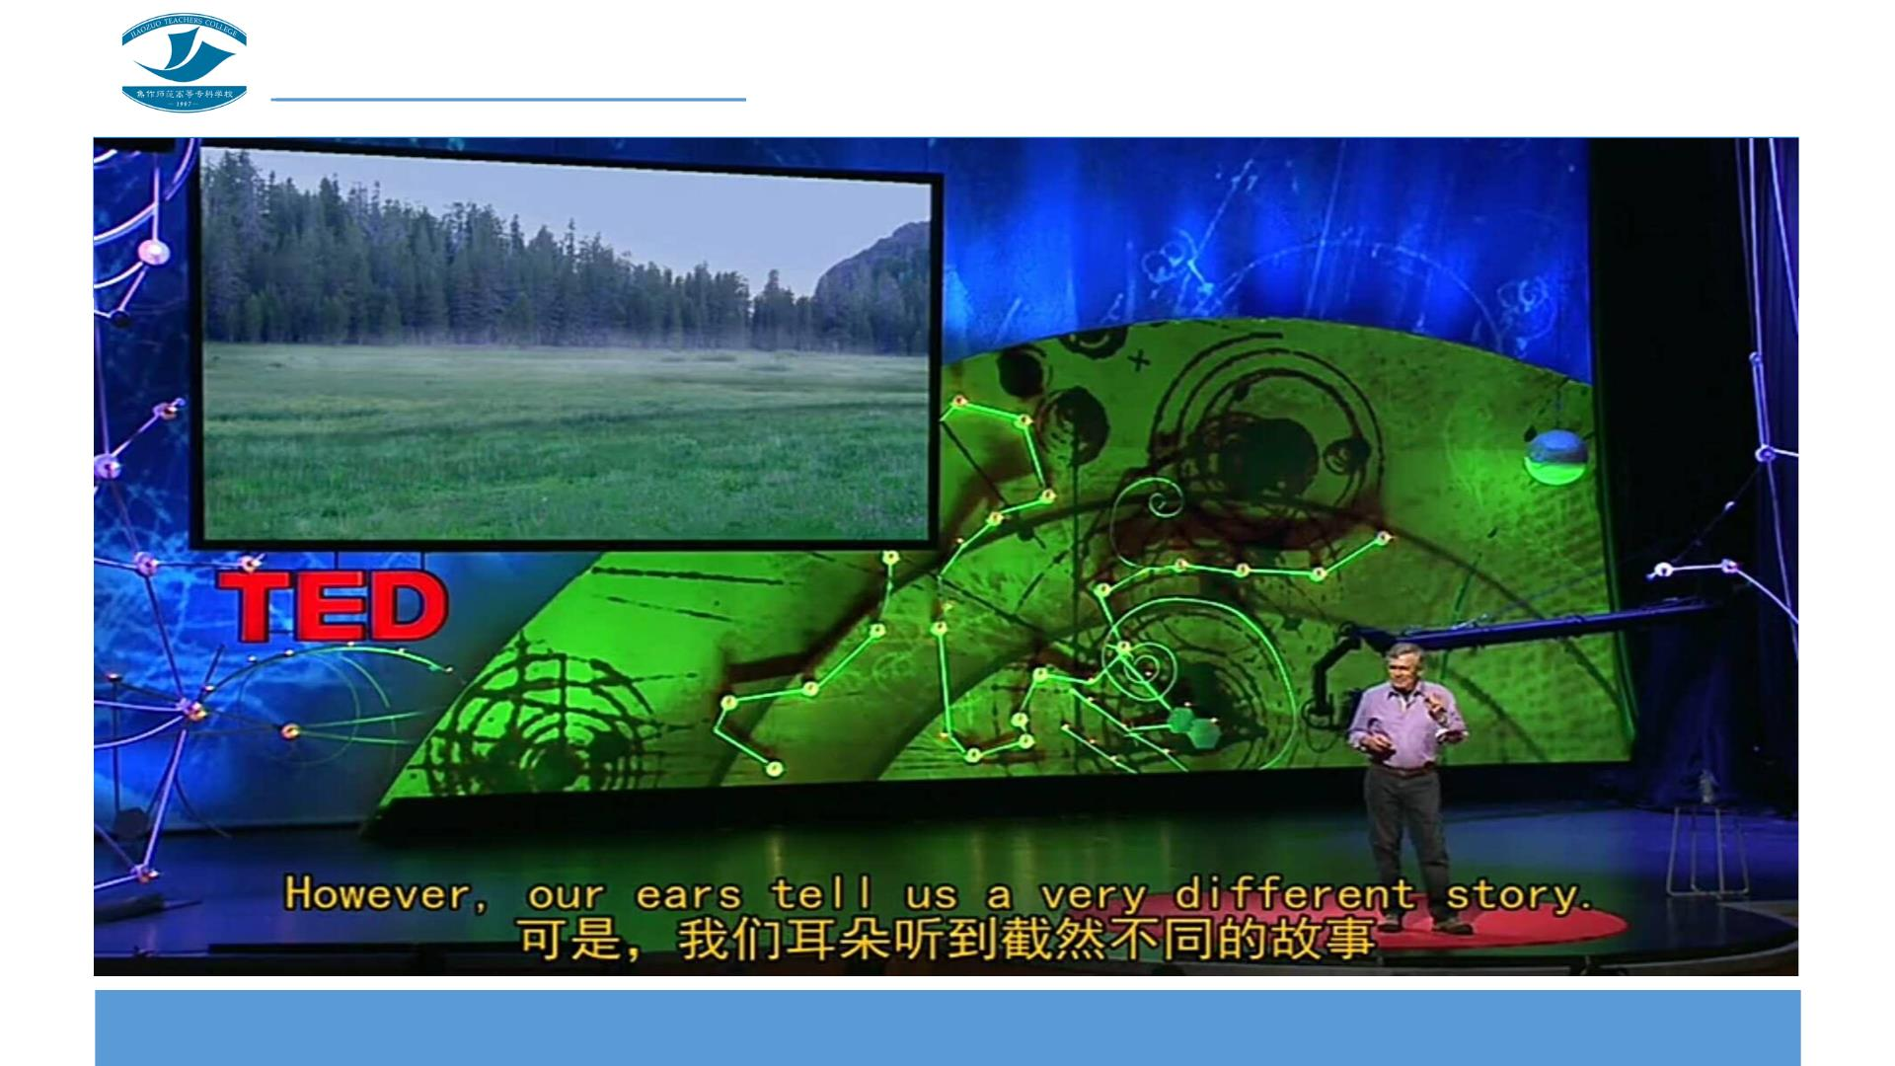

Slide 4
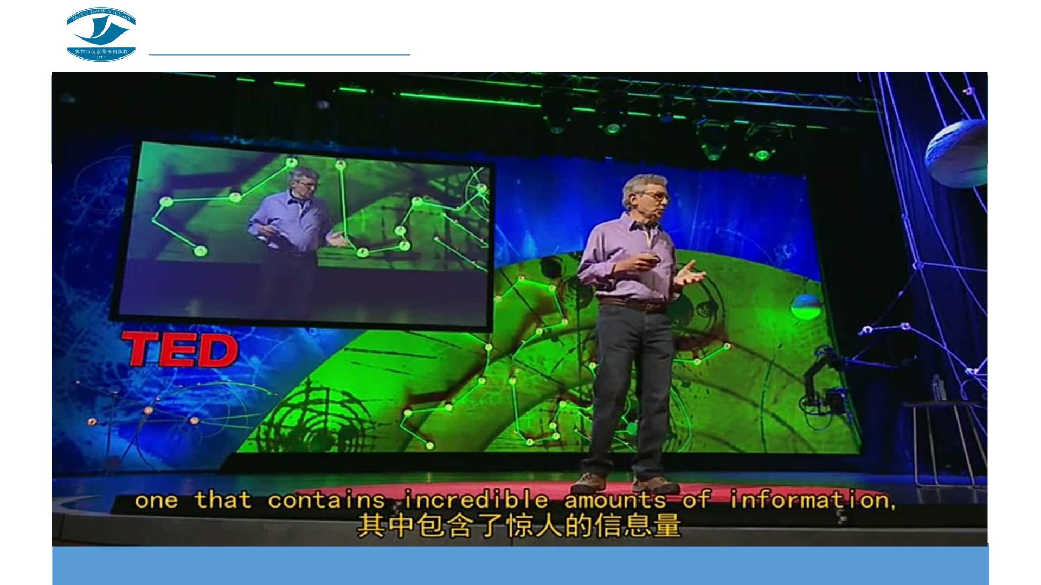

Slide 5

2
探究学习

Slide 6

给下列代词分类，并尝试说出分类的依据。
I
who
anyone
they
their
this
each other
yours
you
these
me
those
his
that
one another
myself
what
your
whom
which
she
mine
everybody
themselves

Slide 7

3
答疑解惑

Slide 8

困惑 1
you，your和yours是同一类代词吗？

Slide 9

困惑 2
that除了用作指示代词，还可以用作什么代词？

Slide 10
答案呈现
类别1：I； me；you； she； they
类别2：his；your；mine； your； their
类别3：this；that；these；those
类别4：each other；one another
类别5：anyone；everybody
类别6：myself；themselves
类别7：who；whom；what； which
类别8：who；whom；what； which
类别9：who；whom；which；that

Slide 11

4
系统归纳

Slide 12

人称代词
人称代词
主格
宾格
I you he she it we you they
me you him her it us you them

Slide 13

物主代词
物主代词
形容词性 my your his her its our your their
名词性 mine yours his hers its ours yours theirs

Slide 14

指示代词
this 这个
that 那个
these 这些
those 那些

Slide 15

相互代词
each other 彼此，互相
one another 彼此，互相

Slide 16

不定代词
anyone 任何人
everybody 每个人
both，either，all，any，
some，something，another…

Slide 17

反身代词
反身代词
myself yourself himself herself itself ourselves yourselves themselves

Slide 18

疑问代词
who
whom
what
which

Slide 19
连接代词
who
whom
what
which

Slide 20
关系代词
who
whom
which
that

Slide 21

代词的分类
人称代词
物主代词
反身代词
指示代词
相互代词
疑问代词
连接代词
不定代词
关系代词
代词分类

Slide 22

5
自我评价

Slide 23

6
知识拓展

Slide 24

谚语欣赏（1）
1.He who does not reach the Great Wall is not a true man.
不到长城非好汉。
2.All that glitters is not gold.
闪闪发光物，并非皆黄金。
3.Every dog has his day.
人人皆有得意日。
4.A candle lights others and consumes itself.
蜡烛照亮别人，却毁灭了自己。
5.All things are difficult before they are easy.
凡事总是由难而易。

Slide 25
谚语欣赏（2）
6.Children are what the mothers are.
耳濡目染，身教言传。
7.Confidence in yourself is the first step on the road to success.
自信是走向成功的第一步。
8.Don't put off till tomorrow what should be done today.
今日事，今日毕。
9.Everybody's business is nobody's business.
人人负责，等于没人负责。
10.Every man for himself, and the devil takes the hindmost.
人不为己，天诛地灭。

Slide 26

7
巩固提高

Slide 27
选出不同类的一项，并给出一个合理的解释。
1. （ ）A. we
2. （ ）A. my
3. （ ）A. this
B. he
B. your
B. what
C. my
C. us
C. these
C. himself D. our
C. which D. when
C. which D. where
C. which D. why
D. they
D. their
D. those
4. （ ）A. myself B. yourself
5. （ ）A.who
6. （ ）A. who
7. （ ）A. who
8. （ ）A. each
B. what
B. what
B. that
B. some
C. all
D. she
9. （ ）A. everyone B. none
10.（ ）A. each other B.another
C. anything D. mine
C. others D.some

Slide 28
答案呈现
1. （C）A. we
2. （C）A. my
3. （B）A. this
B. he
B. your
B. what
C. my
C. us
D. they
D. their
C. these D. those
C. himself D. our
C. which D. when
C. which D. where
C. which D. why
4. （D）A. myself B. yourself
5. （D）A.who
6. （D）A. who
7. （B）A. who
8. （D）A. each
B. what
B. what
B. that
B. some
C. all
D. she
9. （D）A. everyone B. none
10.（A）A. each other B.another
C. anything D. mine
C. others D.some

Slide 29

8
灵活运用

Slide 30
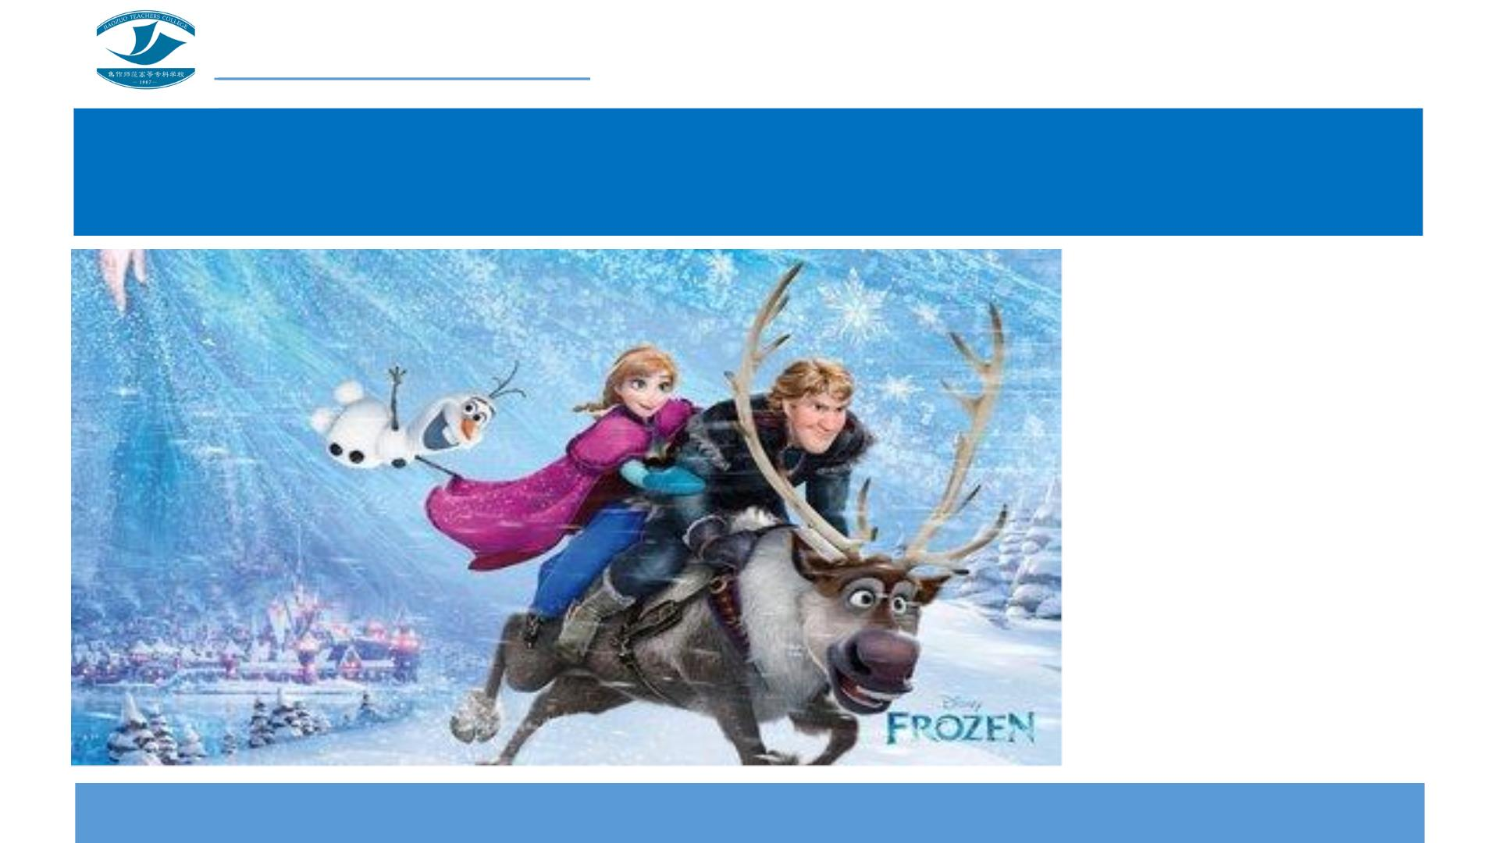
电影欣赏《冰雪奇缘》
请写一篇150词
左右的观后感，
注意行文中使
用不同种类的
代词。

