Slide 1

动词的基本形式

Slide 2

1
知识激活

Slide 3

But remember -- both are qualified.

Slide 4
My colleagues and I created very official terms to describe two distinct
categories of candidates.
A resume tells a story.

Slide 5
2
探究学习

Slide 6

识别下列句子中划线部分动词的原形，并根据动词的形式变化进行分
类。
1. Let ’s make it pretty.
2. She strongly disliked being spoken to like that.
3. The book consists of 10 chapters.
4. I am feeling with my hand.
5. I believe what you said, but I don’t believe in you.
6. He possessed great tact.

Slide 7
观察下列句子划线部分的动词, 根据它们的用法进行分类。
7. The price depends on the quality.
8. At last, an agreement was arrived at.
9. I have just learned that he returned home yesterday.
10. She is having a great time in her school.
类别1 _______________________ 类别2 _______________________
类别3_______________________ 类别4 _______________________
类别5 _______________________

Slide 8
3
答疑解惑

Slide 9
困惑 1
7. The price depends on the quality.

Slide 10
困惑 2
6. He possessed great tact.
9. I have just learned that he returned home yesterday.
焦作师范高等专科学校

Slide 11

答案呈现
原形 1、5
法》
第三人称单数 3、7
现在分词 4、10
过去分词 8、9
过去式 2、6

Slide 12
4
系统归纳

Slide 13
原形 （do）
1. Let ’s make it pretty.
5. I believe what you said, but I don’t believe in you.

Slide 14
第三人称单数 （does）
3. The book consists of 10 chapters.
7. The price depends on the quality.

Slide 15
新思维建构英语语法
现在分词 （doing）
4. I am feeling with my hand.
10. She is having a great time in her school.

Slide 16
过去式 （did）
2. She strongly disliked being spoken to like that.
6. He possessed great tact.

Slide 17
过去分词 （done）
8. At last, an agreement was arrived at.
《建构
9. I have just learned that he returned home yesterday.

Slide 18

原形
第三人称单数
现在分词
过去式
动 词
过去分词

Slide 19
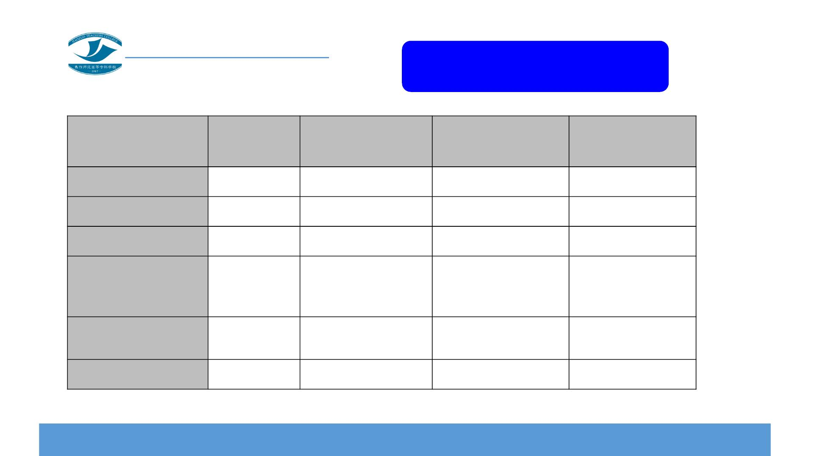
规则动词变化
第三人称单
数
现在分词
过去式
过去分词
一般情况
+s
+es
+ing
+ing
+ing
+ed
+ed
+ed
+ed
s,x,ch,sh,o结尾
辅音字母+y结尾
y→i+es
y→i+ed
y→i +ed
重读闭音节（一个
辅音字母结尾）结
尾
+s
双写辅音字母+ing 双写辅音字母+ed 双写辅音字母+ed
不发音的字母e结
尾
+s
+s
去掉e +ing
ie→y +ing
+d
+d
+d
+d
字母组合ie结尾

Slide 20
5
自我评价

Slide 21
6
知识拓展

Slide 22

新思维建构英语语法
动词短语
1. I agree with you on that point. （动词+介词）
2. She took down what you said. （动词+副词）
3. We don’t go in for that kind of thing. （动词+副词+介词）
4. She came to see us off. （动词+副词）
5. The police are looking for the case. （动词+介词）
6. We must get rid of this bad style. （动词+名词+介词）
7. I couldn’t put up with the noise any longer. （动词+副词+介词）
8. Mary take (good) care of the children. （动词+名词+介词）

Slide 23
7
巩固提高

Slide 24
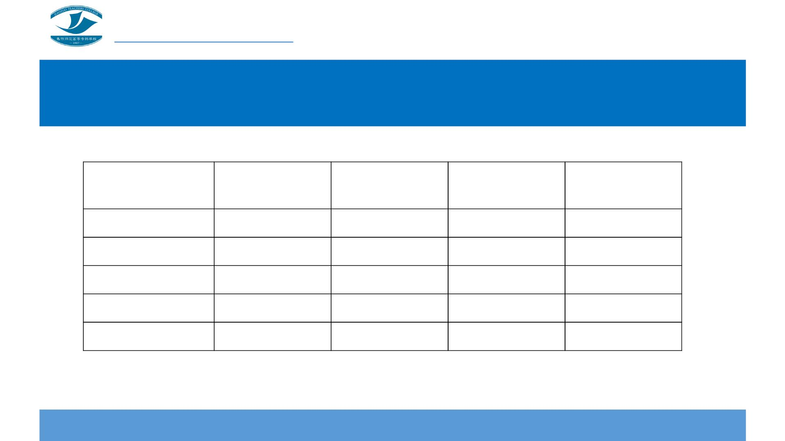
请把下列动词变为相应形式。
动词原形
第三人称单数
现在分词
过去式
过去分词
work
study
plan
close
lie

Slide 25
请把下列动词变为相应形式。
动词原形
第三人称单数
现在分词
过去式
过去分词
run
come
have
go
eat

Slide 26

答案呈现
动词原形
第三人称单数
现在分词
过去式
过去分词
work
study
plan
close
lie
works
studies
plans
closes
lies
working
studying
planning
closing
lying
worked
studied
planned
closed
lied
worked
studied
planned
closed
lied

Slide 27
答案呈现
动词原形
第三人称单数
现在分词
过去式
过去分词
run
come
have
go
runs
comes
has
running
coming
having
going
ran
came
had
run
come
had
goes
eats
went
ate
gone
eaten
eat
eating

Slide 28
8
灵活运用

Slide 29

Once upon a time, there were many young
fish living in a lake. They were very happy
there. As the fish grew up, the lake seemed
too small. They wanted to leave the lake and
live in the big, blue sea. The fish tried to swim
to the sea. They saw a big gate blocking their
way. It had two large dragons carved into it,
and was called the Dragon Gate. They tried to
go under the gate, but it went to the bottom
of the lake. They tried to go over the gate, but
it went high into the sky. All of the fish tried to
jump over the gate, but it was too high. The
fish decided to give up. One small fish did not
want to leave. He said, “ We can jump over the
Dragon Gate if we keep trying.” The other fish
thought it was too high, and they went
home. ...
The Little Fish and the Dragon Gate

Slide 30

Thank you!

