Slide 1
Cinderella

Slide 2
歌手信息
阿米塔·玛利·杨，塔塔杨 (泰语，英语):Amita Marie Young，呢称:Tata，1980年12月14日生于泰国曼谷，'塔塔'是名，'杨'是美国英语姓氏)父亲是美国人，母亲是泰国人，自十五岁塔塔出现在乐坛上以来一直受泰国年轻一代的欢迎与追捧，现在是泰国艺能界超白金唱片出产最多的女艺人。

Slide 3
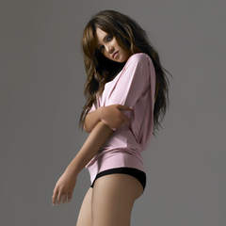
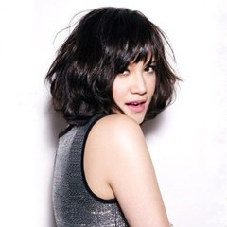

Slide 4
Words and expressions
used to
tuck me into bed
Princess
in distress
end up with
glory
fairy tale
dusty cellar
set sb free
on a horse of white
rescue
slay
knight
armour

Slide 5
歌词
When I was just a little girl 当我还是个小女孩时
My momma used to tuck me into bed 妈妈总是喜欢把我塞进床里
and she'd read me a story 然后 为我讲个故事
It always was about a Princess in distress 总是关于一个不幸的公主
And how a guy would save her and end up with the glory 然后一个王子如何英雄救美,故事唯美落幕
I'd lie in bed and think about the person that I want to be 我就躺在床上,梦想我会成为那个人
Then one day I realized the fairy tale life wasn't for me 终于有一天我明白,那不是属于我的童话

Slide 6
[Chorus] (和声)
I don't wanna be like Cinderella 我不想像灰姑娘一样
Sittin' in a dark old dusty cellar 坐在黑暗脏乱的地窖里
Waiting for somebody, to come and set me free 等待着一个人来解救我
I don't wanna be like Snow White waiting 我也不想像白雪公主那样等待
For a handsome prince to come and save me On a horse of white, 等待一个英俊的白马王子来救我
unless we're riding side by side 我们比翼双飞

Slide 7
Don't want to depend on no one else 不想奢望成为别人
I'd rather rescue myself 只希望可以自我救赎
Someday I'm gonna find someone who wants my soul, heart, and mind 总有天我会找到一个人,愿拥有我的灵魂,我的心,我的思想
Who's not afraid to show that he loves me 他并不害怕将他对我的爱公之于众
Somebody who will understand I'm happy just the way I am 他会理解,他就爱这样的我
Don't need nobody taking care of me 不需要别人的呵护
I will be there for him just as strong as he will be there for me 我要像他一样强壮,就像他做为我付出的那样
When I give myself then it has to got to be, an equal thing 我们的付出彼此相等

Slide 8
Questions
1.How do you understand “Men are equal to women”?
2. Are women really equal to men?
3. How do you think of “Mary Sue”?
4. Why are there so many people absorbed in the “Mary Sue” novels or TV series?
5. Do you think women should earn more or less money than men in a relationship? How to keep the balance ? Why do you think so?
6. How do you understand women should be independent spiritually and economically?
7. How do you think of “iron lady”?

