Slide 1
business meal

Slide 2
focuse:
To introduce your favorite fruit,vegetable, and seafood.
To understand to table manner of weatern counties.

Slide 3
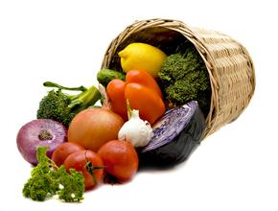
Vegetables

Slide 4
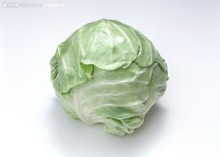
cabbage

Slide 5
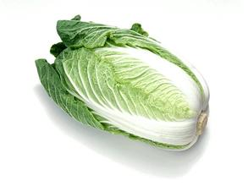
Chinese cabbage

Slide 6
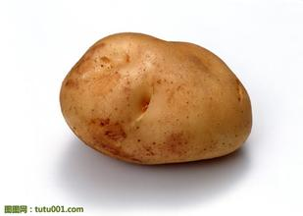
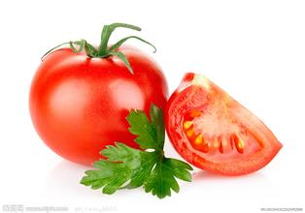
potato
tomato

Slide 7
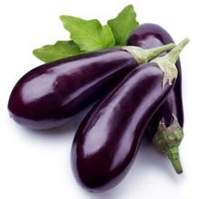
eggplant

Slide 8
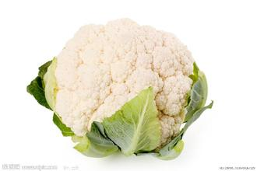
cauliflower

Slide 9
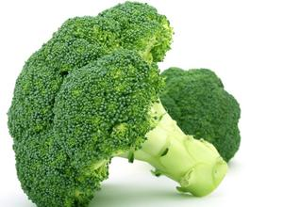
broccoli ['brɒkəlɪ]

Slide 10
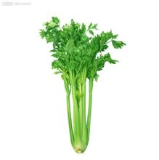
celery

Slide 11
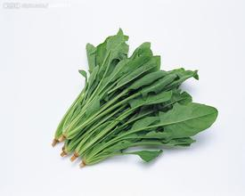
spinach

Slide 12
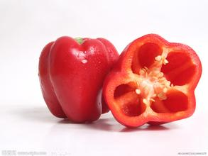
sweet pepper

Slide 13
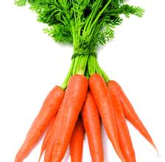
carrot

