Slide 1
Introduction
Introduce your friend and yourself
安佰娟

Slide 2
Greeting&small talk
Introducing yourself
Introducing your friend
Content

Slide 3
I. Lead-in (5 minutes)
Watch a video clip and answer some questions.
Questions:
How do you often start your self-introduction?
What does your self -introduction usually contain?

Slide 4
II. Group work (8 minutes)
任何时候：
Nice to see you again. Long time no see.
How are you？
朋友：
How's everything？
How have you been？
How’s it going?
How’re you doing?
What's up？
What's new？
What's happening？
Think and discuss
初次见面：
Nice to meet you.
Good/Glad to see you.
Good morning!
Good afternoon!
Good evening!
How do you do?
1. Greeting

Slide 5
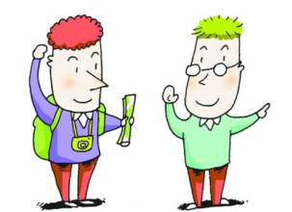
IV. Group work (10 minutes)
Can you introduce yourself ?

Slide 6
III. Group work (5 minutes)
Watch a video clip and discuss
Questions:
What conversation topics can we choose as a small talk?
Is there any taboo?
Topics:
weather
food
travel
activities
Taboo:
Health /Salary
Private life(age,marital status)
Personal gossip
Religion/Politics /Offensive jokes
Small talk

Slide 7
V. Group work (10 minutes)
Can you introduce a friend

Slide 8
谢谢观赏
Thank You

