Slide 1


工业和信息化“十三五”
高职高专人才培养规划教材
朱龙 刘长君 主编
孙雅妮 谢宇 副主编
赵克林 主审

Slide 2
Foundation of Computer Network
（计算机网络基础）
Chapter
教学要求：
掌握专业关键词汇（key words）；能阅读本章所列英语短文；能识别计算机网络的各组件。
教学内容：
计算机网络英语；各相关硬件设备品牌、主要生产厂商；常用的专业术语。
教学提示：
到学校机房或有关网络公司参观，感受本章内容，以学到更多的专业知识和词汇。

Slide 3
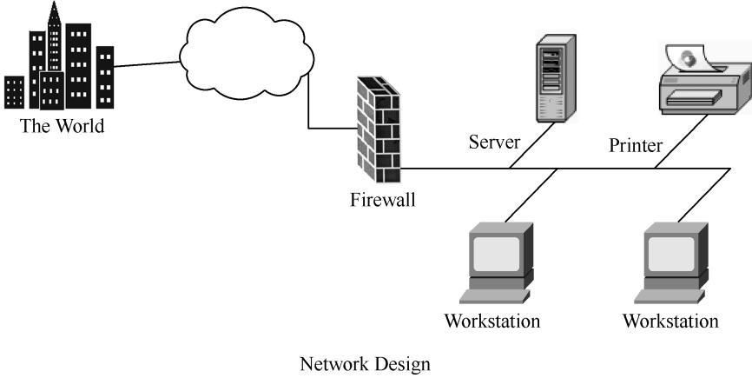

Slide 4
3.1 Network Concepts（网络基础）
Networking arose from the need to share data in a timely fashion. Personal computers are wonderful business tools for producing data, spreadsheets, graphics, and other types of information, but do not allow you to quickly share the data you have produced. If the user were to connect his computer to other computers, he could share data on other computers, including high-quality printers. A group of computers and other devices connected together are called a network, and the technical concept of connected computers sharing resources is called networking. Computers that are part of a network can share data, messages, graphics, printers, fax machines, modems, CD-ROMs, hard disks, and other data storage equipment. According to the scope the network works and the distance for the mutual connection of computers, it has three categories: Wide Area Network, Local Area Network, and Metropolitan Area Network. | 计算机网络的建立是为了满足人们以即时方式共享数据的需求。个人计算机在处理数据、电子表格、图形以及其他类型的信息方面是理想的办公设备，但却不支持快速（用户输出的）数据共享。 如果用户能把他的计算机与其他计算机联系在一起的话，他就可以共享其他计算机上的数据，包括高性能的打印机。一组计算机和其他的设备连接在一起构成的系统叫作网络，互连的计算机共享资源的技术（概念）叫作网络技术。 联网的计算机可以共享数据、消息、图形、打印机、传真机、调制解调器、只读光盘、硬盘以及其他数据存储设备。 按照网络作用的范围与计算机相互连接的距离分，有广域网、局域网和城域网3种类型的网络。

Slide 5

Key words: networking（网络技术），spreadsheet（电子表格），share（共享），network（网络），message（信息），graphics（图形），fax machine（传真机），modem（调制解调器），CD-ROM（只读光盘），data storage equipment（数据存储设备），Wide Area Network（广域网），Local Area Network（局域网），Metropolitan Area Network（城域网）

Slide 6
A computer network is a communication system connecting some computers that work together to exchange and share resources. Generally it is made up of two parts: network operation system (NOS) and hardware or nodes, referring to any devices that are connected to a network. Take LAN for example, the hardware system includes a microcomputer, which is used as file server and workstation, net interface card, T-shape juncture, BNC joint, terminator, and cables etc. File Server is the soul of a whole network, so it must be the best. All the input and output of data are under control of the File Server on the network. A network must have a computer as the network File Server, and it provides the workstation its data on the hard disk. Workstation actually is a set of PC. When it has been connected with File Server and been logged on, it can access data from the File Server, and operates on the workstation with the documents needed. Net card (network interface card: NIC) is the interface between File Server and Workstation. | 一个计算机网络实际上是一个通信系统，它连接了若干一起工作并分享资源、交换信息的计算机。通常网络系统由两部分组成，即网络操作系统和网络硬件或节点，节点指的是连接在网络上的任何设备。以局域网为例，硬件系统包括分别用作服务器与工作站的微型计算机、网卡、T形接头、BNC接头、终端电阻以及电缆线等。 服务器（file server）是整个网络的灵魂，所以它必须是最好的。网络上所有数据的进出都须通过服务器来控制。一个网络必须有一台计算机来做网络服务器，由它将硬盘上的数据提供给工作站使用。 工作站（workstation）实际上就是一台PC，当它与服务器连接并登录后，就可以访问服务器上的数据，在得到所需文件后就可以在工作站上运行。 网卡（network interface card: NIC）是服务器与工作站之间的接口。

Slide 7
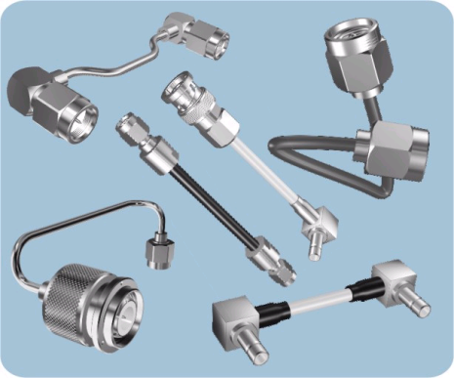
Key words: resource（资源），network operating system（网络操作系统），node（节点），workstation（工作站），T-shape juncture（T形头），BNC joint（BNC接头），terminator（终结器）， cable（电缆），file server（文件服务器），log on（登录），network interface card（网卡），interface（界面，接口）

Slide 8
3.2 Architecture of Computer Networks（计算机网络结构）
The configuration, or the physical layout, of the equipment in a communication network is called topology. Devices connected to a network, such as terminals, printers, or other computers, are referred to as nodes. The four configurations or Network are star, bus, ring, and tree. Star Network A star network contains a central unit, a number of personal computers, terminals or peripheral devices. All of them are linked to the central unit either by point-to-point or multidrop cable lines. This central unit may be a host computer or a file server. All communications in the network are controlled through this central unit by polling. That is, before one user wants to send messages, he or she must be polled or asked if there is any message to be sent. One particular advantage of star network is that it provides a time-sharing system. This allows several users to share resources on a central computer simultaneously. | 拓扑，指通信网中设备的配置或物理布局。节点，指连接在网络上的设备，如终端、打印机或其他计算机。通信网络的设备配置称为拓扑，主要有4种配置方式：星形、总线形、环形和树形。 星形网络 星形网络由一台中央处理器、多台个人计算机、终端或外围设备构成。所有这些设备都可以通过两点连接或多点连接的方式和中央处理器连接，形成星形结构。这台中央处理器可以是一台主机或是文件服务器。所有的网络通信都必须通过访问这台处理器来进行控制。也就是说，用户在传送信息之前将被询问是否有信息要传送。星形网络结构的一个显著优点是它提供分时服务，这使多个用户可以同时分享中央计算机上的资源。

Slide 9
Key words: equipment（设备），topology（拓扑），terminal（终端），star network（星形网络），peripheral device（外围设备），host computer（主机），send message（传送消息），time-sharing system（分时系统）
Star Network

Slide 10
Bus Network In bus network, each device in the network handles its own communications control. There is no host computer. All the devices are connected to and share a single cable. All communication travel along this common connection cable are called bus. As the information passes along the bus, it’s examined by each device to see if the information is intended for it. When only a few microcomputers are to be linked together, bus network is more preferable. This configuration is common in systems for electronic mail or for sharing data stored on different microcomputers. The bus network is as efficient as the star network for sharing resources, because it is not directly linked to the resource. In bus network, any devices can be attached or detached from the network at any point without disturbing the network. In addition, if one computer fails, it doesn’t affect the entire network. | 总线网络 在总线网络中，每一个设备处理自己的通信管理，并没有主机。所有的设备都由一根电缆线连接。所有的通信传输都沿着这根共同连接着的称为总线的电缆进行。当信息沿总线传送时，每个设备对它进行检查，看这条信息是否是对该设备的。 当想要连接少数几台计算机时，总线网络更加适合。这种配置的电子邮件或不同计算机上的数据共享系统是相同的。由于总线网络并非直接和资源连接，因此在资源共享上和星形结构一样有效。 总线网络中的设备可以连接到网络的任何一点，或从网络上任何一点取下，而不影响其他部分。而且，一台机器出故障，并不影响整个网络。

Slide 11
Key words: bus network（总线网络），bus（总线），electronic mail（电子邮件）
Bus Network

Slide 12
Ring Network and Tree Network A ring network doesn’t use a central host computer. Each device is connected to two other devices, forming a ring. Messages are passed around the ring until they reach the destination. | 环形网络和树形网络 环形网络也没有主机，每个机器都和其他两台机器互相连接，形成一个环形。信息沿着环形线传送直到到达目的地。
A tree network consists of several computers linked to a central host computer, just like a star network. However, these computers are also host to other smaller computers. It allows various computers to share database, processing power, and different output devices. | 如同星形网络一样，树形网络由若干计算机连接到一台中央计算机上。然而，这些计算机同时又成为其他更小计算机的主机。树形网络允许各种计算机分享数据库、字处理程序和其他不同的输出设备。

Slide 13
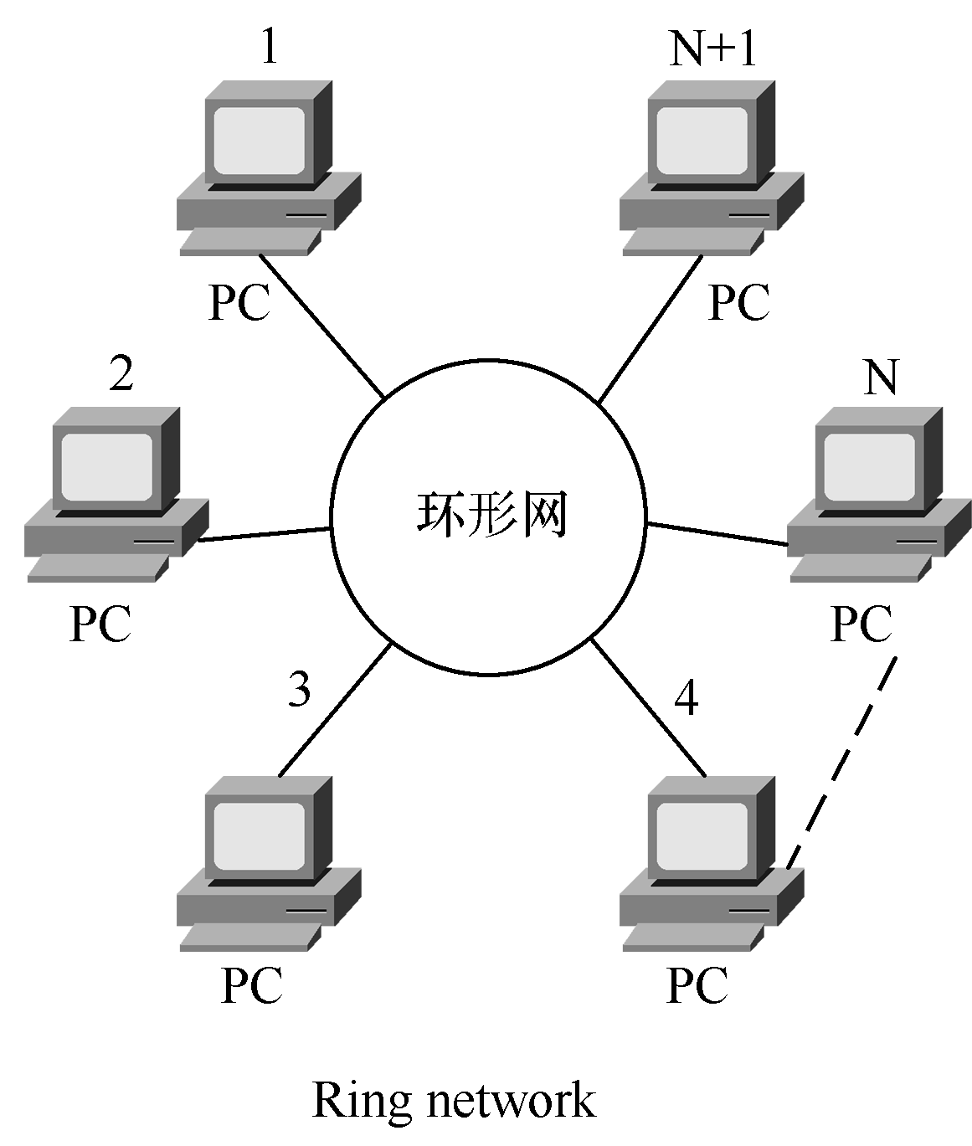
Key words: ring network（环形网络），tree network（树形网络），database（数据库）
Ring Network

Slide 14
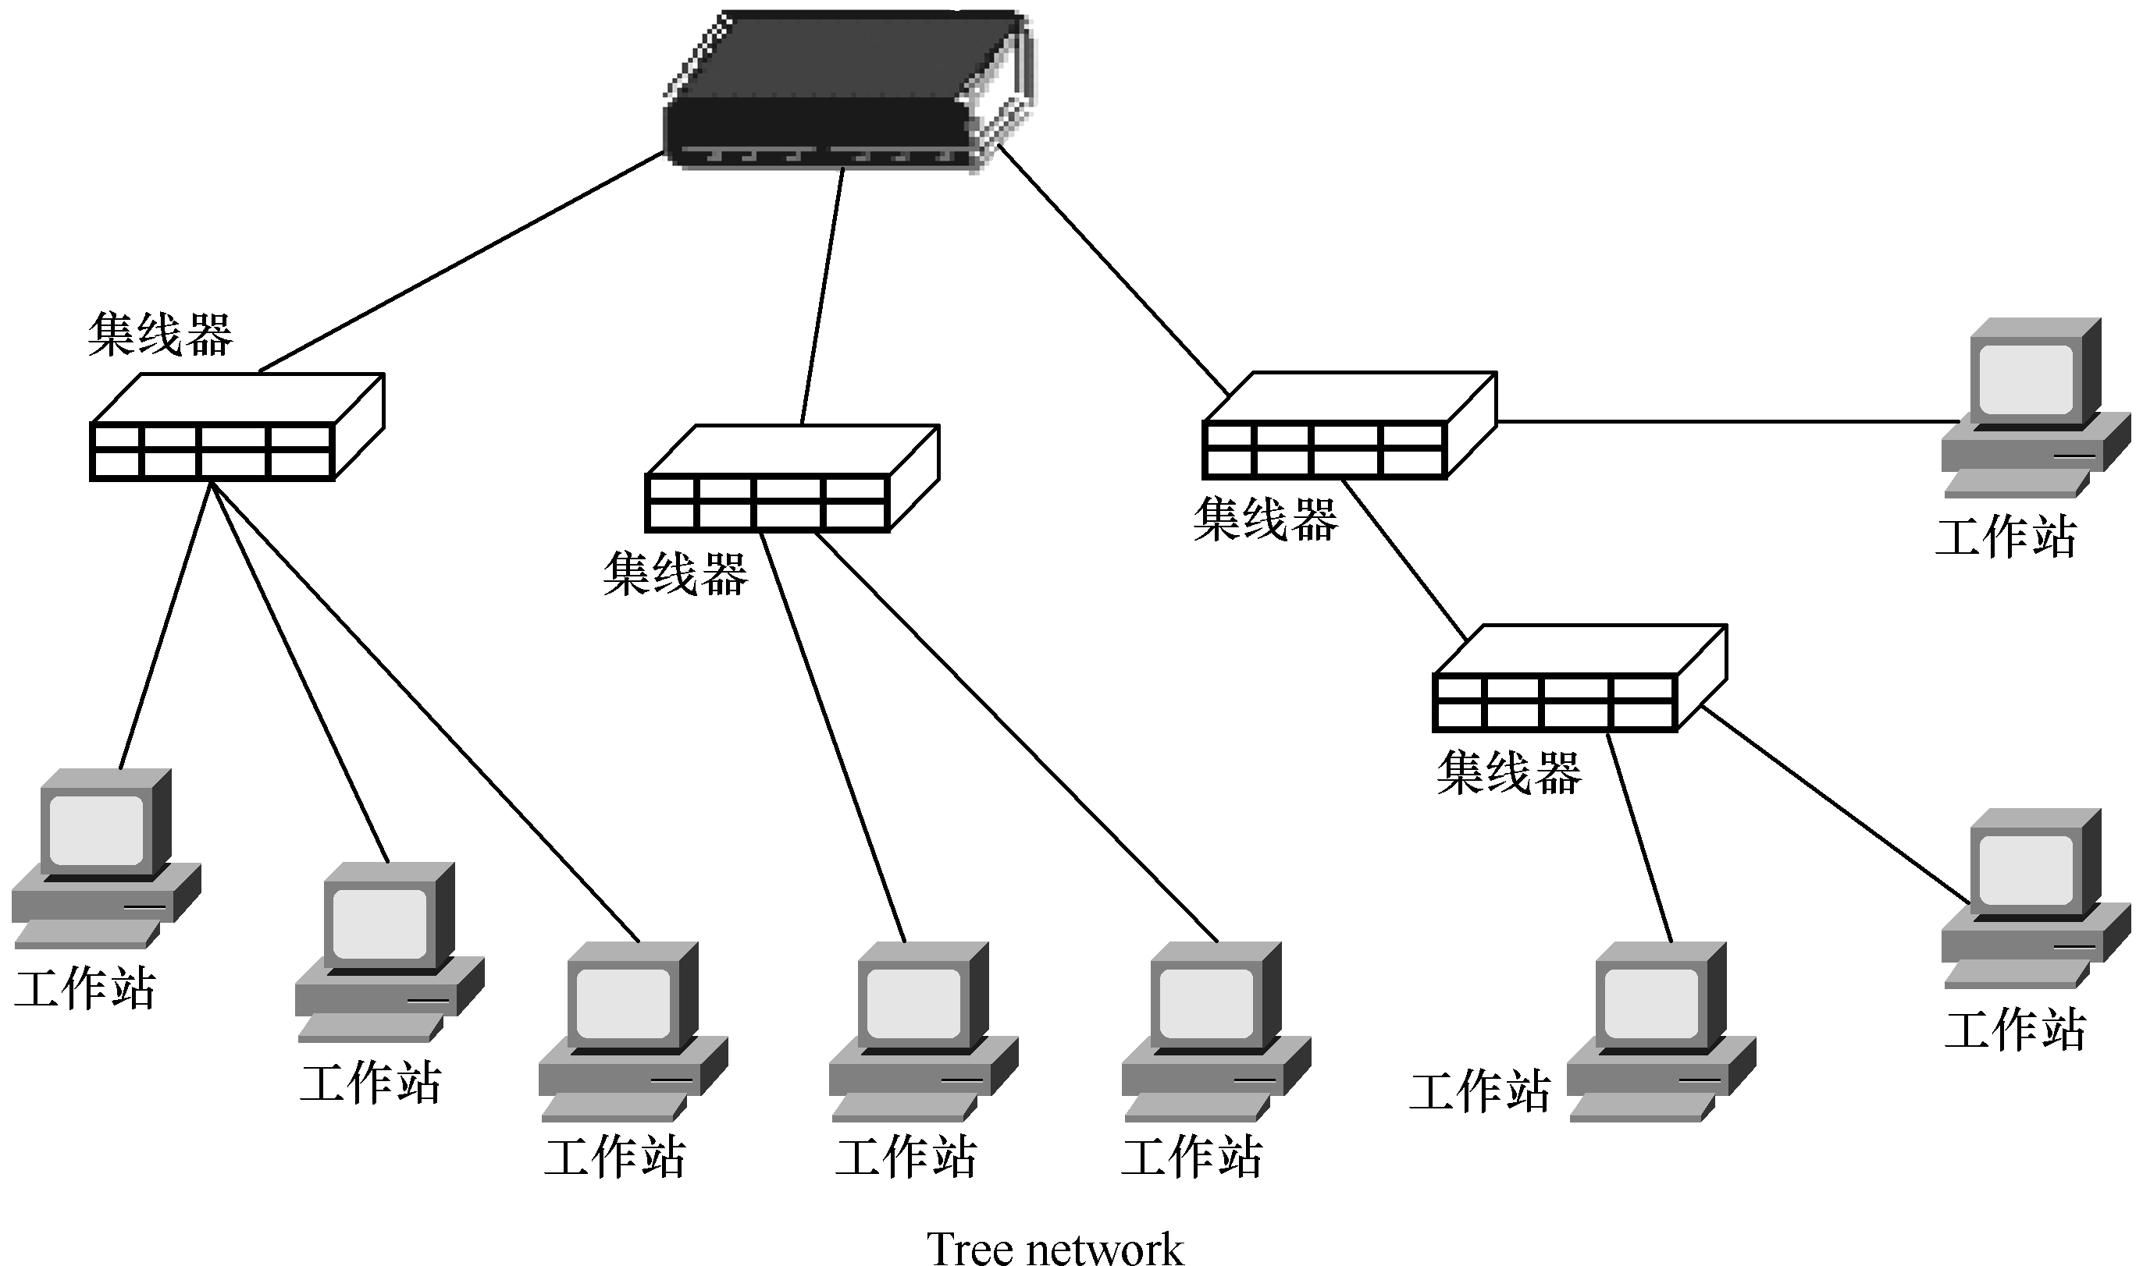
Tree Network

Slide 15
3.3 LAN（局域网）
A network is any collection of independent computers that communicate with one another over a shared network medium. LANs are networks usually confined to a geographic area, such as a single building or a college campus. LANs can be small, linking as few as three computers, but often link hundreds of computers used by thousands of people. The development of standard networking protocols and media has resulted in worldwide proliferation of LANs throughout business and educational organizations. LAN is possible for hardware resource sharing and information resource sharing on LANs. At the same time, each LAN can directly link to WANs, thus gains rich information. | 网络就是连接在一起的独立计算机，相互之间通过一个共享网络媒介进行通信的。局域网通常是指某一地域范围内的一个网络，如一幢建筑物内或一个大学校园内。局域网可以很小，可以少到只连接3台计算机，但通常会连接几百台计算机，供几千人使用。标准网络协议和网络媒介的发展使得局域网在全世界快速发展，它遍及商业领域和各教育机构。 局域网可以实现硬件资源共享和信息资源共享。此外，局域网还能直接连接到广域网上，从而获得上面的丰富信息。

Slide 16
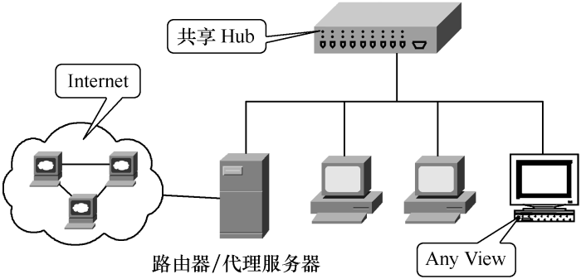

Slide 17
Key words: communicate（通信），network medium（网络媒介），network protocol（网络协议），hardware resource（硬件资源），information resource（信息资源）

Slide 18
What Is Wireless Computer Networking? Wireless networks utilize radio waves and/or microwaves to maintain communication channels between computers. Wireless networking is a more modern alternative to wired networking that relies on copper and/or fiber optic cabling between network devices. | 什么是无线计算机网络？ 无线网络利用无线电波和（或）微波保持计算机之间的通信通道。无线网络比依赖于铜线和（或）光缆来连接网络设备的有线网络更现代些。
A wireless network offers advantages and disadvantages compared to a wired network. Advantages of wireless include mobility and elimination of unsightly cables. Disadvantages of wireless include the potential for radio interference due to weather, other wireless devices, or obstructions like walls. Wireless is rapidly gaining in popularity for both home and business networking. Wireless technology continues to improve, and the cost of wireless products continues to decrease. Popular wireless local area networking (WLAN) products conform to the 802.11 “Wi-Fi” standards. The gear a person needs to build wireless networks includes network adapters (NICs), access points (APs), and routers. | 无线网络与有线网络相比既有优点也有缺点。其优点是移动性强，并且除去了难看的电缆线。其缺点是环境带来的潜在的无线电干扰，如有天气原因，或其他无线上网设备或障碍物（如墙）的阻挡都可能带来干扰。 无线网络在家庭网络和商业网络两方面迅速流行起来。无线技术还在继续提高和完善，而无线产品的价格却在不断降低。一般的无线局域网（WLAN）产品都遵循802.11“Wi-Fi”标准。 一个人要建立无线网络必须有网络适配器（NICs），访问端口和访问通道。

Slide 19
Key words: wireless computer networking（无线计算机网络），radio wave（无线电波）， microwave（微波），communication channel（通信通道），wired networking（有线网络），network device（网络设备），wireless device（无线设备），wireless product（无线产品），wireless local area networking（WLAN，无线局域网）

Slide 20

无线网关键字
802.11x：定义了无线局域网技术的一系列标准。此标准由电气电子工程协会（IEEE）制定，它包括802.11a、802.11b、802.11g和新兴802.11n。802.11ac标准在本文发布时仍在开发中。
Wi-Fi：代表“无线保真”，指802.11标准的IEEE802.11b子集。Wi-Fi支持高达11Mbit/s的数据传输率，是迄今为止最常用的标准。
WLAN：无线局域网的缩写，指采用802.11无线技术进行互连的一组计算机和相关设备。也称为LAWN。

Slide 21
WAN：广域网，指覆盖主要城市中心或整个国家的网络，如GPRS、CDMA和GSM等。
无线热点：通过无线接入点为移动用户提供连网或互联网服务的区域。公共热点建立在图书馆、机场、酒店甚至咖啡厅和餐馆中。
蓝牙：一种低成本、低功率无线“线缆替代”技术，使电话、笔记本电脑、PDA和外设等设备能够通过短程（10米）无线信号进行互连。

Slide 22
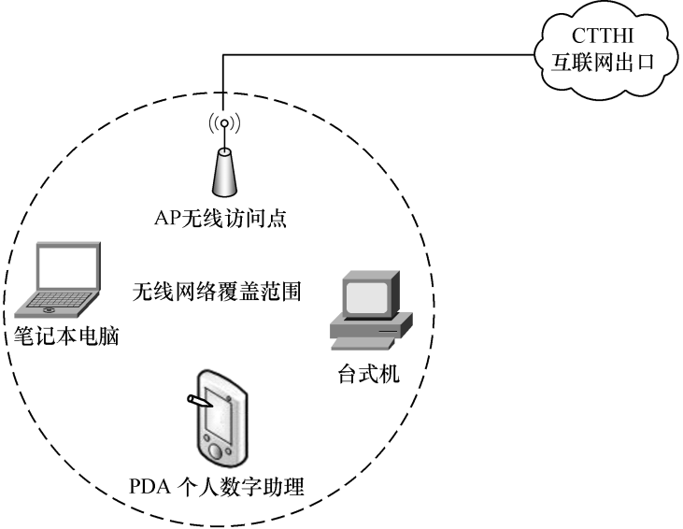

Slide 23
3.4 WAN（广域网）
As the geographical scope of the network grows by connecting users in different cities or different states, the LAN grows into a wide area network (WAN). WAN (wide area network) is also called RCN (remote computer network). Its effective scope can reach from tens of kilometers to ten thousands of kilometers. A wide area network uses telephone lines, microwaves, satellites, or a combination of communi- cation channels. The network between nations belongs to wide area network. At present the biggest wide area network in the world is Internet and it has covered more than 220 nations. It is like a giant highway that connects you to millions of other people and organizations located throughout the world. The Internet is a huge computer network available to nearly everyone with a microcomputer and a means to connect to it. The Web, also known as the World Wide Web or WWW, is an Internet service that provides a multimedia interface to numerous resources available on the Internet. | 随着各个城市、各个国家的用户被连接在一起，网络的地理覆盖范围不断扩展，局域网（LAN）已经发展成了广域网（WAN）。 广域网也称远程网RCN（remote computer network），其作用范围可以达几十公里到几万公里。广域网使用电话线、微波、卫星或这些通信信道的组合来传送信息。国家与国家之间的网络就属于广域网。目前世界上最大的广域网就是互联网，其范围已经覆盖了全球220多个国家。它像一条高速公路一样将你与遍布全世界的多达几百万的人和机构连接起来。互联网是一个巨大的计算机网络，它适合几乎每一个有计算机和上网条件的人去使用它。环球网，也就是众所周知的万维网，是互联网的一项服务，它为互联网上大量的可用资源提供一个多媒体的界面。

Slide 24
Key words: RCN（remote computer network，远程网），telephone line（电话线），communication channel（通信信道），Internet（互联网），Web（环球网），World Wide Web（万维网），Internet service（互联网服务）

Slide 25
Internet The Internet is a system of linked networks that are worldwide in scope and facilitate data communication services such as remote login, file transfer, electronic mail, the World Wide Web, and newsgroups. With the meteoric rise in demand for connectivity, the Internet has become a communication highway for millions of users. The Internet was initially restricted to military and academic institutions, but now it is a full- fledged conduit for any and all forms of information and commerce. Internet websites now provides personal, educational, political, and economic resources to every corner of the planet. | 互联网 互联网是一个全球网络系统，它有许多方便的数据通信服务，如远程登录、文件传输、电子邮件、万维网和新闻组等。 随着联网需求的迅速上升，互联网已成为几百万用户间的信息通信高速公路。互联网最初仅限于军事部门和学术机构使用，而现在它已经是一个完全成熟的通信通道以及信息和商业的窗口。现在互联网各网络站点向全球每一个角落提供个人、教育、政治和经济等资源。

Slide 26
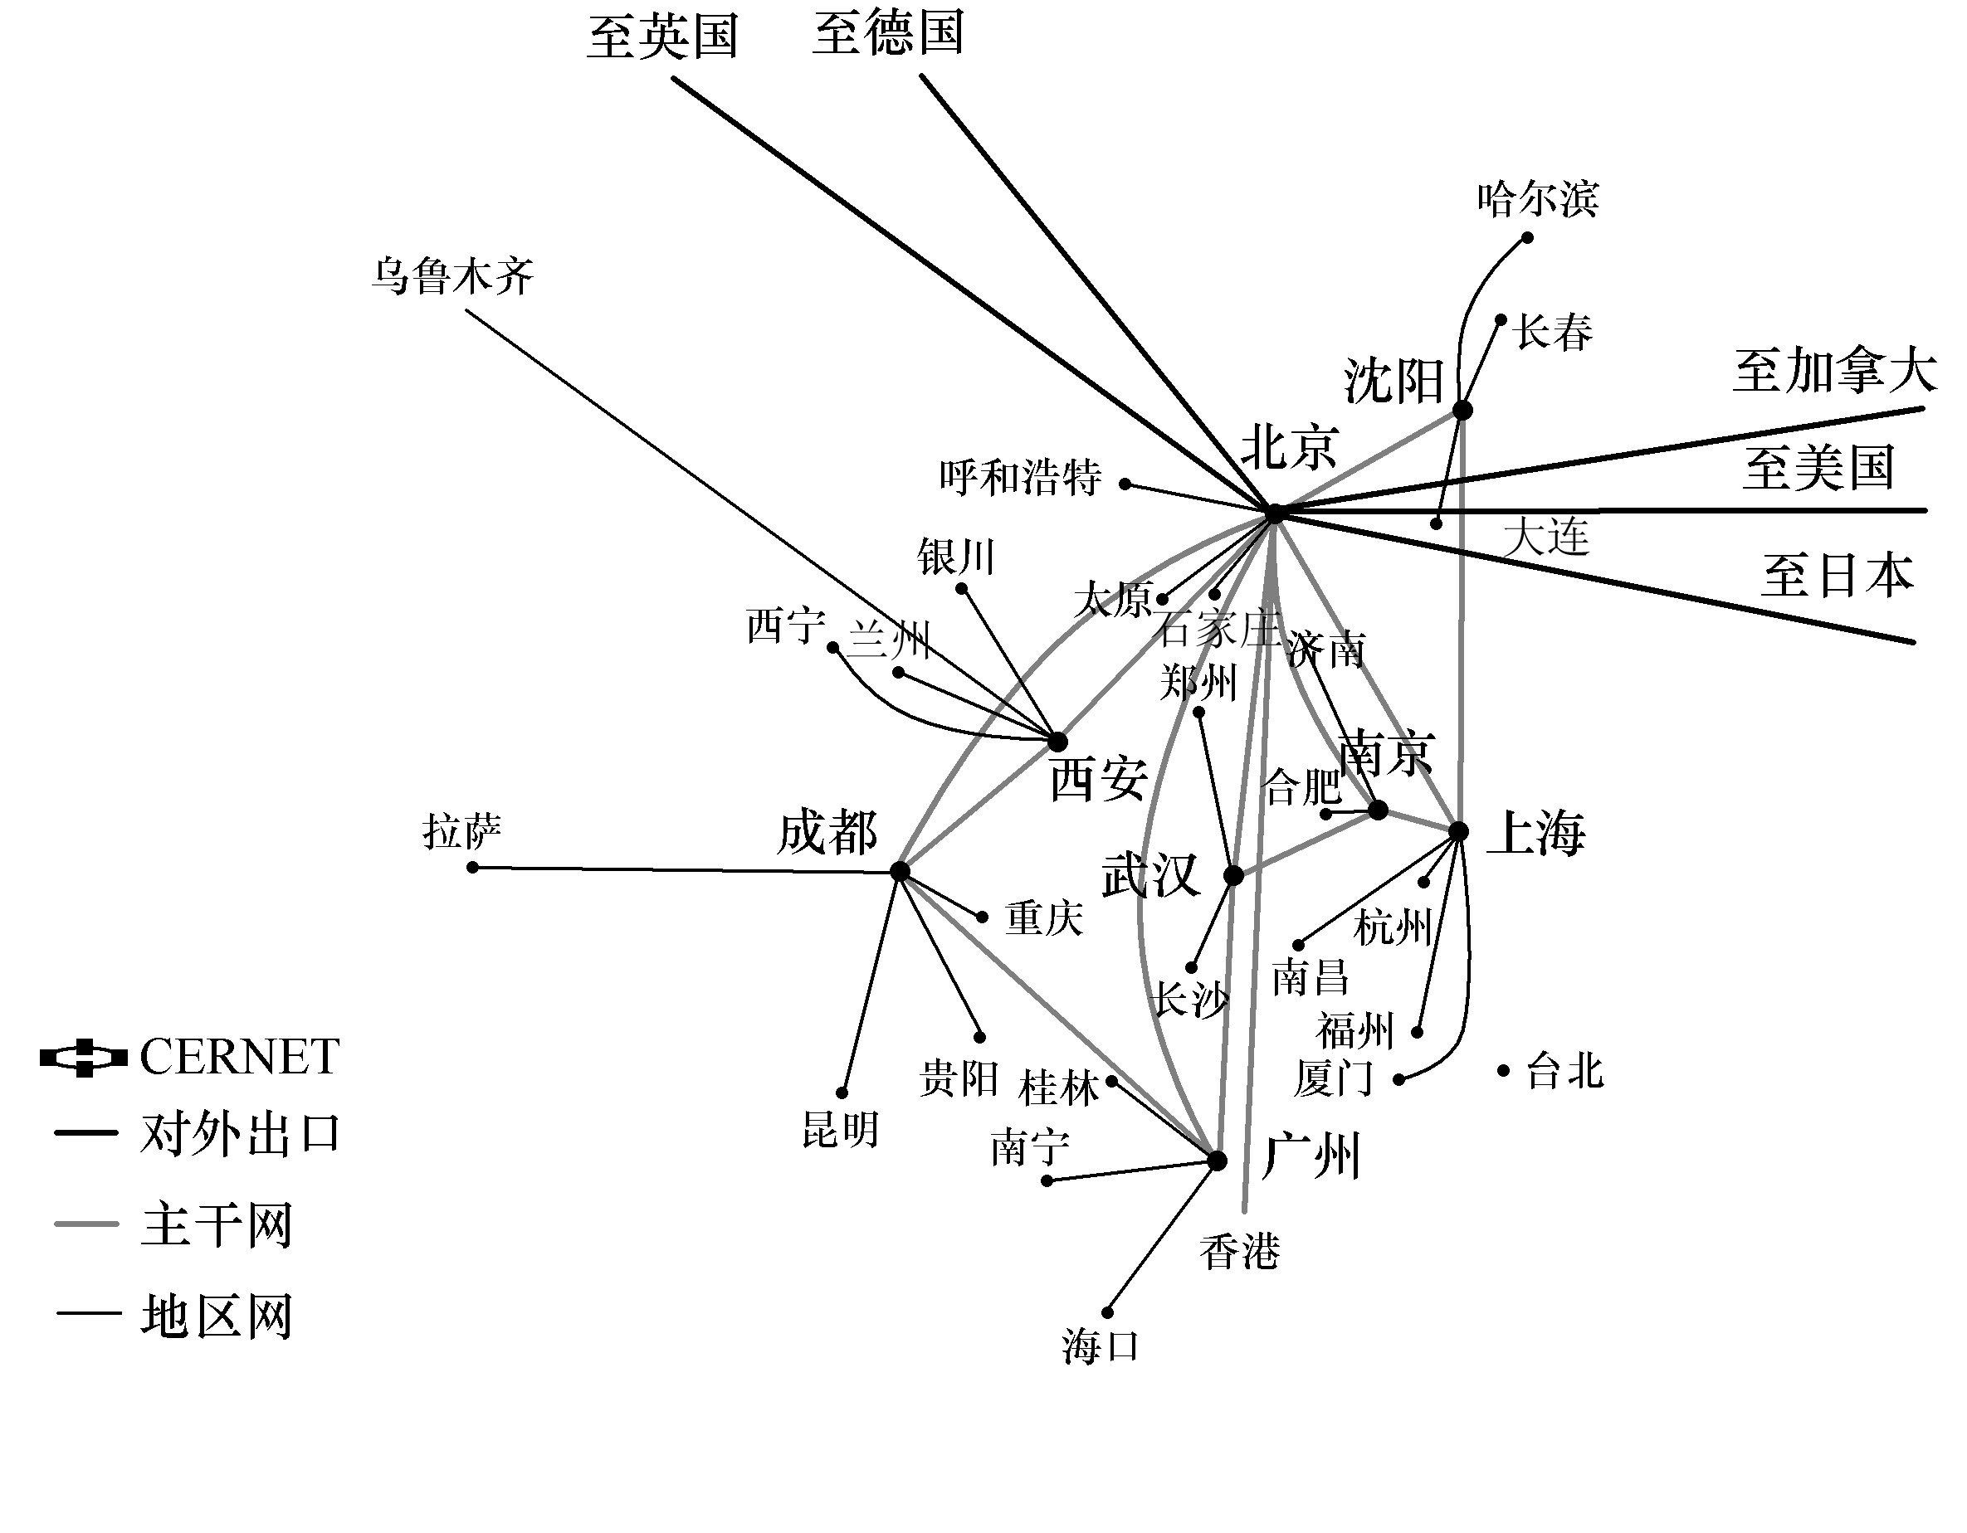
Key words: remote login（远程登录），file transfer（文件传输），newsgroups（新闻组），website（网络站点）
国内主干网络分布图

Slide 27
中国的计算机网络主要有六大互联网络：中国科学技术网（CSTNet）、邮电部中国公用计算机互联网（ChinaNet）、中国教育和科研计算机网（CERNet）、中国金桥信息网（ChinaGBN）、中国联通工联网（UNINET）和中国网通（CNCNET），并实现了网络间的互联互通。中国互联网就是以这六大互联网为依托而产生和发展起来的。

Slide 28
3.5 Hardware Concepts of Computer Network（计算机网络硬件设备基础）
3.5.1 Network Interface Card（网卡）
A network interface card (NIC) is a computer circuit board or card that is installed in a computer so that it can be connected to a network. Personal computers and workstations on a local area network (LAN) typically contain a network interface card specifically designed for the LAN transmission technology, such as Ethernet or Token Ring. Network interface cards provide a dedicated, full-time connection to a network. Most home and portable computers are connected to the Internet through as-needed dial-up connection. The modem provides the connection interface to the Internet service provider. | 网卡是安装在计算机内的一块电路板（或插卡），计算机通过它连接到网络上。在局域网中的个人计算机和工作站中都会有一块专为局域网传输技术而设计的网卡，如以太网或令牌环网。网卡专用于全时连接网络。绝大多数家用电脑和手提电脑通过拨号连接上网。调制解调器为互联网服务提供商提供了一个连接接口。

Slide 29
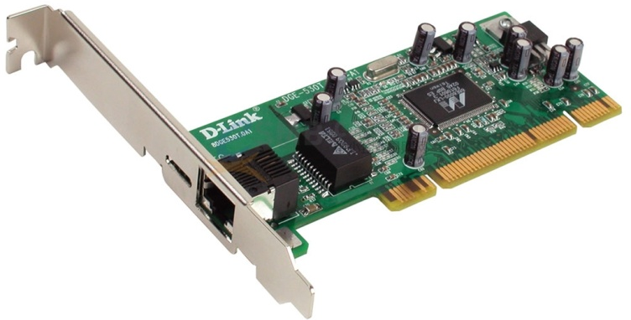
Key words: NIC（网卡），transmission technology（传输技术），Ethernet（以太网），Token Ring（令牌环网），portable computer（手提电脑），dial-up connection（拨号连接），Internet service provider（互联网服务提供商）

Slide 30
常见的网卡（NIC）品牌有：Intel、Winyao（万耀）、TP-LINK（普联）、D-Link（友讯）、LR-LINK（联瑞）、Tenda（腾达）、DIEWU（蝶舞）、GRT（光润通）、B-LINK（必联）、Unicaca（众力）等。

Slide 31
3.5.2 Modem（调制解调器）
Modem is short for “modulator-demodulator”. A modem is a device or program that enables a computer to transmit data over, for example, telephone or cable lines. Computer information is stored digitally, whereas information transmitted over telephone lines is transmitted in the form of analog waves. A modem converts between these two forms. Fortunately, there is one standard interface for connecting external modems to computers called RS-232. Consequently, any external modem can be attached to any computer that has an RS-232 port, which almost all personal computers have. There are also modems that come as an expansion board that you can insert into a vacant expansion slot. These are sometimes called onboard or internal modems. | 调制解调器（Modem）是“调制—解调（modulator，demodulator）”的缩写。调制解调器是一个帮助计算机转换（比如电话线、电缆线）数据的设备或程序。计算机中的信息是以数字方式存储的，而在电话线中传输的却是模拟信号。调制解调器就将这两种信号互相转换。 幸好，外置调制解调器都有一个叫作RS-232的标准接口与计算机相联，因此，任何一个外置调制解调器都能连接到任何一台有RS-232端口的计算机上，而几乎所有的个人计算机都有这种端口。也有的调制解调器以扩展板的形式插入空的扩展槽当中。有时它们被称为内置调制解调器。

Slide 32
Key words: modulator-demodulator（调制解调器），digitally（数字地），standard interface（标准接口），external modem（外置调制解调器），expansion board（扩展板），expansion slot（扩展槽），internal modem（内置调制解调器）

Slide 33
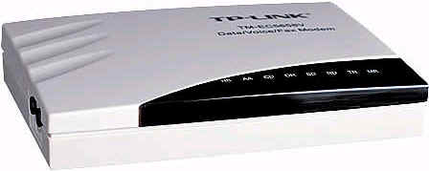
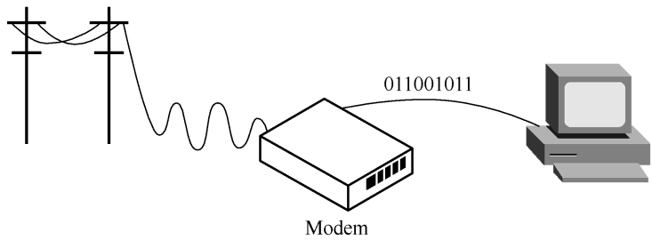
Modem

Slide 34
3.5.3 Hubs（集线器）
A hub is a common connection point for devices in a network, which is commonly used to connect segments of a LAN. A hub contains multiple ports.When a packet arrives at one port, it is copied to the other ports so that all segments of the LAN can see all packets. A passive hub serves simply as a conduit for the data, enabling it to go from one device (or segment) to another. So-called intelligent hubs include additional features that allow an administrator to monitor the traffic passing through the hub and to configure each port in the hub. Intelligent hubs are also called manageable hubs. A third type of hub, called a switching hub, actually reads the destination address of each packet and then forwards the packet to the correct port. | 集线器是网络设备的一个普通连接点，它通常用于连接局域网中的各网段。一个集线器有若干个端口。当一个数据包到达一个端口时，它将被复制到其他端口，因此局域网中所有网段都能看到所有的数据包。 一个被动集线器仅仅是一个数据通道，它使数据从一个设备（或网段）传输到另一个上面。所谓的智能集线器，还包括其他的特征，即允许管理员监控通过集线器的流量和配置集线器的每个端口。智能集线器也被称为可控集线器。 第三种集线器被称为交换集线器，事实上是先读取每个数据包中的目的地址，然后将数据包传送到正确的端口。

Slide 35
Key words: hub（集线器），connection point（连接点），segment of a LAN（局域网段），packet（信息包，数据包），port（端口），passive hub（被动集线器），intelligent hub（智能集线器），traffic（通信量，流量），configure（配置），manageable hub（可控集线器），switching hub（交换集线器），destination address（目的地址）

Slide 36
常见的集线器（HUB）品牌：高档HUB主要由美国品牌占领，如3COM、INTEL、BAY等；我国的D-LINK和ACCTON占有中低端HUB的主要份额；其他的有TP-LINK/普联集线器（HUB）、优越者集线器（HUB）、水星集线器（HUB）、阿尔法集线器（HUB）、SSK/飚王集线器（HUB）、ECOM集线器（HUB）、HP/惠普集线器（HUB）、LANVOLAN集线器（HUB）、TCL集线器（HUB）、TENDA/腾达集线器（HUB）、UGR/联合金彩虹集线器（HUB）、WG集线器（HUB）、XINGNET集线器（HUB）、顶联网络集线器（HUB）、顶星集线器（HUB）、捷讯数码集线器（HUB）、奇胜集线器（HUB）、全码集线器（HUB）、神州数码集线器（HUB）等。

Slide 37
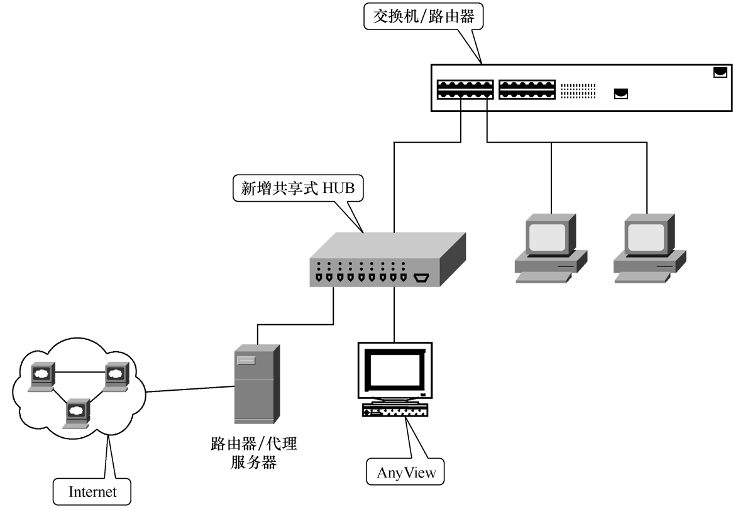
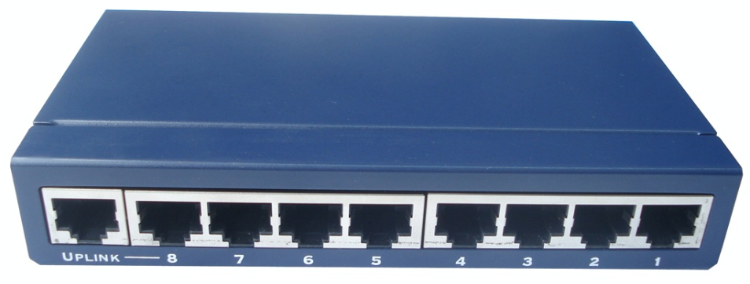
Hub

Slide 38
3.5.4 Network Medium（网络介质）
Twisted-pair cable, a type of cable that consists of two independently insulated wires twisted around one another. The use of two wires twisted together helps to reduce crosstalk and electromagnetic induction. While twisted-pair cable is used by older telephone networks and is the least expensive type of local-area network (LAN) cable. Most networks contain some twisted-pair cabling at some point along the network. Other types of cables used for LANs include coaxial cables and fiber optic cables. | 双绞线，一种由两根独立的绝缘金属丝相互缠绕在一起构成的电缆。两根金属丝相互缠绕在一起是为了降低相互间的信号串扰和电磁感应。虽然双绞线常用于老的电话网和费用低廉的局域网中，但在绝大多数的网络分支上也用到了双绞线。局域网中用到的其他类型的电缆还有同轴电缆和光缆。
Coaxial cable, a high-frequency transmission cable, replaces the multiple wires of telephone lines with a single solid-copper core. In terms of number of telephone connections, a coaxial cable has over 80 times the transmission capacity of twisted pair. Coaxial cable is used to deliver television signals as well as to connect computers in a network. | 同轴电缆，一种高频传输电缆，用一根单一的铜芯取代了多金属丝的电话线。如果在相同的电话线路中，同轴电缆的传输速度是双绞线的80倍。同轴电缆也常被用于传送电视信号，以及在网络中连接计算机。

Slide 39
Key words: twisted-pair cable（双绞线），crosstalk（串音干扰，交调失真），electromagnetic induction（电磁感应），telephone networks（电话网），coaxial cable（同轴电缆），fiber optic cable（光缆），transmission capacity（传输量）

Slide 40
Fiber-optic cable transmits data as pulses of light through tiny tubes of glass. In terms of number of telephone connections, fiber-optic cable has over 26000 times the transmission capacity of twisted pair. However, it is significantly smaller. Indeed, a fiber-optic tube can be half the diameter of a human hair. Although limited in the distance they can carry information, fiber-optic cable have several advantages. Such cables are immune to electronic interference, which makes them more secure. They are also lighter and less expensive than coaxial cable and are more reliable at transmitting data. They transmit information using beams of light at light speeds instead of pulses of electricity, making them far faster than copper cable. Fiber-optic cable is rapidly replacing twisted pair telephone lines. | 光缆通过玻璃纤维以光波的形式传送数据。如果在相同的电话线路中，光缆的传输速度是双绞线的26000倍。然而，它却又是那么的细小，事实上，一根光纤的粗细只有人的头发直径的一半。尽管它们传输信息的距离是有限的，但是光缆仍有几大优点。比如，光缆不受电子干扰，这使得它更安全。它们也比同轴电缆更轻便、更便宜，而且传输数据的可靠性更高。它们用光波取代了电脉冲来传输信息，这使得它们传输的速度比同轴电缆快得多。在电话线路中，光缆迅速地取代了双绞线。

Slide 41
Key words: pulse of light（光脉冲），fiber-optic tube（光纤），electronic interference（电子干扰），secure（安全），beam of light（光波），pulse of electricity（电脉冲）

Slide 42
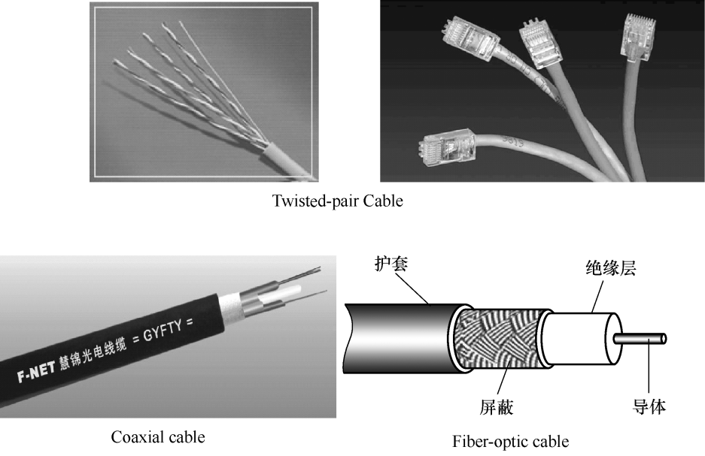
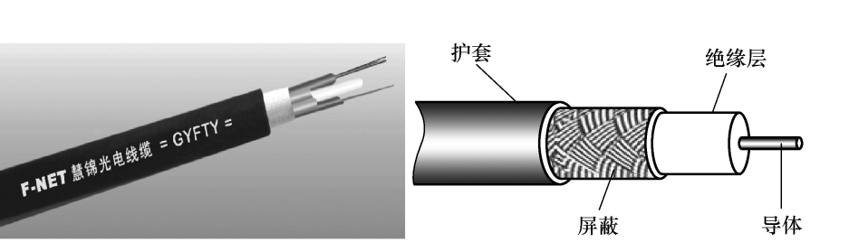
Twisted-pair Cable
Coaxial Cable Fiber-optic Cable

Slide 43
3.6 Network Test Tools（网络测试命令）
Problems happen! Even when the network is monitored, the equipment is reliable, and the users are careful, things may go wrong. The test of a good network administrator is the ability to analyze, troubleshoot, and correct problems under pressure of a network failure that causes company downtime. Besides the processes that are described by some veterans, there are software tools that are available for you to use to solve network connectivity problems. These tools can help in LAN troubleshooting, but are especially helpful in a WAN troubleshooting situation. These commands include the Ping, Tracert, Telnet, Netstat, ARP, and IPconfig, which are run in command-line mode. | 问题来了！就算我们监视着整个网络，设备可靠，并且用户很小心，计算机也可能会发生故障。迫于网络故障导致的公司停工的压力，一个优秀的网络管理员应具备分析、检测和解决网络故障的能力。除了某些经验丰富的老手所描述的处理步骤外，还可借助有效的软件工具来解决网络连接问题。这些工具可用于局域网故障检测，但在广域网中更加有用。它们包括Ping、Tracert、Telnet、Netstat、Arp和IPconfig，都运行在命令行模式下。

Slide 44
3.6.1 Ping命令
While there are several useful programs for analyzing connectivity, unquestionably Ping is the most commonly used one. The Ping program sends an Internet Control Message Protocol (ICMP is the Internet protocol that reports errors and provides information relevant to IP packet addressing) echo request packet to the destination host. When the echo request packet is received, the remote host immediately returns an echo reply packet to the sending device. The format of the Ping command is: | 在几个检测网络流通性的有用程序中，毫无疑问Ping命令是最常用的。Ping命令向目的主机发送互联网控制消息协议（ICMP用来报告IP数据包寻址的错误和相关信息）的echo数据包。当echo包被目的端接收时，该主机立刻向源端回传应答数据包。Ping的格式如下：

Slide 45
Ping [-t] [-a] [-n count] [-l length] [-f] [-i ttl] [-r count] destination
-t | Ping the specified host until stopped. To see statistics and continue—type Ctrl+Break; To stop — type Ctrl+C （Ping指定的主机直到停止操作。看统计信息并继续执行该命令——按下Ctrl+Break，停止则按下Ctrl+C）
-a | Resolve host name and ping address （主机名解析为IP地址，并且Ping该地址）
-n | number of echo requests to send （发送count指明的echo数据包个数）
-l | length—send specified size echo packets [定义echo数据包的大小（byte为单位）]
-f | DO NOT FRAGMENT command sent to gateways （在数据包中发送“禁止分段”标志，将其送至网关）
-i | ttl sets the TTL field [指定TTL值在对方系统停留的时间（1～255）]
-r | count records the route of the outgoing and returning packets （在“记录路由”字段中记录传出和返回数据包的路由）
destination | Specify the remote host to ping, by domain name or by IP address （指定所要Ping的远端主机，它可以是域名也可以是IP地址）

Slide 46
In the examples below (Experiment 1 and 2), an ECHO_REPLY was received. | 下面这个实例中（实验1和实验2），收到了echo应答包。

Slide 47
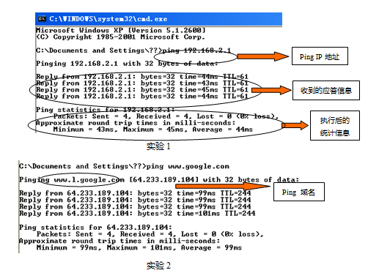

Slide 48
Users can also Ping the local host, this will allow you to see if the computer is able to send information out and receive the information back (Experiment 3). Make sure that this does not send information over a network but may allow you to see if the card is being seen. Maybe you would like to Ping 127.0.0.0, the loopback address for the computer. The Ping is successful, so that eliminates a possible problem between the computer, driver configuration, and the NIC card. If the Ping operation is not able to complete, this should relay back an unsuccessful message which could be an indication of cable issues, network card issues, hub issue, etc. | 用户也可Ping本地主机，这样你就可以知道计算机是否能发送和接收信息，如实验3所示。注意该操作并非通过网络发送信息而是使你能得知网卡是否完好。也许你会Ping 127.0.0.0，这是计算机的回环地址（网卡地址）。Ping操作成功，排除了可能存在于计算机、驱动程序设置和网卡的问题。如果Ping操作未能完成，将有一条失败信息传回来，表明可能是电缆问题、网卡问题或集线器问题等。

Slide 49
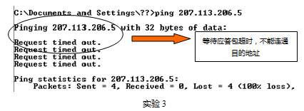

Slide 50
3.6.2 IPCONFIG命令
If you are looking for basic information quickly, Microsoft provides one of two programs for this purpose, depending on which version of Windows you use. The utility Winipcfg is included with Windows 95/98. A command-line program, IPconfig, is included with Windows NT and Windows 2000 and in Microsoft’s TCP/IP stack for Windows for Workgroups. Both programs provide the same information. These Windows utilities display IP- addressing information for the local network adapter(s) or a specified NIC. Command format: | 微软提供了两个程序，以便快速查找网络配置基本信息，这两个程序用哪一个取决于用户使用的Windows版本。Winipcfg是在Windows 95/98下使用的；IPconfig是一个命令行程序，包含在Windows NT、Windows 2000和微软的Windows工作组的TCP/IP堆栈里，它们都有相同的功能。这些Windows实用程序显示了本地网络适配器或专用网卡上的IP寻址信息。 命令格式：

Slide 51
IPconfig [-all | -renew [adapter] | -release [adapter]]
-all | all information about adapter(s) （网络适配器的所有信息）
-renew | renew DHCP lease information for all local adapters if none is named （若所有本地网络适配器都未命名则更新DHCP配置参数）
-release | release DHCP lease information disabling TCP/IP on this adapter （禁用本地系统上的TCP/IP并发布当前的DHCP配置参数）

Slide 52
The following is an example of the output you should expect to see when running IPconfig (Experiment 4). For more details you can execute IPconfig -all. | 下面是一个输入Ipconfig命令后所能看到的结果的实例，如实验4所示。执行Ipconfig-all可以得到更多的具体信息。

Slide 53
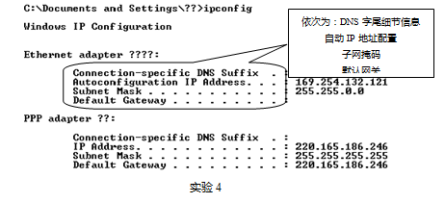

Slide 54
These are the tools that will allow a network administrator or ordinary users to remotely monitor and control the network. As the old saying goes everything has two sides, you must utilize them on the legality ways, not the hacker’s guilty way! | 以上这些都是为网络管理员或普通用户提供的对网络的远程监视和控制工具。正如古谚所说，“事事皆两面”，你必须把这些工具用于合法途径，而非计算机黑客的罪恶行径！

Slide 55
Key words: Ping（发送echo测试包命令），Ipconfig（IP地址配置命令），Time-To-Live (TTL)（生存时间）

Slide 56
3.7 Situation Dialogue（情景对话）
Wonderful Network Yaoyao and Yangyang are good friends. One day, when Yangyang comes to Yaoyao’s home, she is quite surprised at her chatting on computer. Yangyang: Are you chatting on QQ? Yaoyao: yeah, I’m going to install a web-cam, then I can chat on video. Yangyang: The net is so nice! We’ve just bought a computer, but how can I log in Internet ? Yaoyao: Do you have NIC and Modem? Yangyang: Yes, I have. Yaoyao: Then you can install the NIC and drivers program, and apply for an ISP account. Yangyang: So we can chat on video? Yaoyao: Yes, we can also send E-mails and cards to each other conveniently. You only need to spend a few minutes on www.126.com or other web sites to apply for an E-mail adress. Yangyang: How can I apply? Yaoyao: It’s quite easy. You may enter a certain web-site ( such as www.163.com ) and fill in the related information according to the instruction. | 神奇的网络世界 姚姚和洋洋是好朋友。一天，洋洋到姚姚家玩，洋洋看见姚姚正用计算机聊天，洋洋觉得十分惊奇。 洋洋：你在用QQ聊天吗？ 姚姚：是呀。我准备再安装一个摄像头，那样就可以视频聊天了。 洋洋：网络真好！我家也刚买了计算机，可怎样才能上网呢？ 姚姚：有没有网卡和调制解调器/猫？ 洋洋：都一起买了。 姚姚：那你安装好网卡和调制解调器的驱动程序后，再到电信局申请一个ISP账号就可以了。 洋洋：这样，我们就可以视频聊天了吗？ 姚姚：我们还能互相方便地发送电子邮件和贺卡。你只须到www.126.com或其他的网站花几分钟时间申请一个电子邮箱（E-mail）就可以了。 洋洋：怎么申请呢？ 姚姚：很简单，你进入某网站（比如www.163.com）后，只需根据提示填写相应信息就可以了。

Slide 57
Yangyang: Good, I’ll send you the electronic cards in holidays. Is there anything else funny online? Yaoyao: Too much, you may read news, see films, search for materials, listen to music, read books, play games, go shopping, chat, and transmit data. Yangyang: Can I download the learning material and find my favorite stars ? Yaoyao: Sure, playing games on computer is also quite interesting, but you should plan well, don’t spend too much time on it, otherwise it will interfere with your study. Yangyang: I see. I like English very much. Are there many English materials on Internet? Yaoyao: Too much! If you want to learn perfect English, you may directly enter the foreign website. There are all about English. It’s quite helpful to you. Yangyang: So wonderful! Yaoyao: Of course. That’s so-called “The world is a small network, and the network is a big world.” | 洋洋：好，以后的节日我会给你发电子贺卡的。在网上还有其他好玩的吗？ 姚姚：太多了！如看新闻、看电影、查资料、听歌、看书、玩游戏、购物、聊天，还有数据传输…… 洋洋：我可以在网上下载学习资料，并且找到我喜欢的明星吗？ 姚姚：当然啦！玩网络游戏也特过瘾。不过就是要计划好时间，不能玩得太久了，否则会影响学习。 洋洋：知道了。我很喜欢英语，网上英语资料多吗？ 姚姚：很多，如果你要看地道的英语，就直接进入国外的网站，里面全是英语内容，多看看对英语学习会有很大的帮助。 洋洋：太棒了！ 姚姚：当然啦，所谓“世界小网络，网络大世界”嘛。

Slide 58
3.8 Reading and Compacting（对照阅读）
Are Wireless Networks Secure? No computer network is truly secure, but how does wireless network security stack up to that of traditional wired networks? | 无线网络安全吗？ 没有哪个计算机网络是真正安全的，那么无线网络与传统有线网络相比又如何呢？
Unfortunately, no computer network is truly secure. It’s always theoretically possible for eavesdroppers to view or “snoop” the traffic on any network, and it’s often possible to add or “inject” unwelcome traffic as well. However, some networks are built and managed much more securely than others. For both wired and wireless networks alike, the real question to answer becomes—is it secure enough? Wireless networks add an extra level of security complexity compared to wired networks. Whereas wired networks send electrical signals or pulses of light through cable, wireless radio signals propagate through the air and are naturally easier to intercept. Signals from most wireless LANs (WLANs) pass through exterior walls and into nearby streets or parking lots. Network engineers and other technology experts have closely scrutinized wireless network security because of the open-air nature of wireless communications. The practice of ward riving, for example, exposed the vulnerabilities of home WLANs and accelerated the pace of security technology advances in home wireless equipment. Overall, conventional wisdom holds that wireless networks are now “secure enough” to use in the vast majority of homes, and many businesses. Security features like 128-bit WEP and WPA can scramble or “encrypt” network traffic so that its contents can not easily be deciphered by snoopers. Likewise, wireless routers and access points (APs) incorporate access control features such as MAC address filtering that deny network requests from unwanted clients. Obviously every home or business must determine for themselves the level of risk they are comfortable in taking when implementing a wireless network. The better a wireless network is administered, the more secure it becomes. However, the only truly secure network is the one never built! | 遗憾的是，没有一个计算机网络是真正安全的。从理论上讲，任何网络上的信息总是可能被偷看或探听的，并且网络中经常可能会被添加或注入一些不受欢迎的信息。然而，一些更安全的网络已经建立并运行起来了。有线网络和无线网络都一样，它们真正要回答的问题是——它是足够安全的吗？ 与有线网络相比，无线网络增加了一个额外的复杂的安全级别。主要是鉴于有线网络是通过电缆来传送电信号或光波的，而无线电信号却是在空气中传播的，自然容易被截取。大多数无线网络发出的信号都是通过外墙进入附近的街道或停车场的。 由于无线通信的开放环境，网络工程师和其他技术专家已经对无线网络的安全性进行了细致的考察。 对无线电感应（比如家用无线局域网所暴露出的弱点）防护措施的推进，加速了家用无线局域网设备安全技术的步伐。 总的来看，大家普遍认为，对于广大家庭和众多的商家而言，无线网络现在已经足够安全了。像128位的WEP协议和WPA协议加密网络信息的安全特性就使得窥探者不容易解密。同样，无线网络路由器和访问点混合存取控制的特性（如物理地址过滤）也能拒绝非法用户的网络请求。 显然，当使用无线网络时，每个家庭用户和商家都必须确定他们自己的安全级别，以获得最合适的网络信息。当然一个更有效的无线网络管理，也会使它变得更安全些。然而，一个绝对安全的网络还从未建立起来。

Slide 59

Notes
1．WEP：short for Wired Equivalent Privacy, a security protocol for wireless local area networks (WLANs) defined in the 802.11b standard. WEP is designed to provide the same level of security as that of a wired LAN.（WEP：有线等效保密的缩写，在802.11b标准上定义的无线局域网安全协议。WEP被设计为提供与有线局域网同一水平的安全性。）
2．WPA：short for Wi-Fi Protected Access, a Wi-Fi standard that was designed to improve upon the security features of WEP.（WPA：无线保真存取保护的缩写，“无线保真”标准就是被设计来改善WEP的安全性的。）

Slide 60
3.9 术语简介
1．TCP/IP——传输控制协议/网际协议，通常两个协议同时用，称为TCP/IP。
2．IP address——IP地址。连接到互联网上的每台计算机必须有的唯一的地址。它由四段数字构成，又称为“数字地址”，例如168.160.233.10。

Slide 61
3．IPv6：其全称是“互联网协议第6版”，目前的IPv4的地址是32位编码。IPv6的地址是128位编码，能产生2的128次方个IP地址，其资源几乎是无穷的。
IPv6的技术特点：
①地址空间巨大：IPv6地址空间由IPv4的32位扩大到128位，2的128次方形成了一个巨大的地址空间。采用IPV6地址后，未来的移动电话、冰箱等信息家电都可以拥有自己的IP地址。②地址层次丰富，分配合理。
③实现IP层网络安全。
④无状态自动配置。

Slide 62
4．DNS——域名服务器。它负责将域名翻译成IP地址。
5．Telnet——远程登录。互联网的功能之一。它允许用户将自己的计算机远程连接到另一台计算机上，并运行计算机上的各种程序。
6．E-mail——电子邮件。用计算机通过互联网传递信息的通信手段。
7．FTP——文件传输协议。它用于在互联网上传输文件或从网络上下载文件。

Slide 63
8．RS-232：目前RS-232是PC与通信工业中应用最广泛的一种串行接口。RS-232被定义为一种在低速率串行通信中增加通信距离的单端标准。RS-232采取不平衡传输方式，即所谓单端通信。
9．RJ45：是一个常用名称，指的是由IEC (60)603-7标准化，使用由国际性的接插件标准定义的8个位置（8针）的模块化插孔或者插头。IEC(60)603-7也是ISO/IEC 11801国际通用综合布线标准的连接硬件的参考标准。

