Slide 1
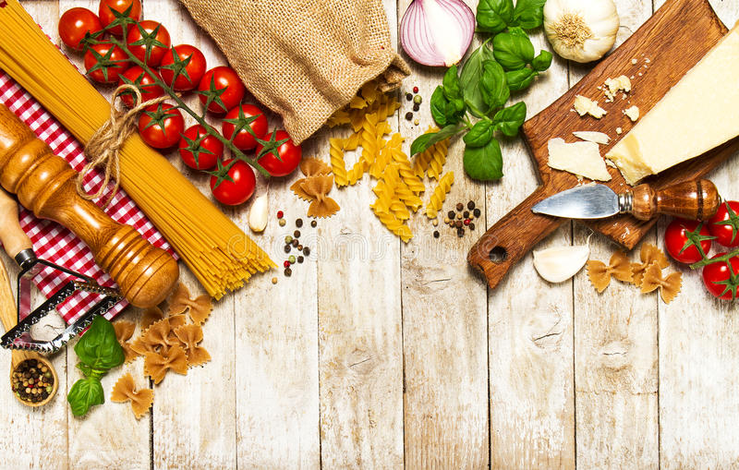
Differences Between Chinese and
Western Food Cultures
中西饮食文化差异
十一小组

Slide 2
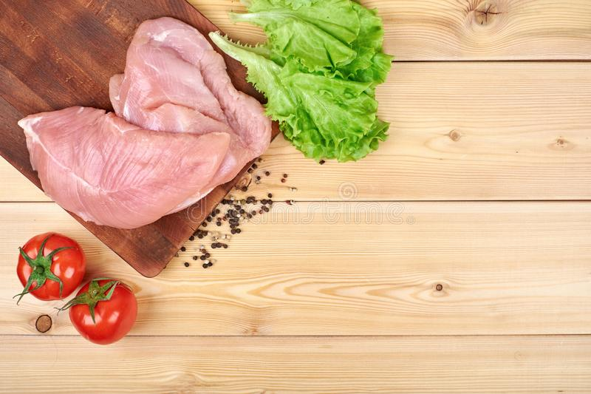
Catalog
1.Differences Between Chinese
and Western Cutlery
中西餐具差异
2.Differences Between Chinese
and Western Diet
中西饮食差异
3.Differences Between Chinese and
Western Cuisine
中西烹饪差异

Slide 3
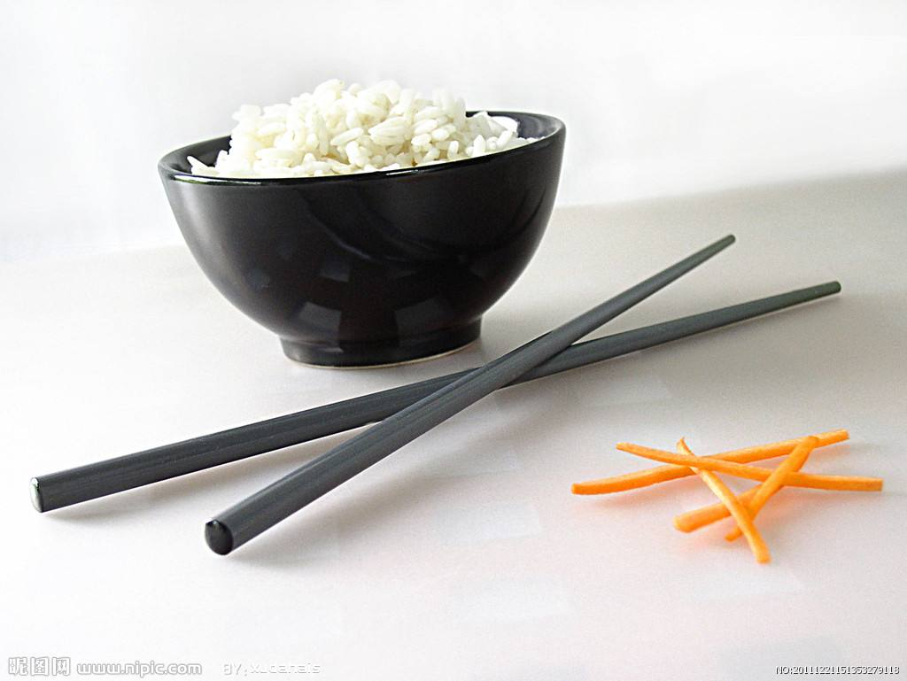
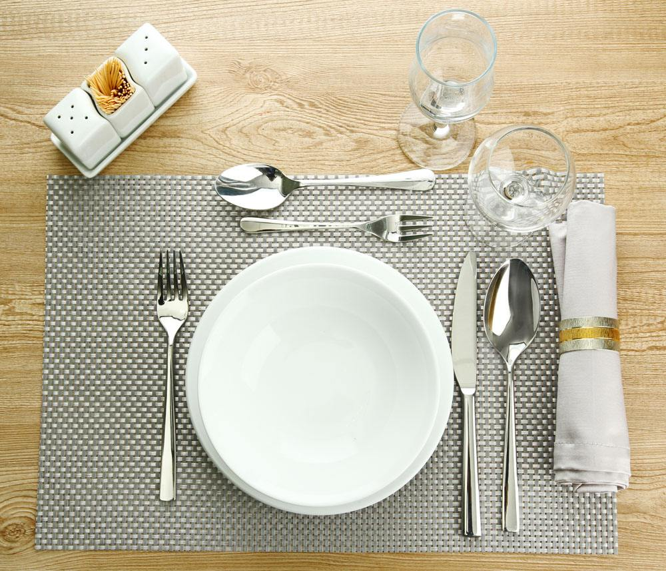
Differences Between Chinese and Western Cutlery
中西餐具差异
China：chopsticks
The west：
knife and fork

Slide 4
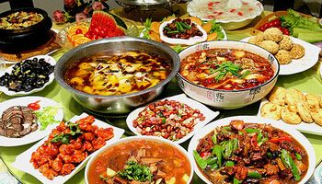
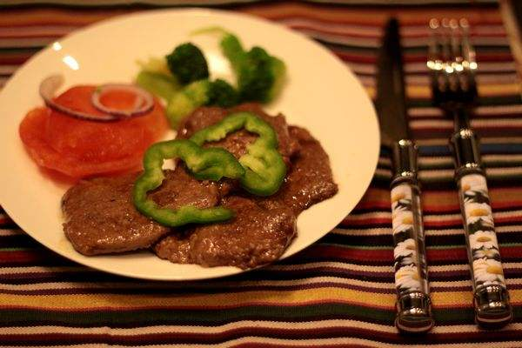
Differences Between Chinese and Western Diet
中西饮食内容差异
Chinese
food
Western
food

Slide 5
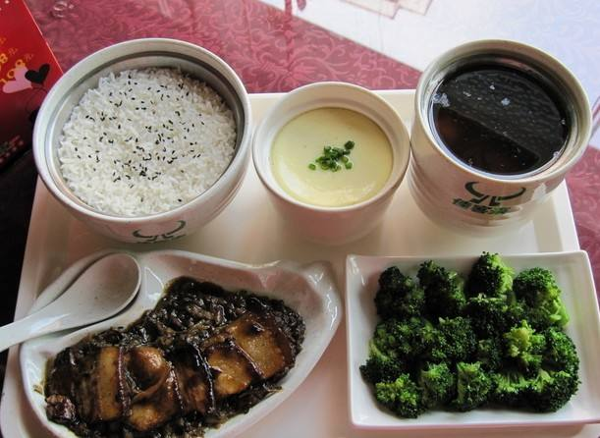
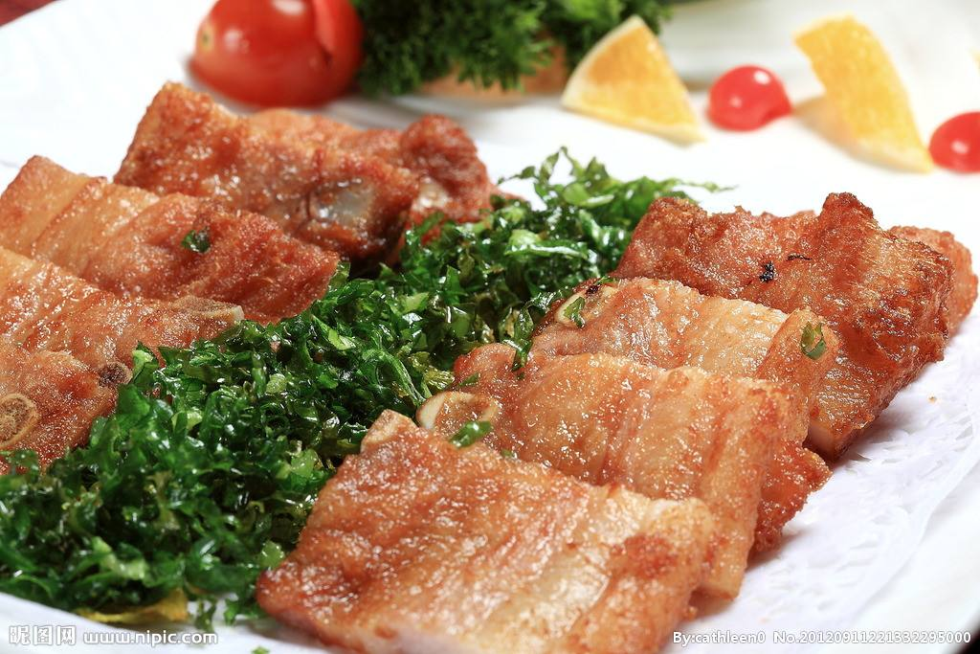
The staple food of Chinese people is mainly cereals and its products such as pasta, while the non-staple food is vegetables, supplemented by meat. [ˈsɪəriəl] [ˈpæstə]
[ˈsʌplɪmənt] 增补; 补充
中国人的主食以谷类及其制品如面食为主，副食则以蔬菜为主，辅以肉类。

Slide 6
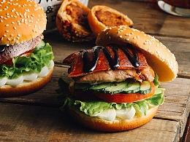
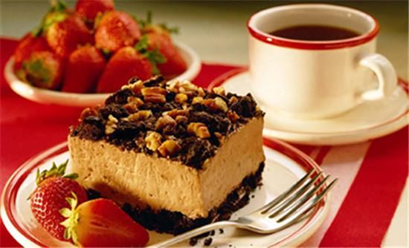
The staple food of westerners is meat and milk.
西方人的主食以肉类、奶类为主。

Slide 7
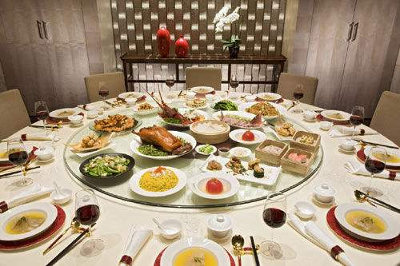
On the table
china：
The dishes are placed on the table and everyone shares.

Slide 8
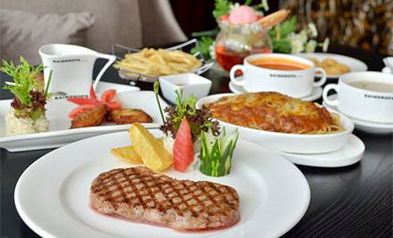
The west:
You have your own plate of food.

Slide 9
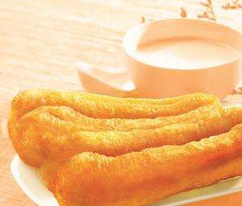
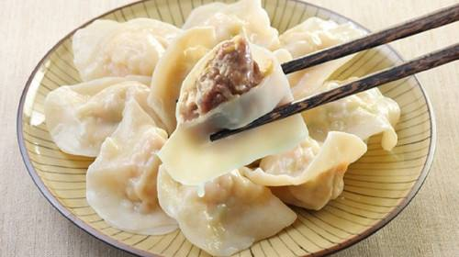
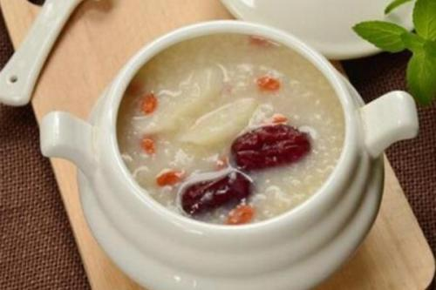
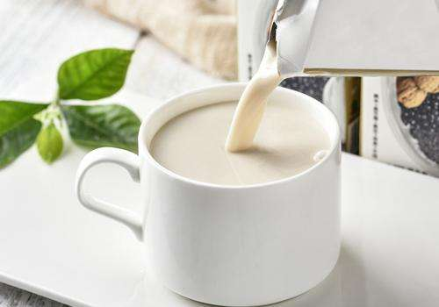
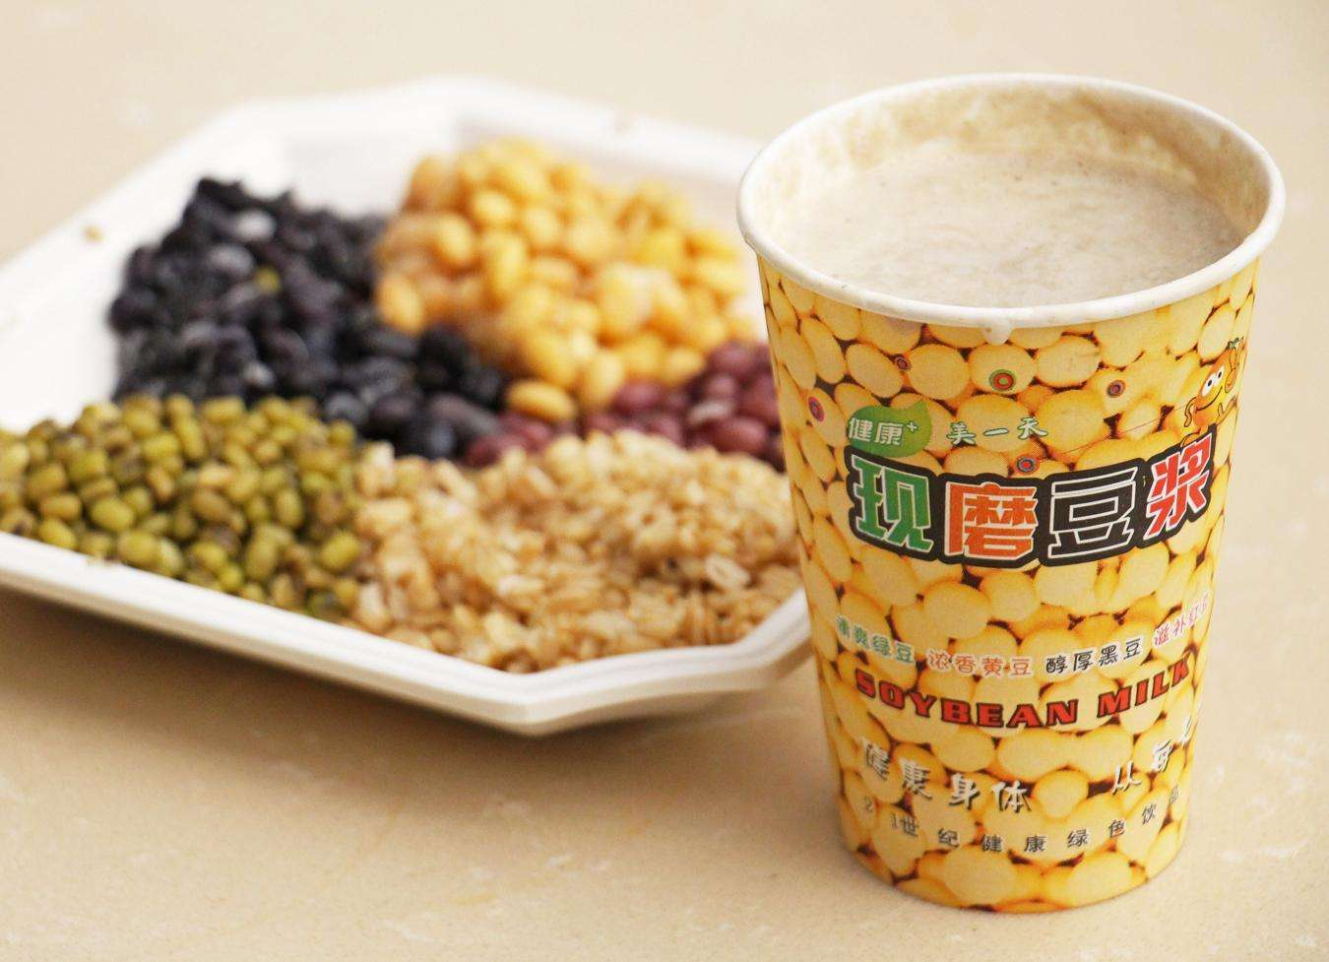
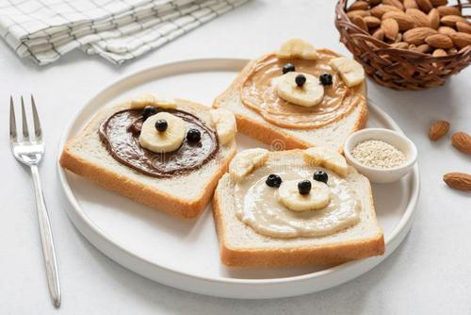
China
油条：Fried bread stick
蒸饺：Steamed dumplings
稀饭：Rice porridge
豆浆：Soybean milk
面包：Bread
牛奶：Milk

Slide 10
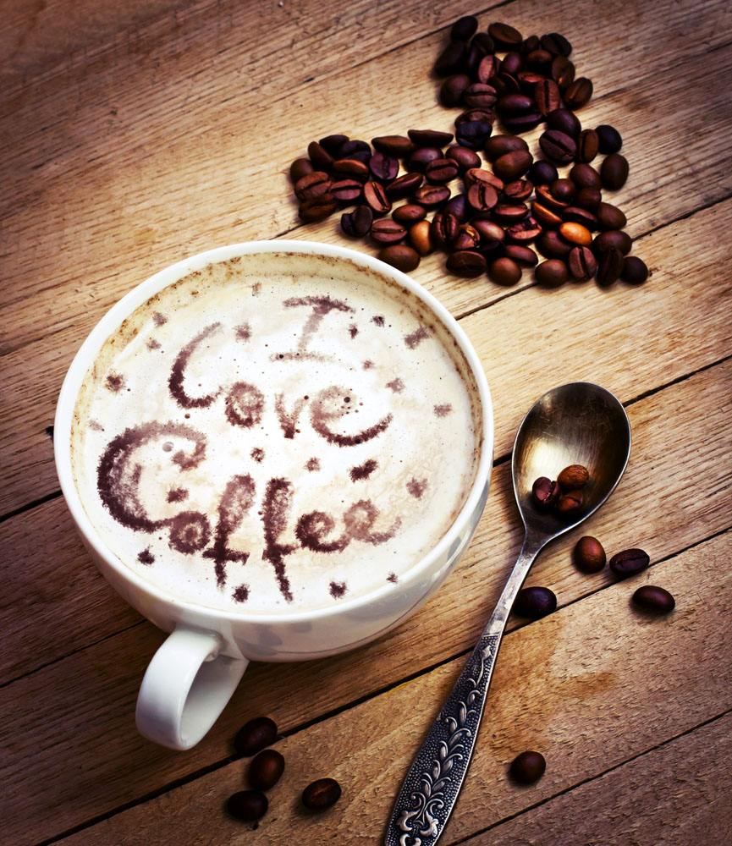
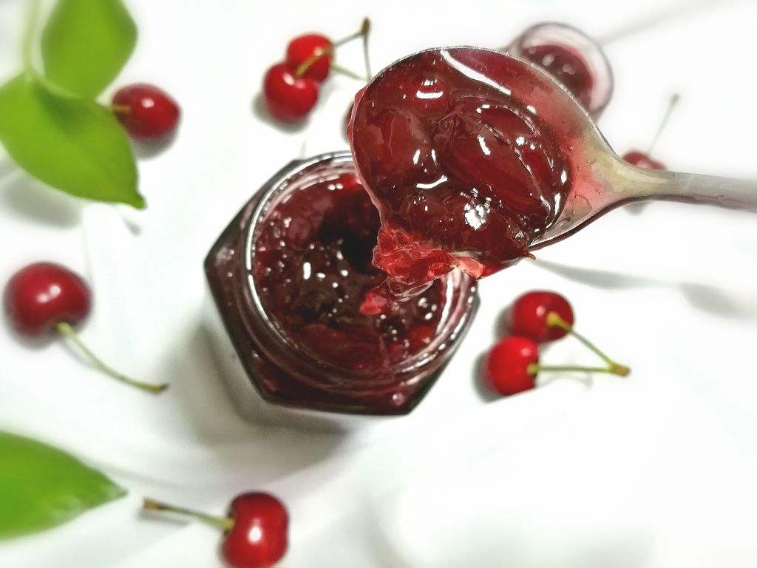
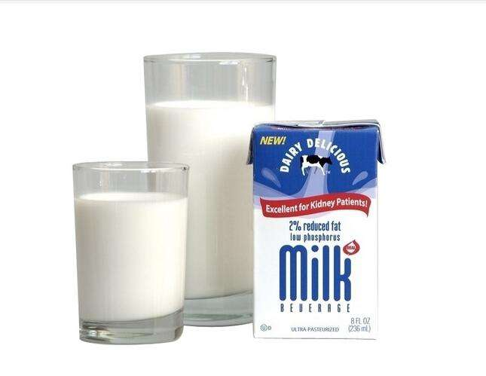
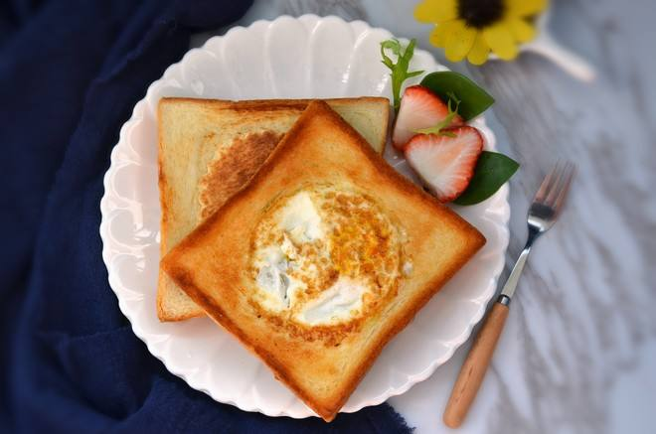
The west
土司：toast
果酱：jam
咖啡：coffee
牛奶：milk

Slide 11
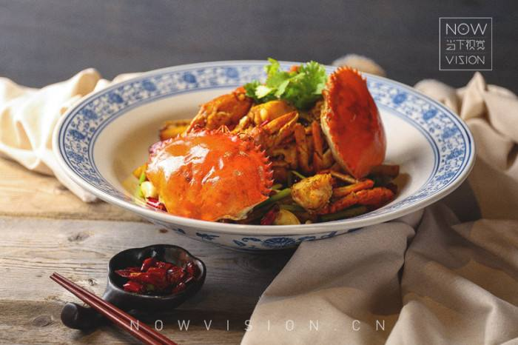
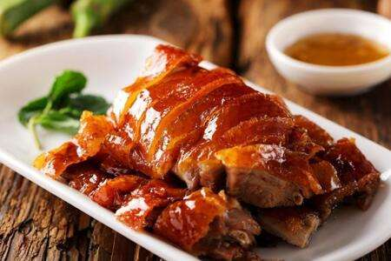
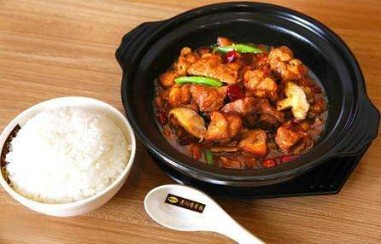
Differences Between Chinese and Western Cuisine
中西烹饪差异
In China, there are many ways of cooking, such as fried, fried, boiled, steamed, roasted, silk drawn, sweet and sour, etc. The dishes made are dazzling.
在中国，烹饪的方式多种多样，有炒、炸、煮、蒸、烤、拔丝、糖醋等，做出的菜肴让人眼花缭乱。

Slide 12
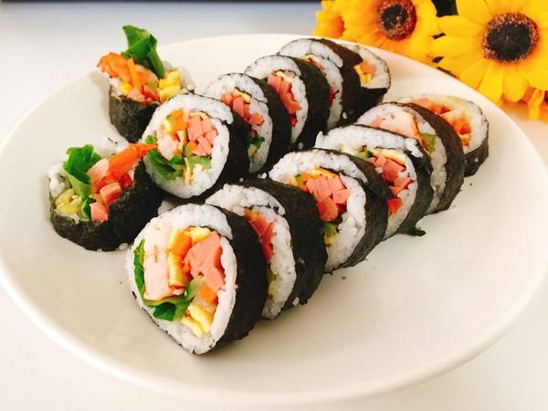
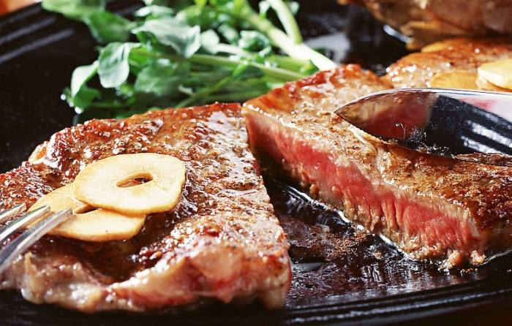
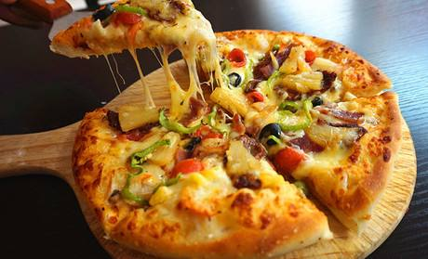
Western dishes are mainly cooked by roasting, frying, roasting, frying and stewing. Few raw ingredients are collected for cooking. In the main dish, fish is fish, chicken is chicken, and seasoning is added while eating.
西餐菜肴烹饪的方法主要是烧、煎、烤、炸、焖，各种原料很少集合烹调，正菜中鱼就是鱼，鸡就是鸡，即使是调味料也是现吃现加。

Slide 13
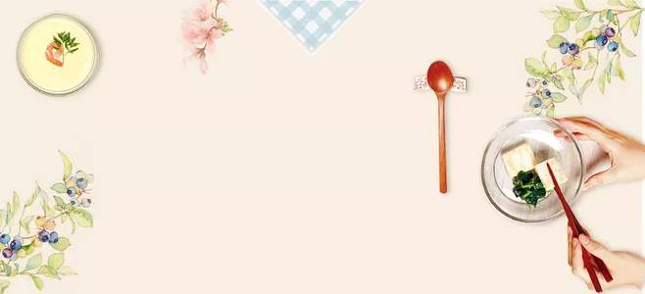
小结
These are the differences between Chinese and Western food cultures. From the comparison, we may be able to understand the meaning of culture. Although they are different, they are all a stage in the history of human cultural development.They have been summarized by people all over the world for many years. For the whole human being, the whole society and the whole world, they are all treasures of world culture, which we should study, learn, master, apply to real life，inherit and develop.
以上就是中西方饮食文化的差异对比，从两者的对比中，我们也许能悟出文化的含义。它们虽然有着千差万别，但它们都是人类文化发展史的一个阶段，是多年来各地人们总结得来的。对于整个人类，整个社会，整个世界而言，他们都是世界文化宝库中的珍宝，都是我们应该好好研究、学习、掌握，应用于实际生活并加以继承和发展。

Slide 14
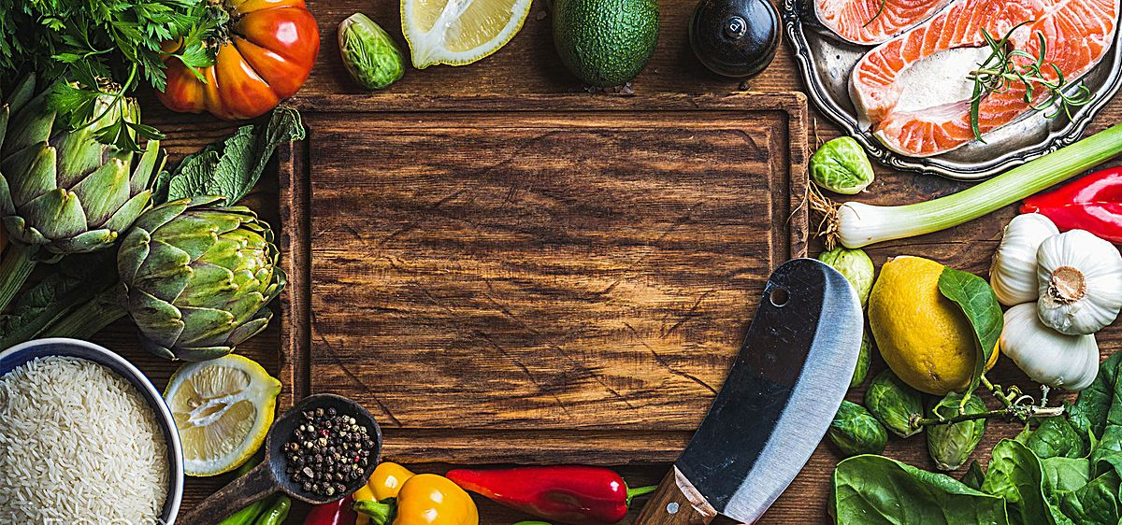
Thank you

